Slide 1

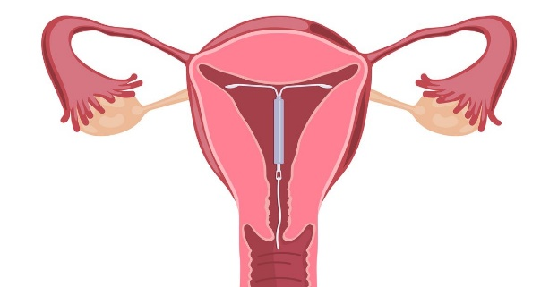
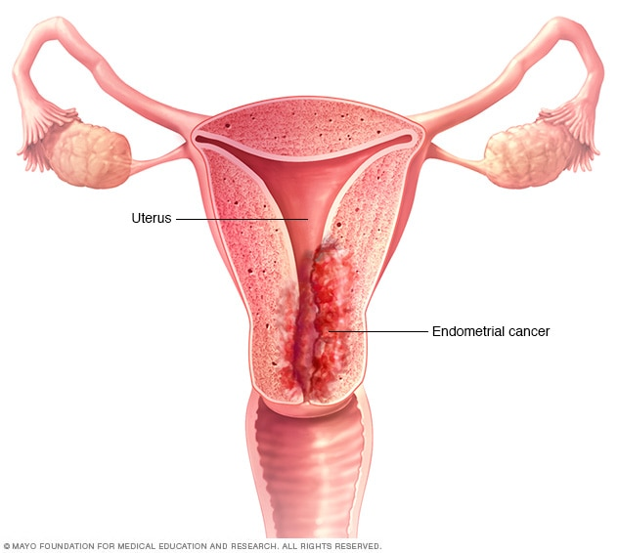

Post-Menopausal Bleed Service: Covid-19 variation in protocol
Paula Bidder, Advanced Nurse Hysteroscopist, Gynaecology Unit,
Swansea Bay University Health Board
Introduction
Swansea Bay University Health Board (SBUHB) have taken a ‘One Stop’ approach to the Post-Menopausal Bleed (PMB) service ensuring compliance with the Single Cancer Pathway (2018) offering women a rapid diagnosis and treatment for their cancer, reducing the number of additional clinic appointments and visits.
As a result of the Covid-19 pandemic improving patient safety and protecting staff by reducing patient visits and face-face contact were paramount, hence several changes were made to the PMB pathway. One major recommendation highlighted by the Gynae-oncology MDT was the insertion of a MIRENA © Intra Uterine System (IUS) at the time of hysteroscopy where the endometrium appeared suspicious for an endometrial cancer– allowing us to safely mitigate delay in surgery in many women
Aim Stakeholders
To provide the highest quality, evidence based service to the population of SBUHB and surrounding areas in a safe and secure environment
To improve patient safety and protect staff by reducing patient visits
To insert a MIRENA© IUS at the time of hysteroscopy where the endometrium appeared suspicious for an endometrial cancer
To allows us to safely mitigate delayed surgery in many patients
Gynae-oncology team retains overall responsibility for clinical governance of PMB pathway.
Led by an Advanced Nurse Hysteroscopist (ANH) trained for outpatient (OP) diagnostic and therapeutic hysteroscopy
Supported by a dedicated PMB team including administrators
Implementation
Prior to the Covid-19 pandemic:
Women who required further management for an endometrial cancer were seen within a one week target by the Gynae-oncology MDT
Management and treatment options were discussed
Change in service due to Covid-19:
To insert a MIRENA© Intra Uterine System (IUS) at the time of hysteroscopy in all women where the endometrium appeared suspicious for an endometrial cancer
Addendum to the Postmenopausal Bleeding Pathway: Standard Operating Procedure
Test of change
As this change in practice was an emergency measure during the pandemic we were unable to carry out a test of change
Audit
1st March-27 November 2020
34 endometrial cancers diagnosed
24 women had a Mirena© IUS inserted.
Endometrial cancer not identified at hysteroscopy reappointed to general outpatient hysteroscopy clinic to insert Mirena© IUS following MDT discussion.
The Future
To continuously audit the effects of the Mirena IUS on the endometrium to ensure safely mitigating delay in surgery
Could this be a short term measure for those with co-morbidities until they are adequately fit for surgery?
My Role
To build a trusting relationships with women
Delivering individualized holistic care, reflecting the woman's’ personal needs, views and opinions
To achieve a “gold standard quality service
All stages of the Covid-19 variation of the pathway are audited by the PMB team which forms part of a regular reporting exercise to the Gynae-oncology MDT
Reference:
Guidelines for Managing Patients on the Suspected Cancer Pathway (2018) available at: http://www.walescanet.wales.nhs.uk/sitesplus/documents/1113/Point%20of%20suspicion%20%28SCP%29%20definitions%20-Final.pdf

