Slide 1

Proposal for the revised
Anonymous Staff Speaking Up Safely Option
Notes:
My aims of this short presentation are to answer and action the queries and discussion points raised against the previous options appraisal paper, based on option 2 being approved as the recommended option.
This would be subject to evolve under the Lead Guardian who will be responsible for setting up the service once established in post.

Slide 2
Objectives of an Anonymous Speaking Up Provision
The objectives of an anonymous provision as an additional option for staff to raise work-related concerns are to:
Increase staff confidence in raising concerns safely and without detriment, resulting in a culture of psychological safety.
Improve resolution and feedback ensuring staff feel heard, experience action taken where appropriate/possible and reducing formal escalation.
Ensure impartiality in the speaking‑up process.
Strengthen organisational learning and improvement through robust recording, monitoring and reporting, which includes a thematic analysis of concerns and triangulation of intelligence across services.
J
Notes:
In looking at the options available for an effective anonymous Speaking Up option, it was first important to be clear on what it should aim to do. These objectives put the person at the centre, link to the internal audit recommendations and well-documented best practice.

Slide 3
Options Appraisal – Reminder of Summary Findings
Across NHS Wales:
6 out of 8 Health Boards use the Work in Confidence digital platform.
Most are supplementing with internal Guardians (typically Band 8a + Band 7).
No “Once for Wales” solution has been confirmed.
Across NHS England:
Internal Guardian models dominate, whilst there has been seen to be an increase in contracting with the Guardian Service since the decommissioning of the National Guardian Office (NGO).
J
Notes:
In summary of the benchmarking, it was found that…
Whilst no standardised provision has been mandated in NHS Wales, it is worth mentioning that Shared Services have commissioned WiC and it is already used to support resident doctors.

Slide 4
Recommendation Agreed
It was agreed by Exec Board following engagement with Trade Union partners:
➡ Commission the Work in Confidence platform
➡ Recruit internal 1 x full‑time Band 8a Lead Guardian + 1 x part‑time Band 7 Guardian
This option was found to provide the best combination of capability, legitimacy, staff trust, and long‑term stability, while avoiding the escalating cost risks.
It was found to be the only option where cost decreases over time and where we align with NHS Wales, supporting consistency and shared learning.
Notes:
As a reminder of the option agreed…

Slide 5
Engagement with Trade Union Partners
Special Sub Partnership Forum held on 10th April 2026 confirmed:
There is support for the recommended option, being clear it does not take anything away from the important role of the Trade Unions in the Health Board going forward.
A full and fair job evaluation process has been undertaken of the Job Description and Person Specifications of the internal Guardian posts.
Trade Union partners are involved in shortlisting and interviews planned during October 2026 – post will be internally restricted and fixed-term for 12 months to support evaluation of impact and effectiveness.
Whilst the posts will have a dotted line into the Executive Lead for Speaking Up, they will sit independently to support impartiality and ensure access to whoever they need to within the organisation.
Notes:
The recommendation as approved in principle, subject to engagement and feedback from our Trade Union Partners.
Following a Special Sub Partnership Forum being held on 10th April, we can share that…

Slide 6
Current internal options for Staff at SBU HB (aside direct line manager as first point of contact)
Speaking Up Safely in SBU HB
Trade Unions
Workforce & OD
Safe-guarding
Health &
Safety
Chaplaincy
Staff OH &
Wellbeing
Datix
Work in Confidence
(Resident
Drs)
Notes:
This visual sets out where the anonymous option sits against the wider internal speaking up options we have available for staff, which is visually outlined here. Any additional anonymous Speaking Up option does not replace managers managing and the will be clear as part of the role-put of this model.

Slide 7
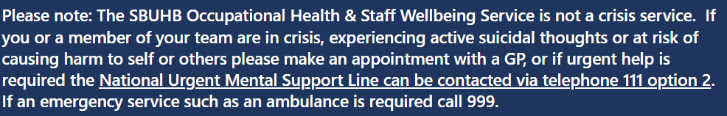

Support for SBU Staff in Crisis
Notes:
The recommended option does not aim to provide a crisis service, however we currently sign post staff to such support via our Staff OH & Wellbeing pages and have additional support through our Trauma Risk Management service and trained TRiM Managers out locally across services as well as REACT Mental Health Training available.

Slide 8
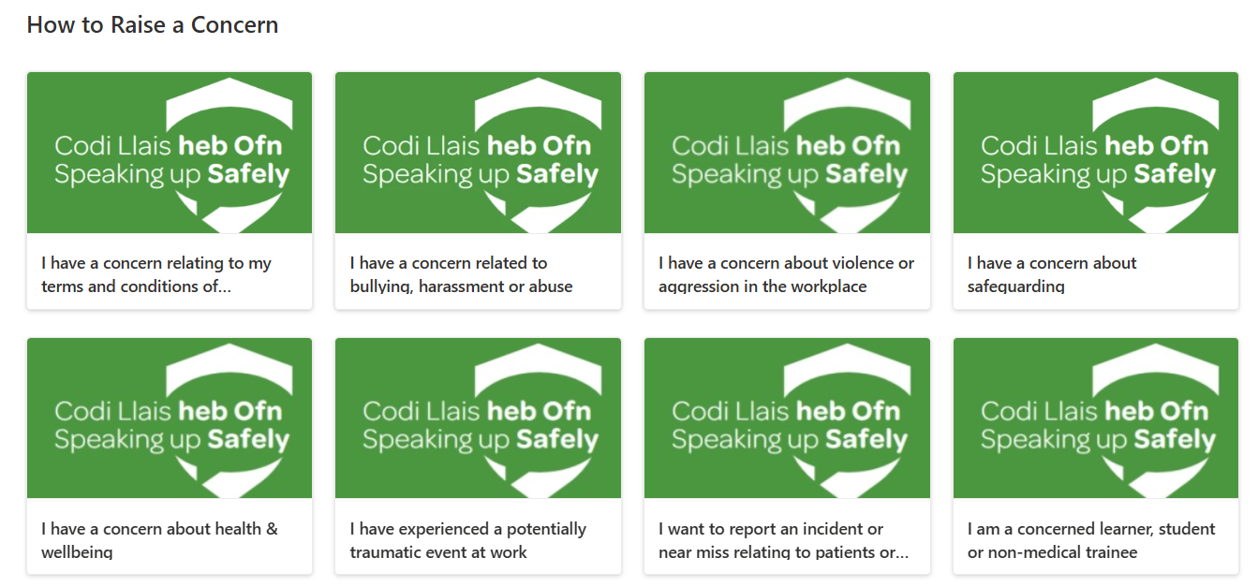
SBU’s Raising Concerns Hub (see below link)
Raising Concerns Hub
Notes:
Everything is also currently sign posted centrally via our Raising Concerns Hub and I’ve extracted a section which directs managers and staff as to how to raise a concern, depending on what the concern is, which we would evolve accordingly with the recommendation that we take forward.

Slide 9
Current Infrastructure & Governance
Concerns raised through speaking up options available. If via Guardian Service, RAG System applies (red out of hours linked to Silver on-call)
Guardian Service share monthly anonymous reports with WOD Director, Chair and Workforce & OD / Services
Monthly meetings between the Guardian Service & WOD Director. 8-weekly with Chair
6-monthly and annual Speaking Up Reports via WOD Delivery Group and Committee to report key local activity and learning
Notes:
Outline the current infrastructure and governance.
Robust triangulation of information is currently a gap and knowing what action has been taken locally, although this has been improved more recently through services attending WOD Committee to report bi-annually.

Slide 10
RAG Response Timeframes
RED
AMBER
GREEN
Includes bullying, harassment, and staff safety. A response is required within 48 hours
General issues. A response is required with 72 hours
Relates to patient safety, safe guarding and care, staff safety, issues of potential danger to any individual including self-harm. These scenarios require immediate escalation and response within 12 hours
Notes:
This system could still operate as part of the new model.
Staff can choose whether they wish to submit anonymously or not via WiC.
From the point of the Guardian (or appropriate MDT Member) picking up the concern from the Work in Confidence system and the contact agreeing escalation (amber and green), these timeframes and definitions could remain in place. Red requires automatic escalation and no guarantee of anonymity which needs to be clear from the outset of the contact.

Slide 11
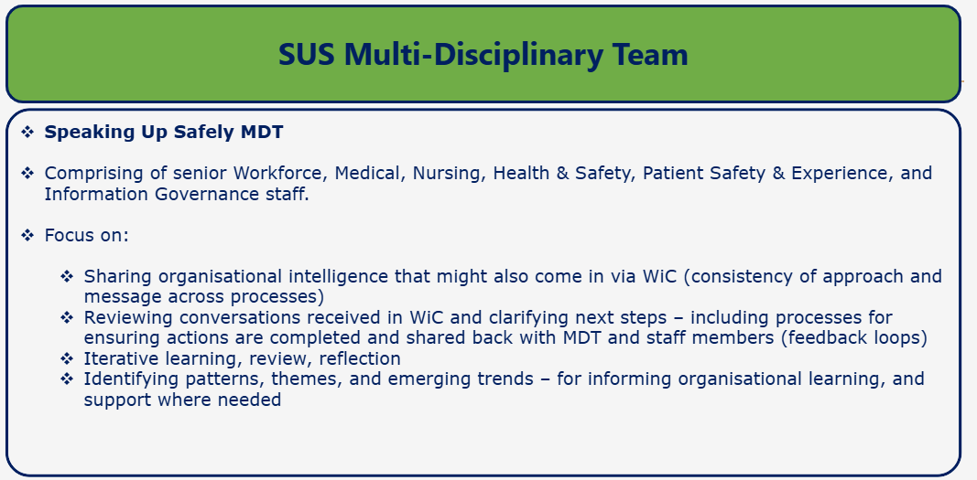
Proposed for new Infrastructure & Governance Arrangements
Example from BCU HB:
J
Notes:
Suggest TU Partners are included along with key Service representatives for local input and ownership.
WiC can have split visibility rights issued to support filter concerns raised to the right people i.e. Guardians, HR, Safeguarding, Equality, Health & Safety, Wellbeing etc. to action, however highlighting as with our current processes this infrastructure does not replace managers or services managing issues locally. The key will be the feed through of any action taken, which will require some thought and collaborative learning from established Health Boards.

Slide 12
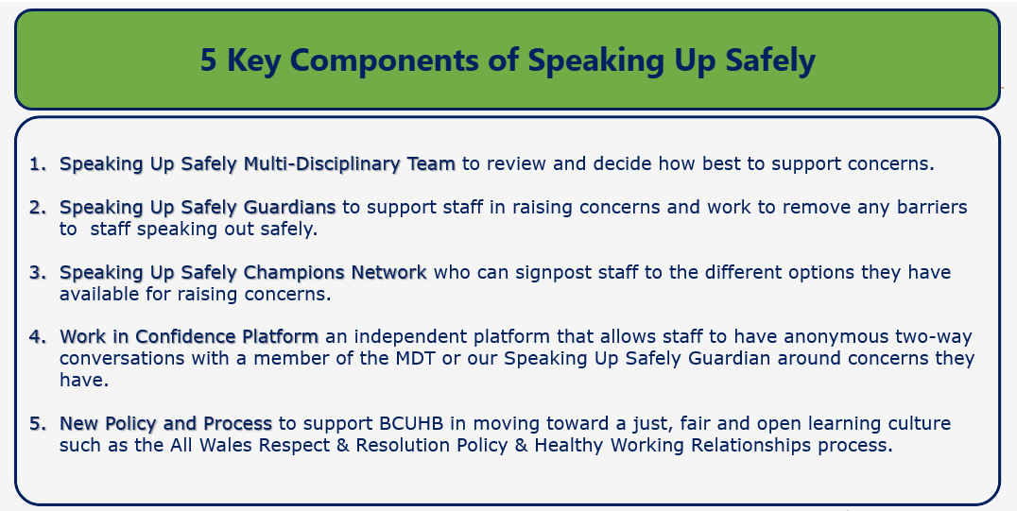
Notes:
Highlight the key components set out as part of the infrastructure in BCU.
Highlight the link to the ‘Just Culture’ approach TUs recently raised with Board, our best practice review work and work we will be looking to take forward in respect of a Behaviour Compact which would be interlinked in SBU.

Slide 13
Proposed for new Infrastructure & Governance (to be set up and led by Lead Guardian from 1st December 2026)
Concerns raised through speaking up options available. If via WiC, internal guardians/lead pick up and provide initial response/contact RAG System applies (red requires escalation as appropriate)
SuS MDT held monthly anonymous WiC reports reviewed and discussed alongside wider data and intelligence from leads and services
Quarterly meetings between the Guardians & WOD Director and Chair as the Executive and non-Executive Sponsors to report on activity, learning and action taken
6-monthly Speaking Up Governance Reporting via WOD & Audit Committees for assurance
Notes:
Speaking Up Safely MDT to replace the current Speaking Up Safely Working Group and part of WOD Delivery Group (or equivalent)

Slide 14
Diolch!
Thank You!

