Slide 1
NHS Wales Staff Survey 2023 – Quantitative Results by Service Delivery Group
Notes:
Thank you for time on the agenda for today’s Team brief and for accommodating the time change due to me presenting to Workforce & OD Committee after this.
Acknowledge Dan Blyth who is in attendance with me today and is a new member of the team as Leadership & OD Facilitator and will be leading on the 2024 Staff Survey so listening in today.
I’ll start with a reminder of some of the key context and may not spend long or will skip over some slides to ensure I focus on key messages, stick to time and allow time for questions too. Karen has the full slide deck however and can circulate if she hasn’t already.
Rather than just include PCT data, I have included the comparison against other service groups so you have a benchmark

Slide 2
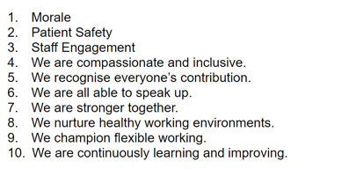
CONTEXT - REMINDER
Led by HEIW – based on NHS England question set, Professor Michael West and the Kings fund research – link to Compassionate Leadership
Launched on 16th October to 4th December 2023 (final count including paper-based) – Open 6 weeks
Electronic, paper-based an phone-line available – greater accessibility and inclusivity
2,625 responses for Swansea Bay UHB – 18.8%
Full quantitative data set by Service Group / Directorate and Staff Group – qualitative data to follow
10 Question areas:
Notes:
Highlight of the total responses for SBU 450 responses (17%) for PCTS of total responses for SBUHB (over 2,500)
Highlight delay in results due to Survey provider, failing to deliver on contracted timeframes, meaning HEIW have had to bring it in house and build the dashboard from scratch.

Slide 3
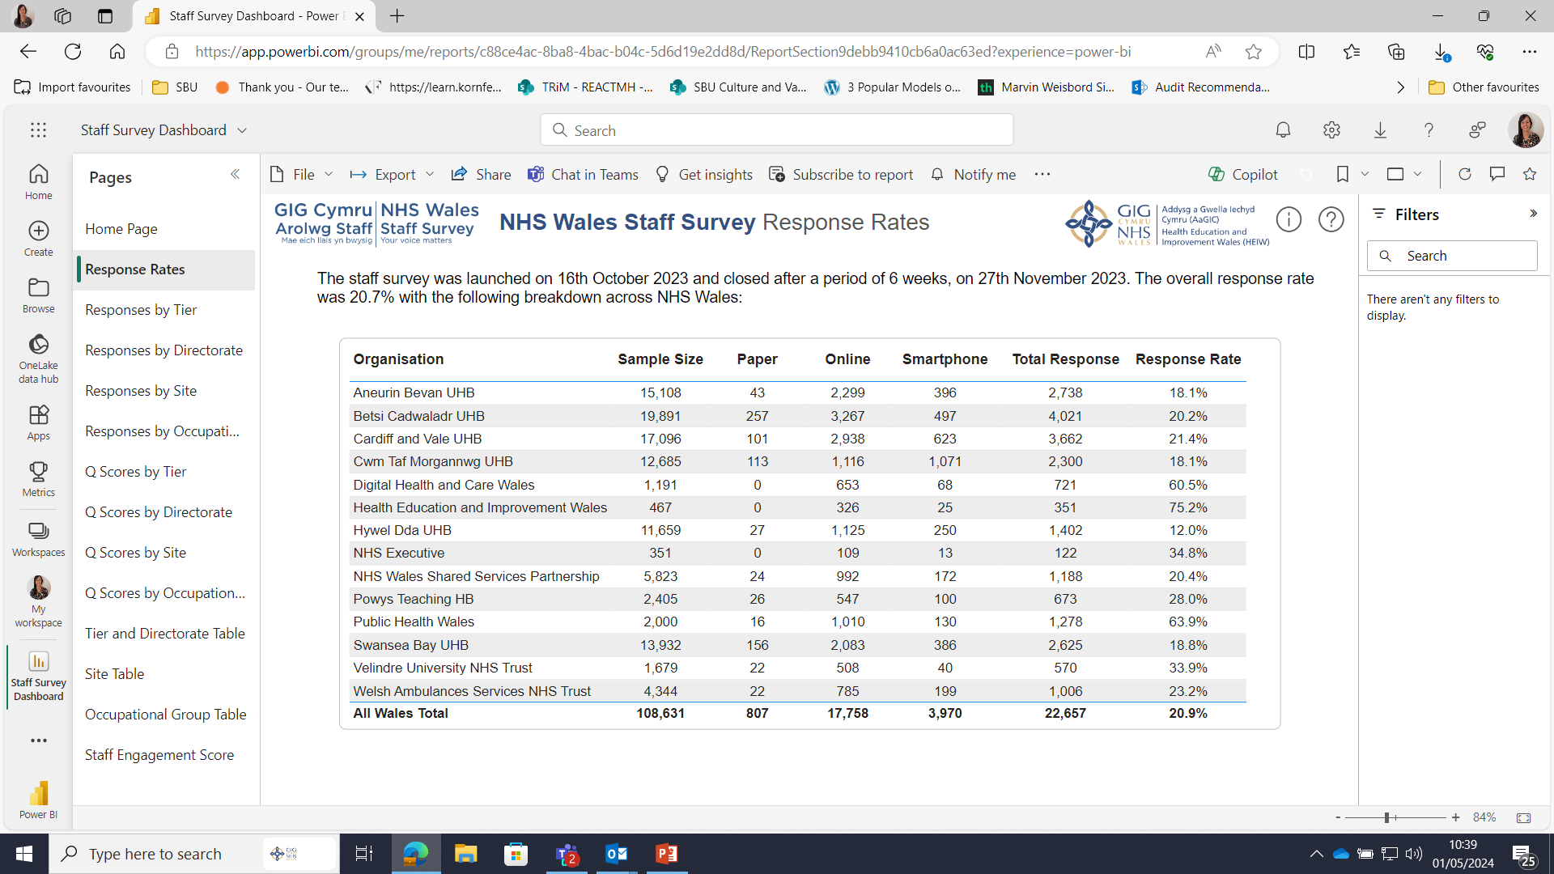
Notes:
This is a generic copy slide.

Slide 4
How do Our Results link with our ‘One Bay Way’ across Service Groups? A High Quality Organisation – Patient Safety
*N.B. New question set for 2023 – no comparible data. Responses are in percentage.
In the last month have you seen any errors, near misses,
or incidents that could have hurt staff and/or patients/service users?
My organisation treats staff who are involved in an error, near miss or incident, fairly.
Notes:
Green – PCTS
In trying to make the data meaningful and focus on what is important to us as an organisation, I have mapped it where I can to our Vision for a High Quality Org and our people Strategy.
There may not be any surprises in relation to this in line with where services are in respect of targeted intervention/enhanced monitoring. PCTS has the post most positive response across Service Groups with 29.8% (67% had not) confirming they had seen errors, near misses, or incidents that could have hurt staff and/or patients/service users in the last month.
I have made an assumption that the high proportion across service groups neither agreeing or disagreeing that my organisation treats staff who are involved in an error, near miss or incident, fairly, is down to them not having been involved and so are unable to comment. From those that have experienced this, a majority of respondents agree across Service Groups that the organisation does treat staff fairly (just over half for PCTS).

Slide 5
Patient Safety Continued…
When errors, near misses or incidents are reported, my organisation takes action to ensure that they do not happen again.
My organisation encourages us to report errors, near misses or incidents.
Notes:
There is more work to be done around encouraging staff to report errors, incidents and near misses, but more importantly, for the organisation/areas to take action and feed back on the back of staff reporting, which is also reflected in the Guardian Service End of Year Report. PCTS had the most positive response in this space between 70 and 80% agreeing/strongly agreeing to both reporting and taking action, however providing feedback to those reporting does need some improvement.
I am now going to move onto the next section on a Compassionate Culture…

Slide 6
Patient Safety Continued…
We are given feedback about changes made in response to reported errors, near misses and incidents.

Slide 7
Compassionate Culture (Patients / Service Users)
N.B. New question set for 2023 – no comparible data. Responses are in percentage
People here are compassionate in the way they behave towards patients/service users.
People here take effective action to help patients/service users in distress.
Notes:
Among other SG’s (Morriston in particular) this is an area of focus for PCTS - There are some concerns with responses across the questions relating to a Compassion Culture in the care of Patients and Service Users. This is then also reflected in the responses in respect of compassion between staff.

Slide 8
Compassionate Culture continued…
Care of patients/service users is my organisation's top priority.
My organisation acts on concerns raised by patients/service users.

Slide 9
Compassionate Culture (staff to staff)
The people I work with are understanding and kind to one another.
People here are compassionate towards colleagues when they face problems.

Slide 10
A High Quality Organisation – Friends & Family Test
Question | SBUHB Response 2023 | SBUHB Response 2020
If a friend or relative needed treatment I would be happy with the standard of care provided by this organisation | 54% agreed/strongly agreed | 67% agreed/strongly agreed
Notes:
Down by 13% across the health board.

Slide 11
A High Quality Organisation – Compassionate Leadership
*N.B. Links to People Strategy aim – Leadership that Lives our Values
New Question Set – No Comparable data
My immediate manager (line manger) is interested in listening to me when I describe challenges I face.
My immediate manager (line manger) takes effective action to help me with any problems I face
Notes:
Some strong and positive responses against the compassionate leadership questions relating to line managers for PCTS.
Overall, 76.2% of respondents agree My immediate manager (line manger) is interested in listening to me when I describe challenges I face.
And 73.6% agreeing My immediate manager (line manger) takes effective action to help me with any problems I face

Slide 12
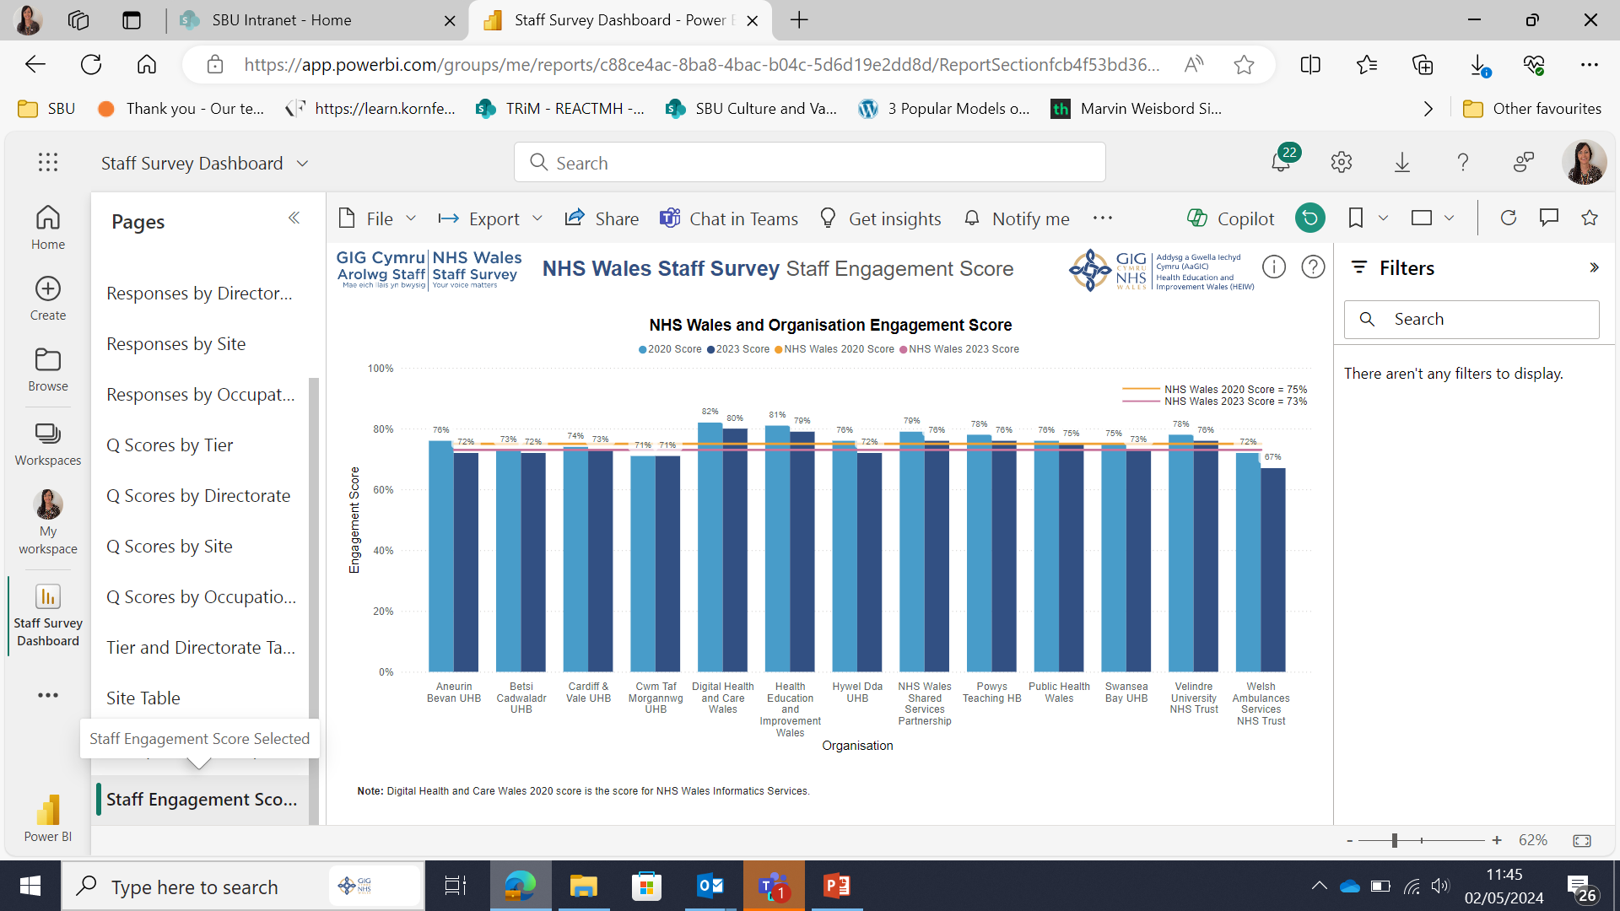
Notes:
Nest we move onto the 7 Staff Engagement questions, which is key. Across Wales overall, this has seen a drop in 2% since 2020.

Slide 13
Our People Strategy – Engagement Score
7 Key questions that specifically measure Staff Engagement
Links to our People Strategy aim - Engaged Motivated & healthy and work of Recruitment & Retention Group
SBU’s score is 73% (down by 2% from 2020) – reflected across NHS Wales
1. I am involved in deciding on changes introduced that affect my work area/team/department.
2. I look forward to going to work.
Notes:
I have used a RAG system for the breakdown of responses to the 7 Engagement Score questions. In spite of the challenges reported against some of the questions, responses across all Service Groups confirmed that a majority are enthusiastic about their jobs and happy to go the extra mile at work. Over half of respondents in PCTS feel they can make improvements in their area of work and are proud to tell people they work for the organisation.

Slide 14
Our People Strategy - Engagement Score Continued…
4. I am happy to go the extra mile at work when required.
3. I am enthusiastic about my job.

Slide 15
Our People Strategy - Engagement Score Continued…
5. I am able to make improvements in my area of work
6. I would recommend my organisation as a place to work.

Slide 16
Our People Strategy - Engagement Score Continued…
7. I am proud to tell people I work for my organisation.

Slide 17
People Strategy Aim – Engaged, motivated & Healthy
Key Headlines
My immediate manager (line manger) values my work
I am satisfied with the opportunity for flexible working patterns

Slide 18
People Strategy Aim – Engaged, motivated & Healthy
Key Headlines continued…
I have unrealistic time pressures
How often, if at all, do you feel burnt out because of your work?
Notes:
Responses across the questions linked to our Engaged, Motivated and Healthy People Aim in our people strategy, particularly relating to wellbeing are areas for improvement across Service Groups and Particularly PCTS. 66% of respondents confirmed they either always or often feel burnt out because of their work.

Slide 19
People Strategy Aim – Engaged, motivated & Healthy
Key Headlines continued…
On average, how many additional UNPAID hours do you work per week for this organisation, over and above your contracted hours?
I often think about leaving this organisation.

Slide 20
Our People Promise – Compassion, inclusivity & belonging
*N.B. Question (asked differently in 2020 / No comparable data))
In the last 12 months how many times have you personally experienced harassment or bullying at work from managers/team leaders?
In the last 12 months how many times have you personally experienced harassment or bullying at work from other colleagues?
Notes:
It is positive to see the high number of responses confirming they have never experienced bullying at work from managers/team leaders or from colleagues, however we do need to consider the cumulative responses from those experiencing this between 1 and more than 10 occasions in the last 12 months and that this, on any occasion is unacceptable.

Slide 21
Our People Promise – Compassion, inclusivity & belonging continued…
In the last 12 months how many times have you personally experienced harassment or bullying at work from patients/service users, their relatives, or other members of the public?
I think that my organisation respects individual differences (e.g. cultures, working styles, backgrounds, ideas)
Notes:
There are definitely areas for concern and improvement in respect of equality in line with responses to whether my organisation respects individual differences (e.g. cultures, working styles, backgrounds, ideas). Over 70% disagreed or strongly disagreed collectively within PCTS. And the responses to those feeling they had experienced discrimination from colleagues Is an area or focus for PCTS.

Slide 22
Our People Promise – Compassion, inclusivity & belonging continued…
In the last 12 months have you personally experienced discrimination at work from a manager/ team leader?
In the last 12 months have you personally experienced discrimination at work from other colleagues?

Slide 23
Our People Promise – Compassion, inclusivity & belonging continued…
In the last 12 months have you personally experienced discrimination at work from patients/service users, their relatives, or other members of the public?
I’d feel able to speak up in my team if I noticed poor or incorrect practice.
Notes:
Whilst lower responses in respect of patients, our Trade Union partners are reporting some serious issues in this space and work has commenced in collaboration to target improvements in hotspot areas.
Lastly, and also linked to the Guardian Service End of Year Report is to note the responses (between 70%-80% agreeing or strongly agreeing collectively) across service groups that they feel able to speak up in their team if they noticed poor or incorrect practice. However, we are seeing an increase in those contacting the Guardian Service and wanting to remain anonymous in doing so. This is an area to monitor further.

Slide 24
Next Steps
No national Staff Survey Action plan published to date
There are some clear areas of focus both for Service Groups and Corporately, linked to our Vision, People Strategy and ‘One Bay Way’. Service Groups are to identify 2/3 key priorities.
Service Groups to be given access to full raw data sets and specific reports provided on request. Areas under TI and hotspots will be prioritised.
Corporate Directorate Data analysis to follow – suppression rules may impact on results and sharing
Further thematic analysis to be undertaken following release of qualitative data
Notes:
Mention Management Board action – should link to your local People Experience Plans and ultimately delivery of our People Strategy.

Slide 25
Diolch
Thank you

