Slide 1
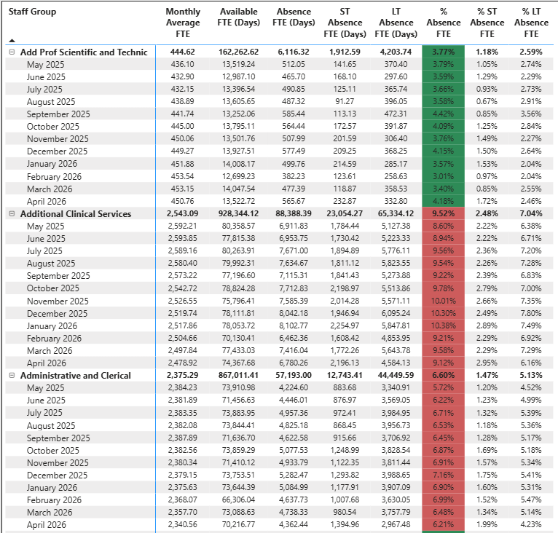
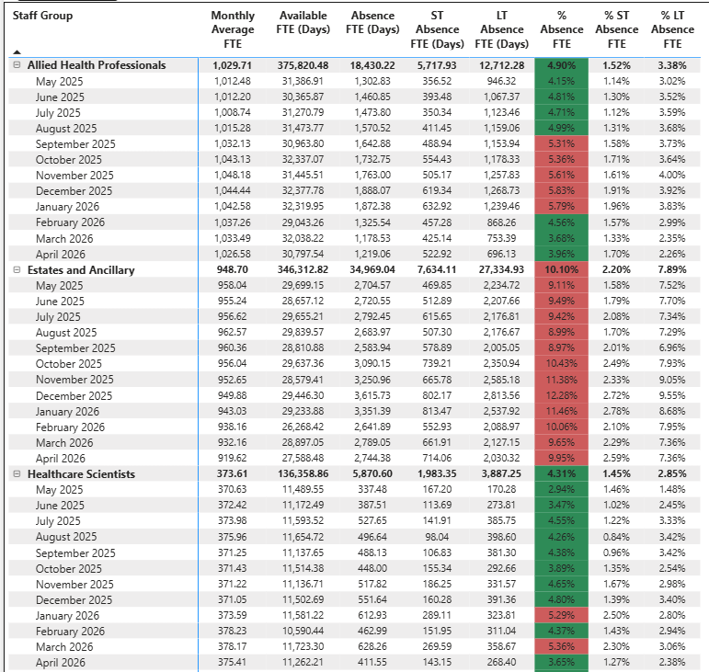
Sickness Report – All Staff (Monthly – May 2025 to April 2026)

Slide 2
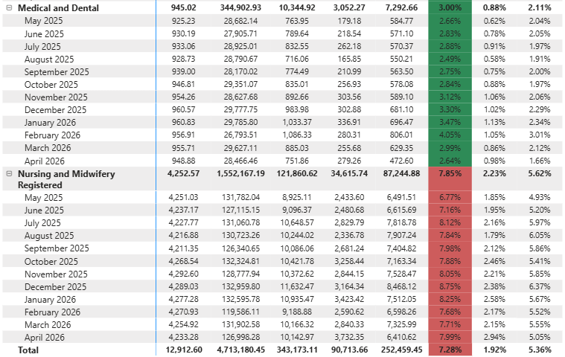
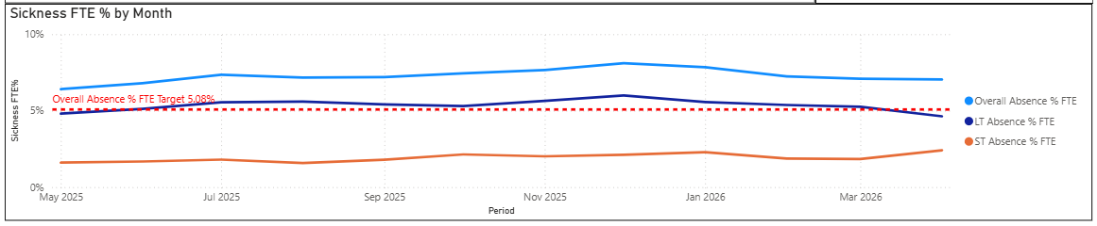
Sickness Report – All Staff (Monthly – May 2025 to April 2026)
When we consider the HB sickness trend for the last 12 months we see that we have seen a slight increase in average sickness rates from 6.41% to 7.04%.
However, when we consider by Staff/Professional Group we see the following;
Add Prof Science & Tech: 3.79% to 4.18%
Add Clinical Services: 8.60% to 9.12%
Admin & Clerical: 5.72% to 6.21%
Allied Health Prof: 4.15% to 3.96%
Estates & Ancillary: 9.91% to 9.95%
Healthcare Scientists: 2.94% to 3.65%
Medical & Dental: 2.66% to 2.64%
Nursing & Midwifery: 6.77% to 7.99%
The conclusion from these results would suggest that the current focus would be as follows;
Estates & Ancillary
Nursing & ADC
A&C
Whilst AHP/HS/APST, and Medical & Dental, always remain below the 5% threshold required.

Slide 3
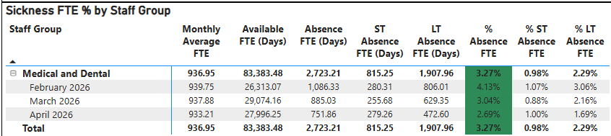
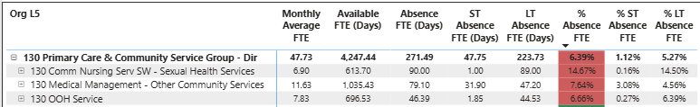

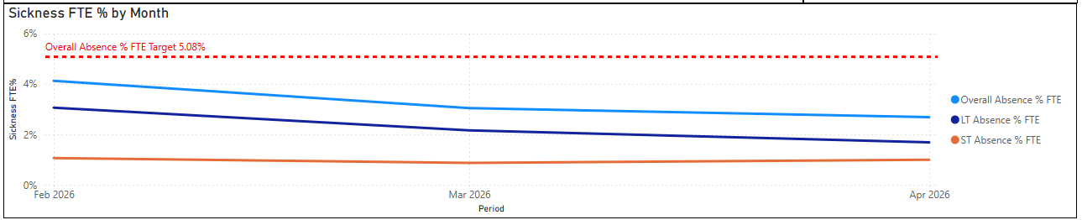
Sickness Report – Medical & Dental (Monthly – February 2026 to April 2026)
As we see in the top left table, overall sickness levels for Medical & Dental in the HB always remain under the 5% threshold.
It is also worth noting that for those areas appearing to have high % of sickness, this is usually due to the small number of staff associated with the area.
Of those areas with high percentages it may be considered worthwhile to focus on any that have over 10 members of staff and also have long-term sickness, to check if any additional support is required from Medical HR.
These are Community Paeds, Haematology, Older People MH and Critical Care.

Slide 4
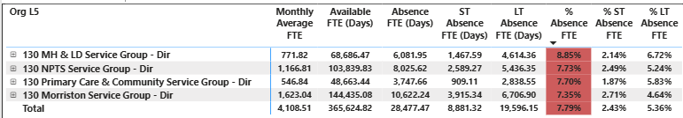
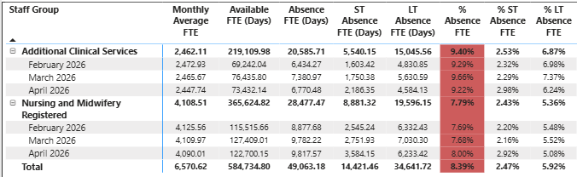
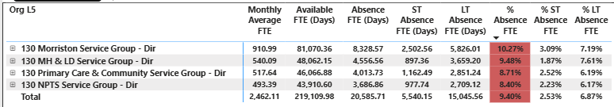
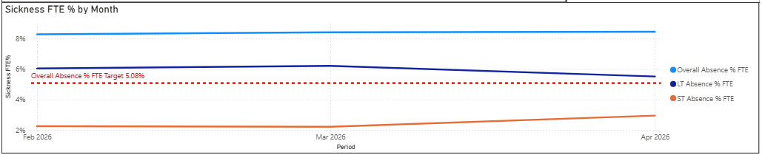
Sickness Report – Nursing & ACS (Monthly – February 2026 to April 2026)
Nursing
ACS
When we consider the 4 main SGs we observe the following;
Nursing: there has been an average of 7.79% sickness for the last 3 months, with the highest percentage being seen overall in MH&LD. Again, whilst we see a positive decline in long-term sickness, short-term sickness has increased.
ACS: there has been an average of 9.40% sickness for the last 3 months, with the highest percentage being seen overall within Morriston.
Whilst we see a positive decline in long-term sickness, short-term sickness has increased.

Slide 5
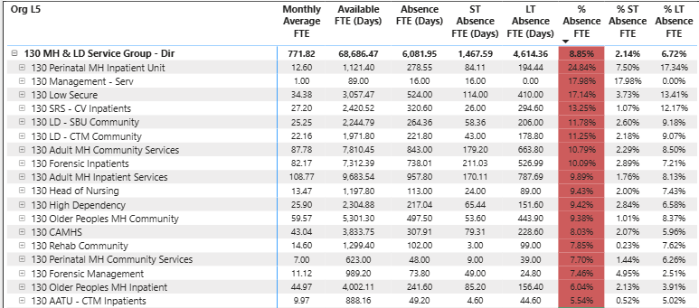
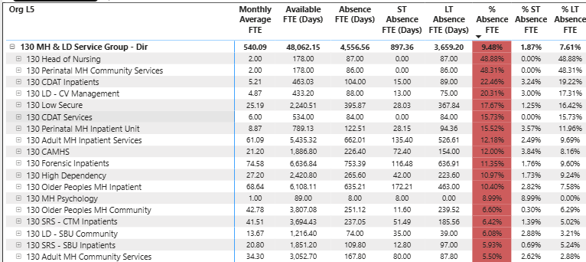
Sickness Report – MH&LD Nursing & ACS (Monthly – February 2026 to April 2026)
Nursing
ACS
When considering the percentages in the tables above, alongside the FTE numbers and long-term sickness associated with the given areas it would appear that the top five to focus on for MH&LD are as follows;
Nursing: Adult MH Inpatient Services, Adult MH Community Services, Forensic Inpatients, Older People MH Community and Low Secure.
ACS: Adult MH Inpatient Services, Adult MH Community Services, Forensic Inpatients, Older People MH Community and Low Secure.
As we see here, we have a direct correlation between the areas of focus for both staff groups.

Slide 6
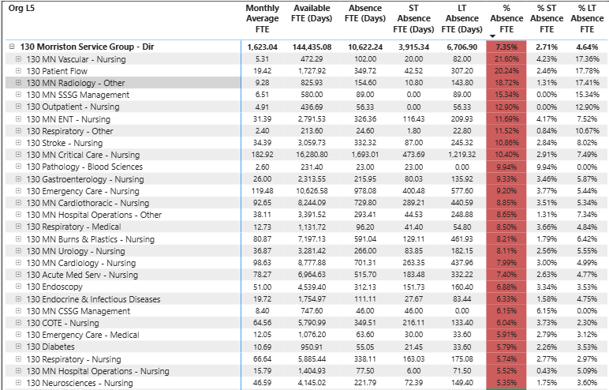
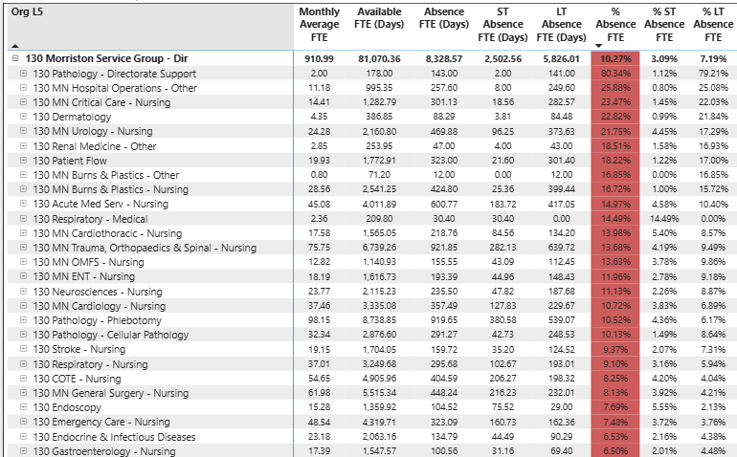
Sickness Report – Morriston Nursing & ACS (Monthly – February 2026 to April 2026)
Nursing
ACS
When considering the percentages in the tables above, alongside the FTE numbers and long-term sickness associated with the given areas it would appear that the top five to focus on for Morriston are as follows;
Nursing: Critical Care, Emergency Care, Cardiology, Cardiothoracic, and Burns & Plastics.
ACS: Phlebotomy, T&O and Spinal, General Surgery, COTE and Emergency Care.
As we see here, the area we see feature for both staff groups is Emergency Care.

Slide 7
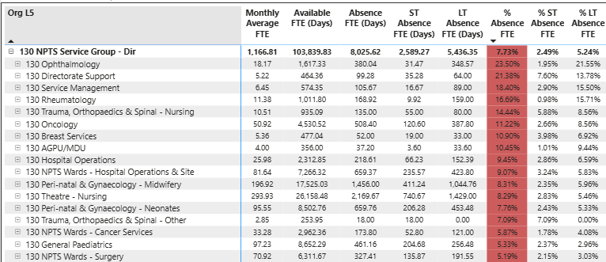
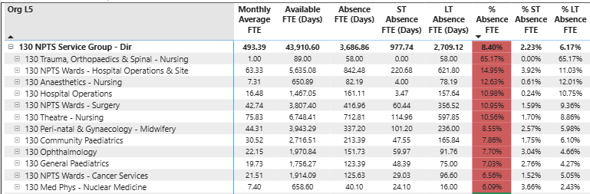
Sickness Report – NPTS Nursing & ACS (Monthly – February 2026 to April 2026)
Nursing
ACS
When considering the percentages in the tables above, alongside the FTE numbers and long-term sickness associated with the given areas it would appear that the top five to focus on for NPTS are as follows;
Nursing: Theatres, Perinatal Midwifery, Perinatal Neonates, NPTS Wards Hospital Ops, and Oncology.
ACS: Theatres, NPTS Wards Hospital Ops, Perinatal Midwifery, NPTS Wards Surgery, and Community Paeds.
As we see here, the areas we see feature for both staff groups are Theatres, NPTS Wards Hospital Ops, Perinatal Midwifery.

Slide 8
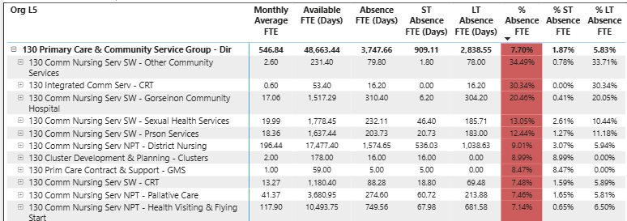
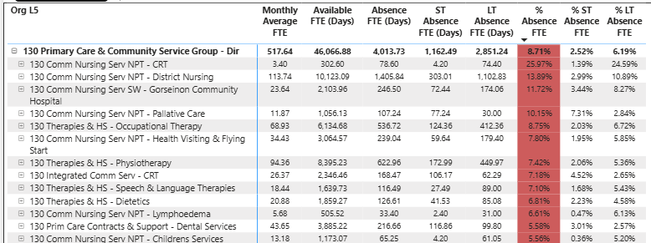
Sickness Report – PCCT Nursing & ACS (Monthly – February 2026 to April 2026)
Nursing
ACS
When considering the percentages in the tables above, alongside the FTE numbers and long-term sickness associated with the given areas it would appear that the top five to focus on for PCCT are as follows;
Nursing: District Nursing, Health Visiting & Flying, Palliative Care, Sexual Health and the Prison Service.
ACS: District Nursing, Physiotherapy, Occupational Therapy, Health Visiting & Flying and Gorseinon Hospital.
As we see here, the areas we see feature for both staff groups are District Nursing and Health Visiting & Flying.

Slide 9
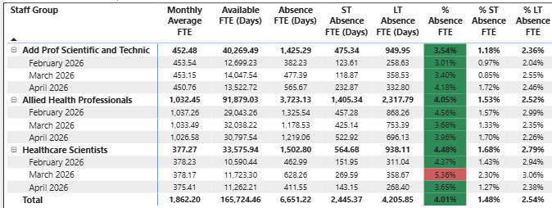
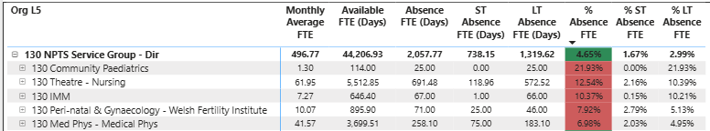
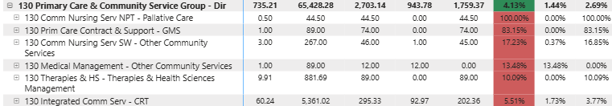
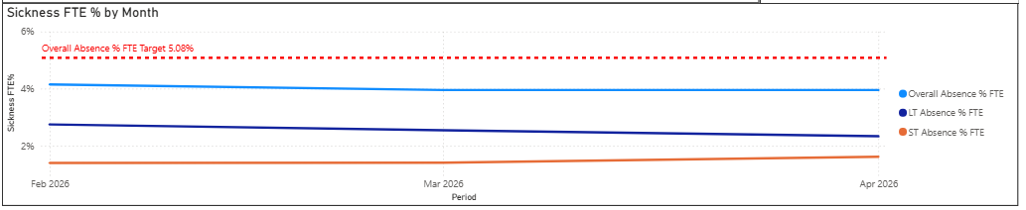
Sickness Report – AHP/HS/APST (Monthly – February 2026 to April 2026)
As we see in the top left table, overall sickness levels for AHP/HS/APST in the HB nearly always remain under the 5% threshold aside slightly over in March for Healthcare Scientists.
When considering the percentages in the table to the right above, alongside the FTE numbers and long-term sickness associated with the given areas, it would appear that the top five to focus on are as follows;
Theatres Nursing, Intergrated Community Services CRT, Medical Physics, Cellular Pathology, and OMF Nursing.
Positive news story for AHPHS in that both long-term and short-term sickness show a downward trend since December. If we are to consider areas outside of those with very small numbers of staff, the focus could be considered in areas such as Audiology, Speech Therapy (Adults & Paeds), Podiatry and Community (Resource and OCC Therapy).

Slide 10
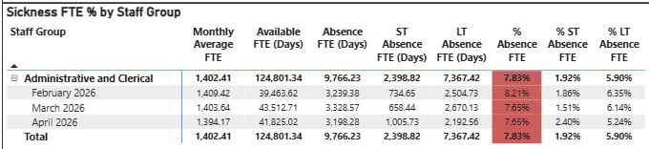
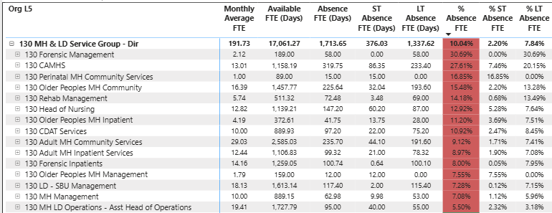
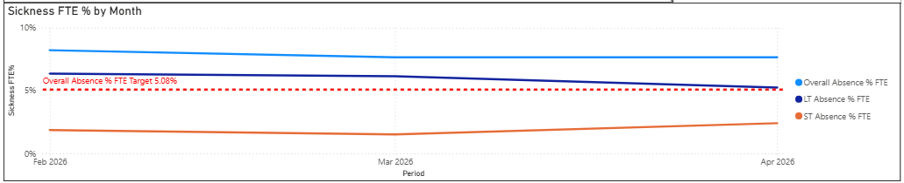
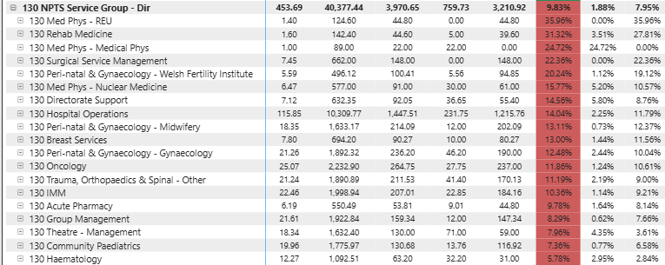
Sickness Report – Admin & Clerical (Monthly – February 2026 to April 2026)
As we see in the top left table, overall sickness levels for Admin & Clerical in the HB are on average 7.83%.
When considering the percentages in the table to the right, alongside the FTE numbers and long-term sickness associated with the given areas, it would appear that the top three to focus on are as follows;
MH&LD: Adult MH Community Services, SBU Management, and Older People’s MH Community.
NPTS: Hospital Ops, Oncology, and IMM.

Slide 11
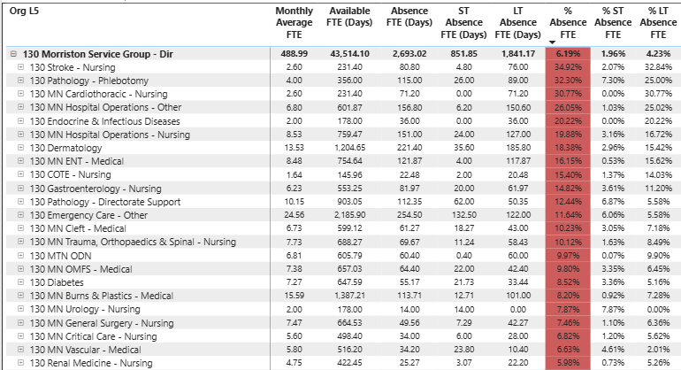
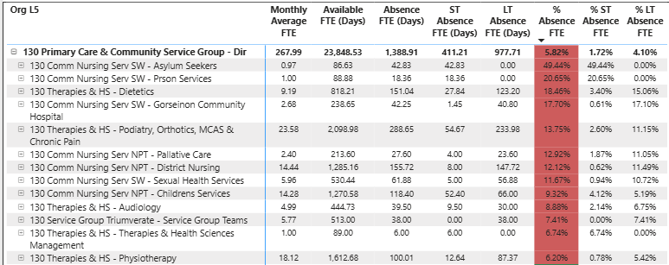
Sickness Report – Admin & Clerical Cont. (Monthly – February 2026 to April 2026)
When considering the percentages in the tables above, alongside the FTE numbers and long-term sickness associated with the given areas, it would appear that the top three to focus on are as follows;
Morriston: Emergency Care, Burns & Plastics, and Dermatology.
PCCT: Podiatry/Orthotics/MCAS & Chronic Pain, District Nursing, and Childrens Services.

Slide 12
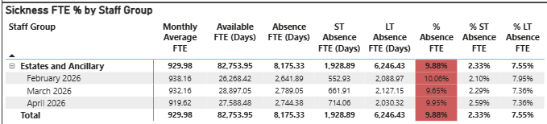
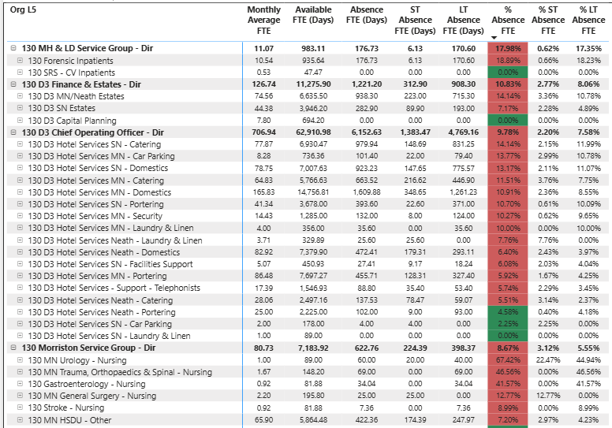
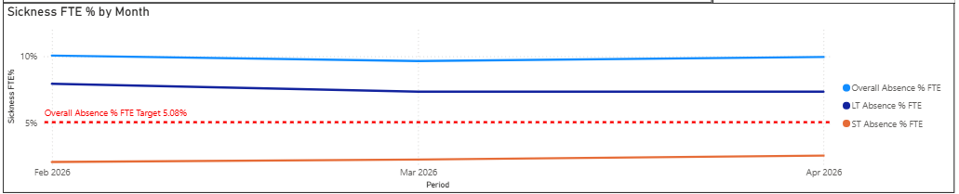
Sickness Report – Estates & Ancillary (Monthly – February 2026 to April 2026)
As we see in the top left table, overall sickness levels for Estates & Ancillary in the HB are on average 9.88%.
When considering the percentages in the table to the right, alongside the FTE numbers and long-term sickness associated with the given areas, it would appear that the top focus across all sites would be for Domestics, Catering, Portering, and Estates.
Is it that these areas do not have consistent use of the sickness absence policy and management of it? Do HR Business Partners report on it?

Slide 13
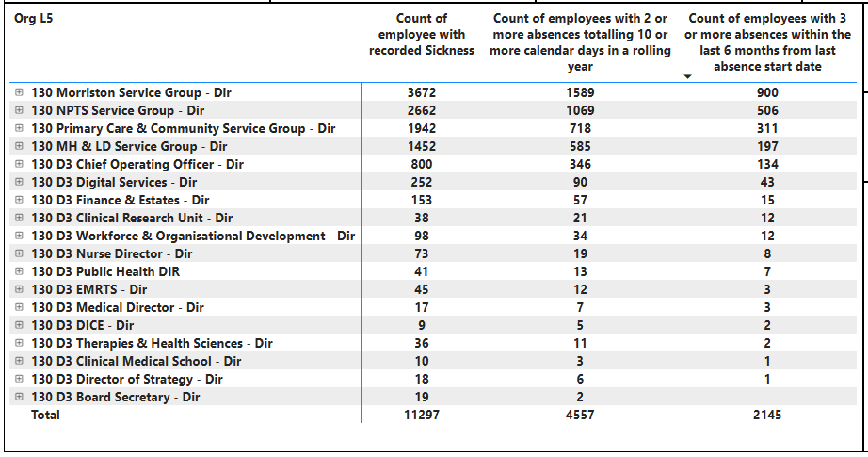
Overview of 3 or more episodes of sickness in rolling 6 month period – All Staff
When we consider those individuals that have had more than 3 sickness absence episodes over a 6 month period we note that the 5 top SG/Areas for this are the 4 main Service Groups and COO.
In the slides to follow we will see which staff groups are most affected. This being Nursing, ACS (especially HCSW and HCA), and Admin and Clerical.

Slide 14
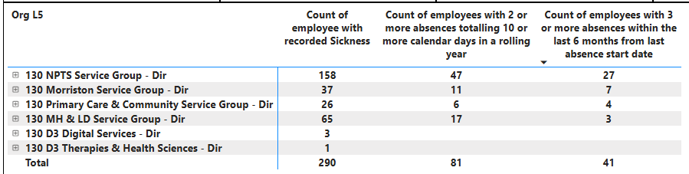
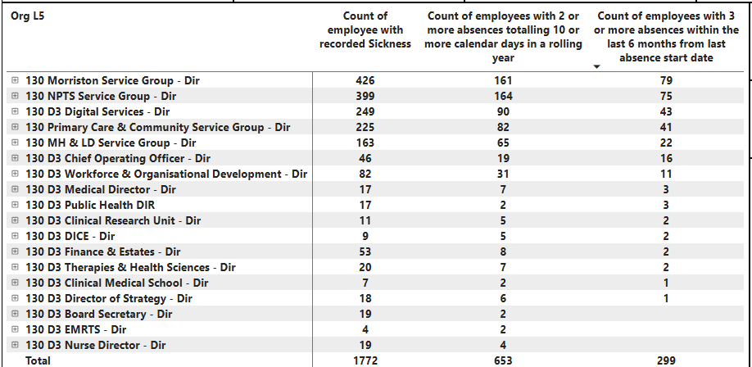
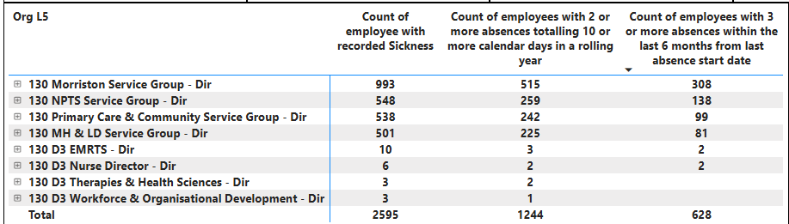
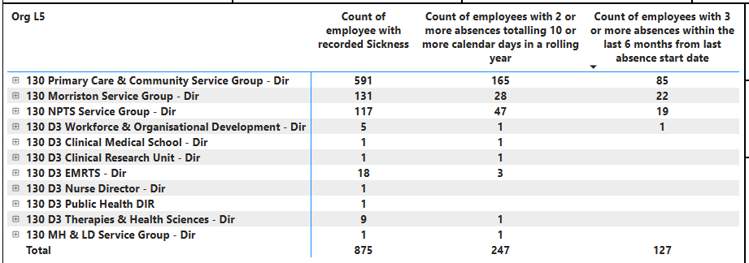
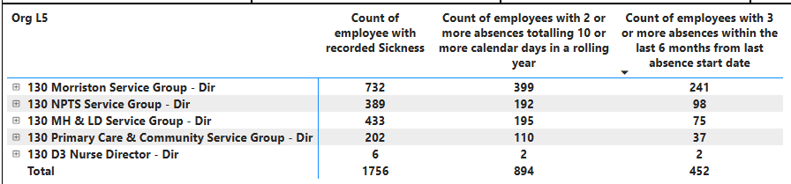
Overview of 3 or more episodes of sickness in rolling 6 month period – All Staff
APST
A&C
ACS
AHP
Of ACS above those that are HCSW or HCA

Slide 15
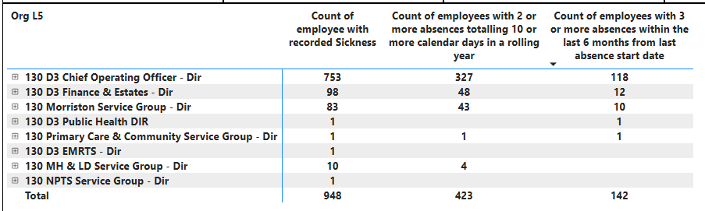
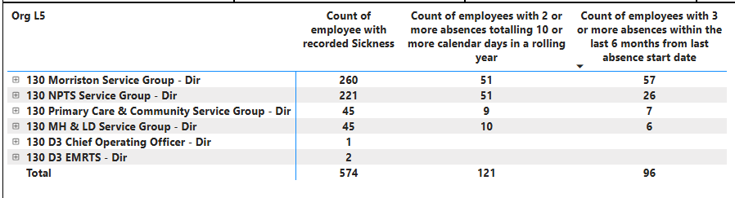
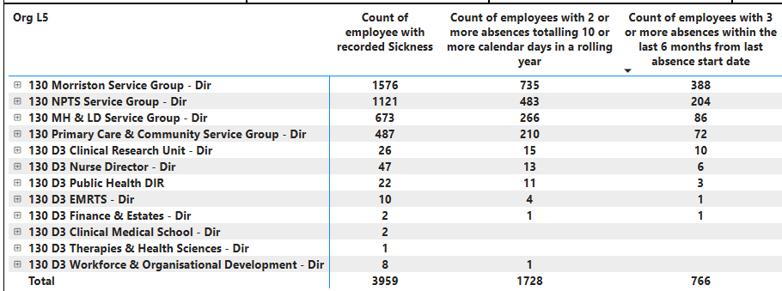
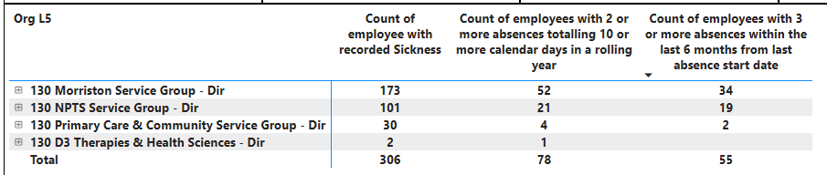
Overview of 3 or more episodes of sickness in rolling 6 month period – All Staff
E&A
Medical
Nursing
HS

