Slide 1

NHS Wales Staff Survey 2024
Results Highlights for SBU HB
Notes:
Reminder of the context
Led by HEIW – based on NHS England question set, Professor Michael West and the Kings fund research – links to Compassionate Leadership
Launched on 1st October 2024 to 29th November 2024 – Open 8 weeks
Total of 2,008 responses for Swansea Bay UHB – 12.9% (a reduction of 5.9 % on 2023 which was 18.8%. We had the lowest response rate in NHS Wales and I am keen we work together to understand this and how we can improve it for this year, acknowledging the importance of the survey for hearing the voices of SBU Staff to inform improvements in experience for both patients and our staff. I will come back to this shortly.
10 Question areas:
Morale
Patient Safety
Staff Engagement
We are Compassionate and inclusive
We recognise everyone’s contribution
We are all able to speak up
We are stronger together
We nurture healthy working environments
We champion flexible working
We are continuously learning and improving
Acknowledge, the results are taken at a snapshot in time and there is a significant amount of work that has taken place since November to improve in a number of areas as we will look at…

Slide 2
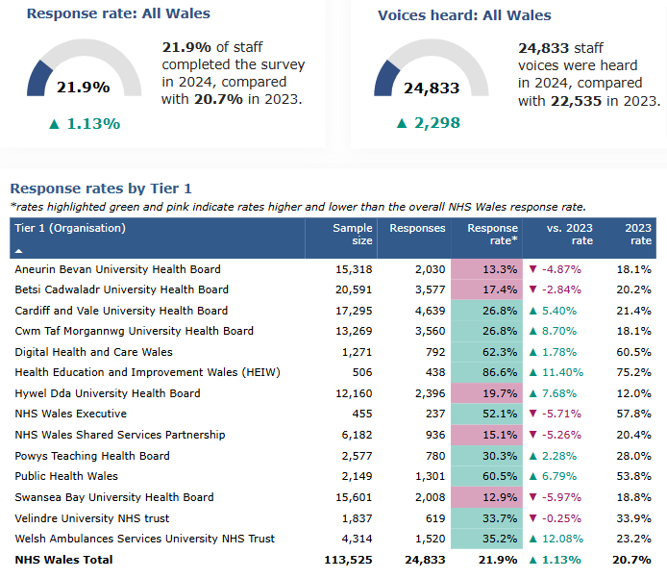
Response Rates – NHS Wales
Notes:
What do we know, looking at engagement with the 2024 National Survey across NHS Wales.
Highlight that we had a reduction in engagement of 6% along with some other organisations, however had the lowest response rate in NHS Wales and I am keen we work together to understand this and how we can improve it for this year, acknowledging the importance of the survey for hearing the voices of SBU Staff to inform improvements in experience for both patients and our staff.

Slide 3
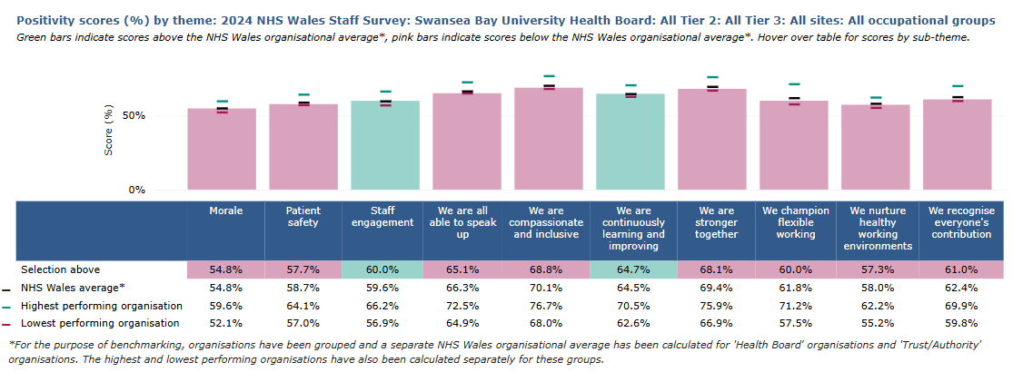
Summary Positivity (%) Scores Across the 10 Question Sets
Notes:
So what else has informed our focus on the top 3 areas. This visual shows at a glance how we fair against the NHS Wales average across the 10 question themes. We are in close alignment in some, however there are others that need attention, such as ‘we are compassionate and inclusive’ and ‘we are all able to speak up’.

Slide 4
Equality, Diversity & Inclusion
Question (*Total % response ranging from 1 to more than 10 times in the last 12 months) | Yes – 2023 | Yes - 2024
*In the last 12 months have you experienced bullying, harassment or abuse by your line manager? | 16.2% | 19%
*In the last 12 months have you experienced bullying, harassment or abuse from other colleagues? | 19.3% | 24%
*In the last 12 months have you experienced bullying, harassment or abuse by patients/service users/relative or members of the public? | 15.3% | 25%
I think that my organisation respects individual differences (e.g. culture, working styles, backgrounds ideas) | 65% | 59%
In the last 12 months have you experienced discrimination at work from a manager / team leader? | 6% | 8%
In the last 12 months have you experienced discrimination at work from other colleagues? | 6% | 8%
In the last 12 months have you experienced discrimination at work from a patient/service user/relative/public? | 7% | 9%
Notes:
Digging deeper into questions relating to compassion, inclusivity and belonging, specifically relating to bullying, harassment and abuse and equality, diversity and belonging, it is disappointing to see the increase in the responses across these questions and why this has been identified as 1 of our top 3 priorities to address.

Slide 5
Free Text – Thematic Analysis of Positive Comments
Supportive Teams: Many comments highlighted the supportive nature of immediate teams and colleagues. Phrases included “support team” and “great colleagues” frequently mentioned, suggesting a strong sense of comradery from respondents.
Job Satisfaction: Many expressed enjoyment and fulfilment in their roles. Comments such as “I enjoy my job” and “I love my job” were a common theme, indicating an overall satisfaction among respondents.”
Patient Care: Comments indicate a strong sense of pride in the quality of care provided to patients. Respondents frequently mention going “above and beyond” to ensure patient wellbeing, reflecting a deep commitment to their roles and their patients.
Notes:
Highlight the main positive themes extracted from the anonymous free-text comments.

Slide 6
Free Text – Thematic Analysis of Negative Comments
Management issues - variation in the quality of line managers negatively impacting on staff experience at work
Resource constraints – not enough resources to do my job. The impact of the additional scrutiny on vacancies and spend
Work Environment – welfare facilities and working environment
Staffing levels – not enough staff to meet the needs of the service
Career Progression – Lack of career progression opportunities/ succession planning
Bullying and Harassment – linked to protected characteristics
Notes:
Highlight the main negative themes from the anonymous free text comments and having looked at all of the data and parity with other workforce intelligence has led us to focus on the top 3 priorities outlined on the slide – briefly run through them

Slide 7
Top 3 Organisational Priorities aligned to our behaviours
Leadership & Management
Empowerment - we involve our staff early in service, process and policy changes and decision making
Visibility and communication – we re-connect with the front-line and enable better 2-way information flow, openness and transparency.
2. Speaking Up Safely/Raising Concerns
Feedback – when someone speaks up and raises a concern, we provide on-going feedback on progress and outcomes.
Listening into Action - we work collaboratively with those speaking up to address the concern, we demonstrate action and tell staff what we are doing (even if its honesty about what we can and we can’t tackle) when our staff are brave and speak up
3. Values and Behaviours
Compassion, inclusivity & belonging - We take demonstrable action to improve experience and perception of how the organisation supports and respects individual differences (e.g. culture, working styles, backgrounds ideas).
Bullying, harassment and abuse - We take a zero-tolerance approach to bullying, harassment and abuse at all levels of the organisation from both internal and external sources and improve the support given to those experiencing it.

Slide 8
Next steps – This will be a continuous journey not a final destination.
‘We Said, We’re Delivering Together’
WOD team developing a programme of work to support improvement inthe 3 organisational priorities
Service Groups will review their top 3 areas for improvement and identify plans of action and engagement activities.
Regular executive check ins through our communication channels around what we have done in response.
Abi’s midweek message will cover a spot light on ‘We said, We’re Delivering Together’, so show what we have learnt and what we are doing in response.
The next annual survey will commence in October 2025.

