Slide 1


Support Services
Sickness Absence
Neil Cooper Asst Director of Operations Joanne Jones, Head of Support Services
Rhian Mansel HR Business Partner

Slide 2

.
Support Services Sickness Absence plan
Introduction
Reducing sickness absence is a key area focus for the Support Services Department.
A commitment to reduce sickness absence consistently by 2% was made in July 2022- 11.98%
In aiming to achieve the reduction a sickness absence improvement plan was implemented, with the main aim to support health and wellbeing at work, sustain a high level of engagement and positive employee experience through the objectives and measures outlined within the plan.
Key actions of the plan were as follows:
Departmental Manager monthly meetings to monitor effectiveness of improvement plan.
Evaluation of MAAW pilot at Morriston.
Regular sickness absence audits.
Support development of management skills in MAAW.
Increase use of preventative measures to support improvement in reduction of sickness absence focused on health & wellbeing.
Conduct 'deep dive‘ analysis into hot spot sickness absence areas
*

Slide 3
Support Services
Monitoring of Progress
Performance against objectives were monitored at monthly hospital site sickness absence meetings, plus a quarterly Senior Support Services sickness absence group, which included Occupational Health Colleagues.
Actions completed:
Review of MAAW pilot at Morriston and appointment of an additional Governance officer post
Sickness Absence Toolbox Guidance developed by the HR operational team and HR monthly memos
MAAW training completed with 20 Supervisors/Managers trained
19 Wellbeing Champions
Weekly Case discussions with Management & HR operational team
Deep dive analysis into high absence areas, Morriston Domestic & Portering

Slide 4
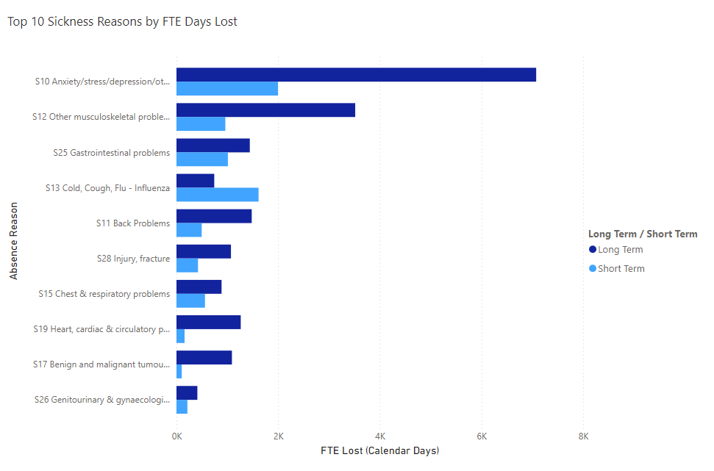
Deep Dive Analysis Morriston Porters since March 2024
ER cases | PADR % | Mandatory training % | Turnover % | Main reason for leaving
1 | 2.17% | 74.49% | 14.97% | Age retirement
<Age Profile | 21-25 | 26-30 | 31-35 | 36-40 | 41-45 | 46-50 | 51-55 | 56-60 | 61-65 | 66-70 | >=71 Years
2 | 2 | 6 | 6 | 11 | 14 | 17 | 17 | 29 | 10 | 1

Slide 5
Deep Dive analysis Morriston Domestics since March 2024
ER cases | PADR % | Mandatory training % | Turnover % | Main reason for leaving
0 | 88.15% | 94.17% | 10.82% | Age retirement
Organisation Name | <=20 Years | 21-25 | 26-30 | 31-35 | 36-40 | 41-45 | 46-50 | 51-55 | 56-60 | 61-65 | 66-70 | >=71 Years | Grand Total
130 P610 Community Domestics |  |  |  |  |  |  | 2 | 5 | 2 | 3 |  | 1
P |  | 3 | 11 | 15 | 16 | 14 | 23 | 37 | 41 | 41 | 10 | 6
Current Age profile analysis

Slide 6
Prevention & Early Intervention Strategies
Wellbeing Through Work
Sign posting staff to the Health Board’s s Wellbeing through work services and Canopi
Work Relates Stress Risk assessment Training
Work related Stress Risk Assessment training has been delivered to managers
Flexible Working
Consideration of flexible working requests i.e. changes in hours, rosters and areas of work 3 Managers are also members of the Flexible working sub-groups.
Menopause Awareness Training
As many department within supports services have a mainly female workforce. Menopause Awareness Training for Managers has been held by Sarah Davies, Senior Nurse Manager- Occupational Health, in order that Managers gained a better understanding of the HB’s Menopause Policy and the risk assessment included within it. There are also plans to create a Menopause Champion Network.
Tailored Adjustment Project
Support Services was the first area piloted for a tailored adjustment project which included working collaboratively with occupational health colleagues. Training sessions for managers were held on the types of tailored adjustment that can be offered to staff, in addition drop in sessions were arranged, facilitated by occupational health colleagues.
Managers were advised to ensure the tailored adjustment paperwork was completed and a review date agreed.
Men’s Health Awareness Sessions
Mathew Tidball, HP Lead, Occupational Health & Staff Wellbeing held a series of sessions with the Portering team, Morriston. The sessions focused on bringing awareness to health issues that affect men disproportionately and to get men to become aware of problems they may have or could develop, and gain the courage to do something about it. A session was also held for Support Services Management Team. There are future plans to hold further sessions.

Slide 7
Challenges
The following challenges are still a risk:
Sickness absence levels are still 10-12% and whatever actions are undertaken do not reduce the levels for any extended period of time.
Resources are stretched to manage sickness as the Managing Attendance policy is resource intensive to administer
The focus on staff well-being and support is a fantastic benefit and occupational health concentrate on staff wellbeing and getting staff to return to work. This often leads to a mismatch between the financial resources and the wellbeing support services offered. Two recent examples include the increased number of staff on restricted duties and certain ailments being “excluded” from sickness review prompts.
THE MAAW policy does not have a method to appeal an escalation to a stage of the MAAW Policy and this had led to the use of the R&R policy to challenge the decision
Organisational change processes, overtime restrictions and modernisation of working practices have led to increased absenteeism from work primarily due to work related stress.

Slide 8
Plans to address challenges:
Ensure that managers continue to deliver the Managing Attendance at Work policy, in a compassionate and emphatic way.
Encourage partnership working with Trade union colleagues, and ensure regular communication with the staff about sickness.
The Governance team will continue to undertaking regular sickness absence audits to ensure best practice is adhered to.
Support Services has been selected as the first department to work collaboratively with occupational health and wellbeing department to trial “Workplace Assessments”. The purpose of these, will be to facilitate ways staff can return to work and remain in work by identifying workplace adjustments to assist them manage their underlying health condition.
Implementation of the new revised sickness action plan
Undertake Café conversations with staff from hot spot sickness absence areas, i.e Domestic, Catering Morriston.
Sickness absence newsletter and sickness absence Golden Rules to be issued in February
Head of Support Services is a member of the Healthy People Forum
Health Board Values Workshops being held throughout February and March.

Slide 9
Diolch / Thank You

