Slide 1
Workforce and OD Committee
February 2025
Supporting Attendance at Work and Reducing Sickness Absence
Notes:
This slide can be used for presentations which are from a health board-wide perspective or for a whole HB audience as the graphic device to the right of the slide includes all four service group colours and red for the corporate team.

Slide 2

Current Challenges Impacting Staff Health & Wellbeing
Public Health data shows SBU is higher than average in relation to poor mental health and related hospital admissions
Highest rates of female suicides in Swansea and males in Neath
Port Talbot and SBU has the highest rate of deaths from diabetes in Wales
Highest long term absence due to mild-moderate Mental Health & MSK issues
Aging workforce with ‘sandwich generation’ pressures
Additional current stressors and pressures include:
  Health Board wide vacancy freeze,
  organisational change
  winter pressures.
Reports from local GP’s and staff wellbeing clinicians suggest increased ‘burnout’ amongst staff
Our 10 year vision requires a more agile, flexible workforce with increased generic clinical team working across sectors to help transfer hospital services that could be delivered in the community
Some staff will embrace change. Effective leadership is paramount to successful change management
Notes:
It is key we maintain a Population Health (North star) focus, working with our Public Health colleagues to understand the future health needs of our local population in a way that supports the development of a sustainable health and care system focused on prevention and early intervention.
There are some really important challenges facing our region such as suicide rates, mental health (psychological and emotional wellbeing) of young people and social deprivation. The projected risk factor related to health conditions in Wales, coupled with an ageing population will increase the number of people living with long term health conditions.
How does some of that translate for us here in Swansea Bay;
Swansea Bay has more deprived communities than average for Wales, over ¼ of communities falling into most deprived category.
In 2023, 386 suicides were registered in Wales, the male suicide rate continues to rise, with a 16% rise in men registered as dying by suicide between 22-23 in Wales.
Port Talbot and Swansea Bay have the highest rate of death from diabetes in Wales.
We have an estimated 7.7m people in the UK now balancing paid employment with unpaid care, with research evidencing links between those with caring responsibilities, and poor mental health. The Kings Fund produced research just last year, that concludes, without our unpaid carers the health and social care system would effectively collapse.
In terms of absence and patterns across the organisation;
sickness absence across the health board, steadily rose from 7.22% to 7.74% during the last quarter.
At the end of Dec-24, Anxiety/stress/depression was the highest reported reason for absence, accounting for 34% of all absence. This was followed by 10% of all absence due to MSK and 8% due to cough/cold/flu.
Over the last 3yrs (2022-24), whilst absences due to anxiety/stress/ depression have steadily increased and have remained the highest reason for absence, absences due to MSK have remained the same for the last 2yrs and the second highest reason for absence.
Monthly absence ranged between 7.77% (Dec-23) and 6.11% (May-23) over the last 2yrs but has remained consistent during both years (2023-24), apart from a slight spike during the months of June and July in 2023.
Absence rates in 2022 varied considerably from subsequent yrs (23/24), with peaks in the months of Apr, Jul, Dec, Jan, and Feb (likely to have been a legacy of the covid pandemic).
Monthly absence peaks were consistent in 2022 and 2023, with Dec being the highest months of absence and Apr/May the lowest.
Factors to consider, that may impact absence in the foreseeable future;
Primary care colleagues and staff wellbeing practitioners have recently reported a resurgence of NHS staff burn-out cases being reported by GPs.
Its too early to report any impact of recent decisions around recruitment, variable pay and the need to increase staff rotation, however, the increase in footfall through our front door services together with rotation may have been a contributory factor in the rise of the spread of infection. In addition, the uptake of vaccinations available to staff has been low.
This research provides us with the valuable insight we need to attain an ‘engaged, motivated and healthy workforce’ in Swansea Bay. The picture is multi-faceted and complex and in order to achieve this outcome, its essential we work together across all our functions, drawing together our local intelligence, expertise and resource to support continued improvement.

Slide 3
Managing Attendance at Work
Reflecting the themes of our People Strategy, staff wellbeing is a priority for the Health Board to ensure an engaged, motivated and healthy workforce that provides high quality and effective care for our patients.
Our sickness data is showing overall an improving trend since the pandemic, but our current levels remain higher than the All Wales target (see next slide).
The Workforce and Organisational Development Directorate supports Service Groups using best practice and evidence-based strategies to promote attendance at work and support the reduction of sickness absence.
There is a continued focus across the organisation on pro-active absence management and increased collaboration with staff-side colleagues in areas of high sickness absence to support this approach. TU partners have indicated one of their preference focus areas for our non-pay deal work is on sickness absences. This will feed into our Best Practice Review and we are creating a Healthy People forum.
Early intervention and prevention focused Occupational Health and Staff Wellbeing support is ensuring more staff are supported to manage their health whilst in work, reducing the need for sickness absence. The Service continues to deliver timely support for managers and staff with key KPI’s, developed between Welsh Government and staff-side, being consistently achieved.
We are shaping a workforce performance framework to ensure organisational wide impact around accountability for workforce and sickness will be a key metric within this. This will be a balanced scorecard approach considering all metrics together for example – consideration of staff utilisation as a whole. This will also allow a more targeted focus on positive performance in this area.
Notes:
Emma – our intensions for this session

Slide 4
Annual Sickness Absence 2022-24
The graph demonstrates annual sickness absence trends over the last 3yrs between 2022 and 2024.
Health Board rolling 12 month figure – 7.06%
NHS Wales rolling 12 month figure – 6.2%
Health Board in-month figure – 7.74%
Notes:
Jess, can you update the graph for this, not sure where it came from sorry.

Slide 5
Sickness Absence December 2024
Sickness absence across the health board, steadily rose from 7.22% to 7.74% during the last quarter (Oct-Dec). Long term sickness fell by 0.3% during the quarter, however, short term absence rose by 0.9% from 2.18% at the end of October 2024 to 3.04% by December 2024.
At the end of Dec-24, Anxiety/stress/depression was the highest reported reason for absence, accounting for 34% of all absence. This was followed by 10% of all absence due to MSK and 8% due to cough/cold/flu.
The highest number of absence occurrences (single episodes) during the quarter however, were as a result of cold, cough and flu, at almost double the number of absence episodes since the last quarter. This was followed by an increase in absence occurrences relating to Gastrointestinal problems. This picture reflects the reported national rise in ‘quad-demic’ viruses.
Over the last 3yrs (2022-24), whilst absences due to anxiety/stress/ depression have steadily increased and have remained the highest reason for absence, absences due to MSK have remained the same for the last 2yrs and the second highest reason for absence.
Monthly absence ranged between 7.77% (Dec-23) and 6.11% (May-23) over the last 2yrs but remained fairly consistent during both years (2023-24), other than a slight increase between April-July of 2024.
Absence rates in 2022 varied from subsequent years (23/24), with peaks in the months of Apr, Jul, Dec, (likely to have been a legacy of the covid pandemic).
Monthly peaks in sickness absence were consistent in 2023 and 2024, with Dec being the highest month of absence and Apr/May the lowest.
Notes:
Emma – our intensions for this session

Slide 6
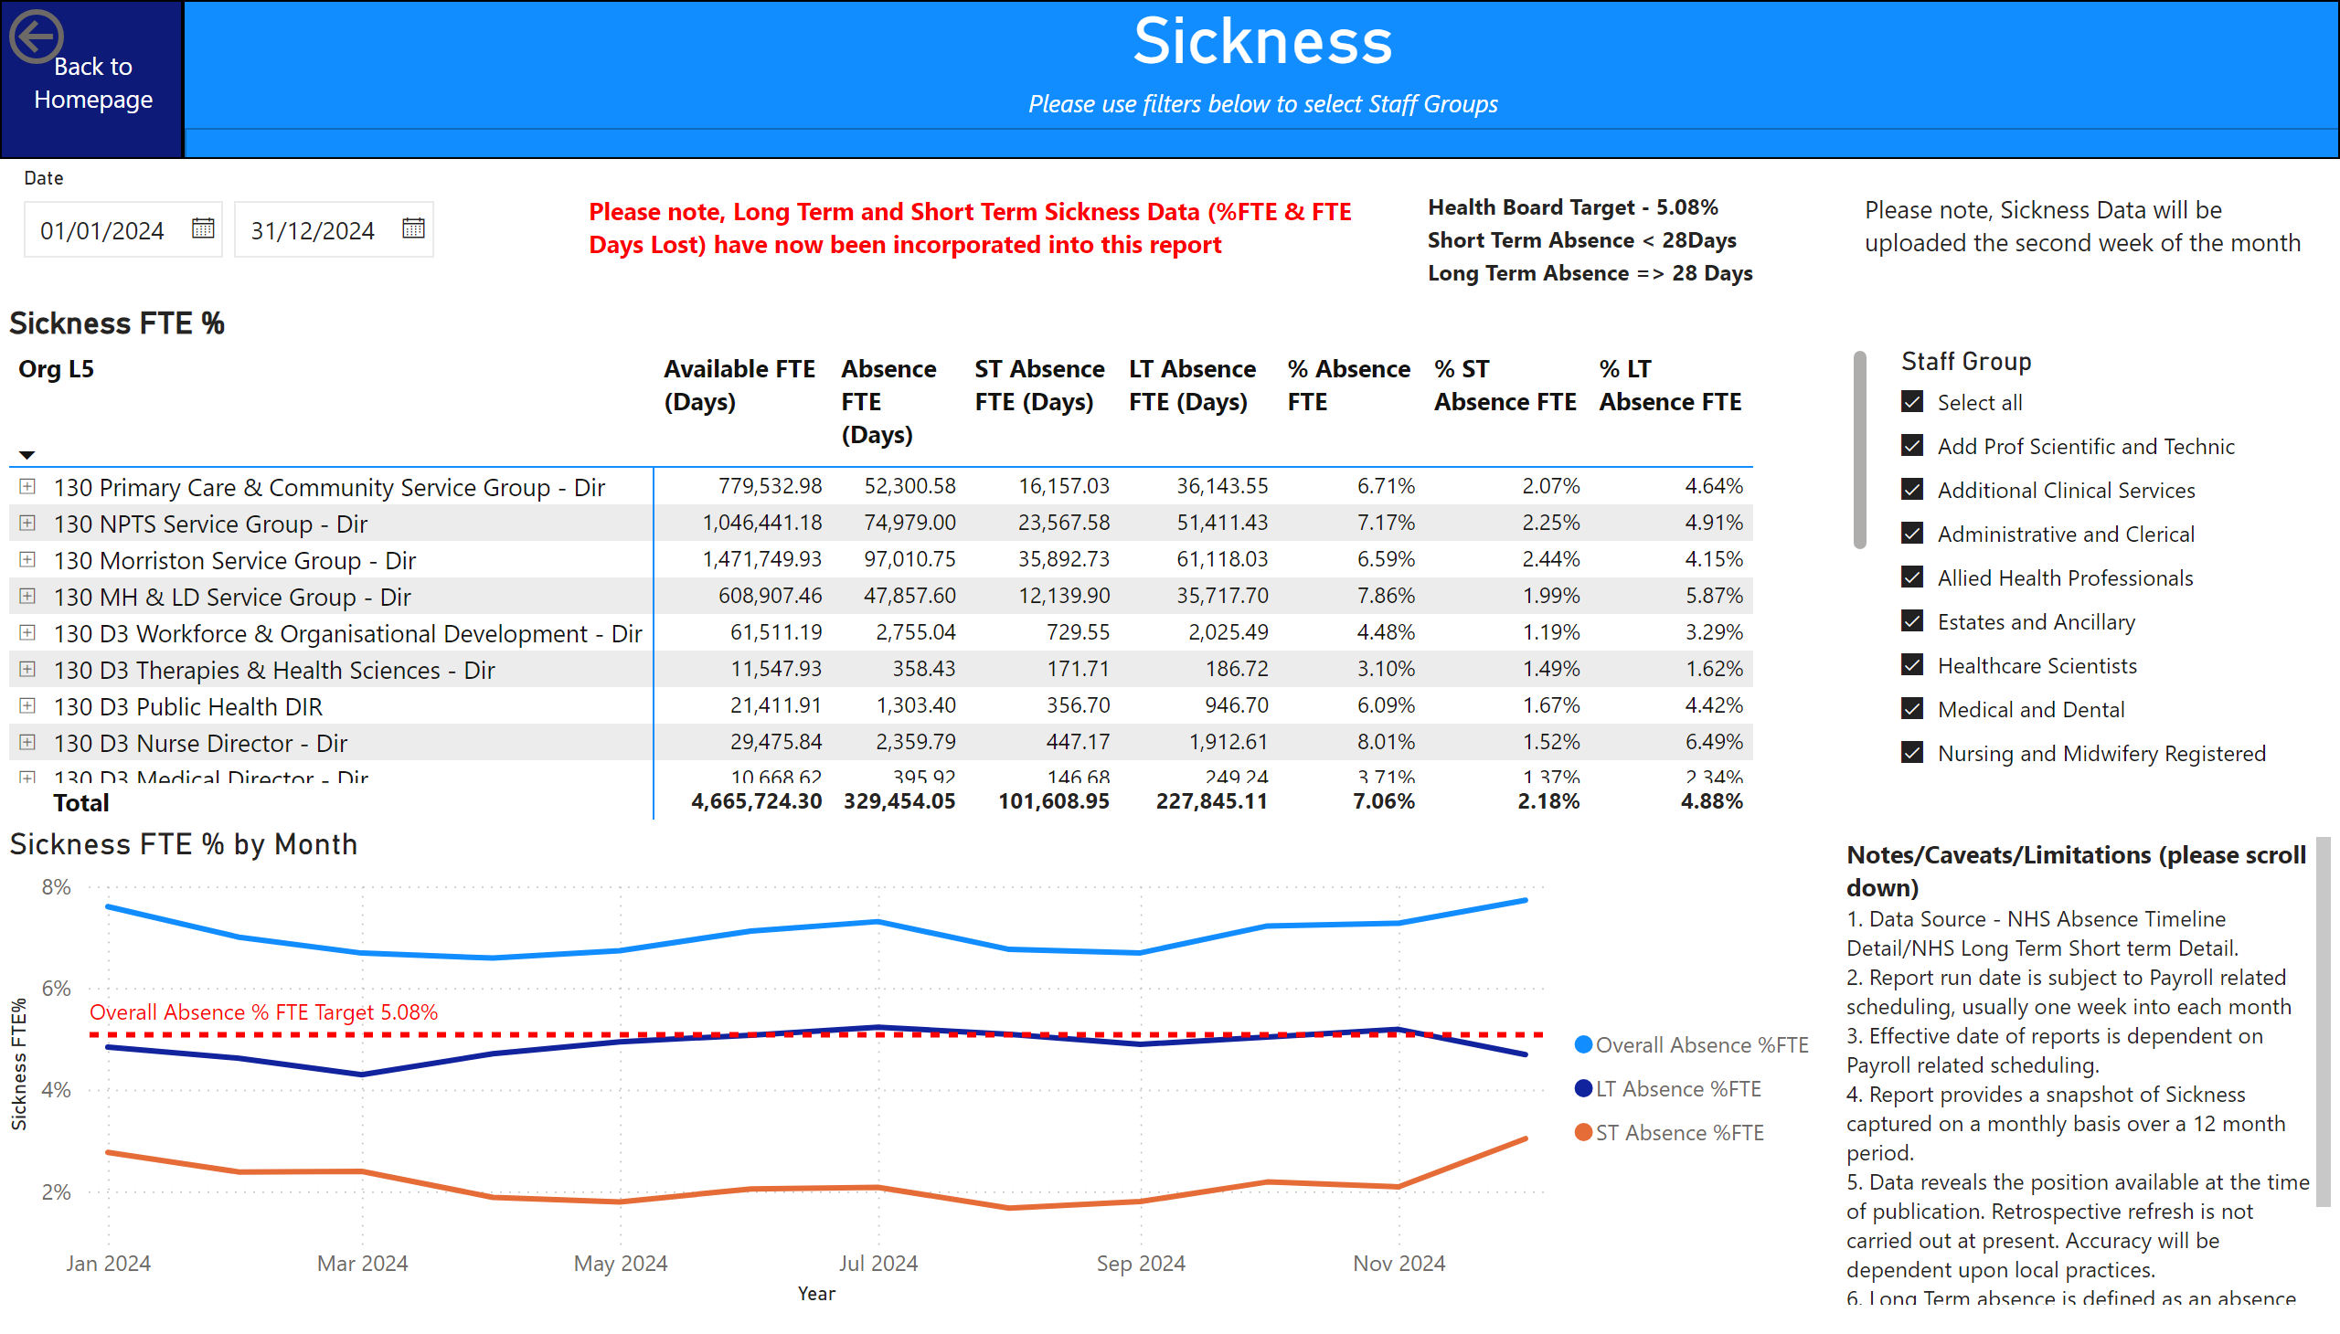
Sickness Absence December 2024
Notes:
Emma – our intensions for this session

Slide 7
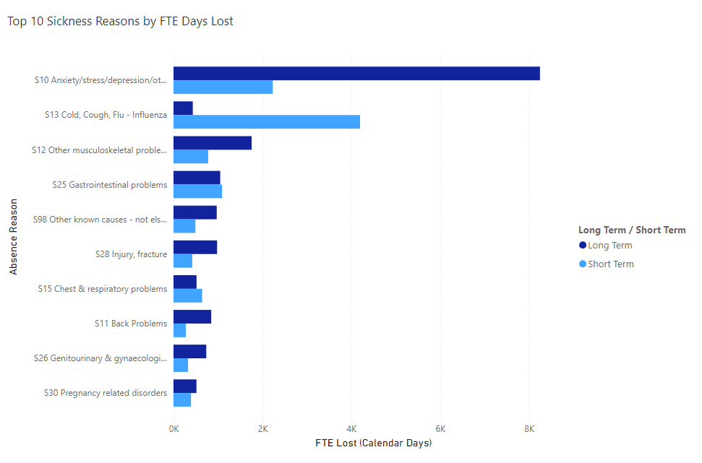
Reason for Absence December 2024
Notes:
Emma – our intensions for this session

Slide 8
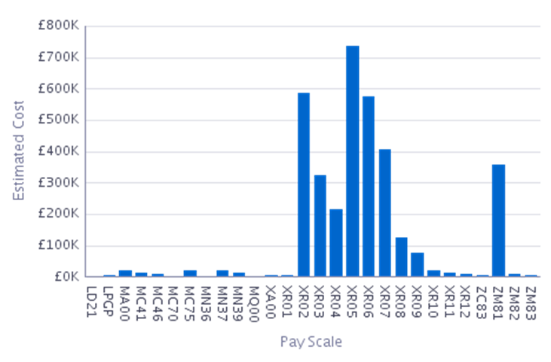
Estimated Cost of Absence Dec-24
130 D3 Board Secretary - Dir | £9,881
130 D3 Chief Operating Officer - Dir | £211,739
130 D3 Clinical Medical School - Dir | £202
130 D3 Clinical Research Unit - Dir | £19,105
130 D3 DICE - Dir | £3,046
130 D3 Digital Services - Dir | £66,089
130 D3 Director of Strategy - Dir | £6,869
130 D3 Director of Transformation - Dir | £260
130 D3 EMRTS - Dir | £12,699
130 D3 Finance & Estates - Dir | £44,572
130 D3 Medical Director - Dir | £4,938
130 D3 Nurse Director - Dir | £18,345
130 D3 Public Health DIR | £5,118
130 D3 Therapies & Health Sciences - Dir | £8,408
130 D3 Workforce & Organisational Development - Dir | £41,046
130 MH & LD Service Group - Dir | £486,886
130 Morriston Service Group - Dir | £1,131,693
130 NPTS Service Group - Dir | £925,602
130 Primary Care & Community Service Group - Dir | £555,141
Grand Total | £3,551,641
Notes:
Emma – our intensions for this session

Slide 9
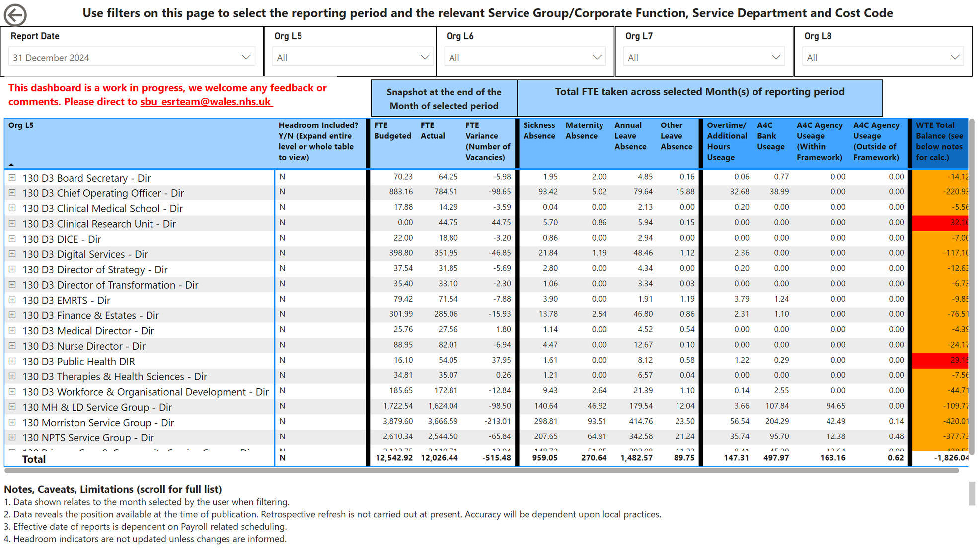
Variable Pay Dec-24
Notes:
Emma – our intensions for this session

Slide 10
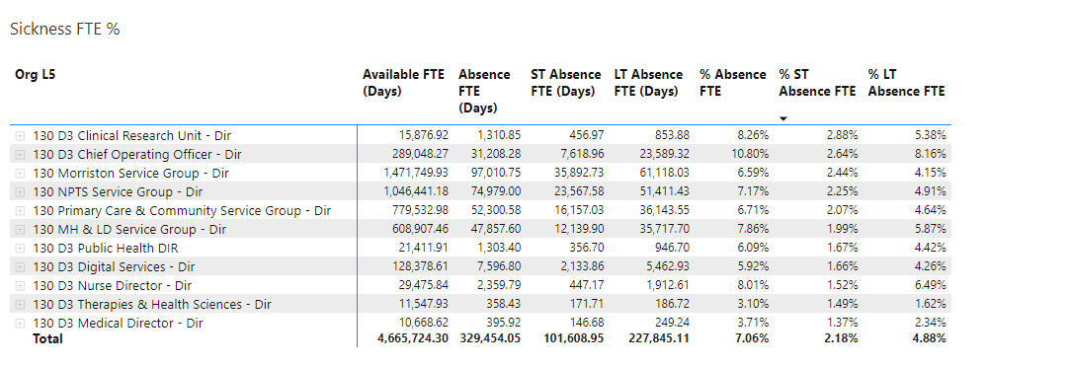
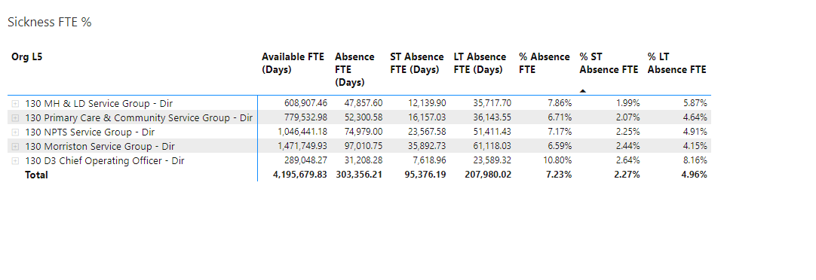
Engaged,Motivated &Healthy December
Sickness Absence Metrics – Health Board Wide
Key Performance Indicator | 2024/2025 NHS Wales Target | NHS Wales 12m av. | Jan 24 | Feb 24 | Mar 24 | Apr 24 | May 24 | June 24 | July 24 | Aug 24 | Sep 24 | Oct 24 | Nov 24 | Dec 24
Sickness Absence | 5.5% | 6.2% | 7.60% | 7.00% | 6.69% | 6.59% | 6.73% | 7.12% | 7.31% | 6.76% | 6.69% | 7.23% | 7.26% | 7.74%
LTS vs STS Analysis – December 2024
Supporting our employees to maintain attendance:
Monthly Events Calendar for Occupational Health & Staff Wellbeing.
Wellbeing resource pack available to all employees.
Access to Guardian Services and working in partnership with Trade Union colleagues.
Refresh and roll out of MAAW Training to all leaders, reinforcing compassionate leadership and supporting employees to maintain attendance, return to work.
Introduction of Tailored Adjustment training for leaders – encouraging flexibility to work arrangement and prevent absence.
Carers Support Group – our data supports that a high percentage of Anxiety/Stress is due to caring responsibilities. Leaders are encouraged to provide flexible working arrangements to support and to signpost employees to the Carers Support Group at each Service Group.
Top 5 Hot Spot areas – December 2024
Action plans in place to reduce absenteeism in hot spot areas:
11.89% in COO Directorate mainly driven by long term absence within Hotel Services. Targeted Intervention Groups have been established within these areas to ensure clear actions and deliverables are set and achieved.
MH&LD remains the Service Group with the highest levels of absence, at 8.62%, a 1% increase since the last quarte. Stress/anxiety/depression reported as highest reason for absence. Dedicated staff counsellor to support early intervention/prevention of sickness absence, targeting areas of high work related stress, TRIM support continues and psychology group wellbeing sessions twice a month for overseas nurses to prevent absence and to support the anxiety of transition.
PCCT were the Service Group with the lowest % sickness absence at 6.91%. Anxiety/Stress Depression reported as highest reason for absence. TRIM support available, deep dive into absence continues, Wellbeing action plan in development.
Both Morriston and NPTS Service Groups saw a 0.6% increase in sickness absence since the last quarter. Anxiety/stress/depression remain the highest reason for long term absence, both SG’s saw a rise in short term absence due to cough/cold/flu cases. Action plans to address absence in both area’s continue to be monitored and implemented.
Notes:
Emma – our intensions for this session

Slide 11
Managing Attendance at Work Action Plan
Action | Target Date | Driven by | Progress Update
Develop a standardised Performance Framework for Health Board sickness absence reporting – common targets with Hywel Dda linked to Joint Committee | 01/04/2025 | Emma Owen/Jessica Rogers/Melanie Dellibovi | Draft presented to R&S Board – Ongoing Action.
Absence data to reflect current position identify HB trends LTS/STS, HB hot spot areas | 01/04/2025 | Emma Evans/Melanie Dellibovi | Workforce Dashboard has been developed – actively engaging with key stakeholders to obtain feedback to support further role out. Ongoing Action.
Service Group Deep Dives – identify hot spot areas, further develop action plans | 01/04/2025 | HRBPs | Findings and action plans developed from each deep dive will be reported to WOD Committee -Morriston, NPT/Singleton service groups having made presentations; Estates & Support Services to attend next committee. Ongoing Action
Conduct a holistic review of process & practices Service Groups – identify opportunities for improvement | 01/04/2025 | Melanie Dellibovi | A report on findings will be produced and shared with key stakeholders – what are we doing, what is working and what do we need to stop doing. Ongoing Action.
Rolling Programme - Managing Attendance at Work stand alone module. | 01/04/2025 | HR Team | Metrics MAAW training attendance will be provided – AHRBP’s to publish schedule and send out teams invites to SG’s, whilst HR Ops work through uploading onto ESR. Ongoing Action.
Publicise MAAW ‘How To’ guides to include bite size training as part of our Brilliant Basics platform | 31/01/2024 | HR Team | How to guides developed – actively working with Communications on a comms plan. Now available on sharepoint pages, signposted through Brilliant Basics. Continued development of further bite sized training. Ongoing Action.
Utilise Partnership Compact to enhance opportunities for employees to return to work which aligns with our commitment in the Welsh Government Non-Pay agreement | 01/04/2025 | HR/TU | Currently exploring what more we can do in partnership - actively exploring any gaps in order to streamline the process. Ongoing Action
Establish Healthy People Forum | 26/11/2024 | Paul Dunning/Melanie Dellibovi | Inaugural Forum on the 26-Nov-24. Date of next meeting 25-Feb-25. Ongoing Action.
Continue to deliver OH&WB early interventions and managers trainings | 01/04/25 | OH & Wellbeing | Mens Health, Staff Health Checks and Menopause training in-situ and related Comms for managers training in place.
Notes:
Emma – our intensions for this session

Slide 12
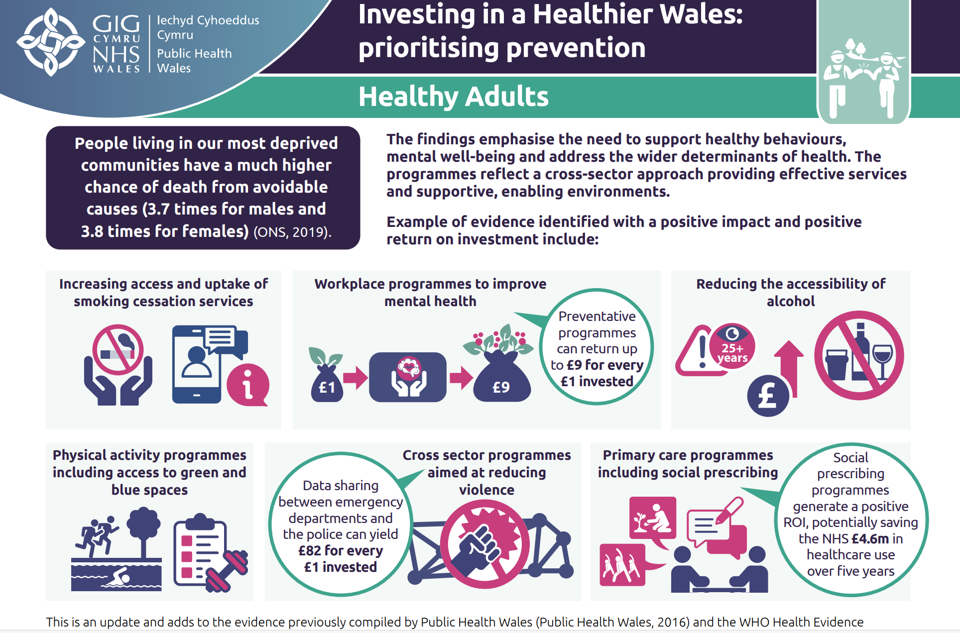
Our Staffs Health & Wellbeing - what we are doing?
Well established evidence base that ‘good work is good for health’ – how do we ensure all our teams provide ‘good work?’
Continued focus across the organisation on early intervention, pro-active absence management and increased collaboration with staff-side colleagues in areas of high sickness absence and corporate areas to support this approach.
The first meeting of the Healthy People Forum took place in November 2024, co-chaired by Staff Side colleagues and the Head of Staff Health & Wellbeing
The Occupational Health and Staff Wellbeing Service continue to deliver timely support for managers and staff with key KPI’s, developed between Welsh Government and staff-side, being consistently achieved.

Slide 13
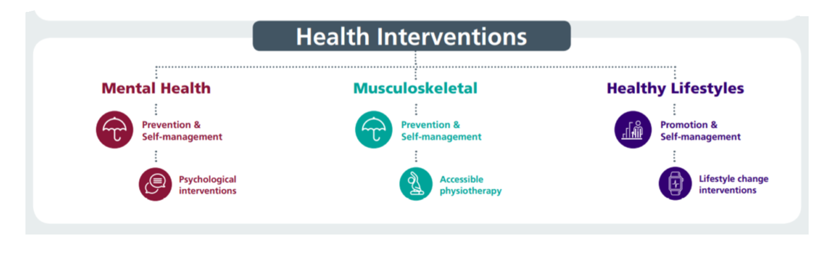
Our Staff Wellbeing Services Supporting Physical and Mental Health with a Focus on Prevention / Early Intervention
53% referrals to the service are staff in work (presentees) supporting early intervention, 47% of referrals are sickness absentees
Increased number of referrals into the Staff Wellbeing Service:
Period | Total Referral | Mental Health Referral | MSK Referrals
Jan – Dec 2023 | 1239 | 1027 | 212
Jan – Dec 2024 | 1654 | 1328 | 326
Percentage Increase | 33% | 29% | 54%
Self-reported outcome data suggests staff sickness absence may be higher without the support of the staff wellbeing service: 70% of staff in work when accessing support stated the service helped them remain in work and 59% stated the service helped improve work performance
Specialist Psychological interventions for trauma & PTSD. Increased capacity in self-management for anxiety, depression, self-harm and suicide
New staff bereavement support map to support managers with breadth of interventions for staff as highlighted by SG’s
Suicide Prevention – 50 disclosures of related thoughts in 12 month period with significant reductions post-intervention.
Trauma Risk Management (TRiM) team rolling out preventative and post-critical incident support - 166 staff TRiM trained to deliver and support, 4281 staff REACT trained, 79 bespoke interventions for teams/services after critical, adverse incidents
634 Wellbeing Champions supporting teams with wellbeing info/signposting and health promotion activities– regular update workshops
Manager training - use of work-related stress assessment, managing mental health at work, use of tailored adjustments and menopause in the workplace
Over 700 staff health checks undertaken since June 2024 with cholesterol blood levels to help identify risk factors of cardiovascular health and other health conditions, including support and signposting.
The first meeting of the Healthy People Forum took place in November 2024, co-chaired by Staff Side colleagues and the Head of Staff Health & Wellbeing, resulting in Health Board wide actions

Slide 14


Next Steps
Tri-partite approach with staff side, Welsh Government and occupational health community to improve equity and access to occupational health services
‘Future proofing’ – evidence = increase in young female MH, aging population & increased caring responsibilities.
Learning from UK best practice – eg West Yorks NHS Trust re approach to Carers
HB Staff as a Population Health Community supporting the Population Health Strategy – focus on early intervention and prevention/health promotion eg development of health checks, G-TEP for accumulative stress, Men’s Health, ‘Steps to Wellbeing’, health promotion campaigns.

Slide 15

Diolch / Thank You

