Slide 1
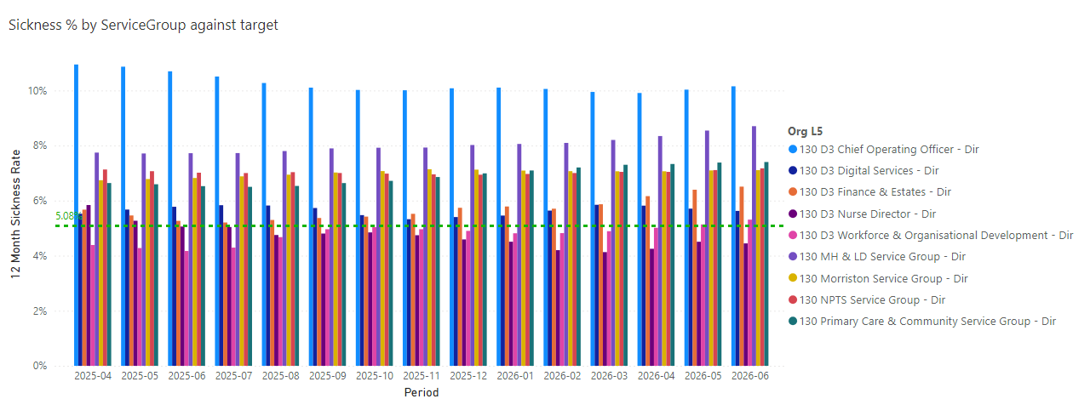
Health Board wide Sickness by Service Group (L5)

Slide 2
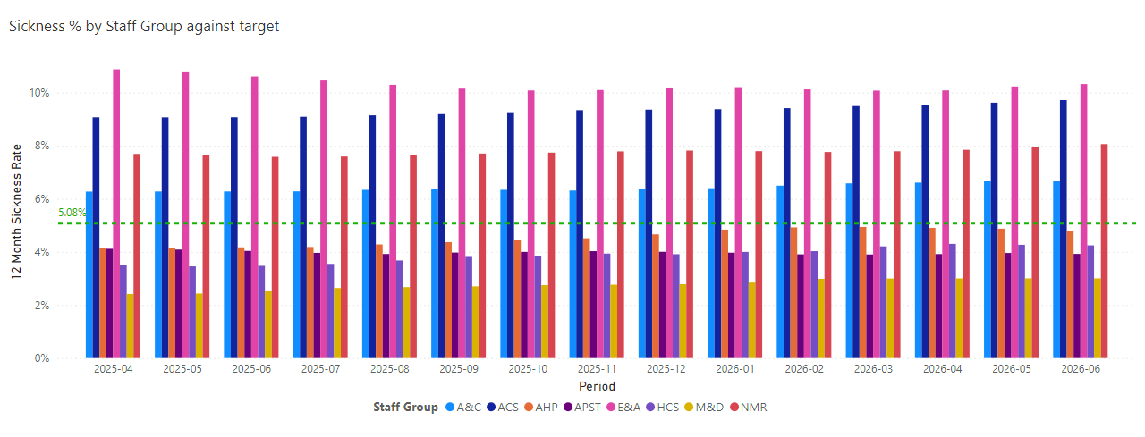
Health Board wide Sickness by Staff Group

Slide 3
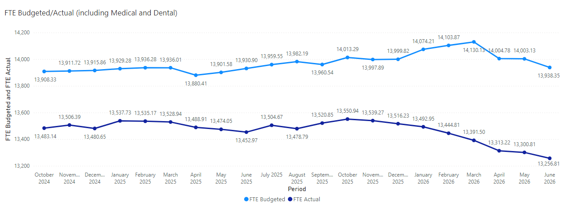
Health Board FTE Budget and FTE Actual

Slide 4
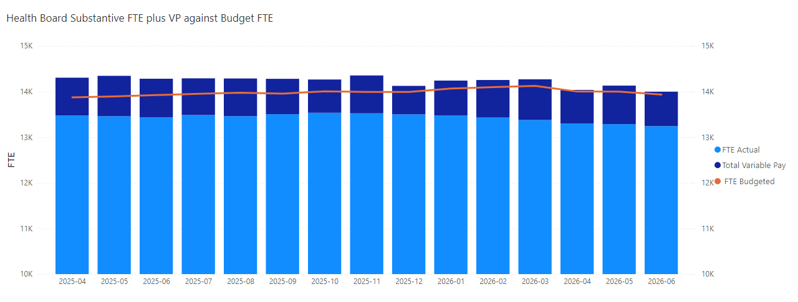
Health Board Substantive FTE Actual plus Variable Pay against and FTE Budget

Slide 5
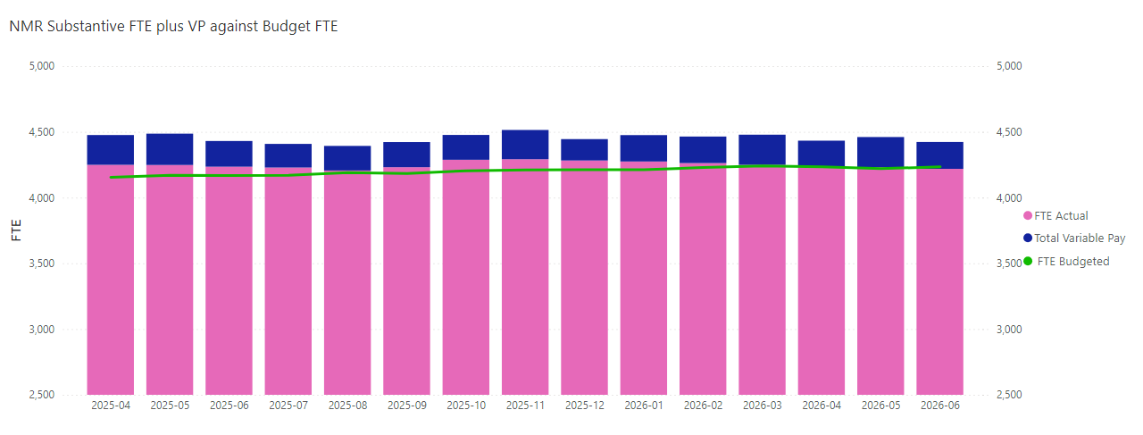
NMC Only

Slide 6
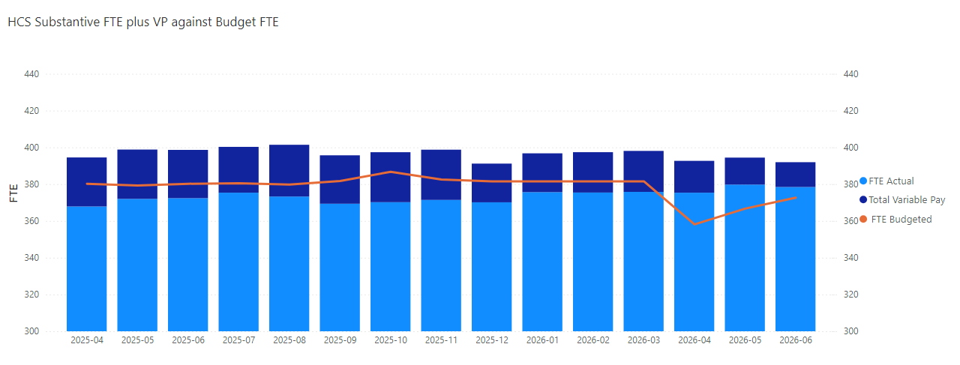
HCS Only

Slide 7
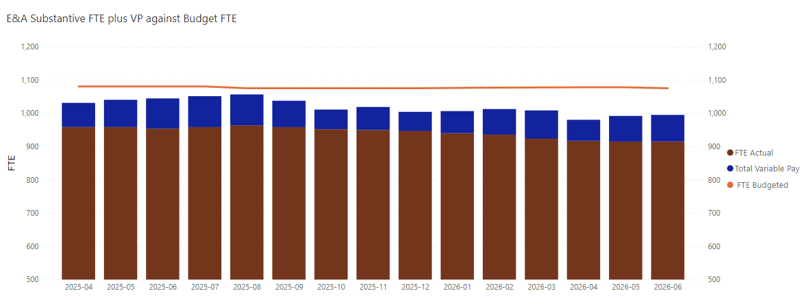
E&A Only

Slide 8
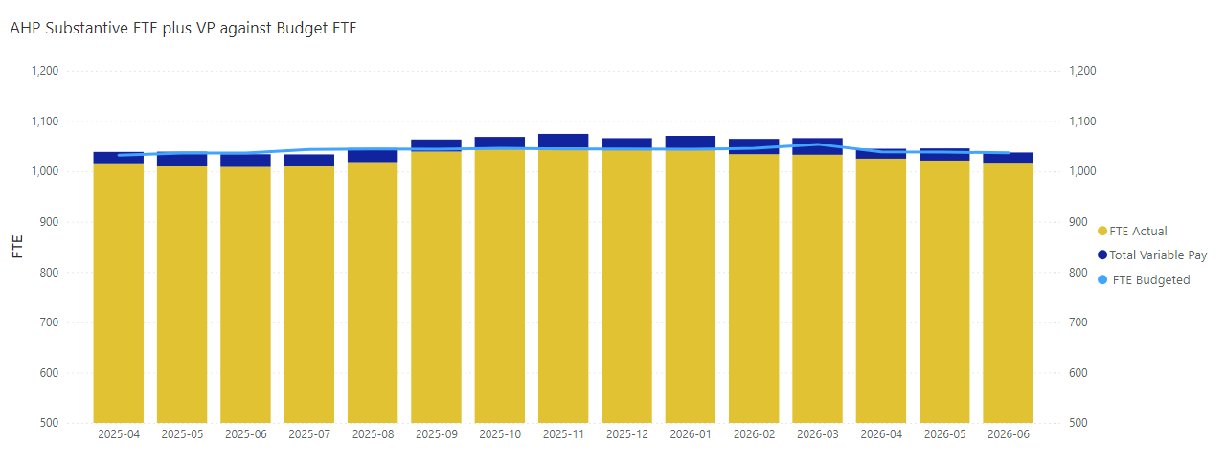
AHP Only

Slide 9
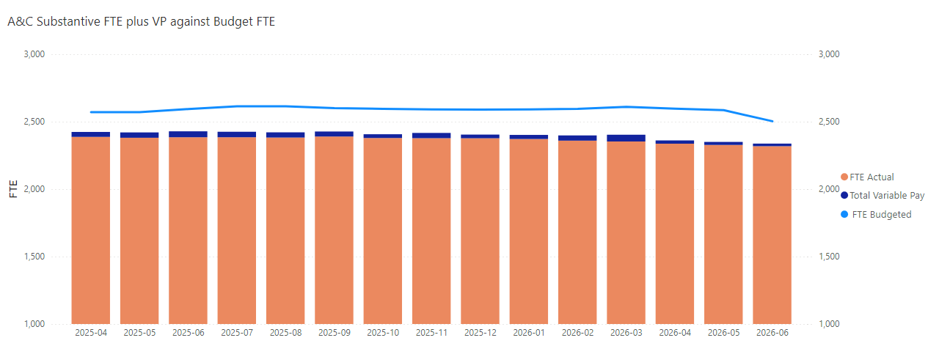
A&C Only

Slide 10
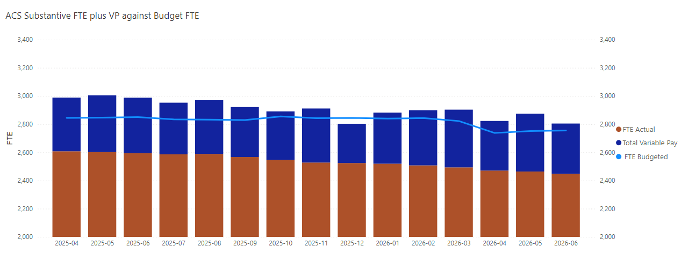
ACS Only

Slide 11
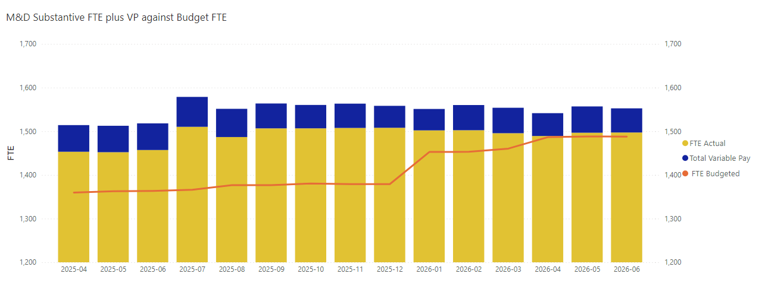
M&D Only

Slide 12
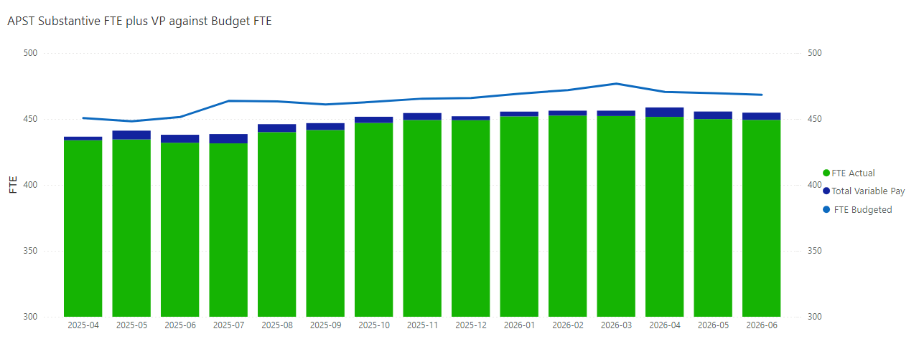
APST Only

