Slide 1
Workforce & OD Committee
14th August 2025
Staff Health & Wellbeing Services
Supporting Sickness Absence
Management
Notes:
This slide can be used for presentations which are from a health board-wide perspective or for a whole HB audience as the graphic device to the right of the slide includes all four service group colours and red for the corporate team.

Slide 2
Staff Health & Wellbeing Executive Summary
Reflecting the themes of our People Strategy, staff wellbeing is a priority for the Health Board to ensure an engaged, motivated and healthy workforce that provides high quality and effective care for our patients
The Workforce and Organisational Development Directorate supports Service Groups using best practice in line with the Managing Attendance at Work Policy and evidence-based strategies to promote attendance at work and support the reduction of sickness absence
There is a continued focus across the organisation on pro-active absence management and increased collaboration with staff-side colleagues in areas of high sickness absence to support this approach. This has also been confirmed with Welsh Government as part of SBUHB Non-Pay Agreement
Early intervention and prevention focused Occupational Health and Staff Wellbeing support is ensuring more staff are supported to manage their health whilst in work, reducing the need for sickness absence.
The Occupational Health and Staff Wellbeing Service continue to deliver timely support for managers and staff with key KPI’s, developed between Welsh Government and staff-side, being consistently achieved.
Notes:
Emma – our intensions for this session

Slide 3
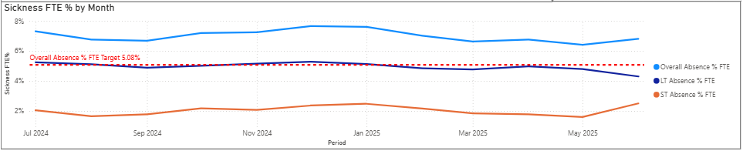
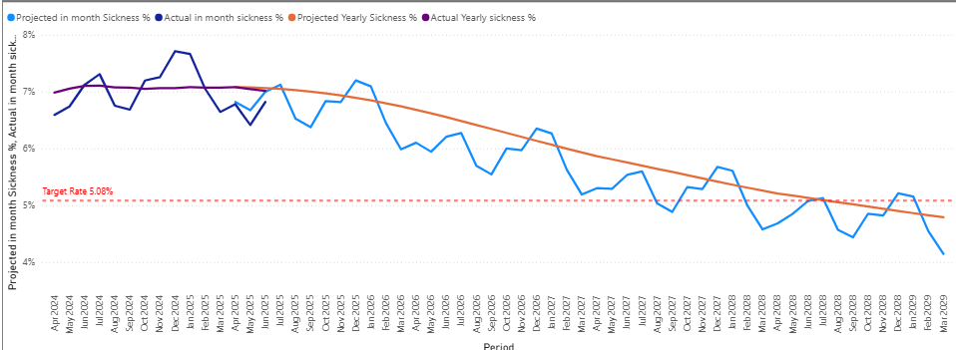
Health Board Absenteeism Trend
In-month June 2025 sickness absence rate 6.82% against a target of 5.08%.
Whilst there is a steady decline in Long Term absence, Short Term absence is increasing
This graph provides a trajectory of when we will meet our sickness absence target of 5.08% based on historical trends. Our Action Plan (included) will assist us in working towards this plan
Notes:
Emma – our intensions for this session

Slide 4
Health Board Plan on a Page
Sickness absence reduction plan – Sickness absence rates remain high and are contributing to the financial challenges of the Health Board. |  |  | Date Agreed: July 2025 Programme Lead: Paul Dunning
1. Problem Statement |  | 2. Scope
Background: The Health Board has a deficit of £46.3million significantly above our control target of £17million which means increased scrutiny by Welsh Government. Unavailability of staff remains high resulting in increased reliance and spend on bank and agency, increasing variable pay. Problem: The average sickness rate in 2024/2025 for SBUHB was 7.10% against a target of 5.08%. SBUHB continue to have the second highest absence rate across Wales. High sickness across the Health Board is resulting in increased variable pay, decreased availability of staff, decreased productivity and low morale within remaining teams. Mental health challenges remain the highest reason for sickness absence. Variability in compliance with the policy is impacting on staff experience and ensuring a timely return to work. Impact: effective scrutiny and governance will support managers to proactively manage sickness absence in line with the policy and ensure that our workforce remain well in work. |  | In Scope: All staff groups |  | Out of Scope: Volunteers Contractors
 |  | 3. Programme Goal(s)
 |  | To implement compliance assurance with policy. To review mental health and wellbeing support
 |  | 4. Key Exit Criteria (what will success look like)
 |  | Assurance on compliance with the policy. A sustained reduction in sickness absence.
5. Short term objectives 2024/25 | 6. Medium term objectives 2026/7 | 7. Key Programme Milestones
Implement monthly service group sickness absence reviews. Support service groups in embedding sickness compliance audits. Undertake a review of the options available for compliance reporting. Scope best practice undertaken across the UK to support Mental Health. Implement return to work reporting information on ESR | 6. To scope collaborative working with other health Boards on manager education. 7. To present an options appraisal (following the scoping exercise) on Mental Health & wellbeing support in relation to best practice. 8. To implement corporate compliance reporting. | Milestones |  | Lead | By When | Status
 |  | Implement Service Group monthly meetings |  | HRBP’s | July | Completed
 |  | Implement Service Group audits |  | HRBP’s | Sep 25 | In progress
 |  | Review Mental Health support |  | Paul Dunning | March 26 | Not started
 |  | Compliance reporting |  | Jess rogers | March 26 | Not started.
8. Key Risks | 9. Driver metrics | 10. Impact: planned benefits relating to Health Board Strategic Objectives
Organisational changes. Operational service demand may impact on progress. Capacity | Sickness absence rate Improved engagement score in the staff survey. | Interdependent with other workstreams under the variable pay steering group
 |  | Co-dependency with workforce and operational plans – to ensure the right staff with the right skills are in the right place to deliver our services
 |  | Co-dependent with the temporary staffing plan
 |  | Co-dependent with safer staffing plans
Notes:
Project Charter: Service Ready
Date Agreed:
Start Date:
End Date:
True North Strategic Themes
Population and System
Patient Experience
Quality Outcomes and Safety
Sustainable Services
Our People
1. Problem Statement
2. Scope
Background:
Problem:
Impact:
In Scope
Out of Scope
3. Project Goal
4. Exit Criteria
5. Sponsor and Project Team
6.Governance Structure
7.Project Roadmap and Timescales
Executive Sponsor:
SRO:
Process Owner(s):
CI Support:
Subject Matter Experts:
Patient Group:
Responsible: to directly manage and deliver the project
Action
Lead
By When
Status
Accountable: to oversee the project and ensure delivery of the stated objectives and outcomes
Consulted: to be engaged in the development and delivery of the project. To ensure engagement with the wider organisation
Informed: to be assured about progress towards the delivery of the project
8. Critical Success Factors and Key Risks
9. Project Targets and KPIs
10. Impact: planned benefits relating to True North strategic priorities
Population and System:
Our People:
Patient Experience:
Quality Outcomes and Safety:
Sustainable Services:

Slide 5
Health Board Absence Trends
In-month June 2025
Sickness absence has increased slightly in June to 6.82% from 6.76% reported in April 2025. Long term absence reported in June is 4.31% a reduction since the last reporting period by 0.67%. Short term absence reported in June is 2.51%, an increase of 0.76% since the last reporting period. Anxiety/stress related absence remains the highest reason for long term and short-term absence, a trend witnessed across NHS Wales. Anxiety/Stress/Depression reported in June 2025 accounts for 2.40% of all in month sickness absence, the number of FTE days lost due to Anxiety/Stress/Depression has increased by 0.01% since the last reporting period The second highest reason for long term absence is Musculoskeletal, which accounts for 0.53% of long-term absence. The second highest reason for short term absence is Gastrointestinal problems which accounts for 0.31% of short-term absences across the Health Board The professional group with the highest absence rate is Estates and Ancillary reported to be 9.56% in June. Our data supports that the hot spot areas within this professional group is Catering and Domestics. The group have a detailed action plan to address. Mental Health & Learning Disabilities remains the Service Group with the highest levels of absence at 7.57%, an increase of 0.53% since the last reporting period. Long term sickness has reduced since the last reporting period but short-term absence has increased by 1.23% Primary Community Care & Therapies Service Group remain to be the Service Group with the lowest level of sickness absence, but this has increased from 6.63% in April 2025 to 6.66% in June, this is due to increased absences in the District Nursing team. Sickness absence in Morrison (6.81%) has increased slightly since the last reporting period, whereas sickness absence in Neath Port Talbot/Singleton (6.71%) has decreased slightly since the last reporting period.
Notes:
Emma – our intensions for this session

Slide 6
Short Term Sickness Absence
HR Team/Occupational Health Support
We are seeing an increase in Short Term absence vs Long Term Absence, with the most common reason for Short Term absence being Anxiety/Stress related
A recent deep dive in Morriston confirmed that from those individuals approached, 80% of short term absence due to Anxiety/Stress was predominately linked to personal stress but that there is evidence to support some Anxiety/stress was work related (15%). The top 3 factors for personal stress were bereavement, caring for dependants and stress at home
Our Staff Survey 2024 confirms that 34.2% of respondents feel burnt out because of work and 41.1% feel worn out at the end of the shift. It is positive to note that 51.6% feel SBUHB take positive action towards improving Health and Wellbeing, recognising that there is more we can do to further improve
In order to support our employees with Anxiety/Stress, specifically personal stress as outlined above, we have partnered with Carers Wales to ensure support is available for our employees, we are also developing a Carers Policy – in alignment with other Health Board across Wales. We are promoting our Flexible Working Policy and automated Flexible Working Applications via ESR. We have introduced a Bereavement Support group available to all employees and we have also developed a Wellbeing Resource pack, outlining additional support available to assist our employees
We have updated our Managing Attendance at Work training and bite-size learning to ensure there is a clear impetus on compassionate conversations and leadership at all times.
Notes:
Emma – our intensions for this session

Slide 7
Long Term Sickness Absence
HR Team/Occupational Health Support
Data in June confirms that 2670 employees reported absent from work due to long term and short-term sickness absence
1367 employees have been referred to Occupational Health for an assessment since January 1st 2025
223 employees are on/approaching half pay
68 employees are on/approaching nil pay
Within the HR Operations team we have 9 FTE Senior HR Advisors. The HR Operations team are currently actively supporting 313 long term sickness cases which has been the area of focus for the last 7 months. The team are supporting these cases in addition to 113 open Employee Relations cases
A recent Time in Motion study within the HR Operations team confirms that 60% of working time is spent on supporting long term sickness cases (attending reviews & advising)
Since April 2025, all Long-Term Final Absence Review meetings are taking place at or before 12 months continuous absence in line with Policy
In the last 12 months the HR Operations team have supported 47 Ill Health Retirement exits.
Notes:
Emma – our intensions for this session

Slide 8
Recent developments within Workforce to support managing attendance at work
HRBP teams are leading Monthly Sickness Absence Summits where long term/short term absence data is analysed, action plans to address hot spot areas/trends agreed and compliance against policy assessed
Audit leads identified in each Service Group have received training on the Morriston Audit tool which enables localised compliance audits against Policy
The HR Operations Team have developed a Managing Attendance at Work Pathway to support leaders in sickness absence management in alignment with Policy (Slide 9)
From April 2025, the HR Operations team and Assistant Business Partners conduct Managing Attendance at Work training on a monthly basis across the Health Board in addition to Managers Pathway training which includes this module. Booking via ESR is enabled for leaders. So far 360 Supervisors and Managers have completed Managing Attendance at Work training
Bite-size learning continues to be developed in line with the Managing Attendance at Work Policy which provides just in time training for leaders (Slide 10)
ESR and Healthroster automatically sends prompts to leaders to remind them to conduct a Return-to-Work interview. Both systems record the number of Return-to-Work interviews undertaken. Since this launched on xx, x Return to Work interviews have taken place
ESR and Healthroster have a trigger prompt functionality which has now been enabled – this will prompt leaders when a trigger has been reached.
Notes:
Emma – our intensions for this session

Slide 9
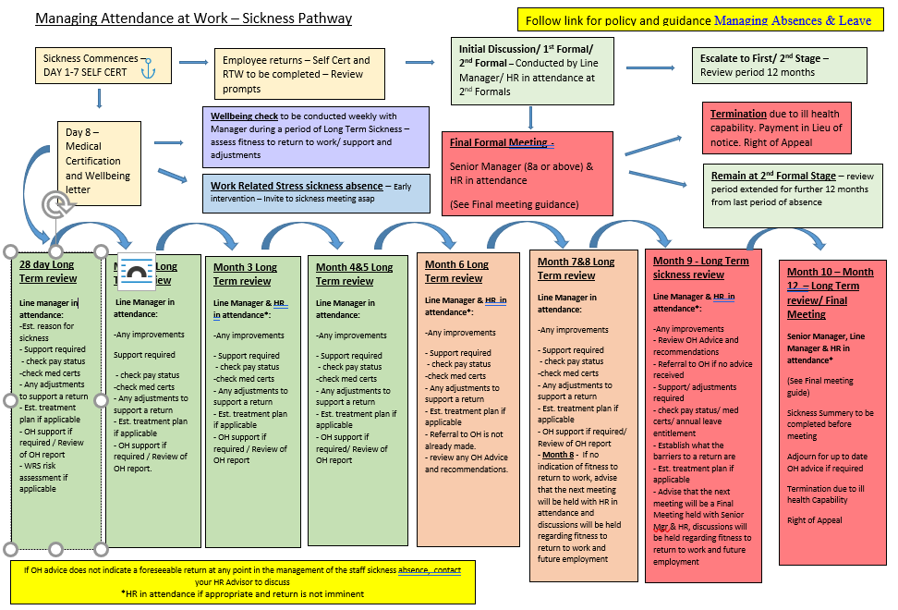
Managing Attendance at Work Pathway
Notes:
Emma – our intensions for this session

Slide 10
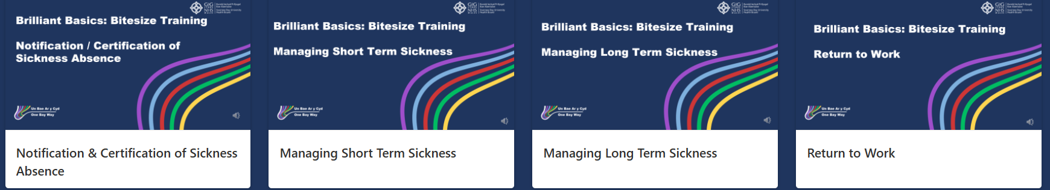
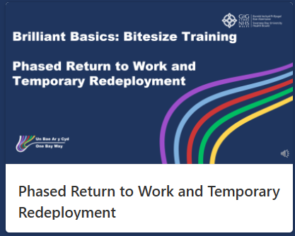
Brilliant Basics Bite-Size Learning
We are in the process of developing further modules to support our leaders in managing attendance at work. Just in time training to support ongoing discussions. So far, the page has been viewed 1393 times
Working jointly with Hywel Dda to develop further bite-size learning which will save time and resources. Collaboration will continue
Notes:
Emma – our intensions for this session

Slide 11
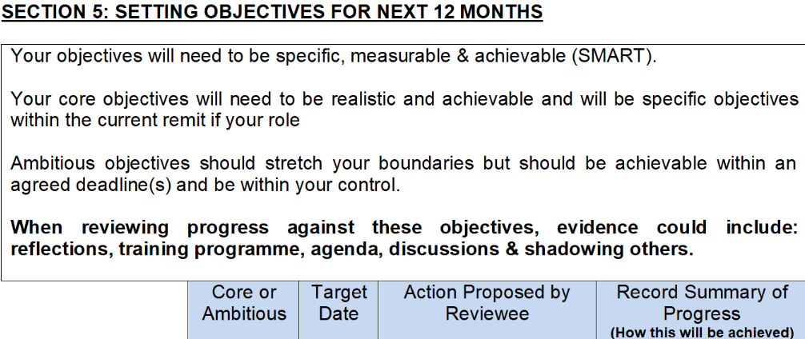
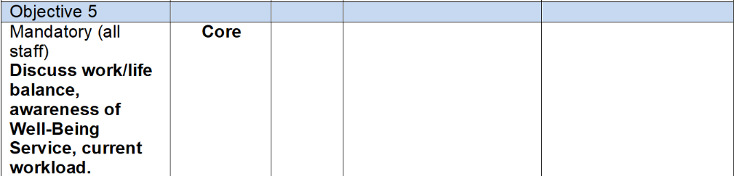
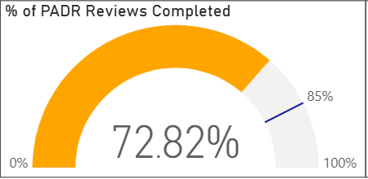
PADRs and Compassionate Leadership Discussions
HRBP teams are reinforcing how critical regular check ins with their teams are in order to support health and wellbeing in the workplace
The PADR is an opportunity to agree this as an objective and review regularly
PADR compliance remains below target – HRBP Teams utilise monthly Service Group performance meetings to review compliance rates and agree actions to reach target, addressing any barriers in completion.
Notes:
Emma – our intensions for this session

Slide 12
Health Board Action Plan
Action | Lead | By when | RAG Status | Comments/ Update | Evidence
Deploy Business Partner (BP) teams to coordinate responses within Service Group (SG) – creating SG teams who will focus on absence | BPs | 16th April 2025 |  | Service Group Sickness Absence Team members: HRBP, AHRBP, HR Ops, SG Leaders, SG Audit Lead Group to meet on a monthly basis to review: Hot spot areas All LTS cases 6+ months – agree next steps All STS cases at trigger level – agree next steps Managing Attendance at Work Training Compliance RTW’s compliance Fit note/Self Certification compliance | SG Action plans
Pull dedicated support from HR operations team to work with SG Team to support the audit of 10 hot spot areas for sickness and confirm action plans | JR | 16th April 2025 |  | Review Ops workload & capacity Dedicated SG Ops members to provide information at Service Group Sickness Absence Team meetings | Capacity reviewed
Deploy Corporate Nursing to coordinate roster managers on roster efficiency to engage in SG teams – focus of review on efficiency of roster scrutiny process | SGD | Immediate Effect
Deploy LW from Morriston SG to train SG teams on deep dive audits | JR | Immediate Effect |  | Agreement from COO and SG Lead to deploy LW temporarily on a train the trainer basis –Lisa has commenced training on the Morriston Audit tool

Slide 13
Health Board Action Plan
Each SG and Department to deploy someone to coordinate their deep dives and to be trained by LW | SG Director | April 2025 |  | The role of the audit lead will be to conduct Managing Attendance at Work compliance audits following training delivered by Lisa as above. This won't be their full role but a requirement to complete in addition to their role. | Audit leads identified – training underway
Dashboard Utilisation to help track and manage sickness absence | BP/SG Director | April 2025 |  | All managers have access to dashboard –BPs have reviewed the dashboard and provided feedback to the ESR team for consideration to further develop the dashboard. The dashboard will be used to report during Performance Routines and Board meetings | Dashboard
BPs to create and publish a consistent report which will be issued to R&S on a monthly basis | JR | w/c 14th April |  | The workforce dashboard will be used to report absence at R&S. Action plans will be shared | Report template completed and utilised

Slide 14
Health Board Action Plan
Each BP team to coordinate a review of those staff who have exhausted sick pay (currently circa 59 on nil pay and 79 further approaching) | BPs | April 2025 |  | SG absence team meetings (point 1 above) review all those on nil pay - BP teams to oversee action plan and ensure that the leaders to work with the Ops team to progress these cases | Data under review- action plan developed
OH to prioritise nil pay group for review. BP team to ensure “effective” OH referral” and support to be given for longer term locum in OH to speed up timescales. | BPs/OH | April 2025 |  | Escalate discussions with OH team to review current status of cases - on a case by case basis the ops team and leader will review with OH where more clarity is required - overseen by the HRBP teams in line with the action plan | HR/OH Huddle arranged Case by case discussions with OH ongoing

Slide 15
Sickness Absence and Staff Wellbeing
Engaged, Motivated & Healthy Workforce: How Occupational Health & Staff Wellbeing Services Support Our Staff
Notes:
This slide can be used for presentations which are from a health board-wide perspective or for a whole HB audience as the graphic device to the right of the slide includes all four service group colours and red for the corporate team.

Slide 16
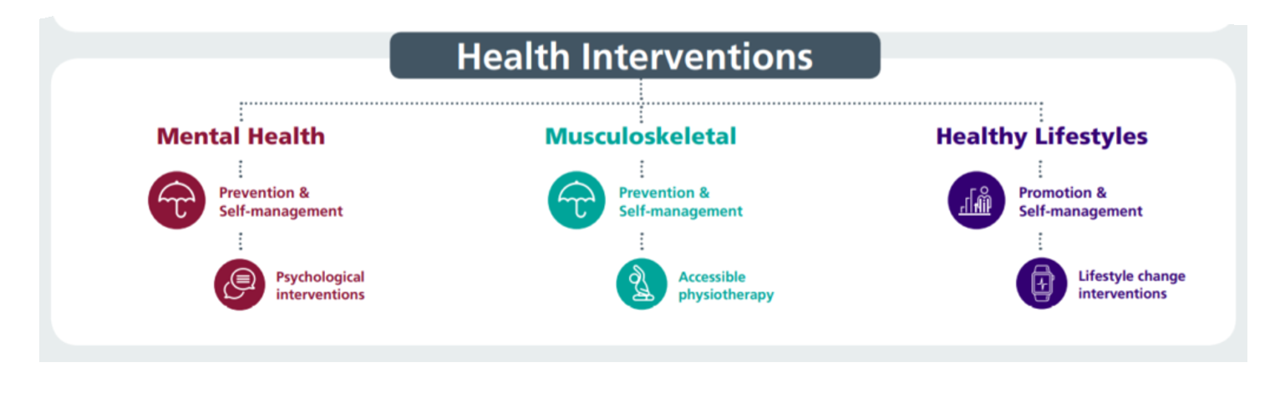

Our Staff Wellbeing Services supporting physical and mental health
46% increase in referrals to wellbeing service in the past 12 months (50% increase MH, 29% increase in MSk)
53% referrals to the service are staff in work (presentees) supporting early intervention, 47% of referrals are sickness absentees
Specialist Psychological interventions for trauma & PTSD. Increased capacity in self-management for anxiety, depression, self-harm and suicide
Suicide Prevention – 30 disclosures of related thoughts in 12 month period with significant reductions post-intervention
TRiM team rolling out preventative and post-incident trauma based support - 193 staff TRiM trained to deliver and support across Service Groups, 4707 staff REACT trained, 98 bespoke interventions for teams/services after adverse incident in past 12 months (46% increase on previous 12 months)
730 Wellbeing Champions (+15% in last 12 months) supporting teams with wellbeing info/signposting and health promotion activities– regular update workshops facilitated
Manager training - use of work-related stress assessment and managing mental health at Work
Staff Wellbeing Forum – HB wide representation to share best practice/disseminate info across the HB with related presentations .

Slide 17
Our Occupational Health Service supporting physical and mental health
OPAS G2 operating system = reduced waits for health clearance, more robust health surveillance programme & reduced waits for reports to managers. Progressing application for SEQOHS accreditation
OH waits (based on most available data) – average wait for appointment for management referrals is 5 working days as end of June 2025. 11% increase in referrals past 12 months
Work-based Physiotherapy support - ergonomic assessments, early interventions and MSk advice. Leading on promoting health campaigns via Team Brief and other Comms
SBU has the only Occupational Health Service in Wales with full complement of Nursing Team using ‘grow our own’ model. Recently appointed substantive Specialty OH Doctor to support complex cases and lead clinical service developments
Staff Health Checks – implemented June 2024; 1139 staff attended in 12 months, after cholesterol blood test, for advice and early intervention. 1 year questionnaire currently being sent to evaluate effectiveness; early feedback suggests timely, helpful for identifying risk factors for underlying health issues and supporting onward GP discussions.

Slide 18
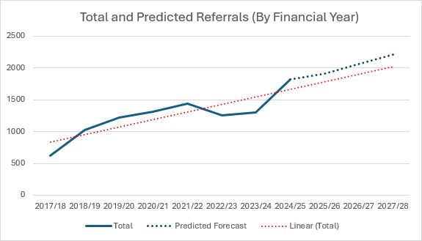
Increases in referrals to staff wellbeing service

Slide 19


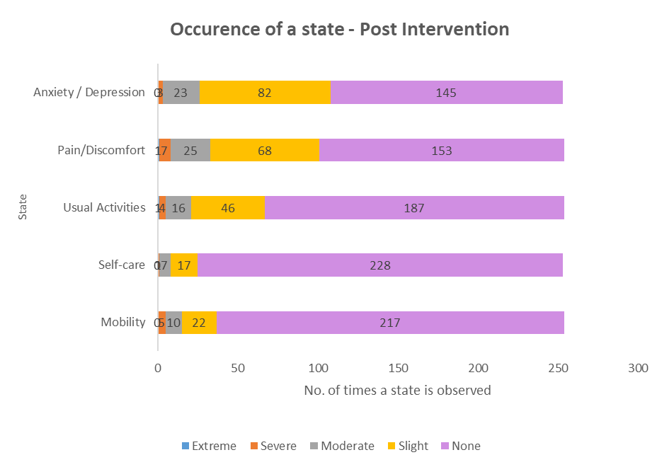
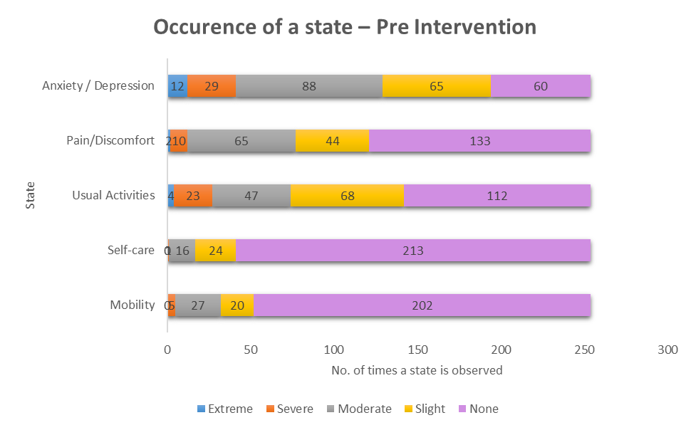
EQ5DL Pre and Post Outcome Scores – Demonstrating Effectiveness of Staff Wellbeing Service

Slide 20
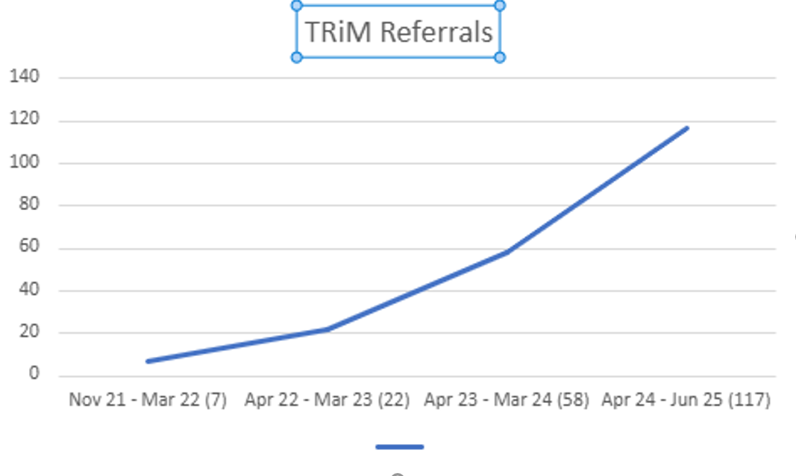
Referrals for TRiM (trauma) support

Slide 21
GTEP sessions (accumulative stress)
Wellbeing Champion Network
Compassion Rounds
React & Suicide Prevention
Staff Health Checks
Menopause Workshops
My Health Passport
Preventative Interventions
Mindful & Meaningful Living course
Steps to Wellbeing webinars
TRiM
Men’s Health Forum
Mental Health Awareness training
Work-related Stress Risk Assessment Training
Managing your Wellbeing course

Slide 22

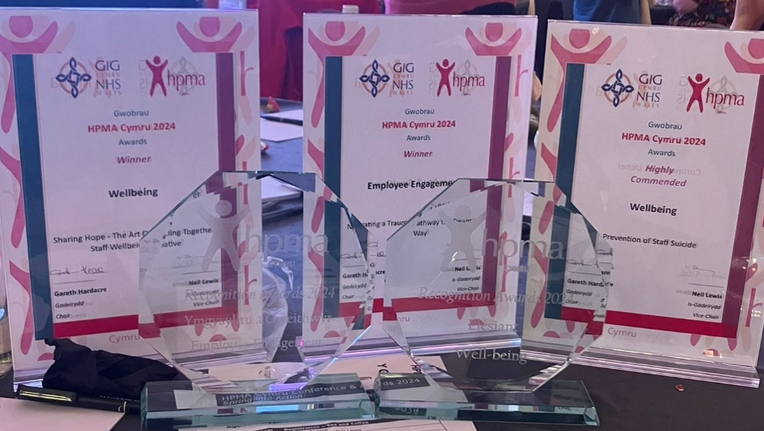
Most Recent HPMA Wales Awards Winners
Employee Engagement - Navigating a Trauma Pathway the Swansea Bay Way
Wellbeing: Sharing Hope - The Art Of Healing Together staff wellbeing initiative
Wellbeing Highly Commended – Swansea Bay Prevention of Staff Suicide
Recruitment Team of the Year: Central Resourcing and Overseas Nurse Recruitment Team - Reducing Variable Pay costs by Reducing Nurse and HCSW Vacancy Gap and Red.
Partnership working with Trade Unions - Working Together as part of our One Bay Way: Our Trade Union Compact

Slide 23


