Slide 1
Personal Appraisal Development Review - August 2024

Slide 2
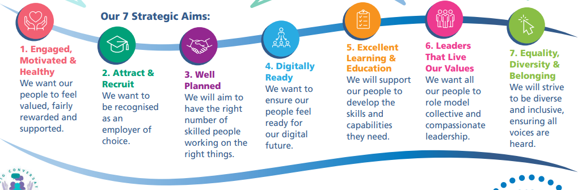
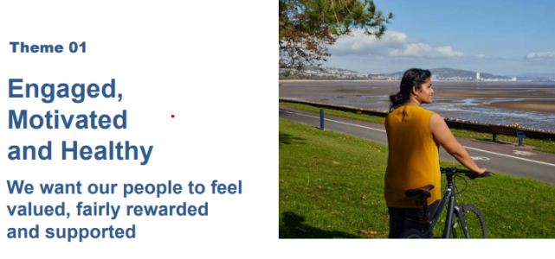

People Strategy 2024-2029; supporting the 10-year vision of a high-quality organisation

Slide 3
Personal Appraisal Development Review (PADR)
Swansea Bay Univeristy Health Board (SBUHB) recognises that its employees are the most valuable resource in providing excellent care to its patients and service users and are critical to the effective and efficient provision of good health care services (PADR Policy)
We would like to share with you the current PADR training offered by the Education and Learning team including data of the numbers of training places booked, numbers of attendees, and the feedback received from colleagues who attended the training.
Deep Dive into Estates and Support Services to highlight the current PADR completion position, identify the current challenges and opportunities.
To share action plan for improvement within deep dive area.

Slide 4
Current PADR Compliance SBUHB Wide
WG Compliance Target 85%

Slide 5
PADR Training Offering
PADR Training is currently delivered by the Education & Learning Team via our Managers Pathway development programme and dedicated standalone sessions that staff can book to attend.
The aim and objective of the training is to provide the essential skills and knowledge to enable managers/reviewers and supervisors to conduct a meaningful and effective PADR.
The programme content includes:
  understanding what a PADR is
  describe the purpose and benefits of PADR
  prepare for the PADR review and setting SMART objectives and options for realistic implementation
  complete PADR documentation
  Monitor and report PADR activity ad compliance
Sessions are delivered twice monthly with additional sessions added when demand is high.

Slide 6
Training Data
The following provides the reason for DNA's Non-Attendance (No Show) 12 Non-Attendance (Re-Schedule) 1 Non-Attendance (Short Staffed) 1 Non-Attendance (Sickness) 1 Non-Attendance (Work Commitments) 3
Unknown 50

Slide 7
I have only now attended this training, but I have done PADR. I think it would be useful to ensure everyone completes training pre doing a PDR.
PADR Training Feedback
My key take aways from the training -To focus on the person, not the paperwork (whilst ensuring the paperwork is all completed correctly). How to set objectives and encourage staff members to achieve the small things as well as the big things. Use open questions and allow the person to talk, ensuring enough time is allocated for the meeting.
I've only recently started in a new role with the HB, and never been involved in an NHS PADR as a reviewee or reviewer although I understand the concepts of employee reviews will be similar. The course has offered an opportunity to provide an overview of what is required to conduct a PADR and some really useful tips on how to ensure the process is beneficial and engages the reviewee.
I feel that attending today has given me more confidence myself to explore and think about other areas to include in the PADR's with all staff.
Well presented, relevant to area of work. Good to be able to discuss queries and experiences with other colleagues attending. Helpful to clarify parts of the PADR form.
Really informative and presented in an easy-to-follow format and made me think of how I have had a PADR and how I undertake them
Lovely session gave me a good refresher on PADRs and how to get out of a bit of a rut when completing them.

Slide 8


Estates & Support Services
PADR Deep Dive &
Action Plan
Des Keighan, Assistant Director, Estates
Joanne Jones, Head of Support Services
Rhian Mansel, HR Business Partner
Estates & Facilities

Slide 9
Estates
In June 2021 PADR compliance was 37.7%, a report was presented to W&OD committe to outline how an improvement could be achieved.
An action plan was developed which incoporated the following key actions:
        Estates Senior Team dedicating time out to focus on PADR’s
        Monthly Estates Board meetings to be used to monitor hotspots, identify barriers and agree solutions
        Adoption of the group PADR approach
        Learning and Development to deliver PADR training
        A monthly PADR target was set in order to achieve 75% compliance by September 2021
I

Slide 10
Estates Progress

Slide 11
Progress/Challenges
Progress:
During September 2023 to January 2024, there was progress in achieving in excess of the 85% target, with the highest percentage of 90% being achieved in November 2023.
Singleton Estates carry out 3 monthly PADR review sessions to review progress on objectives and discuss any issues.
Challenges:
As some of the departments completed staff PADR’s at the same time, this has now caused the current decline to 56.82%.
ESR access and inputting of completed PADR dates.
Availability of staff due to sickness absence/annual leave.

Slide 12
Estates Current Position
Org L8 | Assignment Count | Reviews Completed | Reviews Completed %
130 7200 Morriston Estates Management | 13 | 3 | 23.08
130 7211 Morriston Grounds & Gardens | 7 | 0 | 0.00
130 7212 Morriston Building | 11 | 2 | 18.18
130 7213 Morriston Engineering | 34 | 18 | 52.94
130 7215 HVS 1B | 3 | 1 | 33.33
130 7220 Singleton Grounds & Gardens | 4 | 4 | 100.00
130 7221 Singleton Building | 12 | 10 | 83.33
130 7222 Singleton Engineering | 22 | 20 | 90.91
130 7223 Singleton Estates Management | 12 | 8 | 66.67
130 7500 Waste Management & Incineration | 4 | 3 | 75.00
130 7503 Support Services | 3 | 3 | 100.00
130 7801 Estates Management Support | 7 | 3 | 42.86
 | Target | July 24 | Variance
Estates Completion % | 85% | 56.82% | - 28.18%

Slide 13
Next Steps
Each area and in particular Morriston Estates department (red areas in previous chart) will now be focusing on the completion of their outstanding PADR’s.
Arrangements have been made for managers to have further PADR training in August and further adopt group PADR’s.
Ensure all staff understand the importance of a PADRs and how they benefit both the individual and organisation.
Staggered PADR’s with timeline for completion
Identify any barriers to completing PADRs, such as workload issue, lack of tracking or clarity surrounding PADR process.
Monitoring of progress will be reviewed at board meetings held monthly.
Although there is a focus on completing PADRS and increasing the completion percentage, managers will also be advised to ensure the quality of these PADR’S remains a priority and should be of value to both the staff member and manager.

Slide 14
Support Services
In November 2021 PADR compliance was 43.38% a report was presented to W&OD committe to outline how an improvement could be achieved.
An action plan was developed with the following key actions:
      Undertake a further trial of Group PADR’s
      Monthly board meetings to be used to monitor hotspots, identify barriers and agree solutions.
      A management post has been redirected to undertake PADRs

Slide 15
Support Services Progress

Slide 16
Progress/Challenges
Workforce are mainly Band 2 and therefore don’t have pay progression
Some departments have completed PADR’s and not followed a staggered approach which have now resulted in the current decline to 52.55%
ESR access and delays inputting completed PADR dates
Sickness absence levels
Resources

Slide 17
Support Services Current Position
Org L8 | Assignment Count | Reviews Completed | Reviews Completed %
130 P201 Cimla Catering | 2 | 2 | 100.00
130 P207 Llwyneryr Domestics | 4 | 3 | 75.00
130 P213 NPTH Catering | 23 | 17 | 73.91
130 P214 NPTH Community Domestics | 11 | 9 | 81.82
130 P216 NPTH Hotel Services Management | 3 | 2 | 66.67
130 P217 NPTH Housekeeping | 118 | 107 | 90.68
130 P218 NPT Laundry & Linen | 5 | 2 | 40.00
130 P220 NPTH Portering & Security | 26 | 22 | 84.62
130 P234 Tonna Hotel Services | 15 | 15 | 100.00
130 P600 Singleton Catering | 84 | 17 | 20.24
130 P602 Cefn Coed Catering | 10 | 0 | 0.00
130 P603 Morriston Catering | 62 | 10 | 16.13
130 P610 Community Domestics | 11 | 0 | 0.00
130 P611 Singleton Domestics | 107 | 86 | 80.37
130 P612 Morriston Domestics | 211 | 174 | 82.46
130 P613 West Domestics Management | 1 | 1 | 100.00
130 P620 Facilities Management | 10 | 5 | 50.00
130 P624 Singleton Newsagent | 4 | 0 | 0.00
130 P625 Singleton Car Parks | 2 | 0 | 0.00
130 P627 Morriston Car Parking | 9 | 1 | 11.11
130 P629 MorrIston Accommodation | 1 | 0 | 0.00
130 P640 Gorseinon Hotel Services | 17 | 0 | 0.00
130 P643 Cefn Coed Hotel Services | 23 | 3 | 13.04
130 P652 Singleton Laundry and Linen | 2 | 2 | 100.00
130 P653 Morriston Laundry & Linen | 5 | 0 | 0.00
130 P660 Singleton Porters | 42 | 4 | 9.52
130 P661 Morriston Porters | 89 | 4 | 4.49
130 P662 West Portering Management Team | 5 | 1 | 20.00
130 P663 Cefn Coed Porters | 3 | 0 | 0.00
130 P671 Morriston Security | 12 | 3 | 25.00
130 P680 West & Community Telephonists | 23 | 4 | 17.39
 | Target | July 24 | Variance
Support Services % | 85% | 52.55% | -32.45%

Slide 18
Next Steps
Each area with low compliance (red areas in previous chart) will focus on completing their outstanding PADR’s.
Arrangements will be made for managers to have further PADR training in August and adopt group PADR’s.
Identify any barriers to completing PADR’s, such as workload issue, lack of tracking or clarity surrounding PADR process.
Ensure staggered PADR’s.
The management post redirected to undertake PADRS will work to support low compliance areas.
Monitoring of progress will be undertaken at board meetings on monthly basis.

Slide 19
Considerations/Conclusion

Slide 20
Conclusions & Considerations
5.08% improvement in PADR compliance (67.24% July 2023 to 72.32% June 2024) but still below the WG tier 1 target of 85%
Assurance there is still a focus on PADR compliance and working in collaboration with HR BP’s to ensure there is continued improvement asan integral part of the regular performance reviews within Service Groups and Directorates
Recognise that operational pressures will continue to be a challenge in the year ahead and this may impede progress on our PADR compliance
Continue to support staff through the education programmes as part of the education and learning offering and target training in line with PADR compliance
Identify creative ways to support managers to access learning in a blended and flexible way
The deep dive presented today illustrates the challenges, opportunities and actions for improvement

Slide 21
Diolch / Thank You

