Slide 1
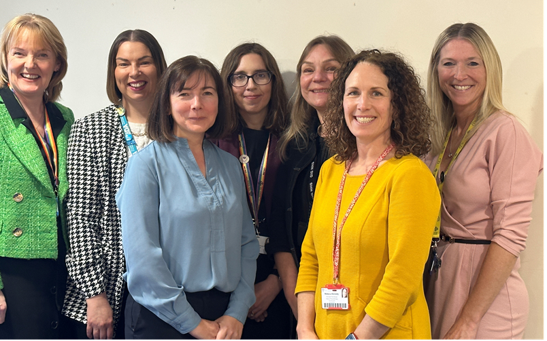
Grŵp Gwasanaeth Cynradd, Cymunedol a Therapïau
Primary, Community and Therapies Service Group
Therapies & Audiology Workforce Planning
Notes:
This slide can be used for presentations which are from a health board-wide perspective or for a whole HB audience as the graphic device to the right of the slide includes all four service group colours and red for the corporate team.

Slide 2
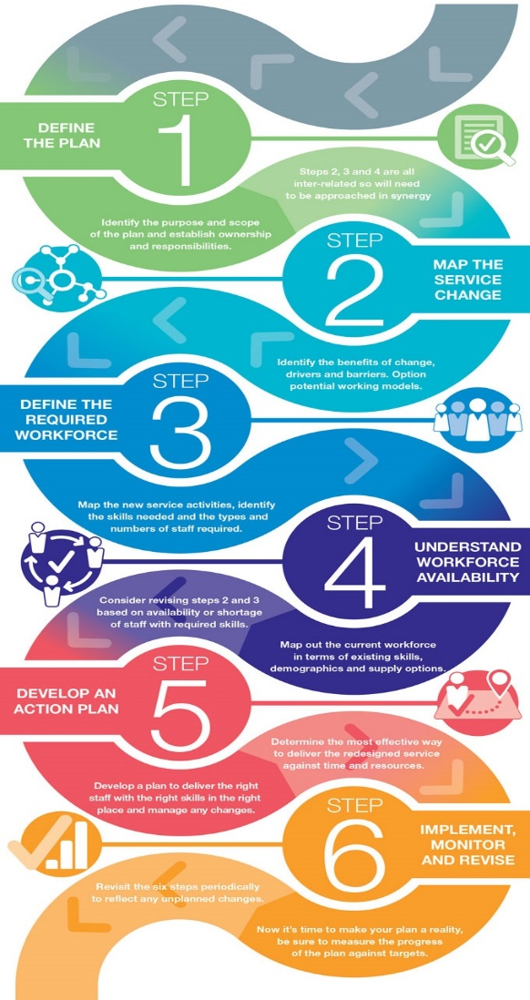
The Wales Approach to Strategic Workforce Planning
The Skills for Health Six Step Framework is based on the following Principles that support effective workforce planning:-
Sustainability – plans should be realistic and affordable
Encourages innovative thinking
A focus on what skills and competences are needed rather than what we currently have
Based on evidence and information
Integrated planning across finance, service and workforce
Iterative process
Requires effective leadership
Promotes Collaboration and shared solutions
The approach to strategic workforce planning in Wales is based on the Skills for Health Six Steps Framework

Slide 3
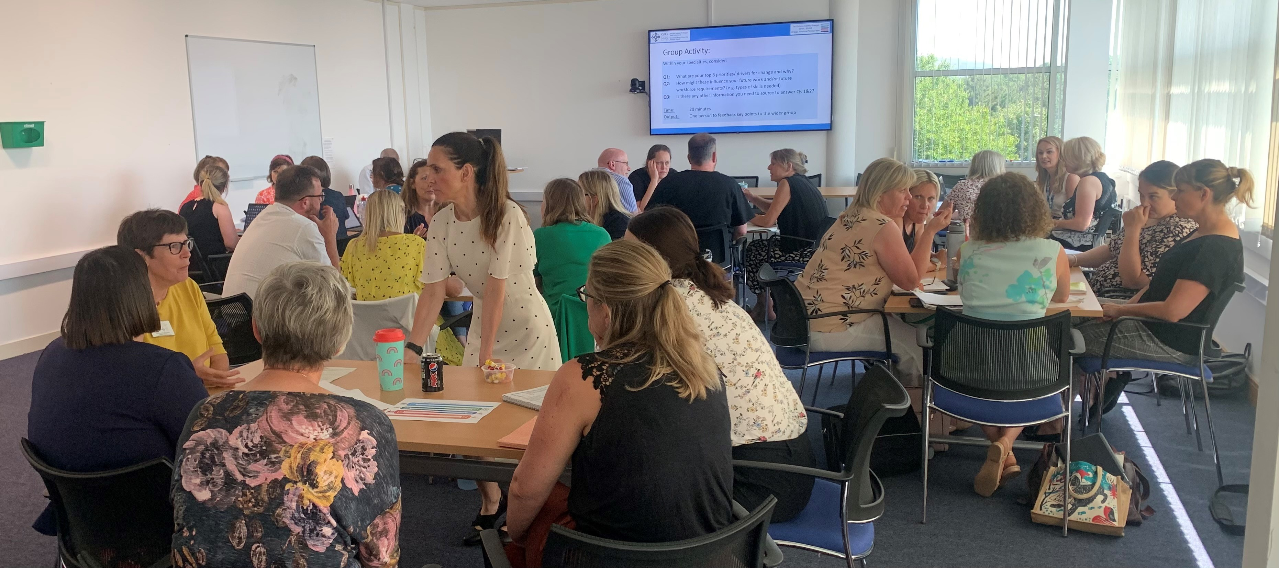
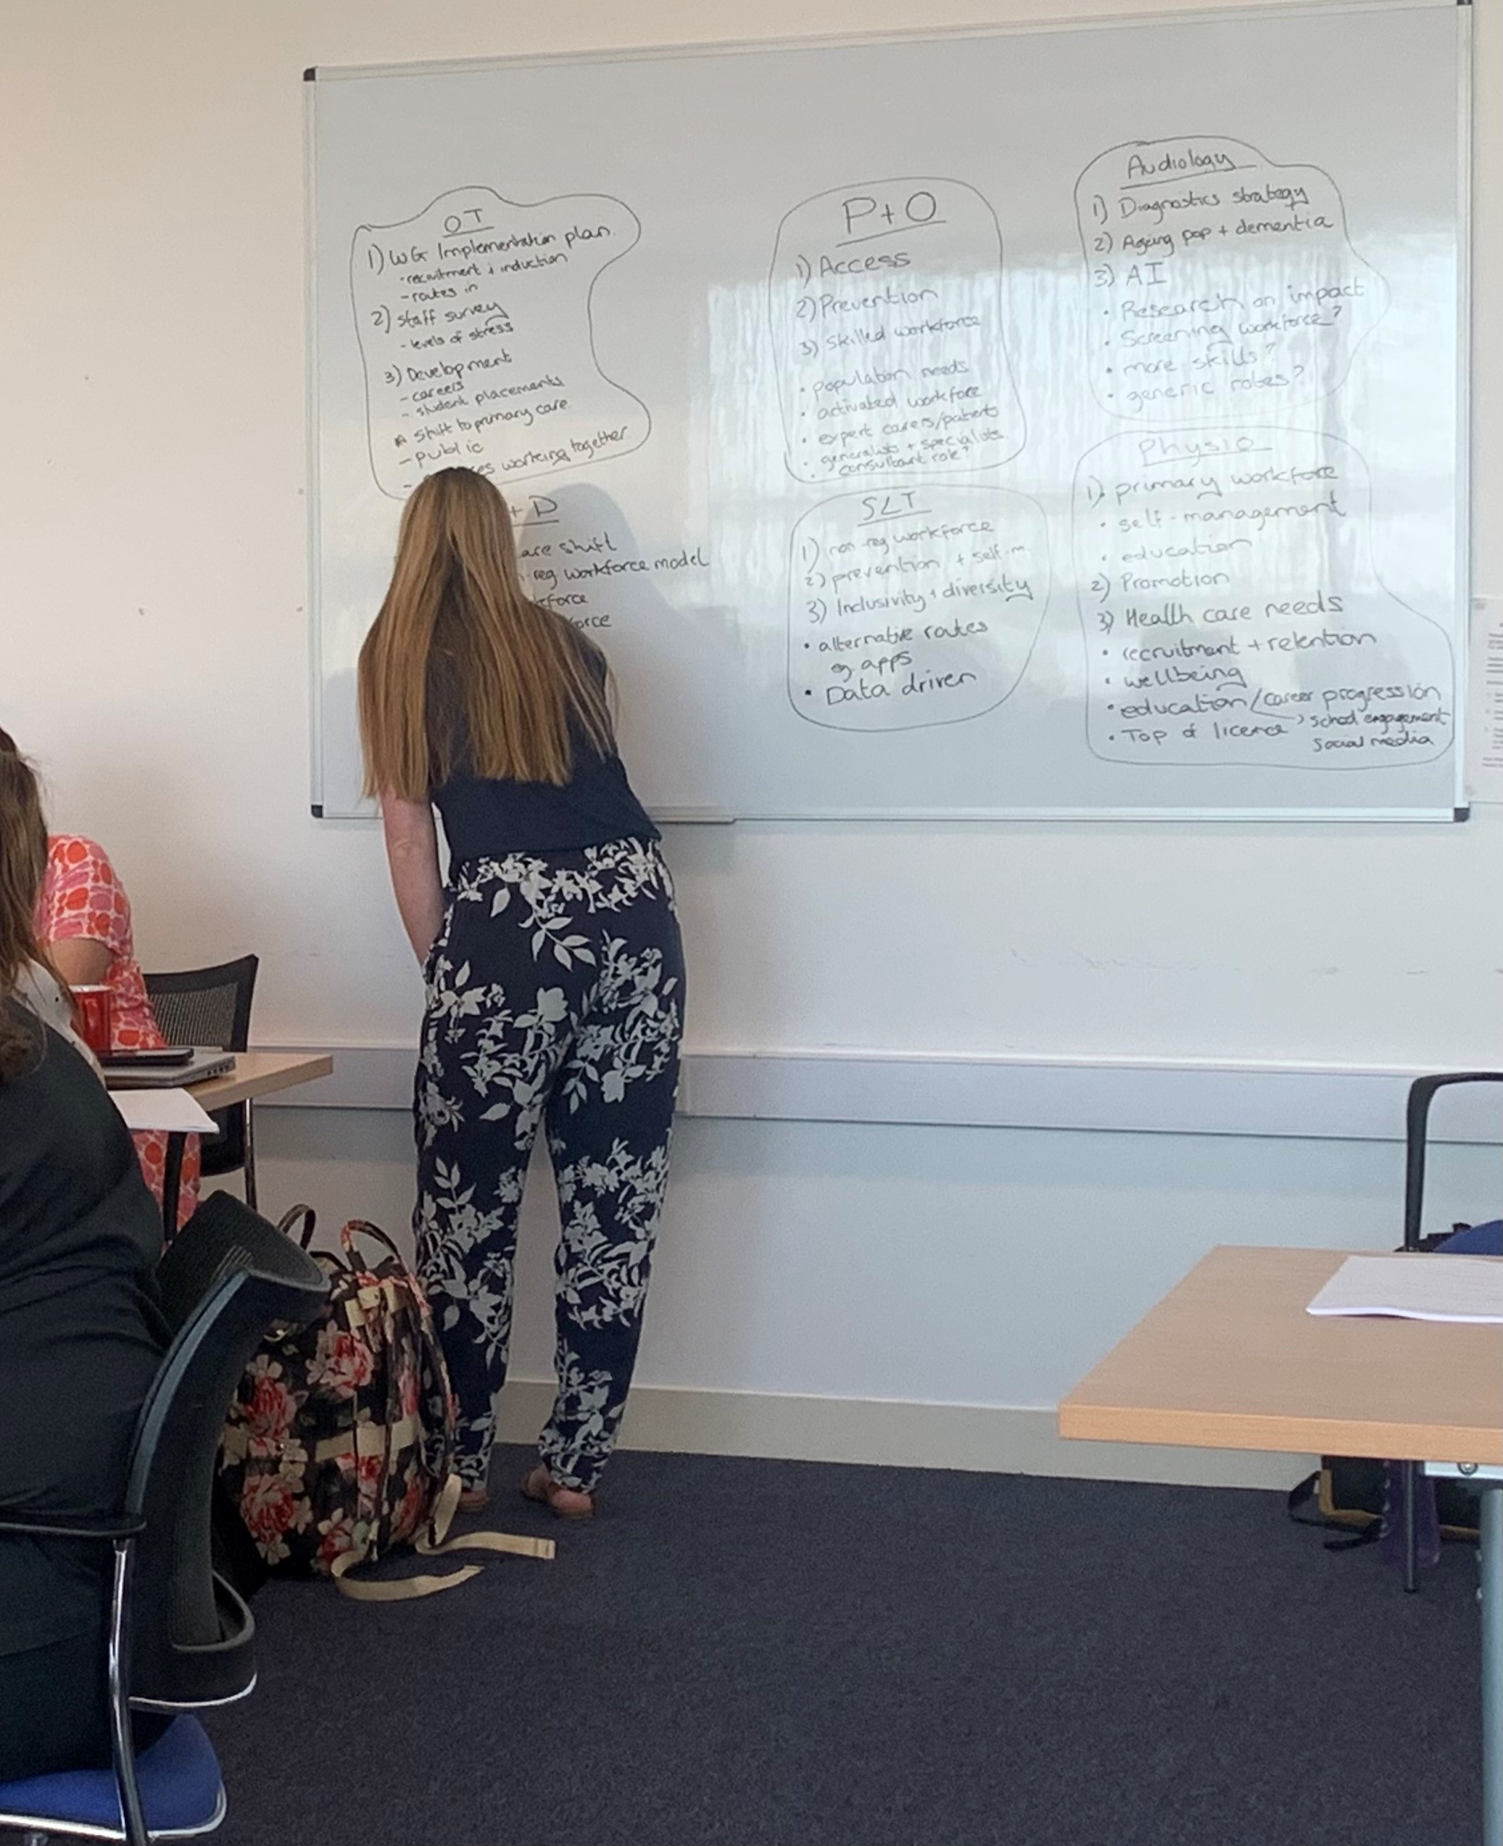
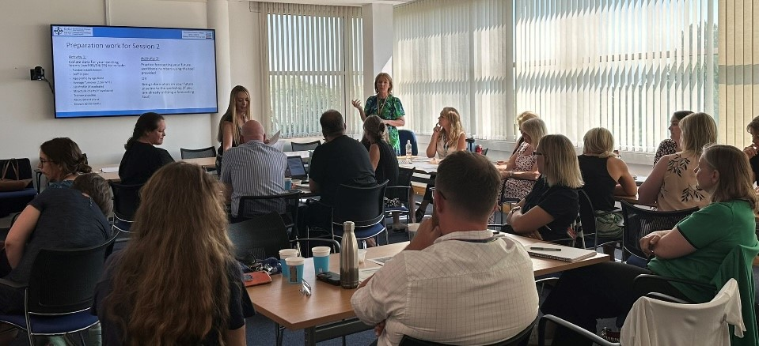
Our Workshops

Slide 4

Current Position
Drivers/ Constraints/ Enablers
Succession planning
Staffing gaps
Diversity
Specialist areas
D & C
WF trends
Benchmarking
National
Professional
Organisation
Prevention
Closer to home
Early access/ Intervention
Pathways

Slide 5
Our Workforce
Trainee Pipeline
Flexible Working – Increase in hours
Recruitment
Reviewed our current workforce supply & considered the profile of the current staff, demographics, types of staff, skill mix, grade mix, skills and services to understand good practice and any problem areas.
Future Workforce
Current workforce
Current Staff Development & Succession Planning
Voluntary Leavers
Retirement
Flexible Working – Reduction in Hours

Slide 6















Slide 7
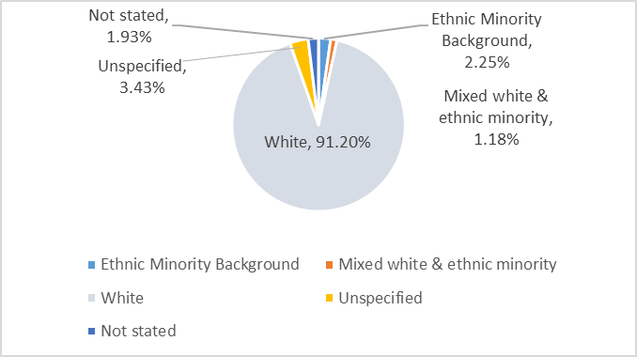
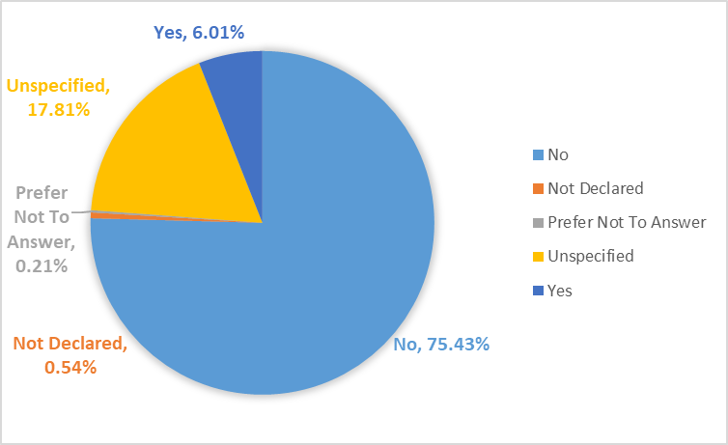
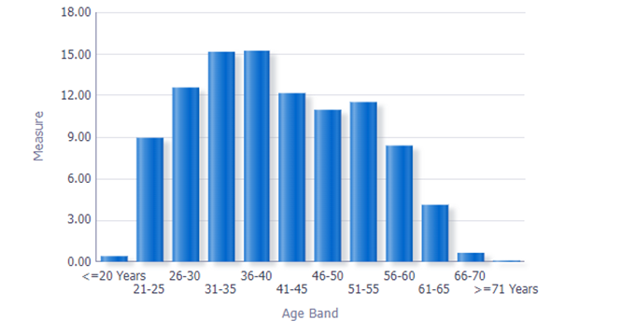
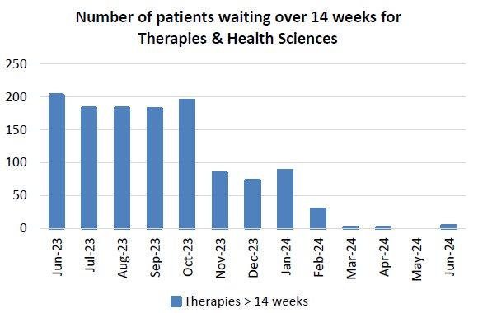
Risks & Our Requirements
Innovation & new Ways of Working
Lack of succession planning
Lack of diversity in workforce
Workforce gaps e.g., Band 6
Increasing numbers required across system- demand
Small, specialist areas- sustainability with hard to recruit posts
Meeting standards/ guidelines e.g., BAPM
Non-registered roles enabling registrants work top of license
Generic/ multi-professional working & roles
New roles including Advanced/ Consultant/ Specialist roles
Upskilling existing staff to meet demand
Digital skills/ solutions
Patient activation/ empowerment

Slide 8
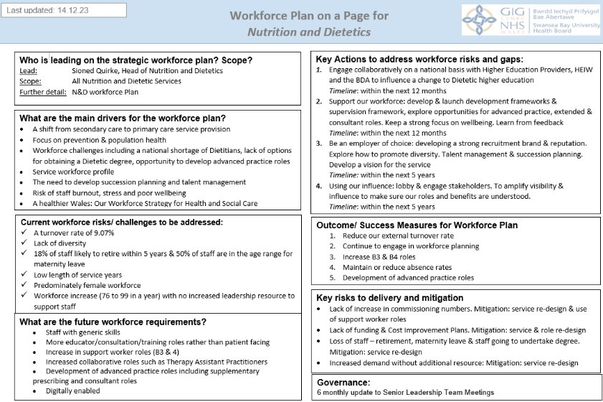

Slide 9
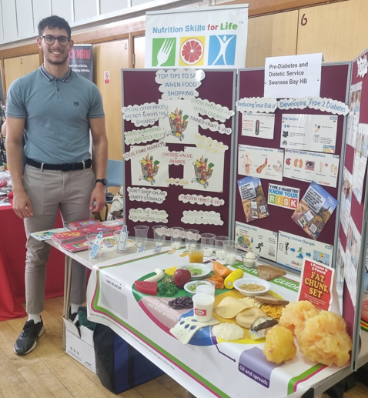
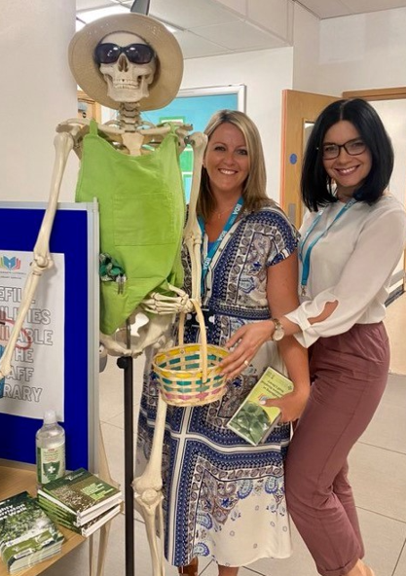
The Ambition
We will have a workforce that is adaptable, resilient, engaged and creative with the capacity and confidence to meet the needs of our population
We will have a workforce with the right values which is curious and innovative with the right support to deliver evidence based care
We will have a sustainable workforce in sufficient numbers to be able to provide the care that meets our population’s needs using a range of workforce models to respond to local need.
We will have a workforce that is reflective of the population’s diversity, Welsh language and cultural identity
We will have a culture of compassionate and inclusive leadership with a workforce that feels valued with their wellbeing being a priority
We will have a workforce that feels supported to develop their careers whilst staying with us in Swansea Bay and feels confident to influence at all levels
We will be able to offer a variety of options for Dietetic higher education to include apprenticeships, part time study, a more flexible entry criteria and increased commissioning numbers.
We will have a service which uses feedback, data and co-production to maximize workforce planning and service development

Slide 10

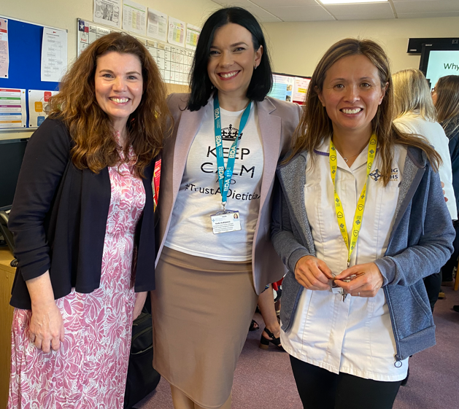
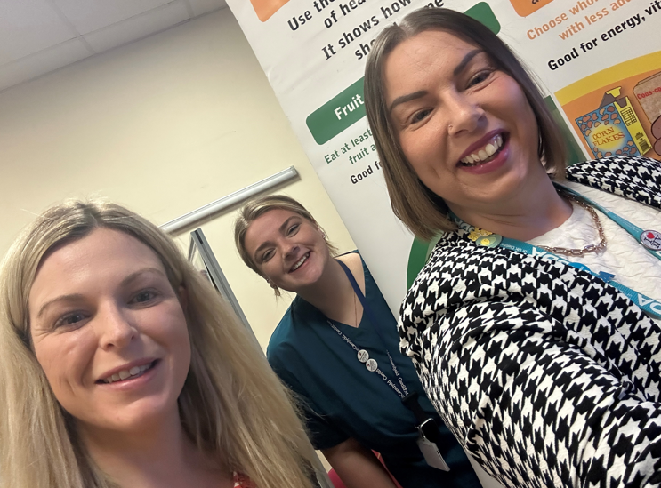
Top 3 Priorities
Shift from secondary care to primary care:
Focus on prevention & population health:
Workforce:
  Building a strong identity and presence – influencing as to our impact
  Staff who work at the top of their professional license
  Change access to education – currently rigid access criteria for degree
  Influence for a growth in commissioning numbers
  Develop a national route for apprenticeships
  Increase the Service’s inclusivity & diversity
  Develop Preceptorship roles
  Better succession planning
  Need to develop future workforce differently – our changing roles
  Consider how to inspire people/children to want to be Dietitians – influencing early
  How to make our profession attractive
  The need for digital competencies
  Visible and transformational leadership
  Support development opportunities e.g. with competency frameworks

Slide 11
12 Month Action Plan
Engage collaboratively on a national basis with HEP, HEIW & BDA to influence change to higher education
Support career advancement & continuing professional development
Be proactive – using every opportunity to influence, lobby and engage stakeholders. To amplify visibility & influence to make sure our roles and benefits are understood.
Have a detailed knowledge and strong engagement with Welsh, national and UK wide drivers in addition to the local challenges and opportunities to inform integrated workforce planning
Have strong strategic leadership which is compassionate, collaborative, courageous and confident
Develop a vision for the N&D Service
Further develop international recruitment opportunities
Monitor and review Service workforce data regularly to identify trends and highlight any concerns early. Monitor potential shortage areas and plan for these
Develop and implement a clerical induction Programme
Improved succession planning and talent management
Learn from feedback and experience – staff & service users
Keep a strong focus on wellbeing where our workforce feels valued, treated fairly, motivated and are engaged
Collaborate with digital colleagues to improve current data collection and reporting with the systems available

Slide 12
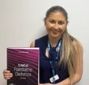
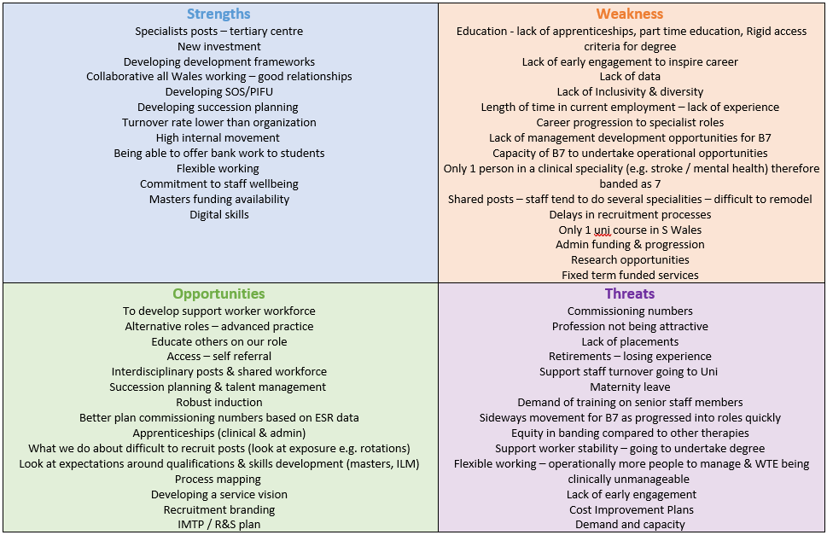
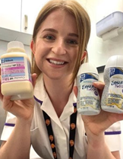

SWOT Analysis

Slide 13
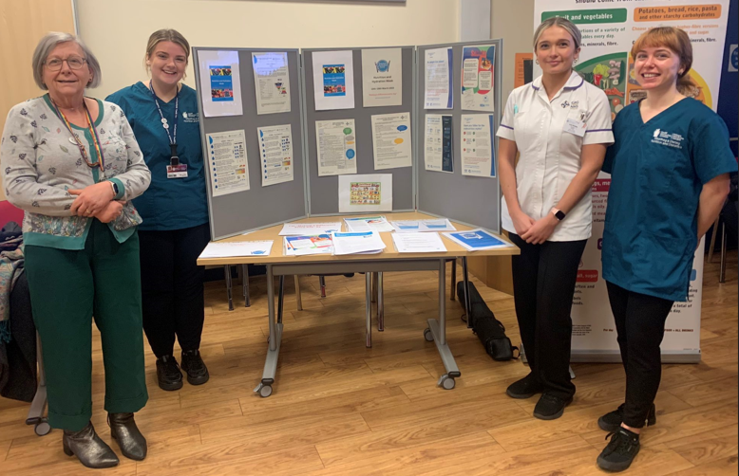
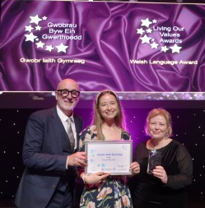
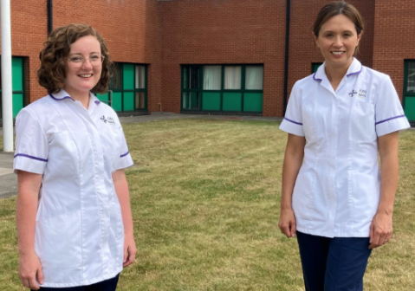
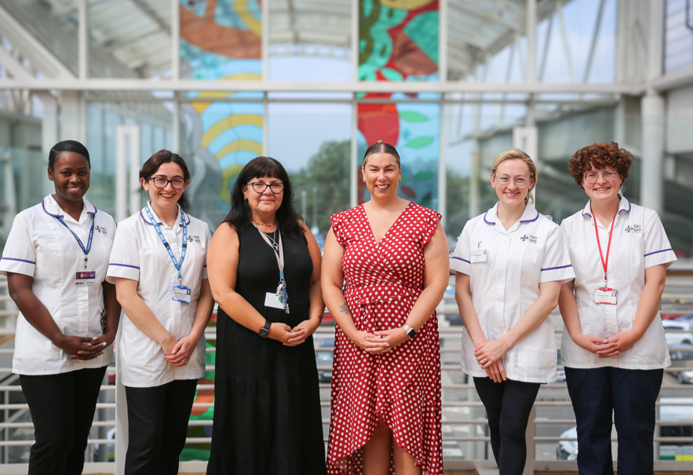
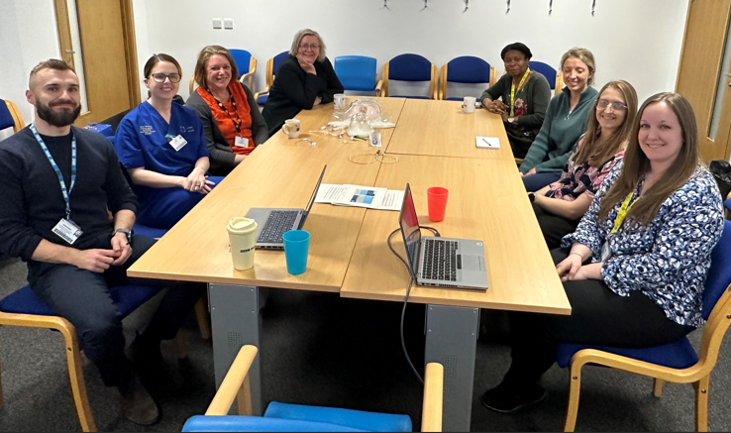
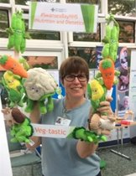
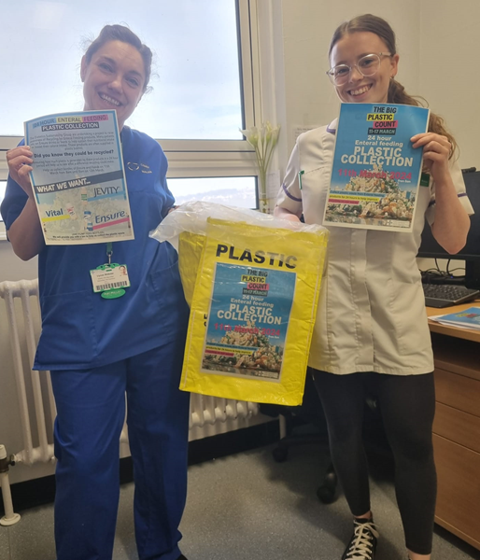
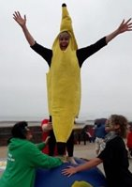
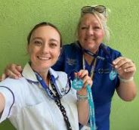
What's Next?
Review & refresh Nov 2024
Set new priorities
Celebrate achievements
Engagement
Continue work on 5-year objectives

