Slide 1
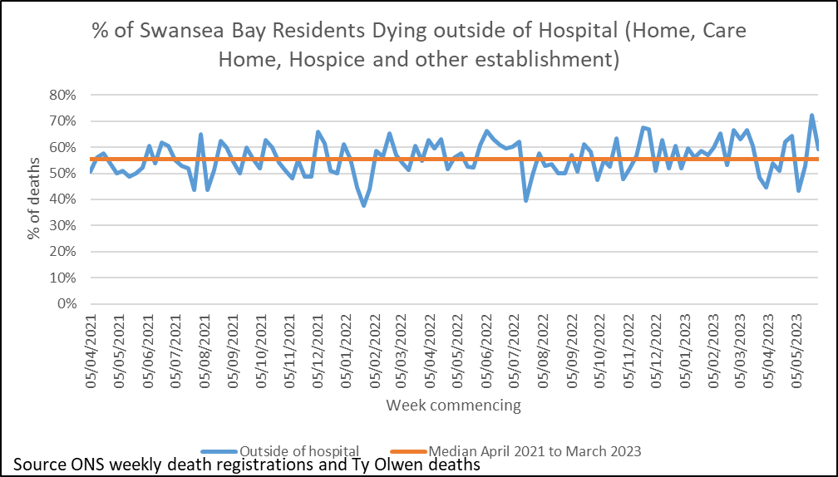
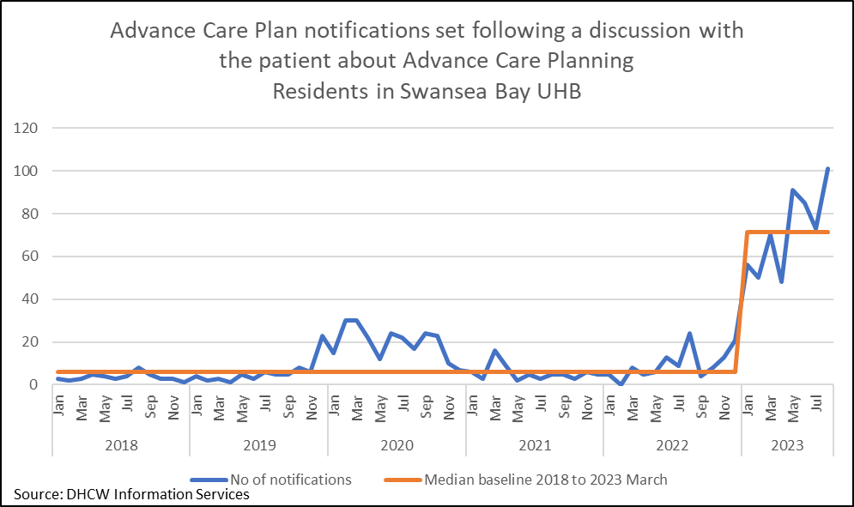
Quality Priority – End of Life Care (EOLC)
Goal - Increase proportion of Swansea Bay residents receiving the right care at the right place at the right time in the last year, months, weeks, days of life
Page 1
Project Team: Senior Responsible Owner – Sue Morgan (Clinical Lead), Project Manager – Tracy Rowe (part-time) , QI lead – Emma Smith
Month – August 2023
Methods
Increased correct identification of people who may be in the last year of life
Increase Advance & Future Care Planning (A&FCP) across all care settings
Increased correct identification of people who may be in the last days of life
Increase the number of staff given education and training to support high quality EOLC
Identify and produce systems that support sharing of A&FCP across all care settings
Other critical success factors
Medical engagement with EOLC throughout service groups, demonstrated through medical EOLC champions within each service
All Service Groups to participate in completing the Health Board End of Life Care audit.
Key achievements
EOLC training established and continues each month 21% of HB staff trained August 2023 – Champion programme, Regular Education sessions, bespoke training requested by Service Groups and care home training.
Internal Audit Spring 2023 gave reasonable assurance for End of Life Care.
Some improvements seen in the National Audit of Care at the End of Life 2022 compared to 2021.
A shift in the number of Advance care plan notifications set in WCP from median of 6 to 72 per month
Key Outcome Measure/s – link to dashboard to be added
Progress in the last month
Digital planning meetings continue to take place with plan due for Sept 2023
Digital intelligence discussions ongoing, plans for development of some measures in Sept 2023.
Palliative Care Project started in July 2023 (Safe Care Collaborative Community Work stream project) – data collection started in July and will be analysed in September.
Recent bespoke training has taken place across Morriston, NPT&S and P,C&T service groups. Care home train the trainer is ongoing after the pilot when care homes ask for support. Up to August 2023 21% of HB staff have received EOLC training.
A&FCP notifications in WCP are increasing – request with DHCW to determine which teams this might be, there has been renewed efforts in Specialist Palliative Care.
Feedback obtained from clinicians after the Treatment escalation plan pilot in ED and AMU, changes are to be made to the Treatment Escalation Plan. Discussions to take place with consultants in Gorseinon and Care of the Elderly in NPT to explore pilots there.
New action log developed and sent out end of Aug 23, awaiting feedback/completion from SGs.
Risks to delivery | Owner | Next Steps
Limitations in digital systems to record discussions relating to EOLC and to share between care settings | Matt John | Meetings continue to develop plan
Uncertainty on use of ONS deaths due to license concerns to measure outcome | Digital Intelligence | Waiting an update to resolution
Actions for the next month | Responsible Owner | Due Date
Continue collection of monthly Palliative care data, ensure next meeting established | Sowndarya Shivaraj, Sue Morgan and Emma Smith | Sept 2023
Continued meetings with Digital systems and intelligence to formulate plan by Oct for remaining year | Sue Morgan, Helen Thomas, Dai Williams and Emma Smith | Sept 2023
Repeat NACEL style staff survey locally to measure staff confidence and knowledge in supporting patients in the last days of life | Sue Morgan | Oct 2023

Slide 2
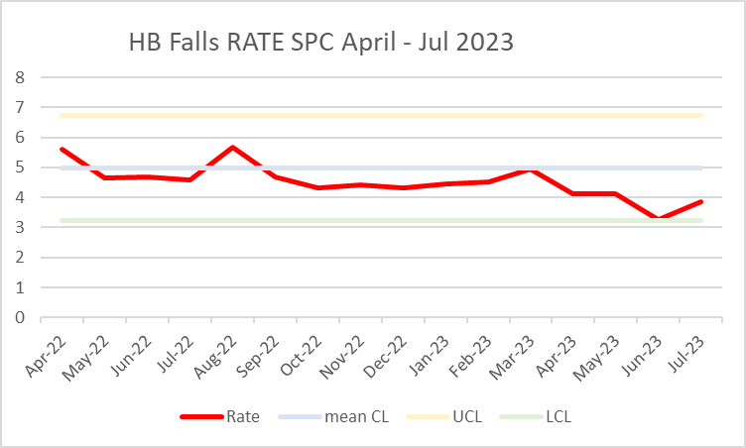
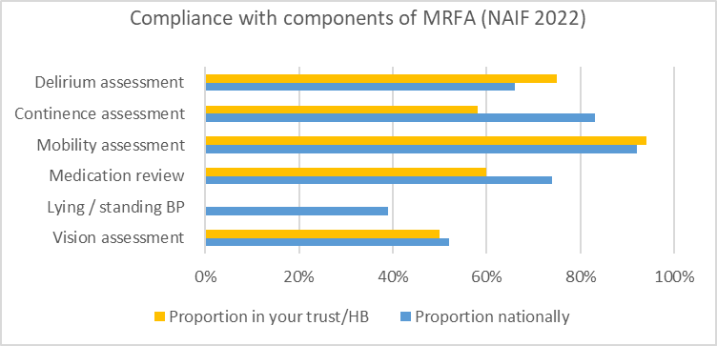
Quality Priority – Falls
Goal – Reduced falls and harm in hospital and across Primary Care and Community services by 10% in 2023/2024
Page 1
Project Team: Senior Responsible Officer: Helen Annandale, QI lead – Eleri D'Arcy
Month – August 2023
Methods
Build on Quality improvement programme.
Embed Falls audit programme.
Embed reporting structures from service groups Targeted QI input to high falls rate wards
Develop/Educate clinical workforce
Development of HB Falls Strategy
Engagement with Improvement Cymru and participation in Safe Care Collaboration Consider training to be mandatory
Promote public health campaigns re: healthy lifestyle and physical activity e.g Reconditioning.
Community Falls services review
Other critical success factors
Regional falls prevention taskforce
Key achievements
reduction of inpatient falls >10% 2022-2023
Agreed Governance structure with nominated SRO and Chair
Improvements noted in National Audit of Inpatient falls 2023
Inaugural Falls Summit held in March 2023
Key Outcome Measure/s –
Progress in the last month
HB Community Falls scoping exercise, Gap analysis and duplication report completed – scheduled for management board October
Falls Audit in OPMH completed all sites – lesson learnt to be shared and QI plan to be developed
Falls Policy updated – out for consultation and feedback
Focus on Reconditioning as pan health board approach – ACTIVE August has been positively received – developed to ACTIVE Autumn for phase 2 – focus on embedding reconditioning throughout HB
Actions for the next month | Responsible Owner | Due Date
Community Scoping Report to be shared at MB | ED'A | Oct 23
Falls Strategy Planning | ED'A and strategy | ongoing
Risks to delivery | Owner | Next Steps
Awaiting Digital dashboard | Digital | Under development

Slide 3
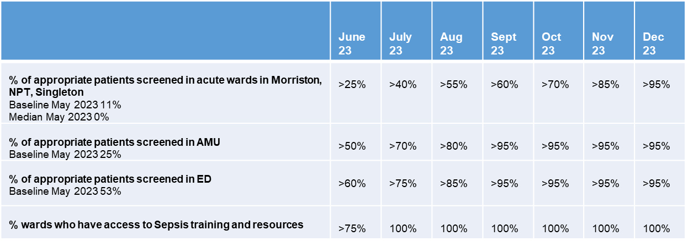
Quality Priority – Sepsis
Goal – Improvement in the recognition and management of Sepsis
Page 1
Project Team: Senior Responsible Owner – Ranga Mothukuri, Project Manager – Lisa Fabb, QI lead – Samantha Scott
Month – Aug 2023
Methods
Team are working with sepsis leads in clinical teams to develop an action plan.
Resus team are working with sepsis champions and ward mangers to complete sepsis audits across acute sites.
Establishment of trajectories for improvement for audit compliance
Other critical success factors
Increase the number of patients appropriately screened for Sepsis
Reduce harm from sepsis
Data not yet available for all areas for June.
Priority was given to auditing the admitting units where there has been a significant increase in number of forms completed but percentage of appropriate patients screened remains about the same.
Plans in place to address this including reaudit, training and raising awareness
Key achievements
All service groups have identified nursing sepsis leads.
Around 1600 staff have received sepsis training in 2023.
Resuscitation team have provided a diminishing programme of support for the sepsis audit process over previous three months, May and June audits were done with sepsis champions or ward managers, July resuscitation team reminded ward teams and offered support. It is hoped that this will now be sustained audit programme by the service groups.
Targeted action plans devised in collaboration with sepsis champions, many of these have focussed on placement of sepsis screening books to ensure timely screening of patients at risk of sepsis.
Sepsis web page
Set up the Sepsis in Wales Group engaging all Health Boards
Progress in the last month
Morriston sepsis leads are in discussion with digital planning to provide a digital solution and a focussed piece of work in SDMU looking at training.
NPTSSG are looking at using existing Signal options to improve communication around sepsis and a targeted training programme.
Awareness campaign including drop-in training sessions, ward-based training sessions and use of sepsis notice board displays are being used across the HB.
Key Outcome Measure/s
% of patients appropriately screened for Sepsis
Actions for the next month | Responsible Owner | Due Date
World Sepsis Day Symposium | Ranga Mothukuri
Blood Culture Improvement | Lisa Fabb/ Louise Wooster
Review GMO | Lisa Fabb
Continued meetings with Digital systems and intelligence to formulate plan for remaining year | Samantha Scott / Lisa Fabb
Risks to delivery | Owner | Next Steps
Lack of leadership within service groups, this is being mitigated against through group nurse and medical director and designated service group leads | Lisa Fabb

Slide 4
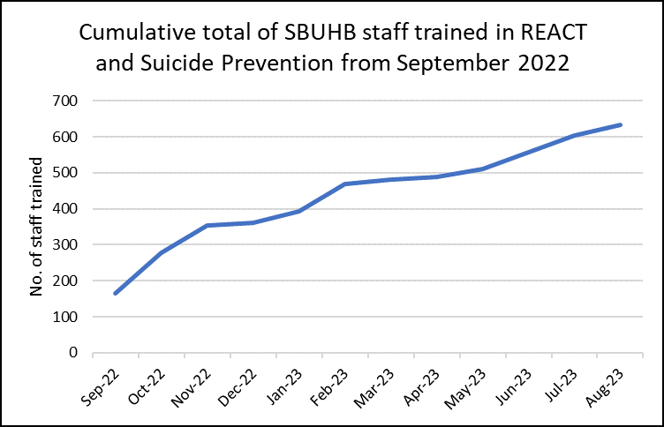
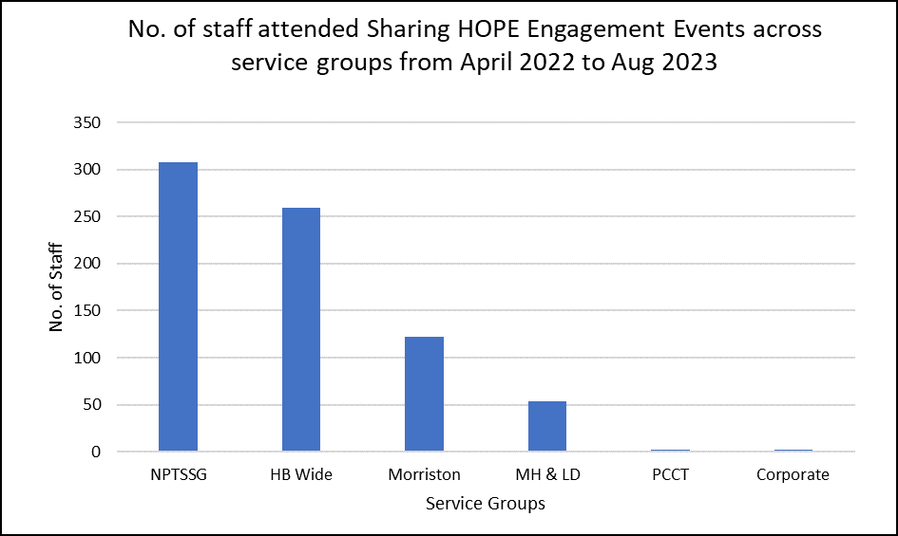
Quality Priority – Suicide Prevention
Goal – Suicide Prevention - early recognition of anxiety and depression leading to risk of suicide
Page 1
Project Team: Senior Responsible Owner – Stephen Jones, Project Manager – Jayne Whitney, QI lead – Samantha Scott
Month – Aug 2023
Methods
Engagement in Sharing Hope project
Delivery of training in suicide prevention across all teams
Other critical success factors
Time to Change Wales
TRiM Responses across the Health Board
REACT
Wellbeing (Early recognition of MH & Suicide ideation)
Quality, Safety & Improvement Intranet page (Quality Priority)
SBUHB Suicide and self-harm prevention strategy
SBUHB Response Policy following death of staff member by suicide & family
Priority places and people and remanded in custody / with high risk of suicide
Key achievements
Successful integration of REACT and Suicide Awareness training.
Planning for development of HB Suicide Strategy underway
REACT & Suicide Prevention level 1 training to be included in Managers’ Pathway
Continued success of Sharing Hope – The Art of Healing Together has won the improving lives through creativity award at the health board LOV awards 2023.
Reached the final for the Best Staff Wellbeing project of the year at the HSJ Patient Safety Awards 18th September and two categories at the NT workforce awards November 21st 2023
Time to Change Wales (Finalists of the NHS Awards)
TRiM Trauma Pathway (Finalists of the NHS Awards)
Progress in the last month
Sharing HOPE 747 staff engaged since April 2022
Social platforms Swansea NHS site on Facebook, Twitter and YouTube = 3.7k views as at end of May 2023.
There have been several Sharing HOPE sessions in ITU Morriston Hospital for high-risk trauma these sessions are ongoing throughout the year.
New combined REACT & Suicide Prevention Training including newly qualified induction nurses Total trained from Sep 2022 = 841
A bespoke REACT & Suicide Prevention training was delivered to Primary Care staff during there BT4L (Protective time for learning). Total trained in March 2023 = 263
Child Health bespoke session was delivered since June 23 where 27 people attended in total.
Between Mar 22 to August 2023 – 5.76% of cases reported suicidal thoughts in the previous 7 days of initial contact.
Between Jan 22 to August 2023 – 3% of cases reported thoughts to end life.
Level 3 Suicide Prevention training for Mental Health professionals (This has been successfully piloted and will be rolled out across the MH division)
Key Outcome Measure/s
Education of all available staff across the HB in recognising and managing suicide.
Continue to support and work with Swansea Multi Agency Group and other stakeholders across the HB in relation to obtaining a baseline assessment of suicide cases and map against national trends.
Occupational Health and Wellbeing support for staff with anxiety/depression to prevent escalation in risk of suicide.
Actions for the next month | Responsible Owner | Due Date
Business Case for Tier 2 Suicide Prevention Training | Jayne Whitney | Oct 2023
HMP Swansea Quality Improvement (SP) | Marie Philips & Jayne Whitney | Sep 2023
Redevelop action plan aligning it to the GMOs for Service groups to complete on a monthly basis | Stephen Jones | Sep 2023
Continue meetings with Digital systems and intelligence to formulate plan for remaining year | Samantha Scott | Sep 2023
Risks to delivery | Owner | Next Steps
There is a risk of being unable to measure impact within this priority due to the lack of real time information on suicide rates, this will be considered as part of the review of GMOs. | MAG | Meeting to reconvene

