Slide 1
Swansea Bay University Health Board
Quality & Safety Performance Report
September 2026

Slide 2
Report Overview
The Health Board Integrated Performance Report will provide updates against all areas under escalation with Welsh Government, all performance metrics outlined within SBUHB Breakthrough Objectives, updates against the NHS Wales Performance Framework 2026-27, along with Service specific or Annual plan updates as requested.
Section 1: Summary of performance against the SBUHB Breakthrough Objectives and the Welsh Government Oversight & Escalation criteria
Section 2: Detailed updates against the SBUHB Breakthrough Objectives and the Welsh Government Oversight & Escalation criteria
Section 3: NHS Performance Framework 2026-27 metrics & Local Measures

Slide 3
Section 1:
Summary of performance against the SBUHB Breakthrough Objectives and the Welsh Government Oversight & Escalation criteria

Slide 4
SBUHB 2026-27 Breakthrough Objectives
Strategic Objective | Long Term Success | Breakthrough Objective 2026/27 | Baseline Data (March 2026) | Aug-26 | Executive Lead
Better Health for all | People of Swansea Bay live healthier, fairer and more prosperous lives | Flu vaccine uptake improved in most deprived areas by 1% to reach 69.9% (Flu programme runs during the winter months) | 68.90% | N/A | Director of Public Health
 |  |  | (65 years +)
 |  | Bowel screening rates up by 1% to reach 63.3% by March 2027 | 62.30% | 64.4%
Improved patient safety | Care is high quality, safe, efficient and delivers the best possible outcomes for people in partnerships | No patients waiting more than 104 weeks for referral to treatment. | 0 | 0 | COO
 |  | Single Cancer Pathway performance to reach 76% | 55% | 44.7% (July 2026) | COO
 |  | Reduce the number of adults placed out of area for mental health inpatient treatment by 50% to 11 patients in March 2027 | 22 | 20 | COO
 |  | 30% reduction in avoidable pressure ulcers to reach < 87 PU's reported in March 2027 | 124 | 104 (Total No.) (August 2026) | Executive Director of Nursing
 |  | Reduce the number of patients waiting 12 hours or more in ED by 10% to < 1,212 by March 2027 | 1,356 | 1,117 | COO
Care is delivered in partnership | Care is delivered in partnership with our communities in safe and appropriate settings, supported by innovation | Delayed Packages of Care patients reduced to <100 at any one time | 223 | 172 | COO
 |  | Increase in the take up of the NHS App by 25% (from a March 2026 baseline) to 111,854 users by March 2026 | 88,842 | 104,373 | Director of Digital
A great place to work | The health board is a great place to work where all staff feel valued and work together towards a common goal | Improvement in staff engagement score by 5% to reach 75.3% (Annual data collection) | 70.30% | N/A | Director of Workforce & OD
 |  | Improvement in staff health & wellbeing by 1% to reduce sickness rates to < 6.09% | 7.09% workforce sickness absence | 8.59% | Director of Workforce & OD
Use every NHS £ wisely | The health board is a resilient, sustainable and responsible organisation | Deliver savings plan of £65m of which £50m is recurrent | £55.4m delivered in year with £22.9m recurring | £4.4m Savings | Director of Finance

Slide 5
Delivery against Welsh Government Targeted Intervention Criteria
Dashboard
TI Area (Level 4) | Criteria to achieve | Performance (Aug-26)
Cancer | 60% performance maintained for 3 months against the SCP target. | 44.7% (July-26)
UEC | 30% reduction in ambulance handovers over 45 minutes and maintained for three months (Based on Q2/Q3 2023/24 baseline) | 690
 | Continuous improvement towards no more than 7% of patients waiting over 12 hours at each individual site and across HB | 9.25%
 | Median time from arrival at emergency department to assessment by a clinical decision maker should not exceed 60 minutes | 84
 | Continuous reduction in delayed pathways of care of 5% for three consecutive months and then maintained for three months (based on Oct-Dec 23 baseline) | 172 (7.5% increase)
HCAIs | A clear improvement plan based on a root cause analysis to address the issue of hospital onset HCAIs. | In place
 | C-Diff: reduce the number of hospital onset infections by 40% and maintain for 3 months (from a baseline of the average number of cases in quarter 3 of 10 cases to no more than 6 per month) | 9 cases
 | Staph aureus: reduce the number of hospital onset infections by 25% and maintain for 3 months (from a baseline of the average number of cases in quarter 3 of 4 cases to no more than 3 per month) | 4 cases
 | E-coli: reduce the number of hospital onset infections by 20% and maintain for 3 months (from a baseline of the average number of cases in quarter 3 of 5 cases to no more than 4 per month) | 5 cases
 | Klebsiella: reduce the number of hospital onset infections by 10% and maintain for 3 months based on 2017/18 figures (baseline –54 cases in 2017/18, reduce to average of at most 4 per month) | 2 cases
Finance | Detailed updates included within the report
Strategy & Planning | Detailed updates included within the report
Maternity & Neonates | Detailed updates included within the report

Slide 6
Delivery against Welsh Government Enhanced Monitoring Criteria
Dashboard
Escalation Area (Level 3) | Criteria to achieve | Performance (Aug-26)
Planned Care | 100% of open outpatient pathways to be waiting less than 52 weeks and maintained for 3 month | 100%
 | Continuous improvement towards 75% of all open outpatient pathways waiting less than 26 weeks | 87.79%
 | 100% of open pathways to be waiting less than 104 weeks and maintained for 3 months | 100%
 | Continuous improvement towards 80% of all open pathways waiting less than 36 weeks | 76.42%
 | 12% reduction in the number of patients delayed by 100% for their follow up appointment in three consecutive months and maintained for 3 months (Based on the November 2024 baseline.) | 44.44%
 | 68% R1 ophthalmology patient pathways to be waiting within or no longer than 25% of their target date for an outpatient appointment and maintained for 3 months | 65.03%
 | 85% of patients waiting for a diagnostic test to be waiting less than 8 weeks and maintained for 3 months | 71.50%
 | 85% of patients waiting for a diagnostic endoscopy to be waiting less than 8 weeks and maintained for 3 month | 50.49%
 | 85% of patients waiting for a NOUS and non cardiac MRI to be waiting less than 8 weeks and maintained for 3 months. | 72.48%
 | 90% of patients waiting for therapies to be waiting less than 14 weeks and maintained for 3 months | 100%

Slide 7
Section 2:
Detailed updates against the SBUHB Breakthrough Objectives and the Welsh Government Oversight & Escalation criteria

Slide 8
Targeted Intervention (Level 4) - Strategy & Planning
Updates against the de-escalation criteria outlined by Welsh Government can be found below;
De-escalation Criteria | Actions – Updated September 2026 | RAG Status
Submission of a balanced and credible three-year medium-term plan or acceptable annual plan in line with the current planning framework. | The Health Board remains focused on sustaining delivery, strengthening organisational grip and progressing towards financial recovery and improved performance throughout 2026/27. Following the formal resubmission of the Annual Plan, the focus has moved to maintaining effective oversight of delivery and using Quarter 2 reporting to assess progress against agreed trajectories, milestones and outcomes. Work is under way to strengthen integrated assurance on Annual Plan Delivery by bringing together key planning, performance and delivery information, enabling greater focus on delivery confidence, material risks, dependencies and areas requiring Executive intervention. Alongside this, preparations are commencing for the 2027/28 planning cycle. Learning from delivery of the current Plan, Welsh Government feedback and the strengthened governance arrangements will inform the opening baseline and development of a credible three-year planning approach.
Evidence of a clear roadmap and implementation of the health board’s Clinical Services Plan. | Clinical and stakeholder engagement has continued through the Clinical Reference Group, Stakeholder Reference Group and targeted workshops including 3 x Clinical Working Groups in August, Clinical Reference Group and Third Sector Workshops in September and ongoing updates and engagement with Stakeholder Reference Group and Partnership Forum. Work is progressing to define the capabilities, service building blocks and transformation priorities required to meet future population health and service needs. Timeline for the publication of T4F has been reviewed and will likely now be in May 2027 to accommodate the output of the National Clinical Services Plan work and the Local Elections of 2027. A report on the emerging model of care will be submitted to Board in November 2026.
Welsh Government’s confidence in delivery based on an assessment against an agreed planning maturity matrix | Letter received from WG setting expectations for assessment on Planning Maturity Matrix to be undertaken and approved through Boards in November 2026. Process initiated and underway
Progress made with regional planning | September has seen continued progress in embedding regional planning and oversight arrangements across the Regional Joint Committee portfolio. Activity has focused on preparing for the September Regional Drive and Delivery Group and October Regional Joint Committee meetings, ensuring clear alignment between regional priorities, programme delivery and governance requirements. Regional updates have been presented to both Health Board Public Boards, supporting transparency and accountability across the partnership. Work has also continued to strengthen strategic planning, risk management, assurance and reporting arrangements, alongside the development of a stronger evidence base to inform future regional decision-making and priority setting

Slide 9
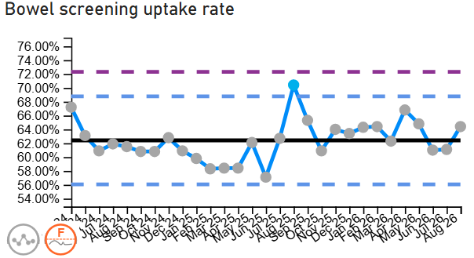
People of Swansea Bay live healthier, fairer and more prosperous lives
Breakthrough Objective: Increase Bowel screening rates in Swansea Bay UHB by 1% | August 2026 Performance | 64.4%
 | How are we doing? The SBUHB public health team continue to support Public Health Wales on efforts to enhance the uptake of bowel screening. What actions are we taking to improve? Bowel Cancer UK’s Early Diagnosis Programme is running for 12 months in Neath Port Talbot and upper Valley Towns from 1st June 2026. The programme combines: Community awareness events and volunteer activity; Education and engagement with GPs, pharmacies and other healthcare professionals; Local advertising and the “Tell Your GP Instead” campaign; Work with community groups and local partners; Encouraging eligible people to complete bowel-screening kits; and Encouraging people with possible symptoms to contact their GP promptly. The programme is intended to address areas where bowel cancer tends to be diagnosed later or bowel-screening participation is lower. The Health Board are engaged with the programme leads and when outcome measure data is available, it will be reported as part of the Integrated Performance Report. WG allocated £1m to endoscopy as part of the Planned Care Recovery Programme to address the backlog of patients waiting for Bowel screening which includes an additional 10 Bowel Screening Wales colonoscopies per week. We are continuing to provide local insight to Public Health Wales in relation to further targeted programmes. What are the risks to delivery? The focus of Public Health Wales may be affected by the development of other areas of responsibility through this year, and changes to staffing.

Slide 10
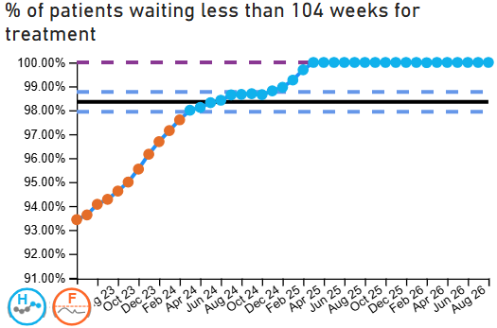
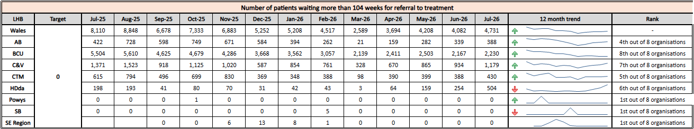
Care is high quality, safe, efficient and delivers the best possible outcomes for people in partnerships
Enhanced Monitoring Target: 100% of open pathways to be waiting less than 104 weeks and maintained for 3 months | August 2026 Performance | 100%
Breakthrough Objective: No patients waiting more than 104 weeks for treatment | August 2026 Performance | 0
 | How are we doing? In August 2026, the Health Board reported 100% of open pathways waiting less than 104 weeks for treatment, maintaining performance against the enhanced monitoring target. What actions are we taking to improve? Grip & Control Six-week forward operational review maintained. Weekly specialty delivery reviews focussed on highest-risk pathways. Enhanced validation programme and establishment of central validation capability. Productivity Theatre productivity programme progressing including utilisation, late starts, turnaround times and job planning. This is a key stipulation for realisation of the additional funding. Outpatient transformation programme progressing including validation, PIFU, direct listing and pathway redesign. Recovery Delivery Welsh Government allocated £8.4m to maintain compliance and support the UHB to reach a sustainable position where demand and capacity are aligned. Additional diagnostic and treatment activity is being increased associated to delivery of the productivity requirements Regional recovery proposals developed with Hywel Dda for orthopaedics, and cataracts What are the risks to delivery? Clinical engagement is a critical dependency for delivery of productivity and theatre transformation Funding is dependent upon the UHB further improving our productivity and treat in turn rates. Workforce availability and sustained productivity improvements remain essential to maintaining 104 week waits.

Slide 11
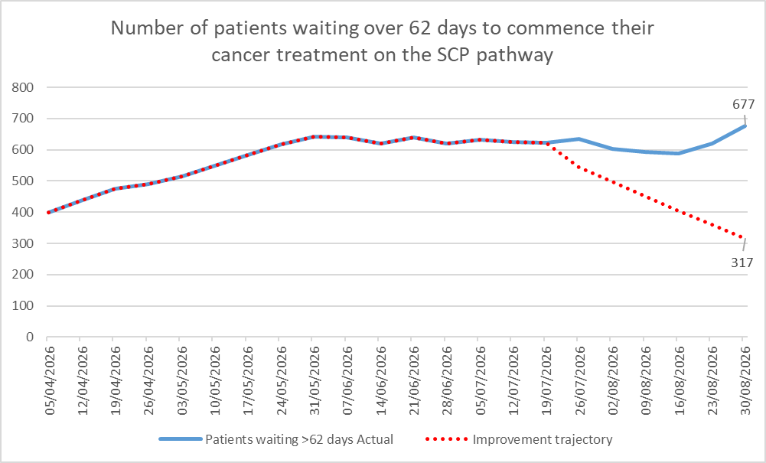
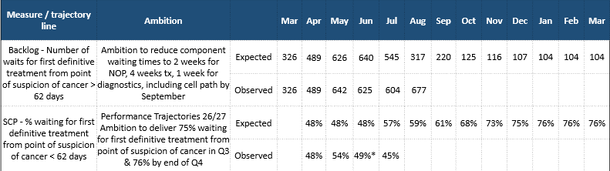
Care is high quality, safe, efficient and delivers the best possible outcomes for people in partnerships
TI Target: 60% performance maintained for 3 months against the SCP target | July 2026 Performance | 44.7%
Breakthrough Objective: Single Cancer Pathway performance to reach 76% by March 2026
 | How are we doing? The organisation reported a deterioration in performance against the SCP target in July 2026, reporting 44.7% compared with the previous 49.5% in June. What actions are we taking to improve? Cellular pathology recovery programme being implemented, including outsourcing, backlog clearance and additional reporting capacity to reduce diagnostic and DTT delays. It is expected that there will be no immediate change in the pathology turnaround figures in the next week, however by 11th October the service will achieve a 7-day turnaround for SCP specimens. Tumour-site improvement plans established for all major pathways, with enhanced weekly tracking and patient-level review of projected breaches. Dermatology and Plastics recovery actions to increase access capacity and reduce first outpatient backlogs. PMB pathway redesign, including ultrasound-first pathways, additional ultrasound clinics and review of hysteroscopy capacity. Endoscopy backlog reduction programme, including validation, productivity improvements and additional capacity. Breast and Lung diagnostic recovery plans focused on radiology reporting turnaround, imaging capacity and pathway efficiency. Enhanced Cancer Improvement Programme governance, with closer monitoring of backlog trajectories, component waits and recovery milestones.

Slide 12
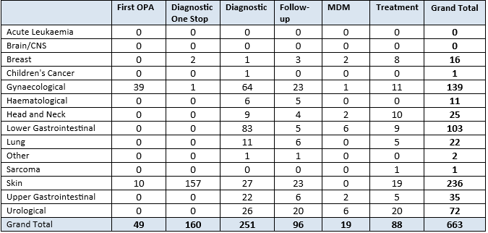
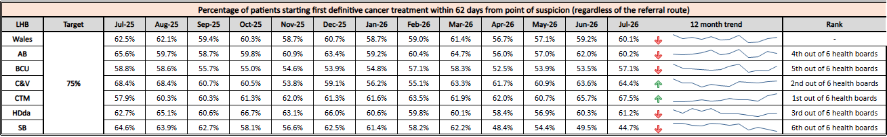
Care is high quality, safe, efficient and delivers the best possible outcomes for people in partnerships
TI Target: 60% performance maintained for 3 months against the SCP target |  | July 2026 Performance | 44.7%
Breakthrough Objective: Single Cancer Pathway performance to reach 76% by March 2026
 | What are the risks to delivery? Cellular pathology remains the biggest risk. Delays continue to affect multiple tumour sites and recovery benefits have not yet translated into sustained performance improvement. Dermatology and Plastics first outpatient backlogs continue to grow and represent a significant constraint on Skin pathway performance. Gynaecology (PMB) remains vulnerable, with risks around hysteroscopy capacity, ultrasound demand and whether pathway redesign delivers the expected whole-pathway benefit. Diagnostic capacity pressures remain in radiology, ultrasound, CT reporting and endoscopy. Workforce fragility across pathology, radiology and specialist cancer services continues to limit resilience. Treatment capacity constraints remain evident in selected pathways including Skin, Gynaecology, Lower GI and Urology. Trajectory delivery risk remains high, with the largest backlog variances concentrated in Lower GI (+48), Gynaecology (+47), Skin (+39) and Urology (+39). | What are the risks to delivery? Looking across the whole PTL, there is evidence of increasing volumes at the start of the pathway and diagnostic stage, this is more noticeable in the following tumour sites: Gynaecological, Head & Neck, Skin, Upper GI & Urological. Pathology delays are the primary driver for the increased volumes in diagnostic backlog, accounting for 50% of the backlog. Seasonal increase in overall skin volumes are beginning to be seen. Healthcare System Engineering Demand & Capacity report findings to be discussed with the COO, date to be agreed. PMB waits are currently more than 6 weeks. The plans to decouple the one stop service and increase Outpatient hysteroscopy capacity has taken place from 1st June 2026, which has coincided with increased scan capacity. The service are now working through a plan to increase capacity by 10-20 patients per day for the scan only clinics to specifically address backlog,

Slide 13
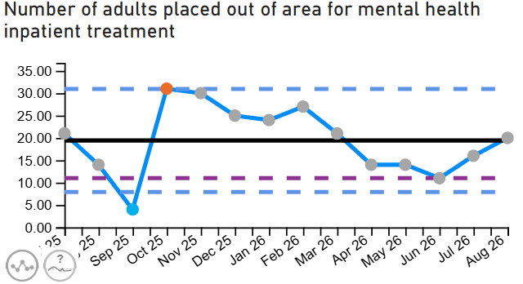
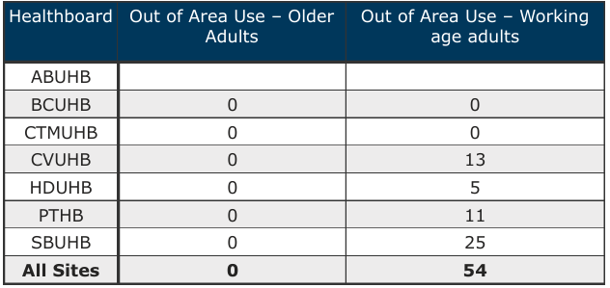
Care is high quality, safe, efficient and delivers the best possible outcomes for people in partnerships
Breakthrough Objective: Reduce the number of adults placed out of area for mental health inpatient treatment by 50% | August 2026 Performance | 20
 | How are we doing? The end of month figure for the number of adults placed out of area for mental health inpatient treatment was 20. There is currently a high demand for both Adult Acute and PICU beds. Previous figures have varied with regards to the number of Out of Area placements reported, however there has been no statistically significant change. How do we compare across Wales? ​ The use of private beds varies across Health Boards and is based on individual population need and is influenced by local clinical models and internal bed capacity. As shown in the table on the left, at the end of August, Swansea Bay had the most patients cared for in out of area placements at 25.​ Swansea Bay was in a steady decline in terms of usage, but a busy weekend 31st-2nd August resulted in a significant spike in usage, which peaked at 33 out of area placements being required. ​ What actions are we taking to improve?​ Private Patient MDT Coordinator in role to ensure oversight of private placements, safe discharge, and accurate financial tracking.​​ Weekly scrutiny meetings are in place within the Adult Directorate, alongside discharge planning meetings.​​ Daily MDT Board Rounds initiated on all three adult mental health wards to improve LOS and flow through our own beds.​ A safe holding space in NPTH is being utilised and staffed to provide overnight capacity.​​ Options to increase Home Treatment Team capacity and input for those in private placements under development. Bid approved by PFAG and now out to advert for posts.​ MDT approach to revising discharge pathways for male patients, and in future female patients, where there is no local low secure or rehabilitation provision and delays due to patients no longer meeting the criteria to reside have been extended.​​ Input into All Wales meetings with NHS Wales PO on the out of area beds workstream.​ Meeting taking place on the 4th September with CTMUHB to explore about increasing the SLA in relation to PICU beds, rather than private sector usage.​ ​ What are the risks to delivery? ​ Ongoing increases in the cost of private provision.​ Challenges related to patient flow and repatriation.​ Unpredictable spikes in USC demand.​

Slide 14
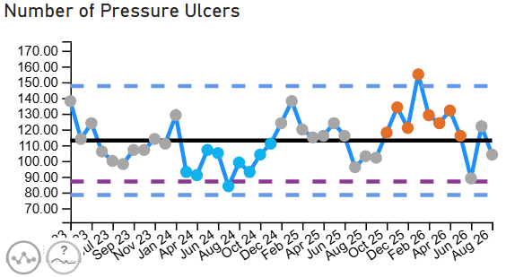
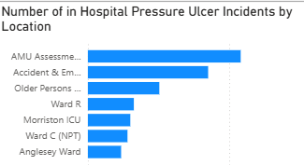
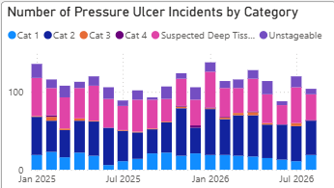
Care is high quality, safe, efficient and delivers the best possible outcomes for people in partnerships
Breakthrough Objective: 30% reduction in avoidable pressure ulcers | August 2026 Performance | 104 (Unvalidated) (Total number of Pressure Ulcers)
 | In August, 104 Pressure Ulcer incidents were reported, compared to the 122 reported in July. Figures remain changeable due to Datix amendments. Inpatient rate: R 2.5 per 1,000 bed days There is no national benchmark, with the highest inpatient rate recorded in Q3 (R 2.84). Primary Care Services rates remain unreliable due to caseload dashboard inaccuracies. We have seen an increase in reporting numbers in Q 4 2026, 34% Hotspots continue to be highest in Unscheduled Care
What actions are we taking to improve? Governance & Assurance - Pressure Ulcer Strategic Improvement Group established, Standardised scrutiny panels aligned to national frameworks, Improved incident closure rates and data quality validation and Service Group-level bespoke Quality Improvement Plans have been developed Clinical Practise and Systems - Implementation of standardised prevention pathways and policies (All Wales alignment), centralised Tissue Viability Service model, Rollout of digital wound imaging (Improvement Cymru), progression of equipment provision (including bed contract) and development of specialist neonatal prevention pathways Workforce & Education - Multi-modal education programme (face-to-face, virtual, video), targeted hotspot training in high-risk areas, Band 6/7 leadership development, Pre-registration Tissue Viability skills training, Tissue Viability Champions network and MDT complex wound forums Audit & Improvement Culture - Health Board-wide tissue viability audits, documentation and care quality reviews, peer review and shared learning processes and Staff engagement campaign: “Pressure Ulcer Superhero League 2026”
What we expect to see (Outcomes by 2027):
↓ 20% PU rates in acute sites; ≤1.6/1000 bed days.
↓ 30 % avoidable PU in HB.
↓ Reduce the total number of HBA incidents by 10%
↓ Reduce HB acquired Deep damage by 10%
What are the risks to delivery?
Patient vulnerability (specifically first 72h of admission).
Staff knowledge, skills and application of risk management principles
Delays in receiving specialist equipment
Limited prevention training, lack of tissue viability expertise, delayed/incomplete digital charting, and limited access to medical photography.
Whole system pressure affecting the timeliness of scrutiny review panels

Slide 15
Care is high quality, safe, efficient and delivers the best possible outcomes for people in partnerships
Complaints – August 2026
What is the data telling us?
We have seen a month on month increase in formal concerns since the introduction of Listening to People.
Our position in relation to overdue concerns managed under Putting Things Right is improving with a reduction of over 50% since June 1st 2026, to 145 open cases.
What do we expect to see change and when?
We are on track to resolving at least 40% of Listening to People concerns through Early Resolution.
QI methodology is being applied to LtP pathways to strengthen triage and correct management of concerns, this is aimed at reducing the number of concerns overdue under LtP, this is showing early progress with a reduction in the number of concerns converting from Early Resolution to formal concerns.
**Please note graphs 1 & 3 only go up as far as June and July, this is due to the complaints to be closed in June/July the due dates are not reached yet

Slide 16
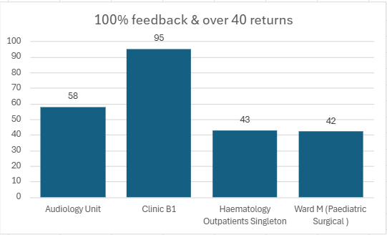
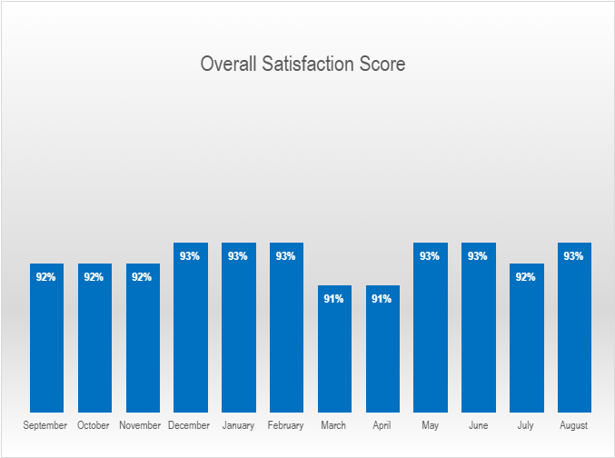
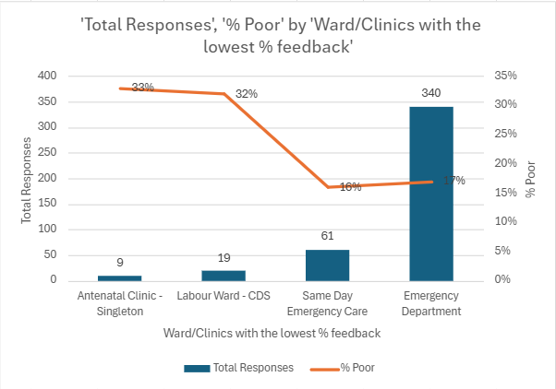
Care is high quality, safe, efficient and delivers the best possible outcomes for people in partnerships
Patient Experience – August 2026
Graph 2
What is the data telling us?
Graph 1 – Our overall satisfaction score remains above the benchmark of 85%, currently standing at 93%.
Graph 2 – Highlights wards/clinics achieving scores above 100%, based on more than 40 responses. Push reports are sent weekly to the services and monthly service group reports are sent out and discussed in the patient experience forum meetings and quality and safety meetings.
Graph 3 – Identifies the wards/clinics with the lowest satisfaction percentages, based on more than 9 responses.
What are we doing about it?
The Patient Experience Team attends various forums where services review feedback, discuss themes, and identify opportunities for service improvement. When care is reported as poor or very poor, the relevant service group is notified, and Quality and Safety teams work with ward or service staff to investigate the identified themes.
What do we expect to see change and when?
Patient experience data is being reviewed as part of wider work to look at our systems for managing quality, moving away from process driven activity towards learning
Graph 1
Graph 3

Slide 17
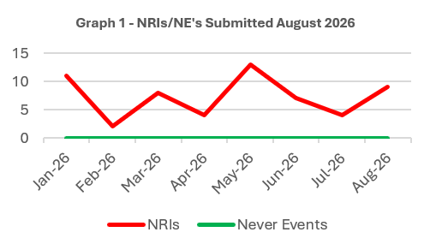
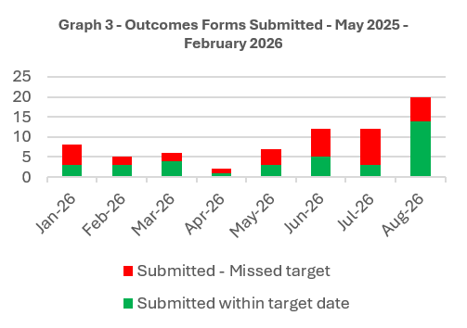
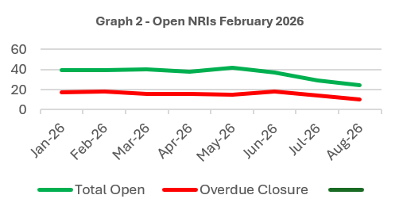
Care is high quality, safe, efficient and delivers the best possible outcomes for people in partnerships
NRIs/NE’s/EWNs – August 2026
What is the data telling us?
Table 1 – Number of NRIs reported to NHSWP & 1-10 (includes retrospective reporting of avoidable pressure damage incident; 2’Must Reports – neonatal death, indirect maternal death).Service Group addressing overdue decisions on pressure damage incidents with additional scrutiny panels.
Table 2 – 40 open NRIs.10 open past closure date (5 external experts) The number of overdue closures has declined in month. Service Group Directors pressed for completed closure forms
Table 3 – 20 closure/combination forms submitted in month - 70% performance for August closures. Variation in performance month on month. Closures dependent on timely completion of reports which requires full engagement from clinicians/specialist advisors/contributors and scrutiny panel decisions along with availability of staff to attend service group closure meeting
What are we doing about it?
Review of processes in partnership with MHLD to identify opportunities for improvement in NRI reporting
Temporary support from corporate team to support with high-risk cases in MHLD
Bi-weekly scrutiny within service groups to progress investigations / closures
Through a Systems Lens training completed with >100 staff trained in serious incident investigations to support timely reviews
What do we expect to see change and when?
Reduction in number of overdue investigation outcomes forms within MHLD September 2026
Improvement in SNPT overdue outcomes forms October 2026

Slide 18
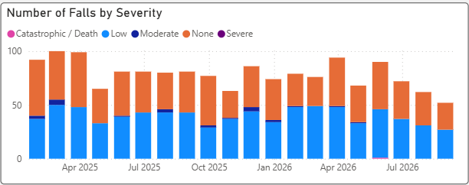
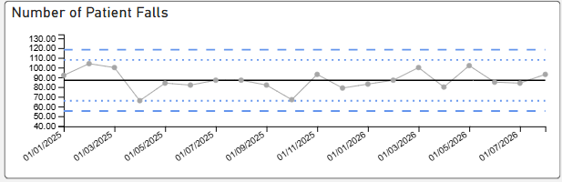
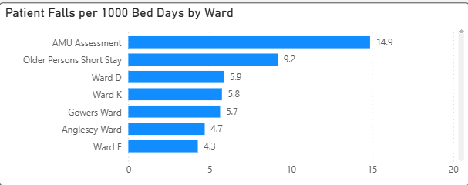
Care is high quality, safe, efficient and delivers the best possible outcomes for people in partnerships
Page 1
Falls Prevention
What is the Data telling us?:
In-patient falls rate for Health board remains below National average
High risk areas such as Morriston Acute medical assessment unit and Older Persons Short stay remain above the targeted falls rate
ED attendance for falls 16% higher September 2026 than September 2025
Falls related serious incidents (Sis) have reduced by 50% (sept-sept 2025 vs 2026)
What are we doing about it:
Ongoing discussions with WAST re direct commissioning of level 1 response for SBUHB
Re-establishing National Safer Mobilisation Group (previously National In patient falls Group)
Regional Falls Prevention taskforce enabling collaboration
Primary Care action plan agreed
Falls prevention (Dance to Health) programme developing due to begin April 2026 – to be managed through SBUHB Arts in Health
Review of Care pathways National & Local level underway
Project lead change for care home and domiciliary care project – having short term impact
Thematic review of inpatient falls incidents – targeted work on appropriate bed rail use planned
Enhanced falls response (therapy led) stood down new pathways to meet WAST demand established
Introduction of new DEWI (Deconditioning Early Warning Indicator) tool across a number of acute ward areas
Focussed work in frailty services, including Older Persons Assessment Unit, on avoiding deconditioning
What do we expect to see change?
Sustained reduction in care home falls admissions
Falls rate not exceeding 5.0 (falls/1000beddays) over preceding 12 months – ON TRACK
Reduction of Bed rail related inpatient falls by 10% - COMMENSED

Slide 19
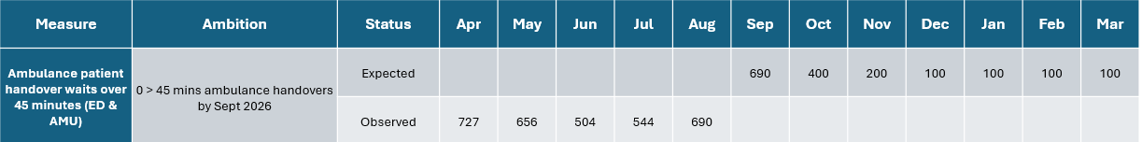
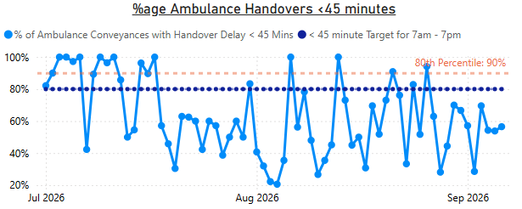
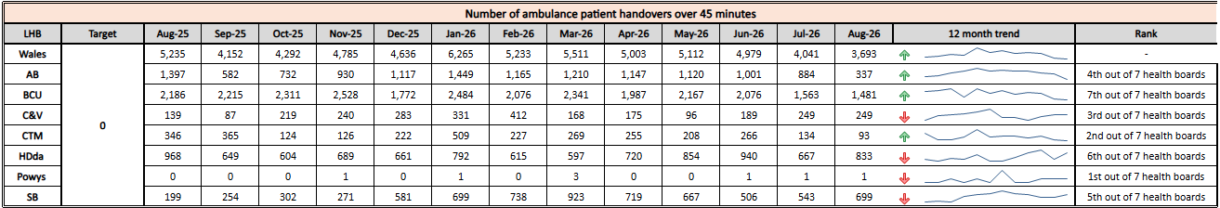
Level 4 - Unscheduled Care Performance
Care is high quality, safe, efficient and delivers the best possible outcomes for people in partnerships
TI Target: 30% reduction in ambulance handovers over 45 minutes and maintained for three months (Based on Q2/Q3 2023/24 baseline) | August 2026 Performance | 690
Annual Plan ambition: 0 ambulance handovers > 45 minutes from September 2026
 | How are we doing? In August 2026, the organisation reported an increase in the number of ambulance handovers over one 45 minutes, reporting 690 compared to 544 in July 2026. It is important to note that reporting parameters have changed following Welsh Government guidance. Ambulance handover figures are to include all ambulance handover locations, this will therefore show an increase in the reported figures. What actions are we taking to improve? Focus on weekend discharge and Home for Lunch Optimal Hospital Flow Framework roll out – NPT and Singleton Join up tactical command Health Board wide – earlier system decision making/flow Heightened WAST focus on the decision to convey, patient by patient SPOA (Single Point of Access) direct referral pathways into all specialties – implemented end June 26. Aim 2-3 diverted away from ED/day (weekdays). Continue CCBC Care Home PDSA 24/7 after 1 week test of change - in place. Acute Medical and Older Persons Assessment units are operating more effectively as a result of various clinically led operational changes – thus creating improved pull from ED / turnaround What are the risks to delivery? The ED area is functioning as a medical assessment/ward due to capacity deficits, which results in overcrowding in the ED and less ability to accommodate patients from WAST. Lead in time to develop Integrated Assessment facility (24 months)

Slide 20
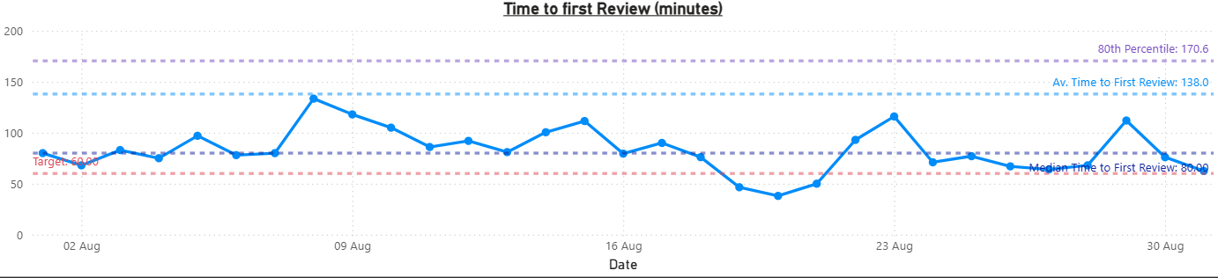
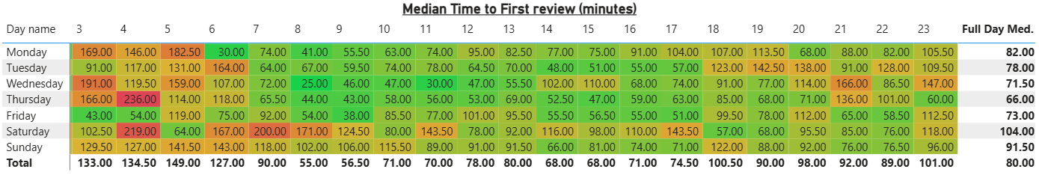
Level 4 - Unscheduled Care Performance
Care is high quality, safe, efficient and delivers the best possible outcomes for people in partnerships
TI Target: Median time from arrival at emergency department to assessment by a clinical decision maker should not exceed 60 minutes | August 2026 Performance | 84 minutes 39.7% seen < 60 mins
Daily median time to first review in the Emergency department is shown below, along with a heat map of the median time by hour and day and the average since recording began on the 1st May 2026. Response times continue to improve, as evidenced by the team reducing to 84 minutes compared with the 4 month average of 138 minutes, but remain in excess of the 60 minute target. | How are we doing? In August 2026, the organisation reported a slight increase in the percentage of patients assessed by a clinical decision maker within 60 minutes, reporting 39.7%. What actions are we taking to improve? 5 tests of change to reduce time to first assessment in ED, these have included zoning of areas with designated medical workforce, rapid assessment models, management of ambulatory majors – some improvement evident with ongoing PDSAs planned. Focussed programme of work on WPAS entries to enable improved understanding of ED journey delays. Adjustment of medical staff rotas to better align to demand. Backfill of junior doctor gaps at weekends following Deanery directive to adhere to 1:3 weekend working pattern. What are the risks to delivery? Workforce & Roster constraints: balancing out of hours demand with clinician capacity vs working time and rota rules. Competing priorities: focus on high-acuity patients limits capacity to progress lower-acuity queue Clinical risk appetite: concern about safely accelerating decisions out of hours with reduced support services Demand unpredictability: 3-4 fold variance in individual hourly arrivals can overwhelm with delayed recovery. Queue management discipline: requires consistent real-time oversight and escalation, underpinned by robust digital system as a key enabler System-wide alignment risk: lack of available alternatives to ED at times of peak demand

Slide 21
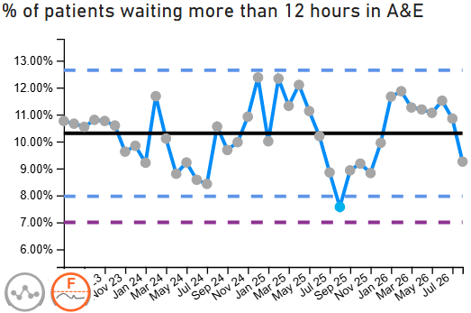
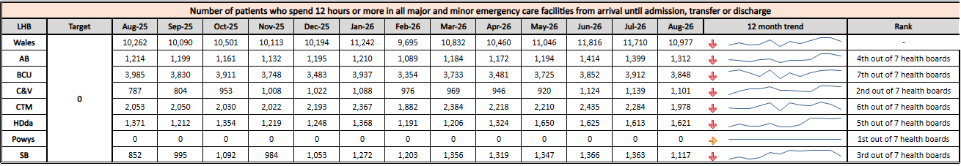
Care is high quality, safe, efficient and delivers the best possible outcomes for people in partnerships
TI Target: Continuous improvement towards no more than 7% of patients waiting over 12 hours at each individual site and across HB | August 2026 Performance | 9.25%
Breakthrough Objective: Reduce the number of patients waiting in ED for over 12 hours by 10% | August 2026 Reduction against March 2026 Baseline | 2.01% reduction against baseline
 | How are we doing? In August 2026, 1,117 patients, which is 9.25% of all attendances, were waiting more than 12 hours in the Emergency Department. Whilst this represents a reduction of 18% on the July position, we remain above our trajectory to reduce the number to below 997 patients. What actions are we taking to improve? Resident Doctor rota redesign (from 5 Aug): Expected to improve weekday afternoon/evening cover, but reduced weekend resident doctor availability presents a risk to weekend performance. Ambulatory pathway trial: Progressing as planned, with a new Category 3/4 assessment process due to be tested from 17th August. Clinician zoning allocation (PDSA 1): Improved ambulance triage flow and pace, but no measurable improvement in overall departmental performance. Redesign planned. Rapid Access Physician (RAP) trials: No improvement seen across four separate tests. Trial discontinued. #NOF pathway redesign – designated ward base has now been agreed Integrated Assessment Unit – Design the Integrated Assessment Unit (Wards A&B) to be co-located with the Emergency Department What are the risks to delivery? Flow dependency risk: reduction depends on improving discharge and bed capacity (same constraint as ambulance handovers) including a reduction in the number of clinically optimised patients in acute/non-acute beds. Integrated Assessment Unit - Current lead time to implementation is 24 months Demand pressure risk: continued high attendances or admissions will offset gains
Measure/ Trajectory Line | Ambition | Extraction Status | Apr | May | Jun | July | Aug | Sep | Oct | Nov | Dec | Jan | Feb | Mar
Patients waiting in ED > 12 hours | 10% reduction in patients waiting >12 hours by end of March 2027 | Expected | 1350 | 1300 | 1190 | 1100 | 997 | 997 | 997 | 997 | 997 | 997 | 997 | 997
 |  | Observed | 1319 | 1347 | 1366 | 1364 | 1117

Slide 22
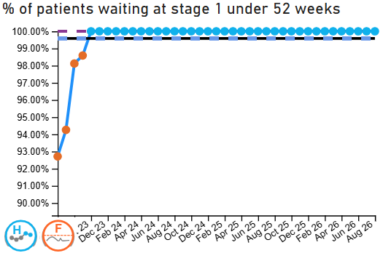
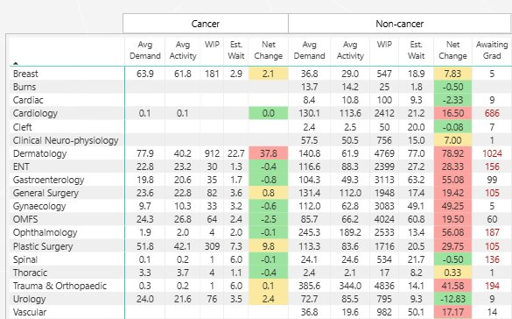
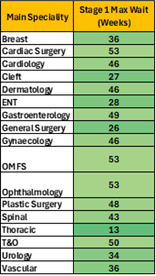
Level 4 – Planned Care Performance
Care is high quality, safe, efficient and delivers the best possible outcomes for people in partnerships
Enhanced Monitoring Target: 100% of open outpatient pathways to be waiting less than 52 weeks and maintained for 3 months | August 2026 Performance | 100%
 | How are we doing? In August 2026, the Health Board reported 100% of open outpatient pathways were waiting less than 52 weeks. How do we compare across Wales? We are currently the only organisation that has maintained the 100% target for 52 weeks over the last year as seen in the comparative table below. What actions are we taking to improve? Reviewing clinic utilisation, slot allocation and template variation across specialties. Using learning from recent targeted improvement work to develop a more standardised approach to clinic template design across services. Strengthening validation and demand/capacity monitoring processes to support sustainable performance. Continuing regular operational oversight to identify risks to pathway waits at the earliest opportunity. What are the risks to delivery? The principal operational concerns are now focused on Gastroenterology, Endoscopy funding, Plastics administrative capacity, Orthodontic August capacity and emerging ENT/Vascular pressures for late summer. Workforce availability and unplanned reductions in clinical capacity. Increasing referral demand

Slide 23
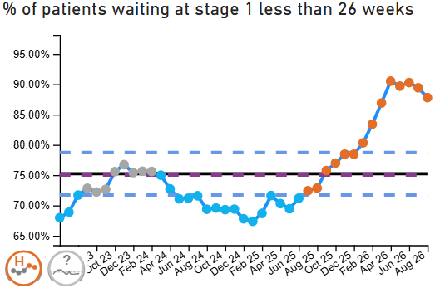
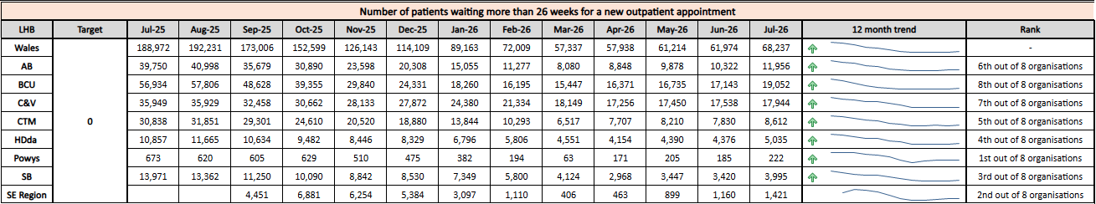
Level 4 - Planned Care Performance
Care is high quality, safe, efficient and delivers the best possible outcomes for people in partnerships
Enhanced Monitoring Target: Continuous improvement towards 75% of all open outpatient pathways waiting less than 26 weeks | August 2026 Performance | 87.79%
 | How are we doing? In August 2026, the Health Board reported 87.79% of open outpatient pathways were waiting less than 26 weeks. What actions are we taking to improve? Continuing focused work to reduce longer waits through demand and capacity oversight. Reviewing outpatient clinic utilisation and template variation across specialties to support improved access and consistency. Using learning from recent improvement initiatives to support a standardised approach to clinic template configuration across services. Strengthening validation and pathway monitoring processes to support sustainable recovery performance. What are the risks to delivery? Outpatient demand exceeds activity volumes; sustainability is dependent upon successful delivery of the outpatient transformation programme. There will be a re-alignment of capacity towards urgent cancer referrals Workforce availability and unplanned reductions in clinical capacity. Increasing referral demand

Slide 24
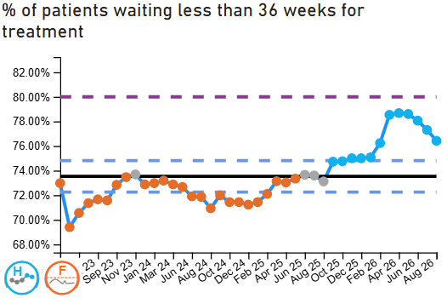
Level 4 - Planned Care Performance
Care is high quality, safe, efficient and delivers the best possible outcomes for people in partnerships
Enhanced Monitoring Target: Continuous improvement towards 80% of all open pathways waiting less than 36 weeks | August 2026 Performance | 76.42%
 | How are we doing? In August 2026, the Health Board reported 76.42% of open pathways were waiting less than 36 weeks. How do we compare across Wales? The Health Board continues to demonstrate sustained improvement in the percentage of patients waiting less than 36 weeks for treatment and is performing close to the enhanced monitoring target trajectory when compared with the all-Wales position What actions are we taking to improve? Continuing targeted work with specialties to reduce longer waits and improve pathway flow. Reviewing clinic utilisation, scheduling practices and capacity variation across services. Maintaining demand and capacity oversight arrangements to support sustainable trajectory improvement. What are the risks to delivery? In order to deliver the 104-week access standard and reduce costs uniformly across the board, resources may need to be re-allocated from specialties with shorter waiting times to those with longer waits. This includes re-alignment of capacity towards patients requiring urgent cancer treatment Increasing referral demand and pressure on treatment capacity. Workforce availability and reduced resilience due to vacancies, sickness or annual leave.

Slide 25
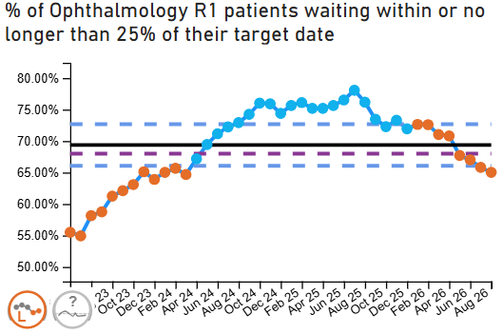
Level 4 - Planned Care Performance
Care is high quality, safe, efficient and delivers the best possible outcomes for people in partnerships
Enhanced Monitoring Target: 68% R1 ophthalmology patient pathways to be waiting within or no longer than 25% of their target date for an outpatient appointment and maintained for 3 months | August 2026 Performance | 65.03%
 | How are we doing? In August the Health Board reported 65.03% of Ophthalmology patients were waiting within or no longer than 25% of their target date, this is a deterioration on the previous months performance. What actions are we taking to improve? Please see table below What are the risks to delivery? Workforce pressures, including consultant and non-medical workforce vacancies, sickness and reduced clinic availability. Competing operational pressures impacting the ability to release additional outpatient capacity.
​ | June | July | August | Risks ​ | Solutions & Mitigations
Vitreoretinal​ | 76% | 84% | 84% | Limited regional VR workforce limiting clinic capacity. ​ | Optimising workforce utilisation​ Regional Consultant started working across SBU & HD – vital skill mix across teams, ensuring activity is delivered at the most appropriate level​
Cataract​ | 58% | 61% | 61% | Core Pre-Assessment capacity does not meet current demand. | Maintaining operational grip​ Weekly review of performance, clinic utilisation, and recovery trajectories at specialty level​ Clear ownership of delivery against improvement actions​
Cornea​ | 48% | 47% | 47% | Backlogs with both news and follow-ups. Only 1 Cornea Consultant within the department. ​ | Targeting backlog reduction​ Systematic validation of long waits and risk stratification to prioritise patients appropriately​ Use focused additional capacity (e.g. super clinics) for paediatric areas​
Orthoptics​ | 94% | 94% | 94% | Workforce gaps in clinical and admin staff ​ | Fully established Clinical staff ​ Full training underway for new Orthoptists – significant improvement already established ​
Paediatrics ​ | 50% | 42% | 41% | R1 backlog mainly consists of new referrals.​ 1 Consultant vacancy ​ | Targeting backlog reduction​ Systematic validation of long waits and risk stratification to prioritise patients appropriately​ Use focused additional capacity (e.g. super clinics) for paediatric areas​
Diabetic Retinopathy ​ | 64% | 63% | 63% | R1 backlog consists mainly of follow up patients. ​ 1 Consultant vacancy | Improving clinic productivity to ensure follow ups are managed​ Optimise clinic templates, reduce unused slots and introduce overbooking where appropriate​ Increase use of technician-led and diagnostic clinics to release consultant capacity​ Utilising 'either or' slots to book to demand of news or FUPs ​
Glaucoma ​ | 72% | 75% | 75% | 2 Consultant vacancies since June 2025. ​ Considerable risk – on service Risk Register since June 2025. ​ | Maintaining operational grip​ Weekly review of performance, clinic utilisation, and recovery trajectories at specialty level​ Clear ownership of delivery against improvement actions​ Two consultants appointed to due to start across the summer. Improvement in performance is anticipated from August onwards once clinics are fully established. ​

Slide 26
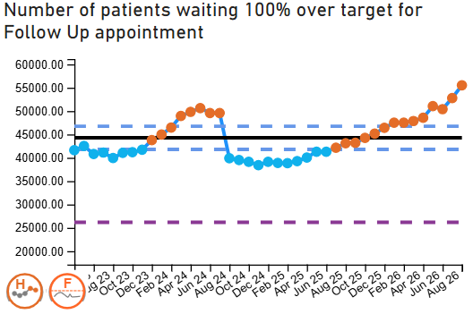
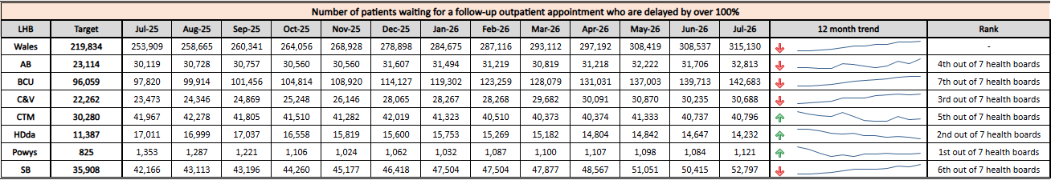
Level 4 - Planned Care Performance
Care is high quality, safe, efficient and delivers the best possible outcomes for people in partnerships
Enhanced Monitoring Target: 12% reduction in the number of patients delayed by 100% for their follow up appointment in three consecutive months and maintained for 3 months (Based on the November 2024 baseline.) | August 2026 Performance | 44.44% (above the baseline)
 | How are we doing? In August 2026, the Health Board reported 44.44% performance against the enhanced monitoring trajectory for follow-up waits. Although some improvement work has been undertaken, performance remains below the required target and follow-up pressures continue across a number of specialties. What actions are we taking to improve? Continuing targeted validation and review of follow-up waiting lists to ensure clinical prioritisation and pathway accuracy. The Health Board are seeking to implement discharge by default to reduce follow-up demand and enable capacity to be re-allocated to new appointments A clinical review of the HSBUK outcomes has been undertaken, which identified some inappropriate listing to follow-up which has since been addressed. Implementing recommendations arising from GIRFT/CIN improvement work to reduce unwarranted variation in follow-up management practices. Reviewing clinic utilisation, follow-up scheduling and capacity variation across specialties. What are the risks to delivery? Workforce pressures, including vacancies, sickness and reduced clinic availability. Competing operational pressures impacting the ability to release additional outpatient capacity.

Slide 27
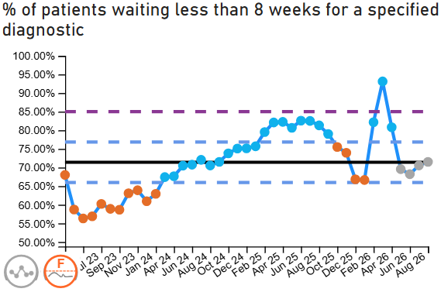
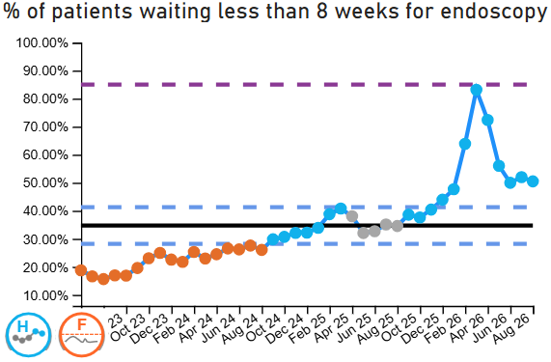
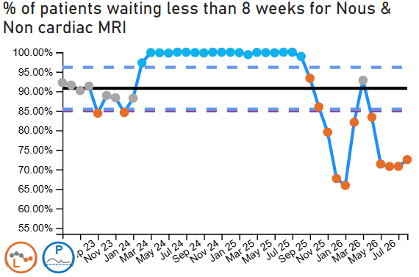
Level 4 - Planned Care Performance
Care is high quality, safe, efficient and delivers the best possible outcomes for people in partnerships
Care is high quality, safe, efficient and delivers the best possible outcomes for people in partnerships
Enhanced Monitoring Target: 85% of patients waiting for a diagnostic test to be waiting less than 8 weeks and maintained for 3 months | August 2026 Performance | 71.50%
Enhanced Monitoring Target: 85% of patients waiting for a diagnostic endoscopy to be waiting less than 8 weeks and maintained for 3 month | August2026 Performance | 50.49%
Enhanced Monitoring Target: 85% of patients waiting for a NOUS and non cardiac MRI to be waiting less than 8 weeks and maintained for 3 months. | August2026 Performance | 72.48%
How are we doing?
In August 2026, the organisation reported:
4,165 patients were waiting greater than 8 weeks for a reportable diagnostic test, a reduction of 455 from the July position
An improvement in performance against the percentage of patients waiting less than 8 weeks for a diagnostic test, with the percentage increasing to 71.50% compared to 70.55% in July 2026.
914 patients waiting over 8 weeks for a diagnostic endoscopy, which is an increase on the number of patients waiting over 8 weeks which was recorded in July 2026.
2,109 patients waiting over 8 weeks for NOUS and non-cardiac MRI, which is a reduction of 184 patients from the figures reported in July 2026.

Slide 28
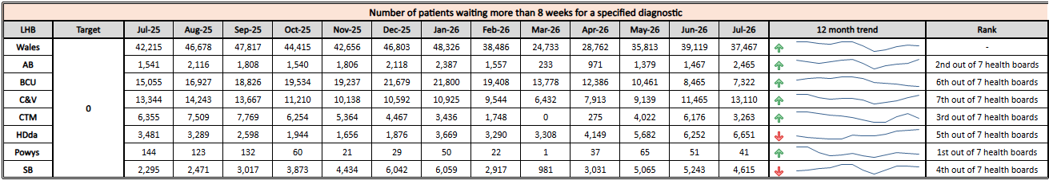
Level 4 - Planned Care Performance
Care is high quality, safe, efficient and delivers the best possible outcomes for people in partnerships
Care is high quality, safe, efficient and delivers the best possible outcomes for people in partnerships
Enhanced Monitoring Target: 85% of patients waiting for a diagnostic test to be waiting less than 8 weeks and maintained for 3 months | August 2026 Performance | 71.50%
Enhanced Monitoring Target: 85% of patients waiting for a diagnostic endoscopy to be waiting less than 8 weeks and maintained for 3 month | August 2026 Performance | 50.49%
Enhanced Monitoring Target: 85% of patients waiting for a NOUS and non cardiac MRI to be waiting less than 8 weeks and maintained for 3 months. | August 2026 Performance | 72.48%
How do we compare the rest of Wales
What actions are we taking to improve?
Welsh Government-funded diagnostics recovery programme now mobilised, with trajectories being refreshed against confirmed activity allocations.
Funding and capacity prioritised to MRI, CT, Endoscopy, NOUS and Neurophysiology recovery. Seven-day MRI and CT provision, additional reporting sessions and insourcing programmes being deployed to restore the 8-week diagnostic standard.
Endoscopy recovery supported through insourcing, validation, BSW accreditation and additional clinical capacity.
Diagnostic validation, vetting and pathway optimisation programmes being expanded to maximise internal productivity and reduce avoidable demand.
Residual sustainability pressures remain in Cellular Pathology, DEXA, Audiovestibular and radiology reporting capacity.
Diagnostics Transformation Programme and Diagnostics Board providing strengthened delivery oversight, workforce planning, digital transformation and AI-enabled productivity opportunities.
What are the risks to delivery?
Resource for elements of the diagnostic programme (MRI, Endoscopy, Neurophysiology, Dexa) are yet to confirmed but are referenced in plan: 5,238 patients in total (MR, NOUS, CT, Endoscopy & NP)
Workforce market very tight, with staff having left to join agencies and other HBs and a 2 year training window to skill up new trainees
Sonography dependent upon returns from maternity leave
NP – shortage of skilled workforce, unstructured programme for developing HSSTs in Wales (Physiologists at doctorate level who can manage own casemix)

Slide 29
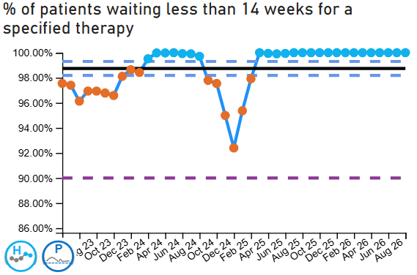
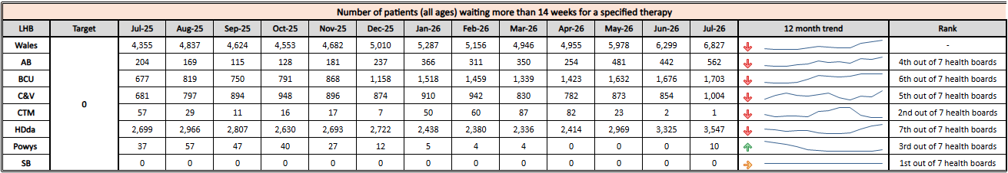
Level 4 - Planned Care Performance
Care is high quality, safe, efficient and delivers the best possible outcomes for people in partnerships
Enhanced Monitoring Target: 90% of patients waiting for therapies to be waiting less than 14 weeks and maintained for 3 months | August 2026 Performance | 100%
 | How are we doing? Therapies services remain fully compliant with the escalation target, with sustained 100% delivery since July 2025. Performance is closely monitored, and assurance processes are firmly embedded to maintain this position. How do we compare across Wales? All adult and children/young people therapy services in SBUHB have consistently met the escalation standard and demonstrate a stable position relative to peers. What actions are we taking to improve? We continue to maintain robust capacity and demand management alongside effective job planning, refining these arrangements to ensure alignment with activity. Currently have bid for planned care additional funding for the physiotherapy service, due to the increased risk of breaching as a result of increased outpatient and diagnostic activity. In parallel, we are improving access routes and pathways to better empower patients, support self-management where appropriate, provide advice to stakeholders (e.g. schools), and optimise use of available capacity What are the risks to delivery? The principal risk to sustained delivery is any reduction in available capacity against a backdrop of sustained or increasing demand. There is also a need to manage clinical risk across the pathway, for example follow-up appointments. These risks are being actively managed through workforce planning, easy and early access and advice, prioritisation, and continued validation and oversight of demand trends.

Slide 30
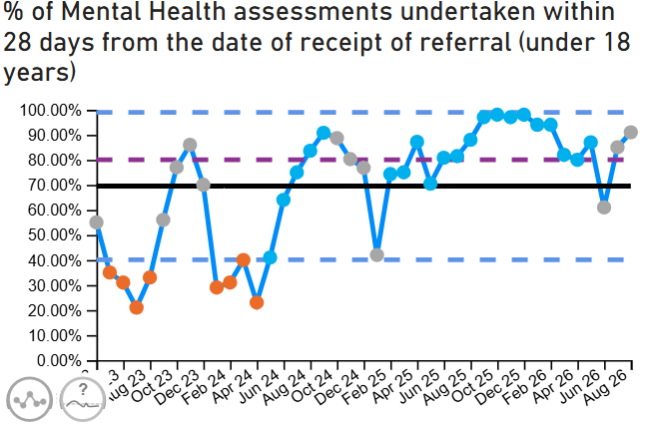
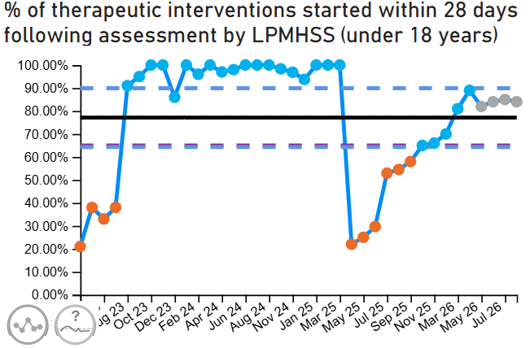
Level 3 – CAMHS
Care is high quality, safe, efficient and delivers the best possible outcomes for people in partnerships
Enhanced Monitoring Target: 80% of LPMHSS mental health assessments undertaken within 28 days from the date of receipt of referral | August 2026 Performance | 91%
Enhanced Monitoring Target: 70% of therapeutic interventions started within 28 days following an assessment by LPMHS | August 2026 Performance | 84%
Enhanced Monitoring Target: 85% of HB residents in receipt of secondary mental health services who have a valid care and treatment plan | August 2026 Performance | 94%
 | How are we doing? Performance within CAMHS continues to show positive progress. Welsh Government has de-escalated CAMHS from Level 3 to Level 1 in recognition of the significant improvements in performance and service outcomes. Part 1A maintained compliance at 90% throughout August, while Part 1B achieved 84% compliance. The dedication and hard work of staff in the service have been invaluable in achieving and sustaining these standards. What actions are we taking to improve? To sustain this level of performance, the service are focusing on several actions: Closely tracking performance data and reviewing pathways to support timely interventions. Providing ongoing support and development opportunities for staff. Applying the Managing Attendance at Work Policy consistently where attendance concerns arise. Strengthening workforce resilience through regular staffing reviews and increased clinical capacity. Working collaboratively with partners and stakeholders to identify and deliver further service improvements. What are the risks to delivery? Key risks include workforce pressures, rising demand for services, and future funding challenges. The service continues to actively manage and mitigate these risks.

Slide 31
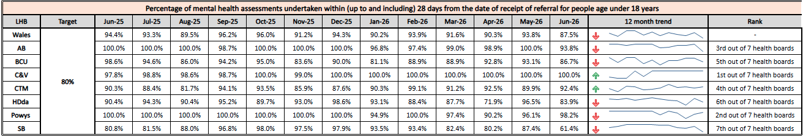
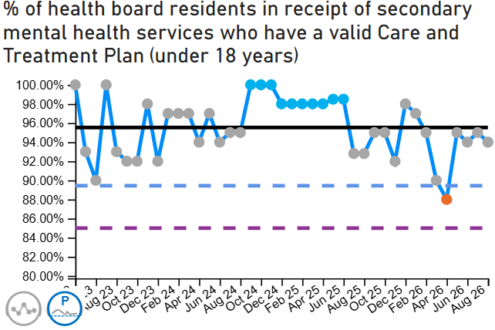
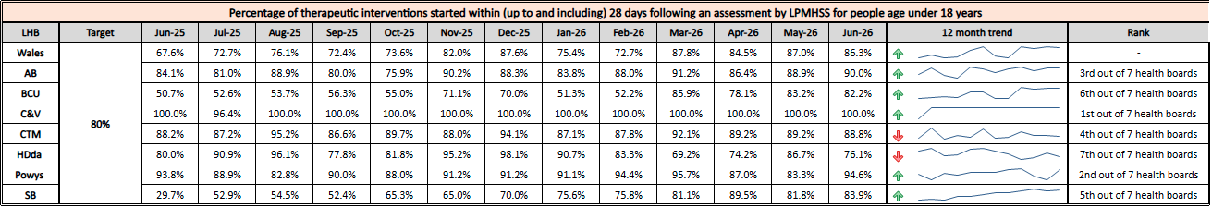
Level 3 – CAMHS
Care is high quality, safe, efficient and delivers the best possible outcomes for people in partnerships
Enhanced Monitoring Target: 80% of LPMHSS mental health assessments undertaken within 28 days from the date of receipt of referral | August 2026 Performance | 91%
Enhanced Monitoring Target: 70% of therapeutic interventions started within 28 days following an assessment by LPMHS | August 2026 Performance | 84%
Enhanced Monitoring Target: 85% of HB residents in receipt of secondary mental health services who have a valid care and treatment plan | August 2026 Performance | 94%
How do we compare across Wales?
Our performance is broadly comparable with other health boards in Wales across all areas. Nonetheless, there remains scope for further enhancement, particularly in domains where national targets are only just being achieved. Ongoing internal scrutiny is maintained to ensure that performance standards continue to be raised wherever possible.

Slide 32
Targeted Intervention (Level 3) – Mental Health
Updates against the de-escalation criteria outlined by Welsh Government can be found below;
De-escalation Criteria | Actions – Updated August 2026 | RAG Status
Immediate Concerns – Three out of six immediate concern actions have been achieved by the service. The service consider there to be sufficient risk mitigations in place for two out of the three unachieved actions. | In July, Capital Planning procured a new personal attack alarm system for roll out across Caswell Clinic (120k). An installation contractor has also been secured, and costs are being finalised prior to commencing installation, which will take approximately 10 months. Awaiting a start date for implementation of the new system from Capital Planning. Security Framework Document ratified at Augusts Service Group Q&S Meeting and now published on COIN. Estates (SBUHB) continue to lead on the procurement and installation of wall mounted boilers (with controllable water temperature) across wards in Caswell Clinic. The service is now waiting for a start date to commence installation of the boilers from SBUHB Estates. Priority Actions for September 2026 Estates (CTUHB) have confirmed that there is insufficient funds to complete the refurbishment of staff changing rooms in Caswell Clinic. Despite this, the service will now procure and install 100 new staff lockers to strengthen the services governance of prohibited items entering clinical areas. This is the only action without sufficient risk mitigation at present.
Wider De-escalation Measures – Fourteen actions in total with 10 complete. One action closed in August (CTP). | Actions across the following domains have been achieved during August: CTP – Quality assurance audit undertaken which evidences that all care plans address identified mental and physical healthcare needs of patients. Priority Actions for September 2026 Increase risk assessment compliance for WARRN (100%) and HCR-20 (80%). Improvement plan developed by Directorate Manager and Consultant Psychologist. In month improvement reported with HCR20 compliance at 88% and WARRN at 54%. This is an ongoing priority for the service.

Slide 33
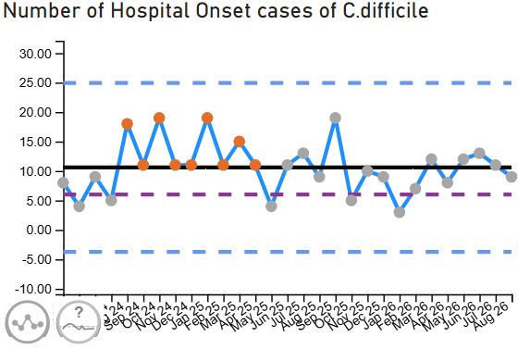
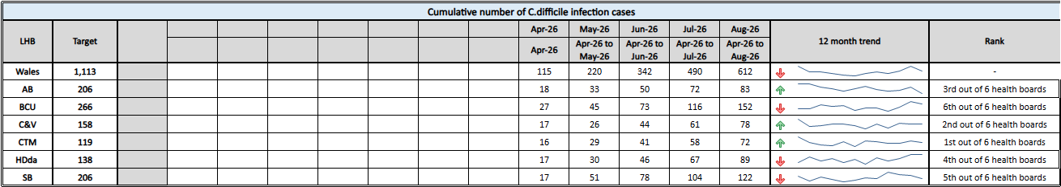
Level 4 - Planned Care Performance
Care is high quality, safe, efficient and delivers the best possible outcomes for people in partnerships
Enhanced Monitoring Target: C-Diff: reduce the number of hospital onset infections by 40% and maintain for 3 months (from a baseline of the average number of cases in quarter 3 of 10 cases to no more than 6 per month | August 2026 Performance | 9 cases
 | How are we doing? There were 9 cases of C.difficile reported as hospital onset in August 2026 SBUHB continues to have the highest incidence in Wales. What actions are we taking to improve? Increased executive oversight of service group HCAI performance and improvement plans. Service Group level Silver cells have been established providing weekly multi-disciplinary reviews of all incidents and understanding root causes where possible and agreeing preventative actions and audits. Autumn Health Board C. difficile Summit – review principal risks, existing strategies, refocus priorities and accountabilities for Q3 & 4. What are the risks to delivery? Increased infection risk to service users: over crowding, bed spacing, single room availability, ratio of toilets: service users, lack of ventilation, patient acuity, co-morbidities, older inpatient populations, increasing number of clinically optimised service users. Risks impacting of cleaning provision: over occupancy, reduced bed spacing, cleaning staff retention and recruitment, funding, lack of decant facility, ageing estate. Lack of mechanical ventilation in majority of inpatient areas increases risk of transmission of infections transmitted through the air.
Notes:
Update chart

Slide 34


Level 4 - Planned Care Performance
Care is high quality, safe, efficient and delivers the best possible outcomes for people in partnerships
Enhanced Monitoring Target: Staph aureus: reduce the number of hospital onset infections by 25% and maintain for 3 months (from a baseline of the average number of cases in quarter 3 of 4 cases to no more than 3 per month | August 2026 Performance | 4 cases
 | How are we doing? August 2026, 4 cases, Previous month – 6 cases What actions are we taking to improve? Focus on asepsis, audits on invasive device presence and Chlorhexidine impregnated wash cloth use. Executive team oversight with the Medical Director meeting regularly with the Service Group Directors. Gold High incidence meetings continue to take place. What are the risks to delivery? Adherence with ANTT, invasive device presence and monitoring, service user acceptance of skin decolonisation wipes - Refresh ANTT training package and drive with assessors to increase competency assessment Inability to sustain the current cleaning hours (2009 minimum standards) due to ongoing recruitment and retention of staff. This would be further compounded when considering the additional hours required to meet the 2025 NHS Wales Standards of Healthcare Cleanliness, which have been introduced without additional national funding.
Notes:
Update chart

Slide 35


Level 4 - Planned Care Performance
Care is high quality, safe, efficient and delivers the best possible outcomes for people in partnerships
Enhanced Monitoring Target: E-coli: reduce the number of hospital onset infections by 20% and maintain for 3 months (from a baseline of the average number of · cases in quarter 3 of 5 cases to no more than 4 per month) | August 2026 Performance | 5 cases
 | How are we doing? August 2026 – 5 Hospital Onset cases July 2026 – 4 Hospital Onset cases What actions are we taking to improve? Actions to improve quality of urine sampling, appropriate diagnosis and focus on reducing unnecessary invasive device presence. Care home work to reduce urinary tracts infections. MDT case reviews for each toxin positive cases reviews are taking place within in each SG to identify themes, share learning and identify potential QI projects. There is a review and gap analysis of the NHS Wales Standards for cleanliness 2025 taking place. Trial of new cleaning systems (microfibre). Additional UV_C cleaning equipment purchased. What are the risks to delivery? Increased acuity, comorbidities and age of inpatient population. Increasing numbers of clinically optimised patients. Inadequate ratio of toilets to inpatient population. Inadequate numbers of available single rooms to meet demands for isolation, thereby increasing risks of infection exposure to higher numbers of patients.
Notes:
Update chart

Slide 36


Level 4 - Planned Care Performance
Care is high quality, safe, efficient and delivers the best possible outcomes for people in partnerships
Enhanced Monitoring Target: Klebsiella: reduce the number of hospital onset infections by 10% and maintain for 3 months based on 2017/18 figures (baseline –54 cases in 2017/18, reduce to average of at most 4 per month) | August 2026 Performance | 2 cases
 | How are we doing? August 2026 – 2 Hospital Onset cases July 2026 – 4 Hospital Onset cases What actions are we taking to improve? Actions to improve quality of urine sampling, appropriate diagnosis and focus on reducing unnecessary invasive device presence. Undertaking risk-based impact assessment of new NHS Wales Standards for Healthcare Cleanliness, to identify quality and financial impact of moving towards implementation. Invasive device audits are being undertaken in the Audit Management and tracking system (AMaT). What are the risks to delivery? The increasing incidence of hepatobiliary disease in the population of Wales, Klebsiella spp. bacteraemia are often associated with hepatobiliary source. Target time for ambulance release impact’s ability to undertake effective cleaning, not only in admission areas, but on the wards that patients are subsequently transferred to. Cleaning provision risks: over-occupancy, recruitment/retention, funding, no decant facility and ageing estate.
Notes:
Update chart

Slide 37
Targeted Intervention (Level 4) – Maternity & Neonates
Criteria to Achieve | Current Performance
Ensure that the recommendations and actions in the Independent Review are progressed in line with agreed timescales and report progress to Welsh Government monthly, highlighting risks to delivery. | Perinatal improvement programme has been established Dec 2025 Exec led workstreams are underway Dec 2025 Quarterly Perinatal updates to Board ongoing Final Perinatal Improvement Programme agreed by Independent Oversight Panel and Health Board July 2026; 70% of recommendations delivered to date.
Ensure that the agreed actions in the family-led review into Swansea Bay maternity services are progressed in line with agreed timescales and report progress to Welsh Government monthly, highlighting risks to delivery. | The agreed actions of the family led review have been integrated to the Independent Review improvement plan – Jan 2026. 70% of recommendations delivered. Reporting to Welsh Government on quarterly basis, additional independent assessment reported by Independent Observer to Cabinet Secretary on quarterly basis.
Receive a positive assessment from the Welsh Government independent observer on progress against the agreed maternity and neonatal action plan. | Complete Positive assessment received on 31 March 2026, full response to be brought to Health Board meeting in May 2026.
Agree a set of sustainability conditions with Welsh Government that can be used to track improvements. | "Scorecard" in development mapping ten thematic recommendations with key metrics to track improvements – will be presented to Board in September 2026 Have developed Perinatal reporting to Board through Quality & Safety committee Jul 2025 Routinely reviewing staff retention and well-being plan – revised plan signed off Jan 2026 Pulse surveys underway – quarterly Robust Governance processes in place – Dec 2025
Evidence effective Board scrutiny and oversight of maternity and neonatal services. | Complete Governance structure in place – July 2025; updated Dec 2025 Although complete, we will continue to review and benchmark against other HBs on cyclical basis to seek out best practice
Embed the maternity and neo-natal dashboard across the service to demonstrate that data is driving real decision making. | Complete
Regularly review the risk register, appropriate risk management, and mitigations. | Complete Embedded as business-as-usual The risk register is reviewed at monthly Perinatal committee and flagged at Quality & Safety Committee and through to the Board Development of an organisation-wide Learning and Improvement Group (due to launch Q3 26/27 will further embed thematic learning from LRI/NRIs, complaints and concerns processes, Listening to People, and other feedback channels. Risks requiring escalation move through governance process e.g. risk relating to split-site work and potential reconfiguration of Perinatal services to mitigate has been escalated to Health Board Corporate Risk Register
Regularly review against agreed outcomes to demonstrate that there is continued embedding of the LRI/NRIs, complaints and concerns process within quality governance, ensuring responses in a timely manner. | Ongoing Monthly reporting through Perinatal Committee and Board Ward to Board reporting Development of an organisation-wide Learning and Improvement Group (due to launch Q3 26/27 will further embed thematic learning from LRI/NRIs, complaints and concerns processes, Listening to People, and other feedback channels.
Evidence a joint and effective PMRT meetings across the service with engagement of affected families. | Ongoing Part of the improvement plan and reported through Perinatal committee Evidence of ongoing family engagement throughout investigations, including contact, communication, and feedback; 100% of families are engaged in investigations which trigger duty of candour.

Slide 38
Targeted Intervention (Level 4) – Maternity & Neonates
Criteria to Achieve | Current Performance
Maintain the required staffing establishment at appropriate numbers and grades. | Ongoing Reported monthly through Perinatal committee, into Quality & Safety committee and into Board. Key element of performance report
Achieve and maintain training compliance rates for all staff in maternity and neonatal services. | Complete Reviewed at monthly performance and perinatal committee – key element of the report
Demonstrate required corrective action against Patient Reported Outcome Measures and Patient Reported Experience Measures data for maternity and neonatal services. | Ongoing All reported monthly through Perinatal committee, into Quality & Safety committee and into Board. Additional requirements included in perinatal improvement plan
Evidence how women and family feedback shapes service design within the health board. | Ongoing – Perinatal Improvement Plan outlines Engagement strategy as follows: Service specific engagement undertaken by the service itself, mostly using its own contact with service users; ongoing rolling programme with reporting through Perinatal Committee. Service specific engagement undertaken by corporate teams, particularly DICE “Always on” engagement at a pan-Health Board level which sees generic engagement activity offering up insights and feedback relevant to the maternity and neonatal services. Ongoing Mapping of groups across the Swansea and Neath Port Talbot areas – completed April 2026 Development of a Network of Sounding Boards, including a Women's sounding board that can focus on maternal experiences, as part of the Women’s Health Plan – completed April 2026
Provide assurance that clinical leadership is consistent, visible, effective, and that leadership development support is in place. | Complete Senior clinical staff present as required by BAPM guidance; underpinned by audit cycle and key indicators which include care planning in decision making. Reported to Perinatal Committee on monthly basis, as follows: Neonatal senior clinician presence in complicated deliveries inc presence at deliveries < 28 weeks gestation compliance against British Association of Perinatal Medicine (BAPM) guidelines Senior obstetrics presence at complicated Caesarean Section or rotational forceps deliveries as per Royal College of Obstetrician and Gynaecologists guidelines. All Wales Midwifery Care Guidelines in Midwifery-led Birth settings. Multidisciplinary Team Development Programme rooted in compassionate leadership, culture and behaviours to be delivered between Feb and April 2026 - Focus on embedding the learning from the leadership development programme and consideration of next phases of cascade following the evaluation.
Provide assurance and evidence of an improving culture through appropriate surveys, and/or qualitative assessment for maternity and neo-natal services. | Ongoing Reported through monthly Perinatal committee and includes: Workforce heat maps that cover staff feedback Patient feedback Guardian service Patient voices forum Pulse surveys Feedback from all visitors reporting positive change Implementation of Rate My Shift for a six-month pilot in collaboration with HEIW - pilot approved 06/26 with plan of Implementation in 09/26

Slide 39


Care is delivered in partnership with our communities in safe and appropriate settings, supported by innovation
TI Target: Continuous reduction in delayed pathways of care of 5% for three consecutive months and then maintained for three months (based on Oct-Dec 23 baseline) | August 2026 Performance | 172 (against a trajectory of 170 for August)
Breakthrough Objective: The number of Clinically Optimised patients should be <100 at any one time
Summary of reasons as to why patients are delayed as of 15.09.26 | How are we doing? In August 2026, the organisation reported that there were 172 patients classified as being clinically optimised compared with 159 reported in July 2026. What actions are we taking to improve? Continue to Strengthen D2RA in line with outcomes requested by the Older Peoples Programme Board, this includes delivering the implementation plan for Pathway 1 over the next 8 weeks which has been endorsed by ROAG. In addition, the finalisation of the P2 Workshop and starting the workshop to map and agree the processes and escalations for Pathway 3. Optimal hospital flow is being rolled out. All pilot wards delivering 2 early morning discharges Alignment work with UEC 3 Pillar Programme and Older Peoples Programme is underway. Assessment capacity is being ringfenced to create space for assessment Improved alignment via Regional Partnership Board on delivery of our COP reduction programme What are the risks to delivery? Understanding of Pathway 1 capacity and demand – Regional Partnership Board/Health Board work stream in progress Workforce reallocation risk: shifting staff/funding (primary care → UEC) may not be achieved or sustained Flow dependency risk: plan requires sustained improvements in discharge and bed turnover, including flow of the high numbers of clinically optimised patients

Slide 40

Care is delivered in partnership with our communities in safe and appropriate settings, supported by innovation
Breakthrough Objective: Increase in the take up of the NHS App by 25% (from a March 2026 baseline) | August 2026 Performance | 104,373 registered users
 | How are we doing? As at the end of August 2026, there were 104,373 registered users of the NHS Wales App within Swansea Bay. This represents approximately 26% uptake across the Swansea Bay population, demonstrating continued growth in adoption across the Health Board. How do we compare across Wales? Swansea Bay's uptake is slightly above the national average and is comparable with some of the highest-performing Health Boards in Wales. Comparative adoption rates across Health Boards are: ABUHB: 27% C&VUHB: 27% BCUHB: 26% CTMUHB: 26% SBUHB: 26% HDUHB: 24% PTHB: 24% What actions are we taking to improve? DHCW has confirmed that Welsh Government supports individual Health Boards promoting the NHS Wales App locally, with plans for a national awareness campaign now stood down. Swansea Bay continues to promote access to the Swansea Bay Patient Portal (SBPP) through the NHS Wales App. Engagement has commenced with Primary Care and GP colleagues to support local promotion of the NHS Wales App and SBPP within GP practices and encourage patient registration. Communications activity continues to highlight the benefits of accessing SBPP through the NHS Wales App, including appointment information and clinical correspondence. Changes have been made within both the NHS Wales App and Patients Know Best (PKB) to streamline the patient journey and improve access to the Swansea Bay Patient Portal directly from the NHS Wales App, reducing barriers to registration and use. What are the risks to delivery? Staff engagement across primary, secondary and community care remains a key dependency. Increasing uptake will require consistent reinforcement and promotion at all patient touchpoints. While local promotion is now supported, the absence of a coordinated national awareness campaign may limit public awareness and place greater reliance on local communications and engagement activity. Capacity pressures and competing priorities within GP practices may impact the consistency and reach of local promotion.

Slide 41


The health board is a great place to work where all staff feel valued and work together towards a common goal
Breakthrough Objective: Improvement in staff health and wellbeing by 1% to reach a target of 6.04% in March 2027 | August 2026 Performance | 8.59%
 | How are we doing? The In-month sickness absence was 8.59% in August, compared to 8.22% reported in July 2026. The rolling sickness absence figure for August is 7.58%, which is an increase compared to July, where 7.47% was reported. What actions are we taking to improve? The Health Board is currently reviewing our approach to sickness to identify opportunities for further improvement. A key focus has been focussed on keeping people well in work. Strengthen data, governance, and early intervention to improve sickness absence management Maintain sickness reporting through the monthly Workforce Steering Group, feeding into R&S Board Embed timely sickness reviews, return-to-work discussions, and access to wellbeing support Adopt a holistic approach to understand cultural and environmental factors influencing absence Target interventions in high-risk areas and promote a proactive, preventative approach to workforce wellbeing What are the risks to delivery? Some of the risks include the cultural challenges, organisational change and capacity. Currently, reporting is retrospective and limited to a monthly view, which restricts the ability to intervene early and effectively manage sickness absence.

Slide 42

The health board is a great place to work where all staff feel valued and work together towards a common goal
Breakthrough Objective: Improvement in staff health and wellbeing by 1% to reach a target of 6.04% in March 2027 | August 2026 Performance | 8.59%

Slide 43


Use every NHS £ wisely
Breakthrough Objective: The health board is a resilient, sustainable and responsible organisation | August 2026 Performance | £4.4m Savings delivered (against the month 3 target of £5.42m)
Month 5 Performance: | Overall Position The Health Board’s actual performance against the planned deficit shows that at the end of Month 5 the reported deficit is £6.0m, which is £0.4m below the planned deficit.
Reported Month 5 deficit
£6.0m
£0.4m worse than the planned monthly deficit.
2026/27 planned deficit
£76.6m
Plan not approved/accepted by Welsh Government; revised submission made 29 May 2026.
PSPP performance
96.69%
Above the reported >95% target for public sector payment policy.

Slide 44


Use every NHS £ wisely
Breakthrough Objective: The health board is a resilient, sustainable and responsible organisation | August 2026 Performance | £4.4m Savings delivered (against the month 3 target of £5.42m)
Main drivers in Month 5: The in-month delivery in Month 5, was £4.4m against a target of £5.4m and remains the key driver of the Health Board overspend. Income remains stable for Month 05, Higher level of recharging other Health Boards for blood products along with other one-off benefits in month including within nuclear medicine. The actual variable pay spend at Month 05 was £5.2m, Bank and Agency continue to be the key driver for this continued high spend | Other Spend Indicators Variable Pay expenditure increased by £0.5m in Month 5. In Month 5 CHC was overspent by £0.6m, with a minimal reduction in case numbers. The impact of CHC has been set out as a risk. Overall, Month 5 pay was higher than month 4, with the main increase driven by variable pay. However, the vacancies are offsetting the pressures in medical & dental and nursing.

Slide 45
Section 3:
Summary of the performance against the NHS Wales Performance Framework Measures 2026-27

Slide 46




NHS Wales Performance Framework Measures 2026-27
Quadruple Aim 1: People in Wales have improved health and well-being with better prevention and self-management
Performance Measure | Target | Data | Latest Position |  | Frequency
Percentage of adult smokers who make a quit attempt via smoking cessation services | 5% Target (2025-26) |  | 4.75% | Q4 2025/26 | Quarterly
Percentage of adult smokers who make a quit attempt via smoking cessation services & co-validated at 4 weeks | 40% |  | 45.12% | Q4 2025/26 | Quarterly
Percentage of children who are up to date with the scheduled vaccinations by age 5 (‘4 in 1’ preschool booster, the Hib/MenC booster and the second MMR dose) | 95% |  | 90.7% | March 2026 | Quarterly
Percentage of children receiving the Human Papillomavirus (HPV) vaccination by the age of 15 | 95% |  | 86.5% | March 2026 | Quarterly

Slide 47




NHS Wales Performance Framework Measures 2026-27
Quadruple Aim 1: People in Wales have improved health and well-being with better prevention and self-management
Performance Measure | Target | Data | Latest Position |  | Frequency
Percentage uptake of the influenza vaccination amongst adults aged 65 years and over | 75% |  | 68.9% | 2025/26 | Monthly
Percentage uptake of the Respiratory Syncytial Virus (RSV) for those turning 75 years old | 70% |  | 47.1% | July 2026 | Monthly
Percentage of Adult population receiving NHS Dental Care over a 24-month period | Improvement compared to the same period in the previous year |  | 43.2% | Q4 2025/26 | Quarterly
Percentage of Children population receiving NHS Dental Care over a 12-month period | Improvement compared to the same period in the previous year |  | 53.8% | Q4 2025/26 | Quarterly

Slide 48




NHS Wales Performance Framework Measures 2026-27
Quadruple Aim 2: People in Wales have better quality and more accessible health and social care services, enabled by digital and supported by engagement.
Performance Measure | Target | Data | Latest Position |  | Frequency
Percentage of Local Primary Mental Health Support Service (LPMHSS) assessments undertaken within (up to and including) 28 days from the date of receipt of referral for adults aged 18 years and over | 80% |  | 97% | August 2026 | Monthly
Percentage of therapeutic interventions started within (up to and including) 28 days following an assessment by Local Primary Mental Health Support Service (LPMHSS) for adults aged 18 years and over | 80% |  | 82% | August 2026 | Monthly
Percentage of children and young people waiting less than 26 weeks to start an ADHD or ASD neurodevelopment assessment | 80% |  | 39.9% | August 2026 | Monthly
Percentage of patients waiting less than 26 weeks to start a psychological therapy in Specialist Adult Mental Health | 80% |  | 36.90% | August 2026 | Monthly

Slide 49




NHS Wales Performance Framework Measures 2026-27
Quadruple Aim 2: People in Wales have better quality and more accessible health and social care services, enabled by digital and supported by engagement.
Performance Measure | Target | Data | Latest Position |  | Frequency
Percentage of people to have a heartbeat restored after a period of cardiac arrest which is subsequently retained until arrival at hospital (Return Of Spontaneous Circulation) | End of quarter on end quarter improvement |  | 37% | July 2026 | Monthly
Median emergency ambulance response time to purple: arrest category calls | 6-8 Minutes |  | 7.57 | July 2026 | Monthly
Median emergency ambulance response time to red: emergency category calls | 6-8 Minutes |  | 9.48 | July 2026 | Monthly
Number of ambulance patient handovers over 45 minutes | 0 |  | 690 | August 2026 | Monthly

Slide 50




NHS Wales Performance Framework Measures 2026-27
Quadruple Aim 2: People in Wales have better quality and more accessible health and social care services, enabled by digital and supported by engagement.
Performance Measure | Target | Data | Latest Position |  | Frequency
Percentage of ambulance patient handovers within 15 minutes | 80% |  | 11.98% | August 2026 | Monthly
Percentage of patients who spend less than 4 hours in all major and minor emergency care (i.e. A&E) facilities from arrival until admission, transfer or discharge | 95% |  | 69.11% | August 2026 | Monthly
Number of adults waiting more than 14 weeks for all audiology pathways (to include new and existing pathways for hearing aids, tinnitus and balance) | 0 |  | 28 | August 2026 | Monthly
Number of children waiting more than 6 weeks for all audiology pathways (to include new assessment and intervention pathways) | 0 |  | 169 | August 2026 | Monthly

Slide 51


NHS Wales Performance Framework Measures 2026-27
Quadruple Aim 3: The health and social care workforce in Wales is motivated and sustainable
Performance Measure | Target | Data | Latest Position |  | Frequency
Turnover rate of nurse, midwifery, medical and dental registered staff leaving NHS Wales | Rolling 12- month reduction |  | 5.7% | June 2026 | Monthly
Agency spend (£000s) | 30% reduction from 2025-26 outturn |  | £983 | August 2026 | Monthly

Slide 52




NHS Wales Performance Framework Measures 2026-27
Quadruple Aim 4: Wales has a higher value health and social care system that has demonstrated rapid improvement and innovation, enabled by data and focused on outcomes.
Performance Measure | Target | Data | Latest Position |  | Frequency
Percentage of episodes clinically coded within one reporting month post episode discharge end date | 95% |  | 74% | June 2026 | Monthly
Nationally reportable incidents open over 12 months | 0 |  | 1 | August 2026 | Monthly
Gabapentin and pregabalin DDDs per 1,000 patients | 10% reduction compared to same period in the previous year |  | 1401.04 | Q1 2026/27 | Quarterly
Average quantity per item prescribed from start period for the reference basket of medicines | 35 |  | 31.06 | June 2026 | Monthly

Slide 53



NHS Wales Performance Framework Measures 2026-27
Quadruple Aim 4: Wales has a higher value health and social care system that has demonstrated rapid improvement and innovation, enabled by data and focused on outcomes.
Performance Measure | Target | Data | Latest Position |  | Frequency
Number of low Global Warming Potential (GWP) inhalers as a percentage of all inhalers prescribed | 60.6% |  | 46.23% | Q1 2026/27 | Quarterly
Number of never events | 0 |  | 0 | August 2026 | Monthly
Overall HB patient experience score | 85% |  | 92% | August 2026 | Monthly

Slide 54




SBUHB Local Watch Metrics
Stroke
Performance Measure | Target | Data | Latest Position |  | Frequency
% of patients Thrombolysed | 20% |  | 10.5% | April 2026 | Monthly
% door to needle within 30 minutes | 95% |  | 0% | July 2026 | Monthly
% received mechanical thrombectomy | 10% |  | 7.4% | July 2026 | Monthly
% received CT scan within 20 minutes | 40% |  | 14% | July 2026 | Monthly

Slide 55




SBUHB Local Watch Metrics
Stroke
Performance Measure | Target | Data | Latest Position |  | Frequency
% admission within 4 hours | 95% |  | 41.7% | July 2026 | Monthly
% received swallow screening within 4 hours | 95% |  | 83.35% | July 2026 | Monthly
% assessed by a Stroke Consultant within 14 hours | 95% |  | 37.2% | July 2026 | Monthly
% received occupational therapy within 24 hours | 95% |  | 73.5% | July 2026 | Monthly

Slide 56


SBUHB Local Watch Metrics
Stroke
Performance Measure | Target | Data | Latest Position |  | Frequency
% received physiotherapy within 24 hours | 95% |  | 73.5% | July 2026 | Monthly
% received SALT within 72 hours | 95% |  | 100% | July 2026 | Monthly

Slide 57




SBUHB Local Watch Metrics
Theatres
Performance Measure | Target | Data | Latest Position |  | Frequency
Theatre Utilisation | >85% |  | 82% | August 2026 | Monthly
Late Starts > 15 mins | <20% |  | 24% | August 2026 | Monthly
Early Finishes > 60 mins | <10% |  | 27% | August 2026 | Monthly
% cancelled Operations on the day | 0% |  | 6% | August 2026 | Monthly

Slide 58




SBUHB Local Watch Metrics
Fractured Neck of Femur (NOF)
Performance Measure | Target | Data | Latest Position |  | Frequency
Prompt orthogeriatric assessment - by a senior geriatrician (ST3+) within 72 hours of presentation | 72.5% |  | 97.4% | July 2026 | Monthly
Prompt surgery - by the day following presentation with hip fracture | 52.1% |  | 36.2% | July 2026 | Monthly
NICE compliant surgery - consistent with the recommendations of NICE CG124 | 65.4% |  | 59.5% | July 2026 | Monthly
Prompt mobilisation after surgery - out of bed (standing or hoisted) by the day after operation | 74.7% |  | 83.5% | July 2026 | Monthly

Slide 59




SBUHB Local Watch Metrics
Performance Measure | Target | Data | Latest Position |  | Frequency
Not delirious when tested - (<4 on 4AT test) when tested in the week after operation) | 59.7% |  | 72.7% | July 2026 | Monthly
Return to original residence - discharged back to original residence, or in that residence at 120-day follow-up | 72.2% |  | 74.8% | April 2026 | Monthly
30-day mortality - Case mix Adjusted | 4.9% |  | 5.0% | Q1 26-27 | Quarterly
Number of children (< 18 years) waiting more than 52 weeks for referral to treatment | 0 |  | 735 | August 2026 | Monthly

Slide 60




SBUHB Local Watch Metrics
Primary Care
Performance Measure | Target | Data | Latest Position |  | Frequency
Number of practices reporting escalation level 3 or above |  |  | 8 | August 2026 | Monthly
Sustainability Risk Score > 55 or > 80 |  |  | 10 | August 2026 | Monthly
Number of sustainability applications received |  |  | 0 | August 2026 | Monthly
GDS Number of courses of treatment |  |  | 13,510 | August 2026 | Monthly

Slide 61




SBUHB Local Watch Metrics
Primary Care
Performance Measure | Target | Data | Latest Position |  | Frequency
GDS Number of unique patients seen |  |  | 14,092 | August 2026 | Monthly
Number of new patients treated at GDS practice |  |  | 1,231 | August 2026 | Monthly
Percentage of ACORNs completed |  |  | 76.9% | August 2026 | Monthly
Percentage of Fluoride varnish application in children |  |  | 81.3% | August 2026 | Monthly

Slide 62




SBUHB Local Watch Metrics
Primary Care
Performance Measure | Target | Data | Latest Position |  | Frequency
Number of patients receiving care from EHEW |  |  | 3,102 | August 2026 | Monthly
Number of NHS eye tests carried out |  |  | 8,451 | August 2026 | Monthly
Number of patients receiving Low Vision Care |  |  | 97 | August 2026 | Monthly
Number of practices (Pharmacy) reporting escalation Level 3 or above |  |  | 6 | August 2026 | Monthly

Slide 63



SBUHB Local Watch Metrics
Primary Care
Performance Measure | Target | Data | Latest Position |  | Frequency
Number of Common Ailment Scheme consultations provided |  |  | 6,057 | August 2026 | Monthly
Number of Independent Prescriber Consultations |  |  | 2,558 | August 2026 | Monthly
Percentage of patients re-attending NHS primary dental care between 6-9 months |  |  | 14.7% | August 2026 | Monthly

