Slide 1
Swansea Bay University Health Board
Quality & Safety Performance Report
May 2026

Slide 2
Report Overview
The Health Board Integrated Performance Report will provide updates against all areas under escalation with Welsh Government, all performance metrics outlined within SBUHB Breakthrough Objectives, updates against the NHS Wales Performance Framework 2026-27, along with Service specific or Annual plan updates as requested.
Section 1: Summary of performance against the SBUHB Breakthrough Objectives and the Welsh Government Oversight & Escalation criteria
Section 2: Detailed updates against the SBUHB Breakthrough Objectives and the Welsh Government Oversight & Escalation criteria
Section 3: NHS Performance Framework 2026-27 metrics & Local Measures

Slide 3
Section 1:
Summary of performance against the SBUHB Breakthrough Objectives and the Welsh Government Oversight & Escalation criteria

Slide 4
SBUHB 2026-27 Breakthrough Objectives

Slide 5
Delivery against Welsh Government Targeted Intervention Criteria
TI Area (Level 4) | Criteria to achieve | Performance (April -26)
Cancer | 60% performance maintained for 3 months against the SCP target. | 55% (March- 26)
UEC | Continuous reduction of ambulance handovers over an hour of at least 11% in three consecutive months and maintained for 3 months (Based on Q2/Q3 2023 baseline | 492 (17.3% reduction)
 | Continuous improvement towards no more than 7% of patients waiting over 12 hours at each individual site and across HB | 11.19%
 | Median time from arrival at emergency department to assessment by a clinical decision maker should not exceed 60 minutes | 79.11%
 | Continuous reduction in delayed pathways of care of 5% for three consecutive months and then maintained for three months (based on Oct-Dec 23 baseline) | 200 (10.3% reduction)
HCAIs | A clear improvement plan based on a root cause analysis to address the issue of hospital onset HCAIs. | In place
 | C-Diff: reduce the number of hospital onset infections by 40% and maintain for 3 months (from a baseline of the average number of cases in quarter 3 of 10 cases to no more than 6 per month | 8 cases
 | Staph aureus: reduce the number of hospital onset infections by 25% and maintain for 3 months (from a baseline of the average number of cases in quarter 3 of 4 cases to no more than 3 per month | 4 cases
 | E-coli: reduce the number of hospital onset infections by 20% and maintain for 3 months (from a baseline of the average number of · cases in quarter 3 of 5 cases to no more than 4 per month) | 5 cases
 | Klebsiella: reduce the number of hospital onset infections by 10% and maintain for 3 months based on 2017/18 figures (baseline –54 cases in 2017/18, reduce to average of at most 4 per month) | 9 cases
Finance | Detailed Updates included within the report
Strategy & Planning | Detailed Updates included within the report
Maternity & Neonates | Detailed Updates included within the report
Dashboard

Slide 6
Delivery against the Welsh Government Enhanced Monitoring Criteria
Escalation Area (Level 3) | Criteria to achieve | Performance (April-26)
CAMHS | 80% of LPMHSS mental health assessments undertaken within 28 days from the date of receipt of referral | 80%
 | 70% of therapeutic interventions started within 28 days following an assessment by LPMHS | 89%
 | 85% of HB residents in receipt of secondary mental health services who have a valid care and treatment plan | 88%
Planned Care | 100% of open outpatient pathways to be waiting less than 52 weeks and maintained for 3 month | 100%
 | Continuous improvement towards 75% of all open outpatient pathways waiting less than 26 weeks | 90.51%
 | 100% of open pathways to be waiting less than 104 weeks and maintained for 3 months | 100%
 | Continuous improvement towards 80% of all open pathways waiting less than 36 weeks | 78.69%
 | 12% reduction in the number of patients delayed by 100% for their follow up appointment in three consecutive months and maintained for 3 months (Based on the November 2024 baseline.) | 26.35%
 | 68% R1 ophthalmology patient pathways to be waiting within or no longer than 25% of their target date for an outpatient appointment and maintained for 3 months | 70.82%
 | 85% of patients waiting for a diagnostic test to be waiting less than 8 weeks and maintained for 3 months | 80.81%
 | 85% of patients waiting for a diagnostic endoscopy to be waiting less than 8 weeks and maintained for 3 month | 72.36%
 | 85% of patients waiting for a NOUS and non cardiac MRI to be waiting less than 8 weeks and maintained for 3 months. | 83.36%
 | 90% of patients waiting for therapies to be waiting less than 14 weeks and maintained for 3 months | 100%

Slide 7
Section 2:
Detailed updates against the SBUHB Breakthrough Objectives and the Welsh Government Oversight & Escalation criteria

Slide 8
Targeted Intervention (Level 4) - Strategy & Planning
Updates against the de-escalation criteria outlined by Welsh Government can be found below;
De-escalation Criteria | Actions – Updated March 2026 | RAG Status
Submission of a balanced and credible three-year medium-term plan or acceptable annual plan in line with the current planning framework. | The Annual Plan for 2026/27 was formally considered by the Board on 26th March 2026 and submitted to Welsh Government on 31st March. In agreeing the Plan for submission, the Board recognised that the plan does not set out a position that meets the requirements of our Planning Framework and acknowledged that our current financial position is unacceptable. The Plan therefore commits to restoring financial balance as quickly as possible, setting out how we will move to a sustainable financial position by March 29, while maintaining service quality and safety, and accelerating transformation required. Initial feedback from Welsh Government received 17th April states the Plan is considered to be unacceptable and unsupportable. The Health Board is working through feedback for formal response due 29th May, that "must demonstrate tangible improvements in performance and finance.
Evidence of a clear roadmap and implementation of the health board’s Clinical Services Plan. | Second meeting of the Clinical Reference Groups for Integrated Community Care and Networked Hospitals held 25th February. Further plan for patient, public and clinical engagement being developed with support from Freshwater ltd. Executive agreed naming of Clinical Services Plan as ‘Transforming for the Future’ to go to Board in November 2026
Welsh Government’s confidence in delivery based on an assessment against an agreed planning maturity matrix | Positive formal feedback receive on our November Submission: “ It was pleasing to see such a comprehensive self-assessment return, giving confidence to the process undertaken and it is positive to see the improvement journey. In addition, it was encouraging to see the process used as an opportunity for objective reflection on planning capability and capacity, including the methodology used for scoring. While some of your own scoring may have been lower than you had hoped, this demonstrates a positive level of maturity - acknowledging areas for development is a critical step toward building a stronger, more resilient planning function.”
Progress made with regional planning | Regional Joint Committee (RJC) met in January and April 2026. The Regional Drive and Delivery Group (Chaired by CEOs Abi Harris and Phil Kloer) meet ahead of and immediately after RJC meetings. This provides the RJC with additional assurance that delivery is prioritised, and that subgroups’ plans and actions are coordinated. Regional plans and progress updates were received from all RJC subgroups – Regional Health Economy; Clinical Service Planning; Finance and Contracting; Workforce and Organisational Development; Data and Digital, and Research, Innovation, and Excellence. A special RJC meeting was convened in February to receive and endorse the Regional Cellular Pathology Business Case ahead of submission to Welsh Government (the business case was supported by Welsh Government).

Slide 9
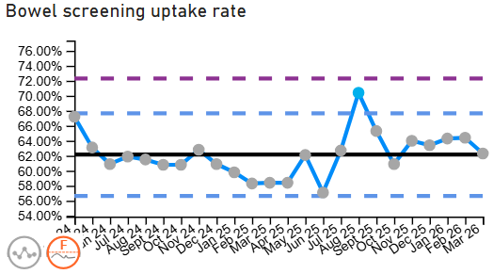
People of Swansea Bay live healthier, fairer and more prosperous lives
Breakthrough Objective: Increase Bowel screening rates in Swansea Bay UHB by 1% | March 2026 Performance | 62.3% (baseline position)
 | How are we doing? There is a six-week lag in reporting Bowel screening uptake rates. Waiting times have improved from 18 weeks to 12 weeks at Singleton/Morriston Sickness absence remains on an improving trajectory. Urgent/routine >8-week backlog reduced from 1,997 patients in Apr 2025 to c.400 by Mar 2026. The SBUHB public health team continue to support Public Health Wales on efforts to enhance the uptake of bowel screening. How do we compare across Wales? The latest official health-board-comparable uptake data is Public Health Wales’ Bowel Screening Wales Annual Statistical Report 2023–24, published January 2026. This identified SBUHB has the lowest uptake rate in Wales. What actions are we taking to improve? We are continuing to provide local insight to Public Health Wales in relation to their range of their target programmes in this area. What are the risks to delivery? The focus of Public Health Wales may be affected by the development of other areas of responsibility through this year, and changes to staffing.

Slide 10
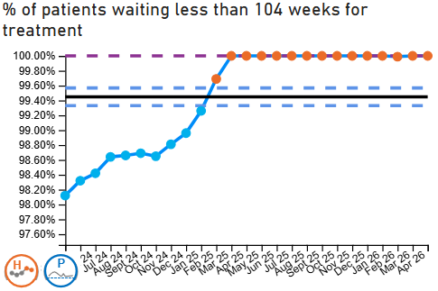
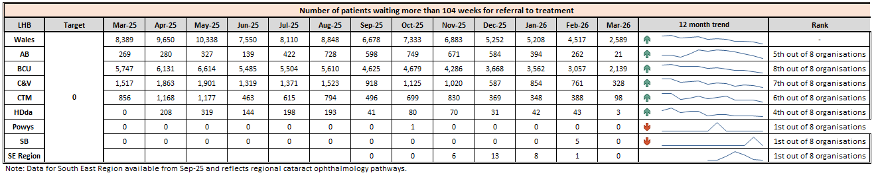
Care is high quality, safe, efficient and delivers the best possible outcomes for people in partnerships
Enhanced Monitoring Target: 100% of open pathways to be waiting less than 104 weeks and maintained for 3 months | April 2026 Performance | 100%
Breakthrough Objective: No patients waiting more than 104 weeks for treatment | April 2026 Performance | 0
 | How are we doing? In April 2026, the Health Board reported 100% of open pathways waiting less than 104 weeks for treatment, maintaining performance against the enhanced monitoring target. How do we compare across Wales? The Health Board remains one of the strongest performing organisations in Wales for the management of 104-week waits and has sustained delivery of the target position over recent months. What actions are we taking to improve? Operational plans to book the remaining 210 patients in the 104-week cohort for Quarter 1 being pursued, enabled by a focus on productivity, 4 joints on a list, treating in turn, and minimising cancellations on the day Revisiting pre-operative element of the pathway, considering role out of pre-op care for older persons service and adherence to the BMI policy to optimise patient’s benefits from surgery to be completed by June 2026. Continuing validation and clinical review processes to identify and address risks, with opportunities of using AI to support the process being explored. What are the risks to delivery? Workforce and capacity pressures impacting timely access to treatment. Increasing demand and pressure on diagnostic and treatment capacity.

Slide 11
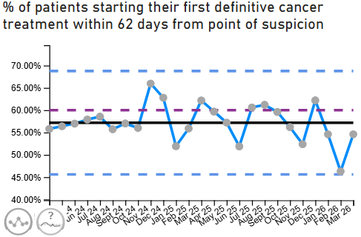
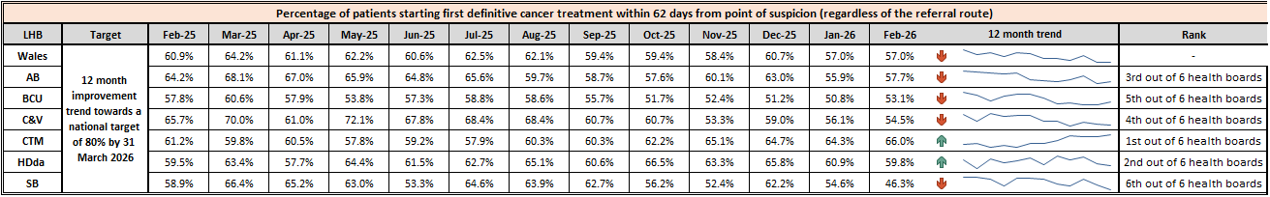
Care is high quality, safe, efficient and delivers the best possible outcomes for people in partnerships
TI Target: 60% performance maintained for 3 months against the SCP target | March 2026 Performance | 55%
Breakthrough Objective: Single Cancer Pathway performance to reach 76% by March 2026
 | How are we doing? The organisation reported an improvement in performance against the SCP target in March 2026, reporting 55% compared with the previous 46% in February. An opportunity for resubmission to reflect a corrected performance for January – March 2026 will be available in August 2026. In the week following submission of February data 40% of the outstanding reports were reported and performance increased to 50% with further improvement expected. Resubmission of October – December 2025 performance demonstrated an uplift to 58% (from 56%), 57% (from 52%), and 63% (from 62%) respectively What actions are we taking to improve? RTT plans have been revisited to ensure that capacity is within the services to achieve a maximum component wait of 4 weeks for treatment and 2 weeks for an urgent appointment. This incorporates theatre timetable redesign, robotic surgery expansion, SACT capacity improvements and targeted workforce support. Reduction of the treatment backlog will start in June and is likely to continue to be required 2 months post management of the pathology backlog reduction. Diagnostic Timeliness - a reduction in waits for imaging, biopsy and endoscopy has been provided for in our diagnostic plans for the year. This includes the outsourcing of the cellular pathology backlog and ongoing maintenance via implementation of cellular Pathology recovery arrangements. The outsourcing is due to start in June. Urology, Lower GI and Skin pathways have been identified as priority operational focus areas during 2026/27 due to the current breach concentration, identified improvement opportunity and anticipated impact on overall SCP performance. A detailed plan has been developed to outline when key improvements are expected at the various stages of the three pathways. Faster Decision to Treat – Pathway deep dives, earlier Multidisciplinary decision making, reduction in administrative delays

Slide 12
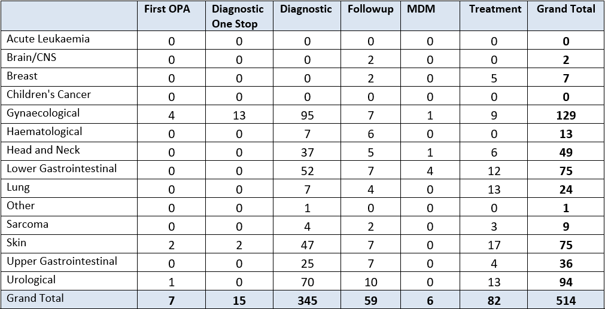
Care is high quality, safe, efficient and delivers the best possible outcomes for people in partnerships
TI Target: 60% performance maintained for 3 months against the SCP target | March 2026 Performance | 55%
Breakthrough Objective: Single Cancer Pathway performance to reach 76% by March 2026
 | What are the risks to delivery? Looking across the whole PTL, there is evidence of increasing volumes at the start of the pathway and diagnostic stage, this is more noticeable in the following tumour sites: Gynaecological, Head & Neck, Skin, Upper GI & Urological. Pathology delays are the primary driver for the increased volumes in diagnostic backlog. Recovery plans are being discussed at Board on 28th May 2026 Seasonal increase in overall skin volumes are beginning to be seen. Healthcare System Engineering Demand & Capacity report findings to be discussed with the COO, date to be agreed. PMB waits currently more than 6 weeks. Plans to decouple the one stop service and increase Outpatient hysteroscopy capacity agreed with Radiology and Gynaecology to commence from 1st June 2026.

Slide 13
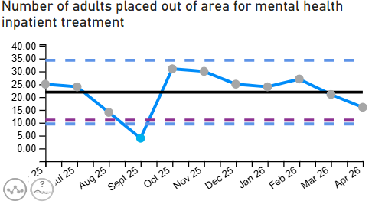
Care is high quality, safe, efficient and delivers the best possible outcomes for people in partnerships
Breakthrough Objective: Reduce the number of adults placed out of area for mental health inpatient treatment by 50% | April 2026 Performance | 16
 | How are we doing? The end of month figure for the number of adults placed out of area for mental health inpatient treatment was 16, in line with the monthly average for the last 12 months of 22. How do we compare across Wales? The use of private beds varies across Health Boards and is based on individual population need and is influenced by local clinical models. Data availability is also reliant on local template completion. What actions are we taking to improve? Private Patient MDT Coordinator in role to ensure oversight of private placements, safe discharge, and accurate financial tracking.​ Weekly scrutiny meetings are in place within the Adult Directorate, alongside discharge planning meetings.​ A safe holding space in NPTH is being utilised and staffed to provide overnight capacity.​ Options to increase Home Treatment Team capacity and dedicated consultant input for outlying patients within our services and those in private placements under development. MDT approach to revising discharge pathways for male patients, and in future female patients, where there is no local low secure or rehabilitation provision and delays due to patients no longer meeting the criteria to reside have been extended.​ the Adult, Secure Services and Rehabilitation Divisions regarding Home Treatment Team staffing levels are to be reviewed to ensure we are supporting as many people as possible to remain out of hospital. What are the risks to delivery? Inpatient consultant proposals have been put forward for consideration to mitigate risk. Discharges from acute wards rely on suitably qualified Approved Clinicians (ACs) and Section 12-approved medical staff. Staffing to date has been fragile, and strengthening this area will help protect flow.​

Slide 14
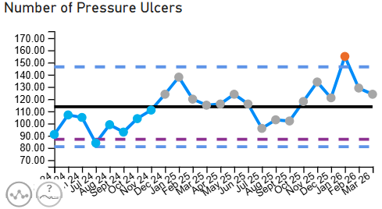
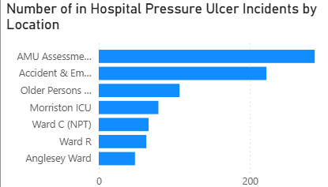
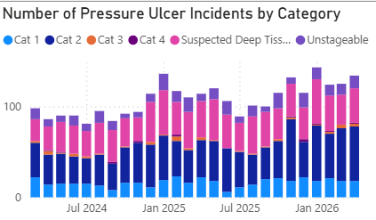
Care is high quality, safe, efficient and delivers the best possible outcomes for people in partnerships
Breakthrough Objective: 30% reduction in avoidable pressure ulcers | March 2026 Performance | 124 (unvalidated position)
 | How are we doing? Swansea Bay University Health Board (SBUHB) has experienced an increase in reported healthcare-acquired pressure ulcers over the past four years, including a 41% rise in deep tissue damage (Category 3, 4 and unstageable). This trajectory presents a significant patient safety concern. In response, pressure ulcer prevention is now a Health Board Quality Target, supported by a zero-tolerance approach to avoidable harm. Current Harm Profile (Q3 to date: Nov–Jan) Note: Data is subject to change due to a backlog in scrutiny panel validation; accuracy is improving but not yet fully assured for quarter 4 period. 87% superficial harm 13% deep tissue damage (increasing trend) 3% severe harm Current classification indicates: 75% deemed unavoidable 52% (106 incidents) closed without an avoidability status have been reopened.
What actions are we taking to improve? Governance & Assurance - Pressure Ulcer Strategic Improvement Group established, Standardised scrutiny panels aligned to national frameworks, Improved incident closure rates and data quality validation and Service Group-level bespoke Quality Improvement Plans have been developed Clinical Practise and Systems - Implementation of standardised prevention pathways and policies (All Wales alignment), centralised Tissue Viability Service model, Rollout of digital wound imaging (Improvement Cymru), progression of equipment provision (including bed contract) and development of specialist neonatal prevention pathways Workforce & Education - Multi-modal education programme (face-to-face, virtual, video), targeted hotspot training in high-risk areas, Band 6/7 leadership development, Pre-registration Tissue Viability skills training, Tissue Viability Champions network and MDT complex wound forums Audit & Improvement Culture - Health Board-wide tissue viability audits, documentation and care quality reviews, peer review and shared learning processes and Staff engagement campaign: “Pressure Ulcer Superhero League 2026” What are the risks to delivery? High patient acuity and vulnerability, especially within first 72 hours of admission Variation in staff capability and consistency of risk management practices Delays in access to pressure-relieving equipment Gaps in specialist tissue viability support and training Incomplete digital documentation affecting timely or risk identification System pressures are delaying scrutiny and learning processes Misclassification of the aetiology of wound or categorisation of pressure ulcer

Slide 15
Care is high quality, safe, efficient and delivers the best possible outcomes for people in partnerships
Complaints
What is the data telling us?
Graph 1 – is indicating that a number of complaints are not compliant with the 30 working day target for responding to formal complaints in line with the Putting Things Right Guidance.
Graph 2 – 73 new formal complaints in April which is a decrease compared to 197 in March and following the introduction of Listening to People.
Graph 3 - The average number of days taken to close a formal complaint has increased by 2 working day compared to the previous month. Average days for February being 31 days which is over the Welsh Government target of 30 working days.
Graph 4 - The number of overdue formal complaints has increased. As of the 27th April 2026, 344 formal complaints were overdue
Graph 5 – The number of Early Res LtP received in April
What are we doing about it?
Weekly report run on all overdue complaints which is sent to each Service Groups requesting updates.
Bi-weekly drop-in sessions where complaint handlers can join to discuss any issues.
Bi-weekly meetings with Service Groups to discuss open complaints and Ombudsman cases.
Corporate are supporting individual service groups with the aim of reducing the number of overdue complaints
Reviewing low graded complaints with a view of setting up hot clinic in the service groups with the aim of resolving in a more timely manner
7 complaints are over 12 months, 2 are currently awaiting external review, 25 over 6 months corporate services are working with service groups to reduce these numbers
What do we expect to see change and when?
Early engagement with the complainant combined with listening meetings which will support an empathetic and compassionate handling of the complaint.
**Please note two graphs only go up as far as February, this is due to the 30 working days for complaints received in March/April not being up yet

Slide 16
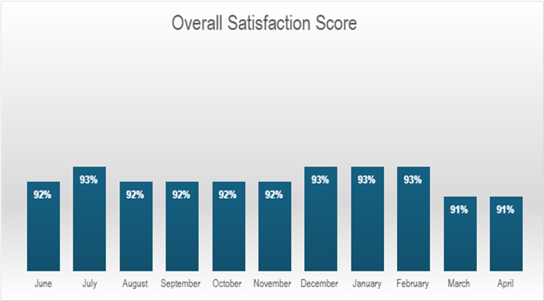
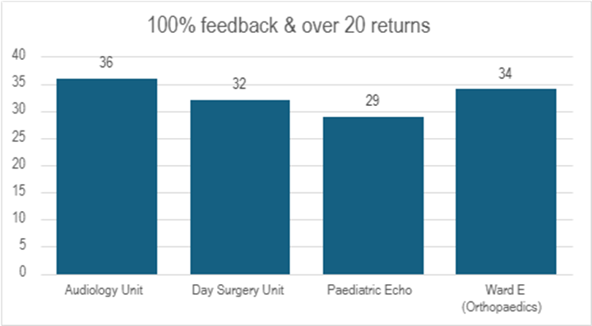
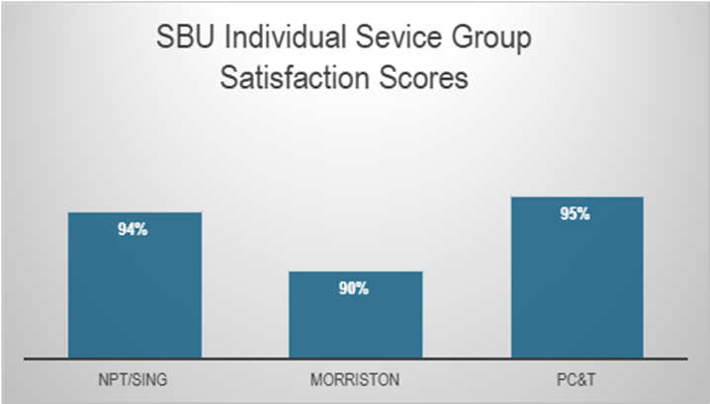
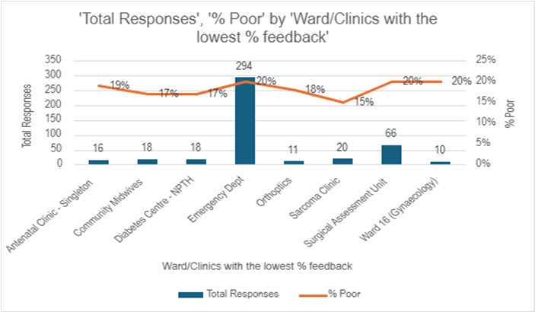
Care is high quality, safe, efficient and delivers the best possible outcomes for people in partnerships
Patient Experience
Graph 1
Graph 3
What is the data telling us?
Graph 1 – Illustrates that Swansea Bay UHB’s overall score consistently exceeds the benchmark of 85%, maintaining a performance of 90% or higher.
Graph 2 – Displays the overall satisfaction scores across the different Service Groups.
Graph 3 – Highlights wards/clinics achieving scores above 100%, based on more than 30 responses..
Graph 4 – Identifies the wards/clinics with the lowest satisfaction percentages..
What are we doing about it?
The system generates weekly feedback summaries for Service Group Leads, enabling timely action on low scores and recognition of positive feedback and comments.
Ongoing drop-in feedback sessions are held to support teams in using Civica effectively and managing their feedback constructively.
For alerts flagged as very poor or poor, the Action Manager is triggered. This tool tracks the progress and resolution of issues within Civica, managed by the PALS and Quality & Safety departments.
What do we expect to see change and when?
We expect departments to take ownership of their low scores and implement improvements based on the feedback provided. Our role is to ensure timely alerts and supply weekly comment reports to support this process.
.
Graph 2
Graph 4

Slide 17
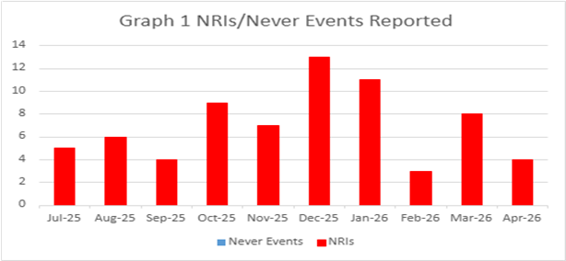
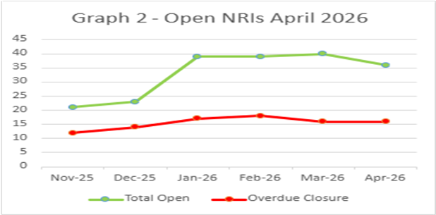
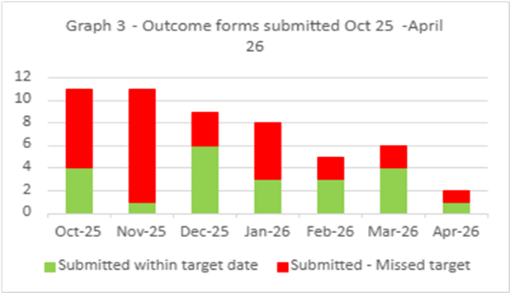
Care is high quality, safe, efficient and delivers the best possible outcomes for people in partnerships
Nationally Reported Incidents/Never Events/Early Warning Notice
What is the data telling us?
Graph 1 – Number of NRIs / NE’s reported to P&I – 4 (includes retrospective reporting of 1 avoidable pressure damage; 3 Must Reports (1 neonatal death; 2 stillbirths)
Graph 2 – 36 NRIs open with NHSWP&I of which 16 are open past closure date (8 awaiting outcome external reviews; 2 x under investigation. 6 x outcome forms awaited from service groups)
Graph 3 – 1 outcome form submitted in month - 100% performance. A downgrade form submitted outside anticipated decision / closure date
What are we doing about it?
Weekly review with PSI investigator to:
  monitor progress of corporate investigations; identify barriers
  escalate outstanding actions required
Fortnightly service group meetings:
  service group investigations - progress towards closure date discussed
  updates on PSI investigation given
  escalate to service group barriers identified with corporate PSI investigations
Service Group Directors contacted separately for outstanding actions
Data presented and discussed at health board Patient Safety and Compliance Group; Quality and Safety Group; Patient Stakeholder and Experience Group - Service Group assurance sought against outstanding actions for completion of investigation / outcome form
What do we expect to see change and when?
Reduction in number of overdue investigation outcomes forms
Reduction in number of NRIs/NEs reported through recommendations/learning monthly
EWNs – April 2026
Employment position for SBU Student Midwives
National shortage of dinoprostone (Prostin® E2) vaginal tablets and gel used for induction of labour
Reconvened NMC Hearing – Registered Nurse misconduct July 2023
Infection outbreak declared – CPO several clinical areas
Potential patient harm – insourcing company
Potential media interest - patient open to secondary mental health services and subject to Section 117 aftercare, who died via euthanasia in Switzerland

Slide 18
Care is high quality, safe, efficient and delivers the best possible outcomes for people in partnerships
Learning from Nationally Reported Incidents
Three nationally reportable incident closure forms were submitted in April 2026:
Learning from these include:-
Staff new to working in the prison environment require robust induction and support
Clear support and guidance is needed by staff who are new to working in an environment where there may be opiate overdose
When opiate dosage increases, patients need to be clear on risks if they do not take medication as prescribed or take additional substances
Incorrect identification of pressure damage as a moisture lesion
The impact of staffing gaps on capacity within the District Nursing service
The need to strengthen communication between services and GP Out of hours, particularly at weekend periods.

Slide 19
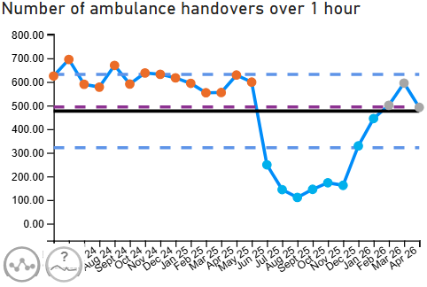
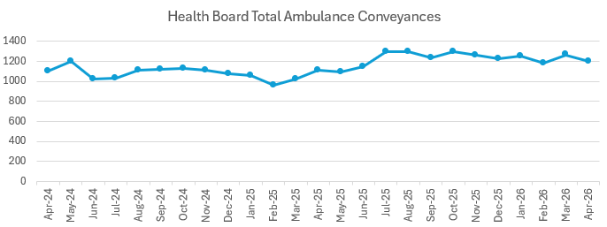
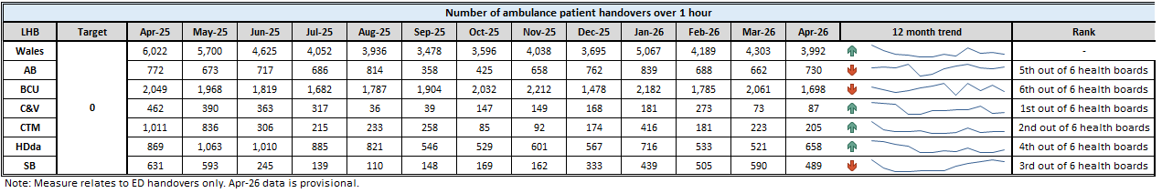
Level 4 - Unscheduled Care Performance
Care is high quality, safe, efficient and delivers the best possible outcomes for people in partnerships
TI Target: Continuous reduction of ambulance handovers over an hour of at least 11% in three consecutive months and maintained for 3 months (Based on Q2/Q3 2023 baseline | April 2026 Performance | 492 (17.3% reduction)
Annual Plan ambition: 0 ambulance handovers > 45 minutes from September 2026
 | How are we doing? In April 2026, the organisation reported a reduction in the number of ambulance handovers over one hour, reporting the first improvement in figures in almost six months. What actions are we taking to improve? Development of a single point of access to manage ambulance demand and to reduce 111 demand into the emergency department. Plan to implement by 1st July 2026. PDSA commencing 18th May 2026 to introduce clinical conversation before conveyance (CCBC) for all care home residents with a view to appropriate redirection and to reduce conveyance to hospital. Scoping development of a pathway 1 bridging team to enable discharge of this patient cohort and therefore release capacity. Redesigning frailty assessment service aimed at direct access and a target of 20 assessments per day from the medical intake. (discharge rate aimed at 40%) UEC improvement group exploring cohorting of pathway 3 patients to reduce assessment timescales and therefore length of stay What are the risks to delivery? Limited opportunity to invest into services, however redeployment of existing resources will be prioritised to deliver key elements of the UEC program. The level of staff engagement and potential use of the OCP policy to realise staff realignment.

Slide 20
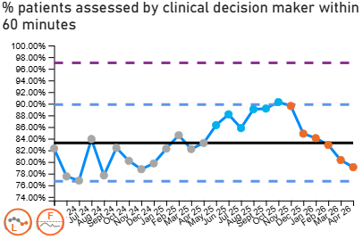
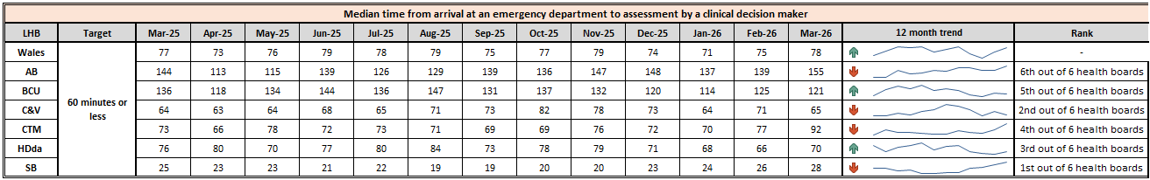
Level 4 - Unscheduled Care Performance
Care is high quality, safe, efficient and delivers the best possible outcomes for people in partnerships
TI Target: Median time from arrival at emergency department to assessment by a clinical decision maker should not exceed 60 minutes | April 2026 Performance | 79.11%
 | How are we doing? In April 2026, the organisation reported a reduction in the percentage of patients assessed by a clinical decision maker within 60 minutes, reporting 79.11%. The Health Board have been reporting this measure in relation to when patients are triaged, in comparison to other Health Boards who have been accurately recording the appropriate criteria due to data availability. What actions are we taking to improve? It is important to note that the current measure relates to triage, however as of 11th May 2026, a digital solution has been implemented in order that this measure can be appropriately reported. We are currently testing the rapid decision-making process in the department and overall we are trying to reduce demand into the emergency department through the single point of access work. What are the risks to delivery? Ability to reorganise the workforce and rotas to meet demand (junior medical staff have parameters set out by HEIW in terms of intensity and frequency of working patterns.

Slide 21
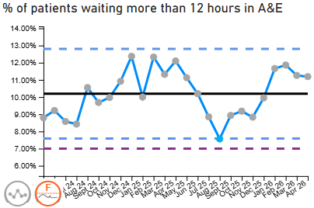
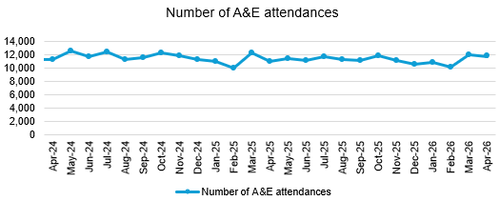
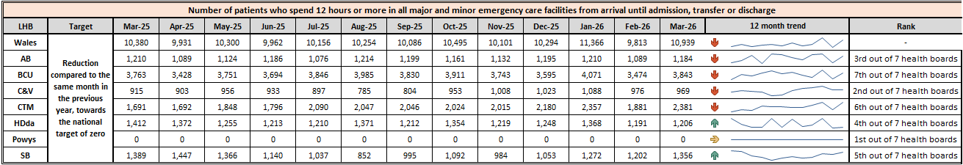
Care is high quality, safe, efficient and delivers the best possible outcomes for people in partnerships
TI Target: Continuous improvement towards no more than 7% of patients waiting over 12 hours at each individual site and across HB | April 2026 Performance | 11.19%
Breakthrough Objective: Reduce the number of patients waiting in ED for over 12 hours by 10% | April 2026 Reduction against March 2026 Baseline | 2.7% reduction against baseline
 | How are we doing? In April 2026, 1,319 patients, which is 11.2% of all attendances were waiting more than 12 hours in the Emergency Department, in line with the 2 year average of 10.2% What actions are we taking to improve? Testing of rapid assessment and decision-making models within the emergency department. Development of a single point of access to manage ambulance demand and to reduce 111 demand into the emergency department. Plan to implement by 1st July 2026. PDSA commencing 18th May 2026 to introduce clinical conversation before conveyance (CCBC) for all care home residents with a view to appropriate redirection and to reduce conveyance to hospital. Scoping development of a pathway 1 bridging team to enable discharge of this patient cohort and therefore release capacity. Redesigning frailty assessment service aimed at direct access and a target of 20 assessments per day from the medical intake. (discharge rate aimed at 40%) UEC improvement group exploring cohorting of pathway 3 patients to reduce assessment timescales and therefore length of stay What are the risks to delivery? Limited opportunity to invest into services, however redeployment of existing resources will be prioritised to deliver key elements of the UEC program. The level of staff engagement and potential use of the OCP policy to realise staff realignment.

Slide 22
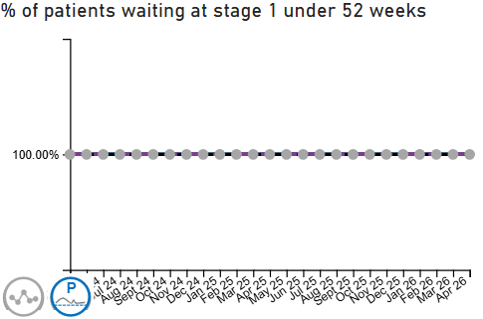
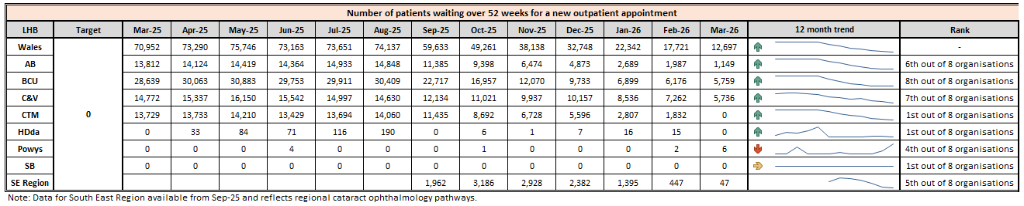
Level 4 – Planned Care Performance
Care is high quality, safe, efficient and delivers the best possible outcomes for people in partnerships
Enhanced Monitoring Target: 100% of open outpatient pathways to be waiting less than 52 weeks and maintained for 3 month | April 2026 Performance | 100%
 | How are we doing? In April 2026, the Health Board reported 100% of open outpatient pathways were waiting less than 52 weeks. How do we compare across Wales? We are currently the only organisation that has maintained the 100% target for 52 weeks over the last year as seen in the comparative table below. What actions are we taking to improve? Reviewing clinic utilisation, slot allocation and template variation across specialties. Using learning from recent targeted improvement work to develop a more standardised approach to clinic template design across services. Strengthening validation and demand/capacity monitoring processes to support sustainable performance. Continuing regular operational oversight to identify risks to pathway waits at the earliest opportunity. What are the risks to delivery? Workforce availability and unplanned reductions in clinical capacity. Increasing referral demand

Slide 23
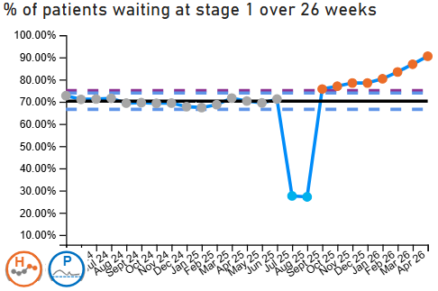
Level 4 - Planned Care Performance
Care is high quality, safe, efficient and delivers the best possible outcomes for people in partnerships
Enhanced Monitoring Target: Continuous improvement towards 75% of all open outpatient pathways waiting less than 26 weeks | April 2026 Performance | 90.51%
 | How are we doing? In April 2026, the Health Board reported 90.51% of open outpatient pathways were waiting less than 26 weeks. What actions are we taking to improve? Continuing focused work to reduce longer waits through demand and capacity oversight. Reviewing outpatient clinic utilisation and template variation across specialties to support improved access and consistency. Using learning from recent improvement initiatives to support a standardised approach to clinic template configuration across services. Strengthening validation and pathway monitoring processes to support sustainable recovery performance. What are the risks to delivery? Increasing referral demand and pressure on available outpatient capacity. Workforce availability, including vacancies, sickness and annual leave pressures.

Slide 24
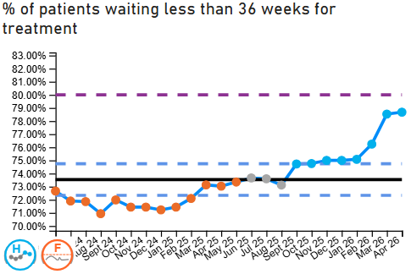
Level 4 - Planned Care Performance
Care is high quality, safe, efficient and delivers the best possible outcomes for people in partnerships
Enhanced Monitoring Target: Continuous improvement towards 80% of all open pathways waiting less than 36 weeks | April 2026 Performance | 78.69%
 | How are we doing? In April 2026, the Health Board reported 78.69% of open pathways were waiting less than 36 weeks. How do we compare across Wales? The Health Board continues to demonstrate sustained improvement in the percentage of patients waiting less than 36 weeks for treatment and is performing close to the enhanced monitoring target trajectory when compared with the all-Wales position What actions are we taking to improve? Continuing targeted work with specialties to reduce longer waits and improve pathway flow. Reviewing clinic utilisation, scheduling practices and capacity variation across services. Maintaining demand and capacity oversight arrangements to support sustainable trajectory improvement. What are the risks to delivery? In order to deliver the 104 week access standard and reduce costs uniformly across the board, resources may need to be re-allocated from specialties with shorter waiting times to those with longer waits. Increasing referral demand and pressure on treatment capacity. Workforce availability and reduced resilience due to vacancies, sickness or annual leave.

Slide 25
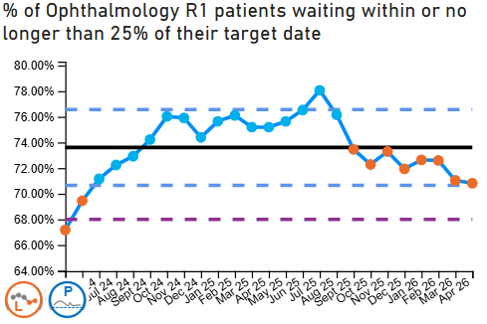
Level 4 - Planned Care Performance
Care is high quality, safe, efficient and delivers the best possible outcomes for people in partnerships
Enhanced Monitoring Target: 68% R1 ophthalmology patient pathways to be waiting within or no longer than 25% of their target date for an outpatient appointment and maintained for 3 months | April 2026 Performance | 70.82%
 | How are we doing? In April the Health Board reported 70.82% of Ophthalmology patients were waiting within or no longer than 25% of their target date, this is a slight deterioration on the previous months performance. What actions are we taking to improve? The Health Board continues to deliver above the 68% de-escalation target and is consistently mitigating the risks outlined below to work towards achieving the national target. What are the risks to delivery? Workforce pressures, including consultant and non-medical workforce vacancies, sickness and reduced clinic availability. Competing operational pressures impacting the ability to release additional outpatient capacity.
​ | Feb​ | March​ | Apr ​ | Risks ​
Vitreoretinal​ | 71%​ | 72%​ | 66%​ | Limited VR workforce limiting clinic capacity. ​
Cataract​ | 75%​ | 60%​ | 57%​ | Core Pre-Assessment capacity does not meet current demand. 3.0 WTE Band 4 vacancies. ​
Cornea​ | 48%​ | 50%​ | 51%​ | Backlogs with both news and follow-ups. Only 1 Cornea Consultant within the department. ​
Orthoptics​ | 69%​ | 69%​ | 78%​ | Workforce gaps in clinical and admin staff ​
Paediatrics ​ | 68%​ | 57%​ | 53%​ | R1 backlog mainly consists of new referrals.​ ​
Diabetic Retinopathy ​ | 93%​ | 75%​ | 70%​ | R1 backlog consists mainly of follow up patients. ​
Glaucoma ​ | 78%​ | 74%​ | 72%​ | 2 Consultant vacancies since June 2025. ​ Considerable risk – on service Risk Register since June 2025. ​

Slide 26
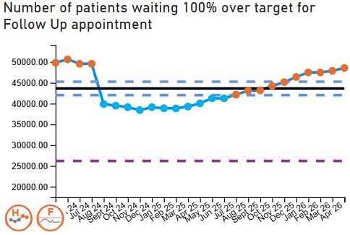
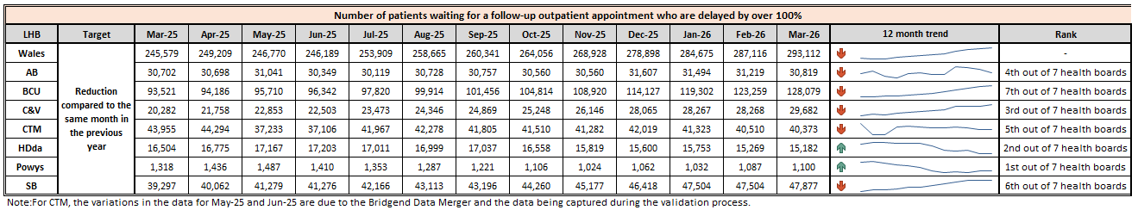
Level 4 - Planned Care Performance
Care is high quality, safe, efficient and delivers the best possible outcomes for people in partnerships
Enhanced Monitoring Target: 12% reduction in the number of patients delayed by 100% for their follow up appointment in three consecutive months and maintained for 3 months (Based on the November 2024 baseline.) | April 2026 Performance | 26.35% (above the baseline)
 | How are we doing? In April 2026, the Health Board reported 26.35% performance against the enhanced monitoring trajectory for follow-up waits. Although some improvement work has been undertaken, performance remains below the required target and follow-up pressures continue across a number of specialties. What actions are we taking to improve? Continuing targeted validation and review of follow-up waiting lists to ensure clinical prioritisation and pathway accuracy. Implementing recommendations arising from GIRFT/CIN improvement work to reduce unwarranted variation in follow-up management practices. Reviewing clinic utilisation, follow-up scheduling and capacity variation across specialties. What are the risks to delivery? Workforce pressures, including vacancies, sickness and reduced clinic availability. Competing operational pressures impacting the ability to release additional outpatient capacity.

Slide 27
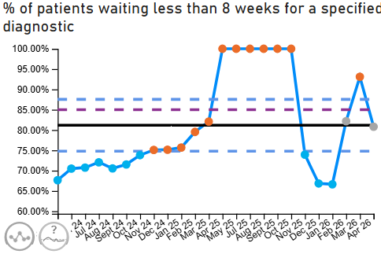
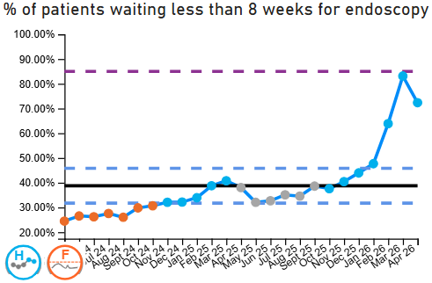
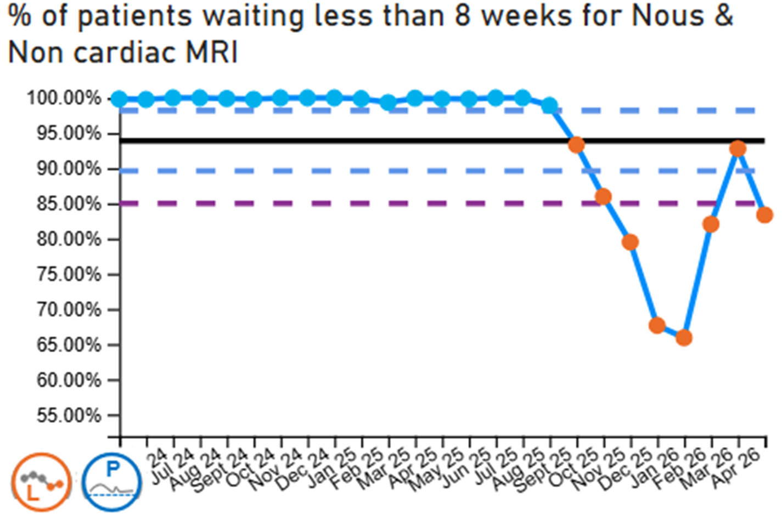
Level 4 - Planned Care Performance
Care is high quality, safe, efficient and delivers the best possible outcomes for people in partnerships
Care is high quality, safe, efficient and delivers the best possible outcomes for people in partnerships
Enhanced Monitoring Target: 85% of patients waiting for a diagnostic test to be waiting less than 8 weeks and maintained for 3 months | April 2026 Performance | 80.81%
Enhanced Monitoring Target: 85% of patients waiting for a diagnostic endoscopy to be waiting less than 8 weeks and maintained for 3 month | April 2026 Performance | 72.36%
Enhanced Monitoring Target: 85% of patients waiting for a NOUS and non cardiac MRI to be waiting less than 8 weeks and maintained for 3 months. | April 2026 Performance | 83.36%
How are we doing?
In April 2026, the organisation reported:
A decline in performance against the percentage of patients waiting less than 8 weeks for a diagnostic test, with the percentage decreasing to 80.81% compared to 93.11% in March 2026. This follows the cessation of most additional schemes at the end of March, which were supporting the UHB meet both backlog and recurrent demand.
497 patients waiting over 8 weeks for a diagnostic endoscopy, which is an increase on the number of patients waiting over 8 weeks which was recorded in March 2026. The increase in capacity is a result of the additional In Health mobile unit capacity being stopped at the end of the financial year as a result of funding constraints. A reduction in clinical vetting has also come to an end due to loss of funding.
1,207 patients waiting over 8 weeks for NOUS and non-cardiac MRI, which is an increase on the 481 patients reported in March 2026. deterioration in the position is for two reasons: cessation of additional activity over core and the late convergence of patients from HBSUK clinics

Slide 28
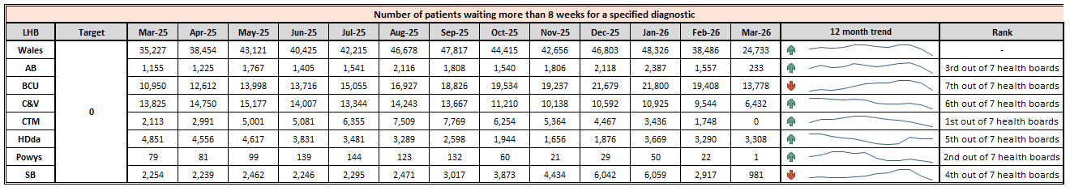
Level 4 - Planned Care Performance
Care is high quality, safe, efficient and delivers the best possible outcomes for people in partnerships
Care is high quality, safe, efficient and delivers the best possible outcomes for people in partnerships
Enhanced Monitoring Target: 85% of patients waiting for a diagnostic test to be waiting less than 8 weeks and maintained for 3 months | April 2026 Performance | 80.81%
Enhanced Monitoring Target: 85% of patients waiting for a diagnostic endoscopy to be waiting less than 8 weeks and maintained for 3 month | April 2026 Performance | 72.36%
Enhanced Monitoring Target: 85% of patients waiting for a NOUS and non cardiac MRI to be waiting less than 8 weeks and maintained for 3 months. | April 2026 Performance | 83.36%
How do we compare the rest of Wales
What actions are we taking to improve?
Following demand and capacity reviews, recurring deficits have been identified in Colonoscopy, Gastroscopy, MRI, NOUS and CT.
Actions to increasing activity through productivity to levels expected from core services in 2024/25 are being pursued, such as better management of late notice cancellations & DNA reduction.
The £34m allocation the UHB received to support services recover post Covid is being reviewed, to determine how these moneys can most effectively be deployed. It is anticipated that there is sufficient funding to maintain 8 weeks from within the diagnostic element of this pool if the productivity challenge is met.
What are the risks to delivery?
Absenteeism of the work force which reduces our capacity to deliver
Rising demand resulting from changes in clinical guidelines and clinical practices
Current data validity issues are being experienced as a result of the RISP data function which is currently not operating and has had multiple operational issues since its installation. Manual downloads are currently being used as an alternative method.

Slide 29
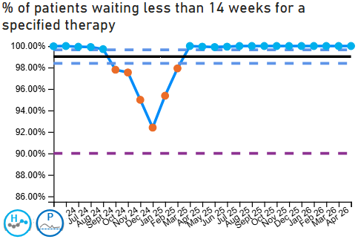
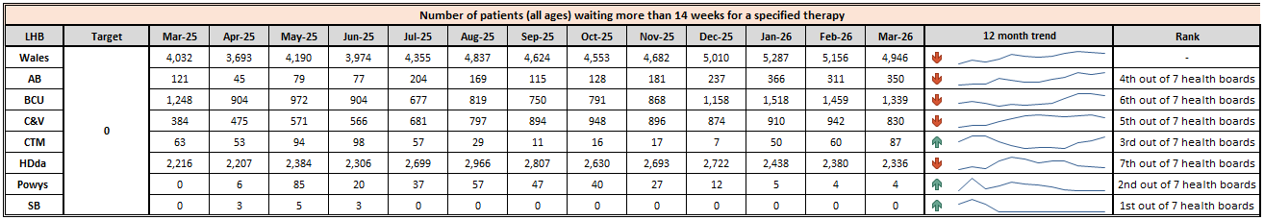
Level 4 - Planned Care Performance
Care is high quality, safe, efficient and delivers the best possible outcomes for people in partnerships
Enhanced Monitoring Target: 90% of patients waiting for therapies to be waiting less than 14 weeks and maintained for 3 months | April 2026 Performance | 100%
 | How are we doing? Therapies services remain fully compliant with the escalation target, with sustained 100% delivery since July 2025. Performance is closely monitored, and assurance processes are firmly embedded to maintain this position. How do we compare across Wales? Our performance remains strong across all therapy professions when compared across Wales. All adult and children/young people therapy services in SBUHB have consistently met the escalation standard and demonstrate a stable position relative to peers. What actions are we taking to improve? We continue to maintain robust capacity and demand management alongside effective job planning, refining these arrangements to ensure alignment with activity. In parallel, we are improving access routes and pathways to better empower patients, support self-management where appropriate, provide advice to stakeholders (e.g. schools), and optimise use of available capacity What are the risks to delivery? The principal risk to sustained delivery is any reduction in available capacity against a backdrop of sustained or increasing demand. There is also a need to manage clinical risk across the pathway, for example follow-up appointments. These risks are being actively managed through workforce planning, easy and early access and advice, prioritisation, and continued validation and oversight of demand trends.

Slide 30
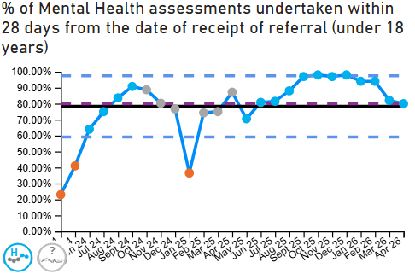
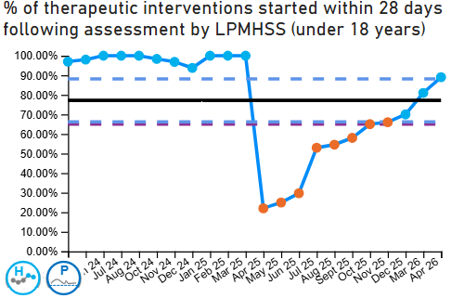
Level 3 – CAMHS
Care is high quality, safe, efficient and delivers the best possible outcomes for people in partnerships
Enhanced Monitoring Target: 80% of LPMHSS mental health assessments undertaken within 28 days from the date of receipt of referral | April 2026 Performance | 80%
Enhanced Monitoring Target: 70% of therapeutic interventions started within 28 days following an assessment by LPMHS | April 2026 Performance | 89%
Enhanced Monitoring Target: 85% of HB residents in receipt of secondary mental health services who have a valid care and treatment plan | April 2026 Performance | 88%
 | How are we doing? We have consistently met all CAMHS de-escalation criteria for several months, which reflects positively on our current performance. Our team’s efforts have been instrumental in achieving and maintaining these standards. When comparing our performance across Wales, we continue to perform strongly in many areas. The 1B target for CAMHS is back into its national target for delivery of 80% as well as the Enhanced Monitoring target of 70%. How do we compare across Wales? Our performance is broadly comparable with other health boards in Wales across all areas. Nonetheless, there remains scope for further enhancement, particularly in domains where national targets are only just being achieved. Ongoing internal scrutiny is maintained to ensure that performance standards continue to be raised wherever possible. What actions are we taking to improve? To sustain this level of performance, the service are focusing on several actions: Actively monitoring key indicators, regularly reviewing processes, and providing ongoing training and support for our staff. Staffing levels are being reviewed and additional clinical capacity has been sought and secured to make delivery of targets sustainable for the future. Engaging with stakeholders to identify further opportunities for improvement and ensuring early intervention where needed What are the risks to delivery? There are some risks to delivery that we need to be mindful of. These include staffing challenges, increasing demand for services, and potential changes in funding long term. The service is working proactively to mitigate these risks.

Slide 31
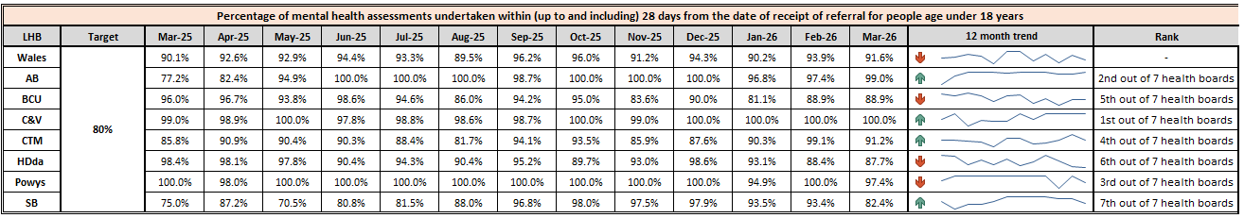
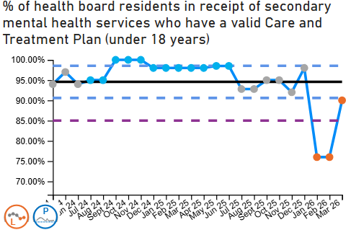
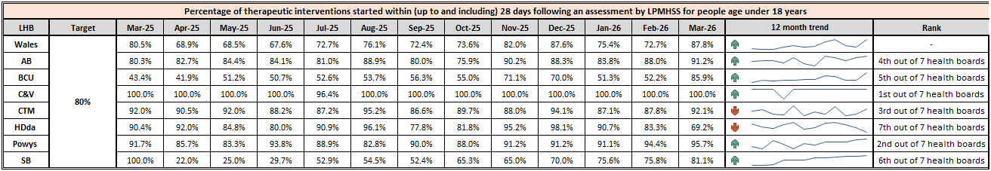
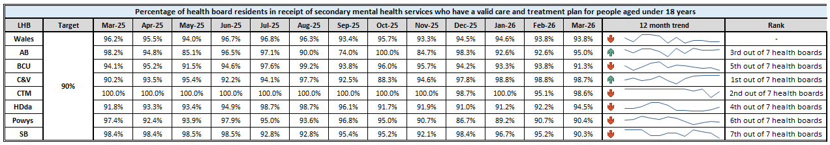
Level 3 – CAMHS
Care is high quality, safe, efficient and delivers the best possible outcomes for people in partnerships
Enhanced Monitoring Target: 80% of LPMHSS mental health assessments undertaken within 28 days from the date of receipt of referral | April 2026 Performance | 80%
Enhanced Monitoring Target: 70% of therapeutic interventions started within 28 days following an assessment by LPMHS | April 2026 Performance | 89%
Enhanced Monitoring Target: 85% of HB residents in receipt of secondary mental health services who have a valid care and treatment plan | April 2026 Performance | 88%

Slide 32
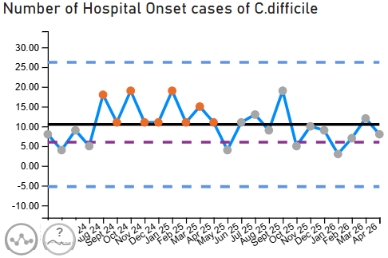
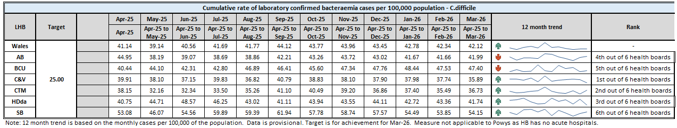
Level 4 - Planned Care Performance
Care is high quality, safe, efficient and delivers the best possible outcomes for people in partnerships
Enhanced Monitoring Target: C-Diff: reduce the number of hospital onset infections by 40% and maintain for 3 months (from a baseline of the average number of cases in quarter 3 of 10 cases to no more than 6 per month | April 2026 Performance | 8 cases
 | How are we doing? April 2026 - 8 cases, previous month - 12 cases, equivalent period in April 2025 - 11 cases. How do we compare across Wales? (All-Wales incidence 43.83/100,000) SBUHB has the second highest incidence rate of all acute health boards. April 2026 - 53.08 /100,000. What actions are we taking to improve? Gold IMT, SG case reviews, antibiotic stewardship audits including vascular surgery, mental health self harm prescribing, hospital acquired pneumonia (HAP) audits, IV to oral switch and asymptomatic C. diff screening study in AMU Morriston, HEPMA & SIGNAL integration for prescribing/ review prompts. Cleaning - Gap analysis on 2025 NSOC standards, a trial of microfibre cleaning system, purchasing new UV-C equipment, cleaning staff recruitment. What are the risks to delivery? Increased infection risk to service users: over crowding, bed spacing, single room availability, ratio of toilets: service users, lack of ventilation, patient acuity, co-morbidities, older inpatient populations, increasing number of clinically optimised service users. Risks impacting of cleaning provision: over occupancy, reduced bed spacing, cleaning staff retention and recruitment, funding, lack of decant facility, ageing estate.
Notes:
Update chart

Slide 33
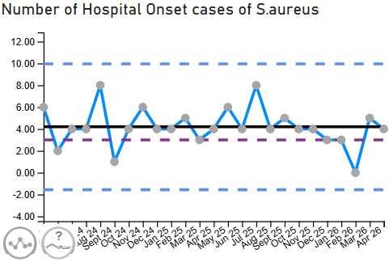
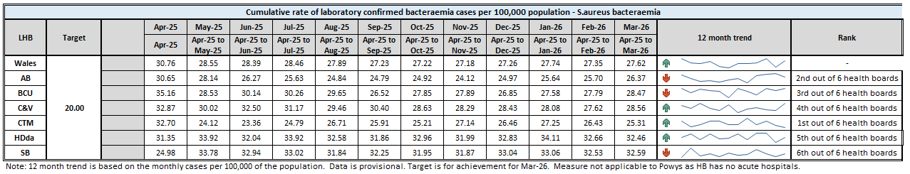
Level 4 - Planned Care Performance
Care is high quality, safe, efficient and delivers the best possible outcomes for people in partnerships
Enhanced Monitoring Target: Staph aureus: reduce the number of hospital onset infections by 25% and maintain for 3 months (from a baseline of the average number of cases in quarter 3 of 4 cases to no more than 3 per month | April 2026 Performance | 4 cases
 | How are we doing? April 2026 – 4 cases, March 2026 - 6 cases, April 2025 – 4 cases. How do we compare across Wales? (All-Wales incidence 33.83/100,000) SBUHB has the second lowest Incidence compared to other acute health boards in Wales. April 2026 - 18.74/100,000 What actions are we taking to improve? Focus on asepsis, audits on invasive device presence and Chlorhexidine impregnated wash cloth use. What are the risks to delivery? Adherence with ANTT, invasive device presence and monitoring, service user acceptance of skin decolonisation wipes
Notes:
Update chart

Slide 34
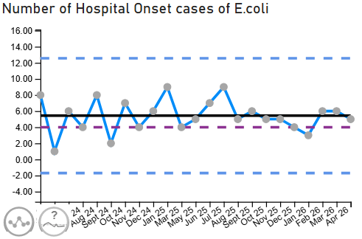
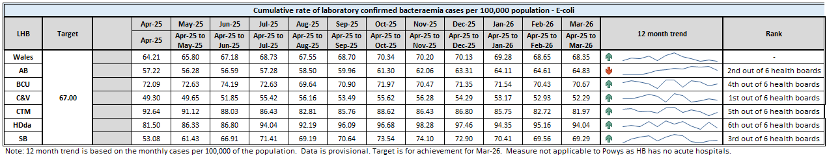
Level 4 - Planned Care Performance
Care is high quality, safe, efficient and delivers the best possible outcomes for people in partnerships
Enhanced Monitoring Target: E-coli: reduce the number of hospital onset infections by 20% and maintain for 3 months (from a baseline of the average number of · cases in quarter 3 of 5 cases to no more than 4 per month) | April 2026 Performance | 5 cases
 | How are we doing? April 2026 – 5 Hospital Onset cases, April 2025 – 6 HO cases. March 2026 – 6 HO cases How do we compare across Wales? (All-Wales incidence - 68.44/100,000). SBUHB has the second lowest incidence. April 2026 – 62.45/100,000. What actions are we taking to improve? Actions to improve quality of urine sampling, appropriate diagnosis and focus on reducing unnecessary invasive device presence. Care home work to reduce urinary tracts infections. What are the risks to delivery? Patient factors linked to risk of developing urinary tract infections and hepatobiliary disease are often a source of E. coli bacteraemia episodes. A number of hospital onset cases manifest shortly after admission but the source of the bacteraemia may be community acquired.
Notes:
Update chart

Slide 35


Level 4 - Planned Care Performance
Care is high quality, safe, efficient and delivers the best possible outcomes for people in partnerships
Enhanced Monitoring Target: Klebsiella: reduce the number of hospital onset infections by 10% and maintain for 3 months based on 2017/18 figures (baseline –54 cases in 2017/18, reduce to average of at most 4 per month) | April 2026 Performance | 9 cases
 | How are we doing? April 2026 – 9 Hospital Onset cases, April 2025 – 4 HO cases. March 2026 – 4 HO cases How do we compare across Wales? ( All –Wales incidence 22.68/100,000) SBUHB has the highest incidence (more than double the incidence of the 2nd highest acute health board). April 2026 – 46.84/100,000. What actions are we taking to improve? Actions to improve quality of urine sampling, appropriate diagnosis and focus on reducing unnecessary invasive device presence. What are the risks to delivery? The increasing incidence of hepatobiliary disease in the population of Wales, Klebsiella spp. bacteraemia are often associated with hepatobiliary source.
Notes:
Update chart

Slide 36

Targeted Intervention (Level 4) – Maternity & Neonates
Criteria to Achieve | Current Performance
Ensure that the recommendations and actions in the Independent Review are progressed in line with agreed timescales and report progress to Welsh Government monthly, highlighting risks to delivery. | Perinatal improvement programme has been established Dec 2025 Exec led workstreams are underway Dec 2025 Quarterly Perinatal updates to Board ongoing Perinatal Improvement Programme agreed in principle by Health Board Jan 2026; final revisions by Independent Oversight Panel be incorporated and approved at May 2026 Health Board.
Ensure that the agreed actions in the family-led review into Swansea Bay maternity services are progressed in line with agreed timescales and report progress to Welsh Government monthly, highlighting risks to delivery. | The agreed actions of the family led review have been integrated to the Independent Review improvement plan – Jan 2026 Reporting to Welsh Government on quarterly basis, additional independent assessment reported by Independent Observer to Cabinet Secretary on quarterly basis.
Receive a positive assessment from the Welsh Government independent observer on progress against the agreed maternity and neonatal action plan. | Complete Positive assessment received on 31 March 2026, full response to be brought to Health Board meeting in May 2026.
Agree a set of sustainability conditions with Welsh Government that can be used to track improvements. | Have developed Perinatal reporting to Board through Quality & Safety committee Jul 2025 Routinely reviewing staff retention and well-being plan – revised plan signed off Jan 2026 Pulse surveys underway – quarterly Robust Governance processes in place – Dec 2025
Evidence effective Board scrutiny and oversight of maternity and neonatal services. | Complete Governance structure in place – July 2025; updated Dec 2025
Embed the maternity and neo-natal dashboard across the service to demonstrate that data is driving real decision making. | Complete
Regularly review the risk register, appropriate risk management, and mitigations. | Ongoing The risk register is reviewed at monthly Perinatal committee and flagged at Quality & Safety Committee and through to the Board
Regularly review against agreed outcomes to demonstrate that there is continued embedding of the LRI/NRIs, complaints and concerns process within quality governance, ensuring responses in a timely manner. | Ongoing Monthly reporting through Perinatal Committee and Board Ward to Board reporting
Evidence a joint and effective PMRT meetings across the service with engagement of affected families. | Ongoing Part of the improvement plan and reported through Perinatal committee

Slide 37
Targeted Intervention (Level 4) – Maternity & Neonates
Criteria to Achieve | Current Performance
Maintain the required staffing establishment at appropriate numbers and grades. | Ongoing Reported monthly through Perinatal committee, into Quality & Safety committee and into Board. Key element of performance report
Achieve and maintain training compliance rates for all staff in maternity and neonatal services. | Complete Reviewed at monthly performance and perinatal committee – key element of the report
Demonstrate required corrective action against Patient Reported Outcome Measures and Patient Reported Experience Measures data for maternity and neonatal services. | Ongoing All reported monthly through Perinatal committee, into Quality & Safety committee and into Board. Additional requirements included in perinatal improvement plan
Evidence how women and family feedback shapes service design within the health board. | Ongoing – Perinatal Improvement Plan outlines engagement blueprint as follows: Service specific engagement undertaken by the service itself, mostly using its own contact with service users; ongoing rolling programme with reporting through Perinatal Committee. Service specific engagement undertaken by corporate teams, particularly DICE and the independent review’s engagement lead “Always on” engagement at a pan-Health Board level which sees generic engagement activity offering up insights and feedback relevant to the maternity and neonatal services. Ongoing Mapping of groups across the Swansea and Neath Port Talbot areas – to be completed April 2026 Develop a Network of Sounding Boards that builds on work being undertaken as part of the Women’s Health Plan – April 2026
Provide assurance that clinical leadership is consistent, visible, effective, and that leadership development support is in place. | Ongoing Senior clinical staff present as required by BAPM guidance; underpinned by audit cycle and key indicators which include care planning in decision making. Reported to Perinatal Committee on monthly basis. Multidisciplinary Team Development Programme rooted in compassionate leadership, culture and behaviours to be delivered between Feb and April 2026; first session held 6 Feb 2026.
Provide assurance and evidence of an improving culture through appropriate surveys, and/or qualitative assessment for maternity and neo-natal services. | Ongoing Reported through monthly Perinatal committee and includes: Workforce heat maps that cover staff feedback Patient feedback Guardian service Patient voices forum Pulse surveys Feedback from all visitors reporting positive change

Slide 38


Care is delivered in partnership with our communities in safe and appropriate settings, supported by innovation
TI Target: Continuous reduction in delayed pathways of care of 5% for three consecutive months and then maintained for three months (based on Oct-Dec 23 baseline) | April 2026 Performance | 200
Breakthrough Objective: The number of Clinically Optimised patients should be <100 at any one time
 | How are we doing? In April 2026, the organisation reported that there were 200 patients classified as being clinically optimised which is an improvement on the 223 reported in March 2026. What actions are we taking to improve? Scoping development of a pathway 1 bridging team to enable discharge of this patient cohort and therefore release capacity. UEC improvement group exploring cohorting of pathway 3 patients to reduce assessment timescales and therefore length of stay An engagement document has been developed to enable centralisation of discharge/transfer workforce into the integrated discharge hub to allow prioritisation of workload and case management of complex discharge. The optimal hospital flow programme is in progress. Training ward multidisciplinary teams in best practise in relation to pathway management Exploring opportunities to improve SIGNAL functionality to allow better understanding of reason in bed codes Audit of health- related delays planned w/c 25th May 2026 What are the risks to delivery? Local Authority engagement to accelerate pathway events. Community capacity to support decreased length of stay for pathway 1

Slide 39

Care is delivered in partnership with our communities in safe and appropriate settings, supported by innovation
Breakthrough Objective: Increase in the take up of the NHS App by 25% (from a March 2026 baseline) | April 2026 Performance | 91,851 registered users
 | How are we doing? As of the end of April 2026, there were 91,851 registered users of the NHS Wales App within Swansea Bay. Registrations are currently increasing at approximately 3,000 users per month. How do we compare across Wales? Swansea Bay’s uptake is around the national average across NHS Wales organisations. Comparative adoption rates: BCU, AB, CAV: ~24% SBU: ~23.5% CTM: ~23% HDD and Powys: ~21% What actions are we taking to improve? Promotion of the NHS Wales App has been restricted due to Welsh Government guidance, which currently limits formal promotion until national launch approval. In the interim, we have been actively promoting the Swansea Bay Patient Portal (SBPP). Communications highlight that SBPP can be accessed via the NHS Wales App, although we are unable to directly promote the app itself at this time. We have escalated this to the Product Owner of the App in DHCW to ask for guidance on local promotion of the App in the absence of the national campaign being approved. What are the risks to delivery? Staff engagement across primary, secondary, and community care remains a key dependency. Increasing uptake will require consistent reinforcement at all patient touchpoints. Dependence on Welsh Government approval for communications presents a risk—without approval, we are unable to undertake broader promotional activity to drive sign-ups.

Slide 40


The health board is a great place to work where all staff feel valued and work together towards a common goal
Breakthrough Objective: Improvement in staff health and wellbeing by 1% to reach a target of 6.04% in March 2027 | April 2026 Performance | 7.04%
 | How are we doing? The rolling sickness absence figure for April is 7.04% which is a slight reduction compared to March 7.09%. We have seen a reduction in long term absence, increase in short term absence and stress, anxiety remain our highest reason for absence. What actions are we taking to improve? Continue to check compliance with the policy, hold sickness absence summits, the Assistant HR Business Partners are focussing on reducing the long-term absence cases. We are proactive in the staff health and wellbeing offer to focus on keeping staff well in the workplace. Currently planning to implement shared learning events to promote best practice. What are the risks to delivery? Some of the risks include the cultural challenges, organisational change and capacity .

Slide 41





Use every NHS £ wisely
Breakthrough Objective: The health board is a resilient, sustainable and responsible organisation | April 2026 Performance | £1m Savings delivered (against the month 1 target of £5.42m)
Month 1 Performance: | Overall Position Performance is adverse to the draft deficit plan from the first month. To meet the £76.6m plan, the £2.1m Month 1 adverse variance needs to be recovered in-year. To meet the Welsh Government minimum/2025/26 outturn position of £53.2m, future months would need to average no more than c.£4m deficit.

Slide 42


Use every NHS £ wisely
Breakthrough Objective: The health board is a resilient, sustainable and responsible organisation | April 2026 Performance | £1m Savings delivered (against the month 1 target of £5.42m)
Main drivers in Month 1: Savings delivery is identified as the key driver of the overspend. Income is below the 2025/26 average; JCC income is breakeven and Dental Contract Income is £0.1m adverse. Pay is lower than expected overall, with vacancies offsetting Medical & Dental and Nursing pressures. | Other Spend Indicators Variable pay is £4.707m, £0.380m lower than the same period last year. Non-pay expenditure is slightly lower than the last two years’ average. Prescribing is breakeven; CHC is £0.3m underspent due to lower patient numbers than planned.

Slide 43
Section 3:
Summary of the performance against the NHS Wales Performance Framework Measures 2026-27

Slide 44




NHS Wales Performance Framework Measures 2026-27
Quadruple Aim 1: People in Wales have improved health and well-being with better prevention and self-management.
Performance Measure | Target | Data | Latest Position |  | Reporting Frequency
Percentage of adult smokers who make a quit attempt via smoking cessation services | 5% Target (2025-26) |  | 3.35% | Q3 2025/26 | Quarterly
Percentage of children who are up to date with the scheduled vaccinations by age 5 (‘4 in 1’ preschool booster, the Hib/MenC booster and the second MMR dose) | 95% |  | 87.7% | December 2025 | Quarterly
Percentage of children receiving the Human Papillomavirus (HPV) vaccination by the age of 15 | 90% |  | 85.5% | December 2025 | Quarterly
Percentage uptake of the influenza vaccination amongst adults aged 65 years and over | 75% |  | 68.9% | 2025/26 | Monthly

Slide 45





NHS Wales Performance Framework Measures 2026-27
Quadruple Aim 2: People in Wales have better quality and more accessible health and social care services, enabled by digital and supported by engagement.
Performance Measure | Target | Data Source | Latest Position |  | Reporting Frequency
Percentage of Local Primary Mental Health Support Service (LPMHSS) assessments undertaken within (up to and including) 28 days from the date of receipt of referral for adults aged 18 years and over | 80% |  | 92% | April 2026 | Monthly
Percentage of therapeutic interventions started within (up to and including) 28 days following an assessment by Local Primary Mental Health Support Service (LPMHSS) for adults aged 18 years and over | 80% |  | 82% | April 2026 | Monthly
Percentage of children and young people waiting less than 26 weeks to start an ADHD or ASD neurodevelopment assessment | 80% |  | 42.3% | April 2026 | Monthly
Percentage of patients waiting less than 26 weeks to start a psychological therapy in Specialist Adult Mental Health | 80% |  | 38.7% | April 2026 | Monthly
Percentage of people to have a heartbeat restored after a period of cardiac arrest which is subsequently retained until arrival at hospital (Return Of Spontaneous Circulation) | End of quarter on end quarter improvement |  | 16.7% | March 2026 | Monthly

Slide 46





NHS Wales Performance Framework Measures 2026-27
Quadruple Aim 2: People in Wales have better quality and more accessible health and social care services, enabled by digital and supported by engagement.
Performance Measure | Target | Data Source | Latest Position |  | Reporting Frequency
Median emergency ambulance response time to purple: arrest category calls | 6-8 Minutes |  | 7.37 | March 2026 | Monthly
Median emergency ambulance response time to red: emergency category calls | 6-8 Minutes |  | 9.27 | March 2026 | Monthly
Number of ambulance patient handovers over 45 minutes | 0% |  | 580 | April 2026 | Monthly
Percentage of ambulance patient handovers within 15 minutes | 80% |  | 19.52% | April 2026 | Monthly
Percentage of patients who spend less than 4 hours in all major and minor emergency care (i.e. A&E) facilities from arrival until admission, transfer or discharge | 95% |  | 68.92% | April 2026 | Monthly

Slide 47


NHS Wales Performance Framework Measures 2026-27
Quadruple Aim 2: People in Wales have better quality and more accessible health and social care services, enabled by digital and supported by engagement.
Performance Measure | Target | Data Source | Latest Position |  | Reporting Frequency
Number of adults waiting more than 14 weeks for all audiology pathways (to include new and existing pathways for hearing aids, tinnitus and balance) | 0 |  | 13 | April 2026 | Monthly
Number of children waiting more than 6 weeks for all audiology pathways (to include new assessment and intervention pathways) | 0 |  | 230 | April 2026 | Monthly

Slide 48




NHS Wales Performance Framework Measures 2026-27
Quadruple Aim 4: Wales has a higher value health and social care system that has demonstrated rapid improvement and innovation, enabled by data and focused on outcomes.
Performance Measure | Target | Data | Latest Position |  | Frequency
Percentage of episodes clinically coded within one reporting month post episode discharge end date | 95% |  | 73% | March 2026 | Monthly
Nationally reportable incidents open over 12 months | 0 |  | 1 | April 2026 | Monthly
Number of never events | 0 |  | 0 | April 2026 | Monthly
Overall HB patient experience score | 85% |  | 91% | April 2026 | Monthly

Slide 49
SBUHB Local Watch Metrics
Stroke
Performance Measure | Target | Data | Latest Position |  | Frequency
% of patients Thrombolysed | 20% |  | 18.5% | March 2026 | Monthly
% door to needle within 30 minutes | 95% |  | 0% | March 2026 | Monthly
% received mechanical thrombectomy | 10% |  | 7.4% | March 2026 | Monthly
% received CT scan within 20 minutes | 40% |  | 18.5% | March 2026 | Monthly
% admission within 4 hours | 95% |  | 32.7% | March 2026 | Monthly

Slide 50
SBUHB Local Watch Metrics
Stroke
Performance Measure | Target | Data | Latest Position |  | Frequency
% received swallow screening within 4 hours | 95% |  | 83.3% | March 2026 | Monthly
% assessed by a Stroke Consultant within 14 hours | 95% |  | 59.6% | March 2026 | Monthly
% received occupational therapy within 24 hours | 95% |  | 81% | March 2026 | Monthly
% received physiotherapy within 24 hours | 95% |  | 83.3% | March 2026 | Monthly
% received SALT within 72 hours | 95% |  | 96.3% | March 2026 | Monthly

Slide 51
SBUHB Local Watch Metrics
Theatre Performance
Performance Measure | Target | Data | Latest Position |  | Frequency
Theatre Utilisation | >85% |  | 82% | April 2026 | Monthly
Late Starts > 15 mins | <20% |  | 27% | April 2026 | Monthly
Early Finishes > 60 mins | <10% |  | 25% | April 2026 | Monthly
Cancelled Operations on the day | 0 |  | 100 | April 2026 | Monthly

Slide 52
SBUHB Local Watch Metrics
Fractured Neck of Femur (NOF)
Performance Measure | All Wales Position | Data | Latest Position |  | Frequency
Prompt orthogeriatric assessment - by a senior geriatrician (ST3+) within 72 hours of presentation | 68.2% |  | 96.4% | March 2026 | Monthly
Prompt surgery - by the day following presentation with hip fracture | 51.6% |  | 34.2% | March 2026 | Monthly
NICE compliant surgery - consistent with the recommendations of NICE CG124 | 66.7% |  | 62.7% | March 2026 | Monthly
Prompt mobilisation after surgery - out of bed (standing or hoisted) by the day after operation | 73.9% |  | 83.7% | March 2026 | Monthly

Slide 53
SBUHB Local Watch Metrics
Fractured Neck of Femur (NOF)
Performance Measure | All Wales Position | Data | Latest Position |  | Frequency
Not delirious when tested - (<4 on 4AT test) when tested in the week after operation) | 55.4% |  | 72.5% | March 2026 | Monthly
Return to original residence - discharged back to original residence, or in that residence at 120-day follow-up | 72.1% |  | 78.6% | December 2025 | Monthly
30-day mortality - Case mix Adjusted | 5% |  | 4.5% | Q3 25-26 | Quarterly

