Slide 1
Easter Sprint: 26th March – 2nd April
Easter Weekend: 3rd April to 6th April
Performance.
Data: 2025 V’s 2026
Enquiries: Joanne.Warriss@wale.nhs.uk Alison.Gallagher@wales.nhs.uk

Slide 2
GP Out of Hours
Easter Sprint: 26th March – 2nd April
Easter Weekend: 3rd April to 6th April
Data: 2025 V’s 2026
Enquiries: Joanne.Warriss@wale.nhs.uk Alison.Gallagher@wales.nhs.uk

Slide 3
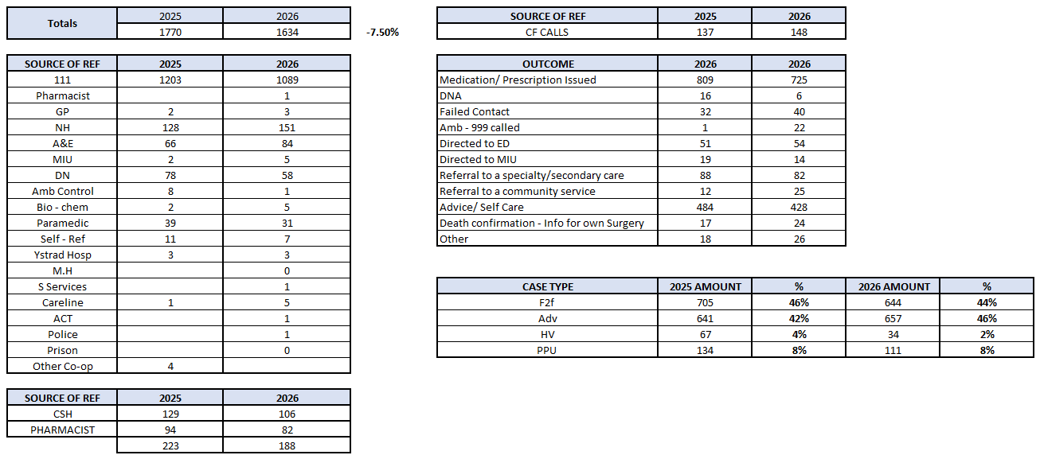
Easter GP Out of Hours – 2025 V’s 2026
Supplied by Joanne Warriss

Slide 4
Morriston Hospital
Easter Sprint: 26th March – 2nd April
Easter Weekend:3rd April to 6th April
@20th April 2026
Data: 23rd March 2026 to 12th April 2026
Enquiries: Jonathan.baglow@wales.nhs.uk Alison.Gallagher@wales.nhs.uk neil.cooper@wales.nhs.uk

Slide 5
Easter Sprint and Easter Weekend Operational Plan – Executive Summary Impact Assessment
Operating context:
  The Easter period was delivered under significantly higher demand than 2024 (the baseline period), with ED attendances and ambulance conveyances frequently 10–30% above baseline, increasing system risk.
  Incidentally, the 2025 Easter Period (18th April to 21st April) also presented a lower baseline level (47 ambulances on average, and 207 ED attends on average, per day, compared to 50 Ambulance arrivals (average) and 235 ED attends (average) each day during Easter 2026.
Overall assessment:
  The Easter plan functioned effectively as a system protection and flow‑stabilisation intervention, mitigating deterioration and maintaining operational control during a high‑risk period rather than seeking transformational improvement.
Ambulance handover performance:
  Ambulance handover delays improved, with a clear reduction in time lost to handovers (>15 minutes) over the period, despite sustained conveyance volumes, indicating improved management of exit block.
ED flow and long waits:
  ED long waits (>12 hours) and associated hours lost reduced in the latter part of the period, providing assurance that ED crowding and delay did not worsen in line with rising demand.
Medical Length of Stay:
  Weekly average medical LOS remained broadly stable across the wider Feb–Apr period (~8.25 days), with only short‑term post‑Easter variation and no sustained deterioration, indicating that increased demand was effectively contained.
Front‑door bed availability:
  The number of patients waiting for a bed at 9am reduced towards the end of the period, supporting improved front‑door flow and operational grip.
Discharge performance:
  Weekday medical discharges remained broadly strong, with rapid recovery after short‑term dips.
  Weekend discharges were more variable, reflecting the known limitations of mitigation during bank holiday periods.
Conclusion:
  Taken together, the evidence supports that the Easter plan successfully mitigated operational risk, protected patient flow, and maintained system stability during a period of materially increased demand.
Enquiries: Jonathan.baglow@wales.nhs.uk Alison.Gallagher@wales.nhs.uk neil.cooper@wales.nhs.uk

Slide 6
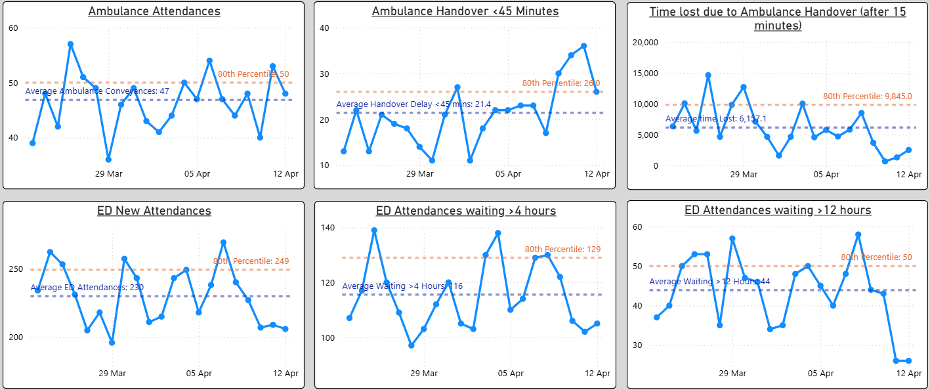
Ambulance and ED DEMAND

Slide 7
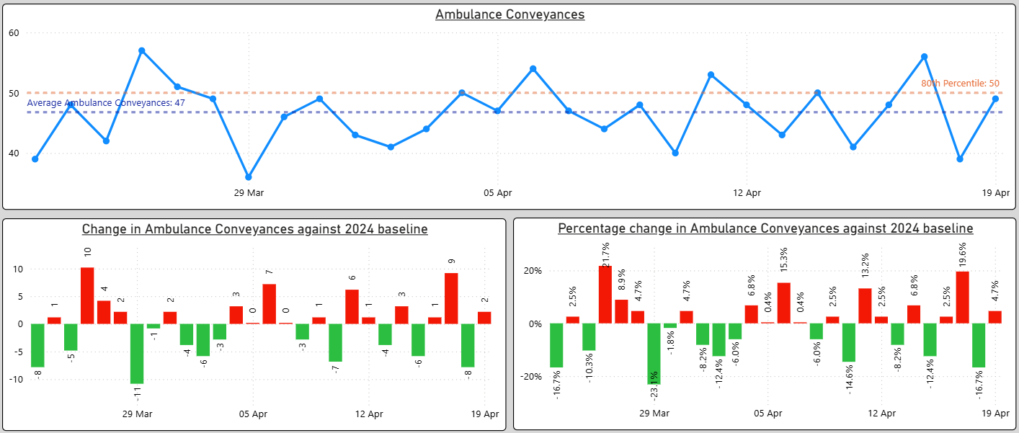
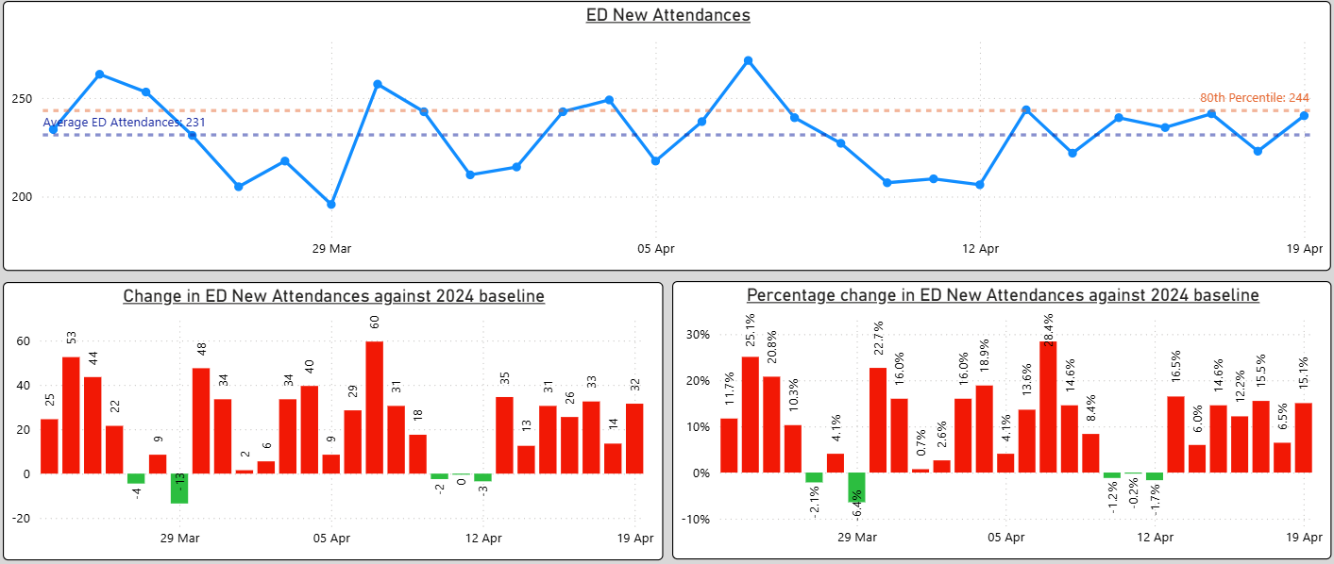
Ambulance & ED Attendance Analysis – versus the 2024 baseline position

Slide 8
1. Ambulance and ED DEMAND - ANALYSIS
Demand context: the plan was operating under pressure
This is critical to interpretation.
ED & Ambulance Demand
ED new attendances were consistently above the 2024 baseline, with daily increases often +10–30%, peaking around +34%.
Ambulance conveyances were also mostly above 2024, several days in the +10–17% range.
Absolute ED attendances frequently reached or exceeded the 80th percentile (~249).
Ambulance conveyances averaged 47, brushing the 80th percentile (50) multiple times.
Conclusion: The system was dealing with materially higher demand than last year. Any flat or improving performance indicators should therefore be read as impactful.

Slide 9
2. Ambulance Handover
Ambulance handover: clear positive signal
What the plan targeted
Board rounds and escalation of constraints
Silver Cell coordination
Focus on flow and bed availability
What the charts show
Ambulance handover <45 minutes:
  Improved trajectory into early April
  End‑period performance close to or above average
Time lost due to ambulance handover (>15 mins):
  Clear reduction towards the end of the period
  Final days show very low minutes lost compared to earlier spikes
This improvement occurred despite high conveyance volumes
Interpretation:
This is one of the strongest areas of evidenced impact. The improvement aligns well with daily operational grip, rapid escalation, and bed mobilisation, consistent with the plan.

Slide 10
3. ED Flow & Exit Block
ED flow & exit block: stabilisation rather than step‑change
ED waits >4 hours
Average around ~116, with peaks near the 80th percentile (129)
Notable volatility, but no sustained worsening across Easter
ED waits >12 hours
Average ~44
A spike into early April, followed by a marked drop by the end of the period
Final values are among the lowest in the series
Hours lost to ED waits >12 hours
Average ~646 hours
Early spike (>1,000 hours), then steady improvement
Final days drop to ~200–300 hours
Interpretation:
Given demand levels, maintaining control — and then improving — strongly suggests that senior decision‑making, post‑take rounds, and escalation processes were effective. This equates to harm avoidance.

Slide 11
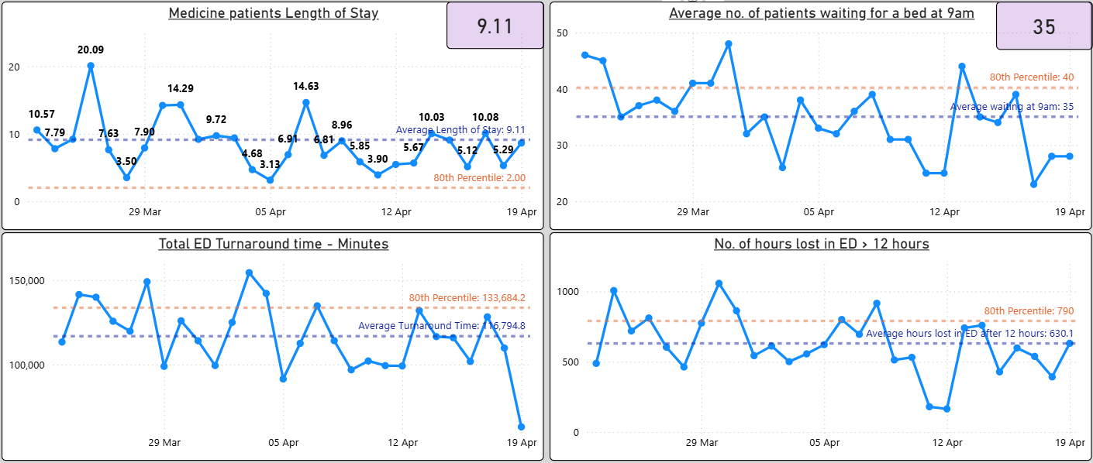
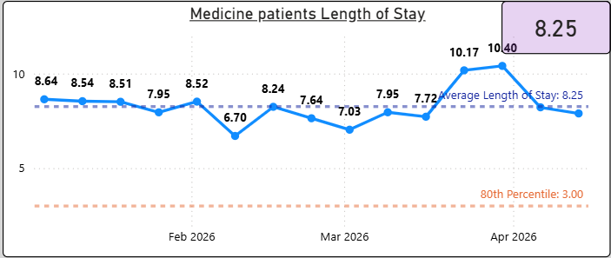
Decompressing ED & Medical LOS (weekly, wider period)

Slide 12
4. Medical Length of Stay
Medical Length of Stay (weekly average):
  Over the wider multi‑week period shown (Feb–Apr), weekly average medical LOS remains broadly stable, with an overall average of ~8.25 days.
  The Easter period sits within normal weekly variation, with a short‑lived uplift immediately after Easter (weeks peaking around ~10–10.4 days) followed by a return towards baseline.
  There is no sustained post‑Easter deterioration, indicating that flow was contained despite increased demand.
  This pattern suggests the Easter interventions prevented prolonged LOS escalation, maintaining LOS broadly in line with historical weekly performance rather than driving a step‑change reduction.

Slide 13
5. Bed availability at the front door (9am)
Patients waiting for a bed at 9am
Average 36, with 80th percentile 41
Clear reduction towards the end of the period
Final days down to mid‑20s
Interpretation:
This aligns directly with board rounds + silver command + discharge focus. This supports the view that flow was improved even if capacity was unchanged.

Slide 14
6. Ward Discharge Performance
Ward discharge performance
Weekday medical discharges
Generally strong (mostly 50–69)
One sharp dip on Bank Holiday Monday (to 22)
Rapid rebound immediately after to 55–69
Weekend medical discharges
More variable
One notably low point (11) on 12th April (Sunday) , but in keeping with wider trend for Sunday performance over a wider period
Otherwise broadly around the 80th percentile
Interpretation:
The infrastructure maintained weekday performance well.
Weekend impact is less consistent, suggesting:
  Variable staffing effectiveness in the face of systemic challenges on a weekend
  Limits to what escalation can offset during bank holiday periods
This does not negate impact, but highlights where the plan is weaker.

Slide 15
Neath Port Talbot and Singleton Hospitals
Easter Sprint: 26th March – 2nd April
Easter Weekend: 3rd April to 6th April
@17th April 2026
Data: 1st January 2026 to 12th April 2026
Enquiries: Louise.Williams@wale.nhs.uk Alison.Gallagher@wales.nhs.uk

Slide 16
Neath Port Talbot & Singleton Discharges & COP – Weeks Pre and Post Easter 2026
 |  |  | Week commencing
Hospital Site | Measure | Site/Ward Location | Thursday 26/03/2026 |  | Thursday 02/04/2026 |  | Thursday 09/04/2026
 |  |  | Total | Median | Total | Median | Total | Median
NPT | Daily discharges per ward | NPT - Ward A (Medical) | 6 | 1 | 6 | 1 | 6 | 0
NPT | Daily discharges per ward | NPT - Ward B2 | 4 | 0 | 1 | 0 | 1 | 0
NPT | Daily discharges per ward | NPT - Ward C | 4 | 1 | 2 | 0 | 4 | 1
NPT | Daily discharges per ward | NPT - Ward D | 3 | 0 | 2 | 0 | 3 | 0
NPT | No. of daily discharges on Singleton/NPT non elective wards. | Wards A, B2, C & D | 17 | 2 | 11 | 1 | 14 | 1
Singleton | Daily discharges per ward | Sing - Ward 3 | 2 | 0 | 0 | 0 | 1 | 0
Singleton | Daily discharges per ward | Sing - Ward 4 | 4 | 0 | 1 | 0 | 3 | 0
Singleton | No. of daily discharges on Singleton/NPT non elective wards. | Wards 3 & 4 | 6 | 0 | 1 | 0 | 4 | 0
COP
NPT | NPT COP medical patients | Wards A, B2, C & D ~ Average |  | 32 |  | 32 |  | 37
Singleton | Singleton COP medical patients | Wards 3 & 4 ~ Average |  | 38.7 |  | 38.5 |  | 38.7

Slide 17
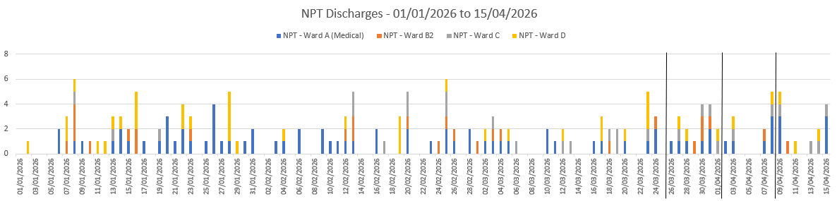
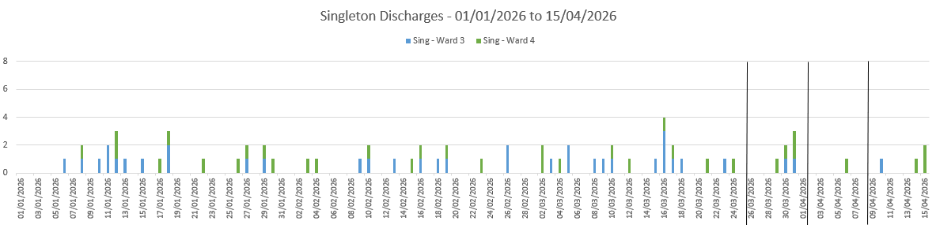
Neath Port Talbot & Singleton Discharges Daily – with a focus on Pre and Post Easter 2026
~Pre ~ Easter ~Post
~Pre ~ Easter ~Post
NPT Wards:
Ward A – (Medical Patients)
Ward B2
Ward C
Ward D
Singleton Wards:
Ward 3 – previously Gorseinon West Ward
Ward 4

Slide 18
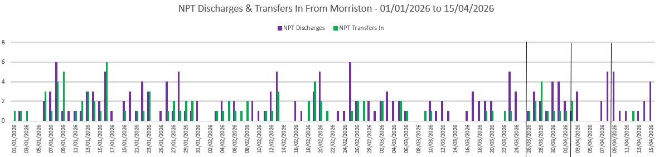
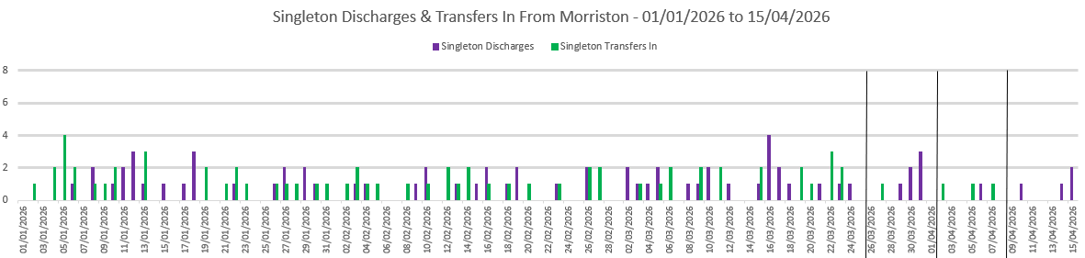
Neath Port Talbot & Singleton Medical Transfers In & Discharges Daily – Pre and Post Easter 2026
~Pre ~ Easter ~Post
~Pre ~ Easter ~Post

Slide 19
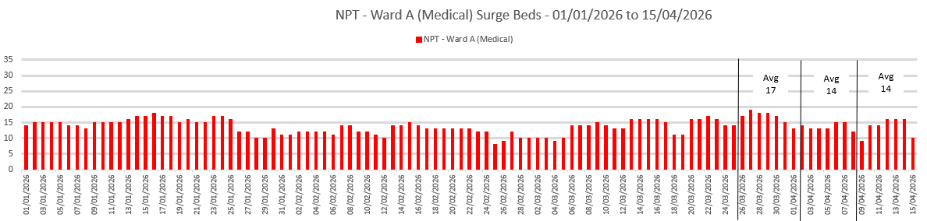
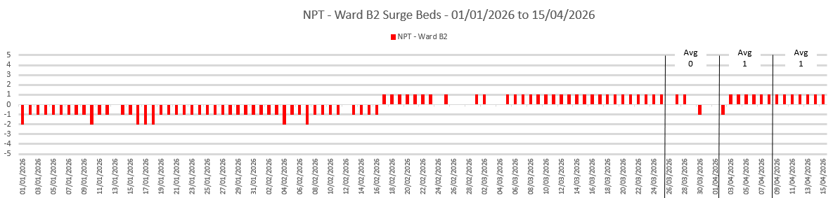
Neath Port Talbot Surge Beds Daily – with a focus on Pre and Post Easter 2026
~Pre ~ Easter ~Post
~Pre ~ Easter ~Post
Funded beds baseline:
Ward A beds - 0
Ward B2 beds - 30

Slide 20
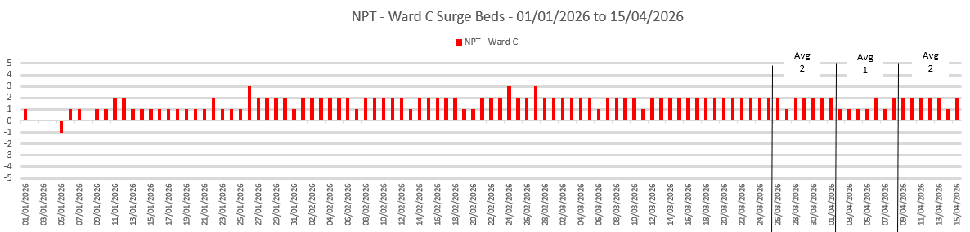
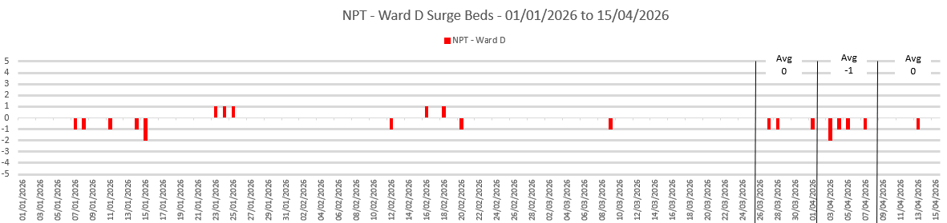
Neath Port Talbot & Singleton Surge Beds Daily – with a focus on Pre and Post Easter 2026
~Pre ~ Easter ~Post
~Pre ~ Easter ~Post
Funded beds baseline:
Ward C beds - 30
Ward D beds - 40

Slide 21
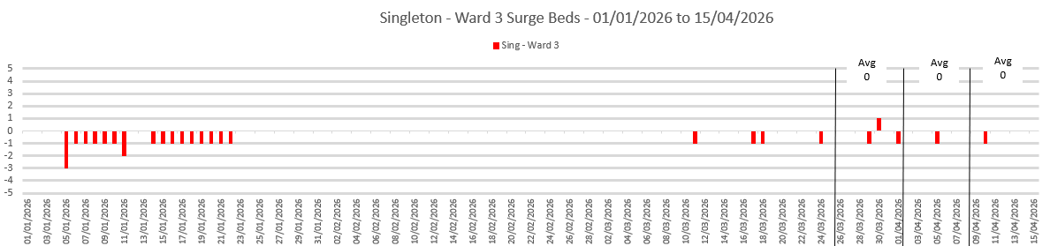
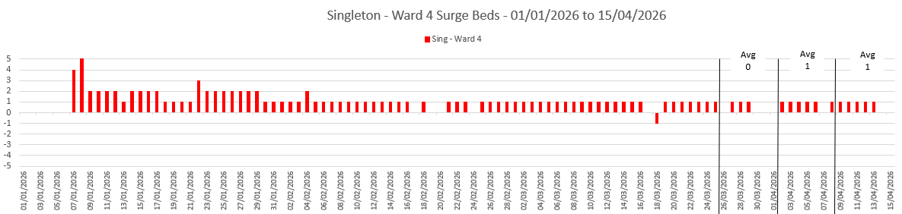
Singleton Surge Beds Daily – with a focus on Pre and Post Easter 2026
~Pre ~ Easter ~Post
~Pre ~ Easter ~Post
Funded beds baseline:
Ward 3 beds - 30
Ward 4 beds - 30

Slide 22
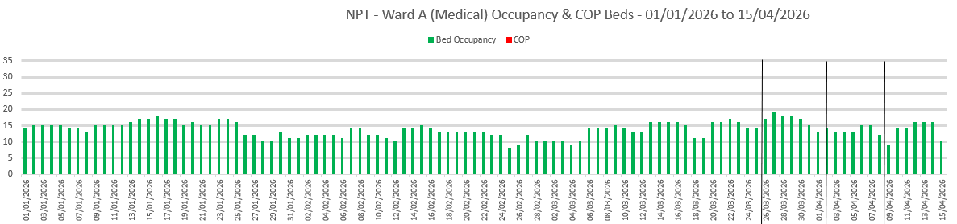
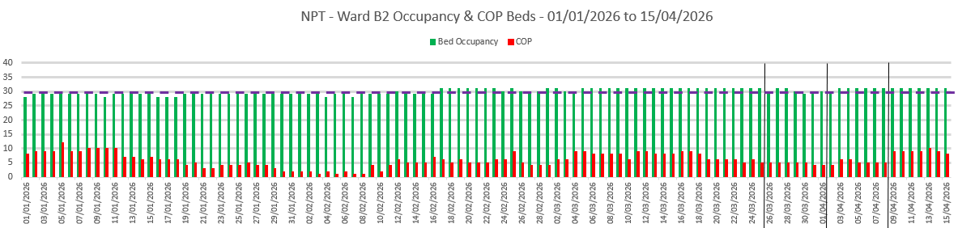
Neath Port Talbot Occupied Beds & COP Daily – with a focus on Pre and Post Easter 2026
~Pre ~ Easter ~Post
~Pre ~ Easter ~Post

Slide 23
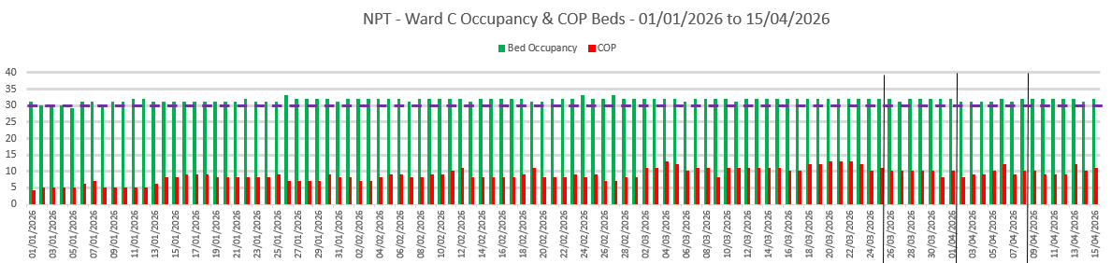
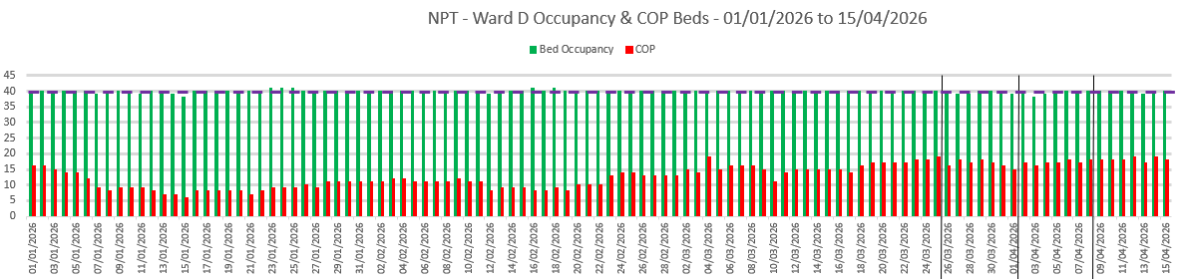
Neath Port Talbot Occupied Beds & COP Daily – with a focus on Pre and Post Easter 2026
~Pre ~ Easter ~Post
~Pre ~ Easter ~Post

Slide 24
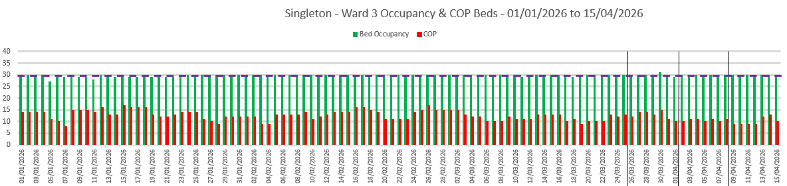
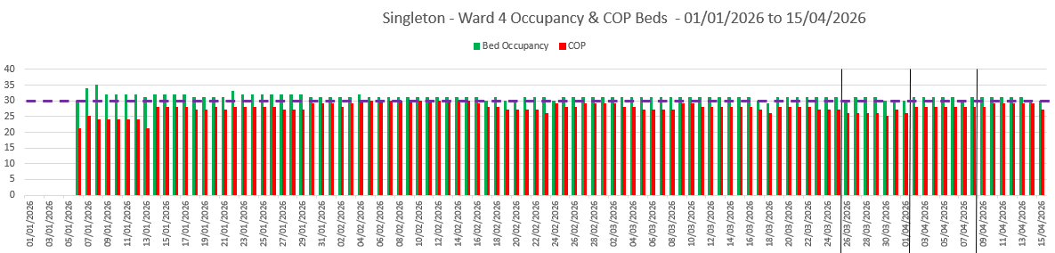
Singleton Occupied Beds & COP Daily – with a focus on Pre and Post Easter 2026
~Pre ~ Easter ~Post
~Pre ~ Easter ~Post

Slide 25
Morriston Transfer List to Singleton Ward 3 – Weeks Pre and Post Easter 2026
 |  |  | Week commencing
Hospital Site | Measure | Site/Ward Location | Thursday 26/03/2026 |  | Thursday 02/04/2026 |  | Thursday 09/04/2026
 |  |  | Total | Median | Total | Median | Total | Median
Singleton | New patients added to Morriston Transfer List | Sing - Ward 3 | 10 | 2 | 14 | 0 | 9 | 0
Singleton | Outcome Transfer | Sing - Ward 3 | 5 | 1 | 8 | 0 | 1 | 0
Singleton | Outcome Removed | Sing - Ward 3 | 5 | 1 | 5 | 0 | 6 | 0
Singleton | Outcome Waiting | Sing - Ward 3 | 0 | 0 | 1 | 0 | 2 | 0
Singleton | Outcome Transfer - Total & Average Days Listed | Sing - Ward 3 | 26 | 5.2 | 43 | 5.37 | 6 | 6
Singleton | Outcome Removed - Total & Average Days Listed | Sing - Ward 3 | 4 | 2 | 6 | 6 | 12 | 3
For consistency, the Information in the above table is based upon the addition to the list date.
Data source – Manual Data Collection – Step down listed patients – emailed Monday to Friday

Slide 26
Morriston Transfer List to Singleton Ward 4 – Weeks Pre and Post Easter 2026
 |  |  | Week commencing
Hospital Site | Measure | Site/Ward Location | Thursday 26/03/2026 |  | Thursday 02/04/2026 |  | Thursday 09/04/2026
 |  |  | Total | Median | Total | Median | Total | Median
Singleton | New patients added to Morriston Transfer List | Sing - Ward 4
Singleton | Outcome Transfer | Sing - Ward 4
Singleton | Outcome Removed | Sing - Ward 4
Singleton | Outcome Waiting | Sing - Ward 4
Singleton | Outcome Transfer - Total & Average Days Listed | Sing - Ward 4
Singleton | Outcome Removed - Total & Average Days Listed | Sing - Ward 4
Information in the above table is based upon the addition to the list date.
Data source – Manual Data Collection – Step down listed patients – emailed Monday to Friday

Slide 27
Bonymaen House – Weeks Pre and Post Easter 2026
 |  |  | Week commencing
Hospital Site | Measure | Destination Location | Thursday 26/03/2026 |  | Thursday 02/04/2026 |  | Thursday 09/04/2026
 |  |  | Total | Average | Total | Average | Total | Average
Morriston List | Total New Patients Added to List | Bonymaen House | 6 |  | 2 |  | 8
Morriston List | Outcome Transfer | Bonymaen House | 6 |  | 2 |  | 6
Morriston List | Outcome Waiting | Bonymaen House | 0 |  | 0 |  | 2
Morriston List | Outcome Removed | Bonymaen House | 0 |  | 0 |  | 0
Morriston List | Outcome Transfer | Bonymaen House

Slide 28
Criteria applied
Date Range
Full date range - 01/01/2026 to 16/04/2026
With a focus on Easter -26/03/2026 to 02/04/2026
Note – Seasonal trends are not available for Singleton Hospital, Ward 3 and Ward 4.
A, Singleton Hospital , Ward 3 - Operational October 2025
B, Singleton Hospital, Ward 4 - Operational early January 2026, with full bed occupancy of 30 patients from the 06/01/2026 .
Site Description
Neath Port Talbot Hospital
Singleton Hospital
Ward Description
Ward Description | Site Description
Ward A (Medical Specialties only) | Neath Port Talbot Hospital
Ward B2 | Neath Port Talbot Hospital
Ward C | Neath Port Talbot Hospital
Ward D | Neath Port Talbot Hospital
Ward 3 | Singleton Hospital
Ward 4 | Singleton Hospital
Specialty Description
General Medicine
Care of the Elderly
Rehabilitation

