Slide 1
Pathways of Care Delays
Position: Update 21st October 2025

Slide 2
Validated POCD Data 21st October
POCD Team attended COP meetings at MGH, SGH & NPTH to ensure consistency of approach across and validation of coding's and COP dates and have worked closely with MH/LD to support accurate coding.
Weekly validation meeting with Site and Social Care leads held 21st October 2025 for Accountable Officers from each service confirmed validated data position
Data correct as of 16:30 21st October:
Site | Delayed Pathways of Care: October 21st | Delayed Pathways of Care: October 15th | WoW Variance
Learning Disabilities | 7 | 7 | 0
Mental Health | 40 | 39 | +1
Morriston Hospital | 96 | 99 | -3
Neath Port Talbot Hospital | 32 | 25 | +7
Singleton Hospital | 15 | 16 | -1
Total | 190 | 186 | +4

Slide 3
Action Plan Position and Key Actions Underway
Programme Delivery
Face to Face summit to target key areas of delay and refocus efforts on reductions coming into the Winter period
Morriston
Board Round Refresh
  Embed Weekend Criteria Led Discharges
  Weekend Board rounds to be explored
  Ward Managers to ensure SIGNAL is updated daily
Digital
Roll out of Reablement, Recovery & Rehab tab on SIGNAL to support POCD reductions and monitoring
Mental Health & LD
Roll out of improvement plan and implementation of changes in DST processes to reduce delays
Performance
Undertake dashboard improvements to incorporate POCD removals and allow for tracking of days at each delay code
Governance
Incorporate changes within POCD SOP to share with site leads to support flow teams with escalations
POCD Action Plan
Metric | Count
Open Actions | 72
Not Started | 12
In Progress | 54
Complete | 5
Blocked | 0
Escalated | 0
On Hold | 1
Delegated | 0
Red | 1
Amber | 52
Green | 19
Blue (Archive) | 42

Slide 4
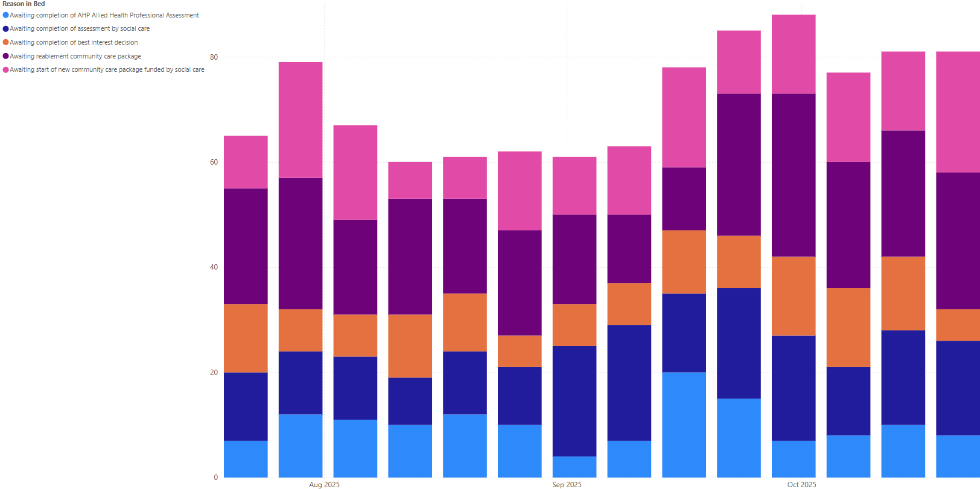
Top 5 Delay Code Progression: Last 3 Months

Slide 5
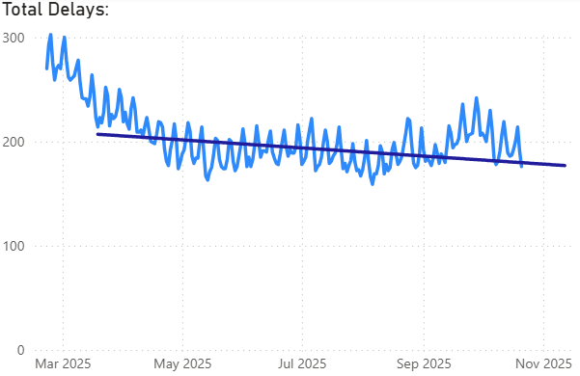
POCD Total Trend to Trajectory* (21st Oct)
*2025 Welsh Government Trajectory
4 below trajectory
Excludes LD and MH sites not reporting on Signal: Brynafon Learning Disabilities Unit; Dan Y Bont; Hafod Y Wennol; Laurals and Briary Continuing Care Bungalows; Lletty Newedd Continuing Care Bungalow; Llwyneryr Hospital; Rowan House Treatment Centre and Assessment Center; Swn y Nant; Ty Garth Newydd;

Slide 6
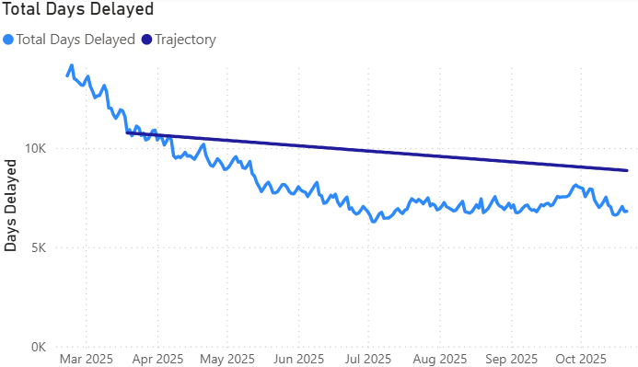
POCD Total Days Delayed Trend (21st Oct)
2,058 days below trajectory
Excludes LD and MH sites not reporting on Signal: Brynafon Learning Disabilities Unit; Dan Y Bont; Hafod Y Wennol; Laurals and Briary Continuing Care Bungalows; Lletty Newedd Continuing Care Bungalow; Llwyneryr Hospital; Rowan House Treatment Centre and Assessment Center; Swn y Nant; Ty Garth Newydd;

Slide 7
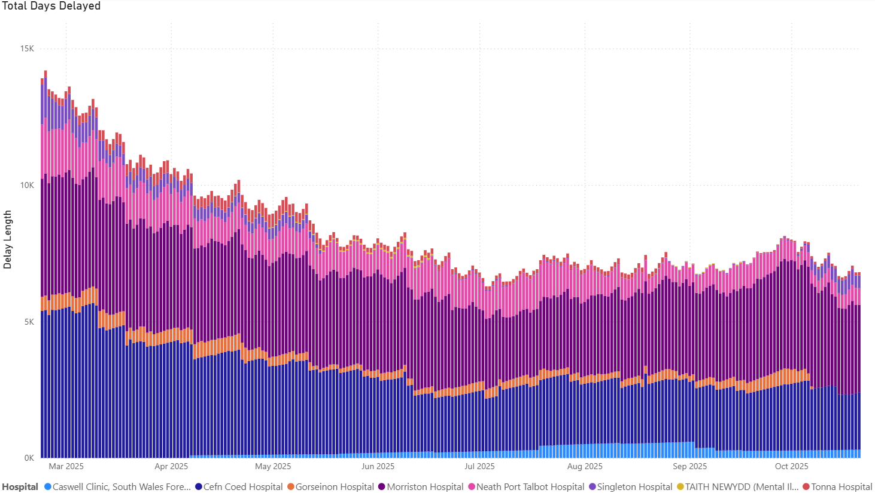
POCD Total Days Delayed Trend by Hospital
Excludes LD and MH sites not reporting on Signal: Brynafon Learning Disabilities Unit; Dan Y Bont; Hafod Y Wennol; Laurals and Briary Continuing Care Bungalows; Lletty Newedd Continuing Care Bungalow; Llwyneryr Hospital; Rowan House Treatment Centre and Assessment Center; Swn y Nant; Ty Garth Newydd;

Slide 8
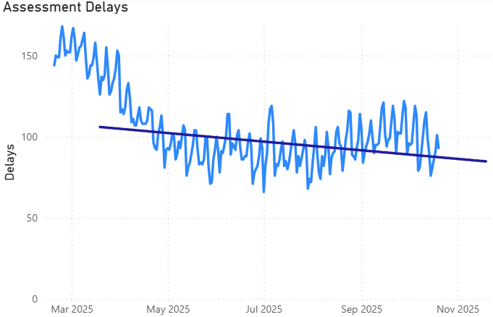
Assessment Delays Trend (21st Oct)
6 above trajectory
Excludes LD and MH sites not reporting on Signal: Brynafon Learning Disabilities Unit; Dan Y Bont; Hafod Y Wennol; Laurals and Briary Continuing Care Bungalows; Lletty Newedd Continuing Care Bungalow; Llwyneryr Hospital; Rowan House Treatment Centre and Assessment Center; Swn y Nant; Ty Garth Newydd;

Slide 9
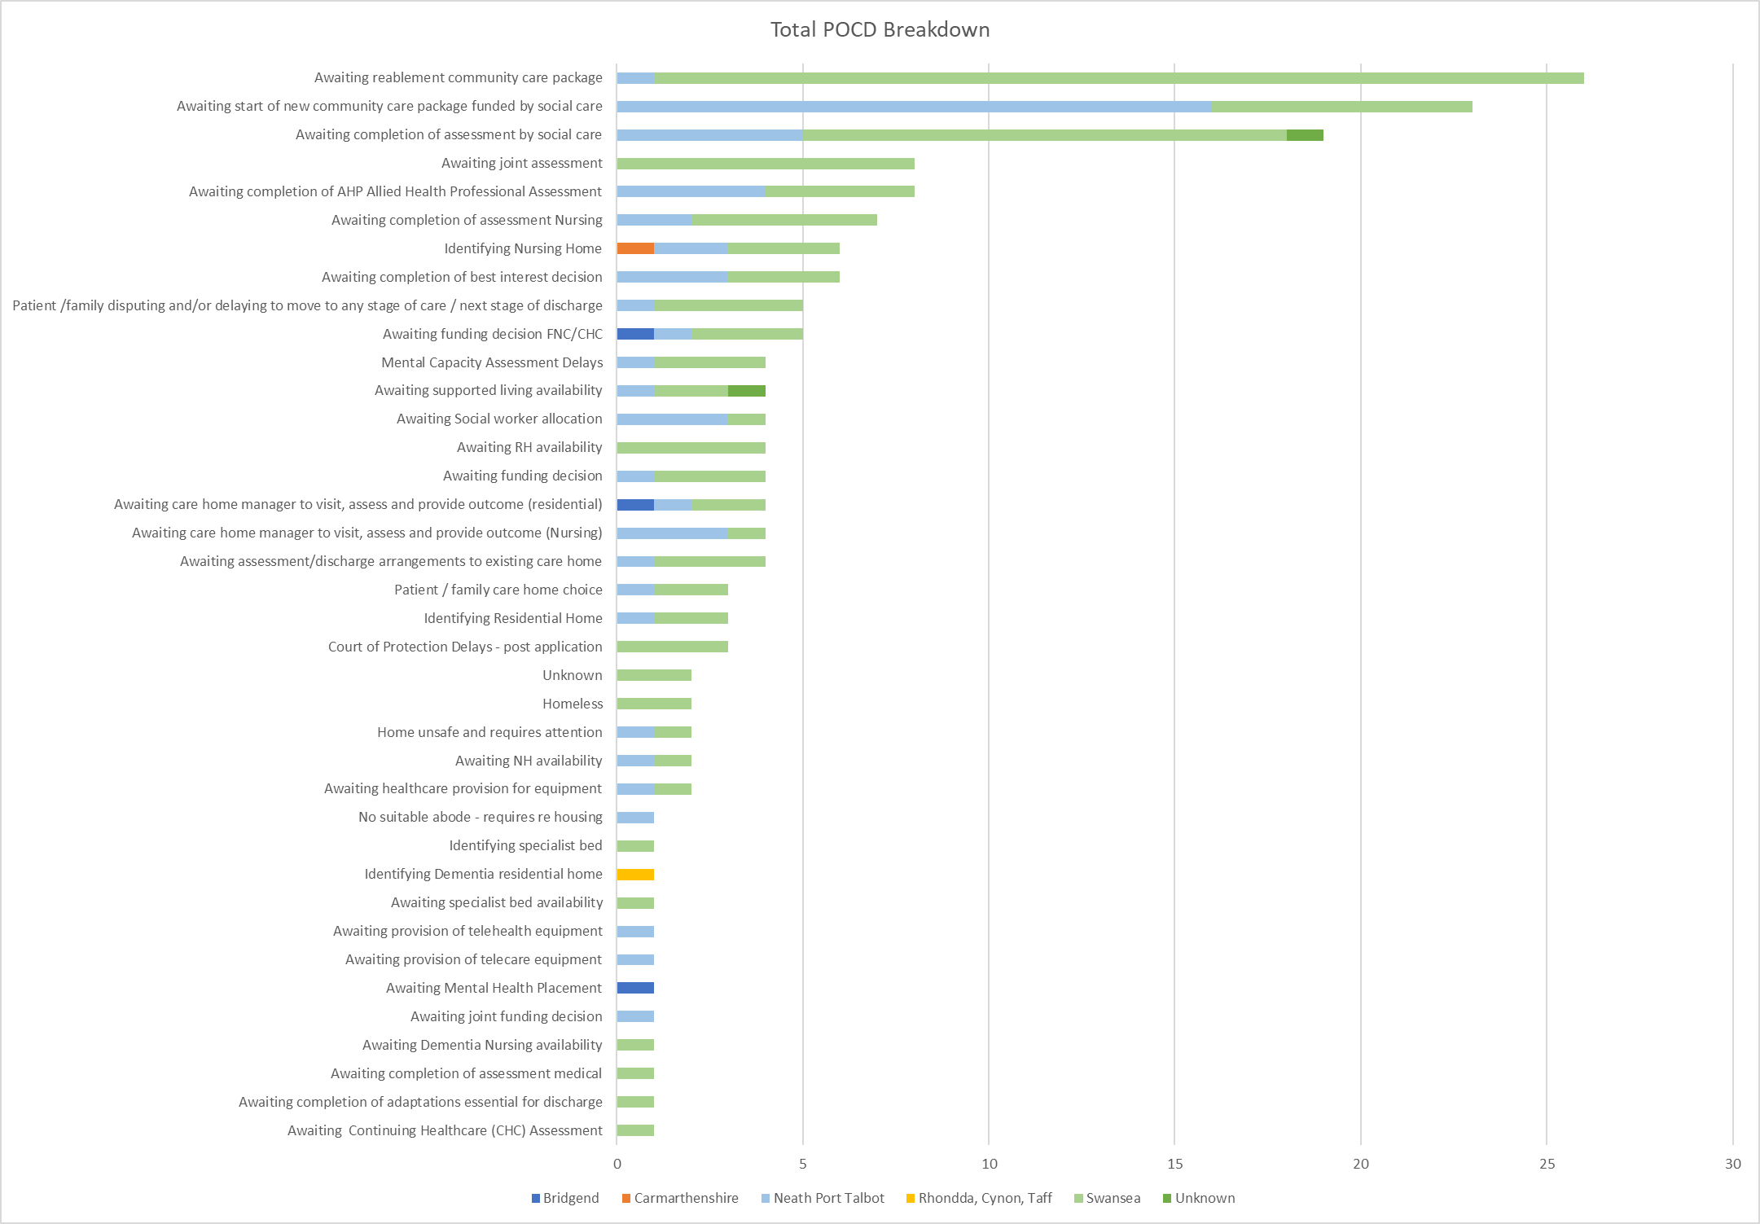
POCD Total Breakdown
Excludes LD and MH sites not reporting on Signal: Brynafon Learning Disabilities Unit; Dan Y Bont; Hafod Y Wennol; Laurals and Briary Continuing Care Bungalows; Lletty Newedd Continuing Care Bungalow; Llwyneryr Hospital; Rowan House Treatment Centre and Assessment Center; Swn y Nant; Ty Garth Newydd;

Slide 10
SITE ANALYSIS

Slide 11
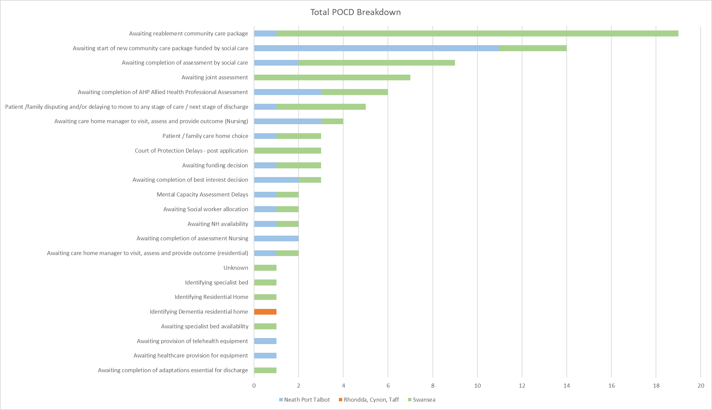
POCD MGH Breakdown

Slide 12
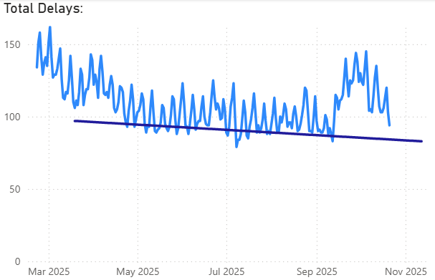
POCD MGH Trajectory
  10 Above Trajectory
*2025 Welsh Government Trajectory

Slide 13
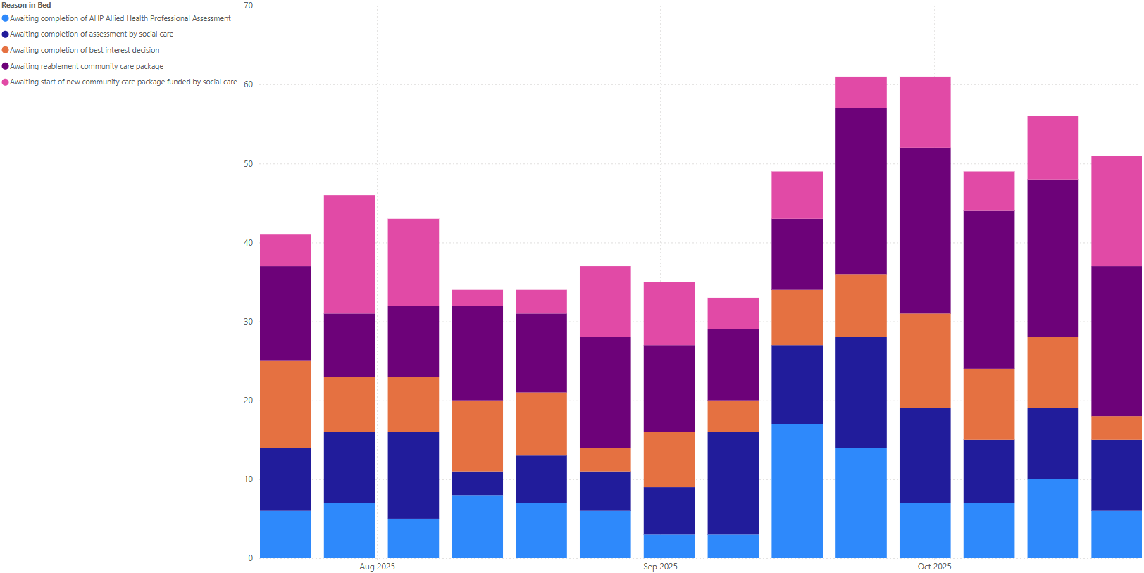
POCD MGH: Top 5 Reasons in Bed progression

Slide 14
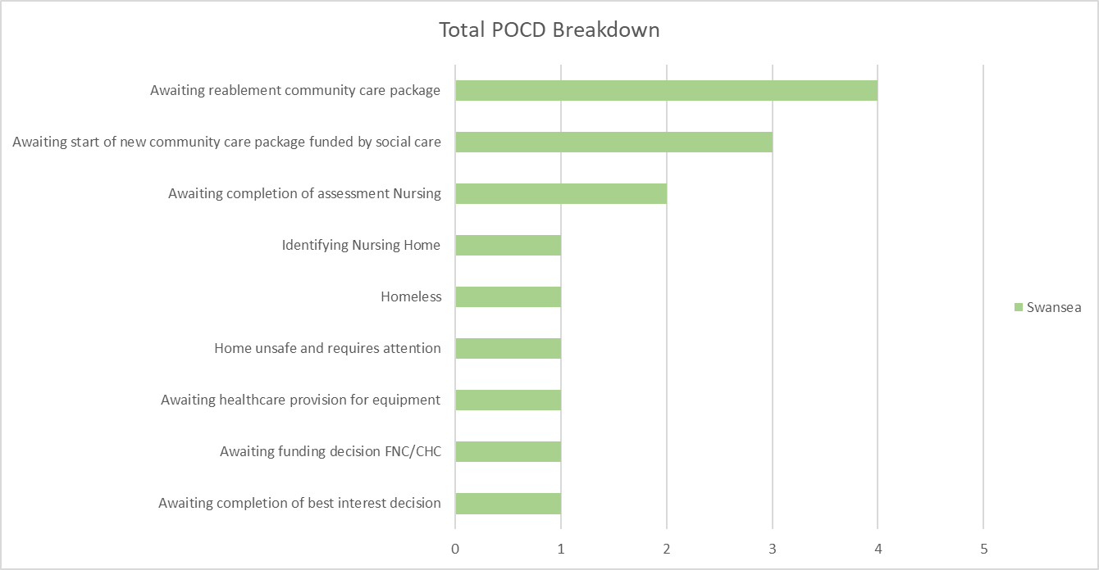
POCD SGH Breakdown

Slide 15
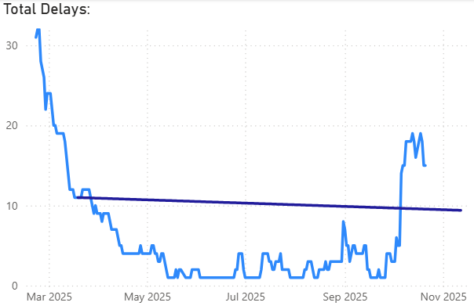
POCD SGH Trajectory
5 above trajectory
*2025 Welsh Government Trajectory

Slide 16
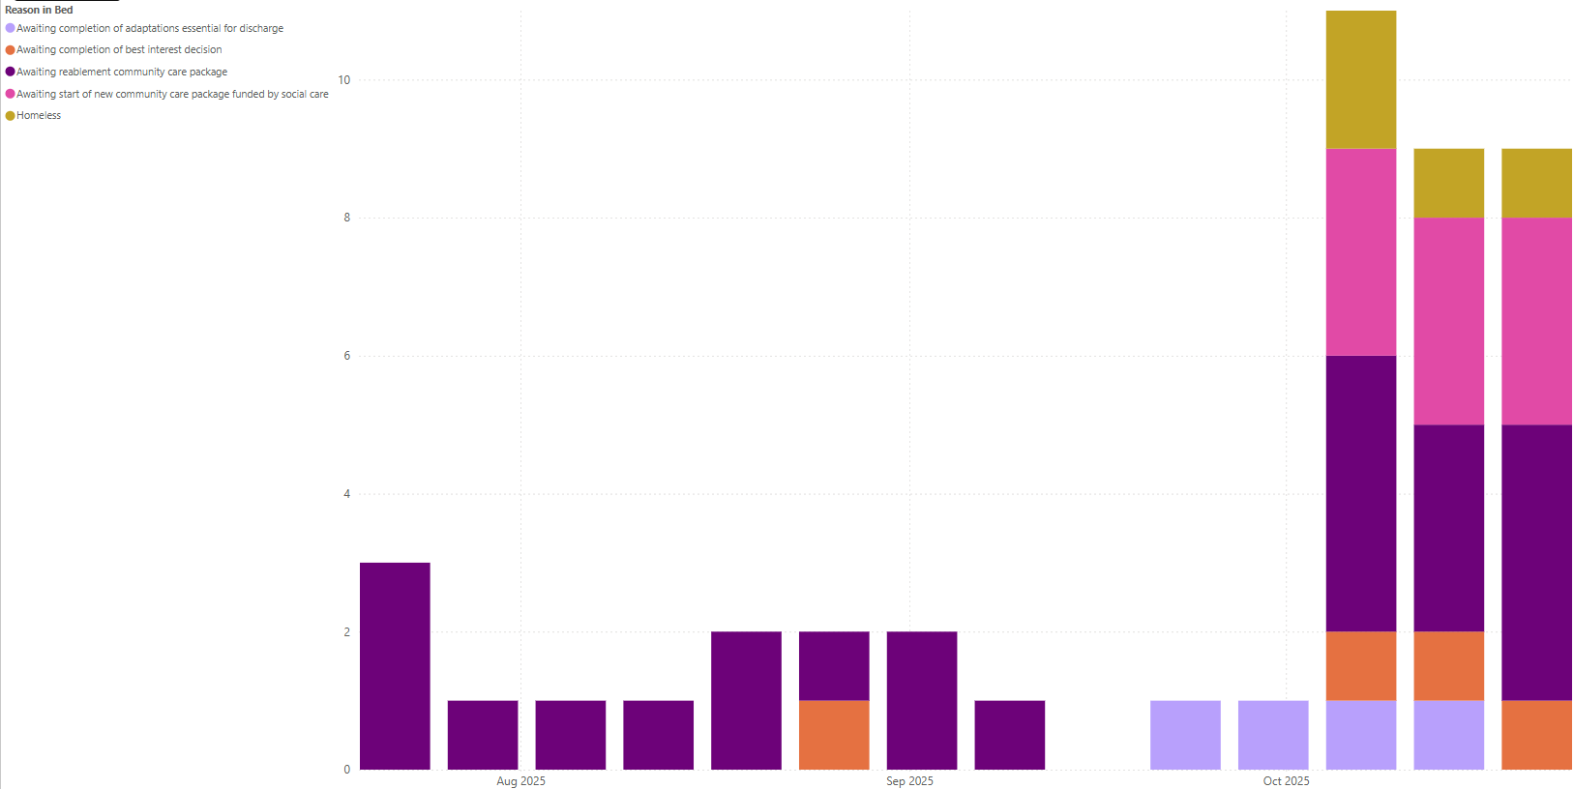
POCD SGH Top 5 Reasons in Bed progression

Slide 17
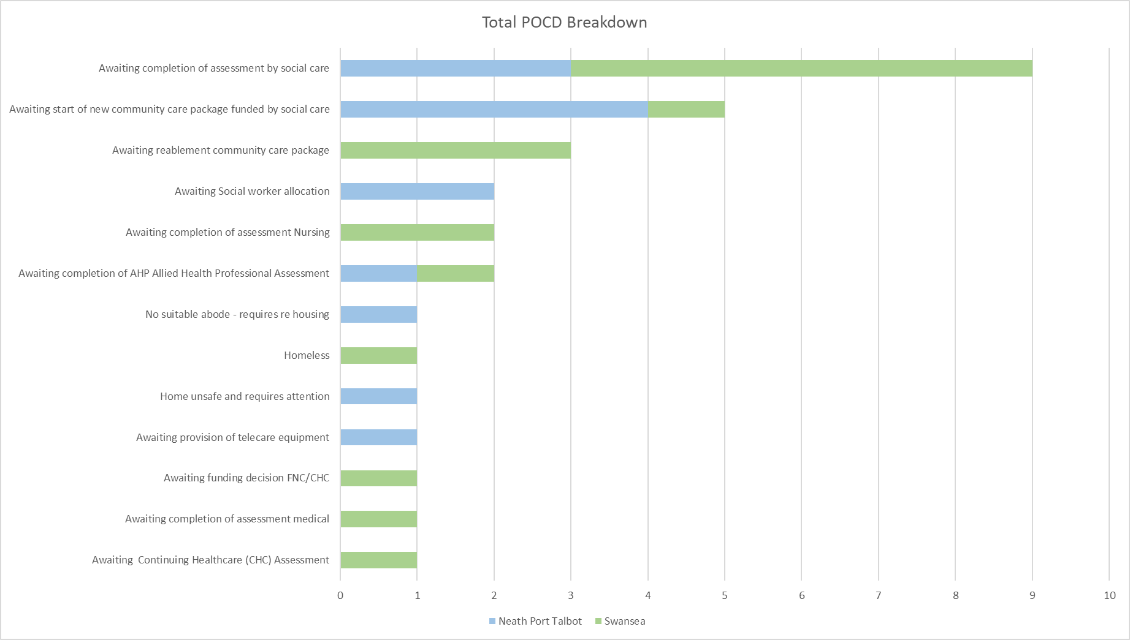
POCD NPTH Breakdown

Slide 18
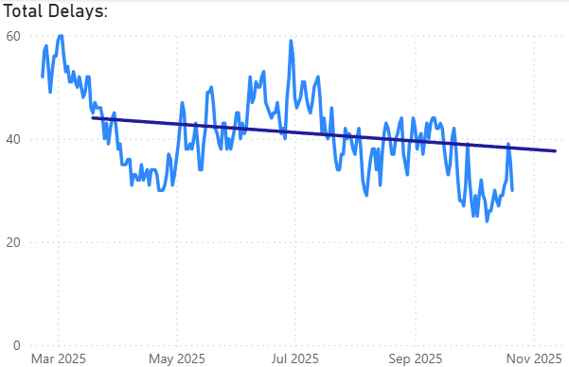
POCD NPTH Trajectory*
8 Below Trajectory
*2025 Welsh Government Trajectory

Slide 19
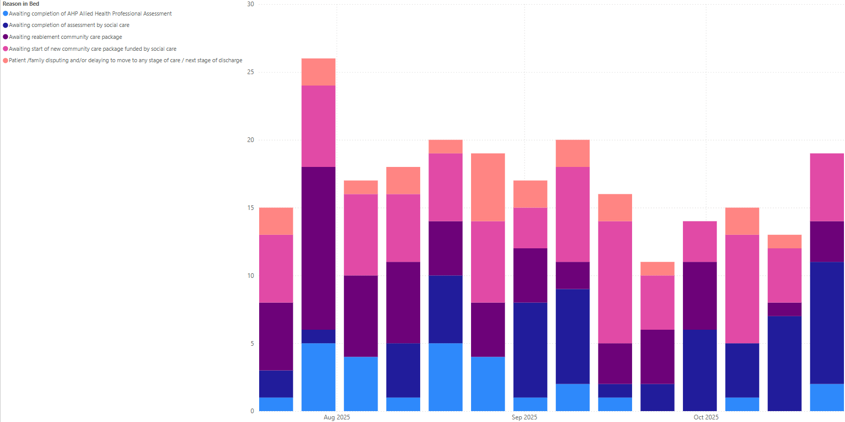
POCD NPTH Top 5 Reasons in Bed Progression

Slide 20
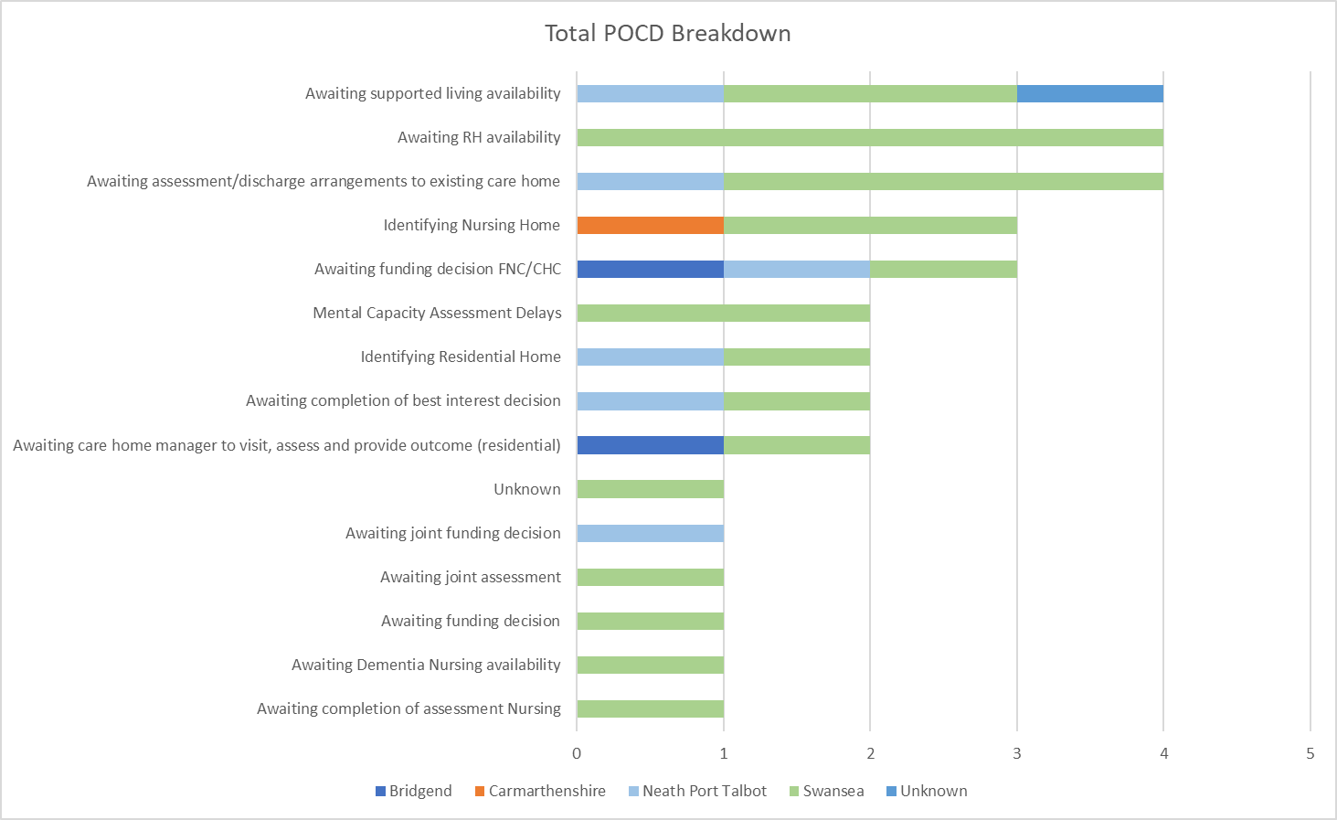
POCD Cefn Coed Breakdown

Slide 21
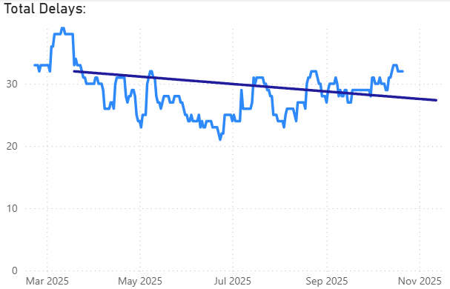
POCD Cefn Coed Trajectory*
4 above trajectory
*2025 Welsh Government Trajectory

Slide 22
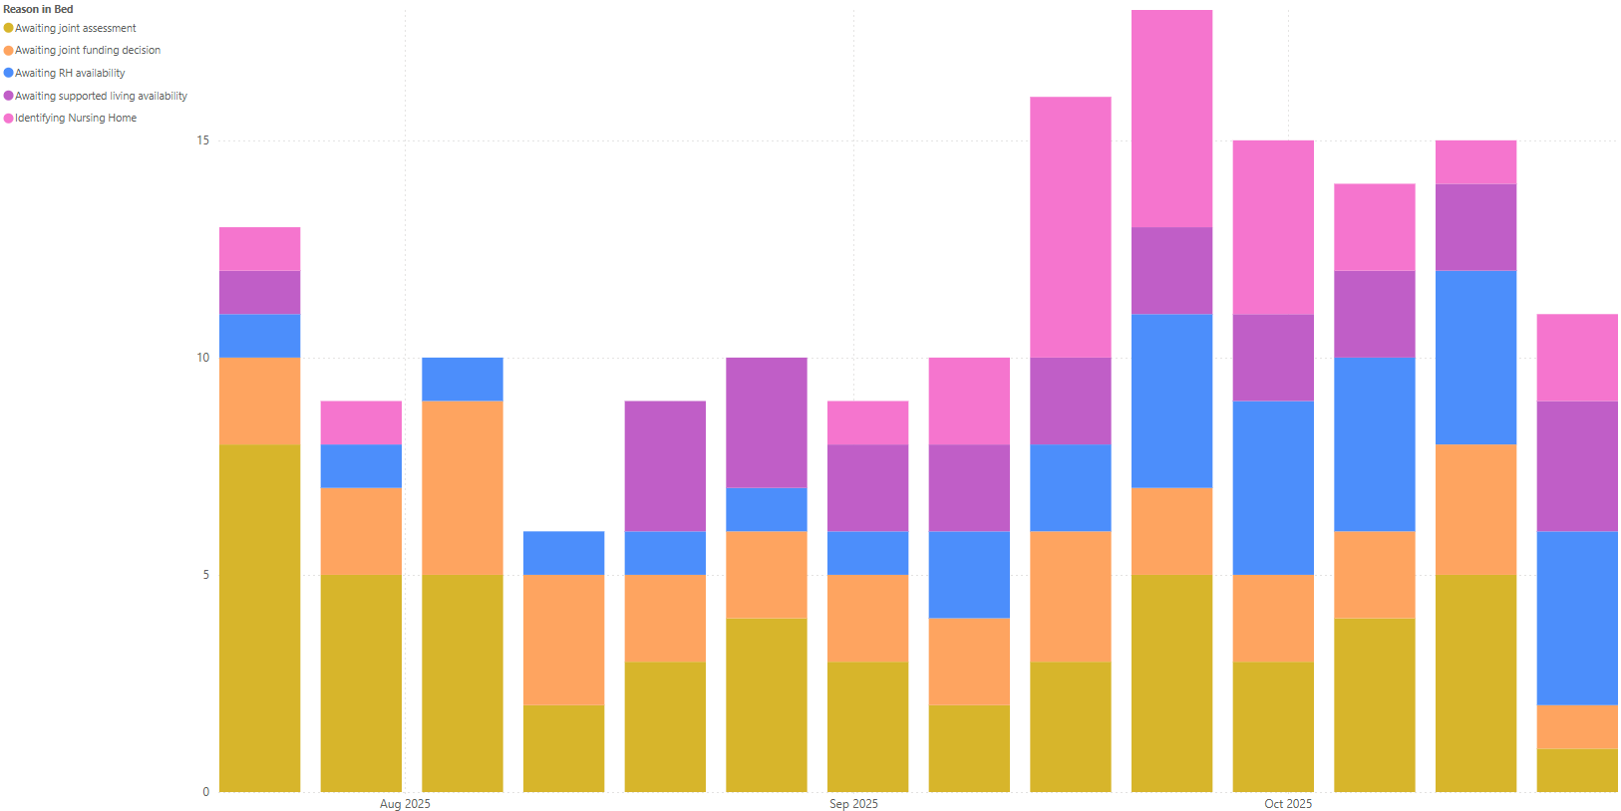
POCD Cefn Coed Top 5 Reasons in Bed progression

