Slide 1
Case Study from the Quality Improvement Project

Slide 2

Case Study: 87 Year Old Male under the current Chronic Oedema Wet Leg Pathway© with the District Nursing Workforce
Past Medical History
Cellulitis
Lymphoedema
Type 2 diabetes
Hypertension
Pacemaker
Atrial fibrillation
Medication
Furosemide
Bisoprolol
Apixaban
Insulin
Social History: Lives alone, doesn’t drive, ex-smoker, Needing carers (since fall 6 months ago)
Carers: Twice daily for 6 months to support morning and nighttime ADLs
Patient not improving despite efforts and input from many services….. Continues to worsen
Management Plan District Nursing ‘Wet leg pathway’ (established pathway)
31 district nursing calls for wet legs over 10 weeks
Input: Following QI Project/Education and NTproBNP:
NTproBNP result ↑1637 (positive 400+)
Referral - made by GP to the Rapid Diagnostic Clinic for possible new heart failure diagnosis

Slide 3
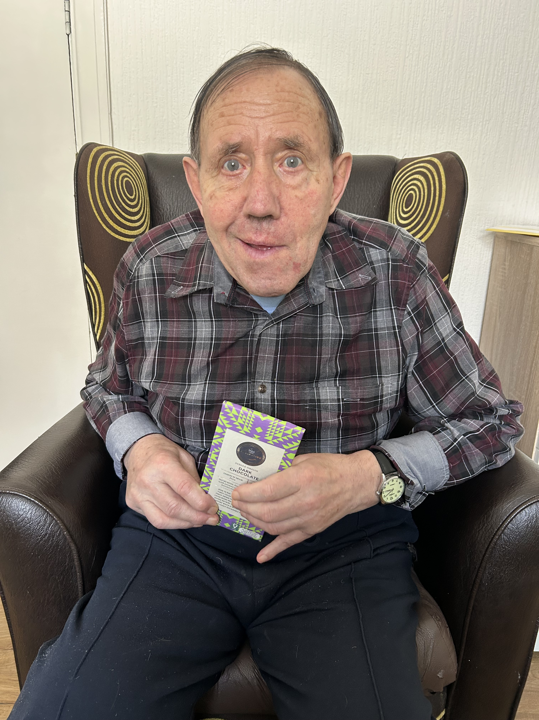
Case Study Intervention
Step 1
District nurse recommends Blood Test – NTproBNP to GP
Step 2 Rapid diagnostic clinic
Step 3 Patient assessment
Improved patient outcomes
No Longer under District Nurses for leg dressings
Improved signs and symptoms of HF (7Kg weight loss)
Reduction in his Insulin
Able to sleep at night
Improved QOL
Can now wear shoes/slippers
No further falls
No longer requiring carers, far more independent
Has not required a hospital admission for cellulitis or heart failure
Step 4
Diagnosis Heart Failure with Preserved Ejection Fraction
NTproBNP should have been considered at the start of the patient pathway
Consider aetiology of the wet leg
Step 5
Community heart failure service for optimisation

Slide 4


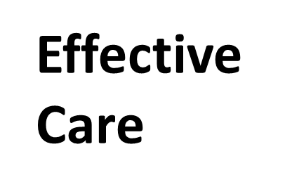

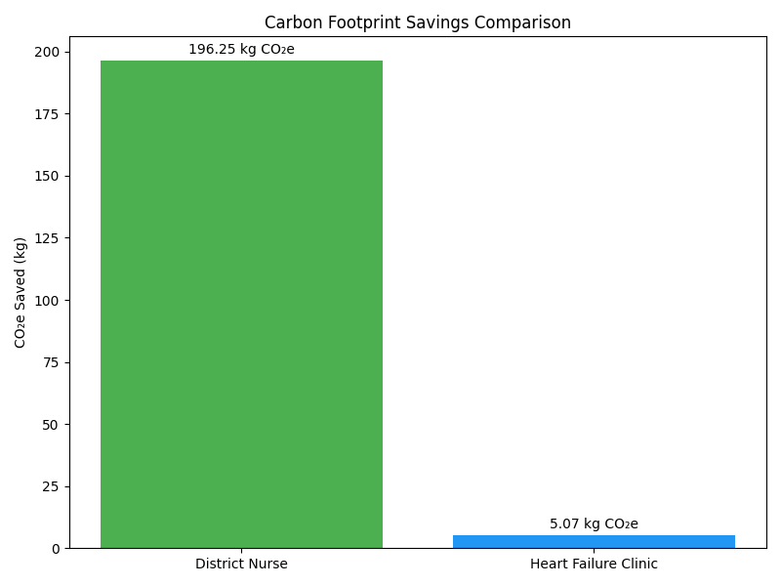
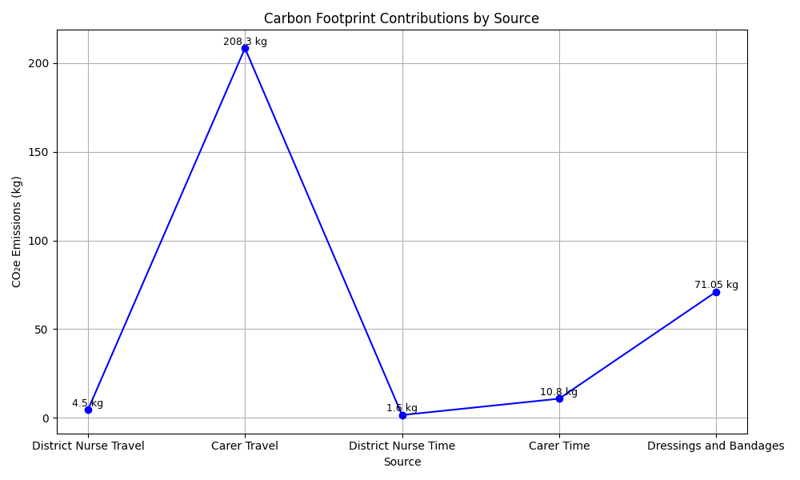
Cost Benefit & Carbon Footprint Impact of QI Project
Estimated Cost Avoidance: £7,442
Reduced landfill/Incineration due to not requiring dressings
Nursing time saved £1500
GP Contacts £1000
Carers £3500
Dressing Costs £1400
Mileage £42 (excluding carers mileage)
Equivalent to:
Driving 1000 miles in a petrol car
Charging 39,250 smartphones
Daily footprint of 5.6 UK adults

Slide 5
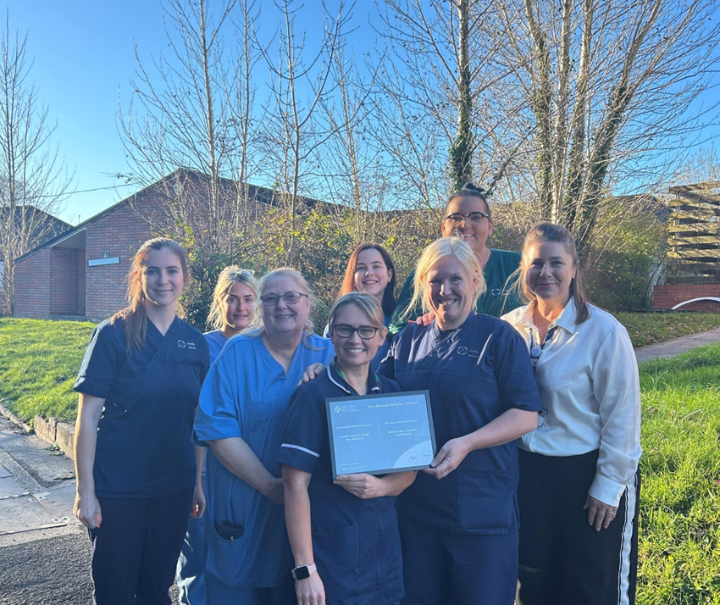
District Nurses - Staff Story on the Quality Improvement Project – Qualitative Data (Link to Staff Story) - Improvement in Practice -Staff Story
Relate to experiences
Clear Information
Empowering
Informative
Relaxed & Inclusive
Engaging

Slide 6


…...... Working Better Together
Improved patient outcomes/Enhancing patient experience of care through collaboration
Changes to All Wales Wet Leg Pathway due to be published
QI project reached the Final 3 for the NHS Wales Effective Care award
Abstract presented at the International Lymphoedema Conference being held in Toronto, Canada October 2025
Collaboration drives sustainable improvement
Notes:
There has been a New Document released from Welsh Government Value & Sustainability Board stating that Heart Failure growth is projected to be 92% by 2040 – There is a need to work better together for the sake of all our patients – This quality improvement project has shown how working better together has led to effective change and shared learning – this change will now be implemented on an all Wales/national level and hope to share our implementation on a global level in October 2025

