Slide 1
Mortuary & Care after Death Services:
Supporting the Final Phase of the
Patient Care Pathway
Yasmin Brown, Regional Mortuary Manager
Hywel Dda & Swansea Bay University Health Boards

Slide 2
With Sensitivity and Respect:
We kindly ask that all content shared in this presentation be treated with discretion

Slide 3
The NHS cares for many people at the end of their lives and that care does not end when they die. Mortuaries are a vital part of the service the NHS gives to patients who die in hospital and to their bereaved families and friends. The services they provide are often overlooked.
People working in mortuaries in NHS Hospitals have an important and challenging role. They have to balance a number of different needs – providing an effective, efficient, safe and secure service, while at the same time treating bereaved families respectfully and sensitively.
Good care after death is not an optional extra. If things go wrong in a hospital mortuary, the impact on bereaved families can be devastating. Providing a high quality mortuary service which respects the dignity of deceased patients and their families is a key part of effective support for bereaved families.
Care & Respect in Death: Good Practice Guidance for NHS Mortuary Staff Norman Warner, Minister of State for NHS Reform

Slide 4
“In a place so few see, we carry out the final acts of hospital care –
with unwavering dignity & respect for those patients who can no longer speak for themselves”

Slide 5

Supporting the Journey After Death: Initial Steps in Care
Following a patient’s passing on the ward, the SBU Care After Death Team initiates the process for completing the Medical Certificate of Cause of Death (MCCD). All bereavement support within the HB is provided by the Care after Death Service.
The patient is then respectfully transferred from the ward to the mortuary by the hospital Portering team.
…Think of our Mortuary exactly the same as a Ward. Our Pathologists are our Doctors, our APT’s are our Nurses and our Deceased are our patients…a continuation of care.

Slide 6

Ensuring Dignity & Accuracy: The Mortuary Admission Process
Upon arrival at the mortuary, the deceased patient is received by an Anatomical Pathology Technologist (APT) or Anatomical Pathology Support Worker (APSW), who carry out the Mortuary Admission process with utmost care and professionalism.
This process includes:
Documenting the condition and presentation of the deceased to ensure respectful handling and accurate records.
Assessing and preserving dignity, with attention to personal presentation and respectful positioning.
Checking for medical devices, such as pacemakers or cannulas, which may require removal or documentation.
Registering the deceased into the mortuary system, ensuring traceability and accountability throughout their stay.
This stage is a vital part of the care pathway, reflecting the hospital’s commitment to treating every patient with compassion, dignity and respect - even after death.

Slide 7

Establishing Cause with Care: Post Mortem Examination and the Role of the APT
In cases where a clear cause of death cannot be determined, HM Coroner may request a post-mortem (PM) examination to establish one. This is a vital step in ensuring legal and medical clarity, and it is carried out with the utmost respect for the deceased.
A Pathologist, supported by an Anatomical Pathology Technologist (APT), is assigned to conduct the examination. The APT plays a crucial role in maintaining the dignity, safety, and security of the deceased throughout the process and is integral to the clinical procedure.
The APT ensures:
The deceased patient is handled with respect and professionalism at all times.
All procedures are conducted in accordance with legal and ethical standards.
The environment remains secure and private, safeguarding the integrity of the examination.
Any findings or observations are accurately documented and communicated as required.
This process is carried out with deep awareness of the emotional and cultural sensitivities involved.

Slide 8

In Loving Hands:
Mortuary Staff Support to Families through visits and memory-making
Following the loss of a loved one, families and close friends may wish to spend time with the deceased to say their goodbyes in a private, peaceful setting. Our hospital supports these moments of connection by facilitating visits to the mortuary, arranged with care and sensitivity by the Mortuary and/or Care after Death teams.
In addition to visits, families, particularly those grieving the loss of a baby or child, may request memory-making. These deeply personal gestures can include:
Locks of hair carefully presented and preserved as keepsakes
Handprints or footprints, often taken using ink or clay, to create a lasting memory
These acts of remembrance are carried out with the utmost respect, ensuring that the dignity of the deceased is maintained and that the emotional needs of the family are honoured. The Mortuary and Care after Death teams work closely with families to support their wishes and provide comfort during this profoundly difficult time.

Slide 9
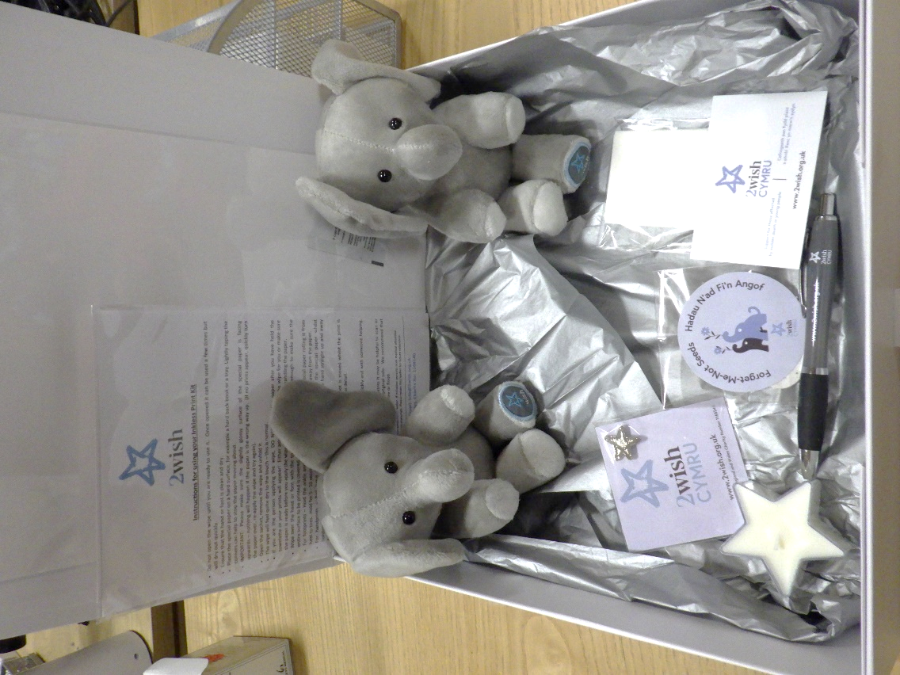
Memory making
Mortuary & CAD teams work closely with 2 Wish
(Welsh Bereavement Support Charity supporting sudden, unexpected loss - 25 years of age and under)

Slide 10
Ongoing Care with Dignity: Mortuary staff support the final journey
When the time comes for the deceased to be released into the care of a nominated Funeral Director, a formal handover process is conducted.
During this handover:
  Mortuary staff and the funeral representative work together to verify the identity of the deceased.
  The condition of the deceased is also reviewed and confirmed
  The Funeral Director is invited to acknowledge and confirm the condition of the deceased prior to release from the hospital mortuary.
This process ensures:
  Transparency in the transfer of care
  Accountability between hospital and funeral services
  Continued, respectful care as the deceased leaves the hospital setting

Slide 11
Why Getting it Right Matters:
The Lasting Impact of Our Work…..

Slide 12


Slide 13
Why Getting it Right Matters:
“I want you to know you do a great job, you helped me enormously. Keep doing what you do, how you do it, it’s important!” | “I can’t thank you all enough for everything. I will remember your kindness and comforting words forever.”
“Thank you all for what you’ve all done in looking after our mammy! | “Thank you to everyone, you really made everything a lot easier to deal with.”

Slide 14
Thank you for listening
If you would like any further information, please do not hesitate to contact us.

