Slide 1
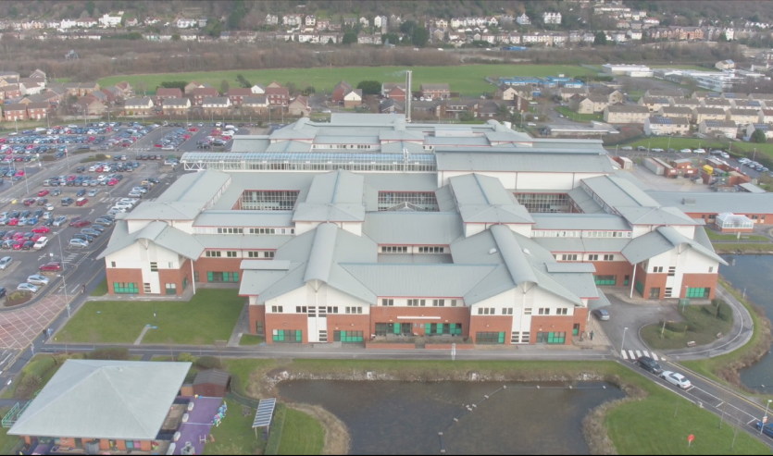
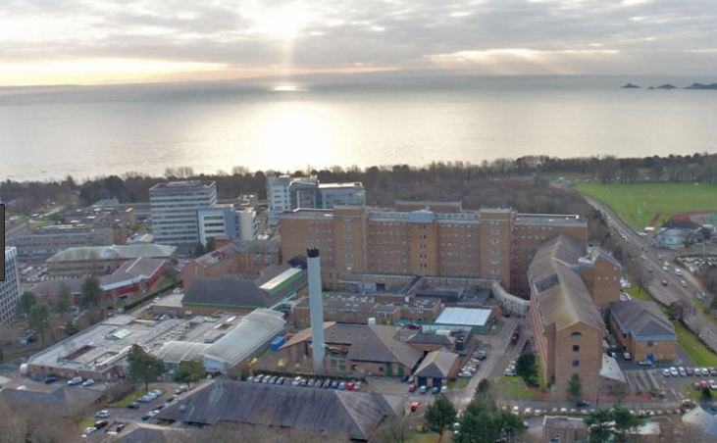
Health Care Acquired Infections
Improvement plan
Neath Port Talbot & Singleton Service Group
2023 - 2024

Slide 2

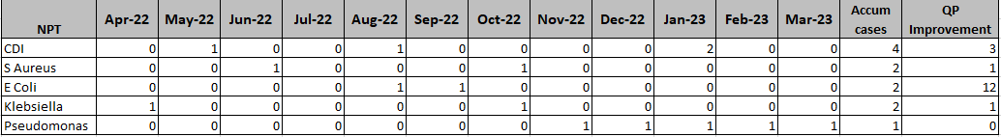

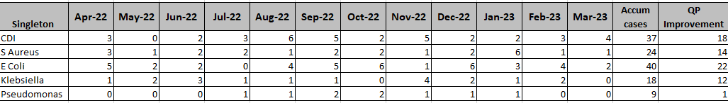
2022 / 2023 Position
Infection Prevention and Control – 22/23 against Tier 1 Targets
Clostridium Difficile
Both Hospital sites have exceeded the improvement goal for 22/23 there has been an improved performance with C-Difficile infections from the previous year with Singleton reporting a 8% improvement from 21/22 and Neath Port Talbot 20%.
Staph Aureus Bacteraemia
The Group has exceeded its QP reduction goal with a total cases of 14 at Singleton and 2 at Neath Port Talbot at year end
There has been am 8% improvement from 21/22 at Singleton and whilst NPT is reporting a 100% increase this relates to only 2 cases in total.
E Coli Bacteraemia
There have been notable improvement in terms of E-Coli Bacteraemia at Neath Port Talbot Hospital with an 87% improvement from 21/22
Pseudomonas
There has been a significant increase in cases of Pseudomonas bacteraemia within Singleton Hospital, work has been done with the estates team due to high levels of pseudomonas reported in water testing.
Slide 2

Slide 3
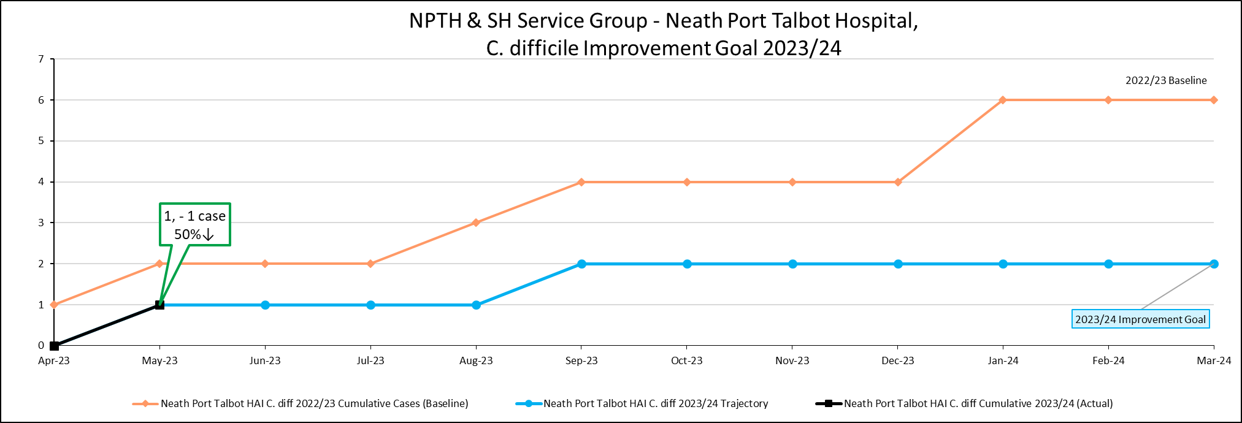
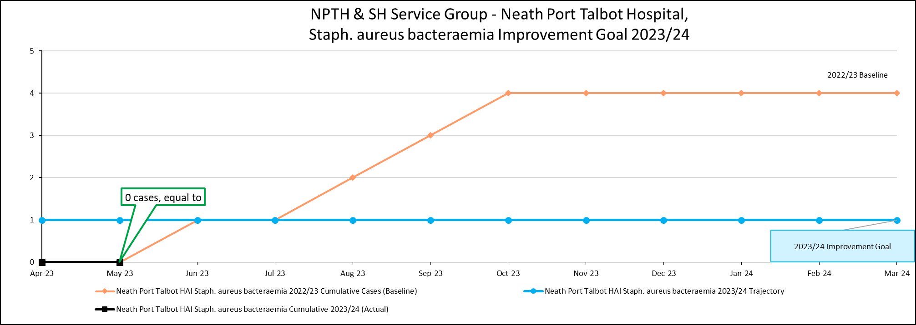
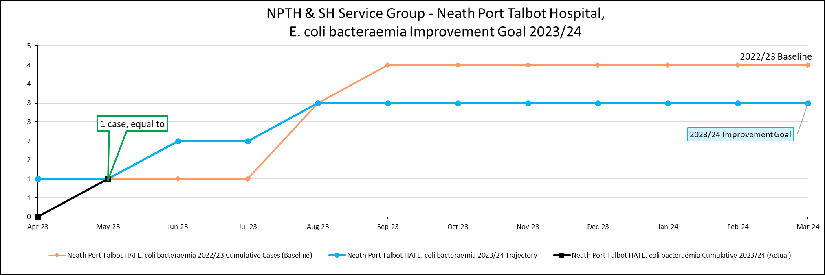
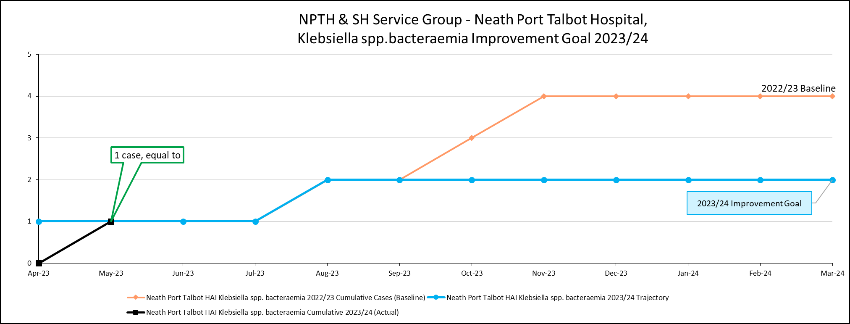
Infection Prevention and Control – Current Position
NPTH
Whilst NPTH is on its improvement target trajectory Ward D has had incidence of E-Coli and Klebsiella bacteraemia.
The ward has been escalated as a “hot spot” and focused review is underway

Slide 4
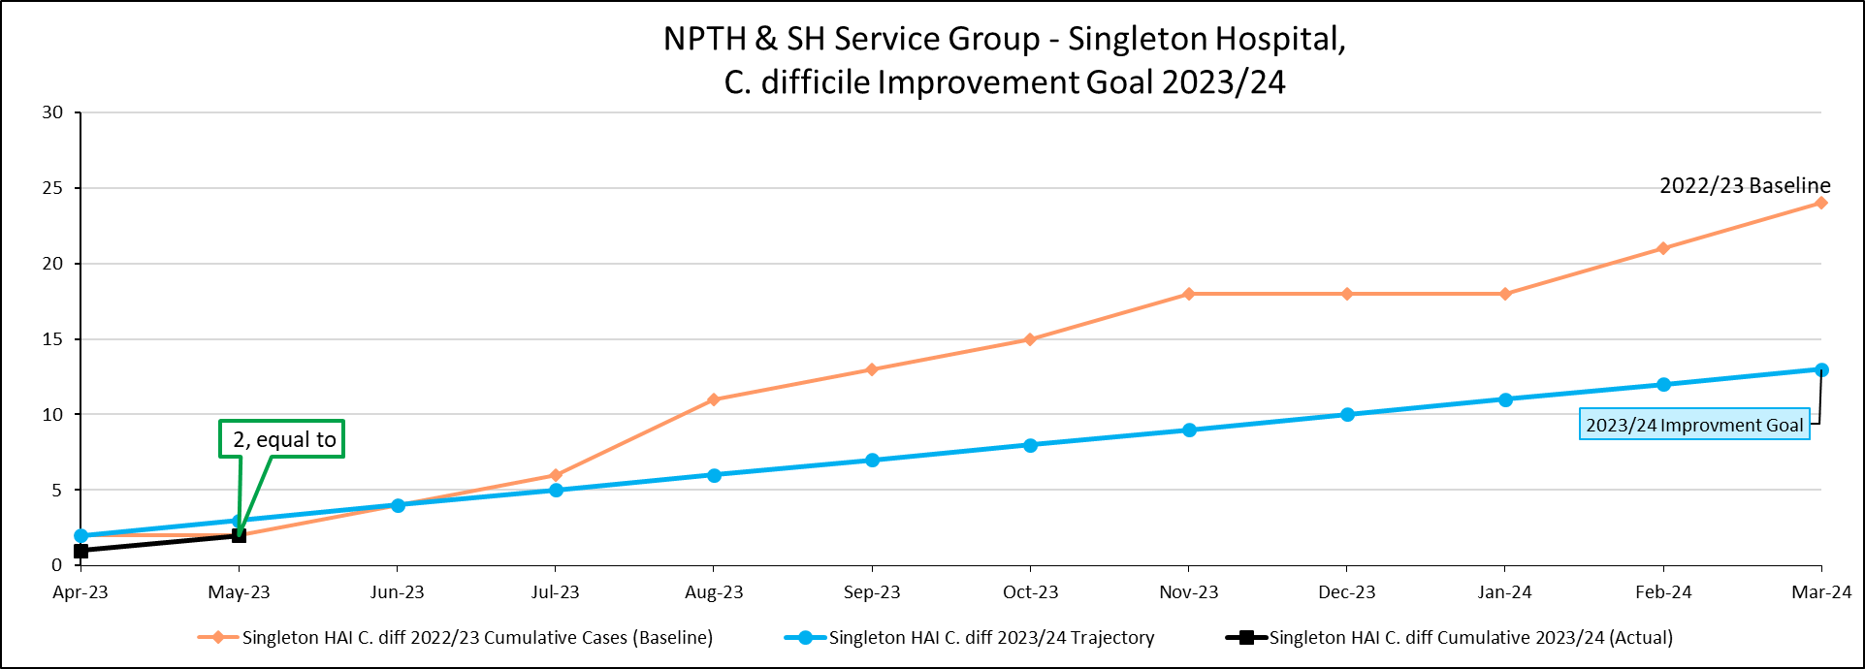
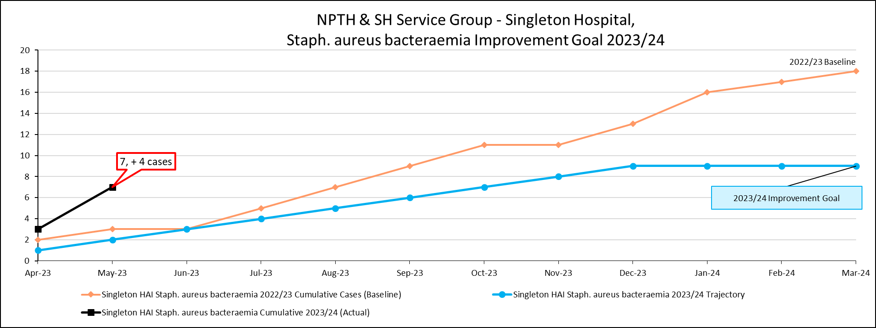
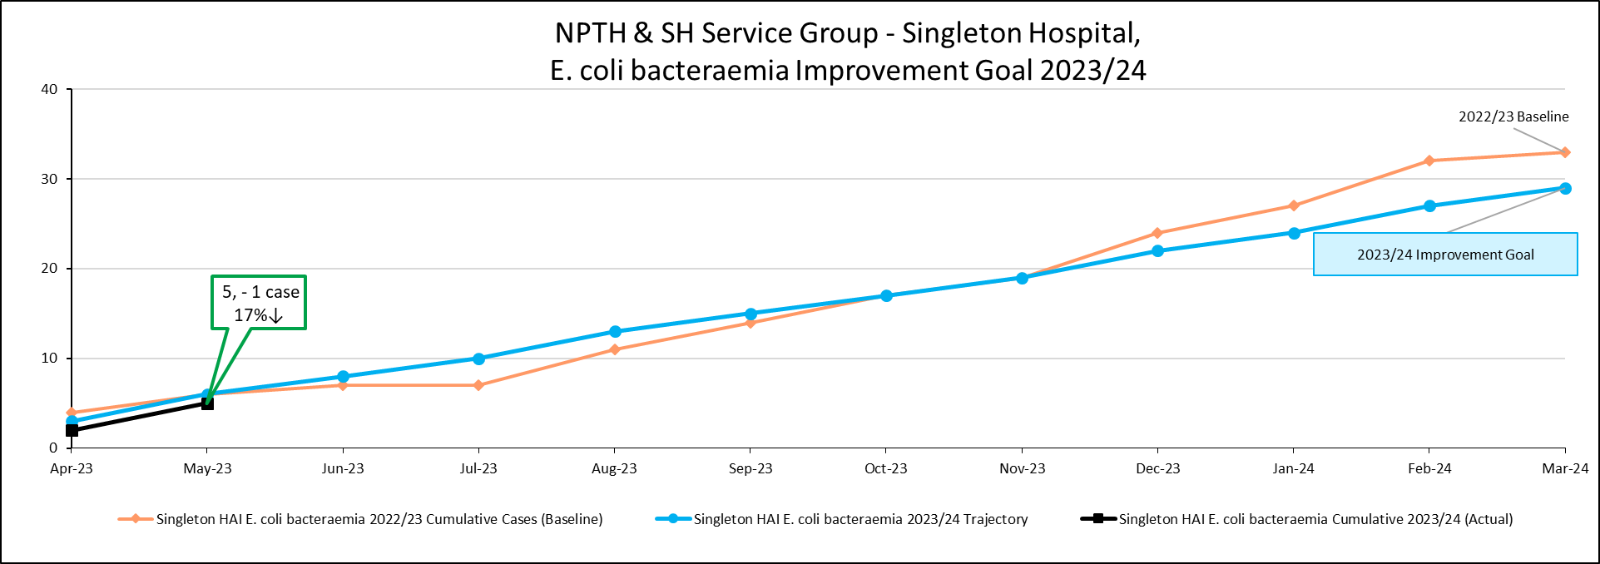
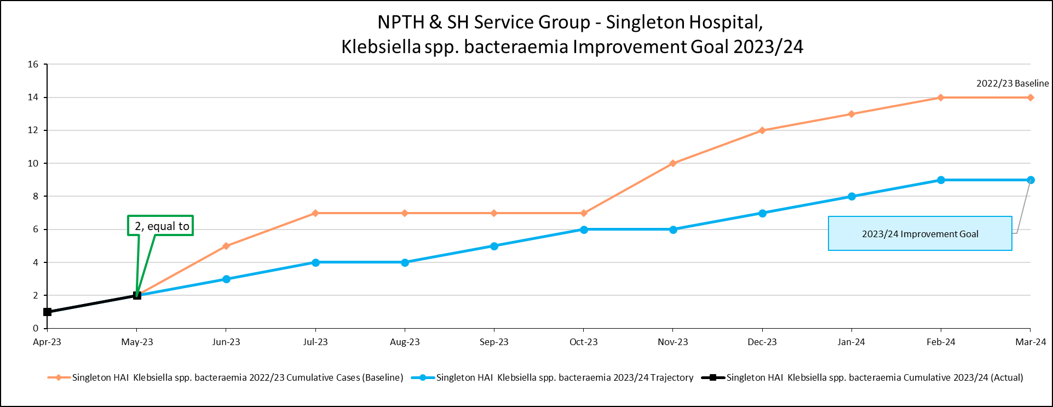
Infection Prevention and Control – Current Position
Singleton
The group is already over it’s improvement trajectory for Staph aureus bacteraemia, with 2 cases on NICU and cases on Ward 12, Chemo Day Unit and Ward 8. Cancer Services has had special measures introduced as an area of concern and director led scrutiny implemented as a result

Slide 5
HCAI Improvement Plan
Improvement Plan workshop held 1st June 2023 to develop and support robust clinical leadership
Multi-professional Attendance at the workshop
Representation from Adult, Childrens and Maternity Services – Service Wide agreement and engagement
Incomplete actions from 21/22 to be carried forward
Divisional tabs have been added to the plan to support divisional ownership and accountability – the overarching plan has been drafted, divisions are working through their individual plans, with excellent engagement from all divisional teams.
Confirm and refresh of Service Group and Divisions Governance structures
This improvement plan is in draft format and will be confirmed in a further workshop and approved through the Service Group Governance Structures
Agreement and sign up to development of Divisional plans, monitored and updated live at local IPC meetings

Slide 6


HCAI Improvement Plan – Culture, Leadership and Governance
Workshop agreed areas for improvement and schemes
Collaboration and engagement across the professional groups
Divisional accountability for improvements
Further Workshop to be held to agree and progress the improvement plan
Exploration of training around leading for improvement for all professional groups
Collaboration and engagement across the professional groups
Adopt a system of reward and recognition to support delivery of the improvement

Slide 7

HCAI Improvement Plan – Focus on Key Infections and Improvement Projects
WG Targets monitored and reported monthly
Ward performance monitored and displayed with improvement goals
IPC Mandatory training to be reported with local stretch targets set

Slide 8

HCAI Improvement Plan
Continue to develop improvements from 22 / 23
Continue with Decontamination improvements, building and improving governance

Slide 9
Infection Prevention and Control – Training Figures
 | May 2022 | June 2023
NHS|CSTF|Infection Prevention and Control - Level 2 - 1 Year| | 37.18% | 24.48%
NHS|CSTF|Infection Prevention and Control - Level 1 - 3 Years| | 84.16% | 88.01%
NHS|MAND|Aseptic Non Touch Technique - 3 Years| | 22.58% | 18.90%
NHS|MAND|Hand Hygiene - 1 Year| | 15.29% | 11.12%
Performance with mandatory training has dropped in all areas since the last reporting period.
Level 1 training across most ward areas is in excess of 90%, there have been some reduction in performance
However, this data is for all staff groups, further work to be completed to establish true baseline of relevant staff compliance for each training module.
ESR data not reflective of locally held records. Validation work by Divisions on going.

Slide 10
Thank you
Slide 10

