Slide 1
RIF Evaluation and Review Process for 2023-24

Slide 2
Overview of RIF Funding
Future Funding: Regional Integration Fund | Allocations 23-24
Regional Infrastructure | £ 750,000
Acceleration AND Embedding | £ 15,647,860
 | £ 16,397,860
National Fund:
Memory Assessment (Ring fenced) | £ 381,000
Dementia (Ring fenced) | £ 1,175,000
IAS (ring fenced) | £ 398,000
WG carers | £ 129,000
Carers Trust | £ 168,460
Total National Fund | £ 2,251,460
Total Allocations in Future Fund 22-23 onwards | £ 18,649,320

Slide 3
RIF Evaluation – Year 2 Acceleration Schemes
RIF funded schemes in year 2 acceleration due formal evaluation to decide whether scheme is moved into embedding stage
Summary of year 2 schemes:

Slide 4
RIF Evaluation – Year 2 Acceleration Schemes
Evaluation Template includes the following sections:
  Summary of Evaluation Review
  Project overview
  Finance
  Story of Change template (narrative)
  Performance / Impact: RBA Measures
All RIF schemes are reviewed to ensure alignment with strategic priorities included in Area Plan / Action Plan, themes within strategies (if available) and national models of care
Example of evaluation template here:

Slide 5
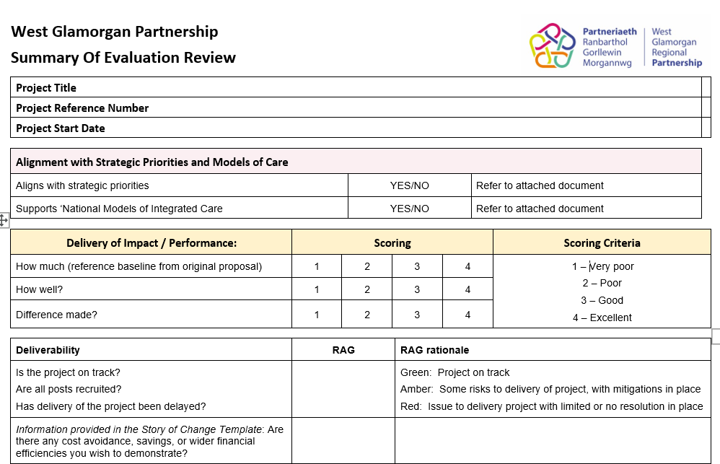
Summary of Evaluation Review

Slide 6
Challenges
Baseline data for how well and difference made measures lost through streamlining measures
Story of change templates includes narrative
No limit on text – lengthy documents
Guidance for story of change template not yet developed but available for qtr 4
Significant task to review information
Tight timescales
Options for completion of summary of review evaluation (Wglam provide draft scoring to aid facilitation?)
Lack of expertise in small third sector organisations to complete story of change templates
Notes:
Option:
TMs to draft scores
Board / panel members to score

Slide 7
S33 Intermediate Care Services Funding
Total Funding £8,842,606
Unable to evaluate a proportion of funding under year 2 given it is part of wider system
Plan to produce one story of change template and performance data for S33 for Intermediate Care Services
Governance is through regional JPB and then C&OP Board
Notes:
Some disparities between Swansea and NPT in terms of what is included in the S33

Slide 8
Review of Quarter 2: Year 1, 3 and 4 Schemes
All RIF schemes only funded until March 2024
Quarter 2 Returns for RIF schemes in year 1, year 3 and year 4 to be reviewed to approve continuation of funding in 24-25

Slide 9
Review of Quarter 2
Quarter 2 Returns reviewed and RAG rated based on:
  Performance / Impact
  Finance
  Deliverability
Light touch approach
Identify any schemes that do not align with strategic priorities and MOC
TM/PMs review and RAG rate all schemes
Boards / panels will review:
  any scheme not aligned with priorities
  schemes with amber and red RAG and further information can be requested by Boards

Slide 10
Future Review of RIF Schemes
Under RIF model a scheme is moved to embedding phase (once agreed) with view to mainstream at end of funding period (or sooner)
Approach in West Glam will need to be different
Not guaranteed that schemes currently under embedding will be mainstreamed
Once strategies are completed, all schemes will need to be evaluated to determine whether part of future model and whether delivering necessary impact
Timing for this will be vary for different programmes
Programme Boards will need to be responsible for this
Future planning will need to be focussed on pooled funds
Notes:
Communication will be key

Slide 11
RIF Evaluation & Review of Qtr 2 Timescales
Programme | Panel | Board / Extraordinary Board *
WB&LD | 18th October | 25th October
Dementia | 3rd November | 16th November
Mental Health | 8th November | 16th November
CYP | NA | 24th November *
Carers | NA | 29th November *
C&OP | Regional JPB – 24th October Third sector panel - TBC | 24th November
Establish extraordinary SAB meeting early December to formally approve Programme RIF schemes
RPB 12th December (not time to circulate papers in advance)
Notes:
ND Board – only 2 schemes. Trying to get date for Board
Panels make recommendations to the Boards and Boards approve the RIF schemes, with formal approval by SAB

Slide 12
Population Programme Boards
RIF Review Elements
Evaluation of Year 2 Schemes:
Consider recommendations from panel (if applicable)
Approve funding for schemes to move into year 3 embedding (24-25)
Review of Year 1, Year 3 and Year 4:
Consider recommendations from panel for amber or red schemes and agree actions in relation to any risks / issues.
Identify schemes that do not align with strategic priorities and MOC
Approve continuation of funding for schemes for 24-25
Programme Story of Change
Review and approve programme story of change report in order to submit to WG

