Slide 1
CSP Development
H&CSI
20th October 2025

Slide 2

Swansea Bay UHB Organisational Strategy 2025–2035
Our Organisational Strategy ‘A Healthier Swansea Bay’ was launched at the AGM on 9th September 2025.
It is now available to read on the internet :
A Healthier Swansea Bay - Swansea Bay University Health Board
The Welsh translation will be available by end of September and communications activities will be taking place throughout September-October e.g. Video summary, Exec presentations for Service groups, Bay Health.

Slide 3


Slide 4


Slide 5
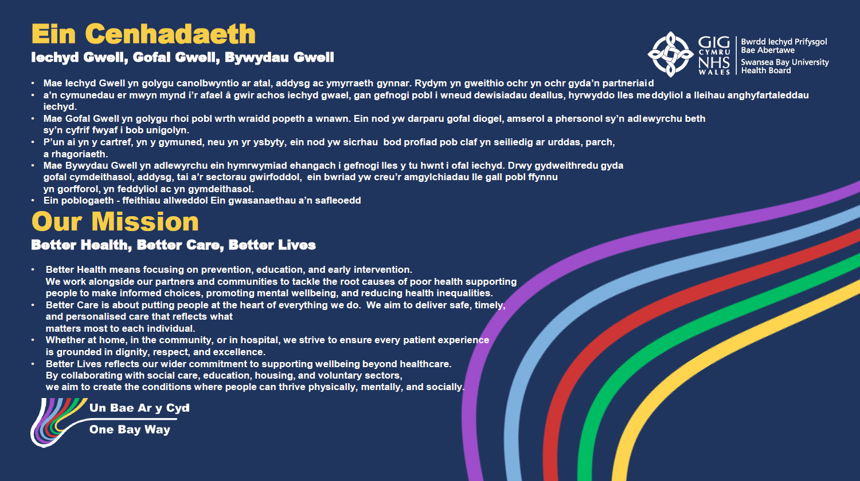

Slide 6
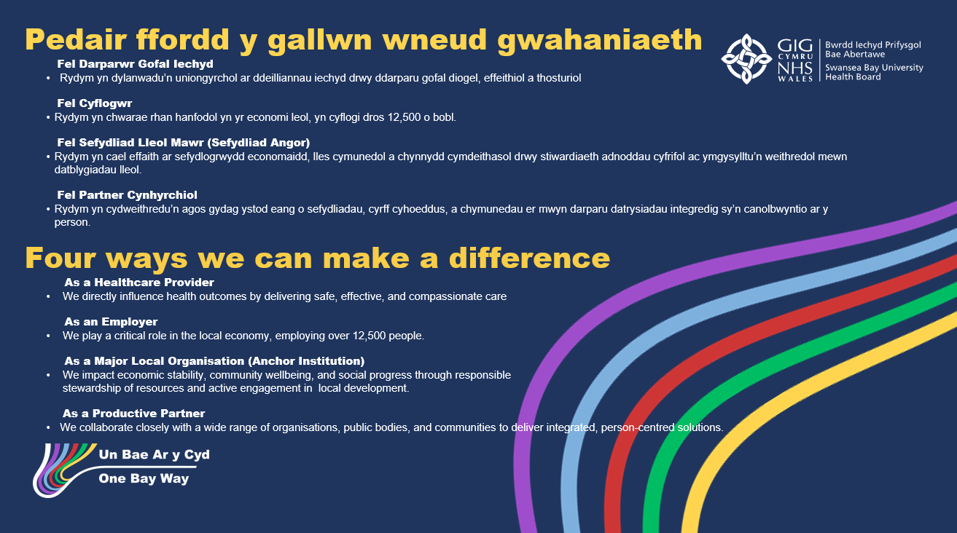

Slide 7


Slide 8


Slide 9


Slide 10


Slide 11


Slide 12
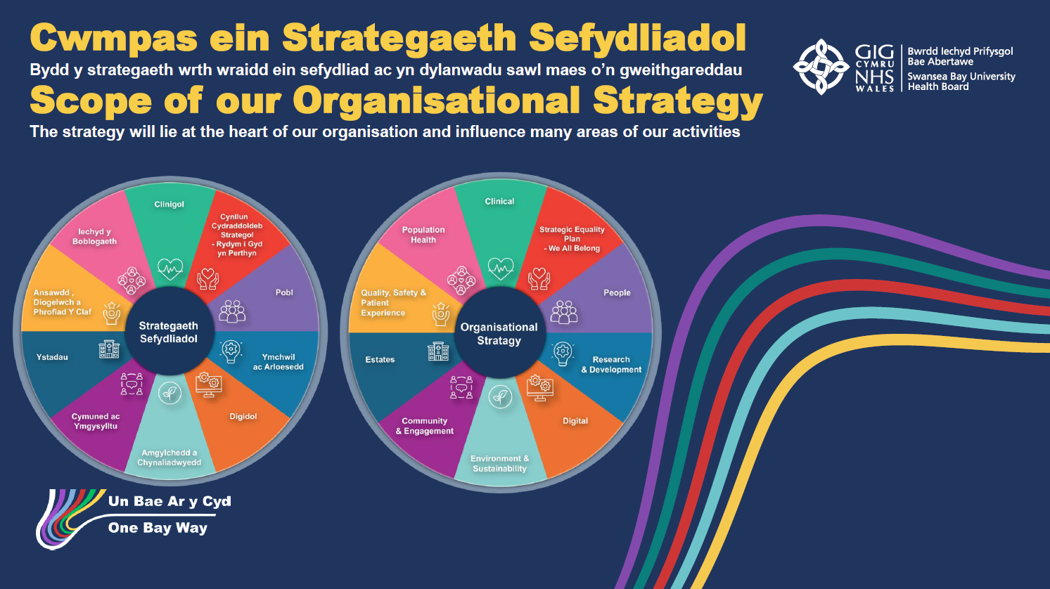

Slide 13
Where We Are
The Health Board’s Clinical Services Plan (CSP) 2019-2025 was extended for 12 months and comes to an end March 2026. An initial CSP assessment demonstrated that we have delivered on or progressed a number of the main commitments including:
  A clear focus on delivering on Networked Hospitals -, Integrated Clusters; Virtual Wards; Outpatient Modernisation; Stroke Early Supported Discharge and Acute Stroke Unit; Community Mental health and Emotional Wellbeing Strategy; Frailty; Surgical Services Remodelling.
A number of changes need to be considered and addressed through a refreshed CSP e.g. A Healthier Wales Refresh (2024), National clinical Framework (2021), Duty of Quality Statutory Guidance and Quality Standards (2023)
The Health Board has also seen significant changes in leadership and in the development of its strategic objectives and various strategies which have been brought together in the Organisational Strategy, being launched at the AGM 9th September 2025.
The Health Board is in Targeted Intervention for Finance, Strategy and Planning. The WG Escalation Framework sets out clear expectations for the Health Board to have in place an agreed clinical Strategy and development of Clinical Plans to lead future planning and investment decisions.

Slide 14
What is the Clinical Strategic Plan (And what Is It Not)
The Clinical Strategic Plan will provide an overall framework for the Health Board, giving high level context and principles and signalling what has already been done (as per previous CSP 2019-2024), what needs to be updated and what will be new for the next 10 years.
The Clinical Strategic Plan:
    Is a high-level road map aligning clinical priorities with the Organisational Strategy
    Focuses on long-term goals, vision and direction for clinical services
    Guides decision-making, investment and partnerships across the health system
    Defines priorities
The Clinical Strategic Plan
    Not a detailed operational plan.
    Not focused on service capacity plans, workforce plans, or detailed estates plans.
    Not limited to one specialty or department.
The Clinical Strategic Plan will be supported by System and Condition specific Clinical Service Plans
Aspect | Clinical Strategic Plan | Clinical Services Plan
Purpose | Sets long-term vision and strategic priorities for services | Defines what services will be provided, where, and how
Scope | System-wide, cross-service, high-level direction | Service-specific, detailed, operational configuration
Focus | Quality, safety, integration, innovation, partnerships | Models of care, workforce, infrastructure, service locations
Time Horizon | 5–10 years (broad direction) | 3 years (tactical planning)
Output | Strategic priorities and guiding framework | Service delivery models, resource allocation, and capacity planning
What it is not | Not an operational or staffing plan | Not about system-wide strategic vision

Slide 15
The Clinical Strategic Plan
The Clinical Strategic plan will include:
Context and Drivers
  ‘State of the Population’ Report
  Horizon Scan Report
  Demand and Capacity Overview
  Infrastructure Challenges

Slide 16
The Clinical Strategic Plan
What we know about our population
Implications of demographic changes for clinical services
Implications of health inequalities on demand for clinical services
Implications of changes in health needs for clinical services
Context and Drivers
  ‘State of the Population’ Report
  Horizon Scan Report
  Demand and Capacity Overview
  Infrastructure Challenges

Slide 17
The Clinical Strategic Plan
Political & Financial
Demographics
Inequality
Workforce
Ways of Working and Organisational Culture
Digital Technologies
Artificial Intelligence
System Approaches
Patient and Public Contract
Climate Change
Adaption
Context and Drivers
  ‘State of the Population’ Report
  Horizon Scan Report
  Demand and Capacity Overview
  Infrastructure Challenges

Slide 18
The Clinical Strategic Plan
Current Demand Profile
Service demand patterns
Capacity Overview
Demand vs Capacity Analysis
Forecasts and Projections
Strategic Implications
Context and Drivers
  ‘State of the Population’ Report
  Horizon Scan Report
  Demand and Capacity Overview
  Infrastructure Challenges

Slide 19
The Clinical Strategic Plan
Estate Profile
Key Challenges
Emerging Opportunities
Strategic Implications
Context and Drivers
  ‘State of the Population’ Report
  Horizon Scan Report
  Demand and Capacity Overview
  Infrastructure Challenges

Slide 20
The Clinical Strategic Plan
The Clinical Strategic plan will include:
  Context and Drivers – ‘State of the Population’ Report, Horizon Scan Report, Demand and Capacity Overview, Infrastructure Challenges
  Quality Statement of Care and Services – Building on established work and evidence this will set out what people can expect from the health board, NHS and care partners at each level of care
Integrated Community Care
Regional Services
Networked Hospitals
Universal
Prevention, wellbeing and self-care
Routine Support
Coordinated and proactive care
Targeted Care
Complex care closer to home
Enhanced Care
Short-term crisis/intensive support
Acute Hospital Care
Planned Hospital Care
Tertiary and Specialist Care
Strategic Future Models of Care – Description of future direction of care delivery across the health board area, ensuring services are designed to meet people’s rightful expectations at every level, while making best use of resources, skills, and technology. To include: Service model description; Key features of the future model, Intended outcomes; Enablers
This approach will support the Welsh Governments plans to accelerate progress with the delivery of integrated health services for and in communities and the national Transformation Programme being established

Slide 21

Level 1 - Universal
Who is this:
A Level 1 patient is any person in the population who may need access to general, everyday healthcare services in the community.
This includes people who are:
Generally well or managing their own health
Accessing healthcare occasionally, e.g. for minor illnesses or advice
Using GP practices, pharmacies, NHS 111, dental or optometry services
Attending routine check-ups, screening, and vaccinations
Seeking preventative care or health information
They do not have complex or high-risk needs, and do not require specialist or intensive support.
They are simply using the NHS at a universal, “first contact” level.

Slide 22
Description– Level 1 | Reference
To easily contact my GP practice and get a same-day or next-day response. | Older People’s Commissioner for Wales (2024) Access to GP Practices in Wales: July 2024 Update Report.
To be offered GP practice appointments within a reasonable timeframe (days/weeks, not months). | Older People’s Commissioner for Wales (2024) Access to GP Practices in Wales: Older People’s Experiences.
To have clear information on how to access my GP (telephone, online, in person). | Welsh Government (2019) Cabinet Committee on North Wales Paper – 6 June 2019.
To have easy access to clinical advice, support, and treatment for minor urgent issues. | Welsh Government (2023) Six Goals for Urgent and Emergency Care.
To receive respectful, person-centred care and be treated as an individual. | Welsh Government (2023) Duty of Quality Statutory Guidance.
To see the same or a small number of clinicians for ongoing issues (continuity) | Kings Fund (2010) Inquiry into the quality of general practice: continuity of care
To have tests (e.g. bloods, imaging) arranged promptly and results communicated without delay. | Welsh Government (2025) Planned Care Waiting Times Guidance.
To receive care that follows evidence-based guidelines (e.g. NICE) | NICE (2025) About our Guidance
To be referred to specialist services when needed, with clear information on waiting times | Welsh Government (2025) Planned Care Waiting Times Guidance.
To receive clear, jargon-free explanations and be involved in decisions about my care. | Welsh Government (n.d.) New Deal to Improve Access to NHS Care and Cut Waiting Times.
To be proactively invited for vaccinations, screening, and long-term condition reviews in a way that is convenient to me. | Welsh Government (2021) A Healthier Wales: Our Plan for Health and Social Care.
To have fair and equitable access to services, with adjustments if I have additional needs. | Older People’s Commissioner for Wales (2024) Access to GP Practices in Wales: July 2024 Update Report.
To be informed promptly if appointments are cancelled and offered a convenient alternative. | Welsh Government (n.d.) New Deal to Improve Access to NHS Care and Cut Waiting Times.
To be able to give feedback or make a complaint and receive a response. | Welsh Government (2023) Duty of Quality Statutory Guidance.
To see public reporting of waiting times and service performance. | Welsh Government (2025) NHS Activity and Performance Summary.
- Core Principle

Slide 23
Governance and Next Steps
CSP Executive Group established to oversee the process, ensuring all products and outputs are managed in line with timelines above – with the ambitious aim of having approved products signed off by Board in January 2026.
Draft Outline Framework developed supported by CSP Exec Group, August 2025.
Next steps to test with clinical and managerial leaders across the organisation, using our existing forums and groups to engage on if this is the right way to frame the CSP and ideas on the key themes/ priorities for the CSP to focus on.
Aug | Sept | Oct | Nov | Dec | Jan | Feb | Mar
Phase 1: Setting the Direction
State of The population Report Completed
 | Develop Integrated Needs Assessment process
Horizon Scan Report completed
Draft Approach & Framework
 | Communicate & Engage on Approach and Framework
 | Data collection and Draft Opportunities and Challenges and Quality Statement Sections
 |  | Agree Approach to Strategic Models of Care
 |  | Develop Strategic Models of Care and test through engagement
 |  | Writing final Product

