Slide 1
Annex 1
Detail Financial Position
Month 6 FY 2026/27

Slide 2

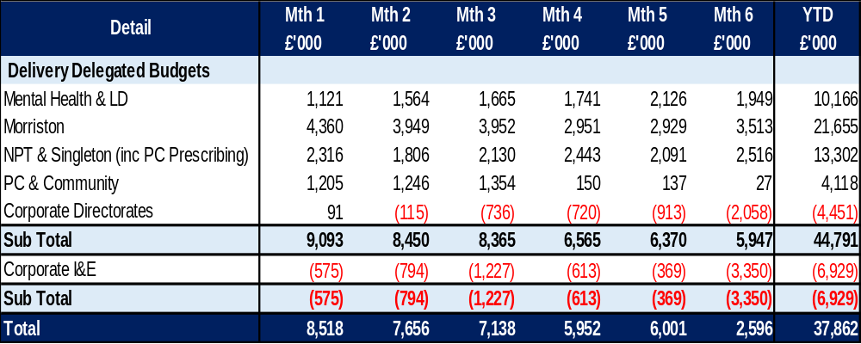
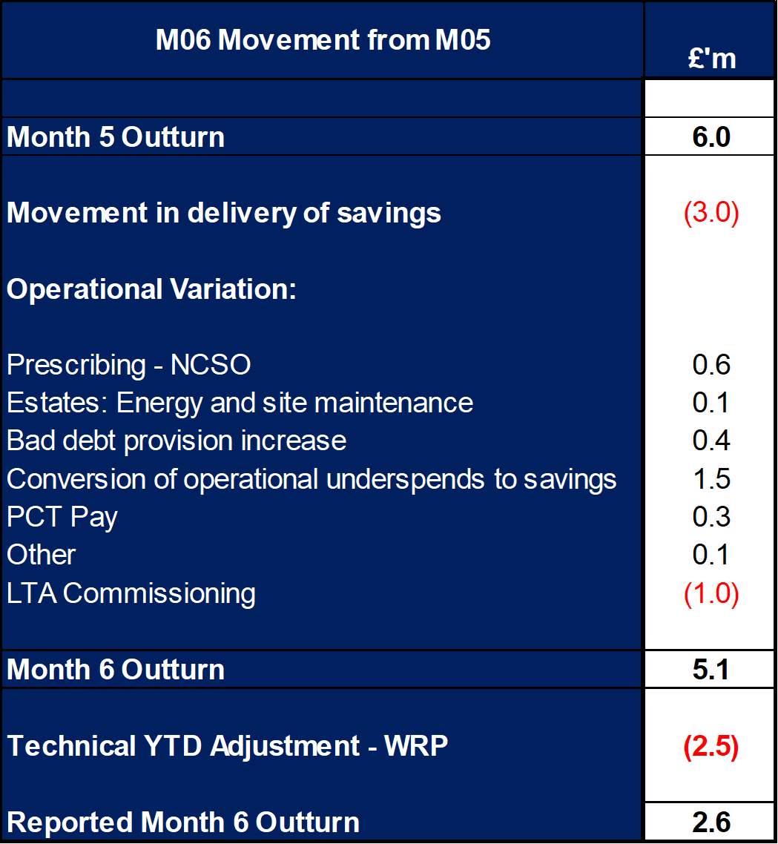
Financial Summary
In-Month Variance
£2.596m
Variance to Plan £(1.3)m
YTD Variance
£37.862m
Variance to Plan £2.0m
Executive Summary
Income and Expenditure Insights
Operational and Financial Performance
Appendices
Key Information
WRP for noting: WRP adjustment was transacted in Month 6 and is reflected as the negative £2.5m in the table opposite. This is an in-month adjustment which does not impact on the financial performance of the HB YTD.
Key Information
Operational Variation. The following operational variation between Month 5 and 6 has been incurred: Prescribing NCSO : There was an in-month increase in prescribing costs relating to both no cheaper stock available (NCSO) and growth. Estates: There was a one-off re-billing of energy costs in month along with ad-hoc maintenance expenditure. Bad Debt provision: There was an adverse movement to the HB bad debt provision. Conversion of operational underspends in savings: A review of operational underspends has commenced and resulted in the identification of £1.5m YTD that can be converted to savings. The estimated full year effect of this is £3m. PCT Pay: Worsened by £0.3m in month across several services but SG remained balance in month. LTA Commissioning: there has been a YTD improvement in the position based on receipt of the latest activity data from CTM and risk share position received from JCC.

Slide 3
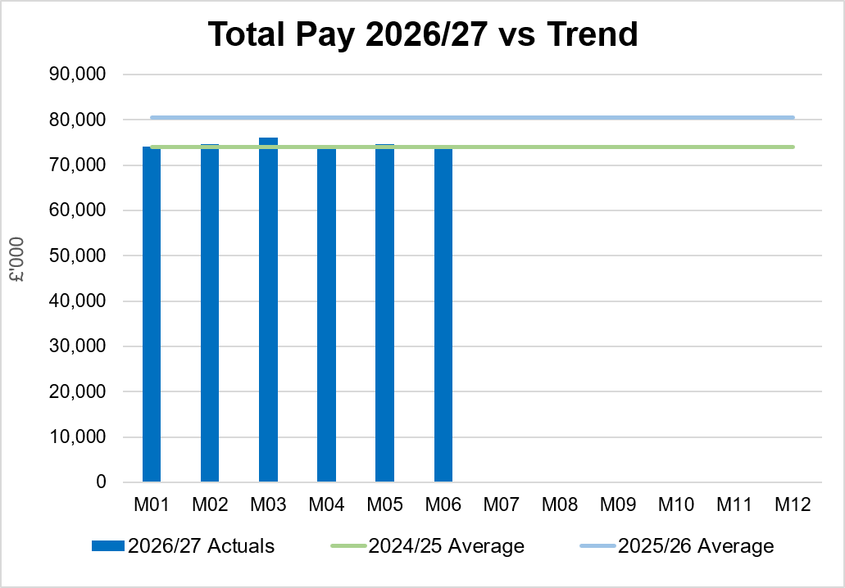
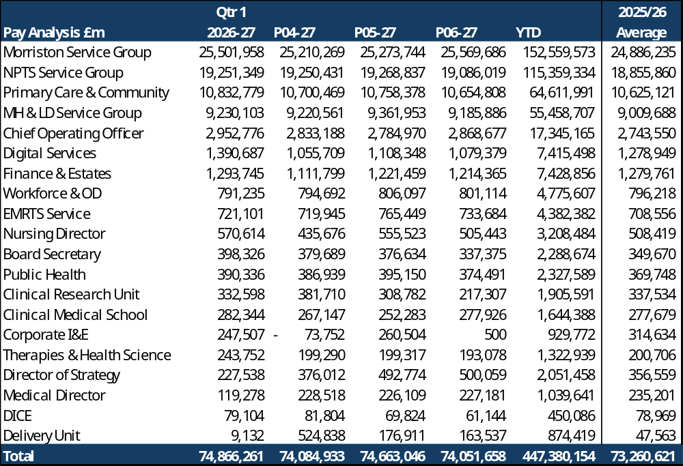
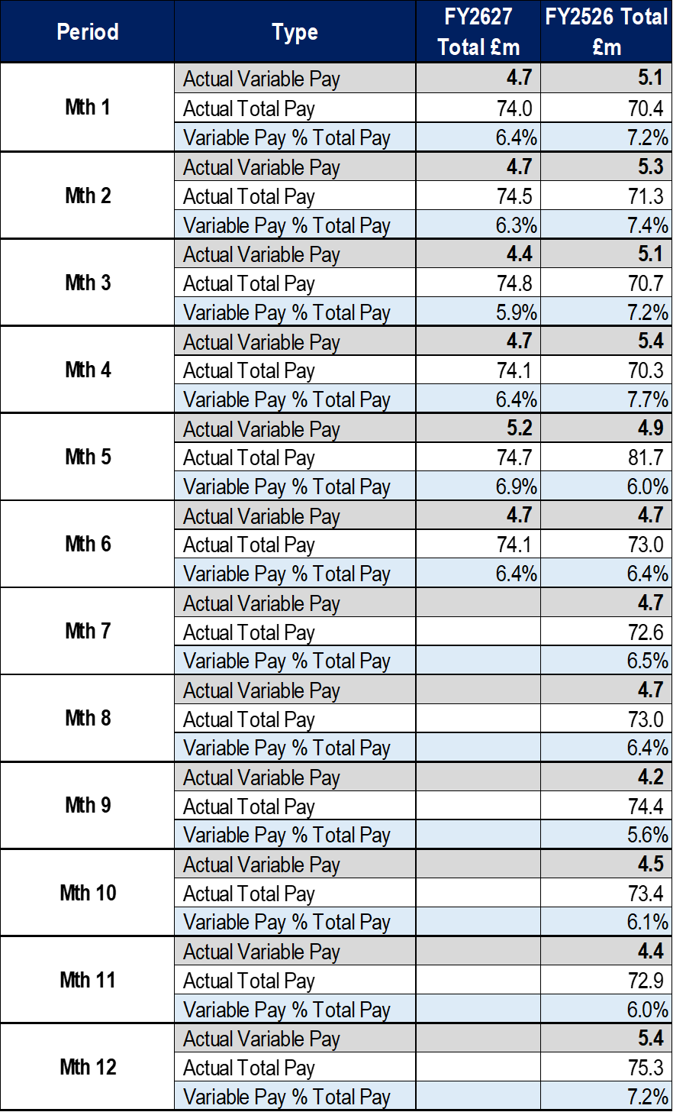
Total Pay Insights (1)
In-Month Actual
£74.052m
Variance to Ledger £0.82m
YTD Actual
£447.380m
Variance to Ledger £4.14m
Executive Summary
Income and Expenditure Insights
Operational and Financial Performance
Appendices
Key Information
Variable Pay expenditure reduced by £0.5m in Month 6, broadly returning to Month 4 levels of expenditure. Overall Month 6 pay was lower than Month 5 by £0.6m. The level of vacancies are partly offsetting the pressures in medical and dental and nursing linked to high levels of sickness absence and a continuation of staffing surge bed capacity. This is linked to the increased Grip & Control in place to oversee recruitment, an element has been converted into savings on a YTD basis in Month 6. Further work continues to assess the TRACs status of posts and work to formally remove vacancies.

Slide 4
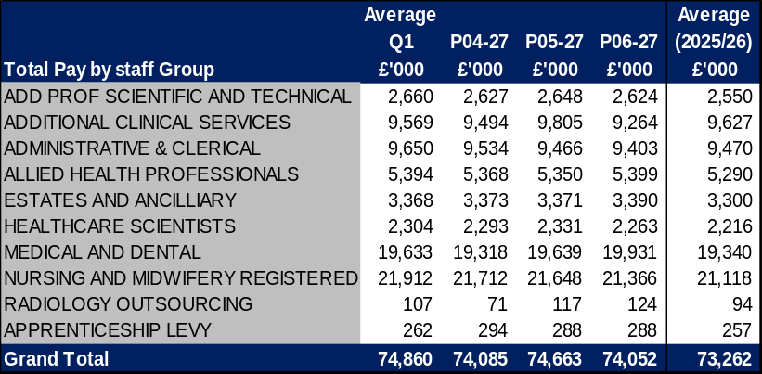
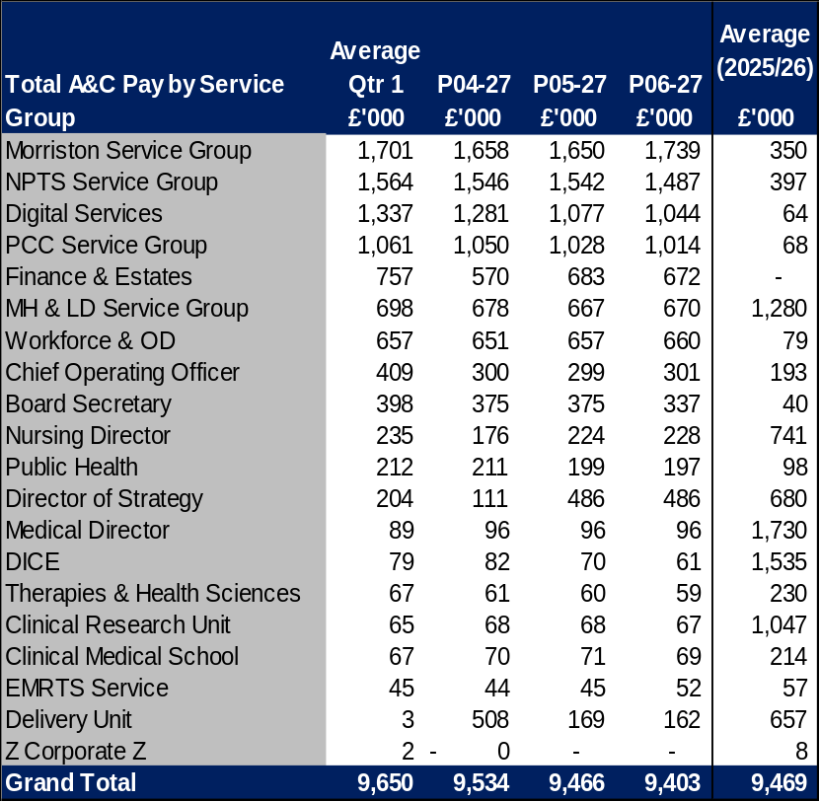
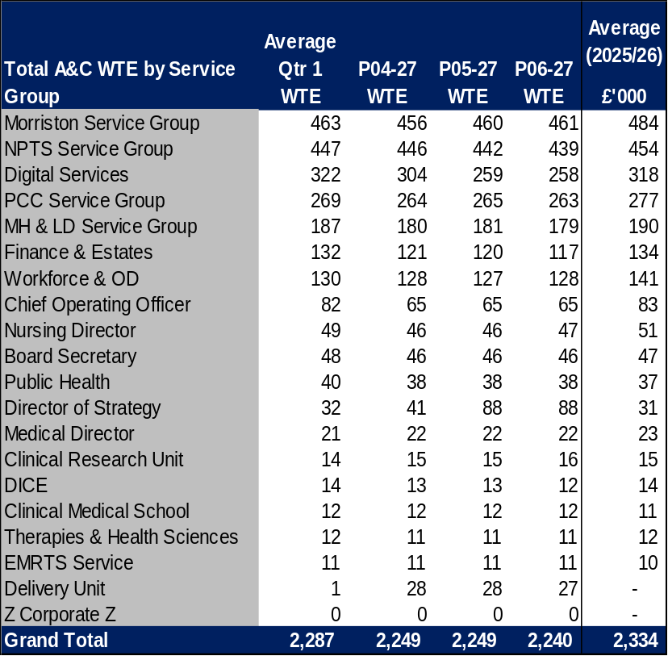
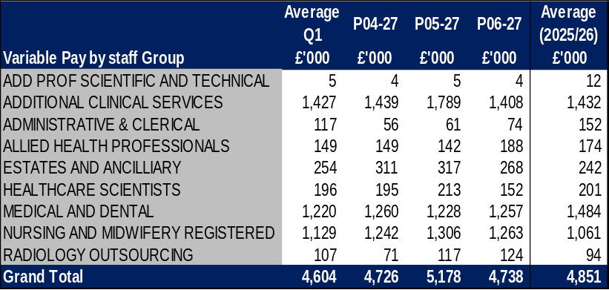
Total Pay Insights (2)
In-Month Actual
£74.052m
Variance to Ledger £0.82m
YTD Actual
£447.380m
Variance to Ledger £4.14m
Executive Summary
Income and Expenditure Insights
Operational and Financial Performance
Appendices
Actual Expenditure By Staff Group
Actual Expenditure & WTE For A&C Staff Group As Per Ledger
Key Information
Month 03 contains the YTD Medical and Dental 2026/27 pay award, total value = £7.1m or £0.6m per month (£1.2m arrears in Month 03) A4C Pay Award 2026/27 = £22.5m and paid from 1st April 2026. Average 2025/26 does not include 2026/27 Pay Award of 3.3% for A4C and 3.5% Medical & Dental. There was a YTD transfer in Month 4 into the Delivery Unit - the R&S team (from Finance), Performance team (from Finance), PMO (from COO), Healthcare systems engineering (COO) and Safety and Quality (from Nursing). In Month 05 the Information systems and clinical coding CC’s (Digital) moved into Strategy.

Slide 5
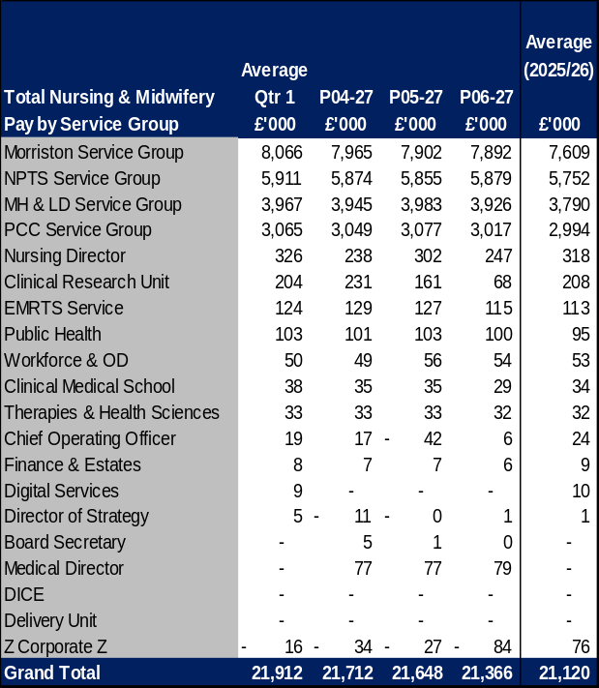

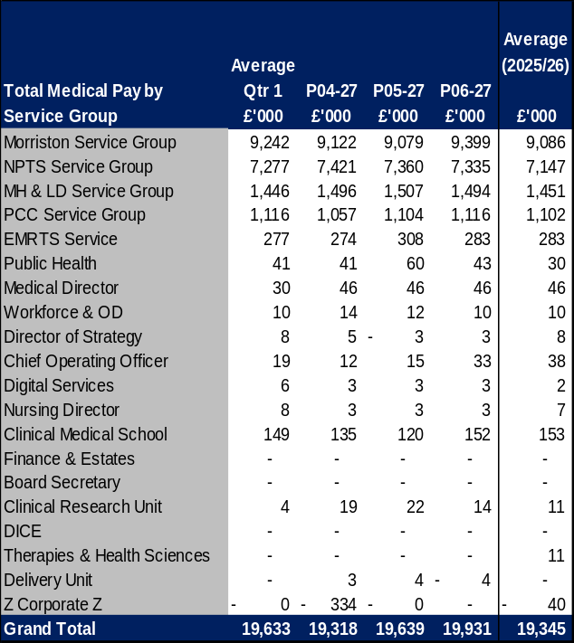
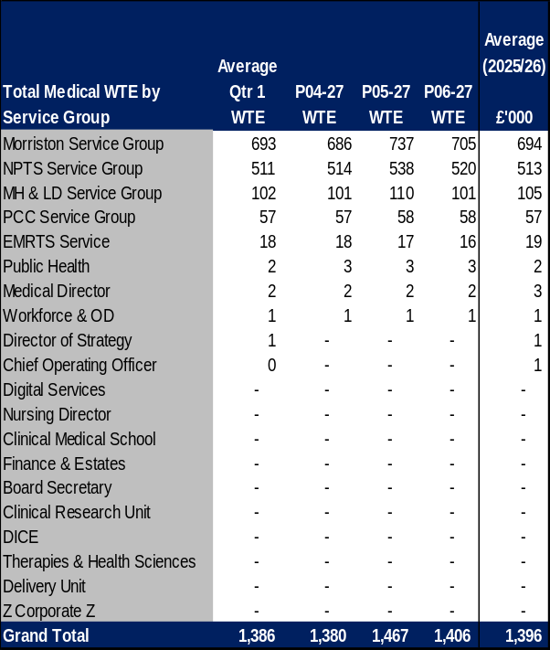
Total Pay Insights (3)
In-Month Actual
£74.052m
Variance to Ledger £0.82m
YTD Actual
£447.380m
Variance to Ledger £4.14m
Executive Summary
Income and Expenditure Insights
Operational and Financial Performance
Appendices
Actual Expenditure & WTE for Nursing & Midwifery By Staff Group As Per Ledger
Actual Expenditure & WTE for Medical & Dental By Staff Group As Per Ledger
Key Information
The above tables detail the total Nursing & Midwifery and Medical & Dental Pay and WTE by Service Area Month 03 contains the YTD medical and dental 2026/27 pay award, total value = £7.1m or £0.6m per month (£1.2m arrears in Month 03). A4C Pay Award 2026/27 = £22.5m and paid from 1st April 2026. Average 2025/26 does not include 2026/27 pay award of 3.3% for A4C and 3.5% Medical & Dental. Medical & Dental WTEs increased in Month 5, which is linked to the rotation of Single Lead Employer Resident Doctors in August, whilst it has dropped slightly in month 6 it has not quite returned to pre month 5 standard levels.

Slide 6
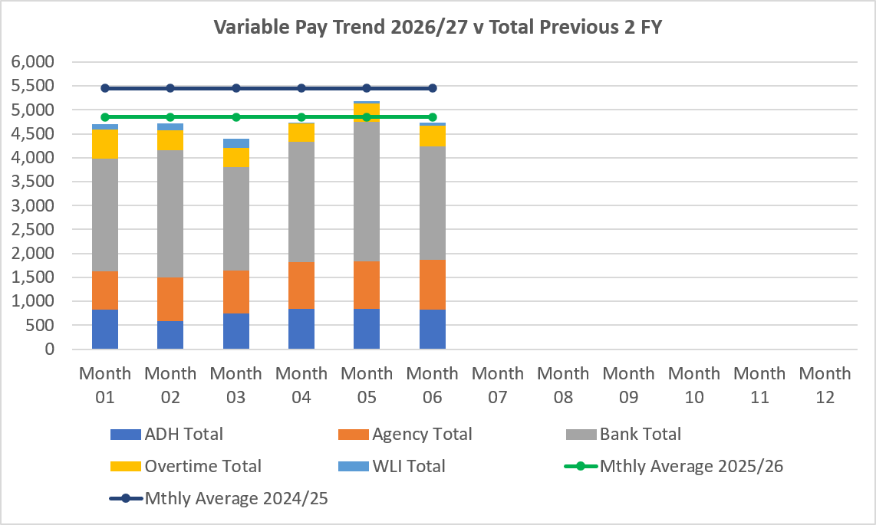
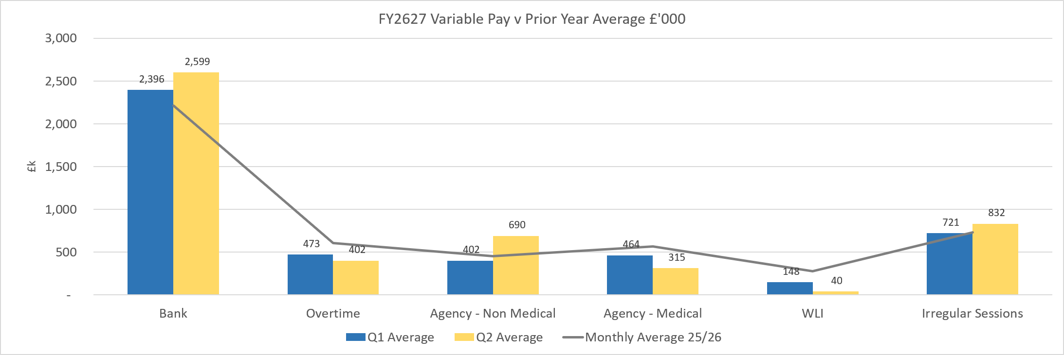
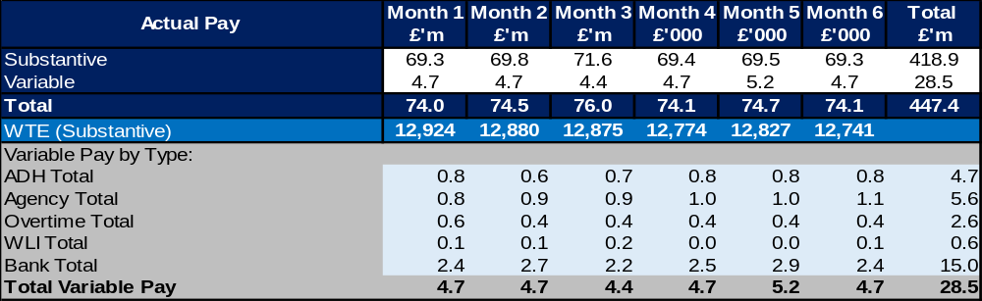
Variable Pay Insights
In-Month Actual
£4.738m
YTD Actual
£28.453m
Executive Summary
Income and Expenditure Insights
Operational and Financial Performance
Appendices
Key Information
The actual variable pay spend at Month 06 was £4.7m. Which is a reduction of £0.5m from Month 5 Bank and agency continue to be the key driver for this continued high spend, however bank spend decreased by £0.5m from Month 5 figures. The reliance on variable pay is still linked sickness, number of open beds and additional activity.

Slide 7
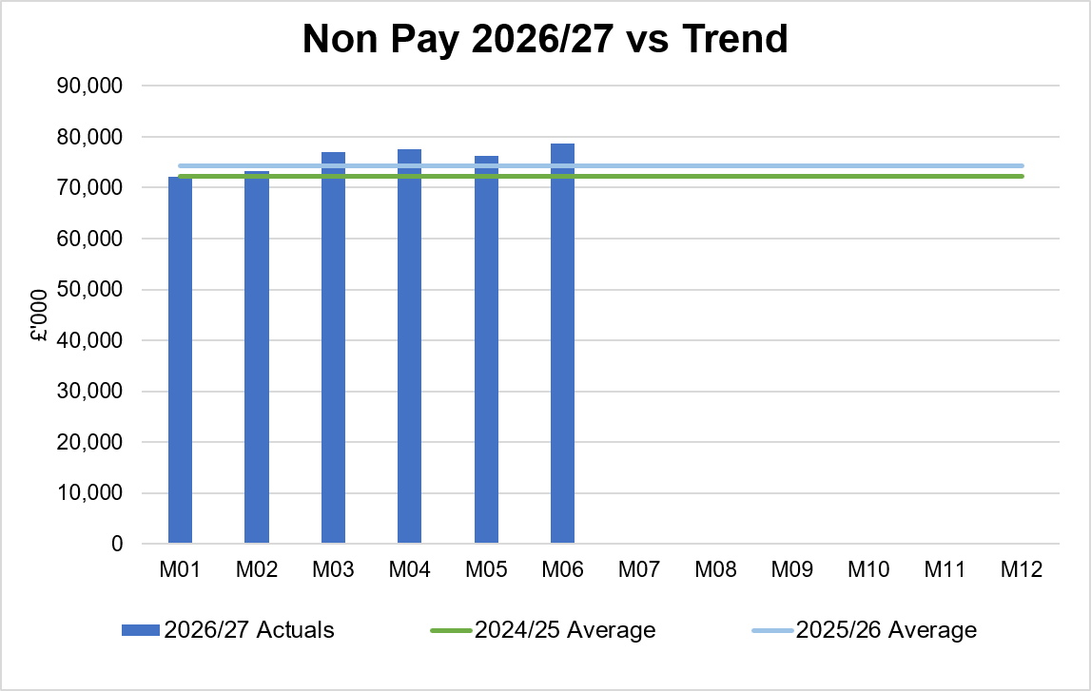
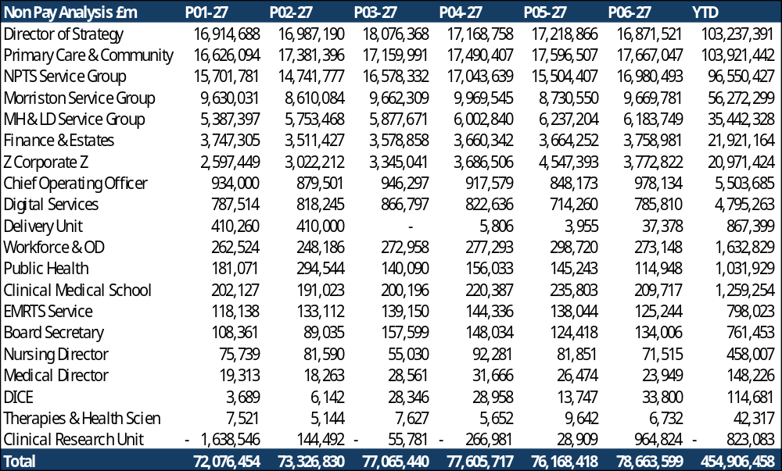
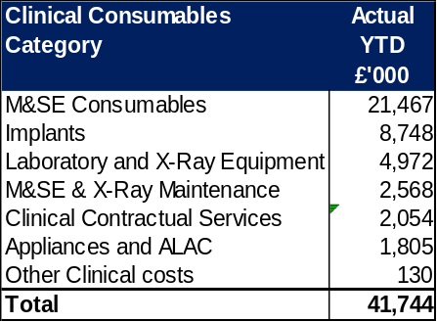
Non-Pay Insights
In-Month Actual
£78.664m
Variance to Ledger £2.8m
YTD Actual
£454.906m
Variance to Ledger £34.3m
Executive Summary
Income and Expenditure Insights
Operational and Financial Performance
Appendices
# includes saving non-delivery
Key Information
Key issue in Clinical Services & Supplies linked to M&SE (General Clinical consumables), bed contracts, additional costs linked to increased activity through improved productivity and transport costs for patient transfers. Within the ledger the gross Joint Commissioning Committee (JCC) income is reflected within the income lines and not netted off against expenditure and so overall the Health Board position is not adversely affected. If JCC activity increases the gross level of expenditure and income will increase. The main drivers within this category of clinical consumable expenditure include heart valves & pacemakers, linked to some JCC activity. Non-Pay also includes secondary care drugs; a breakdown of the categories of Clinical Consumables based on actual spend is provided in the table on the right. Prescribing is overspent by £0.9m in-month (Month 5, £0.4m) following receipt of the latest datasets (July 2026, PAR data is received 2 months in arrears); the overspend is partly driven by the No Cheaper Stock Obtainable (NCSO) position linked to global conflicts are affecting shipping routes which is adversely impacting on the availability of medicines and increasing prices of procurement due to additional delivery costs. Balance is linked to growth.

Slide 8
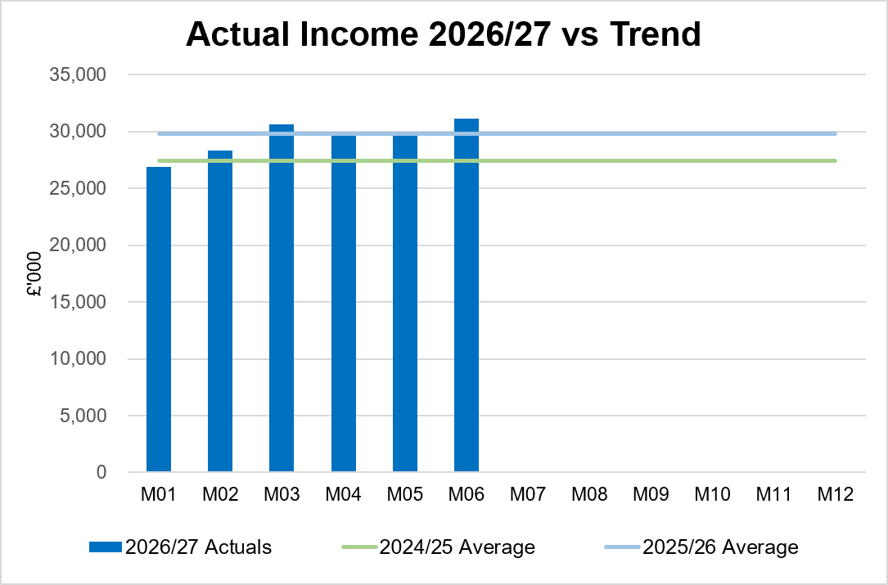
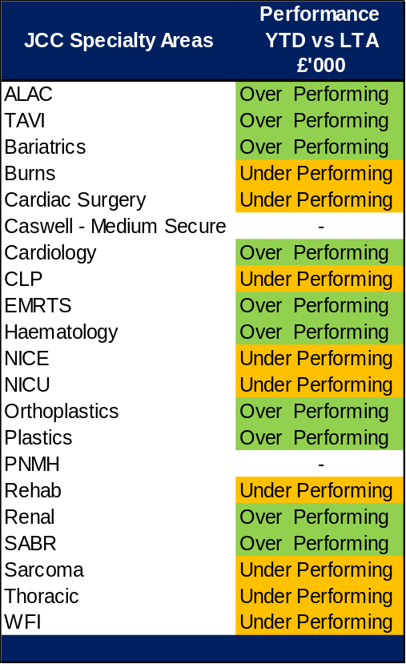
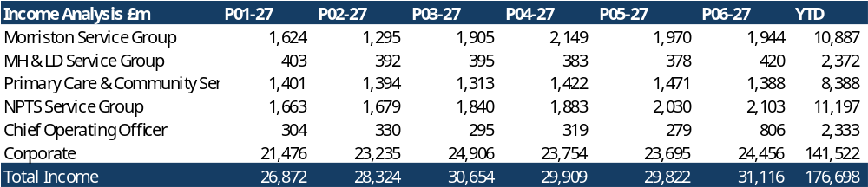
Income Insights
In-Month Actual
£31.116m
Variance to Ledger (£1.0m)
YTD Actual
£176.698m
Variance to Ledger (£0.6m)
Executive Summary
Income and Expenditure Insights
Operational and Financial Performance
Appendices
Key Information
Income increased by £1.2m between Month 05 and M06. A one-off refund from our card services provider for catering income arrears was received in month. The HCRW quarterly funding for Clinical Research Unit was also received during the month. The rebates relating to Mounjaro continue to provide an increase in income. The Joint Commissioning Committee (JCC) income as a provider reported a breakeven position in Month 6 (Month 5 also breakeven). Dental contract income underperformed in-month by £0.1m.

Slide 9
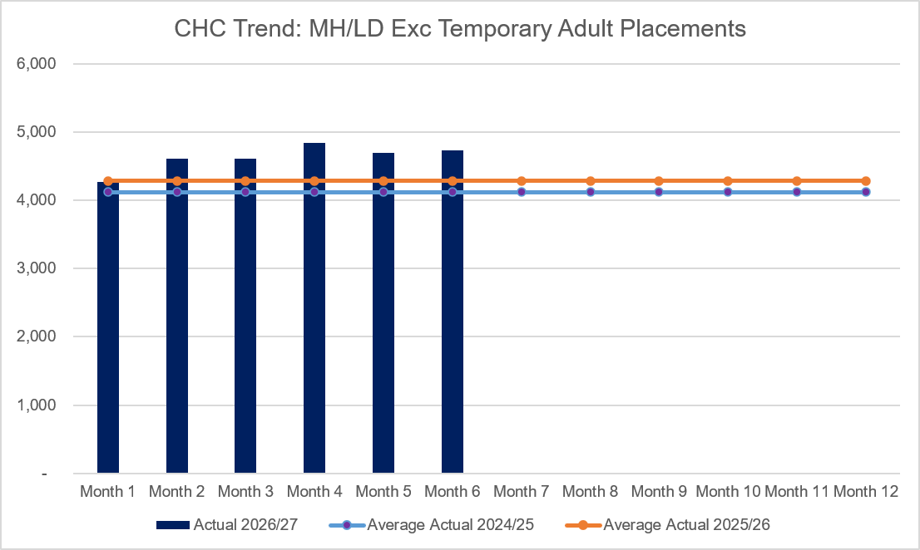
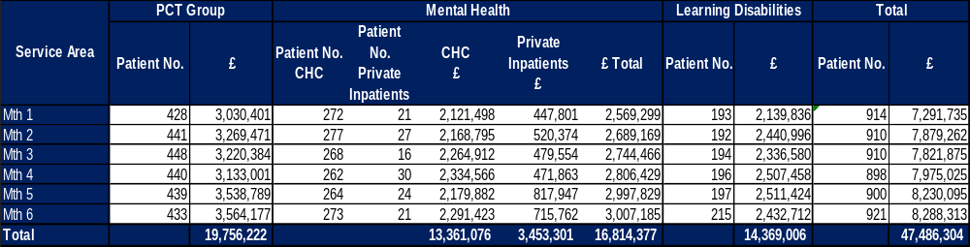
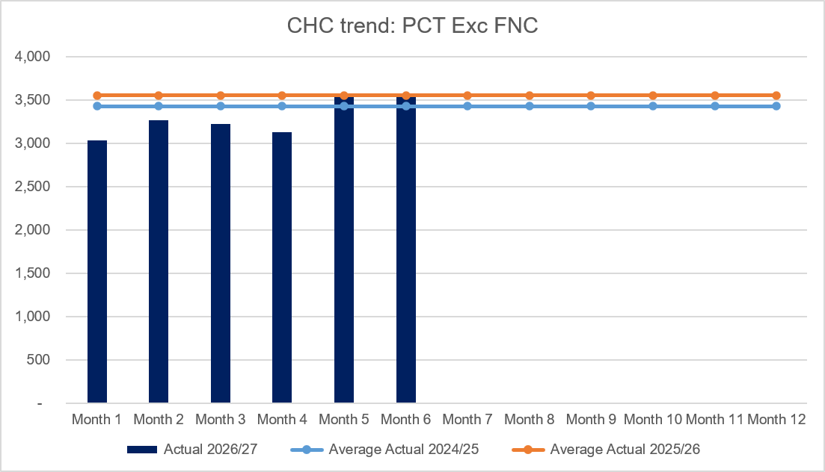
CHC Insights
In-Month Actual
£8.288m
Variance to Ledger £0.7m
YTD Actual
£47.486m
Variance to Ledger £2.7m
Executive Summary
Income and Expenditure Insights
Operational and Financial Performance
Appendices
Key Information
In Month 6 CHC was overspent by £0.6m, (Month 5, £0.6m), with a minimal change in case numbers. Given this position the impact of CHC has been clearly set out as a risk. An analysis of actual expenditure and patient numbers for 2026/27, is provided in table above. The table also includes the Adult Mental Health temporary placements within the Private Sector for transparency. The graphs on the left reflect average expenditure in the last two financial years, compared to the in- month position. MH/LD excludes the temporary placements and PCT excludes Free Nursing Care/Self Funders. Patient No. Private Inpatients (or Out of Areas Placements); the numbers at the end of September were on average 22, down from the 33 seen at highest point in August. There is an expectation of 6 discharges in the opening week of October, leaving 16 patients. The cost pressures above planning assumptions could be £2.4m if there is an unexpected increase in Q3/4. This is now reported as a separate Financial Risk to WG as part of the MMR.

Slide 10
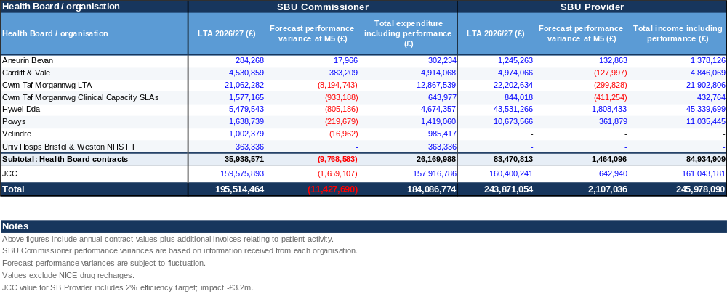
LTA Performance Insight
In-Month Actual
Provider/Commissioner
Variance Ledger = (£1.56m)
YTD Actual
Provider/Commissioner
Variance Ledger = (£3.91m)
Executive Summary
Income and Expenditure Insights
Operational and Financial Performance
Appendices
SBUHB LTA/SLA values and forecast performance 2026/27 per Month 5 activity

Slide 11
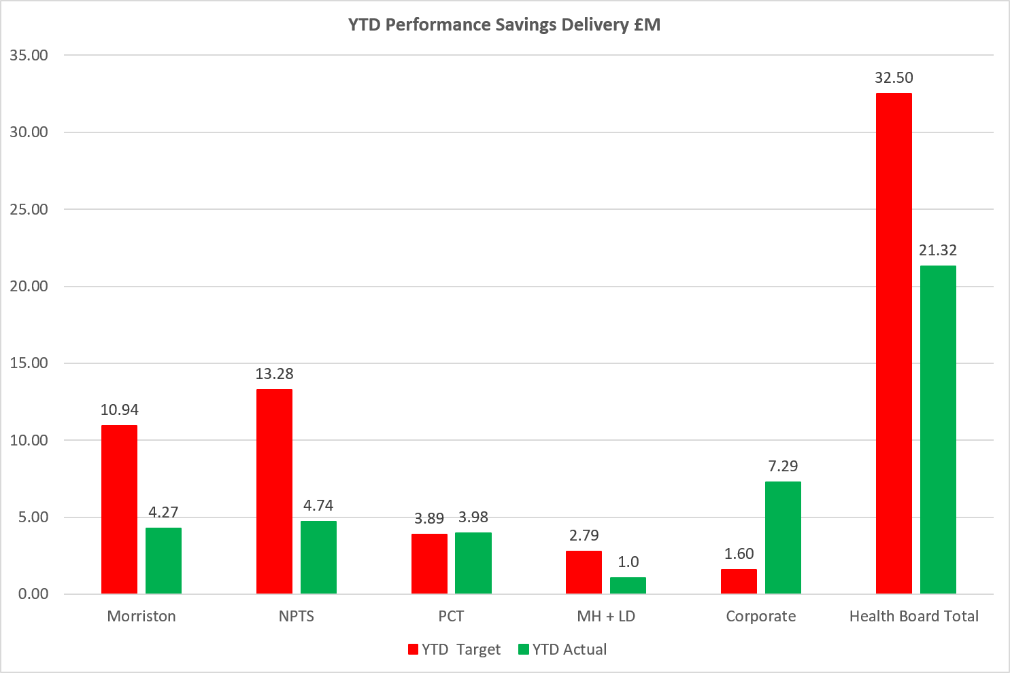
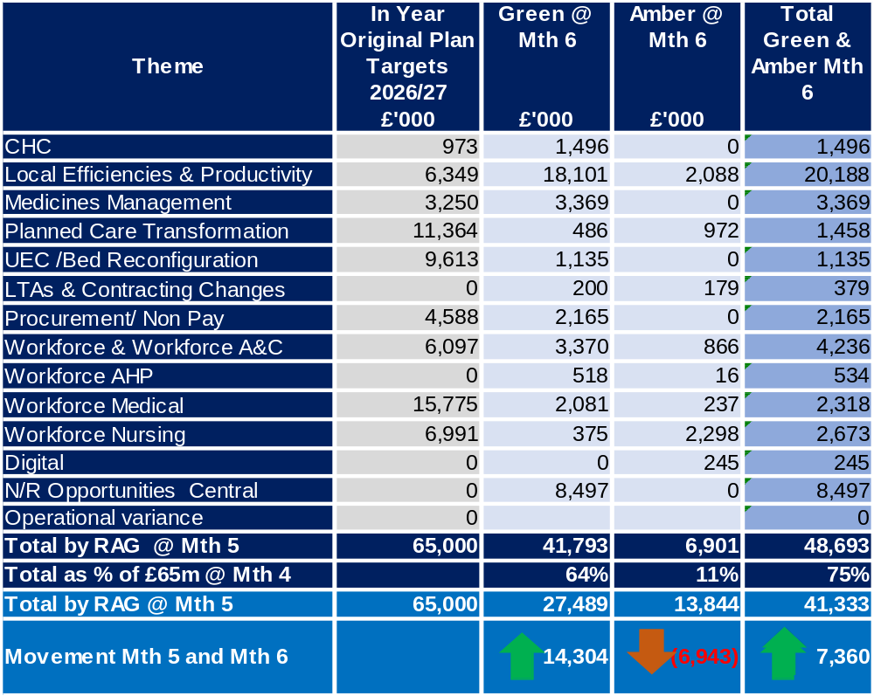
Savings Insights
Executive Summary
Income and Expenditure Insights
Operational and Financial Performance
Appendices
Savings
In Year Savings
Target = £65.0m
Green & Amber = £48.7m
Green & Amber % Target = 75%
Recurrent Savings
Target = £65.0m
Green & Amber = £32.9m
Green & Amber % Target = 50%
In Month Delivery
Target = £5.4m
Achieved = £7.2m
Gap = (£1.8)m
YTD Delivery
Target = £32.5m
Achieved = £21.3m
Gap = £11.2m

Slide 12
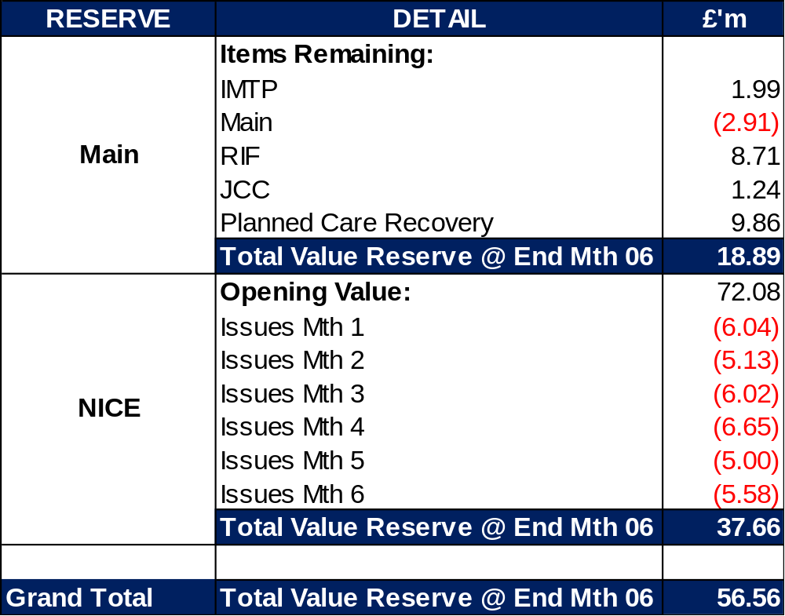
Reserves Insights
Executive Summary
Income and Expenditure Insights
Operational and Financial Performance
Appendices
Key Information
For 2026/27, the Health Board will hold two central reserves, and the purpose of these reserves are below: Main – this holds funding from Welsh Government or the plan that has yet to be issued to Budget Holders. These items are not surplus but either due to timing have not been issued or is an area where funding is issued based on actual values consumed in future months. NICE – this holds the total Health Board funding for all NICE costs (drugs and infrastructure) and is issued to the service each month based on the actual costs consumed as reported through the Pharmacy system.

Slide 13
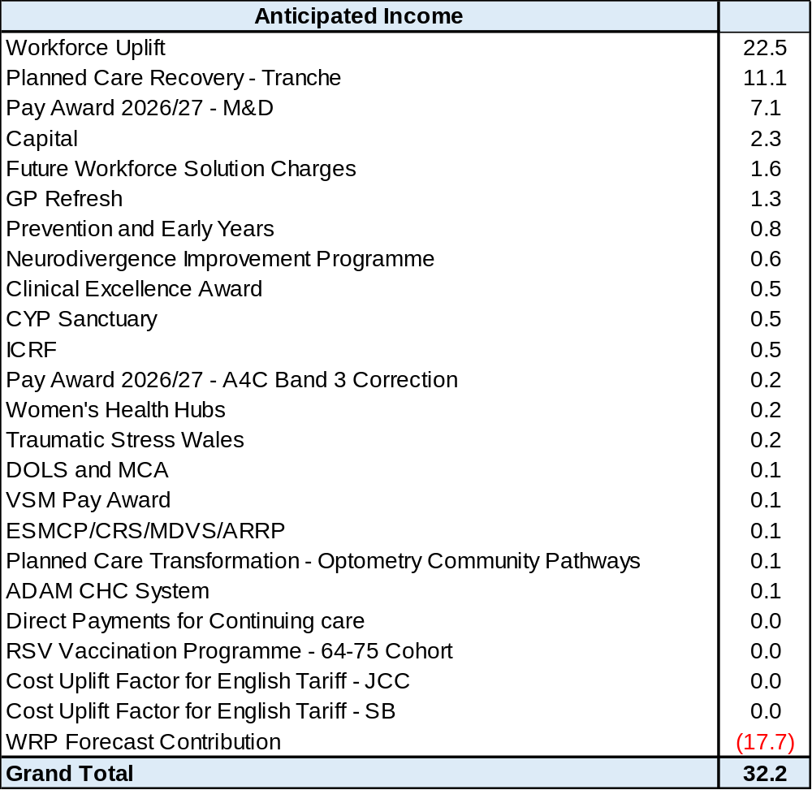
Anticipated Allocations
Executive Summary
Income and Expenditure Insights
Operational and Financial Performance
Appendices
Key Information
The current deficit plan of £71.6m is predicated on receipt of Welsh Government funding at the levels anticipated in the table opposite.

Slide 14
Appendices

Slide 15
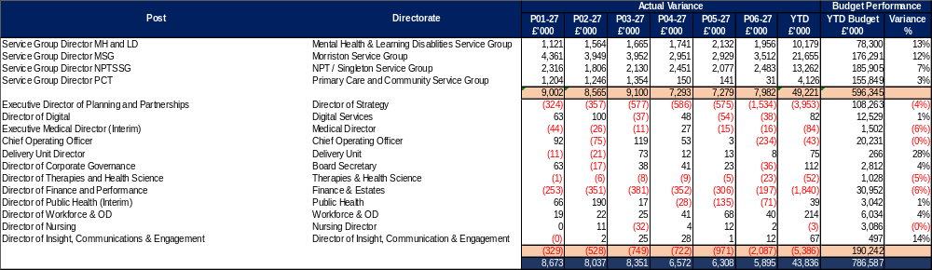
Appendix 1 – Variance by Budget Holder (Directors)
Executive Summary
Income and Expenditure Insights
Operational and Financial Performance
Appendices
Appendices

Slide 16
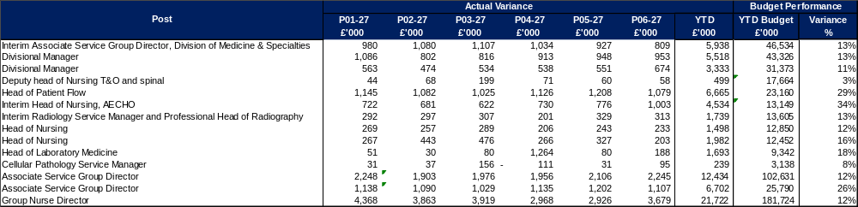
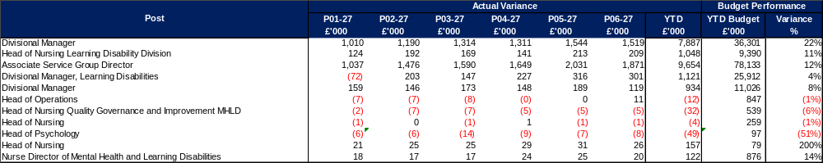
Appendix 2 – Variance by Budget Holder (1)
Executive Summary
Income and Expenditure Insights
Operational and Financial Performance
Appendices
Appendices
Morriston Service Group
MH & LD Service Group

Slide 17
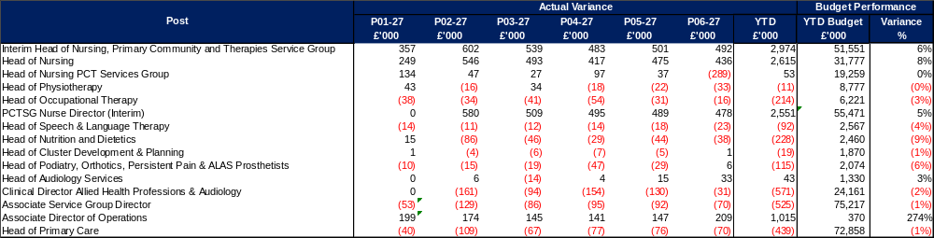
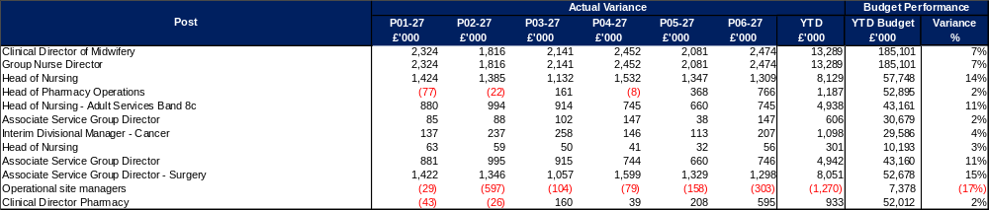
Appendix 2 – Variance by Budget Holder (2)
Executive Summary
Income and Expenditure Insights
Operational and Financial Performance
Appendices
Appendices
PCC Service Group
NPTS Service Group

Slide 18
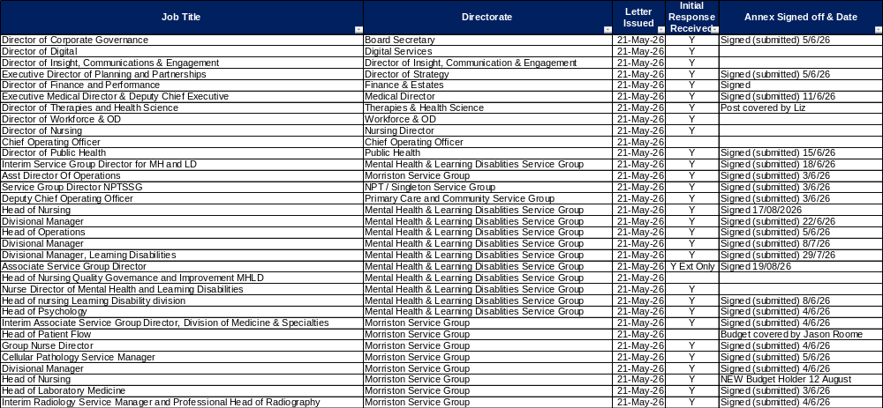
Appendix 3 – Accountability Letters (1)
Executive Summary
Income and Expenditure Insights
Operational and Financial Performance
Appendices
Appendices

Slide 19
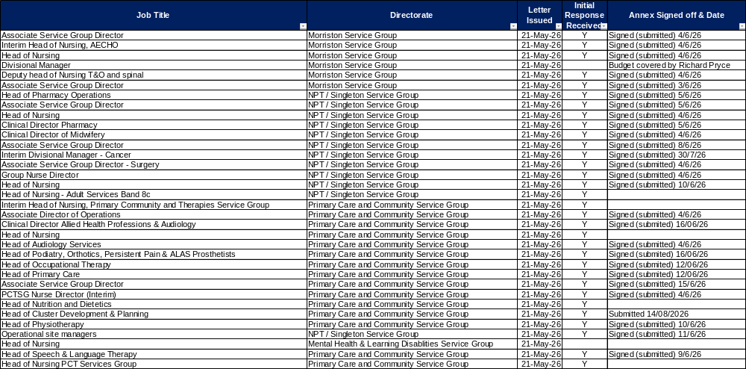
Appendix 3 – Accountability Letters (2)
Executive Summary
Income and Expenditure Insights
Operational and Financial Performance
Appendices
Appendices

Slide 20
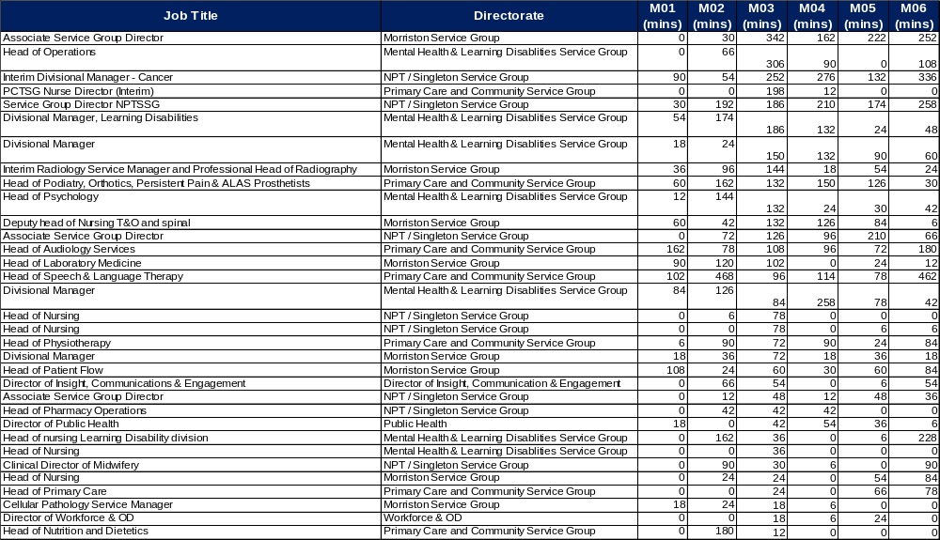
Appendix 4 QlikSense – Finance Dashboard Usage
Executive Summary
Income and Expenditure Insights
Operational and Financial Performance
Appendices
Appendices
These tables monitor the Qliksense Dashboard usage for Month 06 for all 67 budget holders reporting usage in minutes.

Slide 21
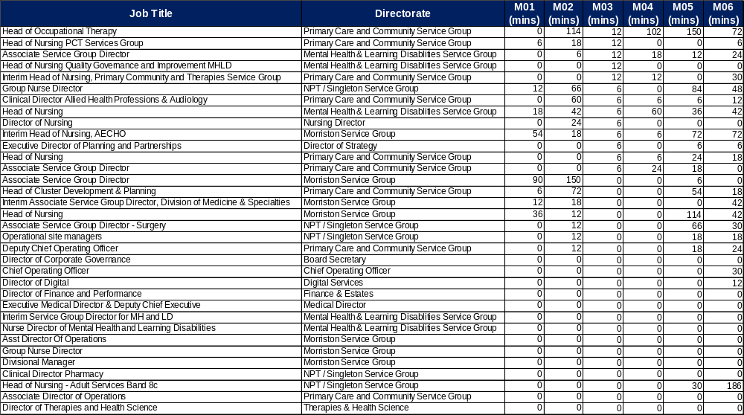
Appendix 4 Qliksense – Finance Dashboard Usage
Executive Summary
Income and Expenditure Insights
Operational and Financial Performance
Appendices
Appendices
These tables monitor the Qliksense Dashboard usage for Month 06 for all 67 budget holders reporting usage in minutes.

Slide 22
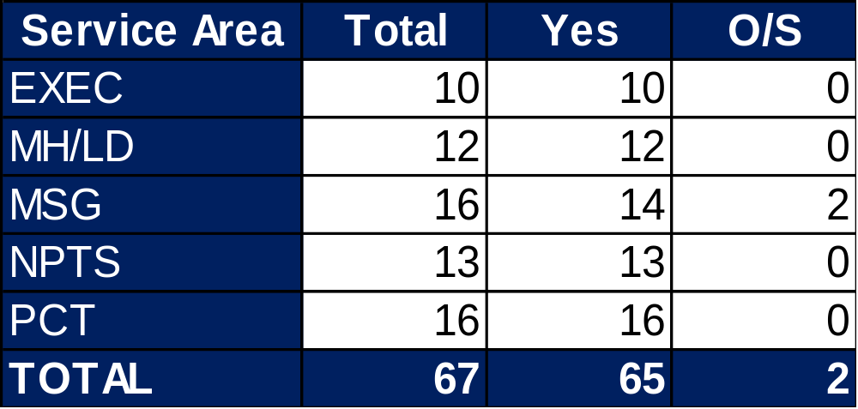
Appendix 5 Summary Budget Holder Training
Executive Summary
Income and Expenditure Insights
Operational and Financial Performance
Appendices
Appendices
Status @ 15 October 2026
Key Information Outstanding Training
1 Service Group 1 retired and new appointment made. Training date being arranged 1 on maternity leave – responsibilities covered by another existing Budget Holder

Slide 23
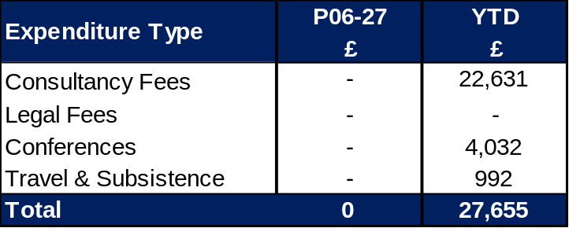
Appendix 6 Summary Other Data
Executive Summary
Income and Expenditure Insights
Operational and Financial Performance
Appendices
Appendices
Maternity Review
The total costs for this are allocated to a dedicated Cost Centre (6F34).
Key Information Central Z Codes
Contracting: SLA /LTA performance: JCC (previously WHSSC), LTA and SLA contract income and expenditure are transacted within this area and financial performance reported. NICE approved high-cost drugs and associated LTAs are also transacted and monitored against targets set. In addition to this, non-contracted activity income in relation to English foundation trusts invoiced on a quarterly basis are reported. Capital: The Finance Capital Team manage a number of cost centres covering the PFI, IFRS16 and Depreciation charges for assets both owned and donated are transacted here. RRL and Central Reserves: The Welsh Government funding received at the start of the year is tracked within this area. Any anticipated allocations in year are also transacted through these codes. Other HB wide funding received from HEIW and SIFT is also captured in here. All central reserves remain within the Z cost centres and details of these are provided in Appendix 2. Corporate income and expenditure. Any income and expenditure that is not service group specific is transacted and reported through a number of corporate Z cost centres, examples include, payroll and pension costs, VAT recovery, losses and receipts in relation to funding from Welsh Risk Pool, overseas visitors’ income and Road Traffic Accident income.

Slide 24
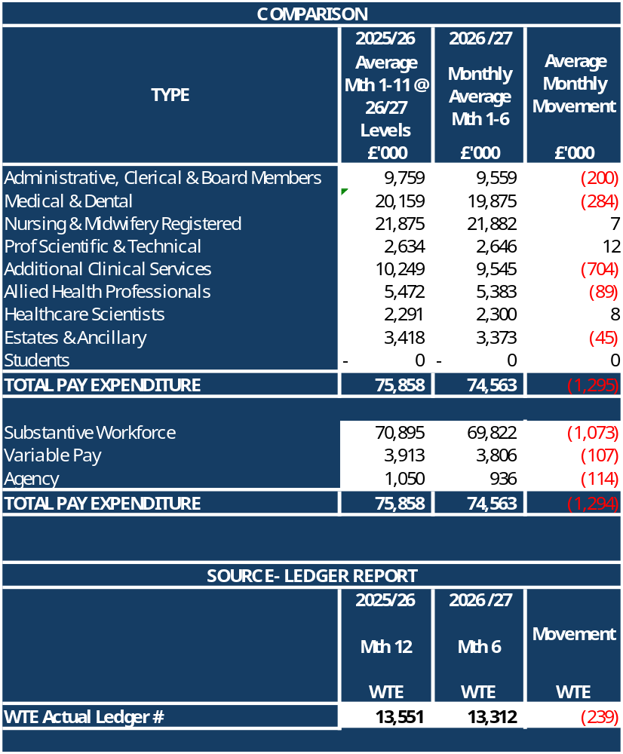
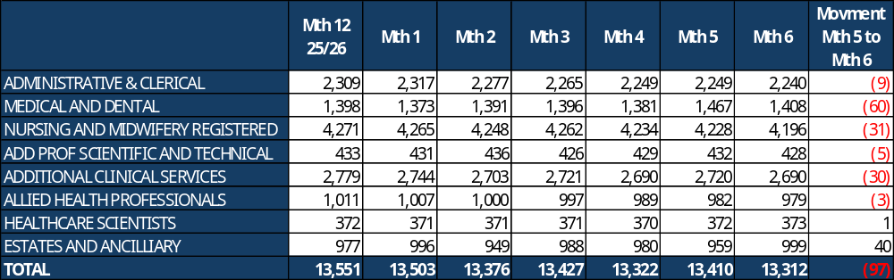
Appendix 7 – Overall Pay Movements
Executive Summary
Income and Expenditure Insights
Operational and Financial Performance
Appendices
Appendices
Key Information
Slide 3 to Slide 5 provide overview of pay position and Appendix 7 provides a summary of position, with breakdown of WTE by Month. Reconciliation key movements between Month 5 and 6: Substantive Staff remained static with small decrease £0.2m Variable Pay decreased by £0.4m driven by reduced Bank costs WTE decreased by 97 WTE: 75 WTE = In Month 05 the Resident Dr WTE was impacted by the August rotation (increase of 86 WTE). This has now returned to previous months reported levels; 12 WTE = bank cost decrease for HCSW (27 WTE) offset by small increases in Estates and Registered Nurses.

