Slide 1
Stroke Update
July 2026

Slide 2
National Stroke Data
Due to significant national issues affecting stroke audit data, no updated performance data has been available since April 2026.
Work is underway nationally to resolve these issues; however no validated data is currently available.
In the meantime, we have sought an alternative solution and are working with the Digital team to explore how temporary internal performance data can be provided to support local monitoring and assurance until national reporting is restored.
However, today's slides demonstrate SBUHB national position following the recent publication of the SSNAP Atlas of Variation April 2025 – March 2026

Slide 3
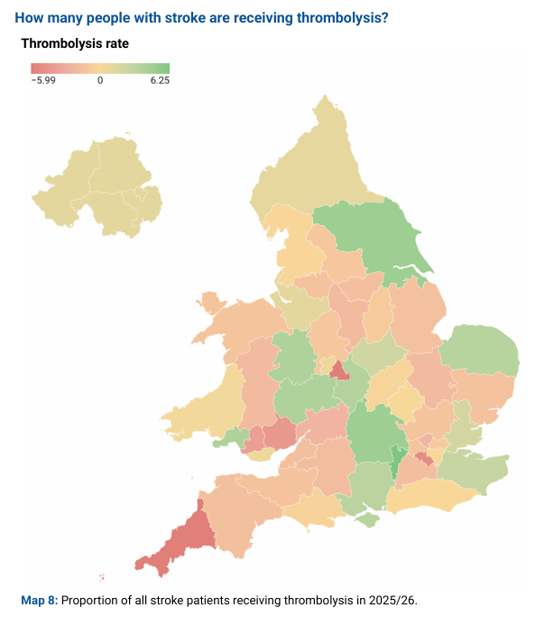


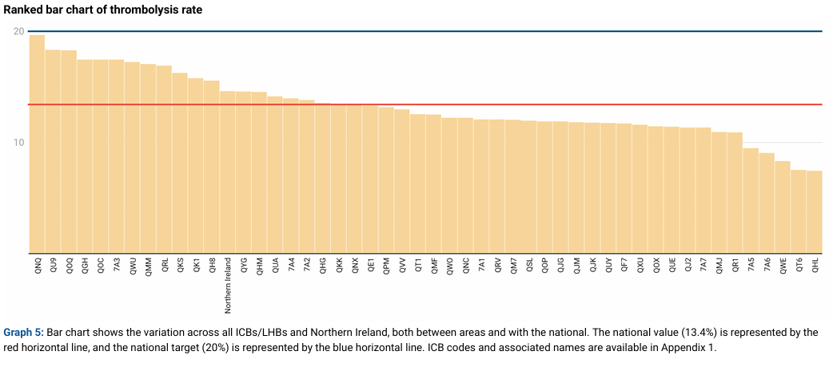

Slide 4
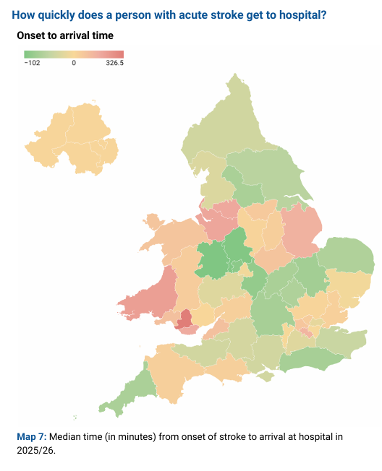

Thrombolysis - The challenge
Time to presentation
Limited stroke specialist input out of hours – therefore limited ability to use advanced imaging for patient selection

Slide 5
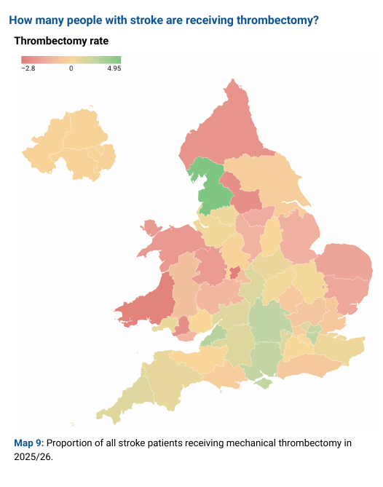
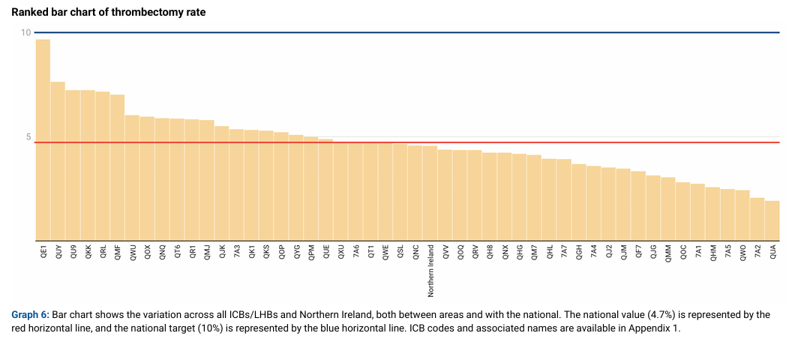
Access to thrombectomy

Slide 6
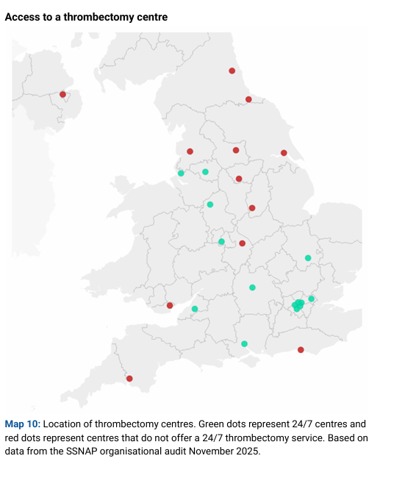
Access to thrombectomy – The challenge
Thrombectomy services commissioned by JCC
Limited Welsh service (UHW)
  Mon – Fri 9am-5pm
Limited service from Bristol
  Mon – Sun 6am – 10pm
No 24/7 service commissioned

Slide 7
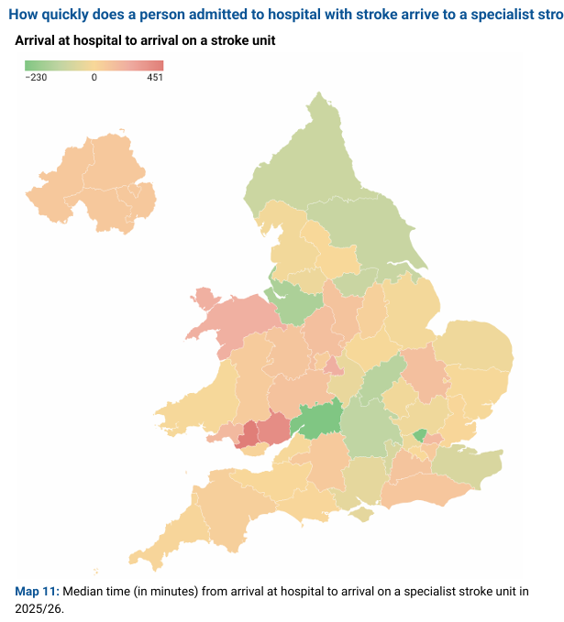
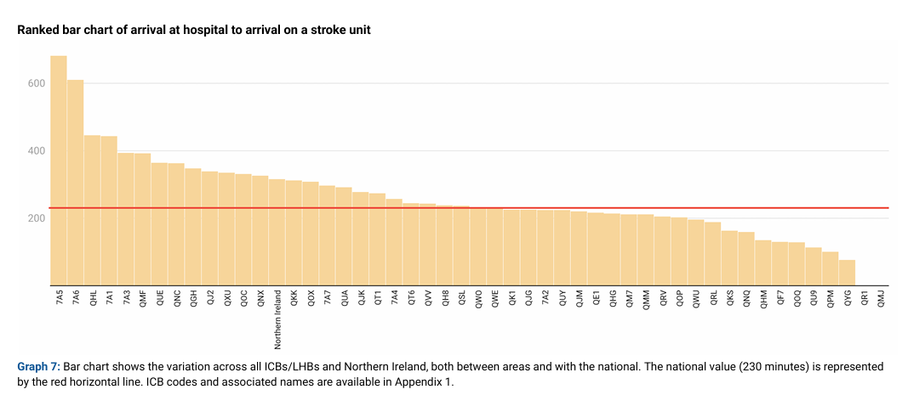
Access to the stroke unit

Slide 8
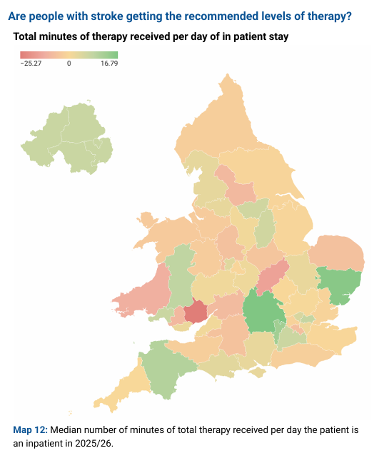
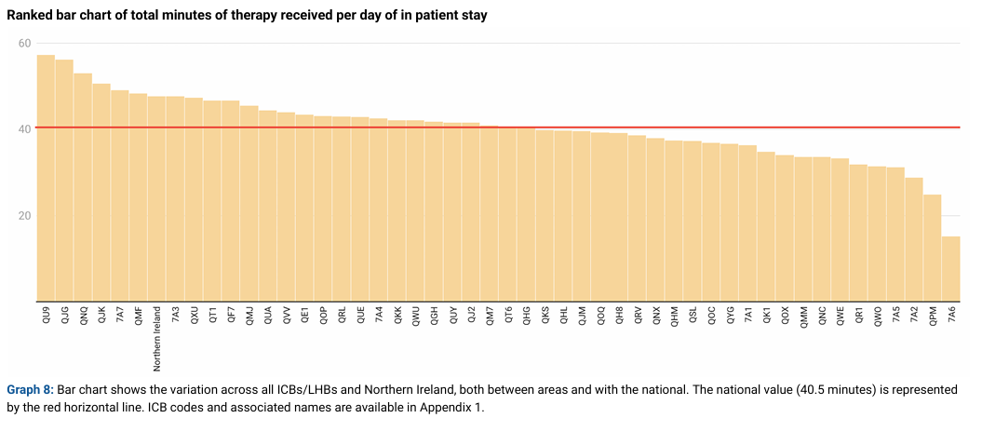
Access to stroke therapy

Slide 9
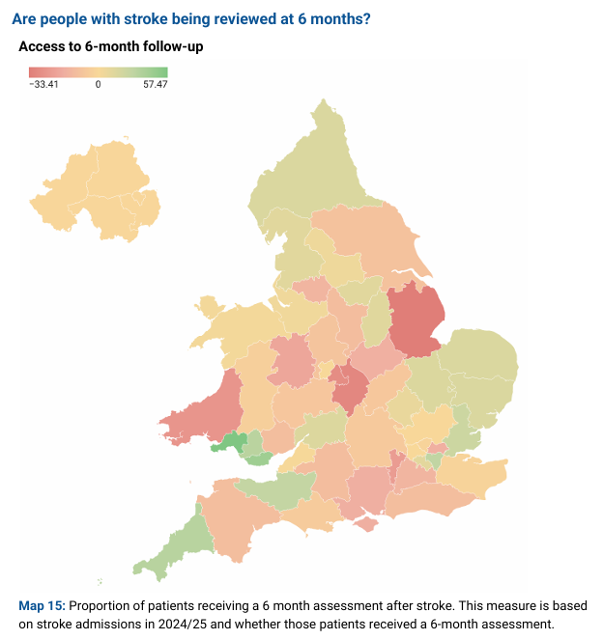
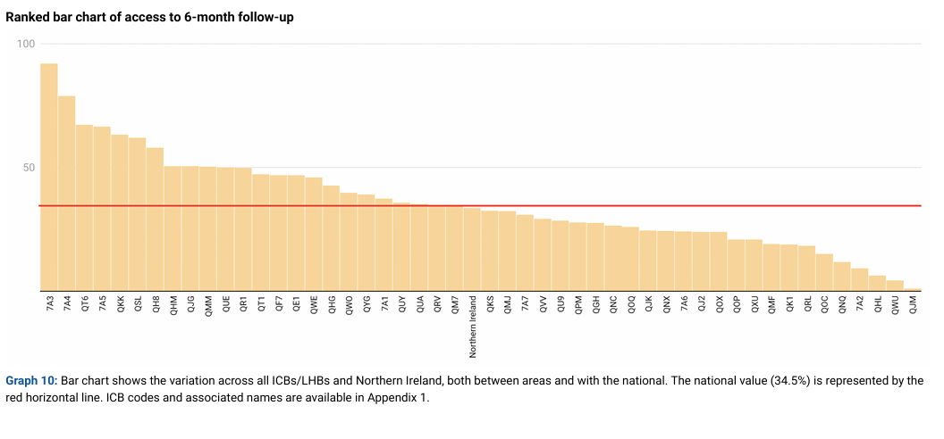
6 Month Follow Up

Slide 10
Summary
Thrombolysis
  Challenging but consistently high rate of thrombolysis
Thrombectomy
  Above median rate of thrombectomy despite lack of 24/7 access
Access to stroke unit
  Limited ability to access stroke unit within 4 hours of arrival
Stroke therapy
  Above median level of therapy input for stroke patients
Follow up
  Highest rate of follow up across England/Wales

Slide 11
Planned Care Improvements Actions
Continuation of the current stroke pathway improvements
Review ability to always instigate increased access to stroke specialist input with consideration of regional working
Review stroke pathways/ability to increase capacity to ringfence beds
Increase capacity to accept pre-hospital video triage calls direct from paramedics

