Slide 1
Annex 1
Detail Financial Position
Month 3 FY 2026/27

Slide 2

Financial Summary
In-Month Variance
£7.138m
Variance to Plan £0.8m
YTD Variance
£23.312m
Variance to Plan £4.2m
Executive Summary
Income and Expenditure Insights
Operational and Financial Performance
Appendices
Key Information
Operational Variation. The following operational variation between month 2 and 3 has been incurred: PCT: There was a shortfall in dental recharge income in month of £0.1m NPTS: There is a £0.3m pressure in month due to prescribing of “No cheaper stock obtainable” (NCSO) drugs. This is a national issue. MHLD: CHC growth in month is £0.1m over and above plan. MSG & NPTS: Clinical consumables costs driven by activity & acuity in month £0.3m. HB Wide variable pay reduction: There has been a reduction in variable pay in month of £0.3m, primarily within Bank . HB Wide Pay: increased enhancement costs across all services in month and one off pay arrears drove an increase of £0.2m. Consultancy services (Deloitte): This contract ended during June delivering a reduction in spend of £0.4m LTA Performance: There was a benefit in month on Provider & Commissioner LTA performance as a result of transacting the 2026/27 Pay Matrix.

Slide 3
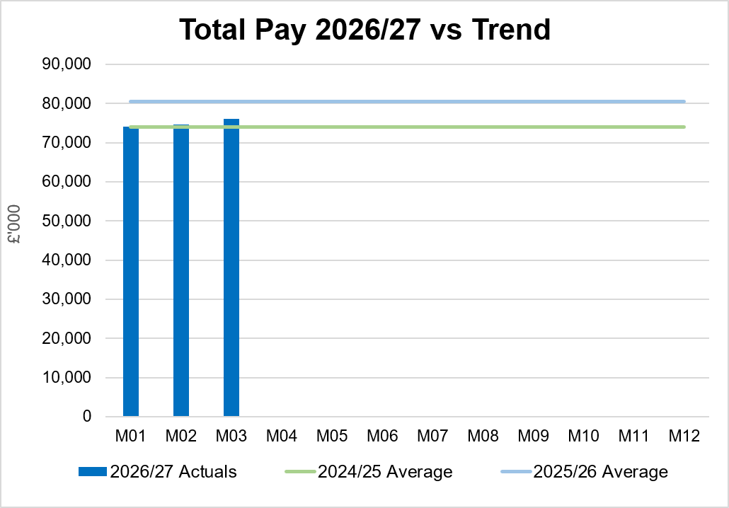
Total Pay Insights
In-Month Actual
£76.036m
Variance to Ledger £0.79m
YTD Actual
£224.581m
Variance to Ledger £1.90m
Executive Summary
Income and Expenditure Insights
Operational and Financial Performance
Appendices
Key Information
Excluding the medical and dental 2026/27 pay award (which was recognised YTD in Month 3) Month 3 pay was broadly in line with Month 2, with vacancies more than offsetting the pressures in medical and dental and nursing linked to high levels of sickness absence and a continuation of staffing surge bed capacity. There was a small improvement in the levels of variable pay expenditure £0.3m compared to month 2. This is linked to the increased Grip & Control in place to oversee recruitment, this has not been treated as a savings at this point as further work is required to assess the TRACs status of posts. Q1 25/26 comparative figure will be at 25/26 rate. If applied flat 3.3% rate to £212m = £219m noting Medical & Dental had 3.5% uplift

Slide 4
Total Pay Insights
In-Month Actual
£76.036m
Variance to Ledger £0.79m
YTD Actual
£224.581m
Variance to Ledger £1.90m
Executive Summary
Income and Expenditure Insights
Operational and Financial Performance
Appendices
Actual Expenditure By Staff Group
Actual Expenditure & WTE For A&C Staff Group As Per Ledger
Key Information
M03 contains the YTD medical and dental 2026/27 pay award, total value = £7.1m or £0.6m per month (£1.2m arrears in M03) A4C Pay Award 2026/27 = £22.5m and paid from 1st April 2026. The 2 tables on the right detail the total A&C Pay and WTE by Service Area, with steady reduction through Q1 in both actual spend and WTE. Average 25/26 not include 26/27 pay award of 3.3% for A4C and 3.5% Medical & Dental.

Slide 5
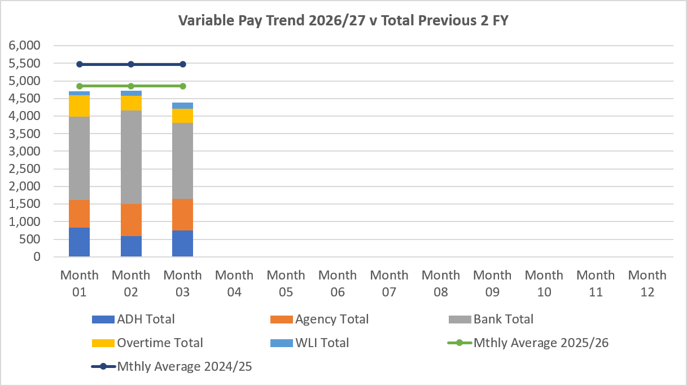
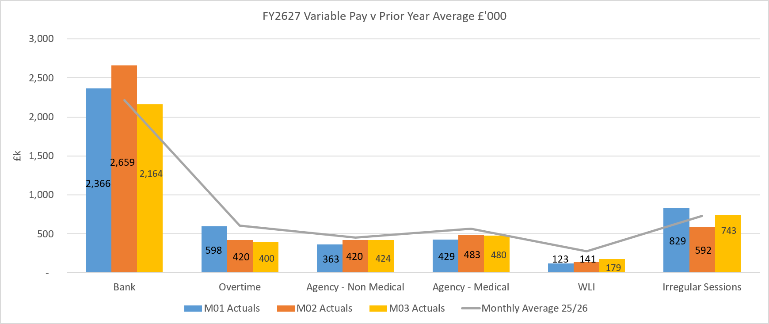
Variable Pay Insights
In-Month Actual
£4.389m
YTD Actual
£13.812m
Executive Summary
Income and Expenditure Insights
Operational and Financial Performance
Appendices
Key Information
The actual variable pay spend at Month 03 was £4.4m. Bank and agency continue to be the key driver for this continued high spend, although there is some improvement in Bank when compared to Month 2.

Slide 6
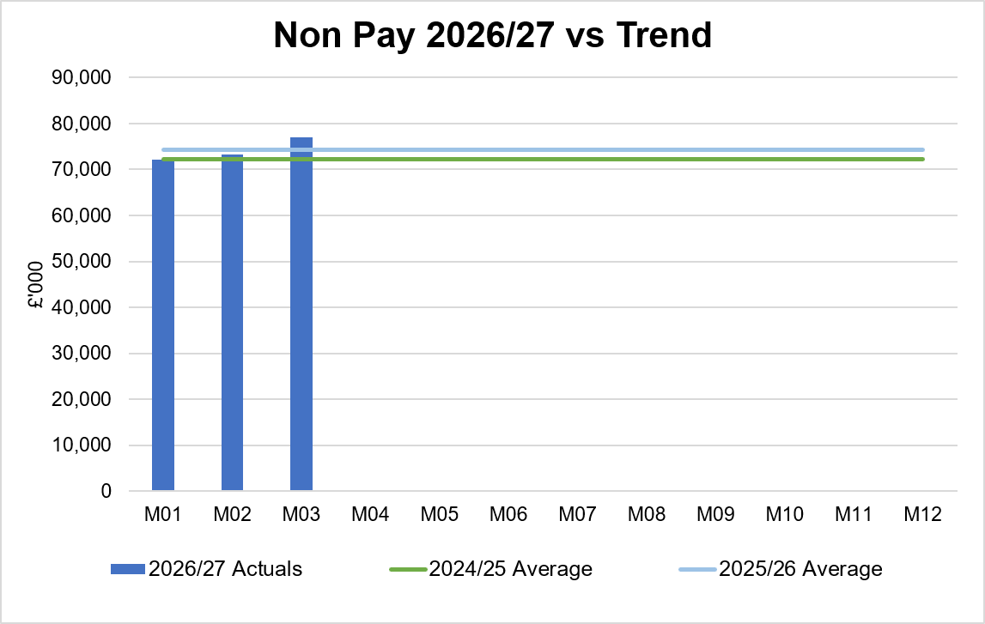
Non-Pay Insights
In-Month Actual
£77.065m
Variance to Ledger £6.6m
YTD Actual
£222.469m
Variance to Ledger £20.3m
Executive Summary
Income and Expenditure Insights
Operational and Financial Performance
Appendices
# includes saving non-delivery
Key Information
The in-month increase relates to clinical consumable costs driven by activity in specialist services and Theatres totalling £1.3m. It should be noted that £0.4m of this is offset by JCC income. Within the ledger the gross JCC income is reflected within the income lines and not netted off against expenditure and so overall the Health Board position is not adversely affected. If JCC activity increases the gross level of expenditure and income will increase. The main drivers within this category of clinical consumable expenditure include heart valves & pacemakers, linked to some JCC activity. Non-Pay also includes secondary care drugs, a breakdown of the categories of Clinical Consumables based on actual spend is provided in the table on the right. Prescribing is overspent by £0.3m in-month following receipt of the latest datasets (April 2026; PAR data is received 2 months in arrears); the overspend is driven by the No Cheaper Stock Obtainable (NCSO) position. This is the pharmacy reimbursement mechanism used in England and Wales when a medicine listed in the Drug Tariff cannot be obtained at or below the standard reimbursement price due to shortages or supply problems. Global conflicts are affecting shipping routes which is adversely impacting on the availability of medicines and increasing prices of procurement due to additional delivery costs.

Slide 7
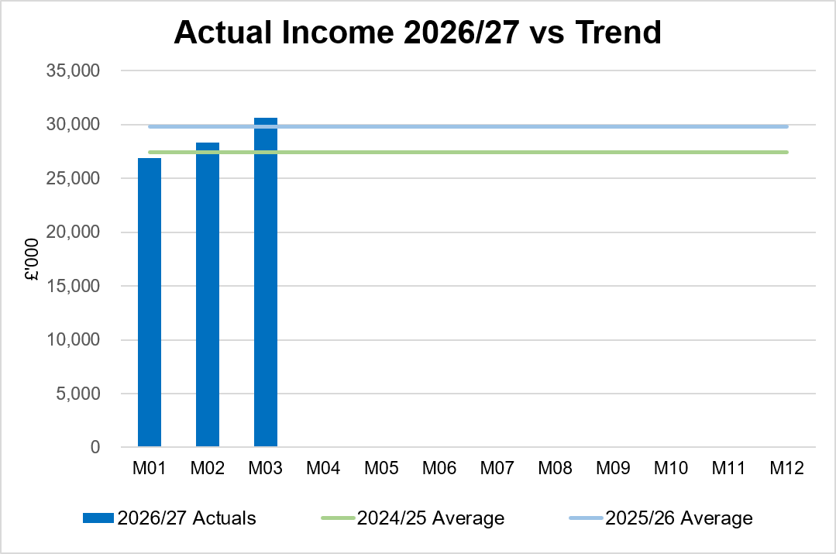
Income Insights
In-Month Actual
£30.654m
Variance to Ledger (£0.251m)
YTD Actual
£85.850m
Variance to Ledger £1.07m
Executive Summary
Income and Expenditure Insights
Operational and Financial Performance
Appendices
Key Information
There was a significant increase in income for Month 03, primarily due to the transacting of the 2026/27 provider element of the pay matrix for months 1-3. The rebates relating to Mounjaro along with an increase in commercial R&D income continue to provide an increase in income. The Joint Commissioning Committee (JCC) income as a provider reported an overperformance of £0.2m in Month 3. Dental Contract Income underperformed in-month by £0.2m.

Slide 8
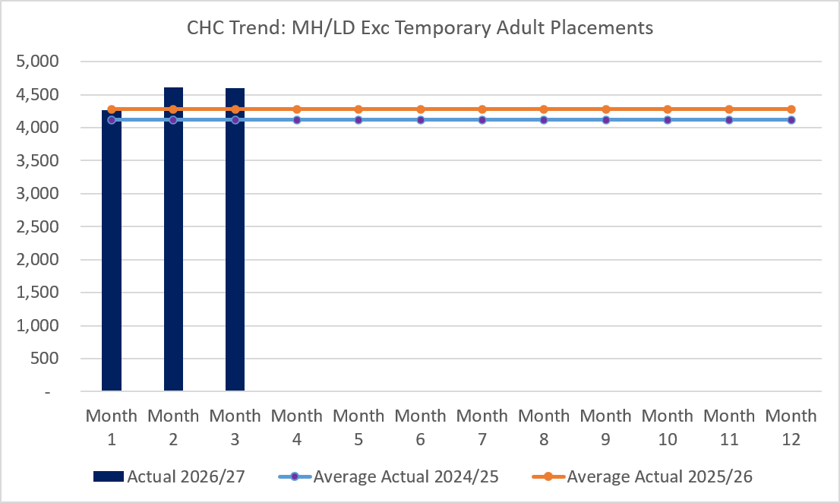
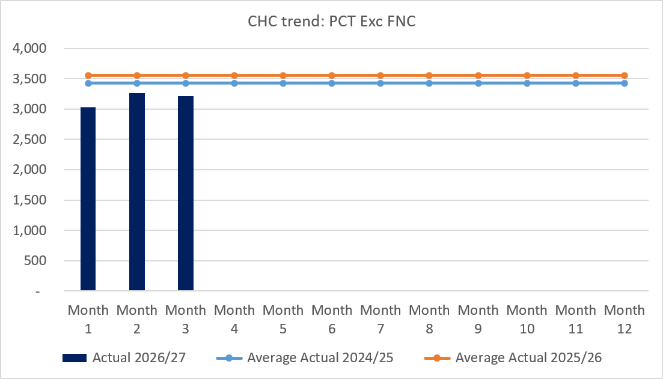
CHC Insights
In-Month Actual
£7.822m
Variance to Ledger £0.5m
YTD Actual
£22.993m
Variance to Ledger £0.8m
Executive Summary
Income and Expenditure Insights
Operational and Financial Performance
Appendices
Key Information
In month 3 CHC (exc FNC) was overspent by £0.5m, this is an increase of £0.144m on the Month 2 position. Given this position the impact of CHC has been clearly set out as a risk. An analysis of actual expenditure and patient numbers for 2026/27, is provided in table above. The table also includes the Temporary Adult Mental Health Placements for transparency. The graphs on the left reflect average expenditure in the last two financial years, compared to the in month position. MH/LD excludes the temporary placements and PCT excludes Free Nursing Care/Self Funders.

Slide 9
LTA Performance Insight
In-Moth Actual
YTD Actual
Executive Summary
Income and Expenditure Insights
Operational and Financial Performance
Appendices
This will be reported quarterly in arrears with the first data being published in the Month 4 report.

Slide 10
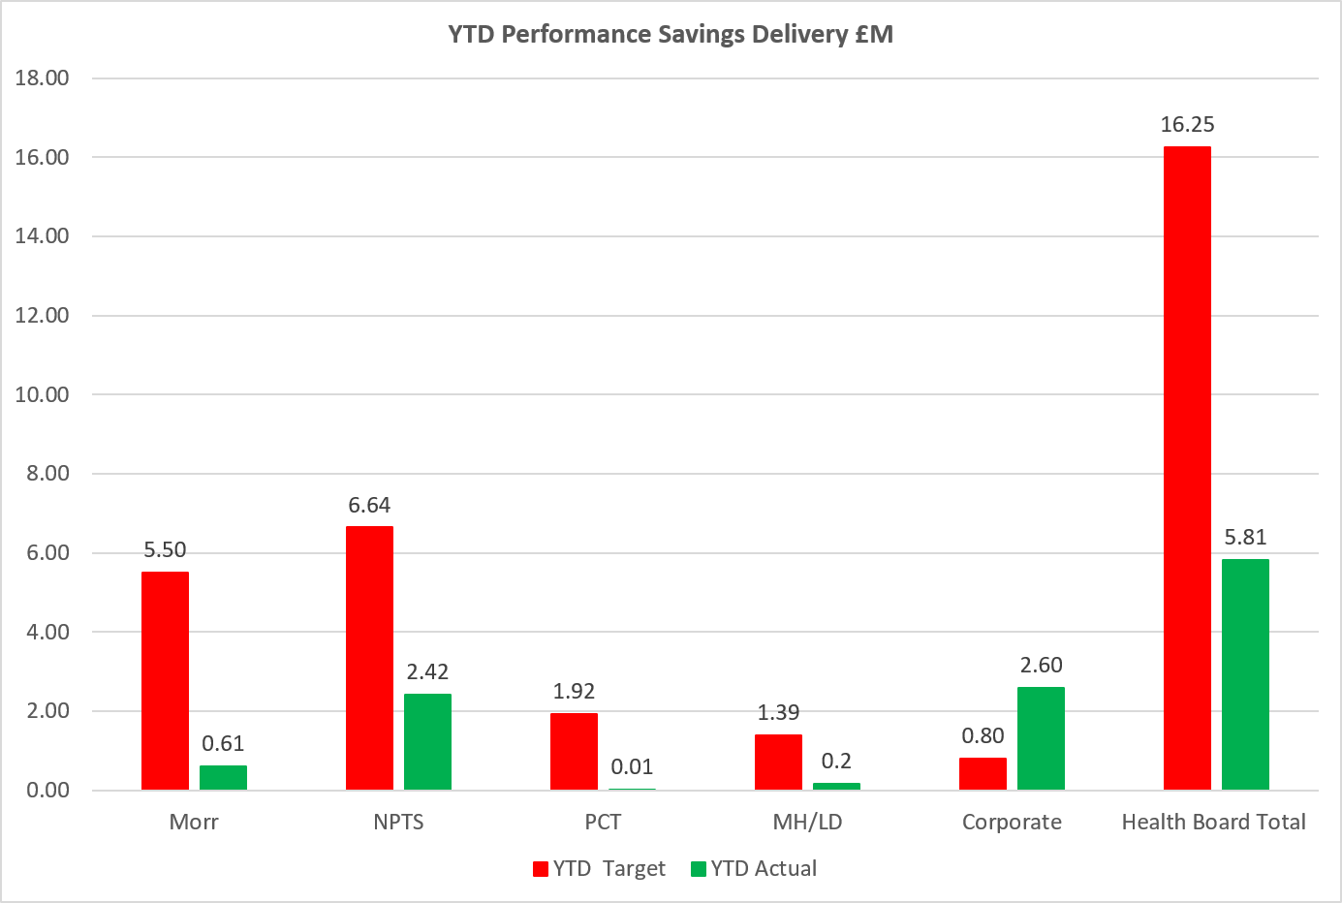
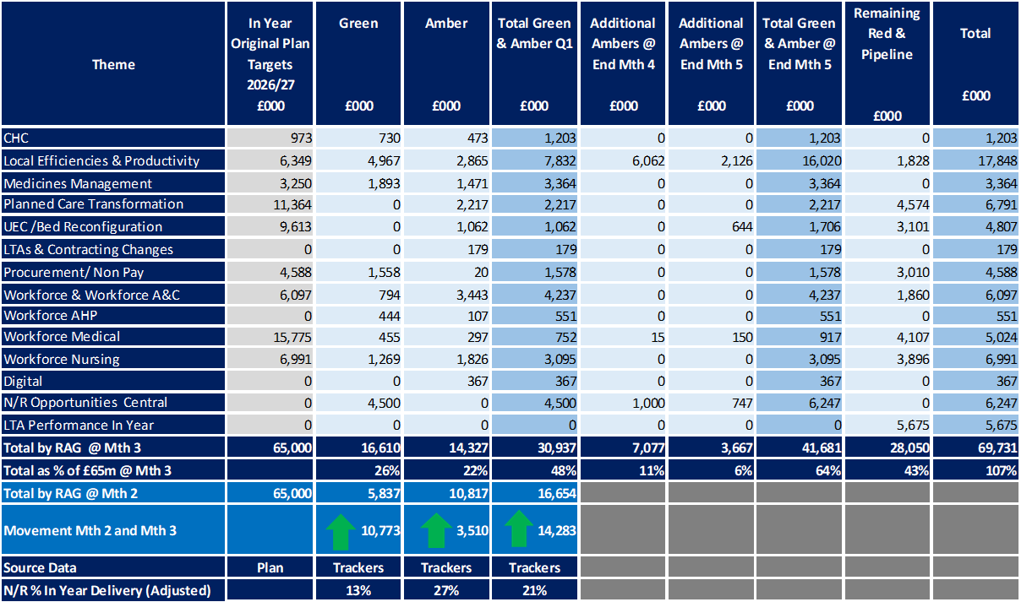
Savings Insights
Executive Summary
Income and Expenditure Insights
Operational and Financial Performance
Appendices
Savings
In Year Savings
Target = £65m
Green & Amber = £30.9m
48%
Recurrent Savings
Target = £65m
Green & Amber = £24.4m
38%
In Month Delivery
Target = £5.4m
Achieved = £2.9m
Gap = £2.5m
YTD Delivery
Target = £16.3m
Achieved = £5.8m
Gap = 10.4m

Slide 11
Reserves Insights
Executive Summary
Income and Expenditure Insights
Operational and Financial Performance
Appendices
Key Information
For 2026/27, the Health Board will hold two central reserves and the purpose of these reserves are below: Main – this holds funding from Welsh Government or the plan that has yet to be issued to Budget Holders. These items are not surplus but either due to timing have not been issued or is an area where funding is issued based on actual values consumed in future month. NICE – this holds the total Health Board funding for all NICE costs (drugs and infrastructure) and is issued to the service each month based on the actual costs consumed as reported through the Pharmacy system.

Slide 12
Anticipated Allocation
Executive Summary
Income and Expenditure Insights
Operational and Financial Performance
Appendices
Key Information
The current deficit plan of £76.6m is predicated on receipt of the Welsh Government funding at the levels anticipated in the table opposite.

Slide 13
Appendix 1 – Variance by Budget Holder (Directors)
Executive Summary
Income and Expenditure Insights
Operational and Financial Performance
Appendices
Appendices

Slide 14
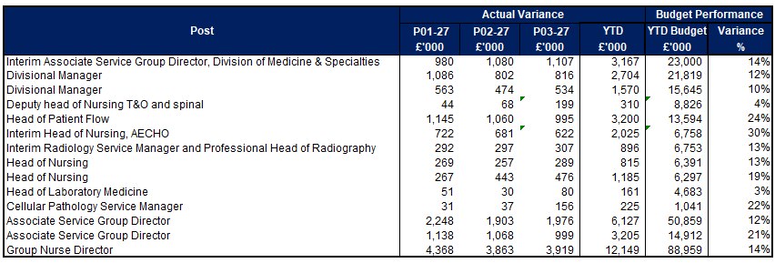
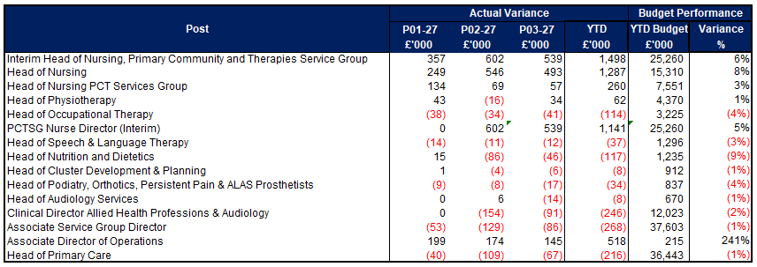
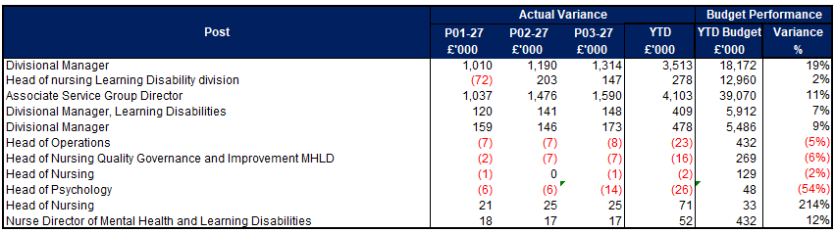
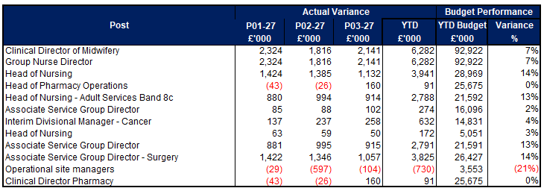
Appendix 2 – Variance by Budget Holder
Executive Summary
Income and Expenditure Insights
Operational and Financial Performance
Appendices
Appendices
Morriston Service Group
PCC Service Group
MH & LD Service Group
NPTS Service Group

Slide 15
Appendix 3 – Accountability Letters (1)
Executive Summary
Income and Expenditure Insights
Operational and Financial Performance
Appendices
Appendices

Slide 16
Appendix 3 – Accountability Letters (2)
Executive Summary
Income and Expenditure Insights
Operational and Financial Performance
Appendices
Appendices

Slide 17
Appendix 3 Qliksense – Finance Dashboard Usage
Executive Summary
Income and Expenditure Insights
Operational and Financial Performance
Appendices
Appendices
These tables monitor the Qliksense Dashboard usage for Month 03 for all 67 budget holders reporting usage in minutes.

Slide 18
Appendix 3 Qliksense – Finance Dashboard Usage
Executive Summary
Income and Expenditure Insights
Operational and Financial Performance
Appendices
Appendices
These tables monitor the Qliksense Dashboard usage for Month 03 for all 67 budget holders reporting usage in minutes.

Slide 19
Appendix 4 Summary Budget Holder Training
Executive Summary
Income and Expenditure Insights
Operational and Financial Performance
Appendices
Appendices
Status @ 15 July 2026
Key Information Outstanding Training
4 Executives 1 retirement and 1 absent 2 x 1:1 – training provided August 6 Service Groups 1 on Maternity Leave and role covered by another existing Budget Holder 1 changed roles post letters published and role covered by another existing Budget Holder whilst HB recruits 1 retired and training provided once replacement postholder commences 3 training booked July/August and provided by FBP’s

Slide 20
Appendix 5 Summary Other Data
Executive Summary
Income and Expenditure Insights
Operational and Financial Performance
Appendices
Appendices
Maternity Review
The total costs for this are allocated to a dedicated Cost Centre (6F34).
Key Information Central Z Codes
Contracting: SLA /LTA performance: JCC (previously WHSSC), LTA and SLA contract income and expenditure are transacted within this area and financial performance reported. NICE approved high-cost drugs and associated LTAs are also transacted and monitored against targets set. In addition to this, non-contracted activity income in relation to English foundation trusts invoiced on a quarterly basis are reported. Capital: The Finance Capital Team manage a number of cost centres covering the PFI, IFRS16 and Depreciation charges for assets both owned and donated are transacted here. RRL and Central Reserves: The Welsh Government funding received at the start of the year is tracked within this area. Any anticipated allocations in year are also transacted through these codes. Other HB wide funding received from HEIW and SIFT is also captured in here. All central reserves remain within the Z cost centres and details of these are provided in Appendix 2. Corporate income and expenditure. Any income and expenditure that is not service group specific is transacted and reported through a number of corporate Z cost centres, examples include, payroll and pension costs, VAT recovery, losses and receipts in relation to funding from Welsh Risk Pool, overseas visitors’ income and Road Traffic Accident income.

