Slide 1


Performance & Finance Committee
Morriston Service Group Update M03
28th July 2026

Slide 2
Part A: Priority Areas & Key Actions

Slide 3
Summary Actions
PRIORITY AREAS FOCUS | Increase savings delivery plans Reduce staff unavailability to reduce variable pay (nursing and medical staffing focus) Stabilising cellular pathology Assessing non pay cost reduction opportunities against key areas of spend pressure (cardiology, cellular pathology, radiology, neurology) Review levers to ensure cross system risk sharing (clinical & financial) and behaviour to support cost reduction is incentivised
5 TOP ACTIONS FOR NEXT 4 WEEKS | Reduction in unavailability via sickness management actions Develop plans to meet local housekeeping targets recurrently Further roll out of nursing transformation work Contribute to thematic workstreams in particular aiming to progress theatres productivity and Urgent & Emergency Care plans Utilise the Morriston Clinical Board and procurement team to identify potential further clinical supplies savings
5 TOPS ACTIONS LAST 4 WEEKS & UPDATE ON OUTCOME | Developed initial administrative staff reduction plans Developed understanding of required actions to support thematic savings delivery Launched Clinical Board to increase clinical engagement in savings delivery Assessed accounting and non recurrent opportunities to bridge savings delivery timing gaps Began roll out of nursing transformation work

Slide 4
Part B: Look Forward

Slide 5
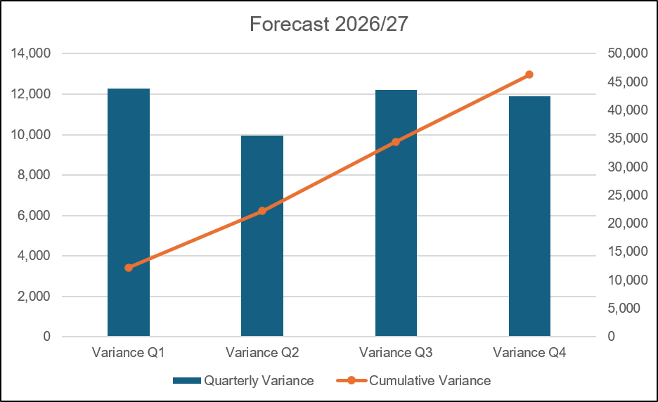
Forecast
Key Assumptions:
Forecast based on month 3 performance
Excludes non pay and drug inflation and potential growth pressures – treated as risks to be mitigated
Assumes no additional cost for recruitment of administration staff beyond identified new starters in system (all recruitment internal transfer)
Full utilisation of any recovery allocations, but no further activity if the funding is exhausted ahead of activity delivery reaching target
NICE spend continues per month 3 with matched funding (no savings or pressure seen in group)
All savings schemes with a forecast against plan assumed to deliver in full going forward
Renal dialysis overperformance on Morriston site continues to support nurse establishments
JCC and Inter Health Board SLA performance assumed to continue at the average quarter one performance levels, with the exception of additional North Wales Bariatric patients
Fill rate for rostered shifts remain at current levels
Excludes potential pressures for winter and the new resident doctor contract which are held corporately.

Slide 6
Forecast

Slide 7
Part C: Look Back

Slide 8
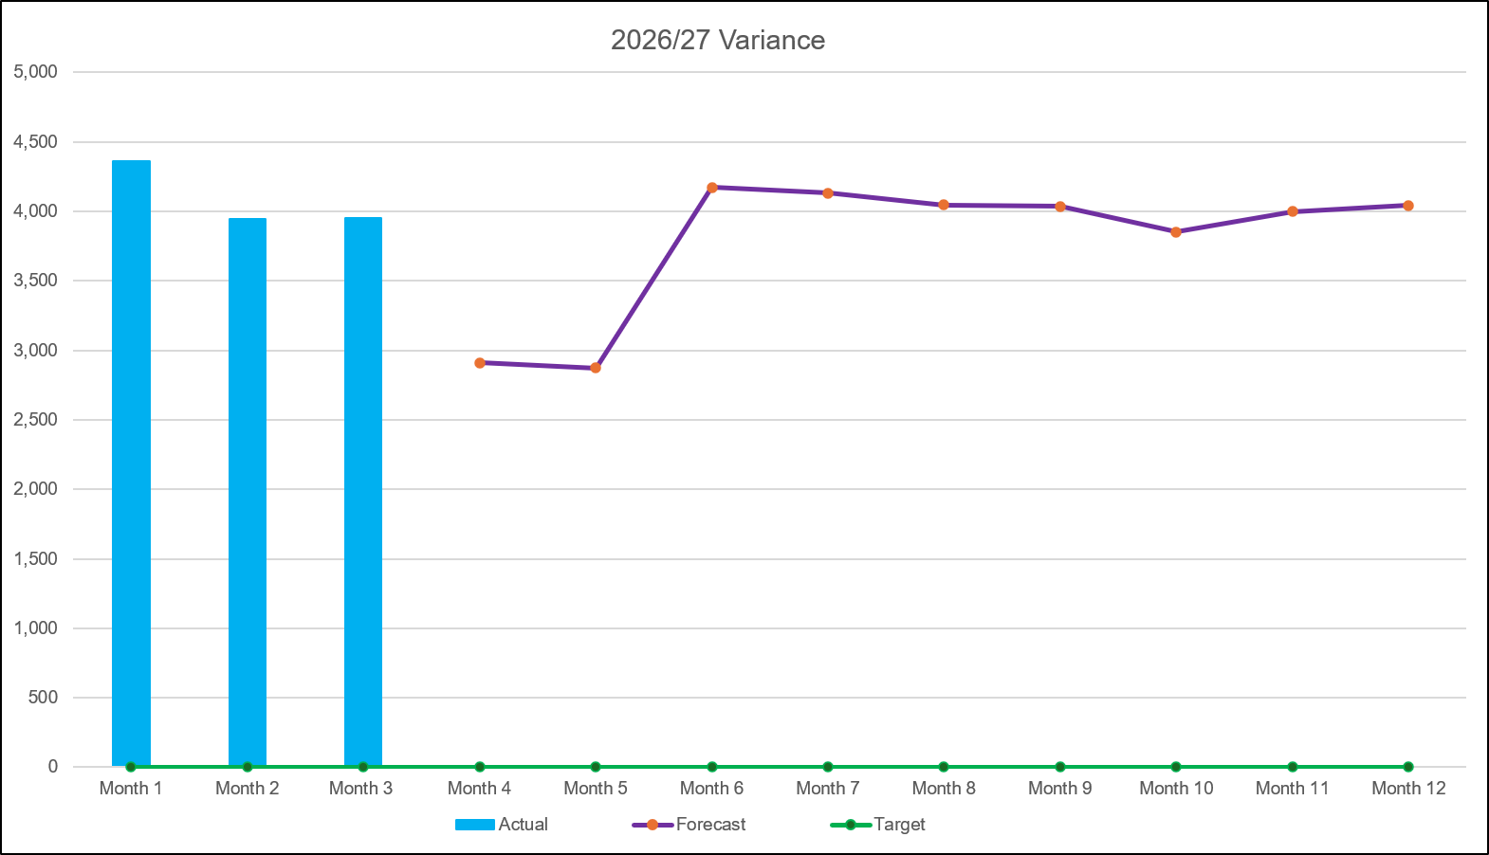

2026/27 Health Board Position & Service Area
SUMMARY
VARIANCE
In-Month Variance
£3.952m
YTD
Variance
£12.262m
Variance:
Current vs
Previous Mth
Forecast Variance:
In Mth vs
Actual
 | IN YEAR PERFORMANCE

Slide 9
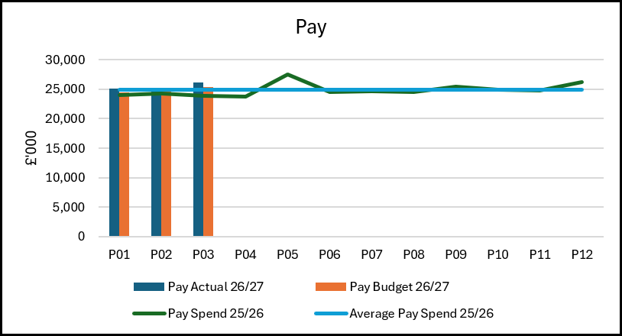
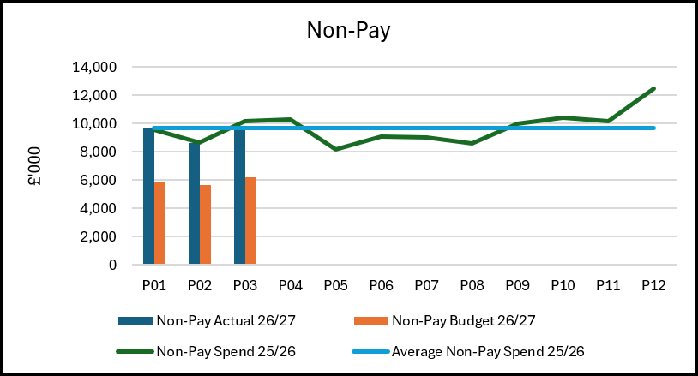
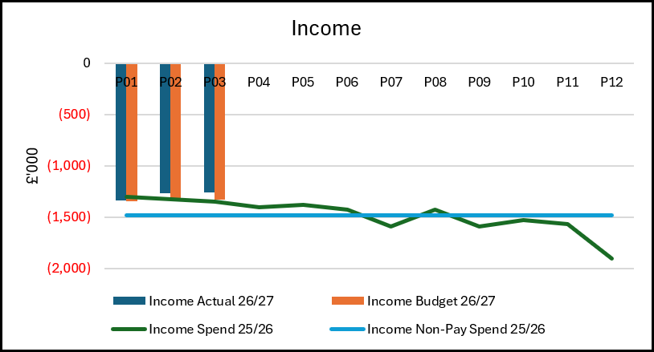
Summary: Income, Pay, Non-Pay
Pay – £2.2m overspent YTD
£2.3m relates to nursing (registered and unregistered) reflecting ongoing challenges to reduce variable pay driven by unavailability due to both sickness and maternity alongside open unfunded bed capacity. Sickness management remains a priority with the rollout of the nursing transformation programme expected to support improvement through this year. The most significant overspends is seen in front door services with the Emergency Department and Acute Medical Unit being the two highest overspending cost centres.
£0.6m Medical staffing with continued variable pay challenges to support acute rota gaps and cover requirements particulalry in OMFS, Cardiology and Burns & Plastics. Recruitment expected to support the OMFS position has taken place, and a trajectory of improvement options is being developed for other services. Pathology is also overspent on medical pay and developing a multifactorial plan for longer term sustainability.
£0.3m under spend on A&C staff offsets these pressures but is mainly due to long term vacancies included in the underlying assessment. A number have been dis-established already, with further discussions ongoing.
Non-Pay £10.2m overspent YTD
£5.0m unachieved cost improvements against the 2026/27 target. This is partly due to delivery phasing increasing in the latter part of the year, and partly due to the overall cost improvement plan shortfall which is £12.9m as at month 3.
£2.5m unachieved prior year cost improvements.
£2.2m clinical services and supplies pressures, £0.4m drugs, £0.2m blood products, £0.4m Pathology Managed Service Contracts, £0.6m specialist services (limbs and devices) offset by income, £0.2m maintenance contracts under review and other smaller drivers across all consumables. All are activity driven and are being reviewed with clinical and procurement teams to improve pricing, stock management and product standardisation.
Other pressures on equipment hire, postage and outsourcing to support Pathology activity are being actively managed and expect to reduce through the year.
Income £0.1m over-achieved YTD
Overperformance on the JCC contract (£0.2m) and other Health Board income (£0.1m) support our clinical consumables spend. However, there are small income shortfalls against longstanding income generation targets, where the capacity is now focussed on achieving performance for Swansea Bay patients, these targets are under review with relevant management and clinical teams.

Slide 10
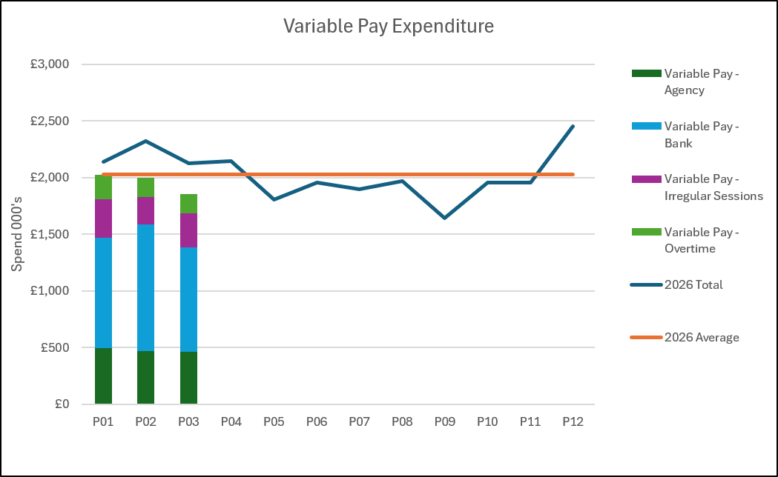
Pay Summary
£2.0m variable pay spend in month, which represents a reduction overall with improvements in nursing (both registered and healthcare support workers) offset by increases in Medical variable pay.
Year to date total spend of £6.3m; of which £452k was funded per the plan submissions for meeting diagnostic targets and £91k was funded per the plan for delivery of the vascular interventional radiology service which remains fragile and dependant on variable pay.
Main Areas of Spend in Month
£1.0m nursing (both registered and unregistered), almost entirely bank with continued pressures in unavailability for both sickness and maternity leave alongside open unfunded beds.
£0.6m Medical staffing of which £0.2m relates to Cellular Pathology where the team has vacancies and a recognised demand and capacity gap. Other areas which continue to see pressures due to gaps in rotas include Radiology, Cardiac surgery and the acute medical rota, which also includes additional costs to cover open surge areas.
£0.2m Healthcare Science due to long term staffing gaps in Laboratory Medicine and Cellular Pathology.
£0.1m Radiology reporting outsourced to Everlight (funded via core Recovery).
Actions
  Continue to manage unavailability
  Reduce variable pay cost where essential (i.e. hourly rates)
  Recruitment to fill workforce vacancies

Slide 11
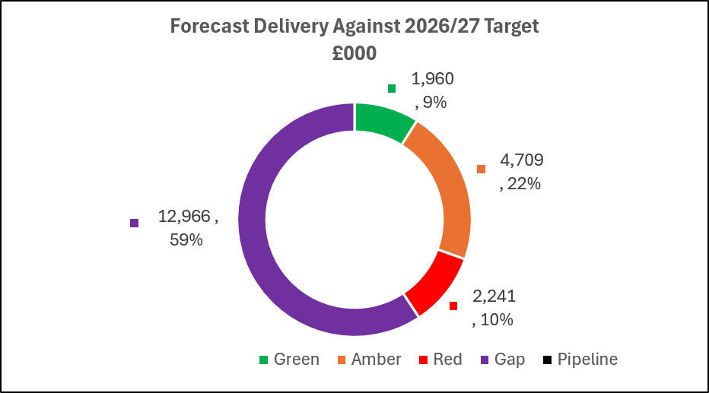
Savings

Slide 12
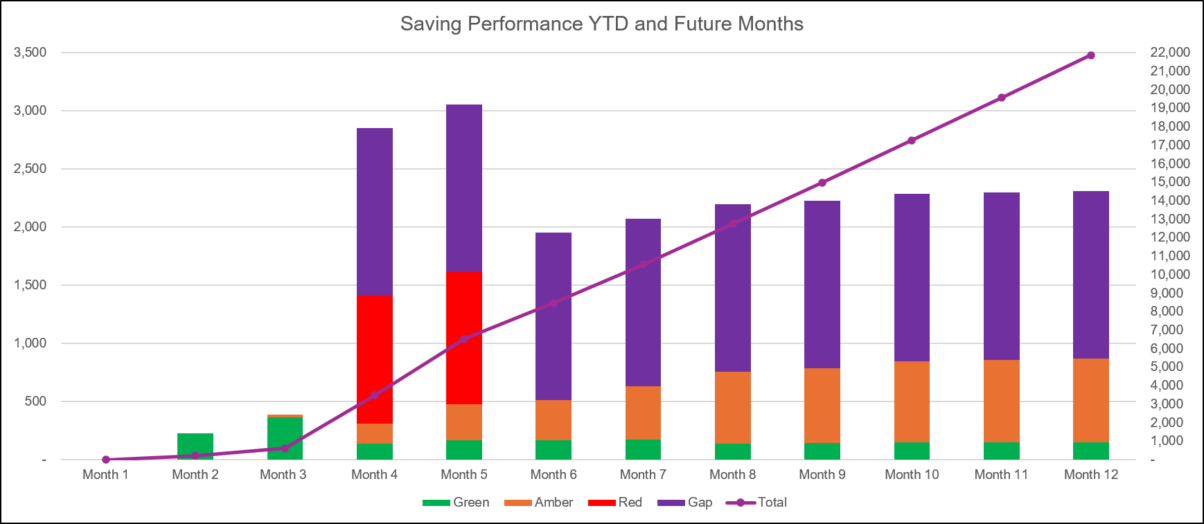
Savings

Slide 13
Identification Opportunities & Risk
Further Opportunities Above £65m |  | Further Notes / Comments It is difficult to ensure that there is no cross over in locally explored opportunities and those captured in the thematic workstreams as those targets are so wide ranging in coverage. Supporting the Health Board to deliver more through the themes is a key aim of the management team, in particular to see reductions in non pay and drugs spend which are currently limited in forecast delivery for Morriston group. It is unlikely that all growth can be mitigated in full in year, alongside inflation. Though the group remain committed to delivering the lowest possible cost up.
Risks (top 7)

Slide 14
Part D: Budget Holder Performance

Slide 15
Accountability Letters: Variance By Budget Holder

Slide 16
Accountability Letters: Replies & Training

Slide 17
Accountability Letters: Qliksense Usage Stats

