Slide 1


Performance & Finance Committee
Neath Port Talbot & Singleton Service Group
28/07/2026

Slide 2
Part A: Priority Areas & Key Actions

Slide 3
Summary Actions
PRIORITY AREAS FOCUS | Workforce Planning Programme - structured workforce planning using the methodology and toolkits available (encompassing A&C headcount reduction). Improve Staff Health and Wellbeing by 1%- A structured sickness improvement programme is operational, supported by hotspot reviews, absence summits, workforce data analysis and wellbeing actions within SEWR Plans. Whilst progress is evident in some areas, continued focus is required to secure delivery of the year end sickness improvement target. Model of Care Transformation - Pilot is progressing on Ward 12 and Ward C, currently in Week 2.
5 TOP ACTIONS FOR NEXT 4 WEEKS | Workforce Planning Programme - Continue to progress the programme in Oncology, Haematology, MPCE and Radiotherapy. Further develop the A&C Headcount reduction PID and putting in place support for Divisions to develop and initiate implementation of their A&C PIDs. Improve Staff Health and Wellbeing by 1% - Continue to support the sickness improvement programme. Understanding the key drivers of medical pay expenditure and agreeing the actions required to mitigate costs Support Thematic Programs Model of Care Transformation – continue to support the roll out of the pilot period. Continue to develop the Clinical Administration Redesign work
5 TOPS ACTIONS LAST 4 WEEKS & UPDATE ON OUTCOME | Further refined the workforce planning approach based on learning from the pilot and applied that to the most up to date NTSSG A&C headcount reduction PID. Significant investment of time from the HR BP Team to support teams through the workforce planning programme. Model of Care Transformation support continued.

Slide 4
Part B: Look Forward

Slide 5
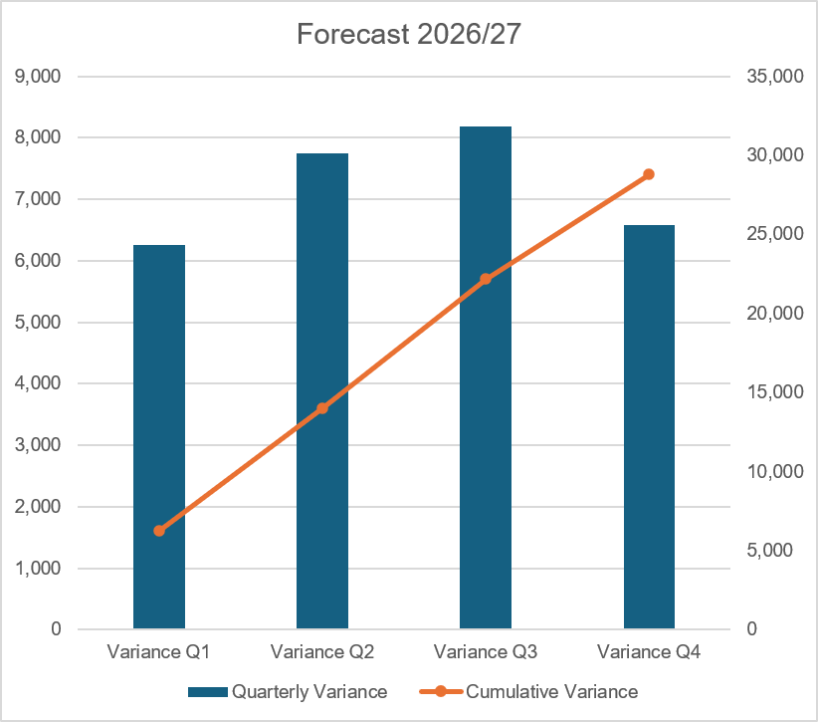
Forecast
Key Assumptions:
Forecast based off M3 performance
Excludes potential impact of non-pay inflation, Drug inflation, and underlying growth pressures
Assumes full utilisation of any recovery funding allocations;
NICE-related expenditure is assumed to continue at the M3 level, with matched funding available.
Amber-rated thematic savings schemes are assumed to deliver in line with planned trajectories as at M3 reporting
Rostered shift fill rates are assumed to remain at current levels
Known external recruitment commitments have been incorporated, with broad assumptions made on start dates

Slide 6
Forecast

Slide 7
Part C: Look Back

Slide 8
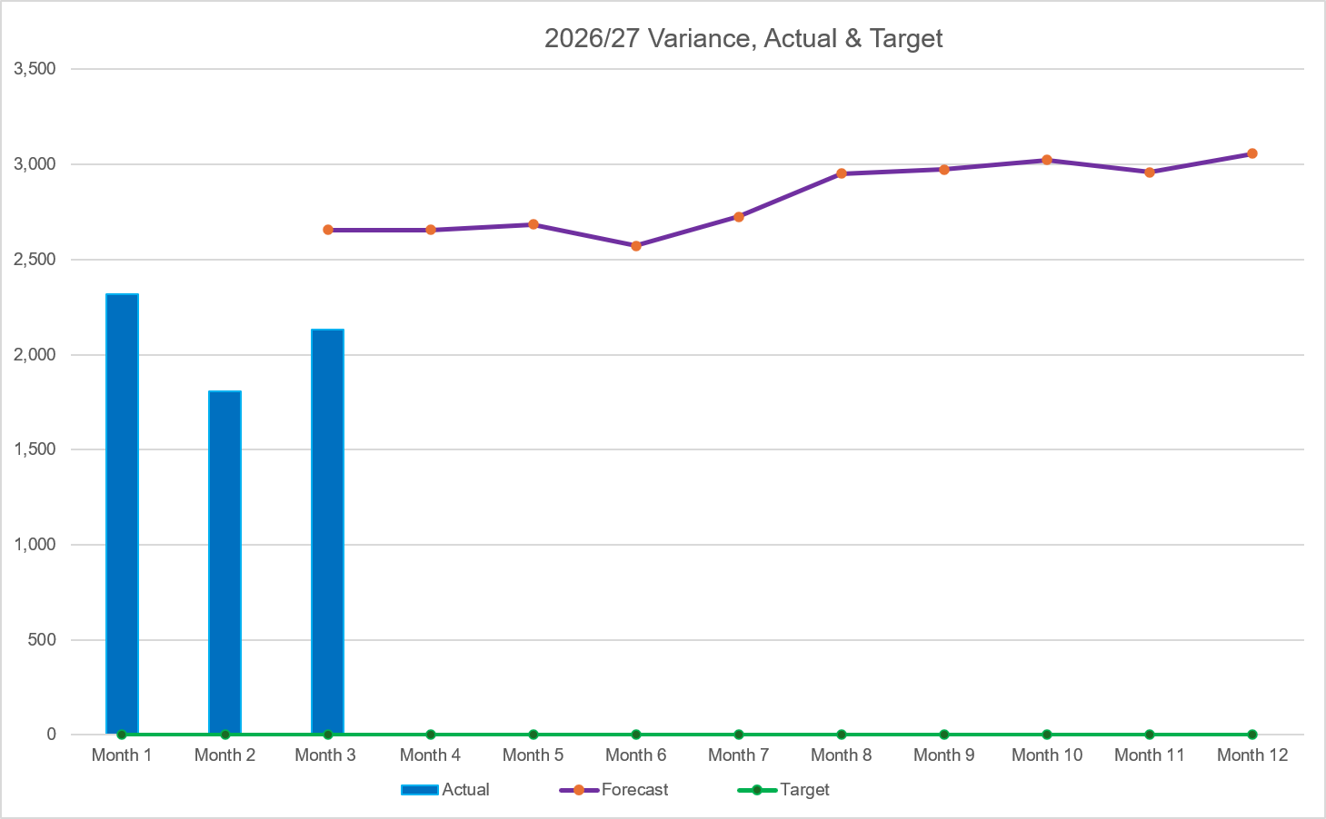
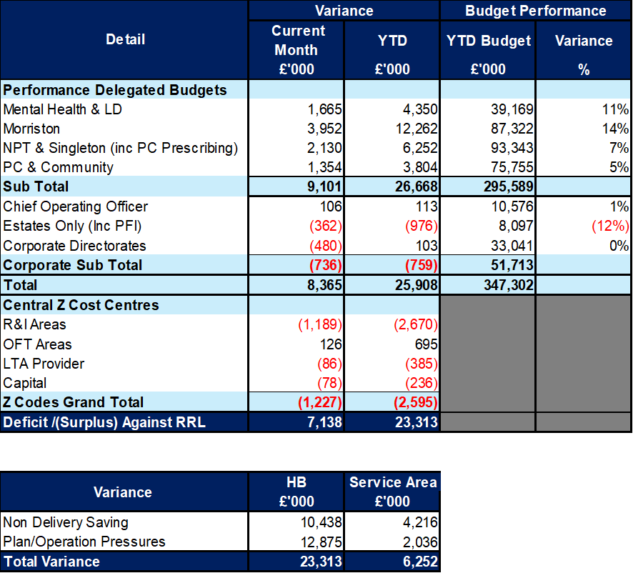

2026/27 Health Board Position & Service Area
SUMMARY
VARIANCE
In-Month Variance
£2.130m
YTD
Variance
£6.252m
Variance:
Current vs
Previous Mth
Forecast Variance:
In Mth vs
Actual
 | IN YEAR PERFORMANCE

Slide 9
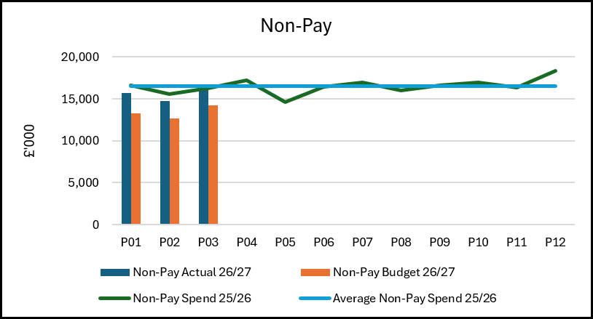
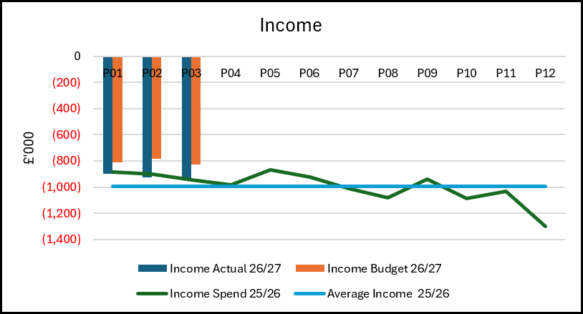
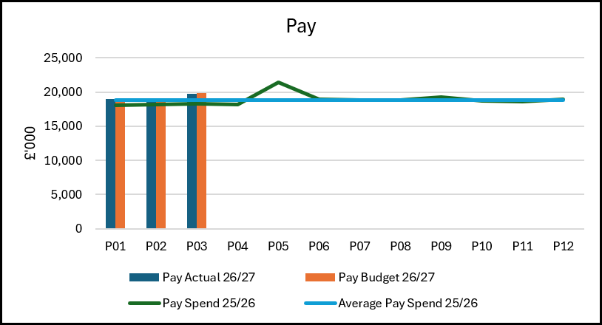
Summary: Income, Pay, Non-Pay
Pay – Pay expenditure delivered a favourable variance of £89k in-month and £155k YTD. Despite the overall underspend, there continue to be significant pressures across several medical staffing budgets within the Surgery and Cancer Division, particularly Anaesthetics, Trauma & Orthopaedics, Oncology and Haematology.
Additional expenditure associated with Ward 4 (£274k YTD) enhanced capacity also remains a cost pressure; however, the ward closure during June generated a reduction in pay spend of approximately £70k, helping offset wider staffing pressures.
Non-Pay – Non-Pay expenditure reported an adverse variance of £2.352m in-month and £6.831m YTD. The principal driver remains the shortfall in the delivery of Cost improvement Programmes (CIPs), contributing £1.301m of the in-month overspend. Other significant pressure include a £323k overspend within Primary Care Prescribing, largely attributable to No Cheaper Stock Obtainable (NCSO) medication costs – a pressure experienced on an All-Wales basis. Within Secondary Care services, expenditure on Medical & Surgical Equipment and Appliances within Theatres and Trauma & orthopaedics contributed further £577k overspend. In addition, the Total Bed Management (TBM) contract continues to exceed plan, reporting an in-month overspend of £78k.
Income – Income performance was £131k below plan in-month and £424k below plan YTD. This position reflect a £60k shortfall in Private Patient Income, driven by reduced activity levels while revised pay rates remain under negotiation and agreement. Offsetting this, SE Wales Radiopharmacy generated a £126k non-recurrent income benefit in-month. However, this performance is expected to diminish from month 4 onwards as activity transfers back to the new Transforming Access to Medicines (TRAMS) facility in the South-East. The reduction in income will be accompanied by lower associated production costs, although the service currently provides a net financial contribution.

Slide 10
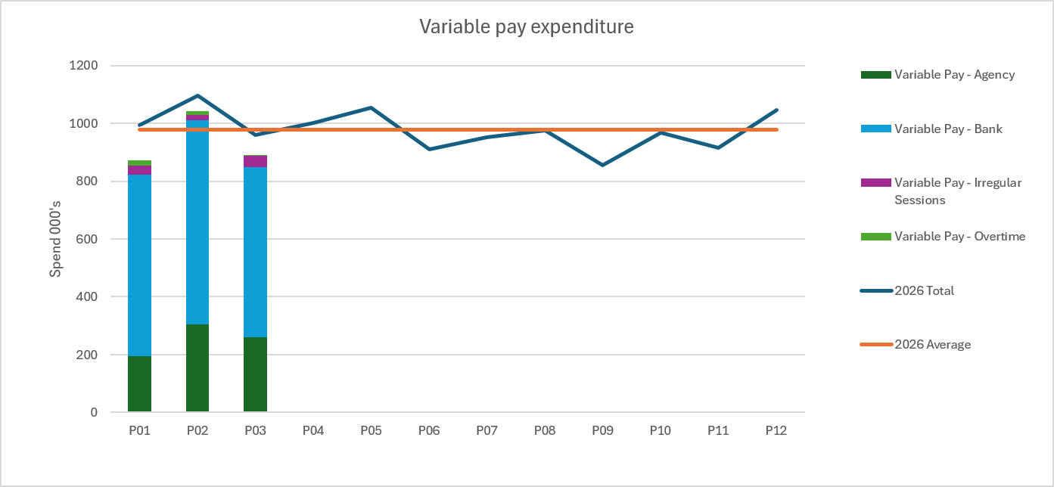
Pay Summary
Pay Position and Key Drivers
The 2026/27 medical pay award uplift, including the YTD arrears element, has been paid within the M3 position, with corresponding budget received to offset the financial impact. The pay position should therefore be viewed net of this adjustment.
Within the Surgery Division, Anaesthetics pay overspend remains one of the most significant cost pressures. The adverse variance is broadly split between Consultant staffing (£150k overspend in month) and Junior doctor expenditure (£157k overspend in month). A significant proportion of the pressure relates to variable pay costs, which account for £321k of the total in month overspend, highlighting ongoing challenges in covering service demand.
Current pay overspends across several clinical services continue to be mitigated by favourable positions elsewhere in the Service Group, including Patient Access, Medical Physics & clinical Engineering (MPCE), Ophthalmology, Neath Surgical wards, Theatres, Community Paediatrics, Neonatal Services, Midwifery and Gynaecology. Whilst this has helped contain the overall pay position, any reduction in the level of underspending within these services would increase the visibility of underlying pay pressures and reduce the Service Group’s capacity to absorb overspends in challenged areas.
Variable Pay
Nursing variable pay expenditure reduced during M3, with spend £120k lower than the average reported across M1 and M2. This improvement was primarily driven by a £60k reduction within Ward 4, following the closure of additional bed capacity during June.
Conversely, Medical variable pay expenditure increased £77k compared with the average position in M1 and M2. The principal driver was Spinal Services, which accounted for £68k of the increase, reflecting higher utilisation of a combination of agency staffing, Additional Duty Hours (ADH) and Waiting List Initiative (WLI) to support service delivery and performance levels.

Slide 11
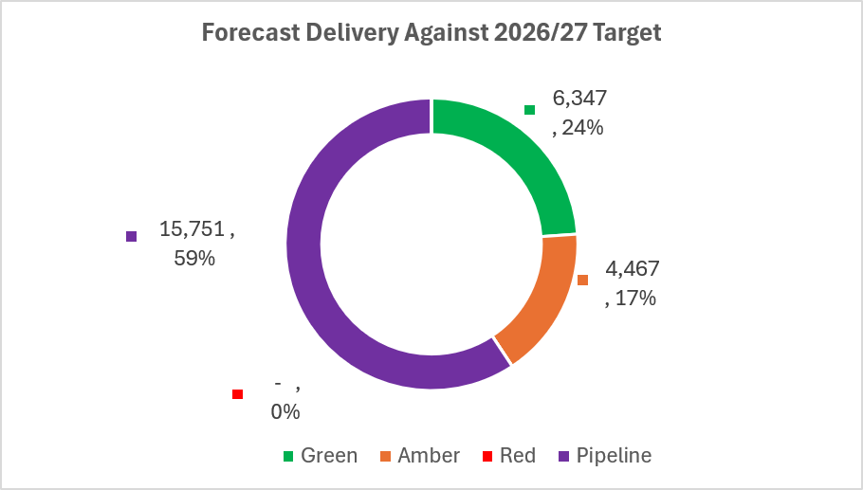
Savings

Slide 12
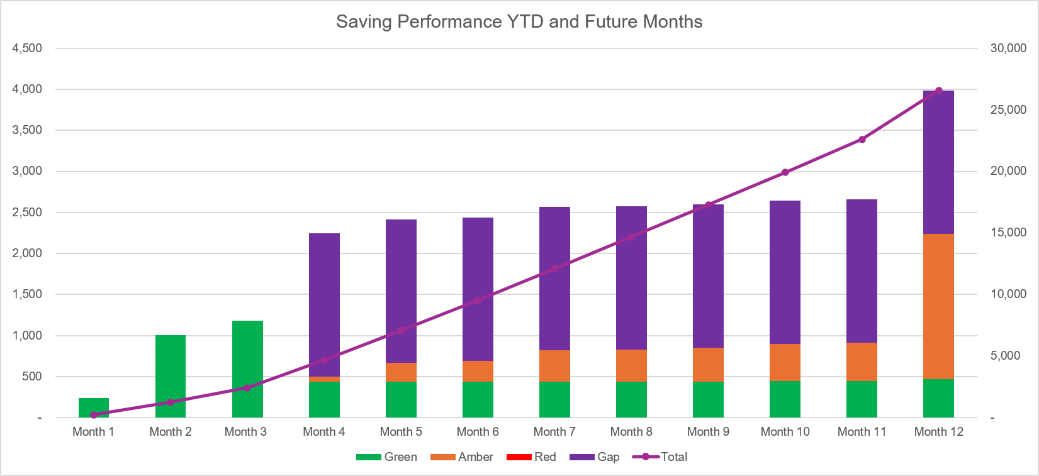
Savings

Slide 13
Identification Opportunities & Risk
Further Opportunities Above £65m |  | Further Notes / Comments Actions to Mitigate Slippage on Thematic Schemes are with the forecast Planning Assumptions
Risks (Top 5)

Slide 14
Part D: Budget Holder Performance

Slide 15
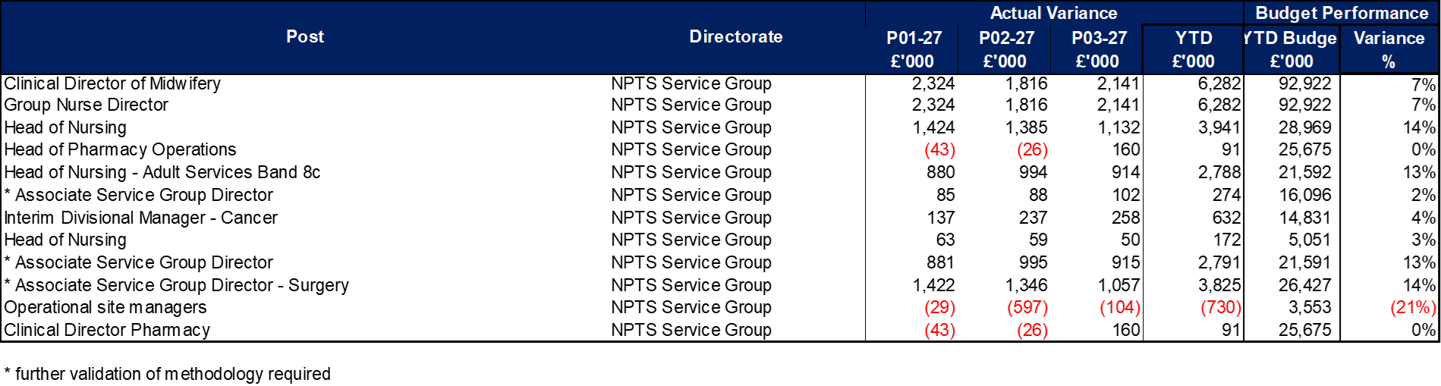
Accountability Letters: Variance By Budget Holder

Slide 16
Accountability Letters: Replies

Slide 17
Accountability Letters: Training Record

Slide 18
Accountability Letters: Qliksense Usage Stats

