Slide 1
Annex 1
Detail Financial Position
Month 4 FY 2026/27

Slide 2

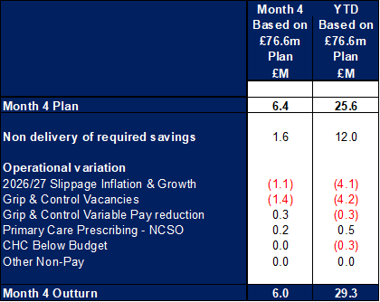
Financial Summary
In-Month Variance
£5.952m
Variance to Plan £0.4m
YTD Variance
£29.264m
Variance to Plan £3.7m
Executive Summary
Income and Expenditure Insights
Operational and Financial Performance
Appendices
Key Information
Operational Variation. The following operational variation between Month 3 and 4 has been incurred: PCT: There was a £0.1m improvement in both CHC and dental income in month. NPTS: There was an increase to Bank and ADH in month of £0.1m offset by an improvement in prescribing. Non pay was overspent by £0.1m in relation to Surgery and theatres expenditure. MHLD: Nursing variable pay was up in month by £0.1m and CHC expenditure continues to overspend. The latter however was offset by a number of underspends within non pay. LTA Performance: There was a benefit in month on Provider & Commissioner LTA performance.

Slide 3
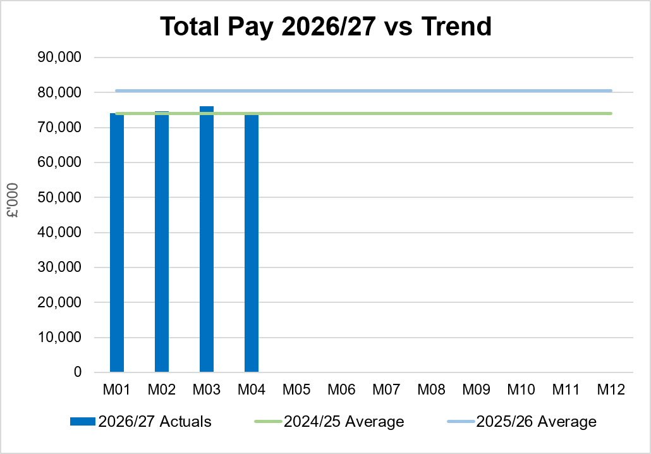
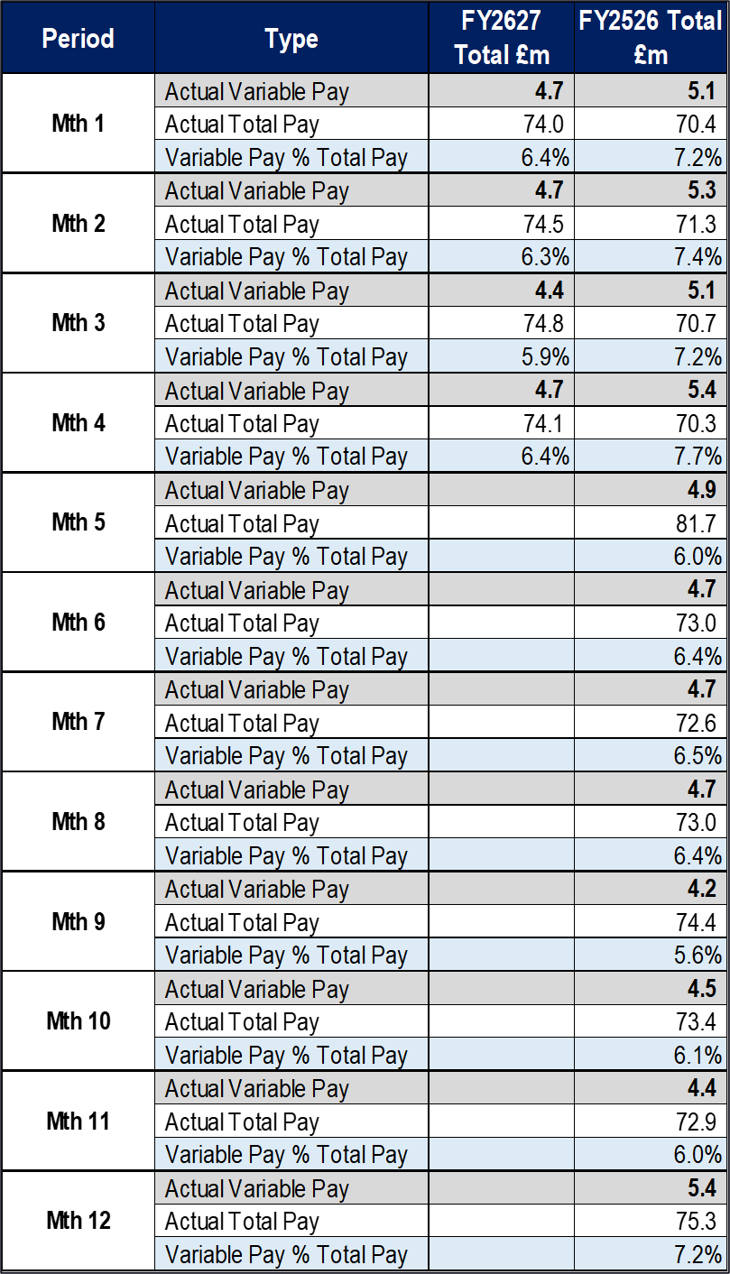
Total Pay Insights
In-Month Actual
£74.085m
Variance to Ledger £0.79m
YTD Actual
£298.665m
Variance to Ledger £2.70m
Executive Summary
Income and Expenditure Insights
Operational and Financial Performance
Appendices
Key Information
Variable Pay expenditure increased by £0.3m in Month 4. Reduction in the actual level of expenditure noting Month 3 included £1.2m for Medical & Dental staff pay arrears. Overall Month 4 pay was lower than Month 3, with increased vacancies, based on the actual pay feeder data within the ledger.

Slide 4
Total Pay Insights (1)
In-Month Actual
£74.085m
Variance to Ledger £0.79m
YTD Actual
£298.665m
Variance to Ledger £2.70m
Executive Summary
Income and Expenditure Insights
Operational and Financial Performance
Appendices
Actual Expenditure By Staff Group
Actual Expenditure & WTE For A&C Staff Group As Per Ledger
Key Information
M03 contains the YTD medical and dental 2026/27 pay award, total value = £7.1m or £0.6m per month (£1.2m arrears in M03) A4C Pay Award 2026/27 = £22.5m and paid from 1st April 2026. The 2 tables on the right detail the total A&C Pay and WTE by Service Area, with steady reduction through Q1 and into Month 4 in both actual spend and WTE. Average 25/26 not include 26/27 pay award of 3.3% for A4C and 3.5% Medical & Dental.

Slide 5
Total Pay Insights (2)
In-Month Actual
£74.085m
Variance to Ledger £0.79m
YTD Actual
£298.665m
Variance to Ledger £2.70m
Executive Summary
Income and Expenditure Insights
Operational and Financial Performance
Appendices
Actual Expenditure & WTE for Nursing & Midwifery By Staff Group As Per Ledger
Actual Expenditure & WTE for Medical & Dental By Staff Group As Per Ledger
Key Information
The above tables detail the total Nursing & Midwifery and Medical & Dental Pay and WTE by Service Area M03 contains the YTD medical and dental 2026/27 pay award, total value = £7.1m or £0.6m per month (£1.2m arrears in M03) A4C Pay Award 2026/27 = £22.5m and paid from 1st April 2026. Average 25/26 not include 26/27 pay award of 3.3% for A4C and 3.5% Medical & Dental.

Slide 6
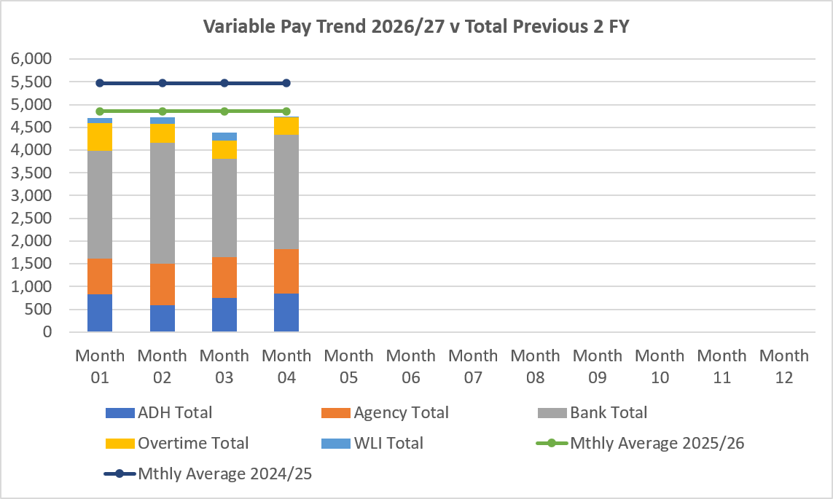
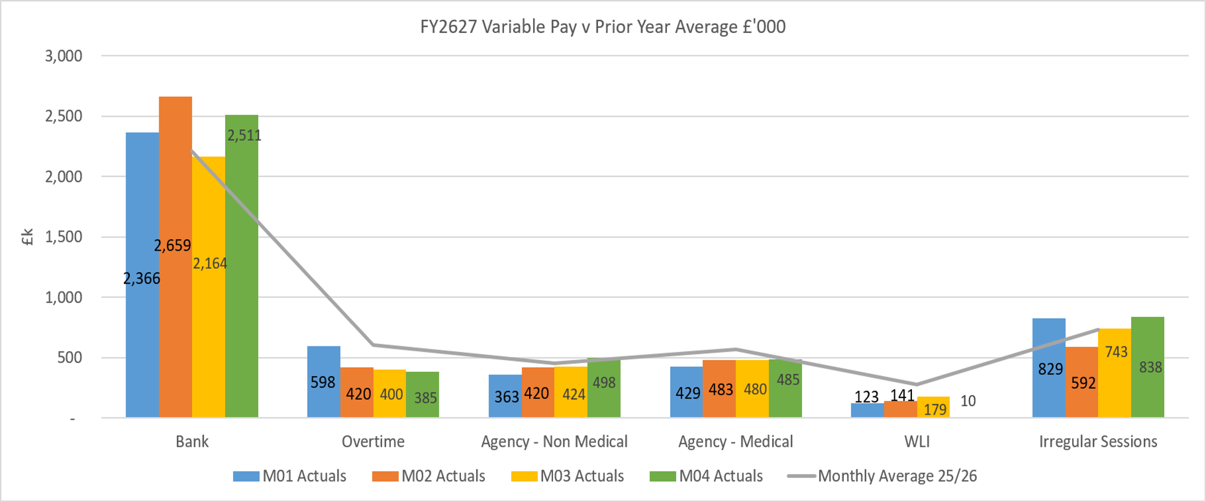
Variable Pay Insights
In-Month Actual
£4.726m
YTD Actual
£18.538m
Executive Summary
Income and Expenditure Insights
Operational and Financial Performance
Appendices
Key Information
The actual variable pay spend at Month 04 was £4.7m. Bank and agency continue to be the key driver for this continued high spend, with bank spend increasing from Month 3 figures.

Slide 7
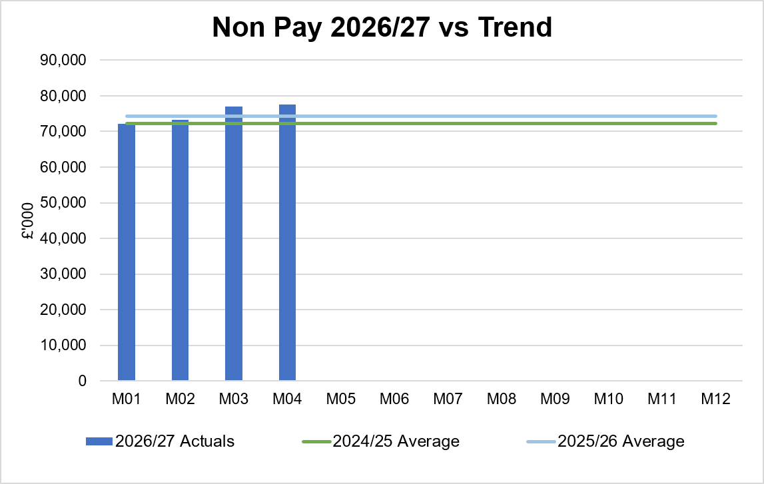
Non-Pay Insights
In-Month Actual
£77.606m
Variance to Ledger £5.6m
YTD Actual
£300.074m
Variance to Ledger £25.9m
Executive Summary
Income and Expenditure Insights
Operational and Financial Performance
Appendices
# includes saving non-delivery
Key Information
The in-month increase relates to clinical consumable costs driven by activity in specialist services and Theatres totalling £1.6m. It should be noted that £0.6m of this is offset by JCC income. Within the ledger the gross JCC income is reflected within the income lines and not netted off against expenditure and so overall the Health Board position is not adversely affected. If JCC activity increases the gross level of expenditure and income will increase. The main drivers within this category of clinical consumable expenditure include heart valves & pacemakers, linked to some JCC activity. Non-Pay also includes secondary care drugs, a breakdown of the categories of Clinical Consumables based on actual spend is provided in the table on the right. Prescribing is overspent by £0.2m in-month (Month 3, £0.3m) following receipt of the latest datasets (May 2026, PAR data is received 2 months in arrears); the overspend is driven by the No Cheaper Stock Obtainable (NCSO) position. Global conflicts are affecting shipping routes which is adversely impacting on the availability of medicines and increasing prices of procurement due to additional delivery costs.

Slide 8
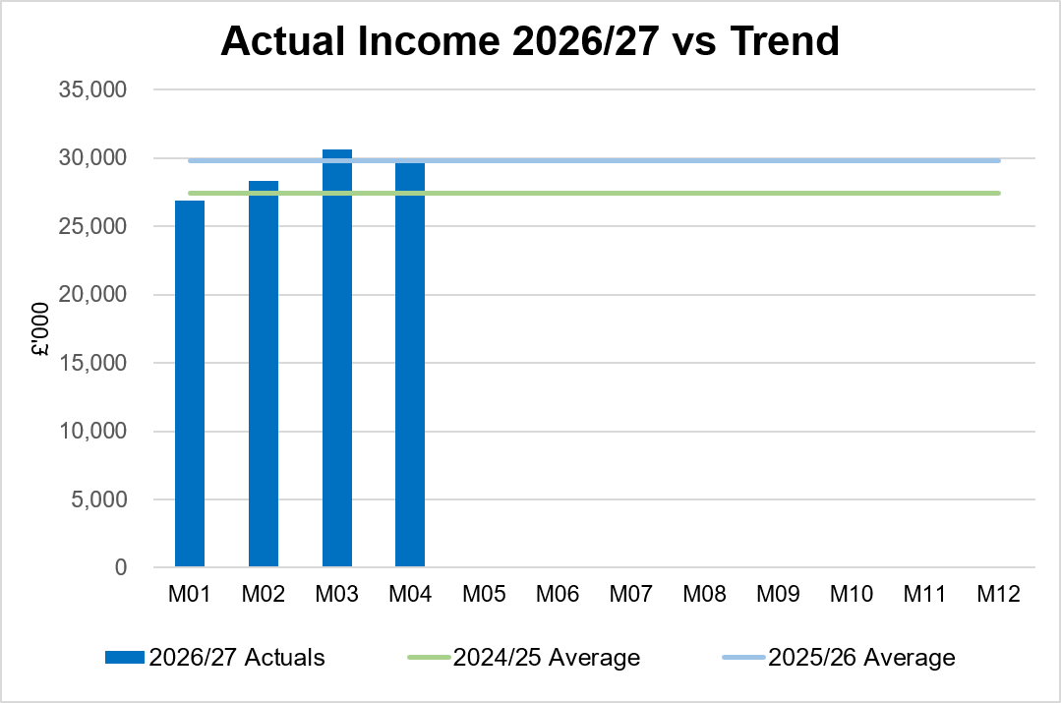
Income Insights
In-Month Actual
£29.909m
Variance to Ledger (£0.438m)
YTD Actual
£115.759m
Variance to Ledger £0.6m
Executive Summary
Income and Expenditure Insights
Operational and Financial Performance
Appendices
Key Information
Income remains high for Month 04. Higher level of recharging between other Health Boards for blood products along with other one-off benefits in month including within nuclear medicine and radiology. The rebates relating to Mounjaro continue to provide an increase in income. The price cap for EPU income took place in June, however, the backdated element of the costs to April have been passed on in July to HEIW resulting in a one-off benefit. The Joint Commissioning Committee (JCC) income as a provider reported an overperformance of £0.6m in Month 4, mainly in relation to Plastics, Cardiology and Cardiac services. Dental contract income underperformed in-month by £0.1m.

Slide 9
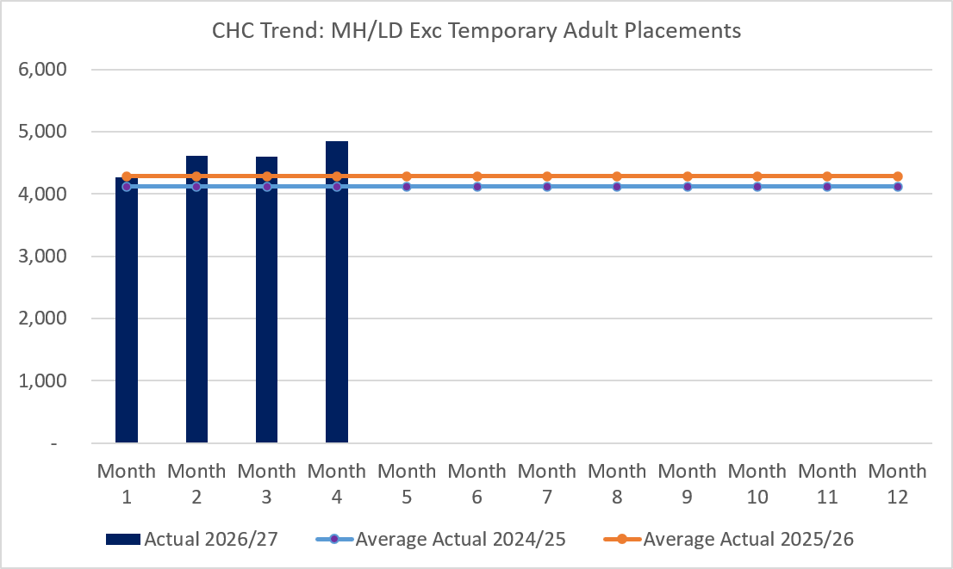
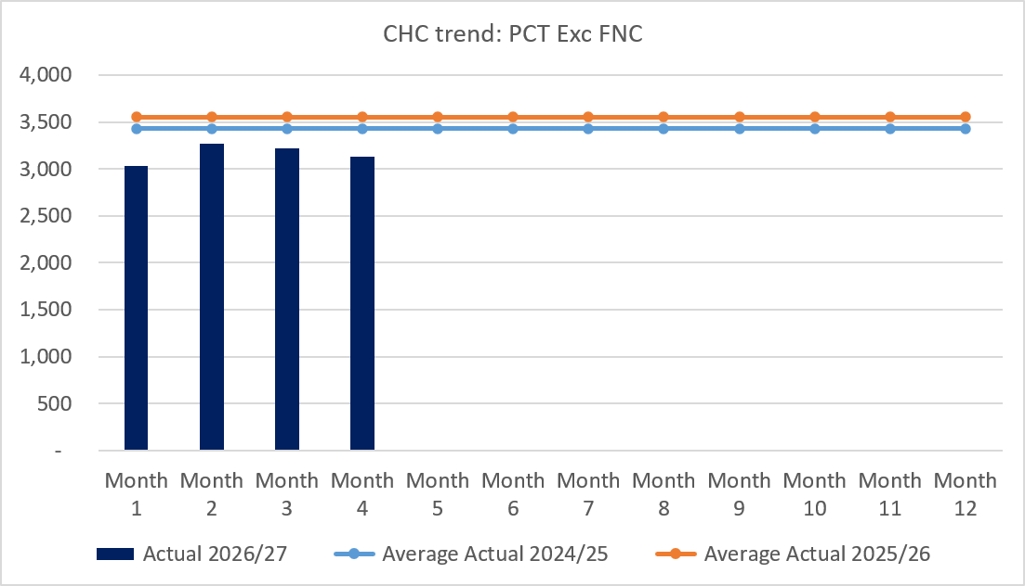
CHC Insights
In-Month Actual
£7.975m
Variance to Ledger £0.6m
YTD Actual
£30.968m
Variance to Ledger £1.5m
Executive Summary
Income and Expenditure Insights
Operational and Financial Performance
Appendices
Key Information
In Month 4 CHC was overspent by £0.6m, this is a slight increase on the Month 3 position despite a reduction in case numbers within PCT. An analysis of actual expenditure and patient numbers for 2026/27, is provided in table above. The table also includes the Temporary Adult Mental Health Placements for transparency. The graphs on the left reflect average expenditure in the last two financial years, compared to the in- month position. MH/LD excludes the temporary placements and PCT excludes Free Nursing Care/Self Funders.

Slide 10
LTA Performance Insight
In-Month Actual
Provider/Commissioner
Variance Ledger = (£0.7)
YTD Actual
Provider/Commissioner
Variance Ledger = (£2.4m)
Executive Summary
Income and Expenditure Insights
Operational and Financial Performance
Appendices

Slide 11
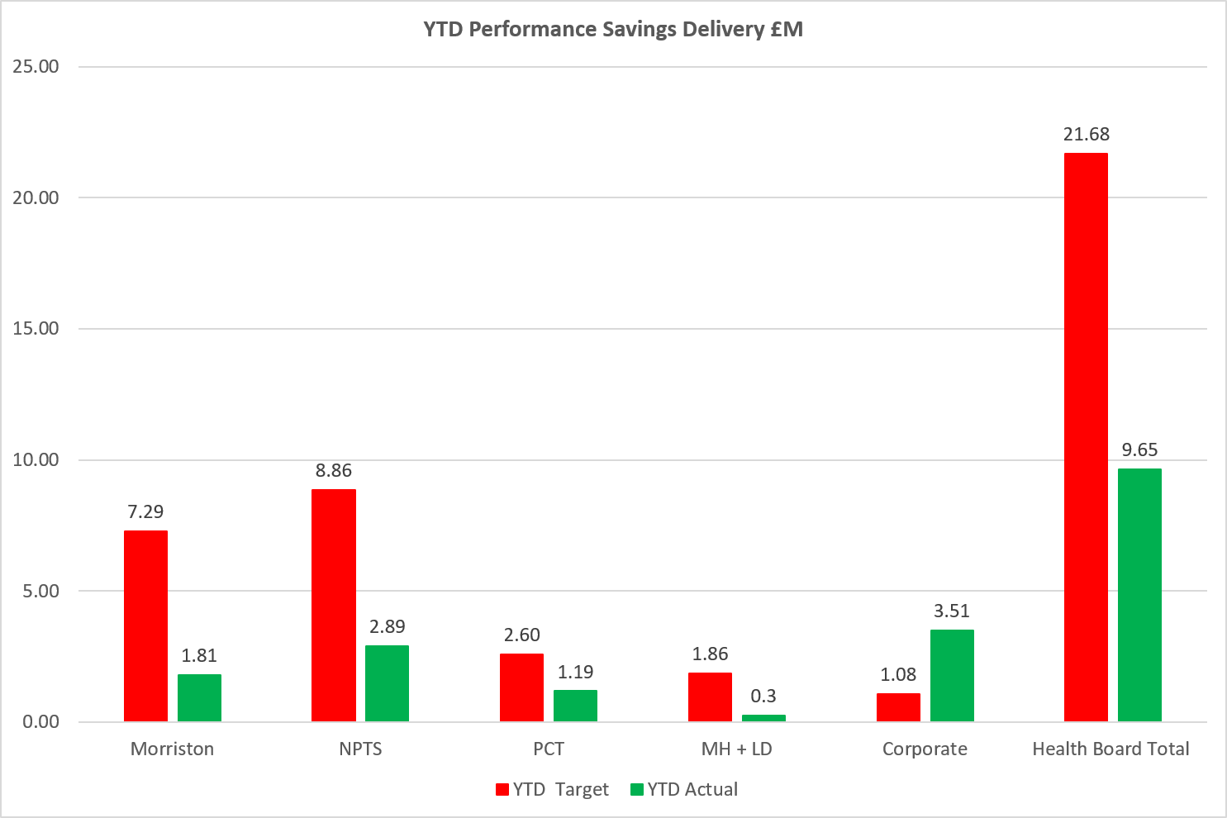
Savings Insights
Executive Summary
Income and Expenditure Insights
Operational and Financial Performance
Appendices
Savings
In Year Savings
Target = £65m
Green & Amber = £40.1m
Green & Amber % Target = = 62%
Recurrent Savings
Target = £65m
Green & Amber = £24.8m
Green & Amber % Target = 38%
In Month Delivery
Target = £5.4m
Achieved = £3.8m
Gap = £1.6m
YTD Delivery
Target = £21.7m
Achieved = £9.7m
Gap = 12.0m

Slide 12
Reserves Insights
Executive Summary
Income and Expenditure Insights
Operational and Financial Performance
Appendices
Key Information
For 2026/27, the Health Board will hold two central reserves and the purpose of these reserves are below: Main – this holds funding from Welsh Government or the plan that has yet to be issued to Budget Holders. These items are not surplus but either due to timing have not been issued or is an area where funding is issued based on actual values consumed in future month. NICE – this holds the total Health Board funding for all NICE costs (drugs and infrastructure) and is issued to the service each month based on the actual costs consumed as reported through the Pharmacy system.

Slide 13
Anticipated Allocations
Executive Summary
Income and Expenditure Insights
Operational and Financial Performance
Appendices
Key Information
The current deficit plan of £76.6m is predicated on receipt of Welsh Government funding at the levels anticipated in the table opposite.

Slide 14
Appendix 1 – Variance by Budget Holder (Directors)
Executive Summary
Income and Expenditure Insights
Operational and Financial Performance
Appendices
Appendices

Slide 15
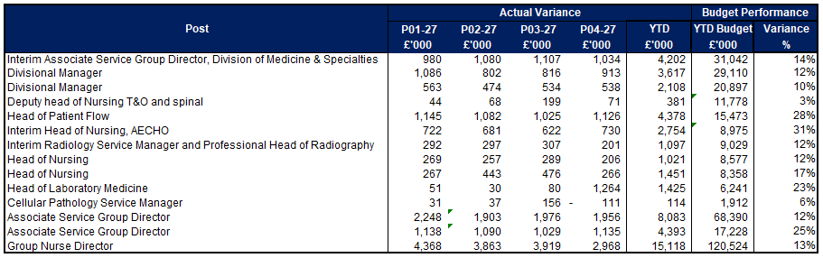
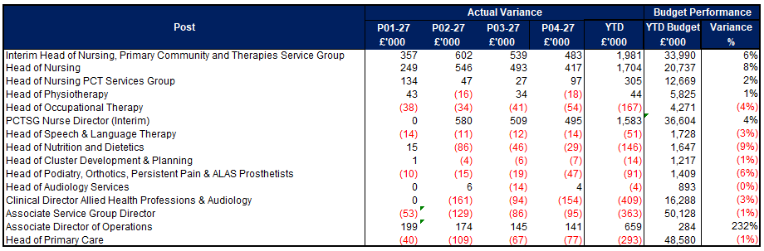
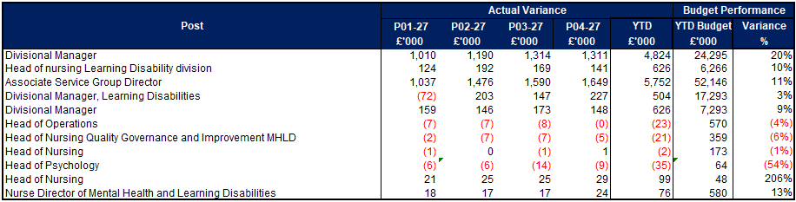
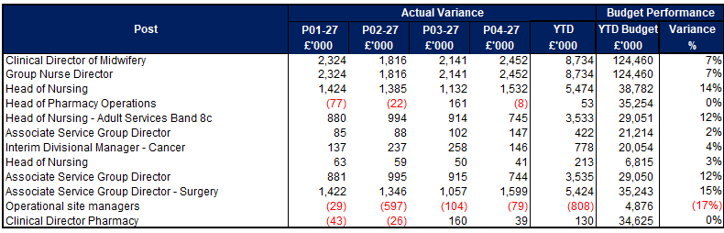
Appendix 2 – Variance by Budget Holder
Executive Summary
Income and Expenditure Insights
Operational and Financial Performance
Appendices
Appendices
Morriston Service Group
PCC Service Group
MH & LD Service Group
NPTS Service Group

Slide 16
Appendix 3 – Accountability Letters (1)
Executive Summary
Income and Expenditure Insights
Operational and Financial Performance
Appendices
Appendices

Slide 17
Appendix 3 – Accountability Letters (2)
Executive Summary
Income and Expenditure Insights
Operational and Financial Performance
Appendices
Appendices

Slide 18
Appendix 3 Qliksense – Finance Dashboard Usage
Executive Summary
Income and Expenditure Insights
Operational and Financial Performance
Appendices
Appendices
These tables monitor the Qliksense Dashboard usage for Month 04 for all 67 budget holders reporting usage in minutes.

Slide 19
Appendix 3 Qliksense – Finance Dashboard Usage
Executive Summary
Income and Expenditure Insights
Operational and Financial Performance
Appendices
Appendices
These tables monitor the Qliksense Dashboard usage for Month 04 for all 67 budget holders reporting usage in minutes.

Slide 20
Appendix 4 Summary Budget Holder Training
Executive Summary
Income and Expenditure Insights
Operational and Financial Performance
Appendices
Appendices
Status @ 11 August 2026
Key Information Outstanding Training
2 Executives 1 newly appointed – training will be provided in August 1 scheduled for August following annual leave 2 Service Groups 1 changed roles post letters published and role covered by another existing Budget Holder whilst HB recruits 1 retired and training will be provided once replacement postholder commences but covered by another Budget Holder 1 on maternity leave – responsibilities covered by another existing Budget Holder

Slide 21
Appendix 5 Summary Other Data
Executive Summary
Income and Expenditure Insights
Operational and Financial Performance
Appendices
Appendices
Maternity Review
The total costs for this are allocated to a dedicated Cost Centre (6F34).
Key Information Central Z Codes
Contracting: SLA /LTA performance: JCC (previously WHSSC), LTA and SLA contract income and expenditure are transacted within this area and financial performance reported. NICE approved high-cost drugs and associated LTAs are also transacted and monitored against targets set. In addition to this, non-contracted activity income in relation to English foundation trusts invoiced on a quarterly basis are reported. Capital: The Finance Capital Team manage a number of cost centres covering the PFI, IFRS16 and Depreciation charges for assets both owned and donated are transacted here. RRL and Central Reserves: The Welsh Government funding received at the start of the year is tracked within this area. Any anticipated allocations in year are also transacted through these codes. Other HB wide funding received from HEIW and SIFT is also captured in here. All central reserves remain within the Z cost centres and details of these are provided in Appendix 2. Corporate income and expenditure. Any income and expenditure that is not service group specific is transacted and reported through a number of corporate Z cost centres, examples include, payroll and pension costs, VAT recovery, losses and receipts in relation to funding from Welsh Risk Pool, overseas visitors’ income and Road Traffic Accident income.

Slide 22
Appendix 5 Summary Linked to Audit Action
Executive Summary
Income and Expenditure Insights
Operational and Financial Performance
Appendices
Appendices
AUDIT WALES UEC REPORT (AUGUST 2025) ACTION: To increase transparency and strengthen assurance that monies allocated to urgent and emergency care are being spent wisely, the Health Board should include information on its use of additional funding within regular finance reports to the Finance and Performance Committee. This should include the use of Six Goals, Further Faster and Regional Integration Fund monies.
RESPONSE: Below is a summary of the 2025/26 position
Six Goals Funding
Total Funding Received: £2,744,000 Six Goals funding was made recurrent in the 2026/27 Allocations (Referred to in letter as UEC). Funding used to support various programmes across the Health Board and is reported to WG on a monthly basis as part of the MMR submission. Areas where funding deployed 2025/26: SDEC Medical (Morriston) SDEC Surgical (Morriston) UPCC (PCT) Contract First (PTC) Overall investment into 6 Goals/ UEC has exceeded the original allocation of £2.7m
Further Faster Funding
Total Funding Received: £1,539,000 Further Faster Funding was made recurrent in 2025/26. The Health Board has invested £1.1m of this funding recurrently in the Frailty Hub The balance was used flexibility to support programmes linked to additional in hospital beds, community beds (including step up and step down) and also new initiatives such as the Directed Supplementary Service in Primary Care.
Regional Integration Funding (RIF)
Total Funding Received: £16,795,860 A summary of the projects funded under RIF and managed through the West Glamorgan RPB are shown: The strategy focused on pooling resources between the Health Board, local authorities and the third sector to deliver preventative, community-based care, ease hospital discharge delays, and protect ring-fenced investments for unpaid carers and mental health.

