Slide 1


Performance & Finance Committee
Month 4 July 2026
Primary Care & Community Service Group
Date 25th August 2026

Slide 2
Part A: Priority Areas & Key Actions

Slide 3
Summary Actions
PRIORITY AREAS FOCUS | Progression of PIDs for Amber schemes Decisions on Red schemes Development of PIDs for other recovery actions / develop new recovery actions Clarity on PCT components of R&S schemes Recurrent Savings Schemes
5 TOP ACTIONS FOR NEXT 4 WEEKS | Impact of Gorseinon / Ward 3 decision Progressing amber schemes to green Decision re: Frailty GMS Directed Supplementary Service Implications of Planned Care funding request decision Review Cluster engagement feedback and plan next steps
5 TOP ACTIONS LAST 4 WEEKS & UPDATE ON OUTCOME | Increased Green CIP schemes by £4.7m and Amber schemes by 0.8m Assessed impact of GP Out of Hour national negotiation request and input into Exec paper Impact assessment on GP OOH and UPCC scheme Planned Care request re Opthalmology risk Completed engagement exercise on reduction in the number of Clusters Completed training for remaining budget holders

Slide 4
Part B: Look Forward

Slide 5
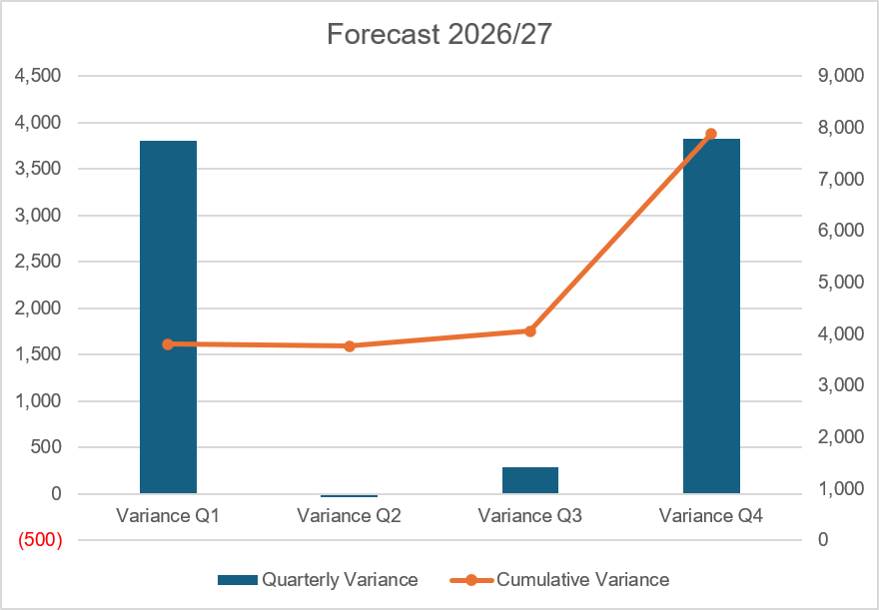
Forecast
Key Assumptions:
The forecast based on M4 is in line with M3. Whilst M4 saw a small improvement versus forecast the overall trend is in line with some offsetting movements.
Forecast is before further identified recovery actions of £0.8m, netting to £7.1m overspend, in line with M3.
Impact of increased travel has been included based on M2 year to date - £200k for the year additional costs backdated to Apr 26
Known external recruitment has been included, notably 3 Palliative Care doctors, 1 Restorative Dental consultant and 2 other dentists plus dental nurses, 1 Audiology and 16 Therapy graduates. All other recruitment expects to net to zero except reductions related to CIPs / recovery actions
2026/27 Prevention and Early Years and CHC and drugs inflation reserve is forecast to be fully spent
NICE drugs budget is assumed to continue at M4 levels in line with spend
Cluster funding is forecast to be fully spent
Primary Care Contracts are forecast at break-even with the exception of Pharmacy which is £270k overspent in line with 25/26 out-turn

Slide 6
Forecast [Continued]

Slide 7

Identification Opportunities & Risk
Further Opportunities |  | Further Notes / Comments
Risks (Top 5) Recovery Actions not on Tracker

Slide 8
Part C: Look Back

Slide 9

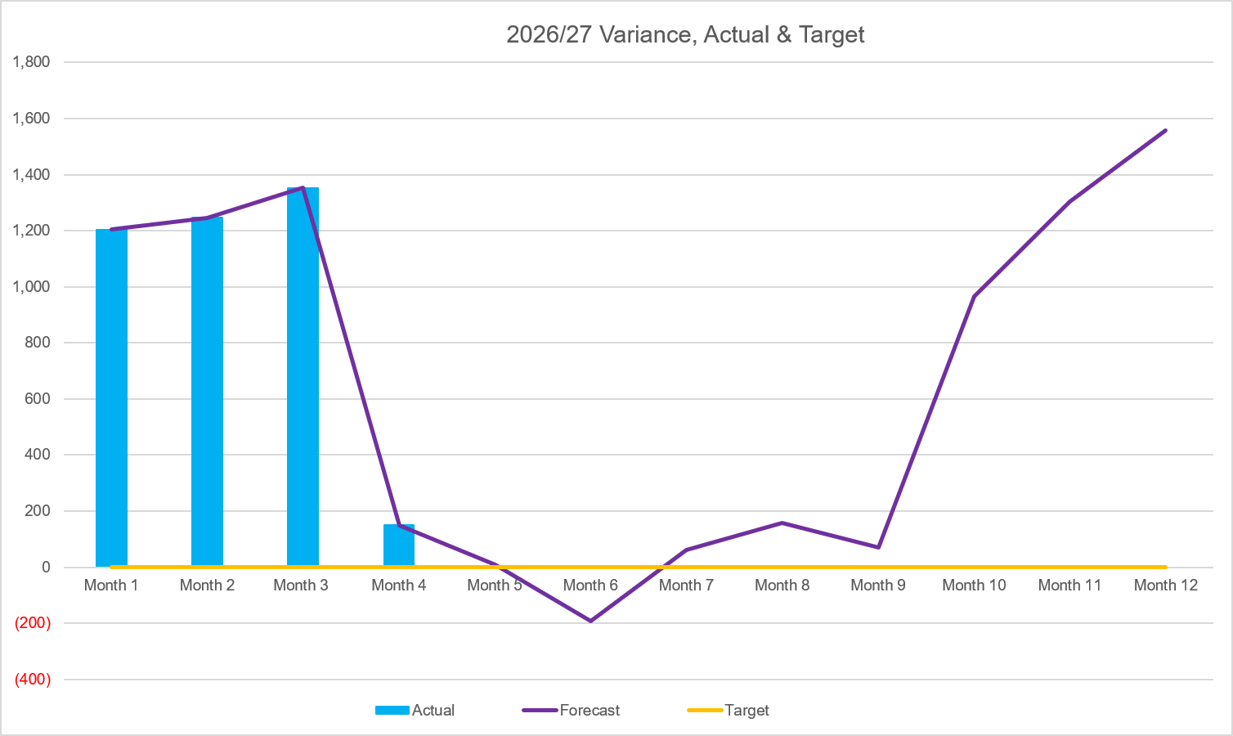
2026/27 Health Board Position & Service Area
SUMMARY
VARIANCE
In-Month Variance
£.150m
YTD
Variance
£3.95m
Variance:
Current vs
Previous Mth
Forecast Variance:
In Mth vs
Actual
ACTUAL & FORECAST VARIANCE TREND | IN YEAR PERFORMANCE

Slide 10
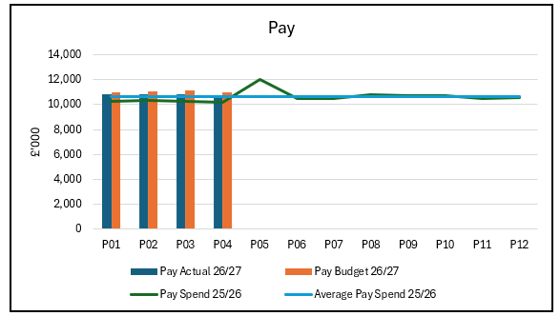
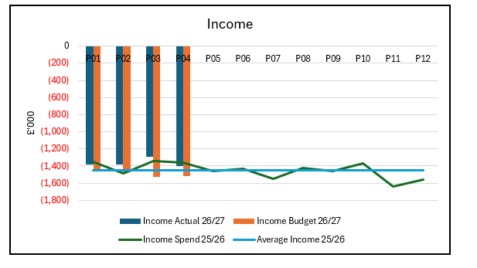
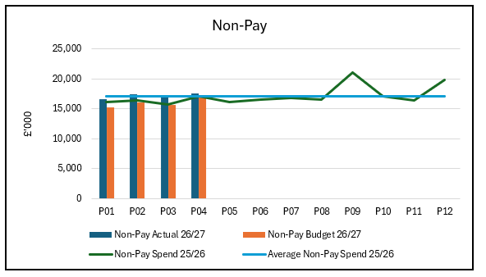
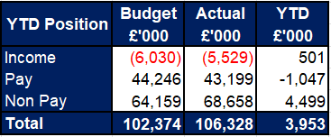
Summary: Income, Pay, Non-Pay
Key Variances:
Income – M4 - £111k shortfall, £501k ytd:
  Shortfall on Dental PCR income (£122k in mth, £497k ytd) continues to be the key area of under achievement of income.
  This is being off by monthly variation across other budgets
Pay – M4-£290k under, £1,047k under ytd
Vacancies across all staff groups are contributing to the underspend in Pay. However there remains key areas of overspend:
District Nursing - M4 £56k over, £259k over ytd
Gorseinon / Ward 3 - M4 £39k over, £141k over ytd
Palliative Care Nursing – M4- £25k over, £120k over ytd
Non Pay - £4,499k over ytd
Overspend here includes the unachieved CIP:
2026-27 CIP - £913k
2025-26 CIP - £2,447k
In M4 identified NR CIP was brought into the financial position improving the in month position and the forecast for 2026-27
There are also several key areas contributing to the overspend on non-pay (excl. cip):
CHC - £844k ytd
Looked After Children - £362k ytd
Joint Equipment Store - £96k (contract value increases in year)
District Nursing - £115k ytd
Pharmacy Contract - £90k ytd (Common Ailments Drugs)

Slide 11
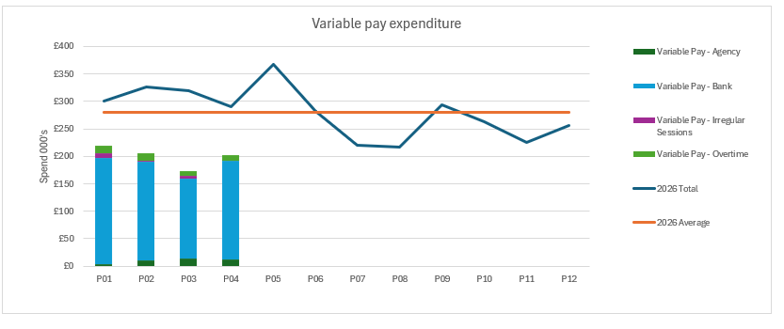
Pay Summary
Key Points
There was an increase in expenditure on variable pay in P04 (£202k) compared to P03 (£173k) This was due to increases in Registered and Non-registered Nursing Bank.
This increase spend on variable pay was offset by a reduction in spend on substantive staff . The net impact of these changes was an overall reduction in pay spend in M4 compared to M3 of £136k
Compared to the same period in 2025-26 the total spend at P02 has reduced from £659k in 2025-26 compared to £427k in 2026-27 (35% reduction).

Slide 12

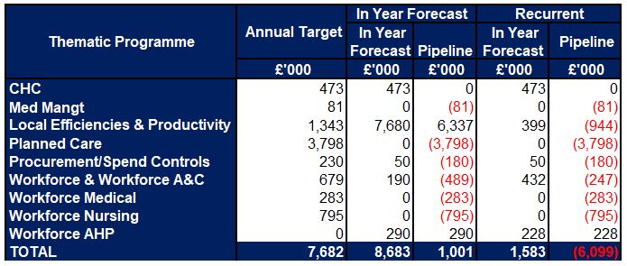
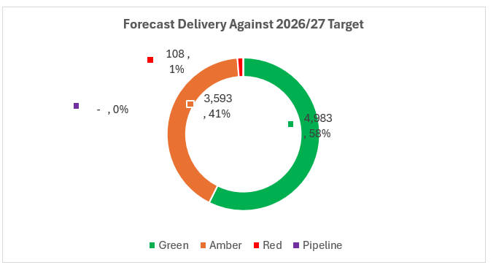
Savings

Slide 13
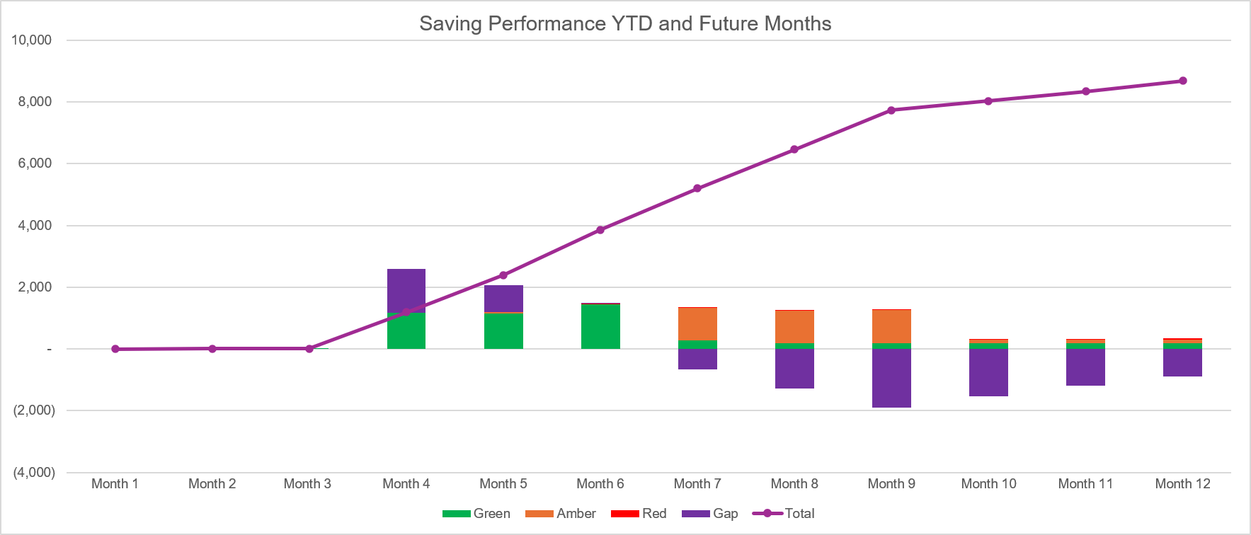
Savings

Slide 14
Part D: Budget Holder Performance

Slide 15
Accountability Letters: Variance By Budget Holder

Slide 16
Accountability Letters: Replies

Slide 17
Accountability Letters: Training Record

Slide 18
Accountability Letters: Qliksense Usage Stats

