Slide 1


Performance & Finance Committee
MHLD Service Group
Date: 25 August 2026

Slide 2
Part A: Priority Areas & Key Actions

Slide 3
Summary Actions
PRIORITY AREAS FOCUS | Nurse staffing variable pay and sickness absence Medical staffing variable pay New year CHC growth and growth mitigation Adult MH cases commissioned in the private sector Savings delivery
5 TOP ACTIONS FOR NEXT 4 WEEKS | Improving flow to reduce the number of the adult MH cases Reduction of sickness absence and management of sickness absence to policy Continued scrutiny on new CHC cases Continuation of review, rightsizing and repatriation to mitigate the cost of growth Continued development of plans to meet housekeeping savings target Contribution to the medical and nursing workforce savings workstreams and identification of other savings opportunities
5 TOP ACTIONS LAST 4 WEEKS & UPDATE ON OUTCOME | Inclusion of additional CHC costs reduction cases in savings plan, leading to over-performance against the CHC workstream target, and closing the overall savings gap. Discharge of two patients from high-cost packages of care during the month in relation to the above. Inclusion of additional income from JCC in savings plan relating to the strengthening of perinatal services that had already been funded from MHLD Service Group resource. Removal of net vacancy from budget as part of budget setting

Slide 4
Part B: Look Forward

Slide 5
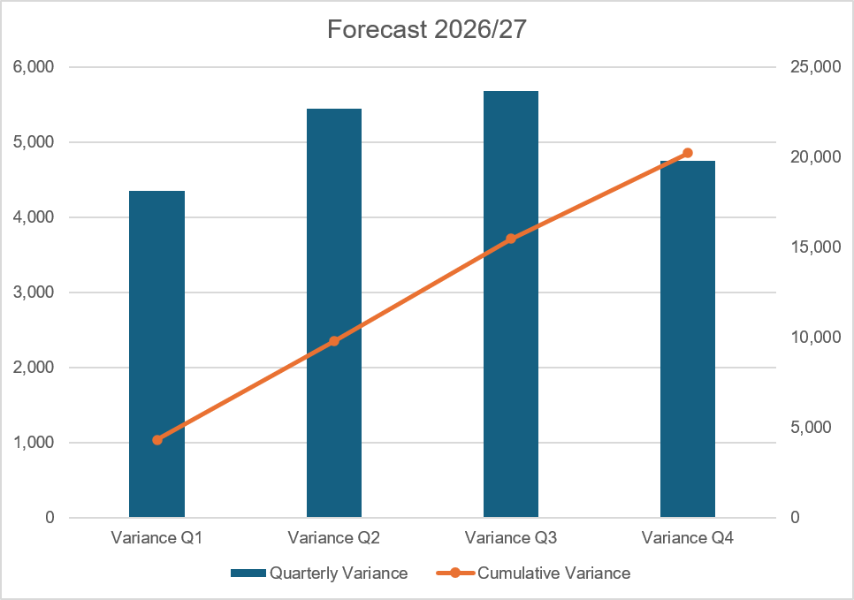
Forecast
Key Assumptions
Any active recruitment offset by turnover or displacement of temporary staffing, pending detailed analysis.
Variable pay based on level of temporary staffing at the start of August 2026.
Investment in clinical staffing for Home Treatment Team to reduce the cost of the adult MH cases.
Investment in NSA staffing levels for adult MH services, noting there is no funding for this investment.
Assessment of the impact of recruitment from student streamlining is now included in forecast.
CHC growth in future months at rate of growth in months 01,02 and 04, not at rate in month 03, there had been very high growth in month 03.
CHC growth mitigation in future months at same rate as in the year to date.
Reduction in the cost of the adult MH cases to 11 by the end of the financial year, being the WG target. The reduction had been to zero in previous forecast.
Delivery of all green and amber RAG rated saving schemes.

Slide 6
Forecast [Cont]

Slide 7

Identification Opportunities & Risk
Further Opportunities Above £65m |  | Further Notes / Comments The opportunities are opportunities to improve the level of the forecast and do include some cost reduction against existing savings target, being the nursing variable pay and the housekeeping savings and balance sheet review. The adult MH cases relates to reducing the number of cases that have been included for value in the forecast
Risks (Top 5)

Slide 8
Part C: Look Back

Slide 9
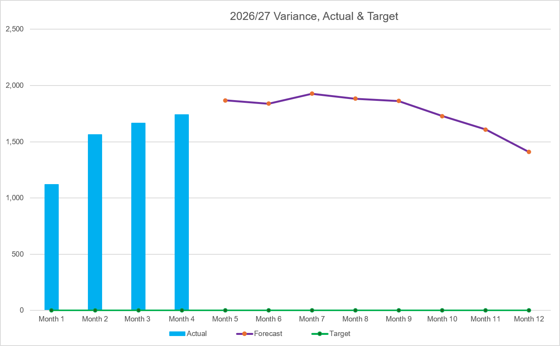
2026/27 Health Board Position & Service Area
SUMMARY
VARIANCE
In-Month Variance
£1.665m
YTD
Variance
£6.091m
Variance:
Current vs
Previous Mth
Forecast Variance:
In Mth vs
Actual
ACTUAL & FORECAST VARIANCE TREND | IN YEAR PERFORMANCE

Slide 10
Summary: Income, Pay, Non-Pay
Key Points
Overall - £1.741m overspent in month (month 03, £1.665m) and £6.091m to date.
Income - £0.03m over in month and £0.08m year to date
Continued SLA income target cost pressure and reduced training income.
Pay - £0.423m in month and £1.548m to date
Continued high variable pay in month and increased month-on-month in medical and nurse staffing
In month net vacancy as part of budget setting has been removed from budget and this is being used to fund variable pay.
There is continued underspending in Psychology and A&C, but this is reduced in month for both due to the removal of vacancy.
Non-Pay – £1.287m in month and £4.461m to date
The overspending continuing to be driven by CHC, the adult MH cases, and savings delivery gap against target.
The CHC overspending is increased to £0.447m (from £0.288m in month 03). The increase due largely to the cost of additional observations
The costs of the adult MH cases is at a similar level to that at month 03 and is at £0.472m in month (month 03, £0.480m). The actual number of cases has increased. There has also been retrospective additional observation costs in month 03.
The charge in the position for the unmet savings delivery is £0.365m, there is some improvement from over-delivery against the CHC workstream target.
There is overall improvement across other non-pay lines.

Slide 11
Pay Summary
Key Points
There is continued high medical and nursing variable pay. The overall variable pay is increased by £0.182m from last month to £1.073m in month 04, the highest it has been in the last 12 months.
Medical variable pay is increased by £0.034m, the increase all in agency. This has come from new agency doctors for maternity leave cover earlier than planned and cover for a doctor not currently working clinically. The ADH expenditure continues to include the unfunded middle grade for Fendrod ward.
Nursing variable pay is increased by £0.134m to £0.842m in month, RNs up £0.043m, HCSWs up £0.090m. And overall bank up £0.065m and agency £0.069m. The average usage in June was 171.69wte and this is increased to 183.75wte through July. The forecast was based on usage at the start of the month but there has been increase throughout the month and this is due to increased cover for acuity across the MH and LD divisions. But also noting that cover for sickness absence remains high.
Agency non-medical has also included A&C and ancillary staffing. There is no A&C agency expenditure in the month and the ancillary is £0.018m.

Slide 12
Savings

Slide 13
Savings
Note: All figures in £’000s, the monthly profiling against the Y-axis on the LHS and the cumulative totalling against the axis on the RHS

Slide 14
Adult MH Nursing – Inpatient Establishments
Approval was given at the July PFC meeting to increase the establishments for adult MH, and some rehabilitation and OPMHS, following a process of scrutiny against the NSA principles with the Executive Nursing Director team. The rehabilitation at Gwelfor and the OPMHS at Ysbryd y Coed, YYC.
The recruitment plan by wte together with the cost profile is set out below. The cost profile ging the cost of the additional substantive staff from recruitment and the reduction in the cost of the temporary staffing.
Monitoring against both is to be provided at future meetings of the PFC.

Slide 15
Part D: Budget Holder Performance

Slide 16
Accountability Letters: Variance By Budget Holder

Slide 17
Accountability Letters: Replies

Slide 18
Accountability Letters: Training Record

Slide 19
Accountability Letters: Qliksense Usage Stats

