Slide 1
Swansea Bay University Health Board
Integrated Performance Report
April 2026

Slide 2
Report Overview
The Health Board Integrated Performance Report will provide updates against all areas under escalation with Welsh Government, all performance metrics outlined within the NHS Wales Performance Framework 202-26, along with updates against the Delivery Expectations and the Ministerial Enabling actions as outlined in the NHS Wales Planning Framework 2025-2028
Section 1: Updates against all Escalation areas with Welsh Government
Section 2: Performance against the Health Board’s Strategic Objectives
Section 3: Welsh Government All Wales Dashboard Update

Slide 3
Section 1:
Updates against all Escalation areas
with Welsh Government

Slide 4
Delivery against Targeted Intervention and Enhanced Monitoring Criteria 2025/26
TI Area (Level 4) | Criteria to achieve | Performance (March -26)
Cancer | 60% performance maintained for 3 months against the SCP target. | 46% (Feb- 26)
UEC | Continuous reduction of ambulance handovers over an hour of at least 11% in three consecutive months and maintained for 3 months (Based on Q2/Q3 2023 baseline | 595 (18.8% increase)
 | Continuous improvement towards no more than 7% of patients waiting over 12 hours at each individual site and across HB | 11.26%
 | Median time from arrival at emergency department to assessment by a clinical decision maker should not exceed 60 minutes | 80.34%
 | Continuous reduction in delayed pathways of care of 5% for three consecutive months and then maintained for three months (based on Oct-Dec 23 baseline) | 223 (11.5% Increase)
HCAIs | A clear improvement plan based on a root cause analysis to address the issue of hospital onset HCAIs. | In place
 | C-Diff: reduce the number of hospital onset infections by 40% and maintain for 3 months (from a baseline of the average number of cases in quarter 3 of 10 cases to no more than 6 per month | 12 cases
 | Staph aureus: reduce the number of hospital onset infections by 25% and maintain for 3 months (from a baseline of the average number of cases in quarter 3 of 4 cases to no more than 3 per month | 5 cases
 | E-coli: reduce the number of hospital onset infections by 20% and maintain for 3 months (from a baseline of the average number of · cases in quarter 3 of 5 cases to no more than 4 per month) | 6 cases
 | Klebsiella: reduce the number of hospital onset infections by 10% and maintain for 3 months based on 2017/18 figures (baseline –54 cases in 2017/18, reduce to average of at most 4 per month) | 4 cases
Finance | Detailed Updates included within the report
Strategy & Planning | Detailed Updates included within the report
Maternity & Neonates | Detailed Updates included within the report
Dashboard

Slide 5
Delivery against Targeted Intervention and Enhanced Monitoring Criteria 2025/26
Escalation Area (Level 3) | Criteria to achieve | Performance (March-26)
CAMHS | 80% of LPMHSS mental health assessments undertaken within 28 days from the date of receipt of referral | 82%
 | 70% of therapeutic interventions started within 28 days following an assessment by LPMHS | 81%
 | 85% of HB residents in receipt of secondary mental health services who have a valid care and treatment plan | 90%
Planned Care | 100% of open outpatient pathways to be waiting less than 52 weeks and maintained for 3 month | 100%
 | Continuous improvement towards 75% of all open outpatient pathways waiting less than 26 weeks | 86.90%
 | 100% of open pathways to be waiting less than 104 weeks and maintained for 3 months | 100%
 | Continuous improvement towards 80% of all open pathways waiting less than 36 weeks | 78.53%
 | 12% reduction in the number of patients delayed by 100% for their follow up appointment in three consecutive months and maintained for 3 months (Based on the November 2024 baseline.) | 20.29%
 | 68% R1 ophthalmology patient pathways to be waiting within or no longer than 25% of their target date for an outpatient appointment and maintained for 3 months | 71.03%
 | 85% of patients waiting for a diagnostic test to be waiting less than 8 weeks and maintained for 3 months | 93.11%
 | 85% of patients waiting for a diagnostic endoscopy to be waiting less than 8 weeks and maintained for 3 month | 83.14%
 | 85% of patients waiting for a NOUS and non cardiac MRI to be waiting less than 8 weeks and maintained for 3 months. | 92.80%
 | 90% of patients waiting for therapies to be waiting less than 14 weeks and maintained for 3 months | 100%

Slide 6
Section 2:
Summary of the performance against the Health Boards Strategic Objectives

Slide 7





SBUHB Strategic Objectives and Quality Aspects
Our refreshed Strategic Objectives –aligned to ‘a Healthier Wales’ articulate the future state of Swansea Bay UHB as a high-quality organisation. We have set out what this looks like for our population, communities, staff , partners and services and are developing strategic indicators that will tell us if our efforts are delivering our objectives
People of Swansea Bay live healthier, equitable and more equal and prosperous lives
Every child has the best start in life
All children, young people and adults are enabled to maximise their capabilities and have control over their lives
Good work and fair employment is created for all
A healthy standard of living is ensured for all
Healthy and sustainable places are created through placemaking
The role and impact of ill-health prevention is strengthened
Racism, discrimination and their outcomes are tackled
Environmental sustainability and health equity are pursued together
Care is high quality, safe, efficient and delivers the best possible outcomes for people
Care is safe, it helps people and avoids harm
Care is evidence based, effective and improves outcomes
Care is timely and delivered by the right person in the right place
Care is efficient
Care delivers equitable outcomes regardless of demographic, socioeconomic or geographic factors
Care is person centred and delivered with compassion, dignity and mutual respect
Care is delivered in safe and appropriate settings supported by innovative digital solutions
Care is delivered around the patient in the most appropriate setting as close to home as possible supported by digital and data solutions
Care settings are fit for purpose, appropriately designed and equipped
Secure, trusted and insightful data and digital platforms empower staff to deliver more and higher quality care and improved patient outcomes and population health
We have a digitally inclusive culture, where patients, clinicians and non-clinical colleagues work collaboratively to create effective and efficient services and patients are empowered to make informed and meaningful choices about their health and care
Through where and how they are delivered, services contribute to the environmental, economic, social and cultural well-being of Swansea Bay
The health board is a great place to work where staff feel valued and work together towards a common goal
Our Workforce is engaged, motivated and healthy; they feel valued, fairly-rewarded and supported
The Health Board is recognised as an employer of choice
We have a well-planned workforce with the right number of skilled people working on the right things
People feel ready for our digital future
People are supported to develop the skills and capabilities they need
People role model collective and compassionate leadership and live our values
We are diverse and inclusive, ensuring all voices are heard
The health board is a resilient, financially sustainable and responsible organisation
The health board is financially balanced and able to invest in service transformation and change
Decisions are made balancing short-term improvements and long-term impacts
Resources are used efficiently and proportionately, reducing waste and variation
The environmental impact of health care delivery in Swansea Bay is minimised
The health board invests in and works with others locally and responsibly, using our assets to positively contribute to the community
Citizen stakeholders are meaningfully involved and engaged in decision making
The health board has the capacity to effectively plan for and respond to incident and emergencies

Slide 8
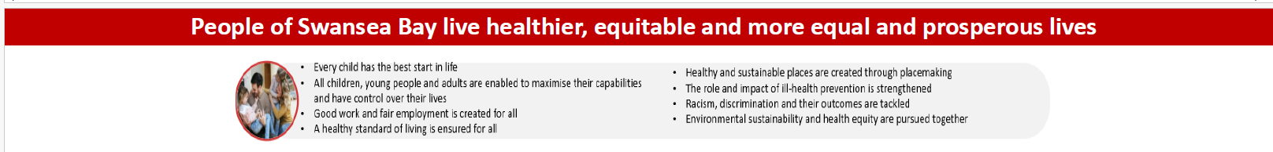
SBUHB organisational strategy indicators | Target/standard | Time period (reporting frequency) | Most recent data available
Percentage of children who are up to date with the scheduled vaccinations by age 5 (‘4 in 1’ preschool booster, the Hib/MenC booster and the second MMR dose) | 95% | Oct-Dec 2025 (quarterly) | 87.7%
Percentage of children receiving the Human Papillomavirus (HPV) vaccination by the age of 15 | 90% | Oct-Dec 2025 (quarterly) | 85.5%
Percentage of adult smokers who make a quit attempt via smoking cessation services | 5% | 2024/25 (annually) | 3.5%
Percentage of eligible adults who participate in bowel screening | NA* | Oct 2024-Sep 2025 (quarterly) | 54.4%*
Welsh Government Immunisation targets 2025/26 | Target/standard | Time period (reporting frequency) | Most recent data available
Percentage uptake of influenza vaccine in adults 65 years and over | 75% | April (monthly) | 68.9%
Percentage uptake of COVID-19 vaccine for all those eligible | 75% | April (monthly) | 5.9%**
*PHW screening data is now available with a reduced 6-month time lag and updated quarterly, but is not comparable with previous months as it is based on a shorter time period for individuals to respond: 8 weeks
**Programme commenced in April 2026

Slide 9
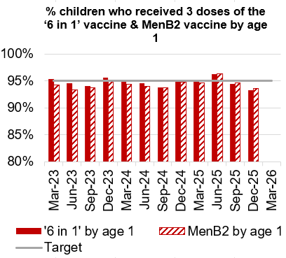
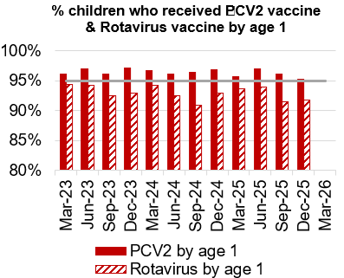
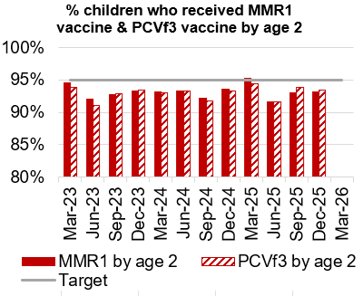
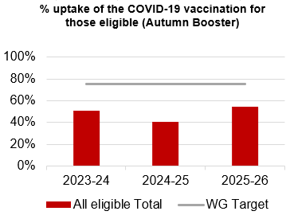
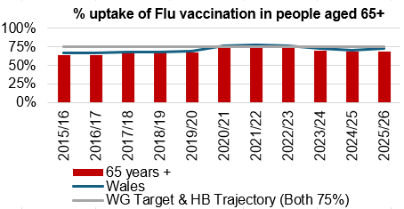
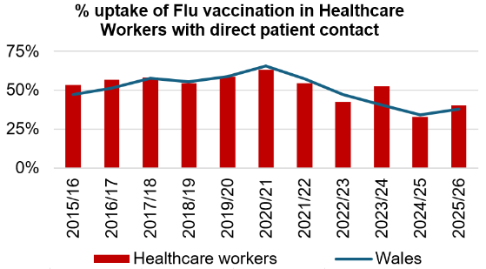
Immunisations
Actions/Updates
Performance against the immunisation targets is reported in arrears on a quarterly basis
Updated targets have been set for the new financial year which can be seen on the graphs above

Slide 10
Care is high quality, safe, efficient and delivers the best possible outcomes for people
Accident & Emergency | Target | March-26
4 -hour performance | 95% | 68.41%
12-hour performance | 0 | 1,356
Number of Delayed Pathways of Care (HB wide) | Continuous Reduction | 223
Number of cancelled Electives | 0 | 11
Median time of arrival to assessment within 60 minutes | 97% | 80.34%
Ambulance
Median emergency ambulance response time to purple: arrest category calls | 6-8 minutes | 7.22 (Feb-26)
Median emergency ambulance response time to red: emergency category calls | 6-8 minutes | 8.33 (Feb-26)
Total Handovers lost over 15 minutes | 0 | 2,577
Total Handover Delays > 45 minutes | 0 | 692
DE
TI
DE
TI
TI

Slide 11
Care is high quality, safe, efficient and delivers the best possible outcomes for people
Stroke | Target | Feb -26
Percentage of admission within 4 hours | 95% | 34.4%
Percentage of stroke patients receiving a CT scan within 20 minutes | 40% | 24.4%
Percentage of patients assessed by a stroke consultant within 14 hours | 95% | 52.1%
Percentage of patients to receive a mechanical Thrombectomy | 10% | 10.2%
Planned Care | Target | March – 26
Percentage of patients waiting < 26 weeks for an outpatient appointment | 75% | 86.9%
Total number of patients waiting < 36 weeks | 80% | 78.53%
Number of patients waiting at Stage 1 > 52 Weeks | 0 | 0
Total number of patients waiting > 104 Weeks | 0 | 0
Diagnostics & Therapies | Target | March – 26
Number of patients waiting > 8 weeks for diagnostics | 0 | 980
Number of patients waiting > 8 weeks for an Endoscopy | 0 | 285
Number of patients waiting > 14 weeks for Therapies | 0 | 0
Number of children waiting > 6 weeks for Audiology | 0 | 176
TI
TI
TI
DE
TI
DE

Slide 12
Care is high quality, safe, efficient and delivers the best possible outcomes for people
FUNB | Target | March -26
Number of patients waiting for an outpatient follow-up (booked and not booked) who are delayed past their agreed target date (All Specialties) | N/A | 75,944
Total number of patients waiting 100% over their target date | 0 | 46,236
Total number of patients waiting for a follow-up appointment | N/A | 159,543
Mental Health & Learning Disabilities | Target | March – 26
Percentage of mental health assessments undertaken within (up to and including) 28 days from the date of receipt of referral | 80% | 93%
Percentage of therapeutic interventions started within (up to and including) 28 days following an assessment by LPMHSS | 80% | 87%
Percentage of patients waiting less than 26 weeks to start a psychological therapy in Specialist Adult Mental Health | 80% | 39.3%
Quality & Safety | Target | March – 26
Number of service user feedback experience responses on CIVICA | Monthly improvement | 6,888
Percentage of complaint responses sent within 30 working days | 80% | 55% (Jan-26)
Number of Nationally Reported Incidents | N/A | 8
Number of New Never Events | N/A | 0
TI
DE
DE
DE

Slide 13
Unscheduled Care

Slide 14
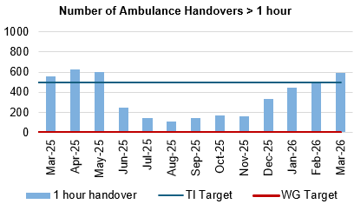
Oversight & Escalation Update (Level 4) – Unscheduled Care
Criteria to Achieve | Current Performance
A continuous reduction of ambulance handovers over an hour of at least 11% in three consecutive months and maintained for 3 months (Based on quarter 2 and 3 2023 baseline). | January – 445 (35% increase) February – 501 (11.2% increase) March - 595 (18.8% increase)
Actions being taken to improve flow include:
Clinical conversation before conveyance has now been agreed with WAST and will commence on the 18th May for all potential conveyances from care homes, with primary care providing rapid access to community services to support the avoidance of conveyances to hospitals.
Revised flow operating model: The revised operating models implemented as part of the test of change in Morriston remain in place. However, increase in demand for emergency care, high levels of patient occupancy driven by medical bed day utilisation has challenged the Health Board’s ability to maintain flow and thus the level of ambulance handover performance achieved following the tests of change. The emergency pressures have tipped the Health Board into three formal Business Continuity incidents since January 2026, and outside of these periods, the level of escalation has remained high. These system pressures continue, however there is evidence to demonstrate that the improvements implemented in June 2025 continue to have impact. This position is further complicated with an increase in the Clinically Optimised patient cohort, which significantly impacts patient flow.
UEC capital redesign – The Health Board ambition to co-locate assessment functions in Morriston into one facility adjacent to tis he Emergency Department features as part of the capital plan. This remains a priority in terms of UEC service delivery however is dependent on Capital funding to progress.

Slide 15
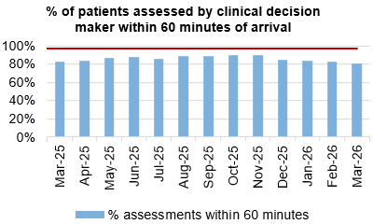
Oversight & Escalation Update (Level 4) – Unscheduled Care
Criteria to Achieve | Current Performance
Median time from arrival at an emergency department to assessment by a clinical decision maker should not exceed 60 minutes. | January – 84.11% February – 82.93% March – 80.34%
Actions/Updates
80% of patients are triaged within 1 hour arrival at ED. The mean time to first clinical review in ED, is not yet measurable within the UHB’s system, although operational intelligence suggests that the mean is often in excess of an hour.
The service are currently running a number of tests of change including Rapid Assessment by senior clinicians, and senior decision making at the point of care. However, due to clinical decision making and assessment area capacity constraints these can only run for a few hours a day and thus the results are inconclusive. Intention is to create the requisite capacity by moving assessment demand away from the ED.
Full implementation of D2RA model – recent communications between the Health Board Chair and CEO and council leaders have enabled a reprioritisation of the work programme to deliver discharge pathways whereby more of the patient assessment occurs within the community. There is a plan to centralise discharge through transfer resources into the IDH to enable clinically prioritised activities Health Board wide including Rapid Access fast track services, front door turnaround where admission is not indicated and the development of pathway specific teams.

Slide 16
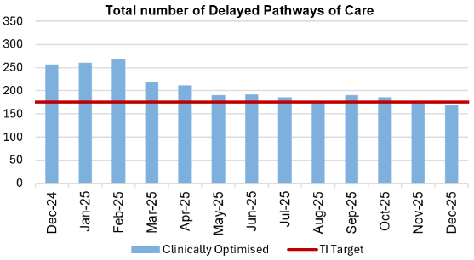
Oversight & Escalation Update (Level 4) – Unscheduled Care
Pathways of Care Delay: Action & Intervention
Criteria to Achieve | Current Performance
A continuous reduction in delayed pathways of care of 5% for three consecutive months and then maintained for three months (based on Oct-Dec 23 baseline). | January – 175 (In target) February – 200 March - 223
Site | Delayed Pathways of Care: March 3rd | Delayed Pathways of Care: March 10th | Delayed Pathways of Care: March 18th | Delayed Pathways of Care: March 24th | Delayed Pathways of Care: March 31st
Learning Disabilities | 8 | 8 | 8 | 8 | 8
Mental Health | 32 | 32 | 28 | 27 | 26
Morriston Hospital | 96 | 111 | 109 | 107 | 95
Neath Port Talbot Hospital | 33 | 41 | 41 | 45 | 41
Singleton Hospital | 45 | 41 | 37 | 39 | 37
Total | 214 | 233 | 223 | 226 | 207
3.25%
What have we done to achieve the positive reduction:
The PoCD position continues to challenge patient flow, despite significant effort being invested in managing the Clinically Optimised patients, the outputs remain limited resulting in patients spending extended periods of time in hospital when they are deemed clinically optimised.
There is a shift in focus to elevate the delay related harm that is caused from extended hospital stay in this frail older patient cohort, and there is a proposal to implement the Deconditioning Early Warning Indicator tool (DEWI).
Focus on individuals waiting for reablement and those needing a LTPOC.
Adjusted Integrated Discharged Hub processes to better meet increased demand and acuity
Used existing escalation and coordination arrangements to manage system pace and complexity
Reduce Length Of Stay through improved Board Rounds and enhanced Multi-Disciplinary Team approach
92.6%

Slide 17
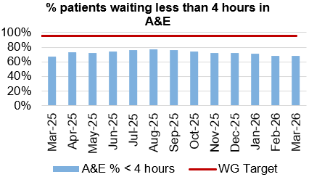
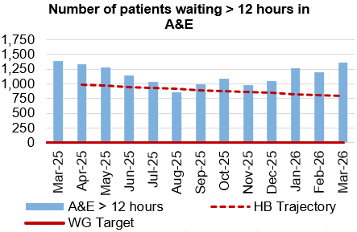
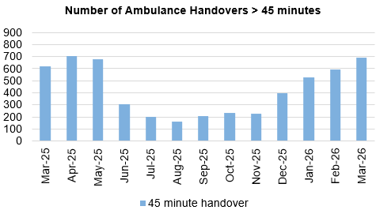
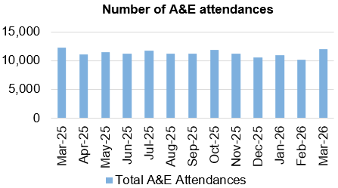
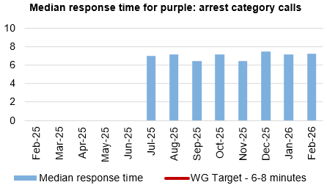
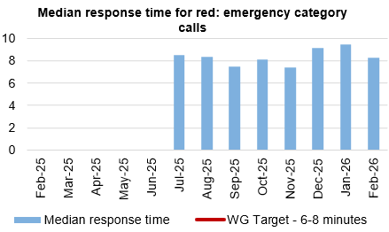
Oversight & Escalation Update (Level 4) – Unscheduled Care
Dashboard
Criteria to Achieve | Current Performance
Continuous improvement towards no more than 7% of patients waiting over 12 hours at each individual site and across the health board. | January – 11.66% February – 11.86% March – 11.26%
Actions/Updates
Seen deterioration in our KPI – ED activity stayed same, overall increase in bed occupancy and COP post Christmas negatively impacting flow
Taking forward quality improvement on improving frailty, rehabilitation and COP pathways
Sickness and Absence continues to affect effectiveness of ACT & OPAU key clinical services

Slide 18

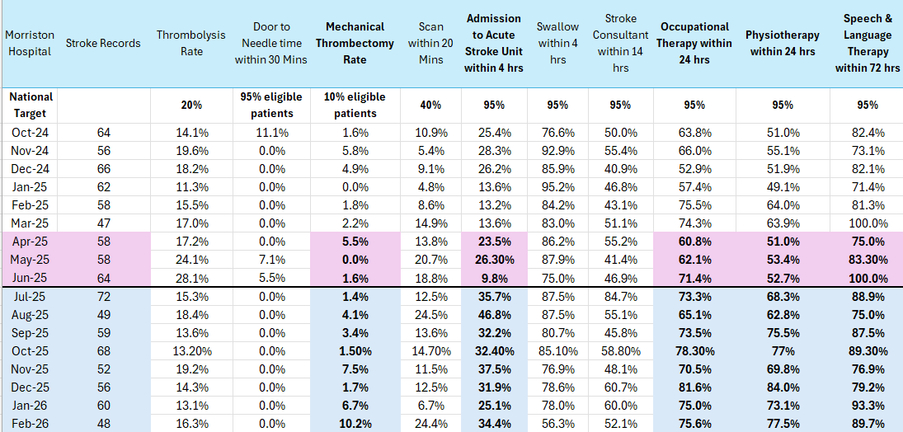
Stroke
Actions/Updates
Sustained 4‑day reduction in Length of Stay on the Acute Stroke Unit (ASU), achieved despite continued growth in admission numbers.
Ongoing increase in admissions and timely discharges from the ASU, reducing the need to outlie stroke patients to other wards
Improved transfer processes, enabling more timely access to stroke‑specific therapy.
Consistent ability to maintain one ring‑fenced bed on the Acute Stroke Unit, supporting timely flow and improved patient experience.
Performance against KPI metrics remains challenging and below expected targets; however, steady and positive progress continues to be made.
Funding has not yet been secured to implement a 24/7 stroke consultant rota.
High compliance maintained in key areas including thrombolysis rates, swallow assessments, and therapeutic assessments.
Increasing Mechanical Thrombectomy access remains a key priority.
CT Perfusion and MRI Perfusion pathways are now embedded, supporting improved diagnostic accuracy and patient selection for advanced stroke treatments

Slide 19
Planned Care

Slide 20
Oversight & Escalation Update (Level 3) – Planned Care
Criteria to Achieve | Current Performance (March 2026)
100% of open outpatient pathways to be waiting less than 52 weeks and maintained for 3 months. | 100%
Continuous improvement towards 75% of all open outpatient pathways waiting less than 26 weeks. | 86.90%
100% of open pathways to be waiting less than 104 weeks and maintained for 3 months. | 100%
Continuous improvement towards 80% of all open pathways waiting less than 36 weeks. | 78.53%
12% reduction in the number of patients delayed by 100% for their follow up appointment in three consecutive months and maintained for 3 months (Based on the November 2024 baseline). | 20.29%
68% R1 ophthalmology patient pathways to be waiting within or no longer than 25% of their target date for an outpatient appointment and maintained for 3 months. | 71.03%
85% of patients waiting for a diagnostic test to be waiting less than 8 weeks and maintained for 3 months. | 93.11%
85% of patients waiting for a diagnostic endoscopy to be waiting less than 8 weeks and maintained for 3 months. | 83.14%
85% of patients waiting for a NOUS and non-cardiac MRI to be waiting less than 8 weeks and maintained for 3 months. | 92.80%
90% of patients waiting for therapies to be waiting less than 14 weeks and maintained for 3 months. | 100%
Actions/Updates
Sustained delivery of key criteria: 52-week outpatients, 104-week pathways and therapies, reflecting 2025/26 recovery actions (additional capacity, validation, pathway management).
Underperformance remains in <26 and <36-week outpatient measures, driven by demand and pathway complexity; action underway to move to embedded redesign (referral management, PIFU, discharge optimisation).
Follow-up waiting list remains a key risk; delivery of the 12% reduction target impacted by backlog and demand growth. Actions include clinical validation, tighter booking controls, and strengthened performance management as well as full compliance with nationally recommended demand management initiatives (PIFU/SOS)
Diagnostic performance expected to deteriorate post-April; transition to a new electronic system limits visibility and predictability of 8-week performance. Mitigations focus on system stabilisation, data quality, and demand/capacity management.
Endoscopy remains challenged due to demand exceeding core capacity; additional capacity and pathway optimisation in place.
Performance likely to destabilise in May/June due to cessation of additional funding for this year however, overall transition underway from non-recurrent recovery activity to a more sustainable model focused on productivity, pathway redesign, and demand management.

Slide 21
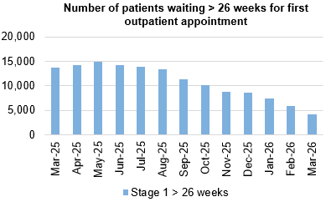
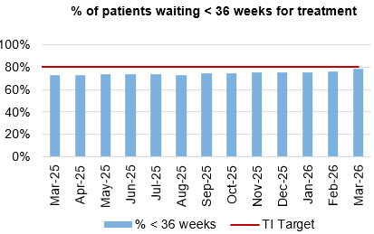
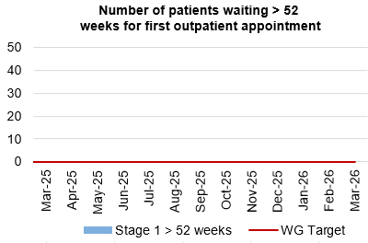
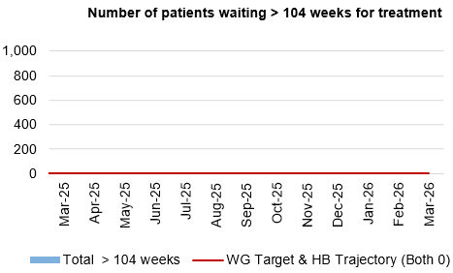
Planned Care
Dashboard
Actions/Updates
The Health Board have maintained the Stage 1 > 52 weeks target of 0 for March 2026.
The Health Board have reported 0 patients waiting > 104 weeks for treatment for March 2026. The breaches previously reported in February were result of the national bone cement shortage which affected the UK. All of these patients were successfully redated in March.
Q1 26/27 baseline reset within core capacity is planned via the Deloitte-supported productivity analysis.

Slide 22
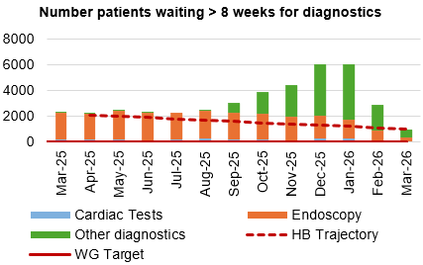
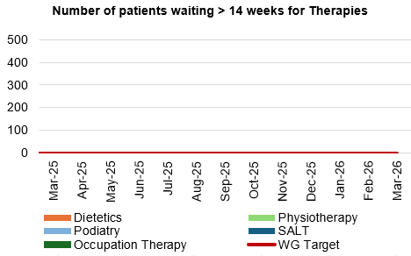
Diagnostics and Therapies
Actions/Updates
The total number of patients waiting > 8 weeks for diagnostics has decreased in March to 980 compared to 2,917 in February 2026.
As part of the recovery plan, the WG have funded a mobile Endoscopy unit which has been sited on Morriston Hospital to support additional capacity. The unit has been supporting the reduction of the number of patients waiting > 8 weeks for an Endoscopy and the waiting list continues to reduce as a result of the additional capacity. It is important to note that the funding availability for this additional capacity has now come to an end and therefore this will result in an impact on the waiting list.
The number of patients waiting > 14 weeks for therapies has been reported as 0 in March 2026

Slide 23
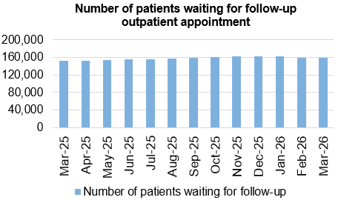
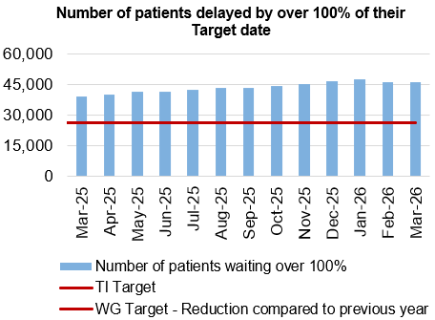
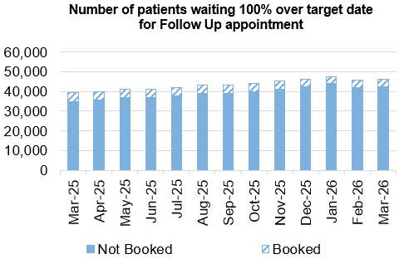
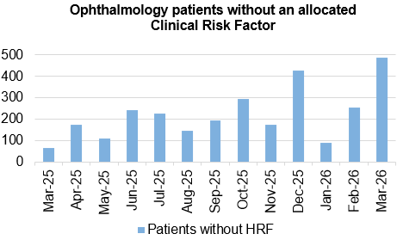
Follow-Ups & Activity
Actions/Updates
Preparation now in place to mandate PIFU & SOS and monitor compliance and patient safety.
Digital and manual validation completed as a pilot, review of clinical administration will provide resource maintain this approach.

Slide 24
Oversight & Escalation Update (Level 4) – Cancer
Criteria to Achieve | Current Performance
60% performance maintained for 3 months against the Single Cancer Pathway (SCP) target. | December – 62% January – 55% February – 46%
Actions being taken to improve include:
Continued focus on front end of pathway for all specialties
Commencing demand and capacity work in relation to the cancer pathway supported by Transformation Team
Outsourcing pathology backlog for Skin, Urology and LGI
Detailed Dermatology demand and capacity exercise, supported by Healthcare Systems Engineering team currently in progress.
Phase 2, business case development for the long-term provision of complex gynae-oncology surgery commences.

Slide 25
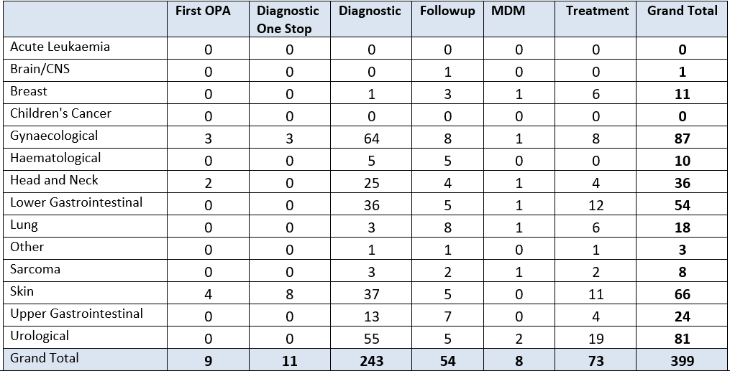
Cancer Backlog
The majority of the backlog is at diagnostics, with approximately 40% waiting for pathology results. A programme has been developed to improve the Cellular pathology capacity with a view to implementation in May 2026.
Through the new internal cancer performance oversight forum, work to target the longest waiting cohort is underway with highest volumes seen in Gynae, H&N, Urology and Skin.

Slide 26
Cancer Improvement Workshop 9th March 2026 - Next Steps
As part of the refreshed approach to Cancer Improvement a successful multidisciplinary workshop was held 9th March 2026, whilst significant challenges were raised, opportunities were identified. To maintain momentum, the following next steps will now be explored and plans for the 90 day sprint developed.
1. Formalise Programme Structure
Circulate a proposed programme structure for review and formal endorsement by the HB Executive Team.
Confirm the establishment of the Cancer Improvement Programme Board and its initial membership.
2. Launch 90-Day Sprints
Develop and initiate the prioritised 90-day sprint plans, ensuring clear task allocation, owners, and regular check-ins.
Communicate the sprint objectives and progress widely to maintain momentum and engagement.
3. Deep Dive Data Analysis
Commission further detailed local data analysis for all identified challenge areas (e.g., workforce gaps, specific pathway bottlenecks) to inform subsequent programme phases.
4. Stakeholder Engagement Plan
Develop a stakeholder engagement plan to ensure ongoing involvement of clinical staff, operational teams, primary care, public health, and patient representatives.
5. Communication Strategy
Establish a clear communication strategy to regularly update all staff and external partners on the programme's progress, successes, and challenges, fostering a shared sense of purpose and accountability.

Slide 27
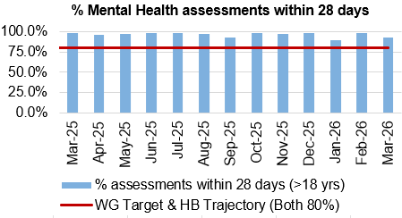
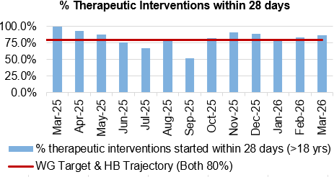
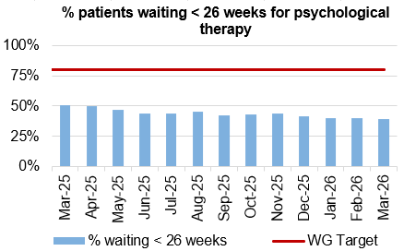
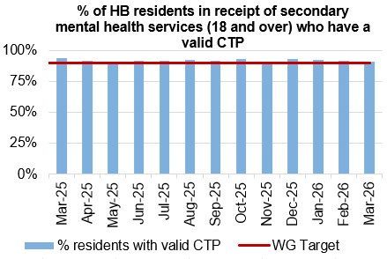
Mental Health & Learning Disabilities
Actions/Updates
The service continues to meet all of the Welsh Government targets, apart from for patients waiting < 26 weeks for Psychological therapies. Waits within this area continue to be a concern Nationally and the service are working closely with Welsh Government colleagues for a solution.
The Health Board continues to report on the work being undertaken as part of the Transformation programme, routine updated are provided to Board.

Slide 28
Oversight & Escalation Update (Level 3) – CAMHS
Criteria to Achieve | Current Performance
80% of LPMHSS mental health assessments undertaken within 28 days from the date of receipt of referral | January – 93.5% February – 94% March – 82%
70% of therapeutic interventions started within 28 days following an assessment by LPMHS | January – 75.6% February – 76% March – 81%
85% of HB residents in receipt of secondary mental health services who have a valid care and treatment plan | January – 97% February – 95% March – 90%
CAMHS 1A & Part 2 ​
Performance remains strong in these areas and no issues anticipated to maintaining this in future. ​
​
CAMHS Part 1B:​
Recovery of the trajectory continues and performance was back in compliance for the end of March 2026. 1B was reported to be 81% compliant (Target 80%). ​
Weekly meetings continue over booking and utilisation of capacity and using our staffing resource as flexibly as possible. ​
Future bookings are also under close scrutiny with chronological booking firmly in place and scrutinization over those booked over target to see if they can be accommodated in earlier cancellation slots to increase compliance. ​
To make aid in meeting the trajectory and target ongoing, 1.0wte B6 funding has been created by repurposing non-clinical posts to provide more 1B capacity, however awaiting break-glass process to enable recruitment.
Further clinical capacity continues to be sourced as one site is currently out of commission due to water ingress. There are multiple venues being pursued by the CAMHS directorate in order to ensure the capacity remains to allow the sustainability of the performance going forwards.

Slide 29
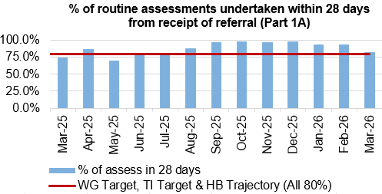
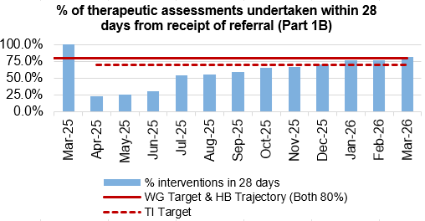
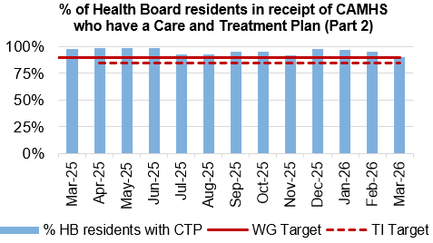
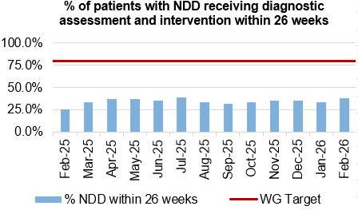
Child and Adolescent Mental Health Service (CAMHS)
Actions/Updates
Maintained delivery of part 1 A and 2, Part 1B Achieved in line with trajectory, by re-alignment of internal resources to provide more capacity and provision of virtual treatment and the tidy minds apps.
From April, ND service is initiating preparation of SPOA ASD pilot with the objective of reducing demand

Slide 30
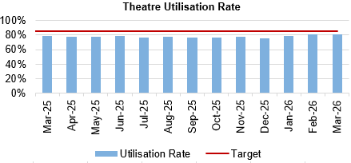
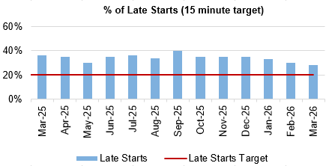
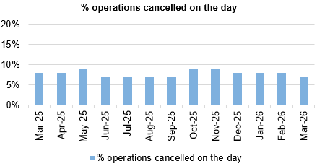
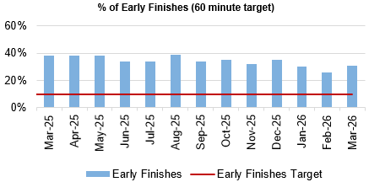
Theatre Efficiency
Actions/Updates
The Planning Framework sets out enabling actions that must underpin the delivery priorities to successfully achieve the core service and changes required. These include value projects, digital innovations, workforce developments, financial sustainability and ways of working. The enabling actions and planning framework have been incorporated into SBUHB’s Theatre performance framework and work is currently underway to report against these measures.
NPTSSG are currently undertaking focussed work to reduce late starts and maximise efficiency within theatre’s, focussing on specific services which require improvement also

Slide 31
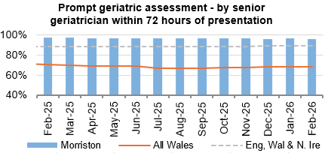
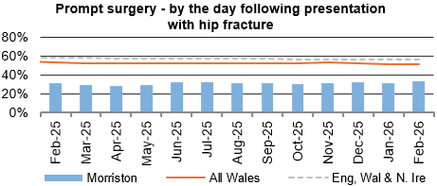
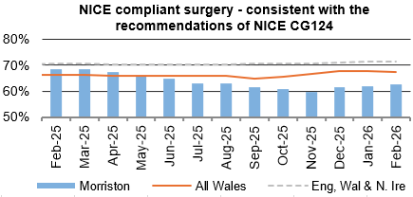
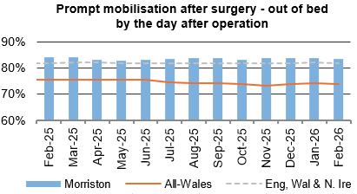
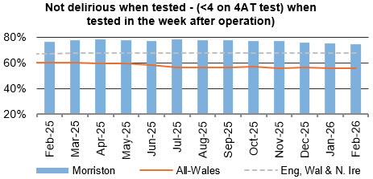
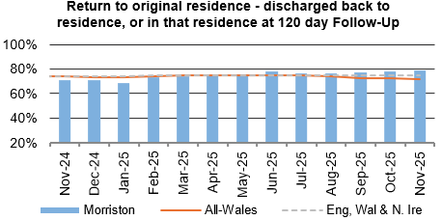
Fractured Neck of Femur (NOF)
Actions/Updates
To improve access to theatre time, since March Fracture NOF cases have been prioritised for access to Theatre 6.
Peer support from C&VUHB continues to be received in support of aspects of improvement.
The demand and capacity work will be implemented in a phased timeline with additional capacity for spinal cases which will hopefully see an impact on access to theatres for #NOF

Slide 32
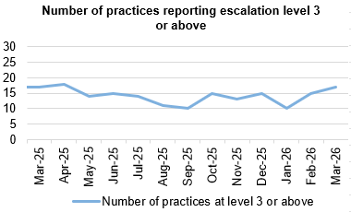
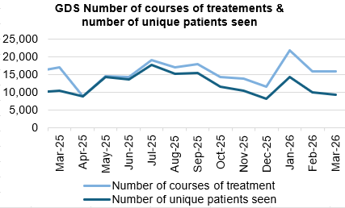
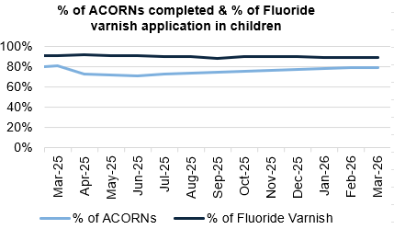
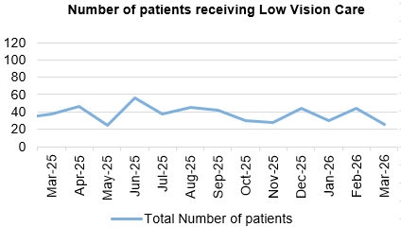


Primary Care
Actions/Updates
GMS escalation levels remain steady with 17 practices reporting level 3 or above. Currently GMS as a whole is reporting level 2. We have the third lowest escalation levels in Wales. There is currently only one practice reporting level 4. Welsh Government has made 1.7 million available to GMS Practices in Swansea Bay this year through a non recurrent workforce fund that is to stabilise practices and enable them to prepare for community by design.
Fluoride varnish remains over target for adults and children. The number of ACORNs has increased month on month and now stands at 79.5% A new dental contractual regulatory framework came into place on the 1st April 2026. The majority of dental practices in SBUHB have continued with the provision of NHS dental care. There will be a period of settling in and this new framework is a substantive change. It has meant a large number of patients have been allocated a dentists after waiting on the dental access portal. New patients under the new framework have to be allocated from the Heath Board.
The number of patients for eye health care Wales (emergency eye care) has increased from an average of 2,245 per month in 24/25 to an average of 2,617 in 25/26. This is an additional 4470 patients who have accessed the service.
There has been a significant increase in the number of patients receiving low vision services with an increase in domiciliary visits in particular. A review into this is underway.
There has been a significant increase in 25/26 in the number of patients who have been accessing the common ailments service run by community pharmacy – this has exceeded 75,000 consultations, an increase of 14692 ( 24%) on the year before. This will partly be due to the launch of a Urinary Tract Infection service in Community Pharmacy. Consultations now average over 6,000 per month.

Slide 33
Quality & Safety

Slide 34


Oversight & Escalation Update (Level 4) – Healthcare Acquired Infections
Criteria to Achieve | Current Performance
A clear improvement plan based on a root cause analysis to address the issue of hospital onset HCAIs. | In Place
C-Diff: reduce the number of hospital onset infections by 40% and maintain for 3 months (from a baseline of the average number of cases in quarter 3 of 10 cases to no more than 6 per month | January – 3 February – 7 March – 12
Staph aureus: reduce the number of hospital onset infections by 25% and maintain for 3 months (from a baseline of the average number of cases in quarter 3 of 4 cases to no more than 3 per month | January -3 February – 0 March - 5

Slide 35


Oversight & Escalation Update (Level 4) – Healthcare Acquired Infections
Criteria to Achieve | Current Performance
E-coli: reduce the number of hospital onset infections by 20% and maintain for 3 months (from a baseline of the average number of · cases in quarter 3 of 5 cases to no more than 4 per month) | January -3 February – 6 March - 6
Klebsiella: reduce the number of hospital onset infections by 10% and maintain for 3 months based on 2017/18 figures (baseline –54 cases in 2017/18, reduce to average of at most 4 per month) | January – 2 February – 2 March - 4

Slide 36




Infection, Prevention & Control
Dashboard
Actions/Updates
Currently mapping trajectories based on WHC 2025/039 for each acute hospital site and community on their individual infection reduction goals and circulating these by 30th April 2026.
Gold C. difficile High Incidence Management Group will continue as Health Board continues to have highest incidence of C. difficile in Wales.
Continuation of QI Project in Acute Medical Unit focusing on AMS and 72-hour review, improving switch to oral route for administration.
Undertaking risk-based impact assessment of new NHS Wales Standards for Healthcare Cleanliness, to identify quality and financial impact of moving towards implementation.
Trial of new microfibre cleaning systems.
Procurement of additional high-level disinfection equipment (UV-C).
Primary care QI projects to reduce urinary tract infections in care home residents.
Repeat Hospital Acquired Pneumonia antimicrobial audit.

Slide 37




Serious Incidents and Risks
Actions/Updates
There were 8 Nationally Reported Incidents reported in March 2026 and there were no new never events reported. The detail surrounding the nature of the reported NRI’s can be found on the subsequent pages.
In March 2026, there were 114 open risks with a score >20 recorded for the Health Bord which is slightly above the figure reported in February. There were 257 open risks with a score >16, which again is a slight increase compared to 251 in February 2026.
There were 211 hospital falls recorded in March 2026

Slide 38



Nationally Reportable Incidents (NRIs) Never Events (NE’s)
Early Warning Notifications (EWNs) – March 2026
What is the data telling us?
Graph 1: 8 NRIs reported to P&I (includes 3 retrospective avoidable pressure damage, 1 avoidable inpatient fall, and 1 neonatal death).
Graph 2: 40 NRIs open with NHS W&P&I; 16 overdue (8 awaiting external review outcomes, 2 under investigation, 6 awaiting outcome forms from service groups).
Graph 3: Outcome forms submitted this month – 67% compliance.
What are we doing about it?
Weekly review with PSI investigator to:
  monitor progress of corporate investigations; identify barriers
  escalate outstanding actions required
Fortnightly service group meetings:
  service group investigations - progress towards closure date discussed
  updates on PSI investigation given
  escalate to service group barriers identified with corporate PSI investigations
Service Group Directors contacted separately for outstanding actions
Data presented and discussed at health board Patient Safety and Compliance Group; Quality and Safety Group; Patient Stakeholder and Experience Group - Service Group assurance sought against outstanding actions for completion of investigation / outcome form
What do we expect to see change and when?
Reduction in number of overdue investigation outcomes forms
Reduction in number of NRIs/NEs reported through recommendations/learning monthly
EWNs – March 2026
Suspected inpatient suicide – Adult mental health
Infection outbreak – Neurorehabilitation
Abscondment – Adult mental health
Potential adverse media coverage - inquest

Slide 39
Learning Identified from incidents – March 2026
Situational Factors:
Co-horting patients into high acuity bay may increase risk of falls where staffing ratio too low.
Incontinence leading to greater moisture damage risk
Organisational factors:
Recognised need for additional training and refresher courses particularly in pressure damage. Despite training, compliance with pressure ulcer prevention protocols remain poor
Communication and Culture:
Missed opportunities for timely assessment and intervention (pressure/nutrition/falls)
Lack of falls prevention advice given.
Significant gaps in clinical documentation.
Core assessments missed on admission/transfer.
Active treatment of pressure ulcers through repositioning not consistent
Local working conditions:
Acuity of wards increasing overall - current staffing levels may not reflect the increasing dependency of patients and demands of the ward
External factors:
Thematic learning linking sedative medication with falls risk across sites

Slide 40

Falls Prevention
Page 1
Project Team: Senior Responsible Officer: Helen Annandale, QP lead – Eleri D'Arcy
What is the Data telling us?:
In-patient falls rate remains below National average
Falls related attendance to MIU up 27% compared to Feb 2026 (Feb had already increased by 20% from Jan) however this is 18% lower than same time last year.
ED attendance for falls 19% higher in Feb 2026 than Jan 2026 (and up 4% from last year)
Underlying causes:
Ageing population with increasing frailty picture
Increased demand on WAST and front door services
Limited alternative WAST response to level 1 and level 2 falls regionally
Inconsistent approach to falls advice in community/primary care
Reduced access and provision of falls clinics across region
Limited prevention offers
Destabilisation at National Level re Governance
What are we doing about it:
Funding has ended for level 1 and 2 falls response
Enhanced falls response (therapy led) stood down new pathways to meet WAST demand established
Ongoing discussions with WAST re direct commissioning of level 1 response for SBUHB
Re-establishing National Safer Mobilisation Group (previously National In patient falls Group)
Regional Falls Prevention taskforce enabling collaboration
Primary Care action plan agreed
Falls prevention (Dance to Health) programme developing due to begin April 2026 – to be managed through SBUHB Arts in Health
Review of Care pathways National & Local level underway
Project lead change for care home and domiciliary care project – having short term impact
Thematic review of inpatient falls incidents – targeted work on appropriate bed rail use planned
What do we expect to see change?
Reduction in WAST call out from care homes following falls incident (goal – 30% reduction per site by March '26) - ON TRACK
Falls rate not exceeding 5.0 (falls/1000beddays) over preceding 12 months – ON TRACK
Reduction of Bed rail related inpatient falls by 10% - commenced.

Slide 41




Patient Experience & Concerns
Actions/Updates
There were 6,607 friends and family surveys completed in March 2026 which is an increase on the previous month where 5,959 surveys were completed.
Of those surveys completed, the 91% of patients would highly recommend the services they received.
There were 192 concerns received in January 2026, and 55% of those concerns had responses sent within 30 days in January.

Slide 42
Complaints
What is the data telling us?
Some complaint responses exceed the 30‑day Putting Things Right (PTR) target.
197 new complaints in March, down from 210 in February
Average closure time increased by 1 day; January average was 29 days (within target).
Increase of overdue complaints ; 297 overdue (31/03/2026)
What are we doing about it?
Weekly overdue reports to Service Groups.
Bi‑weekly handler drop‑in sessions.
Bi‑weekly Service Group review meetings.
NPTSSG Test of Change to support early resolution.
Targeted corporate support for Service Groups.
Review of low‑graded complaints and hot‑clinic approach.
Corporate oversight of long‑running complaints.
What do we expect to see change and when?
Earlier engagement with complainants (immediate).
More prompt and empathetic complaint handling (short term).
Reduction in overdue and long‑standing complaints (short–medium term)
Note: February and March data are incomplete due to the 30‑working‑day response time frame.

Slide 43





Patient Experience
What is the data telling us?
Swansea Bay UHB’s overall satisfaction score maintains above of 90%
All service group satisfaction scores at 90% or above
Graph 3 – Highlights wards/clinics achieving scores above 100%, based on more than 30 responses..
Graph 4 – Identifies the wards/clinics with the lowest satisfaction percentages
What are we doing about it?
Weekly feedback summaries sent to Service Group Leads to support action on low scores and recognise positive feedback.
Regular drop‑in sessions to support teams in using Civica and responding to feedback.
Very poor and poor alerts trigger the Action Manager, tracking actions within Civica and overseen by PALS and Quality & Safety.
What do we expect to change?
Departments to take ownership of low feedback scores.
Departments to implement improvement actions based on feedback received.
Corporate team to issue timely alerts for low scores.
Corporate team to provide weekly comment reports to support improvement activity.
Graph 3
Graph 4

Slide 44
Patient Feedback: Annual Key Themes (Mar'25 – Feb’ 26)
Theme | Mitigation
Communication (staff attitude, and behaviours) | Improved communication quality through clearer correspondence, strengthened MDT handovers and compassionate communication standards.
Communication (lack of information) | Targeted actions to improve access and inclusivity, including signage, information quality and non‑digital engagement.
Waiting Times (Delays and uncertainty increasing anxiety and distress) | System‑wide focus on supporting people waiting for care, safer waiting and deconditioning prevention.
Inequity of voice (older persons, neurodiversity, child and young people, cognitive impairment) | Targeted actions to improve access and inclusivity, including signage, information quality and non‑digital engagement.
Compliments – High levels reflecting kindness, professionalism/compassion | Recognition and celebration embedded, using compliments to support morale and quality improvement.
Preparation underway for Listening to People (April 2026) to embed co‑production and visible feedback‑to‑change loops.

Slide 45




Quality & Safety
Actions/Updates
The percentage of completed discharge summaries was 66% in March 2026, which is slightly higher than what was reported in February.
There were 129 Pressure Ulcers reported in February 2026, of which 46 were recorded in the Community.
The percentage of episodes clinically coded within 1 month of discharge remained at 68% in February 2026.

Slide 46


Pressure Ulcers
What is the data telling us?
94 incidents reported in March 2026, similar to July 2025 and 36% change from recent months
Inpatient rate: 2 per 1,000 bed days in 2026, a 33% reduction overall (Graph 2).
Highest inpatient rates seen in Q3 (3.0); no national benchmark available.
PCT rates remain unreliable but show a 17% reduction.
Harm profile – March 2026
89% superficial harm.
11% deep damage requiring scrutiny (subject to validation).
3% of total incidents involve deep damage.
45% reduction in deep damage incidents compared to December.
Avoidability to be reviewed next quarter following investigations.
Quarter 3 data (validated)
13% increase in Health Board‑acquired incidents compared to Q1/2 average.
23% increase in hospital‑site incidents.
3% increase in deep tissue damage.
>70% of community incidents deemed unavoidable.
What we are doing about it:
Increased closure of incidents (65% closed in Q3), improving data accuracy.
Strengthened governance through Pressure Ulcer Strategic Group, PCS scrutiny panels and peer review.
Targeted audits of documentation and care delivery.
Multi‑modal education programme (face‑to‑face, Teams and video).
Development of pressure ulcer pathways, policies and improvement plans, supported by the All‑Wales Tissue Viability Forum.
Centralised Tissue Viability Service, digital wound imaging (Improvement Cymru) and finalised bed contracts.
Shared education, clinical champions and skills development programme.
Quality Improvement awareness campaign (2026).
PUSIG (Pressure Ulcer Strategic Improvement Group / NPSSG).
What we expect to see (Outcomes by 2026):
↓ 20% PU rates in acute sites; ≤1.6/1000 bed days.
↓ 20 % avoidable PU in HB.
↓ Reduce the total number of HBA incidents by 10%
↓ Reduce HB acquired Deep damage by 10%
Graph 4
Pressure Ulcers Incident Rate per 1000 beds
Graph 2

Slide 47


Mortality
Mortality:
3.25%
The summary of deaths in the Emergency Department can be seen below:
Mortality Data Summary
The crude mortality rate has seen a slight increase in March 2026, reporting 1.17% compared to 1.07% in February 2026.
Crude mortality over the last 4 years is within the control limits and the recent data reflects the predicted decline of mortality as expected during summer months
The summary of deaths in the Emergency Department has remained relatively stable in recent months
92.6%

Slide 48
Maternity & Neonates

Slide 49

Oversight & Escalation Update (Level 4) – Maternity & Neonates
Criteria to Achieve | Current Performance
Ensure that the recommendations and actions in the Independent Review are progressed in line with agreed timescales and report progress to Welsh Government monthly, highlighting risks to delivery. | Perinatal improvement programme has been established Dec 2025 Exec led workstreams are underway Dec 2025 Quarterly Perinatal updates to Board ongoing Perinatal Improvement Programme agreed in principle by Health Board Jan 2026; final revisions by Independent Oversight Panel be incorporated and approved at May 2026 Health Board.
Ensure that the agreed actions in the family-led review into Swansea Bay maternity services are progressed in line with agreed timescales and report progress to Welsh Government monthly, highlighting risks to delivery. | The agreed actions of the family led review have been integrated to the Independent Review improvement plan – Jan 2026 Reporting to Welsh Government on quarterly basis, additional independent assessment reported by Independent Observer to Cabinet Secretary on quarterly basis.
Receive a positive assessment from the Welsh Government independent observer on progress against the agreed maternity and neonatal action plan. | Complete Positive assessment received on 31 March 2026, full response to be brought to Health Board meeting in May 2026.
Agree a set of sustainability conditions with Welsh Government that can be used to track improvements. | Have developed Perinatal reporting to Board through Quality & Safety committee Jul 2025 Routinely reviewing staff retention and well-being plan – revised plan signed off Jan 2026 Pulse surveys underway – quarterly Robust Governance processes in place – Dec 2025
Evidence effective Board scrutiny and oversight of maternity and neonatal services. | Complete Governance structure in place – July 2025; updated Dec 2025
Embed the maternity and neo-natal dashboard across the service to demonstrate that data is driving real decision making. | Complete
Regularly review the risk register, appropriate risk management, and mitigations. | Ongoing The risk register is reviewed at monthly Perinatal committee and flagged at Quality & Safety Committee and through to the Board
Regularly review against agreed outcomes to demonstrate that there is continued embedding of the LRI/NRIs, complaints and concerns process within quality governance, ensuring responses in a timely manner. | Ongoing Monthly reporting through Perinatal Committee and Board Ward to Board reporting
Evidence a joint and effective PMRT meetings across the service with engagement of affected families. | Ongoing Part of the improvement plan and reported through Perinatal committee

Slide 50
Oversight & Escalation Update (Level 4) – Maternity & Neonates
Criteria to Achieve | Current Performance
Maintain the required staffing establishment at appropriate numbers and grades. | Ongoing Reported monthly through Perinatal committee, into Quality & Safety committee and into Board. Key element of performance report
Achieve and maintain training compliance rates for all staff in maternity and neonatal services. | Complete Reviewed at monthly performance and perinatal committee – key element of the report
Demonstrate required corrective action against Patient Reported Outcome Measures and Patient Reported Experience Measures data for maternity and neonatal services. | Ongoing All reported monthly through Perinatal committee, into Quality & Safety committee and into Board. Additional requirements included in perinatal improvement plan
Evidence how women and family feedback shapes service design within the health board. | Ongoing – Perinatal Improvement Plan outlines engagement blueprint as follows: Service specific engagement undertaken by the service itself, mostly using its own contact with service users; ongoing rolling programme with reporting through Perinatal Committee. Service specific engagement undertaken by corporate teams, particularly DICE and the independent review’s engagement lead “Always on” engagement at a pan-Health Board level which sees generic engagement activity offering up insights and feedback relevant to the maternity and neonatal services. Ongoing Mapping of groups across the Swansea and Neath Port Talbot areas – to be completed April 2026 Develop a Network of Sounding Boards that builds on work being undertaken as part of the Women’s Health Plan – April 2026
Provide assurance that clinical leadership is consistent, visible, effective, and that leadership development support is in place. | Ongoing Senior clinical staff present as required by BAPM guidance; underpinned by audit cycle and key indicators which include care planning in decision making. Reported to Perinatal Committee on monthly basis. Multidisciplinary Team Development Programme rooted in compassionate leadership, culture and behaviours to be delivered between Feb and April 2026; first session held 6 Feb 2026.
Provide assurance and evidence of an improving culture through appropriate surveys, and/or qualitative assessment for maternity and neo-natal services. | Ongoing Reported through monthly Perinatal committee and includes: Workforce heat maps that cover staff feedback Patient feedback Guardian service Patient voices forum Pulse surveys Feedback from all visitors reporting positive change

Slide 51




Maternity & Neonates
Perinatal Mortality - Stillbirths | Perinatal Mortality - Neonatal Deaths
There have been 12 stillbirths during January – December 2025, all are included in the MBRRACE reporting data. One case did not receive any antenatal care within Swansea Bay; one was an unknown pregnancy that birthed pre-hospital with maternity services involved postnatally to provide care and support. The crude stillbirth rate for 2025 3.4 per 100 births, this has been corrected following the removal of 1 case not associated with care in SBUHB.
There have been 11 neonatal deaths between January 2025 and December 2025 and of these cases only five are reportable to MBRRACE as two were over 28 days of life. Of these five, only two will be represented in the MBRRACE report as deaths <24 weeks gestation are not included in the final report for analysis. The three deaths not included in MBRRACE analysis were extremely pre-term (less than 24 weeks) at the limit of viability .
1 stillbirth in January - March 2026
3 Neonatal Deaths January - March 2026 -
Perinatal Morbidity – HIE Grade 2 and 3 | Maternal Morbidity – PPH <1.5litres
There have been 6 cases of HIE reported in January – December 2025. All babies survived to discharge with good outcomes. There is limited data published to allow National benchmarking. Latest published data from National Neonatal Research Database (NNRD) is 4 years out of date (Department of Health, 2021 data). This reports a UK average incidence for Moderate and Severe HIE cases of 1.59/1000 births (1.49-1.70).
Due to the low number of HIE and births in SBUHB a rolling 12-month HIE incidence reporting is more appropriate. This shows that in March 2026 our moderate to severe rolling 12-month HIE rate was 0.94/1000 births.
The NMPA published 2023 data for National benchmarking and reported postpartum haemorrhage incidence as 3.41/1000 births (2.98-3.79). SBUHB rate for postpartum haemorrhage in 2025 was reported as 2.49/1000 births, lower than the National benchmark. This showed a steady reduction from 2024 data, of 3.51/1000 births.
In March 2026, the service saw normal variation in the number of cases involving blood loss that met the criteria for reportable obstetric haemorrhage. All cases were subjected to a rapid review by the Multi-Disciplinary Team (MDT) to ensure there were no breaches in duty, confirm compliance with management guidance, and identify any early learning opportunities. All cases were appropriately risk assessed and managed. Importantly, these events remain within national benchmarking standards.
51

Slide 52



Maternity & Neonates
Maternity Triage - BSOTS
Birmingham Symptom Specific Obstetric Triage System (BSOTS) is the Maternity services emergency department to support women experiencing concerns or urgent complications with their pregnancy or postnatal period. The following metrics help the system understand how effective, efficient, timely and safe our triage system is in responding to these. In February 483 women were reviewed in triage and assessed for ongoing care requirements in comparison to 546 in January, an decrease of 11% . Initial trigae within 15 minutes, standard is 90% - rate in February 92.2% which maintains compliance in November of 93.2%. There were 4 medical breaches noted. Caution is advised when interpreting this data due to known inconsistencies associated with the transition to the All‑Wales data collection tool. A macro fault has been identified, which is being investigated and addressed and may have affected the accuracy of recorded breaches.
Workforce – Neonatal Staffing Establishment | Workforce – Maternity Staffing Establishment
52

Slide 53



Maternity & Neonates
Perinatal Training Compliance
 | There have been some challenges within the Neonatal medical workforce due to unavailability, this has been mitigated with flexible working arrangements which has meant there has been no gap in service. Obstetric workforce – 2 fixed term gaps for career break and other leave have been covered with no vacancies impacting on services. Training compliance is improved across the board one area to highlight is the Neonatal MONET course which has yet to be facilitated due to roster challenges and release of staff to attend, this has been raised at Perinatal Committee as is a Welsh Risk Pool mandate, will be discussed at EDoN’s.
53

Slide 54
Care is delivered in safe and appropriate settings supported by innovative digital solutions
Communication with primary care ​ | Target​ | Dec 25 ​ | Jan 26 | Feb 26 | March 26
% of discharge letters sent to GP ​ | 100% | 71%​ | 70% | 68% | 68%
Digital Inclusion ​ | Target​​ | ​
Total number of citizens that have downloaded the NHS Wales App | ​TBC | 77,829 | 82,089 | 85,145 | 88,842
Total number of outpatients that have downloaded the Swansea Bay Patient Portal | 50%​ | 40,699 | 45,022 | 49,011 (18% of patients) | 53,207 ( 20% of patients)
% of Digital Health Assessment forms Completion Rate per month | 60%​ | 57% (1,710 PROMs completed) | 41% (681 PROMs completed) | 46% (1,589 PROMs completed) | 39% (889 PROMs completed)
Diagnostic requesting ​ | ​ | ​
% of secondary care pathology tests raised electronically ​ | ​90% | ​85% | 85% | 85% | 85%
% of primary care pathology tests raised electronically ​ | ​95% | 95%​ | 95% | 95% | 95%
Supporting safe discharge ​ | Target​ | ​
% of patients with a recorded estimated date of discharge | ​100% | 37% | 45.16% | 42.2% | 43.6%

Slide 55


Care is delivered in safe and appropriate settings supported by innovative digital solutions
National and Local Digital System availability​ | Target​ | Dec 25 ​ | Jan 26 | Feb 26 | March 26
National | ​99.90% | 99.987% | 99.990% | tbc | N/A
Local | ​99.90% | 100% | 99.998% | 99.998% | 100%
Data Driven Organisation​ | Target​ | Dec 25 ​ | Jan 26 | Feb 26 | March 26
No. Staff attended Digital Intelligence Data Literacy Course | 10 | 0 | 39 | 20 | 24
No. Unique Users Accessed Digital Intelligence Analytical Tools | 356 | 456 | 506 | 526 | 486
M365 Digital Champions engagement over the previous 12 months

Slide 56

Care is delivered in safe and appropriate settings supported by innovative digital solutions
A summary of the digital projects and their delivery status has been outlined below for Quarter 4:

Slide 57

Care is delivered in safe and appropriate settings supported by innovative digital solutions

Slide 58

Care is delivered in safe and appropriate settings supported by innovative digital solutions

Slide 59


The Health Board is a great place to work where staff feel valued and work together towards a common goal
Dashboard
Actions/Updates:
Performance against the performance and development review compliance has improved March 2026 to 76.34% from 75.79% in February 2026. Performance is currently below the Welsh Government target of 85%
Compliance with the 85% Welsh Government target has been maintained over the last year with regards to staff completing mandatory training. Performance has deteriorated slightly to 88.17% in March from 88.39% in February 2026.

Slide 60

Workforce Sickness
February 2025
Reason | FTE Days Lost | %
Anxiety/Stress/Depression/Other psychiatric illnesses | 11,021.99 | 39.2%
Other musculoskeletal problems | 2,805.48 | 10.0%
Cold, Cough, Flu – Influenza | 1,981.45 | 7.0%
Gastrointestinal problems | 1,817.68 | 6.5%
Other known causes - not elsewhere classified | 1,422.39 | 5.1%
Actions/Updates:
The in-month workforce sickness rates have reduced slightly in March 2026 to 7.04% from 7.20% in Februaryy 2026
The 12-month rolling rate increased slightly in March 2026, reporting 7.25% compared to 7.21% in February 2026.
Anxiety/Stress/Depression/Other psychiatric illnesses has remained the top reason for sickness absence over the last year
Detailed pieces of work are being undertaken within the service groups to address large areas of sickness with workforce colleagues

Slide 61
Oversight & Escalation Update (Level 4) – Finance
The end of Year financial position was not available at the time of publication, slides to be updated when the information is available.

Slide 62

The Health Board is a resilient, financially sustainable and responsible organisation
Revenue Financial Position
The Plan submitted at the end of March, which has not been approved reported a £58.7m deficit with a requirement to deliver £55.4m of savings. The Control Total for the Health Board set by Welsh Government remains £17.1m.
In Month 11 there is an in-month underspend of (£0.1m) which is £5.0m below the planned deficit of £4.9m for the month.
The YTD overspend is £57.3m. This is £3.5m above the planned deficit of £53.8m.

Slide 63


The Health Board is a resilient, financially sustainable and responsible organisation
Workforce Spend
The pay budgets are underspent by £1.4m in Month
Variable pay is £0.969m lower in February 2026 (£4.353m vs £5.322m) when compared to the same period last year.
The biggest spends are attributable to ADH, Bank and Agency which make up 83% of the total variable pay spend.
Percentage of non-NHS invoices paid within 30 days of receipt of goods or valid invoice
PSPP was achieved in month at 96.85% vs a target of 95%. (Cumulatively we remain above the target at 96.42%).
There still remains issues with delays in receipting of invoices which is affecting the achievement of PSPP.

Slide 64


The Health Board is a resilient, financially sustainable and responsible organisation
Capital Financial Position
The forecast outturn capital position is balanced.
Any All Wales Capital schemes where a high/medium risk is reported are closely monitored and discussed at the Capital Review progress meetings with Welsh Government.
Agency spend as a % of the total pay bill
Agency spend as a total percentage of the total play bill has increased slightly in February 2026 to 1.34% from 1.3% in January 2026.

Slide 65
Oversight & Escalation Update (Level 4) – Strategy & Planning
Updates against the de-escalation criteria outlined by Welsh Government can be found below;
De-escalation Criteria | Actions – Updated March 2026
Submission of a balanced and credible three-year medium-term plan or acceptable annual plan in line with the current planning framework. | The Annual Plan for 2026/27 was formally considered by the Board on 26th March 2026 and submitted to Welsh Government on 31st March. In agreeing the Plan for submission, the Board recognised that the plan does not set out a position that meets the requirements of our Planning Framework and acknowledged that our current financial position is unacceptable. The Plan therefore commits to restoring financial balance as quickly as possible, setting out how we will move to a sustainable financial position by March 29, while maintaining service quality and safety, and accelerating transformation required. Initial feedback from Welsh Government received 17th April states the Plan is considered to be unacceptable and unsupportable. The Health Board is working through feedback for formal response due 29th May, that "must demonstrate tangible improvements in performance and finance.
Evidence of a clear roadmap and implementation of the health board’s Clinical Services Plan. | Second meeting of the Clinical Reference Groups for Integrated Community Care and Networked Hospitals held 25th February. Further plan for patient, public and clinical engagement being developed with support from Freshwater ltd. Executive agreed naming of Clinical Services Plan as ‘Transforming for the Future’ to go to Board in November 2026
Welsh Government’s confidence in delivery based on an assessment against an agreed planning maturity matrix | Positive formal feedback receive on our November Submission: “ It was pleasing to see such a comprehensive self-assessment return, giving confidence to the process undertaken and it is positive to see the improvement journey. In addition, it was encouraging to see the process used as an opportunity for objective reflection on planning capability and capacity, including the methodology used for scoring. While some of your own scoring may have been lower than you had hoped, this demonstrates a positive level of maturity - acknowledging areas for development is a critical step toward building a stronger, more resilient planning function.”
Progress made with regional planning | Previous Regional Joint Committee 18th August. Subgroup updates were received for: Regional Health Economy, Clinical Services Planning, Workforce and OD, Data and Digital, Finance and Commissioning, Research and Innovation. The Regional Drive and Delivery Group, Chaired jointly by Abi Harris and Phil Kloer, met on 16 October and provides oversight of subgroup work programmes. Full updates are scheduled to be reviewed at the next RJC meeting 22 January.

Slide 66
Section 3:
Welsh Government All Wales Dashboard Update

Slide 67
Welsh Government All Wales Performance Dashboard
The NHS Performance and Improvement team have led a piece of work developing an All-Wales dashboard which outlines the key performance of each Health Board against the performance targets outlined in the NHS Wales Performance Framework.
Statistical Processing Charts (SPC) have been used in the development of the dashboard, and the P&I team have adapted the ‘NHS Making Data Count’ templates. The methodology included in using SPC charts has been included in the subsequent slides and has been outlined clearly on the All-Wales Dashboard for colleagues to review
The Dashboard is currently live and can be used by NHS Wales employees for performance monitoring and Benchmarking purposes.
The Dashboard will be used as a ‘single version of the truth’ with regards to the Performance data available at an All-Wales basis and will be used to hold organisations to account in all future Welsh Government leadership meetings.
The Data included in the dashboard is a month or two in arrears and the updated Key Performance Indicators which form part of the 2026-27 NHS Wales Performance Framework will be reported in June 2026.

Slide 68


Slide 70
Summary of the icons used as part of the adapted NHS ‘making data count’ principles

