Slide 1
Making Every £ Count
Performance & Finance Committee
28 April 2026

Slide 2
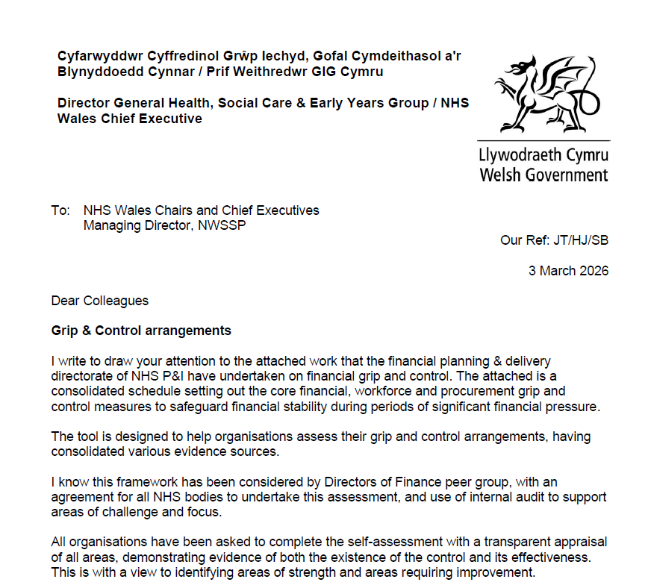
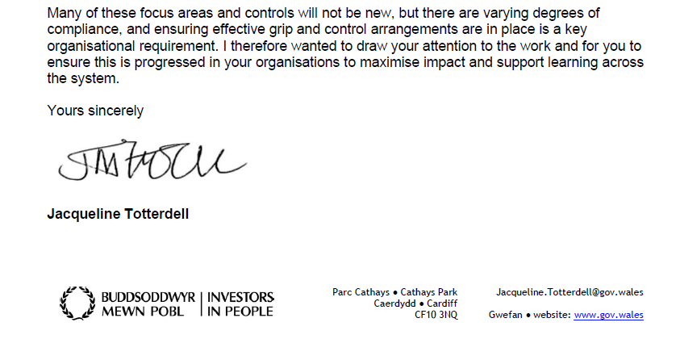
Welsh Government Letter 3rd March 2026 Grip & Control:
Project Health Board = Making Every £ Count

Slide 3
Key Points From 3rd March Letter & Accompanying Guidance
Background:
Given the scale of the pressure, it is essential that the NHS Wales can demonstrate that the financial governance and financial control environment mechanisms are robust and sufficient assurance is received on their effectiveness.
A consolidated schedule of core financial, workforce, and procurement grip and control measures designed to safeguard financial stability, has been developed which brings together all of the below into one Toolkit.
  Grip and Control presentation report (Financial Planning and Delivery May 2022)
  Financial Grip and Control Checklist (NHS England December 2022)
  Establishment Control (HFMA May 2025)
  Budgetary Framework and Grip and Control Discussions (Directors of Finance Forum July 2024)
The toolkit will help organisations assess their current grip and control arrangements by bringing together evidence sources in one framework.
Directors of Finance have agreed that all NHS bodies will complete the assessment.
Overarching Actions
Complete a transparent self assessment, showing evidence of:
  the existence of each control;
  the effectiveness of each control;
  using this information to identify both strengths and areas needing improvement.
Complete the checklist within the Toolkit to consider whether the relevant policy or process exists and secondly to consider operational delivery and compliance. This may require input from representatives from several areas including workforce, procurement, efficiency, finance and audit.
Agree priority issues and how proposed actions to address the issues identified will be taken forward. This may require assembling a working group including representatives from workforce, procurement, efficiency, finance.
Key findings from the exercise to be shared through the Director of Finance forum to identify any national areas of focus.

Slide 4
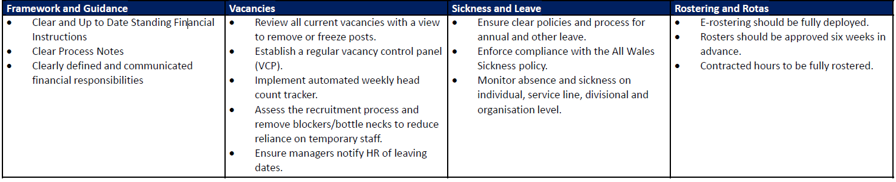
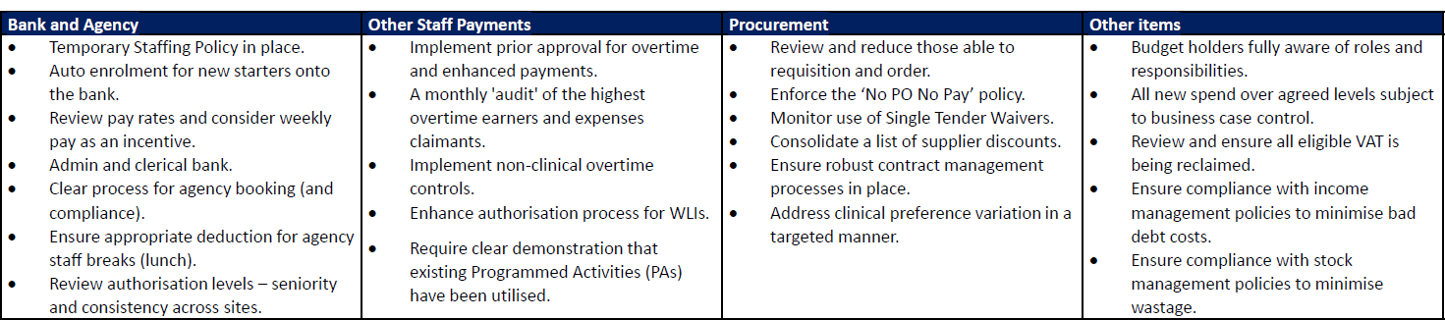
Making Every £ Count Themes
The Tool Kit is broken down into eight thematic areas based on the presentation report provided by the Performance & Improvement Unit back in May 2022. These eight areas and the underpinning actions from the May 2022 presentation are provided below:

Slide 5
Making Every £ Count Tool Kit
Action to Date: Toolkit has been assessed and each of the actions allocated to an Executive Lead, a summary of these, the thematic areas allocated and the number of schemes under each theme is summarised in the table below:
Executive Leads | Themes | Number of Schemes
Director of Workforce & OD | People Costs – Establishment & Vacancies People Costs – Other Staff Payments – Overtime / Enhancements People Costs – Sickness and Leave Management People Costs – Temp Staffing Inc Bank, Agency & Locum Rostering, Rota’s and Job Planning – General | 65
Medical Director | People Costs – Other Staff Payments – WLI’s Rostering, Rota’s and Job Planning – Medical Job Planning | 15
Director of Finance | Procurement Other Items – Financial, Capital and Estates | 55
Board Secretary | Framework and Guidance Controls | 12
Director of Nursing and Patient Experience | Rostering, Rota’s and Job Planning – Nurse Rota Management | 9
Immediate Next Steps: Finance Team will liaise with Executive Leads to complete an initial review of the themes and associated schemes for agreement. Further details are provided on Next Steps slide.

Slide 6
Next Steps & Timeline
Establishment Tool and provisional allocation of themes & schemes
  Sign off principles IET
      Thematic Lead sign off allocation of Themes/schemes
Assessment of effectiveness current controls and supporting evidence
  Based on current assessment agree areas where improvement to strengthening grip and control required
      Consolidation priority issues and how actions addressed
Assessment and independent overview Internal Audit
  Updates progress Monthly Execs / Bi Monthly Audit Committee
      Updates to All Wales DOFs
16/03
TBC
TBC
17/04
30/05
12/06
30/06
30/03
TBC
Phase 1:
Assessment & Establishment Tool Kit
Phase 2:
Assessment and Delivery Actions
Phase 3:
Reporting & Assurance

Slide 7
Update @ 20 April: Every £ Counts Self Assessment
Action to Date:
Details of the themes and underpinning actions to date sent to all Executive Leads.
Realignment of theme allocations across Executive Leads and progress towards identification of existing controls, supporting evidence and their effectiveness is summarised in the table below:
Executive Leads | Themes | Total Number of Schemes | RAG Status: Green | RAG Status: Amber | RAG Status: Red | RAG Status: TBC
Director of Workforce & OD | People Costs – Establishment & Vacancies People Costs – Other Staff Payments – Overtime / Enhancements People Costs – Sickness and Leave Management People Costs – Temp Staffing Inc Bank, Agency & Locum Rostering, Rota’s and Job Planning – General | 69 | 21 | 3 | 1 | 44
Medical Director | People Costs – Other Staff Payments – WLI’s Rostering, Rota’s and Job Planning – Medical Job Planning | 11 | 1 | 9 |  | 1
Director of Finance | Procurement Other Items – Financial, Capital and Estates | 66 | 5 | 2 | 4 | 55
Board Secretary | Framework and Guidance Controls | 1 | 1
Director of Nursing and Patient Experience | Rostering, Rota’s and Job Planning – Nurse Rota Management | 9 |  |  |  | 9
Total |  | 156 | 28 | 14 | 5 | 109
Weekly movement @ 20 April 2026 |  | - | +20 | +7 | -2 | -25
Immediate Next Steps: Continue to work collaboratively with Executive Leads for sign off and with these teams to complete the initial assessment of current controls, supporting evidence and their effectiveness.

