Slide 1
Swansea Bay University Health Board
Integrated Performance Report
October 2025

Slide 2
Report Overview
The Health Board Integrated Performance Report will provide updates against all areas under escalation with Welsh Government, all performance metrics outlined within the NHS Wales Performance Framework 202-26, along with updates against the Delivery Expectations and the Ministerial Enabling actions as outlined in the NHS Wales Planning Framework 2025-2028
Section 1: Updates against all Escalation areas with Welsh Government
Section 2: Performance against the Health Board’s Strategic Objectives
Section 4: Updates on Ministerial Enabling Actions
Section 3: Service Specific Updates

Slide 3
Section 1:
Updates against all Escalation areas
with Welsh Government

Slide 4

Delivery against Targeted Intervention and Enhanced Monitoring Criteria 2025/26
TI Area (Level 4) | Criteria to achieve | Performance (Sep -25)
Cancer | 60% performance maintained for 3 months against the SCP target. This position in draft | 61% (August - 25)
UEC | Continuous reduction of ambulance handovers over an hour of at least 11% in three consecutive months and maintained for 3 months (Based on Q2/Q3 2023 baseline | 145 (30.63% increase)
 | Continuous improvement towards no more than 7% of patients waiting over 12 hours at each individual site and across HB | 9.39%
 | Median time from arrival at emergency department to assessment by a clinical decision maker should not exceed 60 minutes | 89.00%
 | Continuous reduction in delayed pathways of care of 5% for three consecutive months and then maintained for three months (based on Oct-Dec 23 baseline) | 191
HCAIs | A clear improvement plan based on a root cause analysis to address the issue of hospital onset HCAIs. | In place
 | C-Diff: reduce the number of hospital onset infections by 40% and maintain for 3 months (from a baseline of the average number of cases in quarter 3 of 10 cases to no more than 6 per month | 19 cases
 | Staph aureus: reduce the number of hospital onset infections by 25% and maintain for 3 months (from a baseline of the average number of cases in quarter 3 of 4 cases to no more than 3 per month | 5 cases
 | E-coli: reduce the number of hospital onset infections by 20% and maintain for 3 months (from a baseline of the average number of · cases in quarter 3 of 5 cases to no more than 4 per month) | 6 cases
 | Klebsiella: reduce the number of hospital onset infections by 10% and maintain for 3 months based on 2017/18 figures (baseline –54 cases in 2017/18, reduce to average of at most 4 per month) | 2 cases
Finance | Detailed Updates included in the monthly Escalation Report
Strategy & Planning | Detailed Updates included in the monthly Escalation Report
Maternity & Neonates | Detailed Updates included in the monthly Perinatal Report
Dashboard

Slide 5
Delivery against Targeted Intervention and Enhanced Monitoring Criteria 2025/26
Escalation Area (Level 3) | Criteria to achieve | Performance (Sep-25)
CAMHS | 80% of LPMHSS mental health assessments undertaken within 28 days from the date of receipt of referral | 88% (August-25)
 | 70% of therapeutic interventions started within 28 days following an assessment by LPMHS | 55% (August-25)
 | 85% of HB residents in receipt of secondary mental health services who have a valid care and treatment plan | 93% (August-25)
Planned Care | 100% of open outpatient pathways to be waiting less than 52 weeks and maintained for 3 month | 100%
 | Continuous improvement towards 75% of all open outpatient pathways waiting less than 26 weeks | 75.73%
 | 100% of open pathways to be waiting less than 104 weeks and maintained for 3 months | 100%
 | Continuous improvement towards 80% of all open pathways waiting less than 36 weeks | 74.73%
 | 12% reduction in the number of patients delayed by 100% for their follow up appointment in three consecutive months and maintained for 3 months (Based on the November 2024 baseline.) | 12.38%
 | 68% R1 ophthalmology patient pathways to be waiting within or no longer than 25% of their target date for an outpatient appointment and maintained for 3 months | 73.46%
 | 85% of patients waiting for a diagnostic test to be waiting less than 8 weeks and maintained for 3 months | 79.01%
 | 85% of patients waiting for a diagnostic endoscopy to be waiting less than 8 weeks and maintained for 3 month | 38.61%
 | 85% of patients waiting for a NOUS and non cardiac MRI to be waiting less than 8 weeks and maintained for 3 months. | 93.32%
 | 90% of patients waiting for therapies to be waiting less than 14 weeks and maintained for 3 months | 100%

Slide 6
Section 2:
Summary of the performance against the Health Boards Strategic Objectives

Slide 7





SBUHB Strategic Objectives and Quality Aspects
Our refreshed Strategic Objectives –aligned to ‘a Healthier Wales’ articulate the future state of Swansea Bay UHB as a high-quality organisation. We have set out what this looks like for our population, communities, staff , partners and services and are developing strategic indicators that will tell us if our efforts are delivering our objectives
People of Swansea Bay live healthier, equitable and more equal and prosperous lives
Every child has the best start in life
All children, young people and adults are enabled to maximise their capabilities and have control over their lives
Good work and fair employment is created for all
A healthy standard of living is ensured for all
Healthy and sustainable places are created through placemaking
The role and impact of ill-health prevention is strengthened
Racism, discrimination and their outcomes are tackled
Environmental sustainability and health equity are pursued together
Care is high quality, safe, efficient and delivers the best possible outcomes for people
Care is safe, it helps people and avoids harm
Care is evidence based, effective and improves outcomes
Care is timely and delivered by the right person in the right place
Care is efficient
Care delivers equitable outcomes regardless of demographic, socioeconomic or geographic factors
Care is person centred and delivered with compassion, dignity and mutual respect
Care is delivered in safe and appropriate settings supported by innovative digital solutions
Care is delivered around the patient in the most appropriate setting as close to home as possible supported by digital and data solutions
Care settings are fit for purpose, appropriately designed and equipped
Secure, trusted and insightful data and digital platforms empower staff to deliver more and higher quality care and improved patient outcomes and population health
We have a digitally inclusive culture, where patients, clinicians and non-clinical colleagues work collaboratively to create effective and efficient services and patients are empowered to make informed and meaningful choices about their health and care
Through where and how they are delivered, services contribute to the environmental, economic, social and cultural well-being of Swansea Bay
The health board is a great place to work where staff feel valued and work together towards a common goal
Our Workforce is engaged, motivated and healthy; they feel valued, fairly-rewarded and supported
The Health Board is recognised as an employer of choice
We have a well-planned workforce with the right number of skilled people working on the right things
People feel ready for our digital future
People are supported to develop the skills and capabilities they need
People role model collective and compassionate leadership and live our values
We are diverse and inclusive, ensuring all voices are heard
The health board is a resilient, financially sustainable and responsible organisation
The health board is financially balanced and able to invest in service transformation and change
Decisions are made balancing short-term improvements and long-term impacts
Resources are used efficiently and proportionately, reducing waste and variation
The environmental impact of health care delivery in Swansea Bay is minimised
The health board invests in and works with others locally and responsibly, using our assets to positively contribute to the community
Citizen stakeholders are meaningfully involved and engaged in decision making
The health board has the capacity to effectively plan for and respond to incident and emergencies

Slide 8
People of Swansea Bay live healthier, equitable and more equal and prosperous lives
Childhood Immunisations | Target | Sep-25
Percentage of children who are up to date with the scheduled vaccinations by age 5 (‘4 in 1’ preschool booster, the Hib/MenC booster and the second MMR dose) | 95% | 89.0% (Jun-25)
Percentage of children receiving the Human Papillomavirus (HPV) vaccination by the age of 15 | 90% | 85.9% (Jun-25)
Influenza & Covid Immunisations
Percentage uptake of the influenza vaccine in adults 65 years and over | 75% | 68.5% (24/25)
Percentage uptake of the COVID-19 vaccination for all those eligible – Spring Booster | 70% | 50.8% (May-25)
Smoking Cessation
Percentage of adult smokers who make a quit attempt via smoking cessation services | 5% Annual target | N/A
Percentage of adult smokers who make a quit attempt via smoking cessation services who are CO-validated as quit at 4 weeks | 40% annual target | N/A
Screening
Percentage of patients offered an index colonoscopy procedure within 4 weeks | 90%
Percentage of well babies entering the new-born hearing screening programme within 4 weeks | 90%
Percentage of eligible new-born babies who have a conclusive bloodspot screening result by day 17 of life | 95%
DE
DE
DE
DE

Slide 9
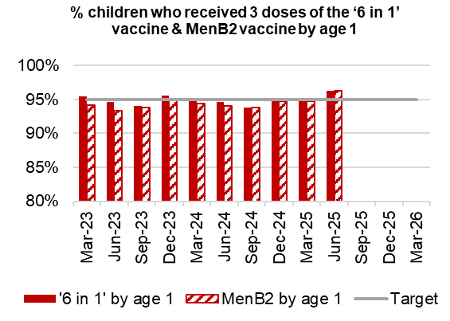
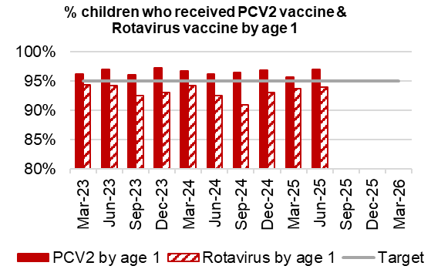
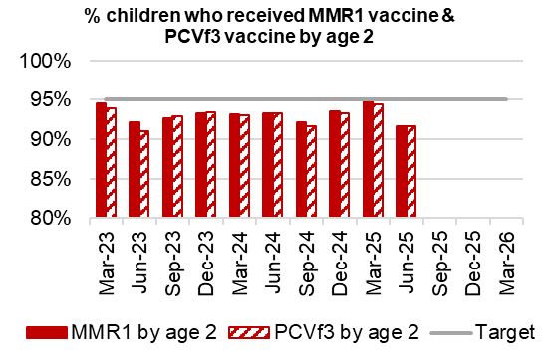
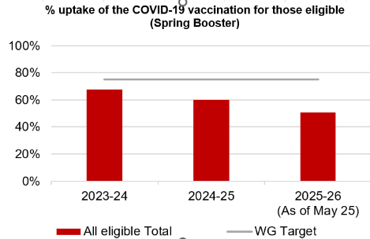
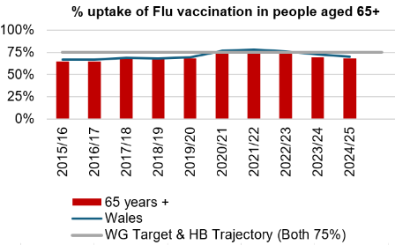
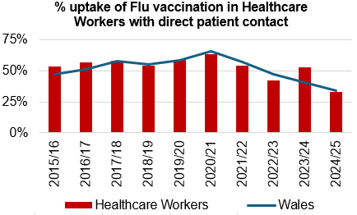
Immunisations
Actions/Updates
Performance against the immunisation targets is reported in arrears on a quarterly basis
Updated targets have been set for the new financial year which can be seen on the graphs above

Slide 10
Care is high quality, safe, efficient and delivers the best possible outcomes for people
Accident & Emergency | Target | Sept-25
4 -hour performance | 95% | 66.22%
12-hour performance | 0 | 1,112
Number of A&E Attendances | N/A | 11,845
Number of Clinically Optimised Patients (HB wide) | Continuous Reduction | 191
Number of cancelled Electives | 0 | 5
Median time of arrival to assessment within 60 minutes | 97% | 89.00%
Ambulance
Median emergency ambulance response time to purple: arrest category calls | 6-8 minutes | 7:12 (Aug-25)
Median emergency ambulance response time to red: emergency category calls | 6-8 minutes | 8:38 (Aug-25)
Median time from arrival at an emergency department to assessment by a clinical decision maker should not exceed 60 minutes | 97% | 89.00%
Total Handovers lost over 15 minutes | 0 | 386
DE
TI
DE
TI
TI
TI

Slide 11
Care is high quality, safe, efficient and delivers the best possible outcomes for people
Stroke | Target | Sep -25
Percentage of admission within 4 hours | 95% | 24%
Percentage of stroke patients receiving a CT scan within 1 hour | 95% | 52%
Percentage of patients assessed by a stroke consultant within 24 hours | 95% | 100%
Percentage of patients to receive a mechanical Thrombectomy | 10% | 10%
Planned Care | Target | Sep – 25
Percentage of patients waiting < 26 weeks for an outpatient appointment | 75% | 75.73%
Total number of patients waiting > 36 weeks | 80% | 74.73%
Number of patients waiting at Stage 1 > 52 Weeks | 0 | 0
Total number of patients waiting > 104 Weeks | 0 | 0
Diagnostics & Therapies | Target | Sep – 25
Number of patients waiting > 8 weeks for diagnostics | 0 | 3,017
Number of patients waiting > 8 weeks for an Endoscopy | 0 | 2,046
Number of patients waiting > 14 weeks for Therapies | 0 | 0
Number of children waiting > 6 weeks for Audiology | 0 | 140
TI
TI
TI
DE
TI
DE

Slide 12
Care is high quality, safe, efficient and delivers the best possible outcomes for people
FUNB | Target | Sep -25
Number of patients waiting for an outpatient follow-up (booked and not booked) who are delayed past their agreed target date (All Specialties) | N/A | 73,028
Total number of patients waiting 100% over their target date | 0 | 43,196
Total number of patients waiting for a follow-up appointment | N/A | 158,228
Mental Health & Learning Disabilities | Target | Aug – 25
Percentage of mental health assessments undertaken within (up to and including) 28 days from the date of receipt of referral | 80% | 97%
Percentage of therapeutic interventions started within (up to and including) 28 days following an assessment by LPMHSS | 80% | 81%
Percentage of patients waiting less than 26 weeks to start a psychological therapy in Specialist Adult Mental Health | 80% | 45.1%
Quality & Safety | Target | Sep – 25
Number of service user feedback experience responses on CIVICA | Monthly improvement | 6,985
Percentage of complaint responses sent within 30 working days | 80% | 56% (Jul-25)
Number of Nationally Reported Incidents | N/A | 4
Number of New Never Events | N/A | 0
TI
DE
DE
DE

Slide 13
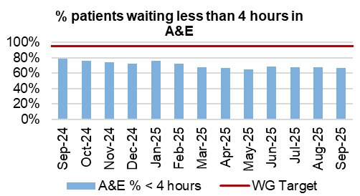
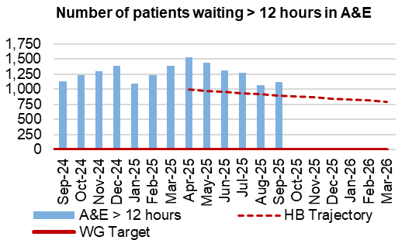
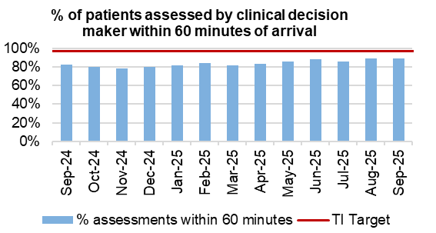
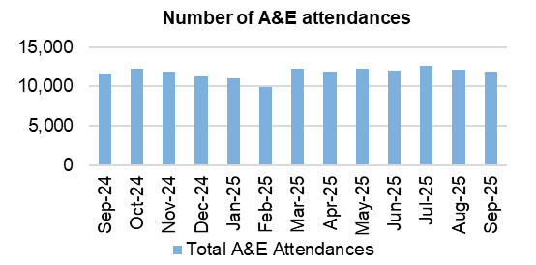
Unscheduled Care
Dashboard
Actions/Updates
Full implementation of D2RA model – Executive agreement between Health & Social Care CEO’S to deliver a D2RA model. Test of change delivered pre-Easter with overwhelming evidence of success. Test of change has continued, a work programme structure has been developed and a formal OCP is required to substantively reorganise workforce. The workshop was delivered on the 21st July 2025, demonstrating both operational and strategic work to drive the model forward. Recent paper presented to community and older persons board, requesting support for joint commitment to OCP in respect of Health and Social care staff required to deliver the D2RA hub.
Grip & control operational management – Full Capacity protocol and zero tolerance on chair and trolley waits in full operation with additional 3:30 huddle now in situ at Morriston Hospital. As part of the UEC test of change programme, new initiatives regarding patient placement and pull into specialty wards have been implemented. Requirement to rewrite Health Board escalation framework pre-winter in light of the learning from test of change.

Slide 14

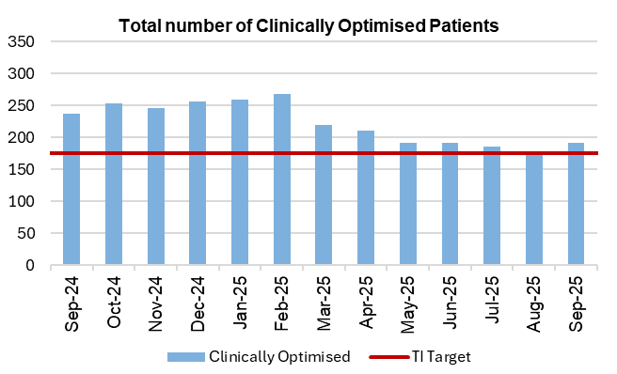



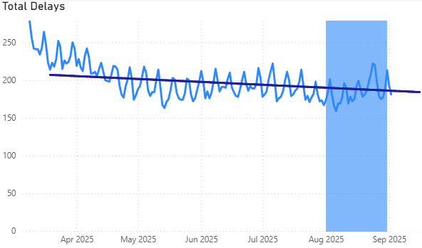
Pathways of Care Delay: Action & Intervention
August: Top 5 Delays | Sep 30th | Sep 23rd | Sep 17th | Sep 9th
Awaiting reablement community care package | 31 | 27 | 19 | 13
Awaiting start of new community care package funded by social care | 20 | 21 | 15 | 22
Awaiting completion of assessment by social care | 15 | 12 | 20 | 13
Awaiting Completion of AHP Allied Health Professional Assessment | 7 | 15 | 16 | 7
Awaiting joint assessment | 5 | 6 | 12 | 7
3.25%
WG target -15% reduction in total delays,
20% reduction in assessment delays,
20% reduction in total days delayed from March 2024 baseline
Total delays against Welsh Government Trajectory
What is currently supporting the reduction:
Robust weekly accountability meetings implemented with all sites – led to improved engagement & traction on delivery
New Standard Operating Procedure issued to ensure clarity of expectation
Plan is refreshed on a 3 monthly cycle
Weekly internal census and validation approach in place
Established In Recovery, Reablement and Rehabilitation Code to go live in October
IDH SOP & Performance framework developed
92.6%

Slide 15
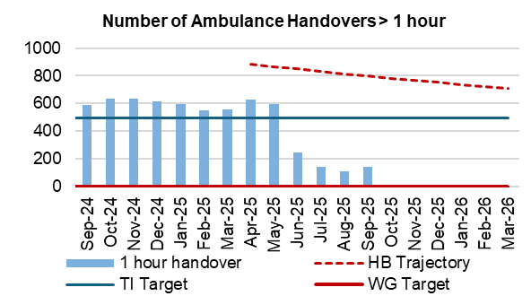
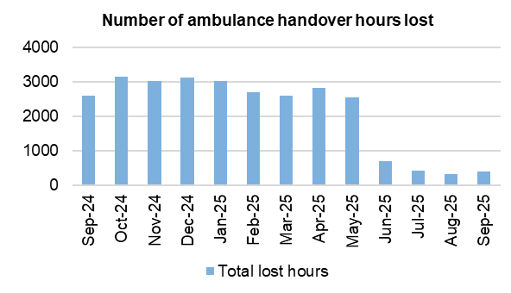
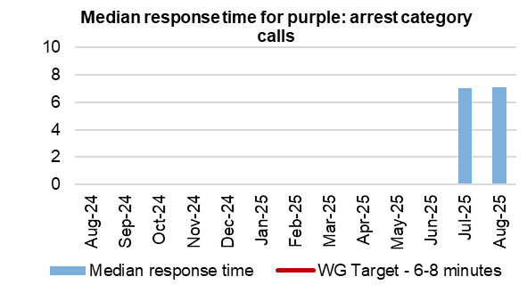
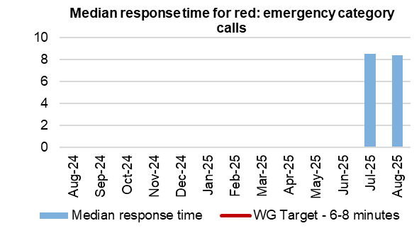
Ambulance
Dashboard
Actions/Updates
A new Ambulance Performance Framework has been introduced which will see updated performance metrics utilised from August 2025
UEC Care co-ordination Hub – Formally referred to as single point of access. Task and Finish group established to deliver Swansea Bay single point of access as from September 2025. Initial focus will be working in partnership with WAST on the national call before convey initiative for care home residents. National bid submitted week commencing the 18th August 2025 and draft Standard Operating Procedure in place.
Revised flow operating model/Anglesey Ward: Anglesey ward remains operational until end of March 2026. Initial UEC tests of change have proven successful in decompressing the Emergency department and improving ambulance handover. Phase 2 UEC test of change will commence September 2025, and will focus on the acute medical unit (AMU) downstream wards and the single point of access.

Slide 16
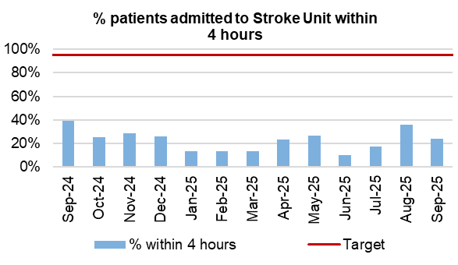
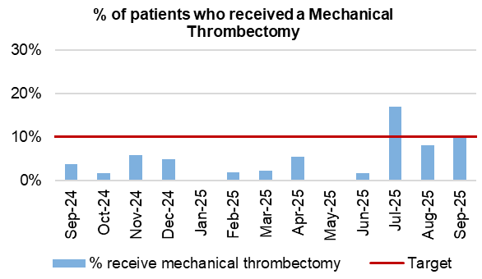
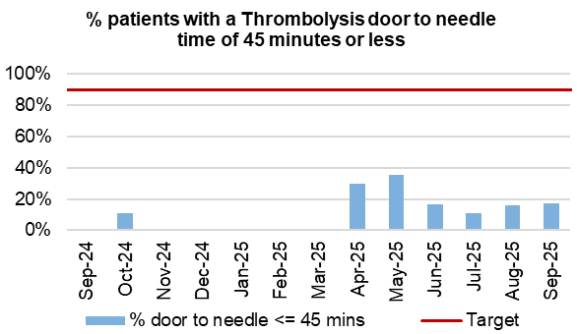
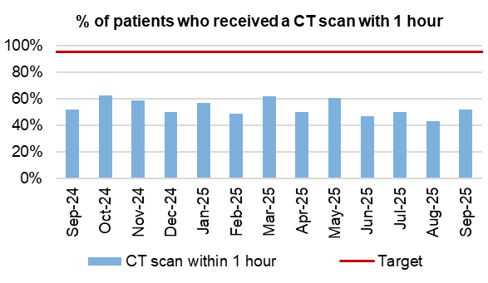
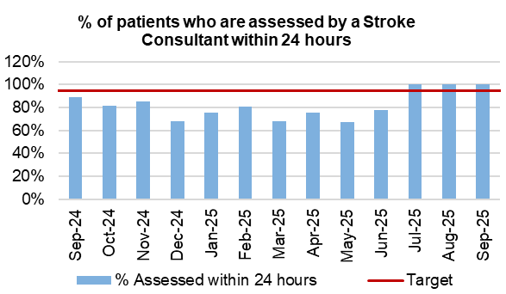
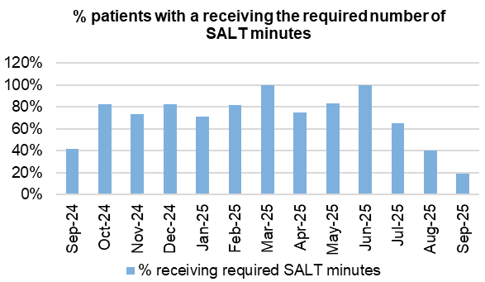
Stroke
Actions/Updates
Due to changes to the Sentinel Stroke National Audit Programme (SSNAP) data repository in October 2024, there have been significant challenges in extracting data from the national system. However, access has now been restored with updated indicators and reporting options. In the interim, the service has implemented local arrangements to extract and report relevant data which is included within this report.

Slide 17
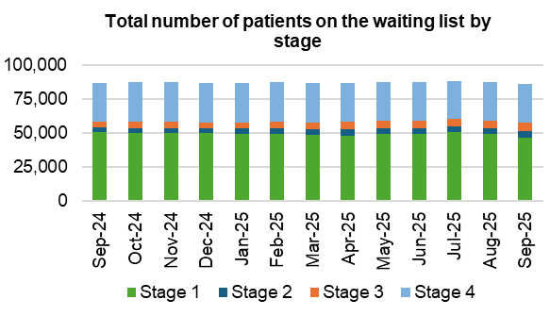
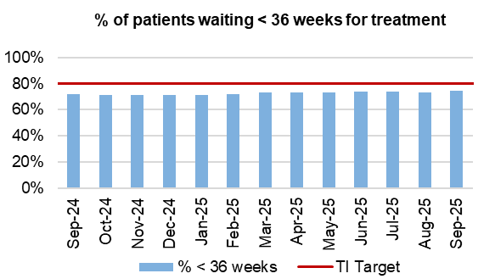
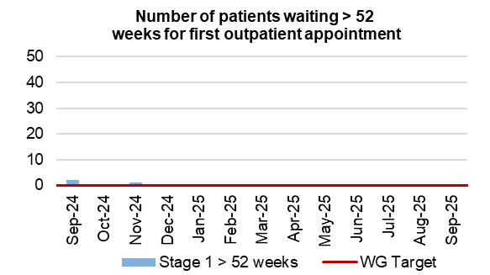
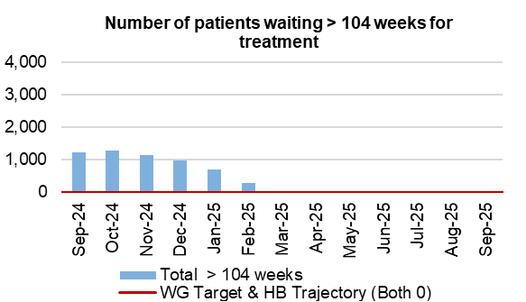
Planned Care
Dashboard
Actions/Updates
The Health Board have maintained the Stage 1 > 52 weeks target of 0 for September 2025.
The Health Board have maintained the number of patients waiting > 104 weeks for treatment target of 0 for September 2025.
Welsh Government have provided updated de-escalation criteria for all planned care metrics which reflect encouragement towards an improved position. Focus has now been placed on achieving a new Targeted Intervention Target for patients waiting <36 weeks for treatment.
Key Risks to delivery include the current physical infrastructure to hold additional clinics, workforce availability, funding and willingness of patients to attend out of hours

Slide 18
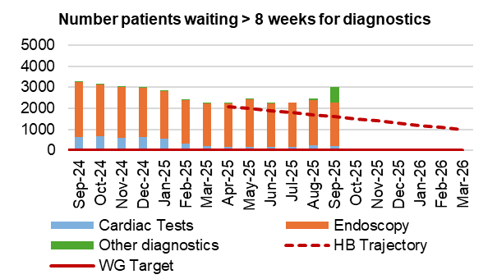
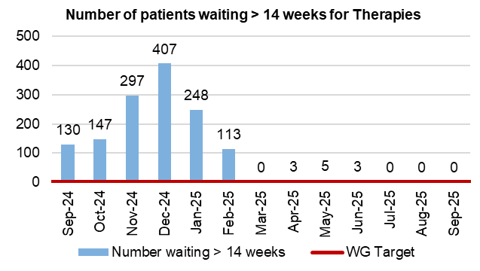
Diagnostics and Therapies
Actions/Updates
The total number of patients waiting > 8 weeks for diagnostics has increased in September 2025 to 3,017, compared to 2,471 in August 2025.
Updated targets have been set for diagnostic de-escalation criteria which encourage further improvement, with the target for patients waiting < 8 weeks for diagnostics increasing to 85% from 80%.
The additional Gastroenterology insourcing gained from recovery monies to support the stage 1 position through Q4, resulted in a greater volume of referrals for Endoscopy which meant further pressure on the 2025/26 Q1 position. Our trajectory has forecast that we will start recovering against the additional demand over the next quarter.
The number of patients waiting > 14 weeks for therapies has been reported as 0 in September 2025

Slide 19
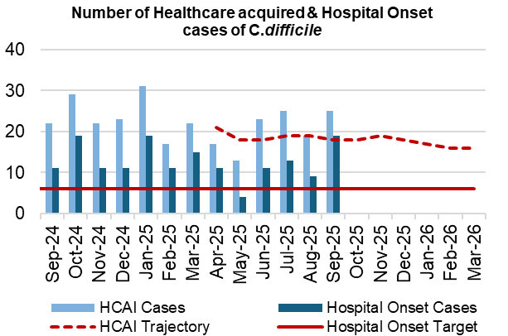
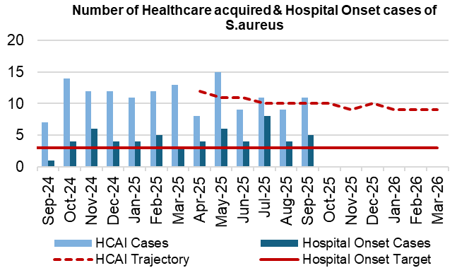
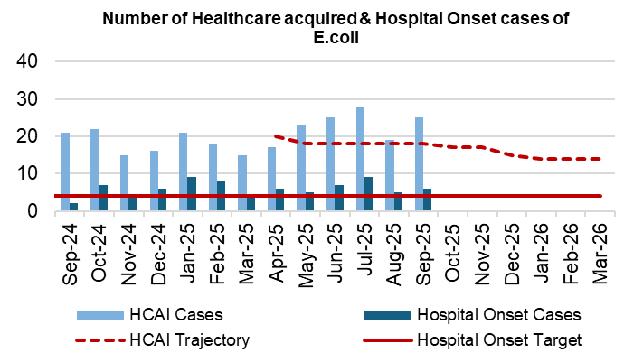
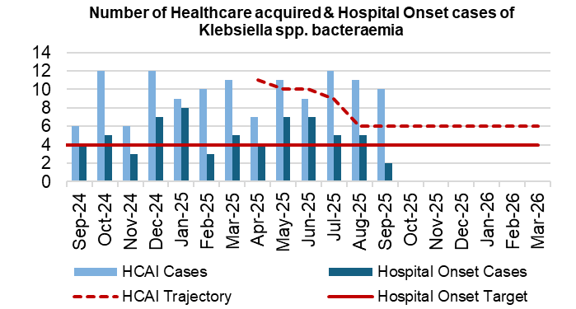
Infection, Prevention & Control
Dashboard
Actions/Updates
Gold C. difficile High Incidence Management Group.
New C. difficile Standards: Risk Assessment & Governance Framework agreed by Management Board and approved by the Infection Prevention and Control Strategic Group August 2025. Multi-channel approach for dissemination and promotion at local level to support adoption.
Scoping small scale project on antibiotic 72-hour review.
Initial financial impact assessment of new National Cleaning Standards 2025 for SBUHB - £5m. Further scoping work to assess the operational and clinical impact and risks.

Slide 20
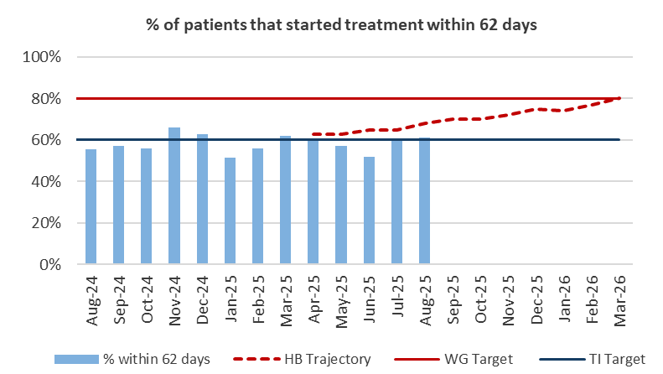
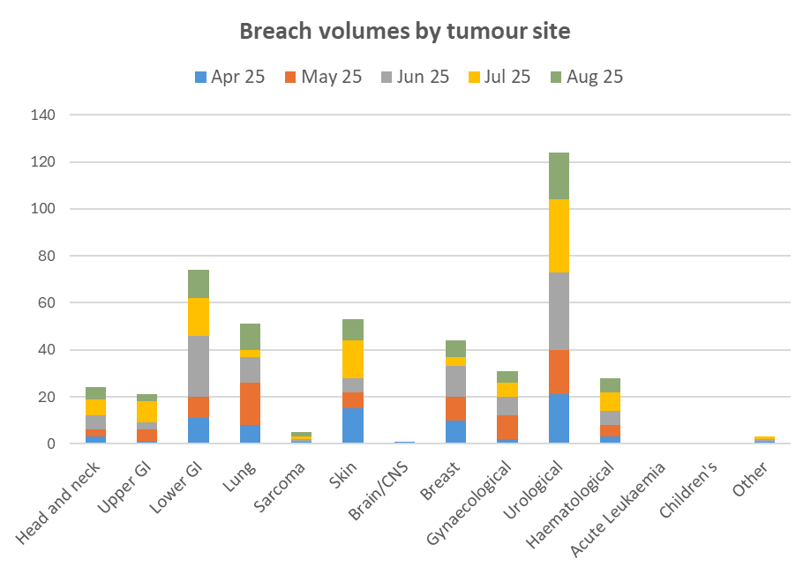
Cancer
Actions/Updates
In August 2025, the service reported 61% of patients had started treatment within 62 days which is above the Welsh Government TI target of 60%. Additional actions are being undertaken to improve performance:
  Continued focus on front end of pathway for all specialties
  Urology – focussed review of prostate pathway, including discussion to develop a true Straight to Test pathway, reducing the number of contacts. We have contacted teams in each of the Welsh Health Boards for learning where STT prostate pathways exist. Discussion with clinical team to take place at audit meeting 16th September.
  LGI: Morriston Medical Director leading discussions for consideration of a timeout/workshop with key representatives.

Slide 21
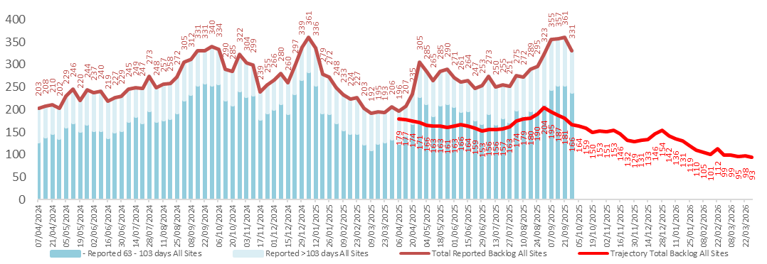
Cancer
Actions/Updates
The backlog has increased over the Summer and above the outlined trajectory. The tumour sites with the largest proportion are Skin, Urology, Lower GI & Gynaecology.
  Skin actions include: Dermatology Locum commenced in post in August. Additional outpatient activity planned for September 2025. HCSE undertaking D&C and process review support development of business case for longer term provision of services.
  Gynaecology: Phase 1 of the Transformation of Gynaecological Oncology Services has commenced. Phase 1 concludes October 2025.

Slide 22
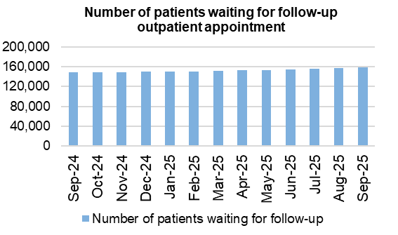
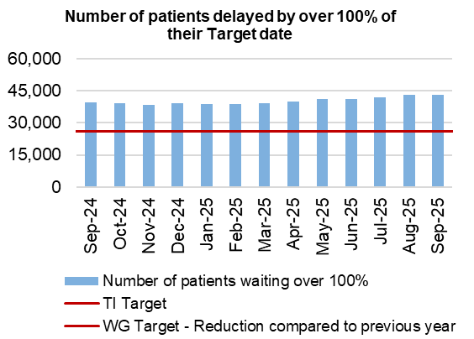
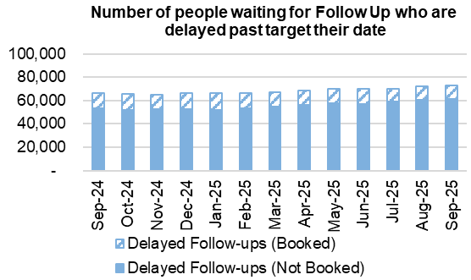
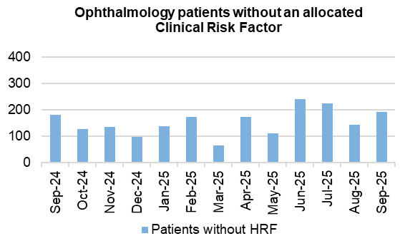
Follow-Ups & Activity

Slide 23
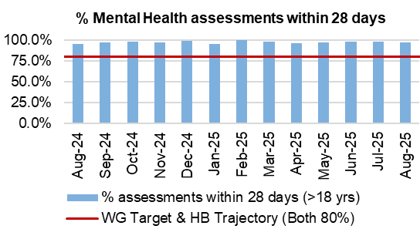
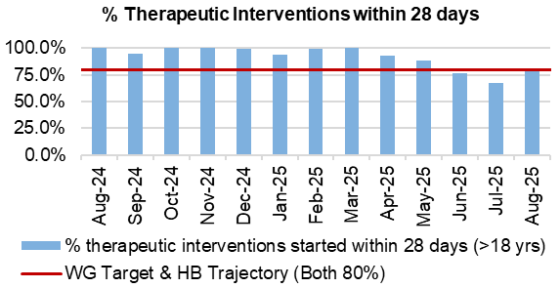
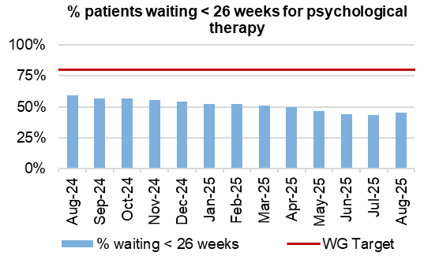
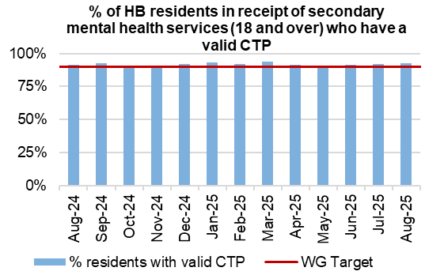
Mental Health & Learning Disabilities
Actions/Updates
Welsh Government has identified Mental Health and Learning Disabilities (MH&LD) as an area of concern, with regards to oversight and escalation. Assurance has been sought with regards to the key areas of concern within the Service Group
The Health Board has commenced work in advance of the receipt of the report and is setting up a Transformation Programme. This has been informed by a review of the service by an external advisor.

Slide 24
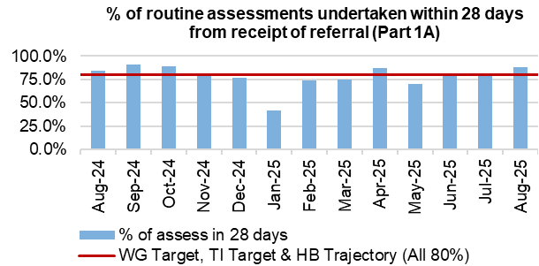
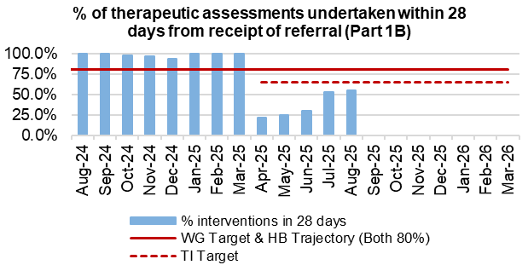
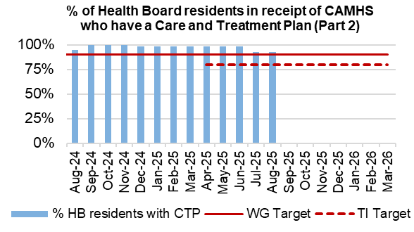
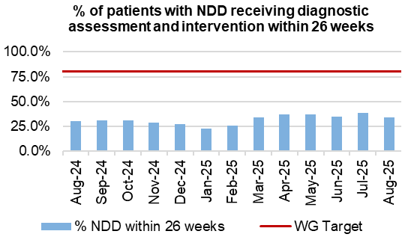
Child and Adolescent Mental Health Service (CAMHS)
Actions/Updates
CAMHS Part 1B – Performance against Part 1B will remain a challenge until the backlog of >28-day waiters is cleared. However, the recovery plan put in place will support this, and the planned Demand and Capacity review will help to identify the gap.
CAMHS part 1B now shows a slight increase from previously reported performance to 53% for the last reporting period (July) from a previous position of 30% - the team have provided assurance that performance will meet the profile in a few months. Part 1A has been maintained at 81%, with Part 2 also maintaining performance against the trajectory reporting 93% in August.

Slide 25
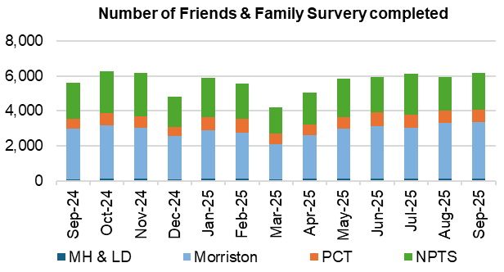
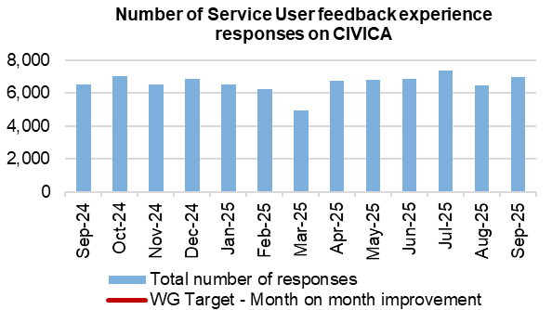
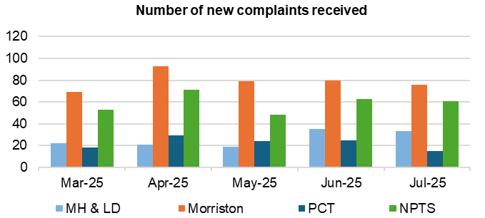

Patient Experience & Concerns
Actions/Updates
There were 6,081 friends and family surveys completed in September 2025 which is an increase on the previous month where 5,853 surveys were completed.
Of those surveys completed, the 92% of patients would highly recommend the services they received.
There were 192 concerns receive in July 2025, and 56% of those concerns had responses sent within 30 days in July.

Slide 26






Patient Experience: Action & Intervention
What is the data telling us?
Graph 1 – Illustrates that Swansea Bay UHB’s overall score consistently exceeds the benchmark of 85%, maintaining a performance of 90% or higher.
Graph 2 – Displays the overall satisfaction scores across the different Service Groups.
Graph 3 – Highlights wards/clinics achieving scores above 100%, based on more than 25 responses..
Graph 4 – Identifies the wards/clinics with the lowest satisfaction percentages.
What are we doing about it?
The system generates weekly feedback summaries for Service Group Leads, enabling timely action on low scores and recognition of positive feedback and comments.
Ongoing drop-in feedback sessions are held to support teams in using Civica effectively and managing their feedback constructively.
For alerts flagged as very poor or poor, the Action Manager is triggered. This tool tracks the progress and resolution of issues within Civica, managed by the PALS and Quality & Safety departments.
What do we expect to see change and when?
There has been a noticeable increase in the overall satisfaction score for the Emergency Department. This improvement may be linked to the implementation of the ‘Your Next Patient’ programme, which focuses on enhancing patient flow and experience.
With the introduction of Action Manager, we expect to see a rise in ‘You said, we did’ outcomes. This will support more visible and trackable responses to patient feedback.
Graph 1
Graph 2
Graph 3
Graph 4

Slide 27




Complaints: Action & Intervention
What is the data telling us?
Graph 1 – is indicating that a number of complaints are not compliant with the 30 working day target for responding to formal complaints in line with the Putting Things Right Guidance.
Graph 2 – 178 new formal complaints in September which is an increase compared to 160 in August.
Graph 3 - The average number of days taken to close a formal complaint does appear to be reducing over the last 6 months. Average days for July being 30 days.
Graph 4 - The number of overdue formal complaints is increasing bi-weekly. As of the 30th September, 277 formal complaints were overdue. This is the most overdue formal complaints the Health Board has had in the last 6 months.
What are we doing about it?
Bi-weekly report run on all overdue complaints which is sent to each Service Groups requesting updates.
Bi-weekly drop-in sessions where complaint handlers can join to discuss any issues.
Bi-weekly meetings with Service Groups to discuss open complaints and Ombudsman cases.
Test to Change in SNPT to trial new way of managing complaints and trying to resolve early on.
What do we expect to see change and when?
Reduction in the overdue complaints by December 2025, in readiness for the new Putting Things Right Guidance being introduced in April 2026.
Early engagement with the complainant combined with listening meetings which will support an empathetic and compassionate handling of the complaint.

Slide 28




Serious Incidents and Risks
Actions/Updates
There were four Nationally Reported Incidents reported in September 2025 and there were no new never events reported. Of those NRI’s reported, they were related to two stillbirths, a neonatal adverse occurrence and an assessment/diagnosis issue. In September 2025, there were 115 open risks with a score >20 recorded for the Health Bord which is a reduction compared to 119 in August 2025. There were 254 open risks with a score >16, which again is a reduction compared to 263 in August 2025.
There were 173 hospital falls recorded in September 2025

Slide 29



NRIs/EWNs: Action & Intervention
What is the data telling us?
Graph 1 – Number of NRIs/Never Events reported to NHSWP&I over rolling 6-month period. The data shows a declining reporting picture for September 2025
Graph 2 – 40 open NRIs (inc Never Events) open with NHSWP&I. Of these, 13 are open past closure date.
Graph 3 – Total number of outcome forms submitted per month / missed target closure date over a rolling 6-month period.
What are we doing about it?
Weekly review with PSI investigator to:
  monitor progress of corporate investigations; identify barriers
  escalate outstanding actions required
Fortnightly service group meetings:
  service group investigations - progress towards closure date discussed
  updates on PSI investigation given
  escalate to service group any barriers identified with PSI investigations
Service Group Directors contacted separately if actions remain outstanding
Data presented and discussed at health board Patient Safety and Compliance Group; Quality and Safety Group; Patient Stakeholder and Experience Group - Service Group assurance sought against outstanding actions for completion of investigation / outcome form
What do we expect to see change and when?
Reduction in number of overdue investigation outcomes forms monthly
Reduction in number of NRIs / NEs reported through recommendations made / learning shared – rolling 12-month period
EWNs – September 2025
Pathology Department - concerns about quality / accuracy of some pathology reports that were being published by a consultant pathologist
Outcome of concluded court case of staff member relating to sexual misconduct - Doctor found not guilty. GMC undertaking a fitness to practice review
Potential for adverse media attention - Outcome of Child Practice Review being published 03/09/25
Community Pharmacy Compliance Issue - Concerns regarding their compliance with the Terms of Service within The National Health Service (Pharmaceutical Services) (Wales) Regulations 2020. The contractor has received two breaches for temporary suspension to pharmaceutical services (pharmacy closures) and has subsequently breached a third time.

Slide 30

NRI Learning
What is the data telling us?
11 outcome forms submitted Sept ’25 – graph 1
The Yorkshire Contributory Factors Framework includes the issues identified for learning – graph 2
Graph 2
Domain 1 – Situational Factors Task characteristics: Clinician previously not reported on scans displayed in format presented *Lack of control and assurance within the follow-up booking process *Unknown origin of infection *Monotonous task leading to confirmation bias *Inadequate checks of consent documentation Individual Staff factors: Staff required enhanced support with IT path links and clinical approach in the past *Rushed - staff member under time pressure due to theatre waiting and took over care mid-process *Over-reliance on assumptions re documentation accuracy *Lack of adherence to LocSSIP * Decision making without support of relevant staff Patient factors: Impact of past medical history *Preterm infants | Domain 2 – Local Working Conditions Workload and staffing issues: Clinicians absent from work * Insufficient medical workforce * High unit workload due to last-minute changes to the theatre list *Temporary absence of the ODP during a critical safety step Leadership, supervision, and roles: Lack of assurance and challenge to the process Domain 3 – Organisational Factors Staff training and education: Staff understanding of management/FU requirements of STIC lesions *Incorrect clinical investigations *Lack of control processes to support staff in clinical decision-making *Lack of process to ensure control of booking process in place and delivery outcomes within nationally accepted standards *Lack of awareness or understanding of procedures for verifying updated consent in rapidly changing lists Support from other departments: Radiology addendum report months after original scan *Ability to perform MRI OOH Scheduling and bed management: Delay in transfer critical care area | Domain 4 – External Factors Design of Equipment: System failure (TOMS) which introduced safety risk during a critical phase of care. National Policies: Guidelines not followed *Local Policy not in place. Domain 5 – Communication and Culture Safety culture: No pre-existing control and assurance to support/enable workforce to mature safety culture Verbal and Written communication: Patient was not contacted re report addendum *Lack of explicit SOP *Comms issues with families *Daily checks not completed / documented with clinical information *Lack of verbal comms between staff

Slide 31





Falls: Action & Intervention
Page 1
What is the Data telling us?: PLEASE NOTE DATA ERROR SEPTEMBER 2025 NO CHART DATA AVAILABLE
In-patient falls rate remains below National average with a down trajectory in last 6 months
The numbers of incidents causing harm Aug '24-sept '25 is down 7% from the previous year
Falls rate by ward over 12 months shows high rates in mental health services, AMU and older persons rehabilitation wards.
Falls related attendance to ED/MIU averages 2700 per month (approx.. 20% of all ED/MIU attendances) Aug '25 is 17% higher than Aug '24
There have been 5 NRI falls related incidents in the last 12 months (Sept'24-Aug'25) compared to 10 in the previous 12 months = 50% decrease
Underlying causes:
Ageing population with increasing frailty picture
Increased demand on WAST and front door services
Limited alternative WAST response to level 1 and level 2 falls regionally
Inconsistent approach to falls advice in community/primary care
Reduced access and provision of falls clinics across region
Insufficient access to appropriate strength and balance exercise provision
Some ward areas including AMU do not have an environment which enables safe monitoring of patients at risk of falls
Risk assessment and care planning inconsistent and inaccurate in some areas of HB
Key Outcome Measure/s –
What are we doing about it:
Regional Falls Prevention taskforce enabling collaboration
Primary Care action plan agreed
Development of Level 1 and level 2 falls pathways in collab with therapies, St Johns Ambulance and LA
Dashboard for care home data now live
Safe Care partnership work on deconditioning progressing
Falls page on Waiting Well internet pages
falls policy update to reflect changes to NICE guidelines and introduction of digital care records
Improvement in digital audit through AMAT
Application to fund community strength and balance classes
Falls due for discussion at Management Board Oct '25
Recognising progress of level 1 falls response project through shortlisting in 2 National Awards (NHS Wales and HSJ)
What do we expect to see change?
Reduction in WAST call out from care homes following falls incident (goal – 30% reduction per site by March '26)
Falls rate not exceeding 5.0 (falls/1000beddays) over proceeding 12 months
Reduction in conveyance to hospital via WAST for level 2 falls (WG target of 25% reduction)
New falls policy to be shared 'Oct 25
Level 2 falls response due to go live by Nov ‘25

Slide 32




Quality & Safety
Actions/Updates
The percentage of completed discharge summaries 65% in September 25, which is the same as reported in August.
There were 103 Pressure Ulcers reported in August 2025, of which 41 were recorded in the Community.
Ther was an increase in the percentage of episodes clinically coded within 1 month of discharge, increasing from 51% in July, to 67% in August 2025

Slide 33



Pressure Ulcers: Action & Intervention
What is the Data telling us?:
Incident reporting for pressure ulcers has increased by 8.4% when comparing 2024 to 2025. This reflects higher numbers both in hospital settings and on community caseloads.
Key Data Points, Graph 1: Total number of HB acquired incidents across SBU (hospital, community, MH & LD combined).Graph 2:. The HB deep damage reported with or with aviodability status. Deep damage incidents have dropped by 61% from Aug to Sep 2025
The inpatient incident rate is 1.7 per 1,000 bed days. The SPC reflects the previous 4.3% reduction when comparing the same period in 2024/25; however, the overall trajectory remains upward from the previous rate of 1.38. The Highest inpatient rates were observed in Morriston (R 2.6), and NPSSG remains low (R 1.1).
Severity: 90% of incidents remain superficial in nature . Of incidents closed in the last quarter: 55% deemed unavoidable 11% deemed avoidable 34% closed without a recorded status, 29% of incidents remain pending investigation and are not reflected in current figures.
Harm Profile
There has been a 50% reduction in serious harm incidents compared to 2024/25 to date in both NPSSG and PCS.
No nationally reportable incidents have been recorded in Morriston.
Location of Incidents
Health board–acquired pressure ulcers remain more prevalent in patients’ homes. The highest report on inpatient sites remains ED/AMAU, with an average of 30 HB acquired per Quarter
Underlying causes:
Patient factors: Vulnerability, deconditioning (esp. first 72h of admission).
Leadership/Process: Poor accountability, admin gaps.
Risk assessment & care planning: Incomplete or poorly linked to interventions; staff skill gaps in ulcer recognition, repositioning, and offloading.
Equipment/Resources: Delays in dynamic mattress/bed provision; no targeted support in high-incidence wards.
Education/Training: Limited prevention training, lack of tissue viability expertise, weak engagement in QI.
Documentation/Technology: Delayed/incomplete digital charting; limited use of medical photography.
Governance/Learning: Gaps in guideline implementation and feedback systems
Risks:
Limited access to accurate data; executive dashboards don’t reflect site-level
SG data.
Lack of medical photography for validation (RR 15 / 3701).
Insufficient Tissue Viability Nurse (TVN) resources.
Bed contract delays → risk to patients due to failing equipment.
Key Outcome Measure/s –
Graph 1
Graph 2
Actions to Address Pressure Ulcers (HB):
Governance & Oversight: Pressure Ulcer Strategic Group, scrutiny panels, peer reviews.
Audits & Data: Spot audits, Datix QA audits, data reviews/cleansing. Service provision and efficiency reviews
Education & Training: Multilayered education (face-to-face, Teams, videos), skills days, champions programme, Care home QI education, neonatal & maternity guidelines.
Pathways & Policies: Development of PU pathways, policies, and improvement plans supported by .
Resources & Technology: Centralised Tissue Viability service, digital wound imaging (Improvement Cymru), bed contract finalisation. Shared education, champions and skills programme
Collaboration: Shared responsibility across HB, data sharing. Lessons and good practice, accountability,
Graph 3
What we expect to see (Outcomes by 2026):
↓ 20% PU rates in acute sites; ≤1.6/1000 bed days.
↓ 10% avoidable PU in HB.
Improved staff skills, governance, and learning culture.
Equitable access to tissue viability services & medical photography across
sites.
Better supported care homes.
Patients consistently receive “right care, right time.”

Slide 34


Mortality: Action & Intervention
3.25%
The summary of deaths in the Emergency Department can be seen below:
Mortality Data Summary
The crude mortality rate has seen a reduction in September 25, reporting 1.16% compared to the previous figure of 1.39% in August 2025.
Crude mortality over the last 4 years is within the control limits and the recent data reflects the predicted decline of mortality as expected during summer months
The summary of deaths in the Emergency Department shows a significant reduction in deaths in recent months.
92.6%

Slide 35




Theatre Efficiency
Actions/Updates
The Planning Framework sets out enabling actions that must underpin the delivery priorities to successfully achieve the core service and changes required. These include value projects, digital innovations, workforce developments, financial sustainability and ways of working. The enabling actions and planning framework have been incorporated into SBUHB’s Theatre performance framework and work is currently underway to report against these measures.

Slide 36






Fractured Neck of Femur (NOF)

Slide 37






Primary Care

Slide 38
Care is delivered in safe and appropriate settings supported by innovative digital solutions
Quality Aspect | Action | Outcome
Care is delivered around the patient in the most appropriate setting as close to home as possible supported by digital and data solutions | Implementation of Rio to support integrated teams in Mental Health, Learning Disabilities and Community Services. Increased access to services through the development of electronic self-referral forms for the population of Swansea Bay. Implementation of Digital Maternity to support a single pregnancy record with real time recording of information in community and hospital settings. | 750 users in integrated teams will be supported by a digital solution in the community. Shared Care record for maternity with a patient facing app launching by end of March 2026.
We have a digitally inclusive culture where patients, clinicians and non-clinical colleagues work collaboratively to create effective and efficient services and patients are empowered to make informed and meaningful choices about their health. | The digital platforms listed above will support clinicians to work collaboratively and effectively. Additionally, patients will be empowered to manage their own health through the increased adoption of: Swansea Bay Patient Portal (SBPO) in conjunction with the roll out of Hybrid Mail to improve patient communication by delivering outpatient letters digitally via the SBPP. Implementation of Digital Health Assessments (DHA’s) to include the Waiting Well holistic assessment question set. Pilot the use of artificial intelligence to increase the efficiency and timeliness of clinical coding. | Over 20,000 patients are accessing the portal, increasing by 500-1000 per week, empowering them to make informed and meaningful choices about their health. Effective and efficient services enabled by digital technology. Empowering patients to make informed and meaningful choices about their health. Data insights will inform clinical and operational decisions to improve patient outcomes

Slide 39
Care is delivered in safe and appropriate settings supported by innovative digital solutions
Quality Aspect | Action | Outcome
Secure, trusted and insightful data and digital platforms empower staff to deliver more and higher quality care and improved patient outcomes and population health | Implementation of a new pathology digital system (LIMS2.0) Implementation of a new Radiology Information System and Picture Archiving and Communication System (PACS). Enhancements to Signal functionality to support patient flow. Implementation of Open Eyes to provide a digital eye care Electronic Patient Record (EPR). Go live of the WNCR paediatric module, in line with the National Programme. e-Prescribing and Medicines Management - Deliver successful integration with National Shared Medicines Record and Pharmacy Stock Control. Implementation of Hospital Initiated Referral (HIR), enabling a consistent approach to dealing with referrals and a mechanism to monitor and analyse to inform service change Implement the ED app to facilitate data capture of the WECDS and explore options for the procurement of a solution to support unscheduled care. Replacement of the core networks at Morriston and Singleton. Replacement of the Singleton Hospital network by replacing the hospital network switches which provide access to computers, video surveillance systems, and medical equipment. Replacement of the wireless network at Neath Port Talbot Hospital. The replacement of the computer backup system providing additional protection against cyber-attacks. A suite of Quality and Safety dashboards to visualise key measures reporting from multiple systems. Data literacy and Value training programme to support staff in the use of data and digital technology. | Implementation of key digital platforms to enable staff to deliver higher quality of care. The refresh of infrastructure technology to strengthen the Health Board’s cyber resilience.

Slide 40


The health board is a great place to work where staff feel valued and work together towards a common goal
Dashboard
Actions/Updates:
Performance against the performance and development review compliance has improved slightly in September 2025 to 72.81% from 72.28% in August 2025. Performance is currently below the Welsh Government target of 85%
Compliance with the 85% Welsh Government target has been maintained over the last year with regards to staff completing mandatory training. Performance has deteriorated slightly to 86.01% in September 2025 from 89.97% in August 2025.

Slide 41

Workforce Sickness
July 2025
Reason | FTE Days Lost | %
Anxiety/Stress/Depression/Other psychiatric illnesses | 10,426.47 | 37.6%
Other musculoskeletal problems | 2,983.71 | 10.8%
Cold, Cough, Flu - Influenza | 1,800.90 | 6.5%
Gastrointestinal problems | 1,744.62 | 6.3%
Other known causes – not elsewhere classified | 1,486.27 | 5.4%
Actions/Updates:
The in-month workforce sickness rates have increased slightly in September 2025 to 7.15% from 7.14% in August 2025
The 12-month rolling rate also increased slightly in September 2025, reporting 7.08% compared to 7.04% in August 2025.
Anxiety/Stress/Depression/Other psychiatric illnesses has remained the top reason for sickness absence over the last year
Detailed pieces of work are being undertaken within the service groups to address large areas of sickness with workforce colleagues

Slide 42

The health board is a resilient, financially sustainable and responsible organisation
Revenue Financial Position
The Plan submitted at the end of March, which has not been approved reported a £58.7m deficit with a requirement to deliver £55.4m of savings. The Control Total for the Health Board set by Welsh Government remains £17.1m.
Since the plan was submitted Welsh Government has confirmed the expectation for 2025/26 only, is as a minimum the Health Board must equal the outturn from 2024/25 (£42.5m deficit). This requires an additional £16.2m of savings to be delivered, in addition to addressing and mitigating all risks arising in year.
In Month 06 there is an in-month overspend of £5.3m which is £0.4m above the planned deficit for the month.
The YTD overspend is £43.0m. This is £13.7m above the planned deficit of £29.3m.

Slide 43


The health board is a resilient, financially sustainable and responsible organisation
Workforce Spend
The pay budgets are underspent by £1.049m in Month.
Variable pay is £180k lower in September 2025 (£4.676m vs £4.856m) when compared to the same period last year.
The biggest spends are attributable to ADH, Bank and Agency which make up 83% of the total variable pay spend.
Percentage of non-NHS invoices paid within 30 days of receipt of goods or valid invoice
PSPP was achieved in month at 96.38% vs a target of 95%. (Cumulatively we remain above the target at 96.16%).
There still remains issues with delays in receipting of invoices which is affecting the achievement of PSPP.

Slide 44


The health board is a resilient, financially sustainable and responsible organisation
Capital Financial Position
The forecast outturn capital position for 2025/26 is an overspend of £1.750m. Allocations are anticipated from Welsh Government which will balance this position. The forecast outturn capital position assumes income from disposals of £0.500m.
All Wales Capital schemes where a high/medium risk is reported are closely monitored and discussed at the Capital Review progress meetings with Welsh Government.
Agency spend as a % of the total pay bill
Agency spend as a total percentage of the total play bill has increased in September 2025 to 1.34% from 1.04% in August 2025.

Slide 45
Section 3:
Service Specific Updates

Slide 46
Planned Care

Slide 47
Planned Care Performance – August 2025
Notes:
52 week & 104 week
8 week
14-week therapies

Slide 48


Planned Care Performance – August 2025
Notes:
52 week & 104 week
8 week
14-week therapies

Slide 49


Planned Care Performance – August 2025
Notes:
52 week & 104 week
8 week
14-week therapies

Slide 50
Planned Care Priorities / Focus Next Month
Continued close monitoring of progress against our RTT Delivery Plan.
Clinical Lead for Planned Care meeting with CIN specialties individually to understand actions required to deliver national optimisation frameworks
Progressing our planned care transformation priorities via our dedicated programme/systems approach in Outpatients, Diagnostics and Theatres with primary focus currently on pre-surgical pathway improvement, delivery of enabling actions/MAG recommendations for outpatients and theatres and Diagnostics recovery.
Presentation of system wide transformation approach to Ministerial Summit on 22nd October.

Slide 51
Mat/Neo – metrics remain under development – to be presented
in November

Slide 52
Section 4:
Updates on Ministerial Enabling Actions

Slide 53
Enabling Actions
Operational Productivity and Efficiency – Urgent and Emergency Care
Improve timely access to care, reducing the length of wait in key areas of the UEC stream through addressing variation
Delivery of the Urgent Emergency Care (UEC) Enabling Actions are firmly embedded in the Health Board UEC 6 Goals Programme. We will implement key initiatives aimed at enhancing patient care and operational efficiency. The focus on falls and breathing problems will drive the reworking of pre-hospital pathways, ensuring timely access to respiratory services. Additionally, management of frailty will be expanded to prevent unnecessary pre-hospital admissions, thereby optimising resource allocation. Improvements to front door services will streamline patient flow, enhancing operational management across the board. A comprehensive review of the beds will be undertaken as part of a Health Board-wide assessment of bed provision. Furthermore, working with our partners in the Local Authorities through the RPB, the ‘Discharge to Recover & Assess’ model will ensure patients receive appropriate care and support during recovery, reinforcing the commitment to patient experience improvement.
SBUHB Baseline Information
# | Enabling Action | Current position (July 2025)
1 | Implementation of community falls response- 6 goals | Initial trial of national St Johns service within SBUHB boundaries – conveyance home and or pick up completed – trial to be continued with July with alignment to UEC Navigation Hub (SPOA) SBUHB in attendance/ contributing to National Falls Framework Implementation meetings(s) Initial scoping what is possible within resource envelope undertaken - resource required in relation L2 falls service coverage Work underway regarding development of dashboard to monitor falls incidents and outcomes at care homes/ dom. care provider site(s) (so as to direct resource and monitor impact of initiatives implemented)
2 | Implementation of the remote clinical assessment services framework - 6 Goals | Completed piloting of Single Point Of Access at front door by utilising existing workforce. Baseline review underway regarding key components of SPOA (as requested by NHS Executive/ 6 Goals Team). Understand ambition for SPOA (SBUHB UEC Navigation Hub) to be operational from Sept. 25.
3 | Implementation of acute frailty model at the front door- 6 goals | Baseline assessment (as requested by NHS Executive/ 6 Goals team) underway Older Persons Assessment Unit (OPAU) launched in July 2024 and operational since then with short stay unit and assessment/ quick turnaround space. Aim to identify, treat and turnaround from acute hospital as soon as safely possible. OPAU has seen 572 Assessment Attendances in April, May & June 25. 12.2% of Medical take is an Older Persons Assessment (OPAU) Attendances. This figure skewed due to challenging patient flow and bedding in assessment space (expectation of higher throughput). Front door improvements during June 25 have shown an increase to 14.4% of Medical take through OPAU
4 | Implementation of the Welsh Health Circular - Ambulance Handover Guidance - 6 Goals | Work underway complete ED Quality Statement priority actions/ positively impact GIRFT SEDIT metrics. 6 Week targeted intervention to reduce overcrowding in ED and improve patient flow. Anglesey Ward temporarily operating as a General Medical ward to decompress ED and support PDSA cycles namely: (1) Streamlining ED assessment & direct referrals to medicine; (2) Redesigning the medical assessment model in the AMU (3) Enhancing speciality assessment & patient allocation; (4) Implementing a 7-day SDEC model (5) Applying a consistent criteria to reside A step change improvement in performance has been seen in June since the implementation of PDSA cycles/ decompression of ED activity

Slide 54
Enabling Actions
Operational Productivity and Efficiency – Urgent and Emergency Care
Improve timely access to care, reducing the length of wait in key areas of the UEC stream through addressing variation
Delivery of the Urgent Emergency Care (UEC) Enabling Actions are firmly embedded in the Health Board UEC 6 Goals Programme. We will implement key initiatives aimed at enhancing patient care and operational efficiency. The focus on falls and breathing problems will drive the reworking of pre-hospital pathways, ensuring timely access to respiratory services. Additionally, management of frailty will be expanded to prevent unnecessary pre-hospital admissions, thereby optimising resource allocation. Improvements to front door services will streamline patient flow, enhancing operational management across the board. A comprehensive review of the beds will be undertaken as part of a Health Board-wide assessment of bed provision. Furthermore, working with our partners in the Local Authorities through the RPB, the ‘Discharge to Recover & Assess’ model will ensure patients receive appropriate care and support during recovery, reinforcing the commitment to patient experience improvement.
SBUHB Baseline Information
# | Enabling Action | Current position (July 2025)
5 | Implement the Optimum Hospital Flow Framework | SAFER Board Rounds in place – refresh of Optimal Hospital Flow activity planned within 25/ 26 (test and review SAFER compliance etc) Red2Green in place/ recorded as part of SAFER. Wards recording daily at Board Rounds (further work being undertaken re; recording of pre-COP reason codes to highlight internal delays – plan to add to digital system once resource is available) Weekly in-depth review of all COPs undertaken by COO’s Office to ensure correct escalations are being undertaken .
6 | Maintaining the actions within the 50 Day challenge that can be delivered consistently with minimal additional resource, within organisation and as a priority within regional partnership arrangements. Ensure consistent delivery of effective integrated discharge planning, utilising the National Discharge Guidance issued by the 6 Goals Programme. | Current position is outlined within the weekly reporting templates submitted to WG. There will be a continued Regional focus during 2025/26 on maintaining the actions within the 50-day challenge and delivering the POCD/ CAC targets (taking into account any previously noted funding constraints). Aligning with the 6 Goals for Emergency Care, D2RA / flow will continue to be a regional priority during 2025/26. A regional dashboard is in place to monitor compliance against CAC/ POCD National targets. Regional targets will be set early in the financial year. Regional and internal Governance arrangements are in place to monitor compliance and delivery. 50 day challenge actions aligned with 6 Goals actions - focus continues to be on Ministerial Priorities.

Slide 55
Operational Productivity – Planned Care
Improving timely access to care, reducing unwarranted variation in clinical productivity
We are committed to enhancing timely access to planned care by implementing our Outpatients Transformation Programme focused on modernising outpatient services. This includes introducing patient-initiated follow-ups and virtual reviews, enabling active discharge processes to streamline patient flow. Furthermore, we are committed to delivering improvements in Surgical and Theatres. We aim to right-size theatre and anaesthetic capacities, while also improving efficiencies within all surgical specialities. Taking forward the major capital prioritised case to operationalise the OR1 Theatres at Neath Port Talbot Hospital, will also support our planned care ambitions. The Planned Care Board will monitor all of the key planned care performance measures and delivery of related Enabling Actions set out below, which have been incorporated into respective SBUHB Outpatients and Theatres Board’s Performance Frameworks. While many measures will be available for reporting as of April 2025, further developments will be required once national data definitions and standards have been clarified.
Baseline Information
# | Enabling Action | Current position (July 2025)
7 | Implement national guidelines with thresholds by Clinical Implementation Network (CIN) and procedure. This includes delivery of effective outpatients through See on Symptom (SOS) and Patient Initiated Follow-up (PIFU) by default. Individual CINs will establish PIFU / SOS targets by specialty & sub-specialty on an ongoing basis by March 2025 | In March 2025 Planned Care Board agreed to mandate all CIN approved SOS & PIFU pathways. At present there are x15 SOS pathways in development within T&O and x1 PIFU and x5 SOS pathways that have been implemented within the organisation in T&O and ENT. Another x73 PIFU and x39 SOS pathways are yet to start being developed. The average SOS rate (New and Follow up) for all CIN specialities for 1st May to 30th June was 2.55% and the Average PIFU rate (New and Follow up) was 2.33%. Due to emerging priorities and reduction in the Transformation Team size it was agreed in June 2025 to pause the Follow-Up project and reallocate the Senior Project Manager. A Clinical Committee has been established to provide expert clinical leadership, oversight, and guidance to ensure the safe, effective, and locally appropriate implementation of national healthcare programmes. This includes overseeing implementation of the CIN Optimisation Frameworks and associated programmes. The CIN specialities have been asked to develop a prioritised plan for the remainder of 2025/26 and present in July's committee meeting. It is unknown at this stage if Follow-Ups and PIFU / SoS will be included in the services prioritised plans.

Slide 56
Operational Productivity – Planned Care
Improving timely access to care, reducing unwarranted variation in clinical productivity CONTINUED
Baseline Information
# | Enabling Action | Current position (July 2025)
8 | All new Cataract referrals should be direct listed to treatment stage of the pathway following an admin triage by the end of Q2 | SBUHB is due to commence with the new cataract pathway and direct booking in Q2. We currently are not recording numbers of directly booked patients.
9 | Ensure monitoring of DNA/CNA rates is in place for every Outpatient clinic. When DNA/CNA as a combined rate is greater than 5%, overbooking additional patients should be implemented and monitored. | Currently CNA and DNA rates are available for all CIN specialities via the FUP Vitals Dashboard. A new view will be created to show the combined view as required by the metric. Clinical decisions required as to the appropriateness of further overbooking clinic slots as many clinics overrun and are dependent on DNAs to run to time. Assessment also required on capability of the system, i.e. how long is needed to see a new patient vs FUP patient vs New USC vs follow up USC and also determining how long we currently allocate in standard template. Dashboard developed to enable tracking of DNA rates across all specialities via the Planned Care App. Average DNA rate (New & Follow up) for all CIN specialities 1st May to 30th June was 3.73%, Average CNA rate was 8.71 % for the same time period.
10 | Implementation of CIN follow up criteria both prospectively and retrospectively to established Follow-up waiting lists. | Dashboard developed by Healthcare System Engineering (HCSE) team to allow tracking of effect that implementation of follow up CIN criteria will have on follow up waiting lists and appointment outcomes.
11 | On 90% of days planned care inpatient/day case/theatre recovery capacity should be protected from unscheduled care pressures and outlying of patients by the end of Q1. | Requires further consideration internally as to monitor in practice as currently unable to track this.
12 | Ensure effective utilisation of theatre capacity through: - Reducing late starts to less than 20%; - Reducing early finishes to less than 10%; and - Increasing session utilisation to the GiRFT standard of 85% by March 2026. | We have created views within surgical pathway dashboard that allows tracking of late starts (locally defined as; any list which starts 15 or more mins later than its intended start time) and early finishes (locally defined as; any list which ends 15 mins earlier than its intended finish time) list utilisation vs GIRFT 85% target and cancellation rates. See Figures 11-12 overleaf. However, clarification is required on the definition of late starts and early finishes for HBs to use, also if targets stipulated are based on number of lists or the total funded list time available. Locally we have included a Gannt chart view of individual cases and used utilisation vs effectiveness calculated from what was planned vs what was delivered.

Slide 57
Operational Productivity – Planned Care
Improving timely access to care, reducing unwarranted variation in clinical productivity [CONTINUED]
Baseline Information
# | Enabling Action | Current position (July 2025)
13 | Improvement in the implementation and delivery of High Volume Low Complexity (HVLC) Theatre lists, with an initial focus on: - Arthroplasty 90% compliance with GiRFT standard of 4 primary joints/day, 2 by end of quarter 2; - Cataract 90% of lists to have 7 Cataracts per list by end of Q2 - 90% of the time achieve at least 6 HVLC general surgery procedures on an all day list made up of hernia or gallbladders by end of Q2. | Through mapping and measuring the behaviour of our system and subsequently calculating what it can deliver, we are able to show that not all surgeons are able to deliver 4 joints a day; some completing 3 whilst starting on time/finishing on time/ 85% + utilisation rate; others completing 4 joints comfortably but having utilisation figures below 85% and having enough spare time to do 5 joints. As such, we are able to manually calculate compliance against these standards, however we feel that we will get more out of our system if we schedule to what is capable of being delivered – tracking increased activity and scheduling to the speed that the individual consultant is capable of working at. We have developed a dashboard (Figure 13 overleaf) that shows how each consultant benchmarks against their colleagues who do the same procedure, based on start of anaesthetic to time patient leaves theatre. This is being used to inform that can reliably fit into the available space capacity. An additional view allows us to track what was planned, how long we predicted the work would take and how long it actually took.
14 | Deliver improvements in day surgery rates, with an expectation to achieving a BACDS day case rate of 70% from April 2025, moving to 80% by the end of June 2025 | Further clarification required regarding the definition of a day case. This metric can be calculated manually at present. To be accurate we will need to include all surgical procedures completed in outpatient settings, such as the Plastic Surgery Treatment Centre. Once we have clarity on the definition, we can put together a view to track % compliance over time, to be available within the Surgical Vitals dashboard. To do this accurately we would need to include all of the day case procedures currently completed in outpatient environments. Currently these are recorded as outpatient attendances. As a result any metrics reported wouldn’t be accurate
15 | Consistent clerical and clinical validation should be in place on an ongoing basis and reported quarterly for impact. | We have developed several digital solutions that provide clinicians with direct access to their waiting lists. Access has been made available to all service managers and clinicians as part of the roll out, and they have been encouraged to undertake admin and clerical validation of waiting lists, starting with patients who are most overdue. Individual performance by main speciality and consultants is available. In addition, training programme established to support the accuracy of the information being inputted into digital systems, as admin and clerical error patterns were identified as an issue.

Slide 58
Workforce Productivity
Maximise workforce productivity and efficiency, strengthening value and effective deployment of workforce
Our People Plan approved by the Board in 2024 confirms we are committed to maximising workforce productivity and efficiency through strategic initiatives that strengthen the value and deployment of its workforce. By implementing workforce-related programmes aligned with ministerial priorities, we aim to significantly reduce agency expenditure. A key focus will be the effective execution of job planning policy, ensuring that 100% of Consultants possess an agreed job plan. This will be supported by speciality level reviews in update of existing job plans aligned to robust demand and capacity planning. To further enhance health at work, line managers will receive timely Occupational Health advice to facilitate employees' swift return post-sickness absence, fostering improved attendance and workplace morale. The Recovery & Sustainability Board, established in 2024 and chaired by the CEO, will monitor delivery of the following Enabling Actions.
Baseline Information
# | Enabling Action | Current position (July 2025)
16 | Fully implement the actions outlined in the Variable Pay & Agency Control Framework Welsh Health Circular | Spend on variable pay in 23/24 was £35m and forecast to be £20m in 24/25, a predicated saving of £15m from last year which is predominantly down to Registered Nursing. Enhanced controls on Agency and recruitment also implemented. As at month 3 total agency expenditure is £3.398m an average of £1.13m per month As at month 3 total agency spend for Healthcare Support Worker, Admin & Clerical, and Estates & Ancillary staff is £524,980 - month 3 expenditure reduced to £103k
17 | Deliver a further continued and sustained reduction in agency expenditure, with a target 30% reduction in 2025/26 from 2024/25 outturn, and ensuring no off-contract expenditure.
18 | Ensure a reduction in agency spend on Healthcare Support Worker, Admin & Clerical, and Estates & Ancillary staff to zero by 30th September 2025

Slide 59

Workforce Productivity
Maximise workforce productivity and efficiency, strengthening value and effective deployment of workforce
Baseline Information [CONTINUED]
# | Enabling Action | Current position (March 2025)
19 | Ensure effective implementation of job planning policy, to include ensuring that > 90% of all Consultants have an agreed job plan in place at all times by 30 September 2025. | SBUHB Maintain a compliance rate of 95%
20 | Ensure a reduction in sickness absence in 2025/26 in comparison to 2024/25, through maximising adherence to the requirements of agreed attendance at work policies and adhering to the all-Wales Occupational Health minimum service levels | ‘Month 3 sickness absence figure is 6.82% (there has been an increase in short term absence). We have implemented a corporate action plan which include compliance audits against the policy. Action plans are monitored through the Workforce & OD Committee

Slide 60
Maximising Value for Money
Continue to optimise value for money and contribution to overall efficiency through key non-pay areas, optimising both efficiency and effectiveness
We are committed to taking action on the recommendations from the Value & Sustainability Board, with local implementation being driven through the Recovery & Sustainability Board. In 2025, a series of key programmes will be delivered aligned to the Enabling Actions, such as; Accelerating non pay opportunities, examples including review of skin products substitutes used in Burns & Plastics and Dermatology , seeking to achieve cost efficiencies without compromising quality. National opportunities via V&S Board been identified for 2025/26, and work is progressing with organisations on these. A model for the progression and adoption of savings schemes is being developed, and common principles to encourage All Wales or regional approaches are being considered. Clinical engagement will be key to progressing standardisation and product rationalisation which will be a focus area for 2025/26.
Baseline Information
# | Enabling Action | Current position (July 2025)
21 | Non-Pay - ensure implementation of Value & Sustainability Board recommendations, which includes local implementation of clinically endorsed and mandated product choice to maximise market share and deliver best value. | For SBUHB, the work on procurement and non-pay, the Focus is placed on the following priorities; Price and Volume, Contract Negotiations and Management, Management of Service Contracts. In response to this, the National Welsh Shared Services Partnership (NWSSP) has set an annual targets of cash releasing savings for health boards across Wales for 2024-25. The SBUHB savings plan target has been updated to £3.464m. Currently SBUHB are reporting a cash releasing saving of £3.6m to February 2024, against a profile target of £3.175m. The All Wales V&S procurement workstream recently gave an update on the progress made to date, with savings of £34.8m reported in year exceeding the original target of £20.4m. In addition to the cash releasing savings, there has been significant avoidance of inflationary pressures which exceeded the level of recognised cost pressures reported. The workstream reported that actions such as competitive tendering and benchmarking have contributed to achievement this year. Procurement are working towards identifying further opportunities in both the Med & Non Med categories from a National and Integrated Care Systems (ICS) perspective. Subsequent reporting will be designed to identify variation and highlight potential areas of focus. In addition, Procurement are developing a 3 Year pipeline of initiatives to determine the art of the possible using managed Services etc. A Theatre Procurement Group has been introduced to review saving opportunities in Theatres & Critical Care Areas

Slide 61
Maximising Value for Money
Continue to optimise value for money and contribution to overall efficiency through key non-pay areas, optimising both efficiency and effectiveness
[CONTINUED] We are committed to taking action on the recommendations from the Value & Sustainability Board, with local implementation being driven through the Recovery & Sustainability Board. In 2025, a series of key programmes will be delivered aligned to the Enabling Actions, such as; Medicines – Acting on national recommendations balanced with consideration to resource requirements, these have identified national medicines financial savings opportunities, in supporting health boards to: Choose the best value product; Minimise losses from local procurement; Eliminate no or low value prescribing We will also develop a comprehensive Medicines Management Strategy which will build on and consolidate the existing work in train to optimise the use of medicines, support patient outcomes, and manage resources effectively.
Baseline Information
# | Enabling Action | Current position (July 2025)
22 | Medicines Management - ensure full implementation of the high value medicines Value & Sustainability Board programme, which includes delivering opportunities against each of the four programme areas (maximise use of biosimilars, switch to generics, preferential use of medicines in primary care, restrict low value prescriptions) | 1). Maximise use of biosimilars: All new SBUHB patients are started on biosimilars when available. Some rheumatology patients remain on reference products, mostly due to intolerance or treatment failure after switching. Recent efforts in the etanercept group of patients to identify unswitched patients have increased biosimilar use We are actively undertaking infliximab biosimilar to biosimilar switches to the least costly product (Flixabi) in Paediatrics and Rheumatology, with Flixabi now the highest prescribed infliximab preparation in these specialities. 2). Implementing the use of six priority generic products within secondary care: performance with regard the generic use of the six priority products in secondary care are shown in the embedded document. Many of these switches were implemented prior to the Value and Sustainability Board recommendations being circulated. Apixaban and sugammadex switches were implemented as soon as the generic product became available to purchase. 3). Preferential use of medicines in Primary Care: AWTTC has produced a Brand to Generic efficiencies dashboard, updated monthly. Primary care pharmacy teams review and identify opportunities on a monthly basis. Details are also flagged to GPs at the point of prescribing via a ScriptSwitch. Data available in embedded document. 4). Restricting the prescribing of low-value medicines: AWTTC has produced three dashboards based on three, ‘Low Value for Prescribing Papers,’ updated monthly. Primary care pharmacy teams review and identify opportunities on a monthly basis within this dashboard. Details are also flagged to GPs at the point of prescribing via a ScriptSwitch software program.

Slide 62
Maximising Value for Money
Continue to optimise value for money and contribution to overall efficiency through key non-pay areas, optimising both efficiency and effectiveness
[CONTINUED] We are committed to taking action on the recommendations from the Value & Sustainability Board, with local implementation being driven through the Recovery & Sustainability Board. In 2025, a series of key programmes will be delivered aligned to the Enabling Actions, such as; CHC Programme: Strengthened commissioning approach to be implemented in 2025/2026.
Baseline Information
# | Enabling Action | Current position (July 2025)
23 | CHC - ensure implementation of Value & Sustainability Board recommendations which include continued actions to improve clinical and financial effectiveness associated with packages of care. This includes implemented a standard digital solution to support effective intelligence capture on a national basis | A review by the former National Collaborative Commissioning Unit (NCCU) identified a number of opportunities for the Health Board to strengthen its commissioning approach through the establishment of a central commissioning function. CHC Programme Board established to design an optimum model for SBUHB which will aid in streamlining processes, negotiating contracts, ensuring consistent pricing as well as working with Local Authority partners on a joint fee setting process. A proposal to implement a pooled budget for continuing care with both LAs is being jointly developed through the RPB. Changes in senior leadership within NWJCC and lack of resources available to support a dedicated CHC programme has resulted in work being paused. The only areas being progressed are the all-Wales IT system and nurse assessor training. WG are funding the IT system but not the revenue costs associated with implementation, and funding source is yet to be identified for the nurse assessor training. Market engagement sessions have just concluded for the IT system, next step is the formal tender process. In the absence of a national programme, the HB will look at implementing as many of the recommendations as possible at al local level: Work being driven through the RPB on repatriation of high cost placements Regional Commissioning Board being established via the RPB with supporting workstreams focusing on implementation of an integrated approach to CHC/ complex care commissioning including pooled budgets for health and social care. The HB is working with LAs on alignment of fee setting processes and exploring joint utilisation of benchmarking tool to aid pricing.

Slide 63
Maximising Value for Money
Continue to optimise value for money and contribution to overall efficiency through key non-pay areas, optimising both efficiency and effectiveness
Ongoing refresh of the Health Board Estates Strategy which will include primary care estate.
Baseline Information
# | Enabling Action | Current position (July 2025)
24 | Estate - ensure ongoing actions to strengthen estate utilisation including the appropriate repurposing and disposal of under-utilised estate. | Completed Estates Strategy May 2022 which included space and utilisation reviews and concluded that due to the age of much of our estate, many of our clinical environments were not designed for the service function they are now providing. As services have grown and developed, they have expanded on an ad hoc basis into environments that are less than optimal for modern patient care in many instances The strategic objectives cannot be achieved with the existing infrastructure (estates and IT) due to restricted envelope footprint. Estate utilisation is ongoing process informed by the 6 Facet Survey. Given the age of the buildings and with over 50% of the estate in Condition C or worse the cost of repurposing would be prohibitive for the benefits realised as a consequence. That said there is a proactive approach, which includes a number of initiatives. In addition, the Health Board is actively pursuing options for rationalising Cefn Coed Hospital, although site disposal is dependent upon more suitable adult mental health facilities; and the Health Board will be reviewing its Primary Care estate as part of a restructuring of the Operational Estates department, which will focus on ensuring that space needs to be fit for purpose. Land & Property Disposals: Phillips Parade disposal completed. Morriston Land disposal expected to complete Q1 2025/26 Still in progressive discussions with the land owner and agents.▪ Reviewing options to support WG request for suitable sites to support the Affordable Housing Task & Finish Group for immediate development, with 2 options being proposed to undertake further feasibility on the HQ land and Cefn Coed Hospital. There is also the opportunity of redeveloping Clos George Morgan and part of the 55 acres, say 10 acres, acquired for hospital expansion (ED and possibly an Adult Acute Mental Health facility), which would strengthen the case for the access road, and provide accommodation for clinicians and researchers as the University becomes more engaged in potential catapult research initiatives. Ty Samlet, the new centralised Medical Records facility in Llansamlet that will deliver massive benefits to the service, is now online, although estates support is still being worked through, and is an additional pressure on existing resources. The Hybrid Planning application for the Morriston land 55 acres was submitted on the 11th July and is now awaiting approval from Swansea Local Authority by November for the full planning of the access route and outline planning for development of the 55 acres of land. Capacity and capability. The Estates team has undertaken a review of current challenges facing the team and has recommended a 3-year recovery plan, which was supported by IMs (Finance & Performance Committee, 27th May 2025). Restructuring proposals have been prepared for further approval. These are fully funded and it has been estimated that once new roles are in place there would be a net contribution to the Health Board of around £200k per annum. The Health Board was also successful in securing for the largest WG TEF allocation across NHS Wales. This is helping to mitigate serious risk issues, such as the viability of the steam line serving Morriston Hospital, but this has placed considerable pressure on existing Estates resources who are now fully engaged in the capital project delivery process (which is another positive)

Slide 64
Improving Value Optimising Outcomes and Minimising Variation
Support improvements in outcomes, effectiveness, and value, through optimising how resources are utilised and focus on improving outcomes
Cancer focus - Improving cancer care remains a key priority for the Health Board; this includes the delivery of cancer pathways that are wider than the Single Cancer Pathway key performance metric, for example, time to diagnostics (straight to test), SACT and radiotherapy pathway waiting times are essential for excellent patient outcomes and these are monitored through the Cancer Programme and Information Group. Delivery of the National Optimal Pathways for Cancer remains the ambition for all tumour sites, and we are committed to working towards these optimal standards.
Baseline Information
# | Enabling Action | Current position (July 2025)
25 | Ensuring full implementation of the nationally optimised pathways in the cancer recovery programme | Agreement that NOPs are widely followed by each tumour site MDT in SBU -however local issues with timeliness •Wales Cancer Operational Managers Group exploring how NOPs can be measured as the Cancer Tracker cannot collect the data required as the useful information is collected in free text and is unreportable in this format • There is no consistency between NOPs and no allowance for variation on sequencing of processes for each stage from initial referral through to DC • Due to the above issues we are unsure of where we truly are with delivery of all NOPs •We are able to report data in a number of pathways, per tumour sites, included in the NOPs, e.g. time to diagnostics, time to treatment, time to pathology. However unable to do all of the bespoke reporting as stated in the NOPs. The HB has set its own local targets for some reporting areas, e.g. pathology turnaround time, as it is felt the NOP targets are unachievable •Links to NHS Cancer Recovery funded Colorectal Pilot -data gathering from this •Suggest to include monitoring of NOP in new JD and SOP for MDT Leads •BCUHB digital team leading on exercise scoping suggested changes and upgrades to WPAS Cancer Tracker to submit to DHCW for consideration. Scoping exercise commenced in June 2025. A meeting with DHCW planned for mid July 2025,all HB's to be updated thereafter. •We continue to report on available data in relation to USC diagnostics, USC first appointments, time to DTT and DTT to Treatment •Digital Team are continuing to progress with work for the colorectal project, currently linking in radiology data and visualisation of data in the form of a dashboard. •SOP for MDT's based on the national MDT Charter and JD for MDT Leads with Associate Medical Director for Cancer for review with aim to present to CPIG in September 2025.
26 | Ensuring full compliance with straight to test guidance | Data as per NHS Exec Cancer Resources, SCP compliance assessment dashboard: % compliance STT: Jan 25 = 79% Feb 25 = 78% Mar 25= 79% Apr 25= 79% *Data for May 2025 is not yet available nationally. Percentage of patients following a STT pathway is consistently above the all Wales percentage. There is no recommended attainment measure.

Slide 65
Improving Value Optimising Outcomes and Minimising Variation
Support improvements in outcomes, effectiveness, and value, through optimising how resources are utilised and focus on improving outcomes
Diabetes focus We have taken a number of strategic and operational actions to improve performance against the diabetes eight Care Standards and has signed up to the Tackling Diabetes Together programme. The Diabetes Development & Planning Group has been re-established to focus on the key goals of: Keeping patients with diabetes well and prevent complications Reducing the prevalence/onset of diabetes The aim is also to build on work already undertaken, to establish a community multi-disciplinary diabetes service to deliver specialist care for more complex patients.
Baseline Information
# | Enabling Action | Current position (July 2025)
27 | Ensure progress with the implementation of Value & Sustainability Board High Value High Impact pathway - Diabetes | To deliver this agenda, performance against the Care Standards is key, with particular focus on improving the reporting against the Care Standards elements, particularly in relation Type 1 diabetes. Performance against the eight Care Standards is measured via the National Diabetes Audit tool, which is fed by the Audit+ digital system; only data held in GP records is uploaded and so secondary care data is not included. A robust digital solution will be explored so that a more accurate performance position can be demonstrated, as the Health Board’s performance position (as per Ministerial Delivery Expectations Trajectories) is much higher than nationally reported. In terms of cluster development, the Health Board’s largest GP practice has enrolled in a pilot for patients to have urine home testing pilot (Urine albumin), with the initial engagement and compliance rates being extremely positive. Each cluster now has a dedicated secondary care consultant from whom advice and expertise can be sought for more complex patients. Through the Primary Care Academy, a Diabetes Training Programme is offered to general practice with scoping/planning training for HCSWs.
28 | Ensure progress with the implementation of Value & Sustainability Board High Value High Impact pathway - Bone Health | Duplicate of EA.13
29 | Ensure progress with the implementation of Value & Sustainability Board High Value High Impact pathway - Arthroplasty (Hip & Knee) | Duplicate of EA.13

Slide 66
Improving Value Optimising Outcomes and Minimising Variation
Support improvements in outcomes, effectiveness, and value, through optimising how resources are utilised and focus on improving outcomes
The Health Board Digital Strategy (approved 2025) sets out how we will deliver service driven transformation by cultivating a collaborative and inclusive digital culture. This will underpin the organisational ambitions and deliver tangible benefits to every citizen and colleague, whilst supporting and sustaining our high-quality organisation. The aspiration is for the Health board to become a UK exemplar for digital, technology and data innovation in health and care.
Baseline Information
# | Enabling Action | Current position (July 2025)
30 | Ensure implementation of national digital priorities, specifically the implementation of the digital maternity system, and NHS Wales app. | All national digital priorities have been included in the Annual Plan 25/26 – see Digital Delivery Actions. Digital Maternity - The local business case has been approved by Welsh Government, recruitment and planning is underway. The inaugural local project board took place on 2nd June. Open Eyes - The South West Wales Regional Project Board and a Clinical Reference Group have been established to ensure alignment with clinical priorities and governance, both met in June 2025. The technical configuration is in progress, including process mapping and establishment of minimum data sets. A go-live for September 2025 is being proposed. NHS Wales app - Integration of the NHS Wales with the Swansea Bay Patient Portal has completed. Adoption of the Swansea Bay Patient Portal (SBPP) has reached 14,500. The digital team carried out promotion of the SBPP at the Urdd Eisteddfod in May and engagement across all Hospital sites continues Immutable backups system has been implemented. Testing of Welsh Clinical Portal and the Welsh Patient Admin system has concluded in readiness to migrate Colposcopy and Screening Teams off CaNISC from early July. Increase in proportion of devices migrated from Windows 10 to Windows 11 from 78% to 84% in Q1.
31 | Support the implementation and roll-out of the NHS Wales app for maximum impact and benefit to include the uptake of its use for repeat prescriptions.
32 | Eradicate unsupported systems and devices and ensure a clear cyber response plan for the organisation.

Slide 67
Improving Value Optimising Outcomes and Minimising Variation
Support improvements in outcomes, effectiveness, and value, through optimising how resources are utilised and focus on improving outcomes
All-Wales INNU Implementation Group established to review a number of INNU Guidelines on an All-Wales basis. One representative from each Health Board invited to contribute to the review. Phase 1 of the review has commenced, relating to the following 8 interventions: 1. Inguinal Hernia 2. Haemorrhoidectomy 3. Tonsillectomy 4. Removal of adenoids for glue ear 5. Grommets for glue ear 6. Carpal tunnel decompression 7. Excision of ganglion in the hand and wrist 8. USS guided shoulder injections Following this initial pilot phase, a rolling programme to review every intervention on the INNU will be implemented if the pilot phase is successful. Local work is planned to developing an amendment to the current INNU dashboard in order to ensure that we can specifically track INNU activity within the 8 priority areas in line with phase 1. The Dashboard developed to date by Informatics shows activity undertaken in relation to SBU’s local INNU policy, there are a number of exclusions that have been applied to the data e.g. malignant pathways, in an attempt to cleanse the information. Further work to be done to ensure that the tracked activity remains accurate, this is heavily reliant on validation from secondary care clinicians, and we will be progressing with this in 25/26.
Baseline Information
# | Enabling Action | Current position (July 2025)
33 | Progress implementation of the national approach to Interventions not normally undertaken (INNU) - Deliver the 8 priority procedures determined for implementation as part of Phase 1. | SBUHB has undertaken a task of reviewing the numbers of requests made from the core 8 procedure areas utilising the local Dashboard to collate this information. This highlighted some issues with the data collection and filtering. A meeting was held with the Information Team that manages the Dashboard and some updates were made to the Dashboard to make it more user friendly, such as adding options to filter to determine activity levels for the 8 procedures. This has been actioned and the dashboard is now able to provide a better accuracy of data due to the updates made.
34 | Progress implementation of the national approach to Interventions not normally undertaken (INNU) - continue to implement ongoing recommendations throughout 2025/26 | The AWCEG are considering the EBI list as part of the evidence review, however some of the evidence used in the EBI list has since been updated/out of date or not agreed by the Clinical Implementation Networks (CINs). The All-Wales list will therefore be more up to date and supported by the clinical networks in place across Wales.

Slide 68
Improving Value Optimising Outcomes and Minimising Variation
Support improvements in outcomes, effectiveness, and value, through optimising how resources are utilised and focus on improving outcomes
Baseline Information
# | Enabling Action | Current position (July 2025)
35 | Ensure delivery of effective referral management processes. This includes consistent implementation of Health Pathways (Pathway Alliance Programme) across all Health Boards with the rapid adoption of the 282 pathways within the programme | Project Governance The SRO for the HealthPathways project is now Deb Lewis, Chief Operating Officer. The SRO changed in Q1 of 25/26 following Dr Anjula Mehta's departure from SBUHB. A HealthPathways Steering Group was established in Q1 of 25/26. The Group is chaired by Deb Lewis, project SRO and COO. An evaluation of HealthPathways has commenced and next steps will be agreed at the Steering Group on 29th July 2025. Pathway Development National Lead Region Pathways 46 National Lead Region Pathways live on Wales Collaboration which includes: 2023/24 - 19 published 2024/25 - 22 published 2025/26 - 5 published Local "Lift & Shift" Pathways 150 Local "Lift & Shift" Pathways live on Swansea Bay HealthPathways which includes: 2023/24 - 57 published 2024/25 - 61 published 2025/26 - 32 published (inc. 12 in July) Utilisation The total accumulative views as of 15/07/2025 is 22,490

