Slide 1


Performance & Finance Committee
Mental Health & Learning Disabilities Service Group
28th October 2025

Slide 2

Agenda Detail
Health Board & Service Group Financial Summary
In-Month Revenue Position
Savings Performance
Key Drivers
Risks, Next Steps & Mitigating Actions
Appendices

Slide 3

Summary

Slide 4
Summary Health Financial Plan & Service Group Element
Financial Plan | SBU
 | £M
Opening Underlying Deficit Funding | 92.5
Growth / Inflation
National Cost Pressures - core | 4.1
Local Inflation Cost Pressures | 16.2
Local Growth Cost Pressures | 13.5
Sub Total | 33.7
Commissioning
Commissioner | 6.8
Provider | (3.8)
SLA | 0.1
Sub Total | 3.1
WG Funding | (15.2)
Savings 2025/26 | (55.4)
FINANCIAL PLAN & BUDGETARY CHANGES | 58.7
MHLD SG
£M
2.3
0.0
2.9
0.0
3.0
0.0
0.0
0.0
0.0
0.0
(5.7)
(0.4)

Slide 5

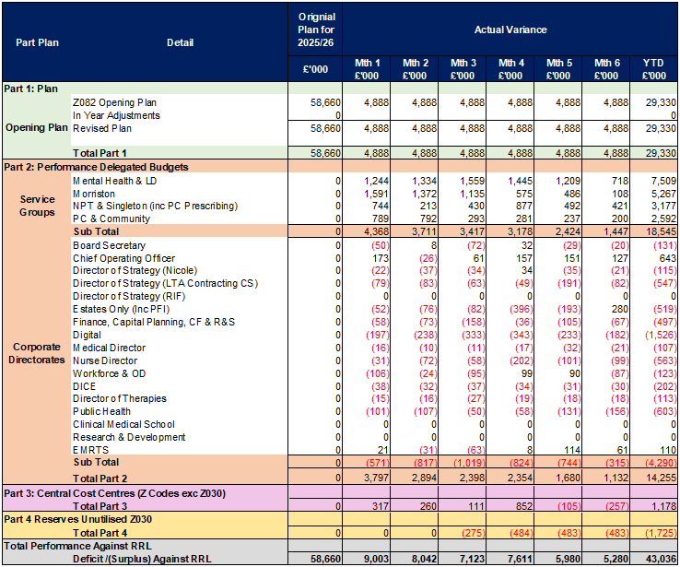
2025/6 In Year Health Board Position & Service Group Element

Slide 6
Service Group Position By Month & Divisions
KEY MESSAGES
MHLD is £0.718m overspent in month (month 05, £1.209m) taking the Year to Date overspend to £7.508m. The main drivers of the overspend continue to be high variable pay, new year CHC growth, the continued commissioning of adult MH cases in the private sector, and shortfall in delivery against savings target.
The improvement month-on-month from month 05 to 06 is due to; reduced variable pay, across both medical and nurse staffing; reduction in the new year CHC growth following the high retrospective costs reported in month 05; one-off benefits in CHC; and a reduction in the number of the adult MH cases.
There is a brought forward variable pay pressure in the new financial year. Variable pay remains high but there is improvement compared to the last financial year and there is improvement month-on-month.
There are new CHC growth costs of £0.311m in month and £1.255m YTD, there is no funding in the Health Board Financial Plan for these costs.
There has been continued need to commission adult mental health case in the private sector due to demand on in-house services. This position is much improved at month 06 with 4 cases and expenditure of £0.264m having peaked in month 03 at around 25 cases and expenditure of £0.789m.
And there is a large charge in the financial position for the shortfall against savings target. To date the Service Group has identified savings from green and amber schemes of £3.8m against a target of £5.7m.

Slide 7
Year-To-Date Service Group Position By Division & Type Expenditure/Income
Income
There is year to date underspend of £0.027m
There is additional income in year for the Veterans Service, and posts in Eating Disorders and Offender Personality Disorder Pathway, OPDP, teams. This is offset by underperformance against the training income target.
Non-Pay
There is overspending to date of £6.178m, this is due to overspending against CHC budgets and the charge for the shortfall against savings target.
The CHC overspending is due to CHC growth from increased cases in the year and the cost of the adult MH cases in the private sector.
The Service Group has identified savings delivery of £3.8m in year against the target of £5.7m leaving a charge in the position to date of £1.839m.
There is also overspending against drugs budgets from high drugs issues expenditure and especially from the increased prescribing of Buvidal in Substance Use services.
Pay
There is overspending to date of £1.314m, the overspending is against medical and nurse staffing budgets and is driven by high variable pay.
In medical staffing there is high agency and additional duty hour, ADH, expenditure. This is for cover for vacancy, sickness and other absence, and rota gaps.
In nursing the overspending is against the HCSWs that are included in Additional Clinical Services, this comes from stepping up nursing levels for acuity and cover for vacancy and sickness,
There is underspending in A&C and Psychology budgets from vacancy from staff turnover.

Slide 8

Drivers: Summary
Income: Income in the year to date is largely in line with the income in 2024-25, there will be some SLA/LTA inflationary increase. In 2024-25 there was increased income in month 08 for a CAMHS pathfinder project, additional staffing from Rowan House and LD consultant sessions. In month 06 of the current year there has been additional income for the Eating Disorders and Offender Personality Disorder Pathway, OPDP, teams. There is also income that is non-recurrent in nature that will be included in full in 2024-25 but only part year in 2025-26
Pay: Monthly expenditure is higher than the 2024-25 average. This is mainly driven by the 2025-26 pay award, this was paid in August, and an increase in the Health Board NI costs. The pay award and arrears were paid later in the last financial year, in November 2024. There has been a reduction in temporary staffing and expenditure during the year compared to the end of the last financial year and this is reflected in a reducing wte trend.
Non-Pay: Monthly expenditure in the new year is higher than the 2024-25 average and there are a number of reasons for this. There will be the full year effect of last year’s new CHC cases; this year’s CHC growth; the cost of the adult MH cases that only commenced in quarter 3 of last year; and the associated transport costs; and the profiling of the CHC inflationary uplift. There was also increased buvidal prescribing through the last financial year and this has continued in the new year.

Slide 9
Drivers: Pay
  Nursing pay is above the average of 24-25 but there is increased cost in the new year from the increased employers NI and the pay award. The pay award is earlier in 2025-26, in August as opposed to November last year. There was recruitment last year from overseas recruitment and from the new registrants from the student streamlining from quarter 3 onwards. While nursing variable pay remains high it is reduced compared to the 2024-25 average. The variable pay is from the temporary staffing, bank and agency, that is needed to cover vacancy and sickness and the step up for acuity. Actual staffing levels are above the funded establishment.
  Medical staffing expenditure is also above the 2024-25 average. Again, there is increased expenditure from NI and pay award, the pay award having been made in August this year whereas it was later in the year last year. There is continued temporary cover from agency and additional sessions to cover vacancy, sickness, rota gaps and other absence. There has been successful recruitment at consultant and specialty doctor grade, and this has led to reduced use if agency staffing during the year.
  The WTE staffing has been reducing during the year but remains above 2024-25 levels and the 2024-25 average. The reductions are largely against nursing and HCSWs. In 2024-25 there had been a large increase in the workforce primarily from nursing as referenced above, this was offset by some agency reduction which is not reflected in the wte. There were also increases to medical and HCSW staffing.

Slide 10
Drivers: Variable Pay & Performance Against 30% Reduction (Actual)
There is a continuation of the high variable pay in 2025-26 from previous years but there is a significant reduction in 2025-26 compared to 2024-25. The high variable pay is across medical and nurse staffing. The use of temporary staffing in nursing is to cover vacancy and sickness and to step up staffing levels to manage acuity. MH and LD services have been outside the scope of the Nurse Staffing Act, NSA, and have received no additional funding for safe staffing levels leading to the use of the temporary staffing. There is agreement from the Director of Nursing that current establishments need to be increased.
The reduction in the nursing variable pay in nursing has come from successful recruitment in 2024-25 from the overseas recruitment and from the recruitment of the new registrants from the student streamlining in the second part of that year. There has also been reduction in medical agency usage, and this has also come from recruitment at both consultant and specialty doctor grade.
The Service Group has weekly Medical And Nursing Variable Pay groups in place to scrutinise and challenge the use of temporary staffing in order to reduce the variable pay bill.

Slide 11
Drivers: Non-Pay (Actual)
Clinical Supplies
There has been increasing clinical supplies cost from increased pharmacy issue expenditure due to the increased prescribing of buvidal in substance use services. Additional funding has been received through the Area Planning Board, APB, arrangements, but this prescribing has continued to increase in 2025-26
Establishment Costs
The high expenditure is due to transport costs and legal expenses..
The high transport costs are related to the commissioning of the adult MH cases out of area with increased cost from quarter 3 of 2024-25, see also below.
The high legal costs relate primarily to cases that are being managed through the Court of Protection.
CHC
There is expenditure growth in year, both in 2024-25 and 2025-26 from new cases and from inflationary price increases. There has also been a significant increase in expenditure from the commissioning of the adult MH cases in the private sector. This is due to the increased demand for adult inpatient services and not being able to admit directly into in-house provision. This commenced in quarter 3 of last year and peaked at around 25 cases in month 03 of this year. That number has then reduced to 4 in month 06 but there have been further admissions directly into the private sector during October. Other Health Boards in Wales are also experiencing increased demand on their adult MH inpatient services and are also commissioning high number of cases in the private sector.
There is some reduction in expenditure from the review and rightsizing of cases and from the repatriation of cases that have been commissioned out of area back into in-house provision, these are included for value in the Service Group Savings Plan.

Slide 12

Savings Summary

Slide 13

Identification Opportunities & Risk
Further Opportunities for 25/26:
• Further work up of savings schemes from the additional savings targets, this will include
  • CHC pipeline from further repatriation, review and right-sizing
  • Medical staffing and variable pay
  • Nurse staffing and variable pay
  • Non-pay expenditure
• Recovery of costs of additional staffing on Rowan Ward through the Welsh Risk Pool claim relating to the fire at Taith Newydd in the last financial year. There is need to challenge the original decision of the WRP.
• Variable pay reduction from Medical and Nursing Variable Pay Reduction Plans. This will largely come from recruitment and from reducing high levels of sickness absence. This will count against the additional savings targets that have been set.
• Reduced number of Adult MH placements in the private sector.
Further Risks:
• Increased Nursing variable pay from increased acuity, sickness absence, and turnover
• Additional costs of band 2 to 3 Support worker agreement
• Further increase to number of Adult MH placements in the private sector
• Impact of move to Alliance model for substance misuse services
• Impact of new guidance for cleanliness standards for medium and low secure services.
• The cost of further CHC growth in the new year.
• Slippage of schemes included in the Savings Plan that have yet to commence.
• There are risks in the Service Groups saving plans and overall financial position that may require support from the wider Health Board being; reduction in bed capacity across OPMHS, regional funding arrangements for Complex Care; and the current over funding of joint commissioned packages of care.

Slide 14
Actions & Next Steps To Be Taken By Service Group
The Service Group needs to reduce expenditure against the underlying deficit to the level of the funding provided in the Health Board’s 2025-26 Financial Plan. This will include reducing variable pay, both agency and bank expenditure; to manage new years costs to available funding; and to deliver against savings target.
The agency staff reduction will come from the actions in response to the NHS Wales 2025-26 Planning Framework and specifically.
  Deliver a further continued and sustained reduction in agency expenditure, with a target 30% reduction in 2025-26 from 2024-25 outturn and ensuring no off-contract expenditure.
  Ensure a reduction in agency spend on Healthcare Support Worker, Admin & Clerical, and Estates & Ancillary staff to zero by 30th September 2025.
Further action is required on the delivery of the Medical and Nursing Variable Pay Reduction Plans to meet the variable pay cap set by the Health Board. The cap for nursing variable pay is now deferred awaiting the outcome of the NSA scrutiny work.
This has then been replaced by new targets on variable pay as included in the additional Part C and D savings targets included in the Health Board’s revised financial plan submission to Welsh Government. It is noted that the NSA scrutiny work is on-going.
Action on the delivery of the new Part C and D savings targets.
And to continue delivery on the locked down Part B3 savings, where there is slippage there will be need to identify new savings opportunities for delivery.
Action is also required to manage overall CHC expenditure within available resource. This includes action to reduce the current level of CHC expenditure from the number of adult MH cases in the private sector, this action is on-going.

Slide 15
Appendices

Slide 16
Savings Schemes in place

Slide 17
Additional Savings Schemes

