Slide 1


Targeted Intervention Update
October 2024

Slide 2
Planned Care

Slide 3
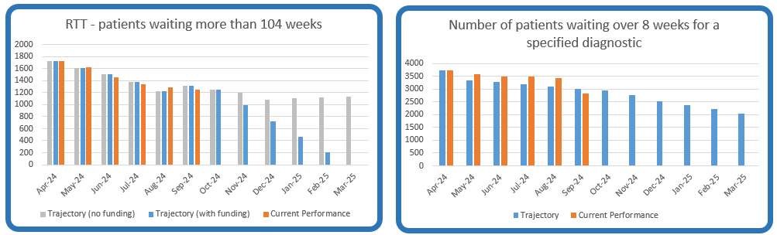
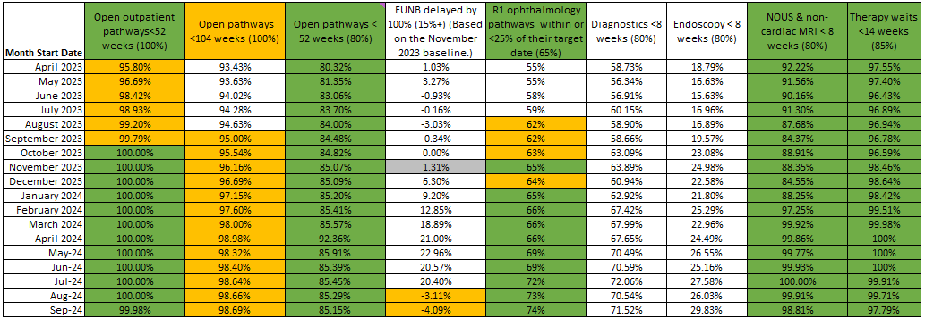
Planned Care Performance – September

Slide 4
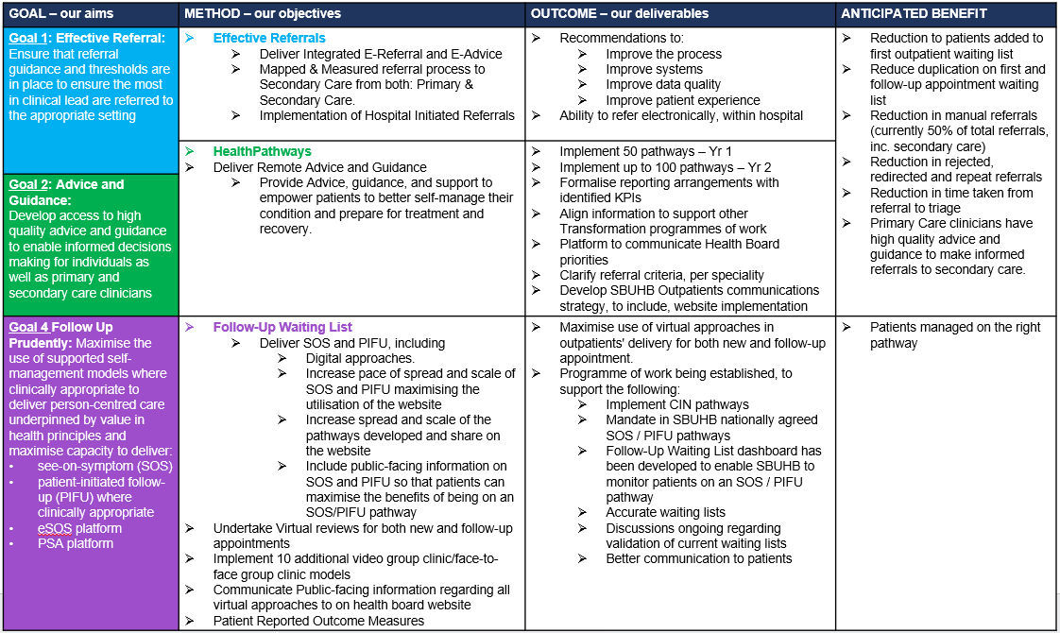
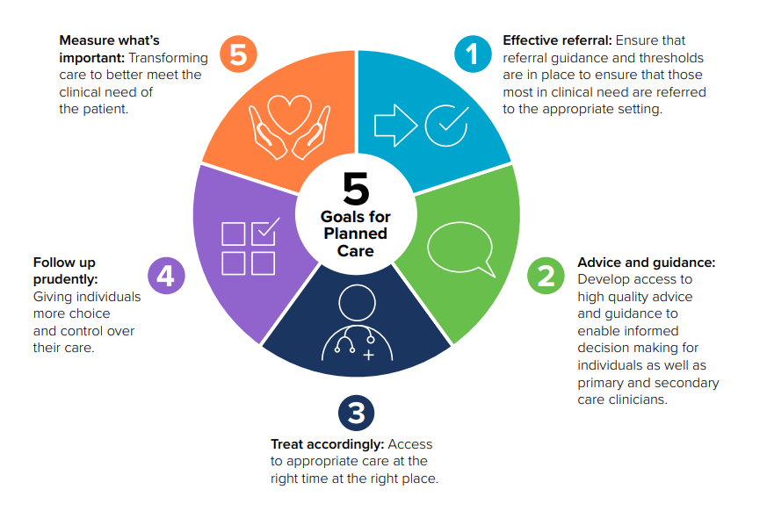
Outpatient Transformation Programme
Effective Referrals – Project 1 | HealthPathways – Project 2 | Follow-Up Waiting List – Project 3
Notes:
This is a generic copy slide.

Slide 5
Patient Access Management
Treat Accordingly | Measure What’s Important
GOAL | METHOD | OUTCOME | ANTICIPATED BENEFIT
Delivery against Ministerial Targets & Goal 3: Treat Accordingly: Access to appropriate care at the right time at the right place | Ministerial Targets Maintain 52-week position Achieve 104-week position for treatment Maintain 156-week position for treatment Reduce the number of patients on a Follow Up waiting list by 30% Reduce the number of patients who are more than 100% delayed on their Follow Up appointment by 30% Targeted Intervention 15% reduction in the number of patients delayed by 100% for their follow up appointment in three consecutive months and maintained for 3 months Quality Improvement Standards Annual incremental improvement trajectory to achieve 50% reduction in Hospital Initiated Cancellations by 2026 DNA rate no more than 5% for new and follow up patients | Weekly Performance Scrutiny meetings established to continually scrutinise, measure and challenge operational performance, by engaging with senior clinical leaders and management to support delivery of the following activity: Developing RTT dashboards to provide information on accurate waiting lists to monitor performance; Demand & Capacity plans Identify areas at risk of achieving targets and supporting those services by planning revised trajectories Supporting the prioritisation to allocate recovery funds | To deliver and maintain the Ministerial targets and ensuring all patients are seen at the right time and place.
Goal 5: Measure What's Important: Transforming care to better meet the clinical need of the patient | Patient Access Training programme Develop and deliver a Patient Access Training Programme for all staff | PAM has a key role in the management, planning and implementation of patient access standards in SBUHB together with the responsibilities of an educationally and clinically sound training programme, including: PAM Policies & Procedures PAM Training Programme PAM Dashboards PAM SharePoint site and communications | To support a competent and safe workforce that is well trained and skilled ensuring patient access management meets clinical needs of the patient.
Notes:
This is a generic copy slide.

Slide 6
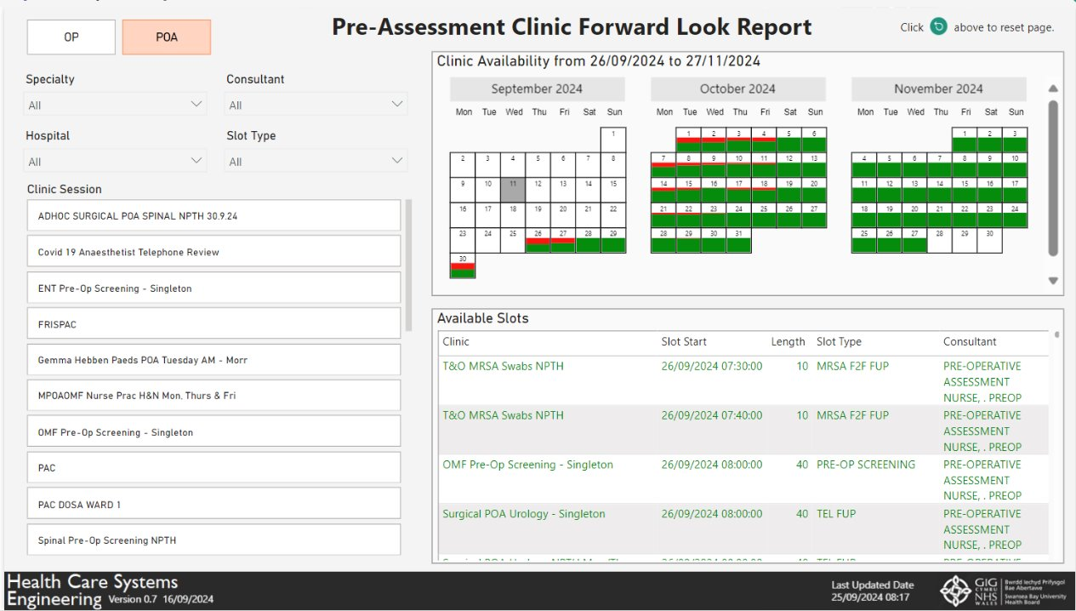
Outpatients Forward Look Report
Notes:
Purpose:
To reduce lost OPD and POAC appointment slots by making slots still available to book patients into visible to the booking teams and the service.
Allows drilling down per speciality, sub speciality, day of week, consultant.

Slide 7
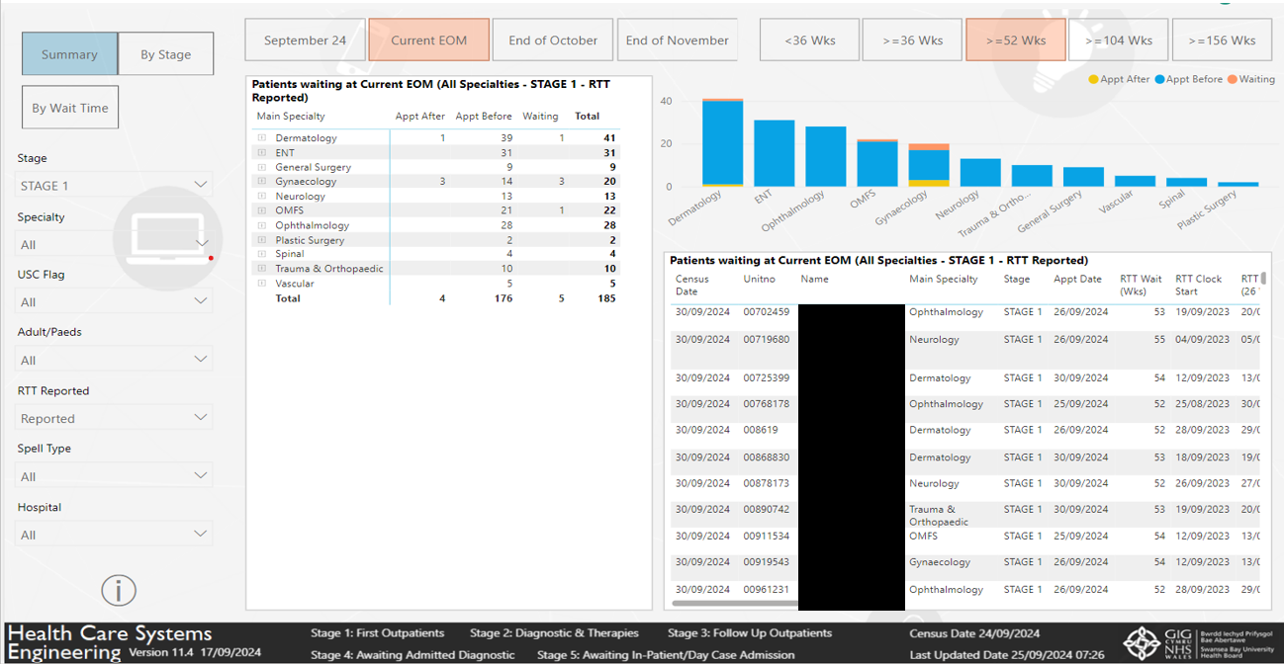
Performance Stage 1 Treat in Turn – Implemented June 2024
Notes:
Purpose:
To facilitate performance review meetings held with the services and support TI meetings with COO.
Shows how many patients need to be treated in month to maintain zero breach position down to individual patient level.
Show what's coming over the hill in the next 2 months following the end of the current month.
Helps facilitate TIT and identifies how many patients need their appointments bringing forward in month to prevent them becoming end of month breaches.

Slide 8
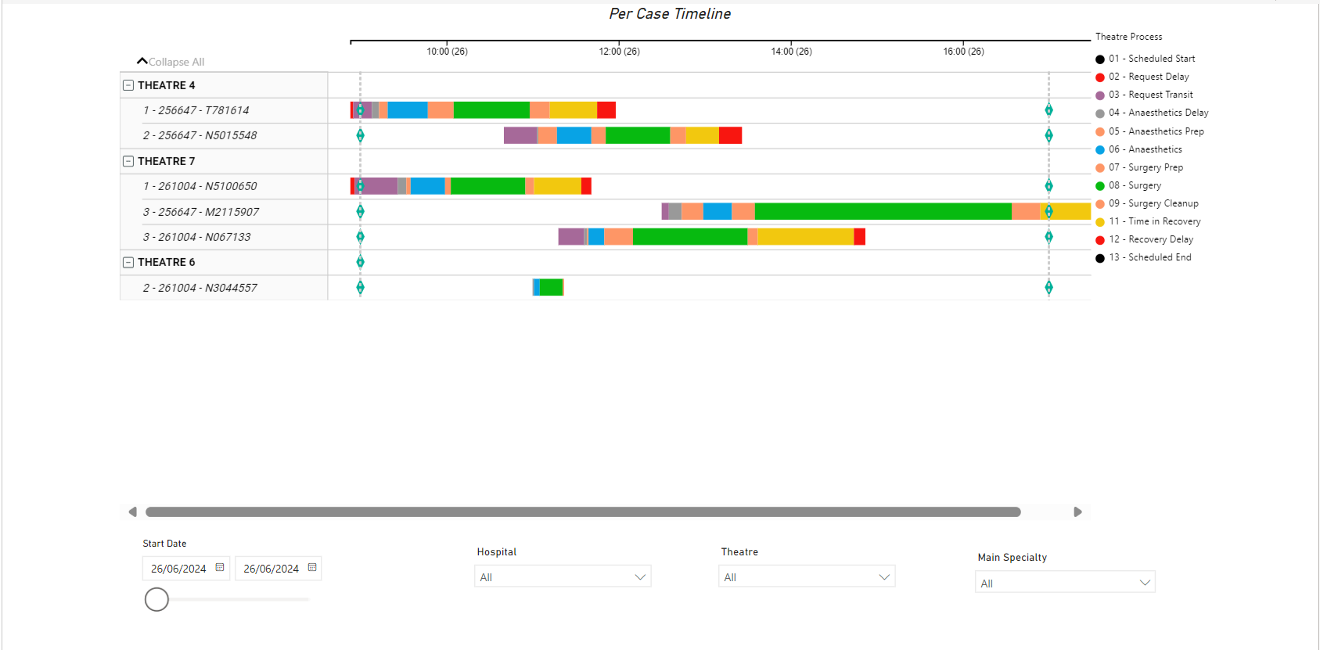
Surgical Pathway Dashboard – Prototype September 2024
Notes:
Purpose:
Visualisation of everything that happens between sending for the patient and sending the patient back to the ward.
Demonstrates where the current waste is within the system and helps inform what the focus of future service improvement projects should be.

Slide 9
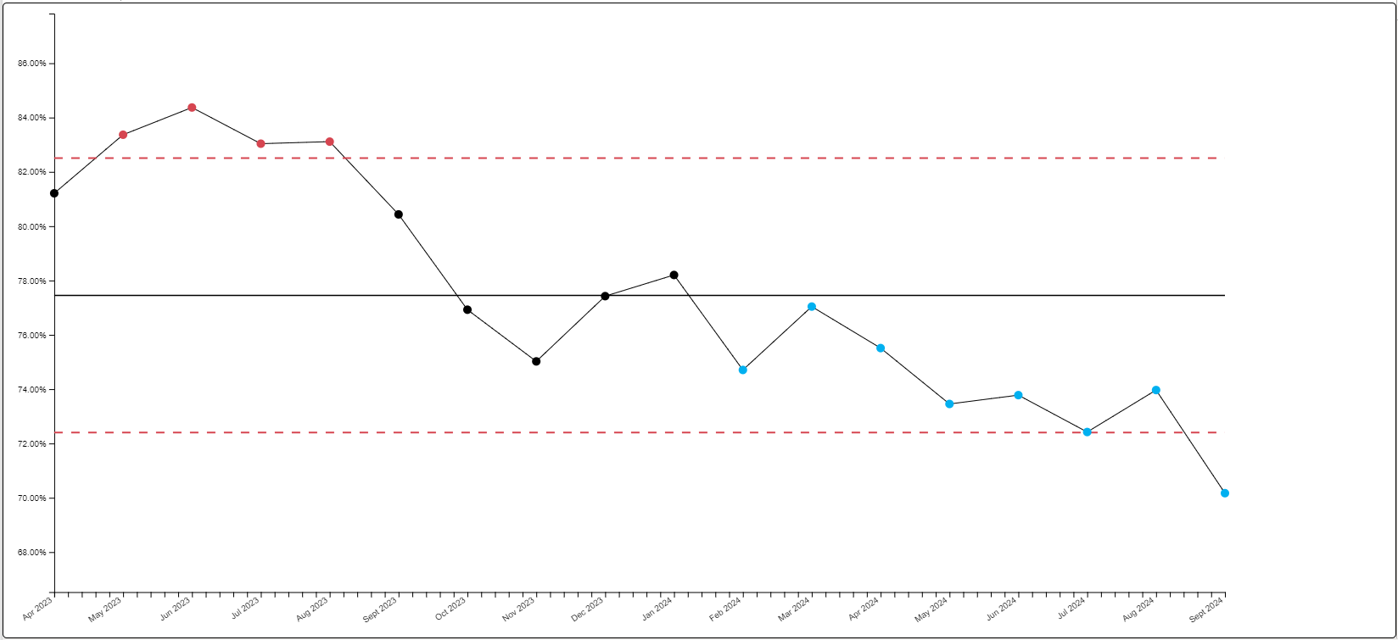

Endoscopy

Slide 10

Regional Working
Regional Working in 2024/25 and 2025/26
17th October 2024

Slide 11
Context
We have been working regionally for some time…
Vascular Network
DXA scanning & reporting
Radiotherapy services
Nuclear Medicine
Lymphoedema services
Audiology / Bone conduction Hearing Implant Service
Dietetic support from Oncology patients
Renal services
Paediatric Orthopaedic Surgery
Oral Surgery

Slide 12
Priority Areas
Three main areas that we have been progressing with greater focus over the last 12 months:
Orthopaedics
Ophthalmology
Pathology
Radiology and Endoscopy

Slide 13
Regional Orthopaedic Programme
Regional Orthopaedic Programme 2025-26
Andrew Carruthers

Slide 14
Regional Orthopaedic Programme
Key Objectives 2025-26
  Address and resolve disparities in waiting times across the South West Wales region.
  Optimise infrastructure usage to support the long-term sustainability of regional services.
  Ensure patients receive care in hospitals that are fully equipped to meet their specific needs.
  Consistently implement best practices across the region in a systematic manner.

Slide 15
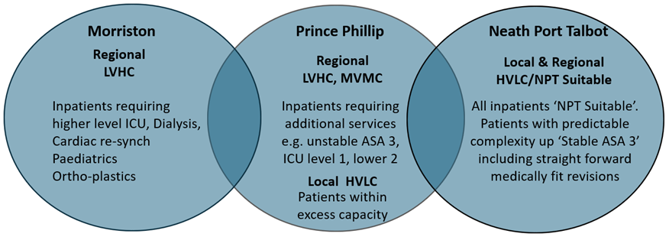
The Proposed Model
At a senior leadership meeting on May 31st, key principles were agreed upon to ensure equity of care across the South West Wales region and long-term service sustainability. Patients will be treated in hospitals equipped with the necessary resources to meet their needs, and where possible, this care should be provided as close to home as regional demand and capacity allow. The model must remain adaptable to changes in the waiting list and population needs over the next 6, 12, and 24 months.

Slide 16
Regional Orthopaedic Programme
Regional Orthopaedics Sub-Specialty Plans
Hand & Wrist
Shoulder & Elbow
Hip and Knee
Foot & Ankle
On-going implementation of the Hand Surgery Network
Resource optimisation across the region
Region Service sustainability
Educational enhancement
Reduced Carbon foot print
Regional approach to complex procedures
Standardisation of clinical processes
Shared expertise
Educational enhancement
Regional approach to complex procedures
Standardisation of clinical processes
Shared expertise
Educational enhancement
Continued implementation and iterative development of the regional model
Standardise clinical processes
Resolve disparities in waiting times across the region
Develop a centre for complex primary and revisions procedures
Please note that some of this work is currently in progress, while other sub-specialty work streams are still under development in preparation for 2025/26.

Slide 17
Regional Orthopaedic Programme
What has worked well
The establishment of the South West Wales Hand Surgery Network.
Developed a bespoke Arthroplasty Standard Operating Procedure for South West Wales.
A commitment to regionally focussed recruitment of orthopaedic consultants to enhance regional collaboration.
Increased consultant participation across health boards in various sub-specialties.
Strengthened stakeholder involvement in the Clinical Reference Group.
Current Challenges
Significant waiting times for hip and knee arthroplasty patients, with inequities in wait times across the region.
Ongoing challenges with arthroplasty consultant engagement in regional collaboration within Hywel Dda.
Issues in the purchasing and storage of kit/equipment, that need resolving to progress with the regional arthroplasty model.

Slide 18
Regional Orthopaedic Programme
2025-26 High Level Plan
0-6 Months
6-12 Months
Continuously monitor and proactively manage waiting times across the region.
Continuously monitor and proactively manage waiting times across the region.
Invest in both medical and non-medical workforce at Prince Philip Hospital to support local and regional activity.
Optimise the use of regional resources and infrastructure for all sub-specialty activities.
Collaboratively manage the longest-waiting patients through a shared patient tracking list (PTL).
Develop a business case for establishing a complex primary and revision service.
Expand the hand surgery network model across the region.
Continue advancing regional arthroplasty initiatives.
Identify and implement research opportunities to enhance orthopaedic practices.
Collaborate with the Welsh Orthopaedic Network to organise a conference showcasing best practices.
Maximise resource use across the region.
Continue to review options around shared waiting list/PTL.
Advance the business case for a complex primary and revision service, preparing for implementation if practicable.
Evaluate the implementation of the various sub-specialty initiatives.
Review regional arthroplasty outcomes and plan for future collaboration.
Apply research insights to enhance clinical practices and explore new opportunities.
Run a regional conference, showcasing best practices and regional collaboration.

Slide 19
Regional Eye Care Programme
Regional Eye Care Programme 2025-26
Deb Lewis

Slide 20
Regional Eye Care Programme
Key Objectives 2025-26
  Work towards developing sustainable regional services
  Improve the equity of access to eye care services across South West Wales
  Reduce waiting times
  Implement the recommendations from the Pyott report and GIRFT guidelines

Slide 21
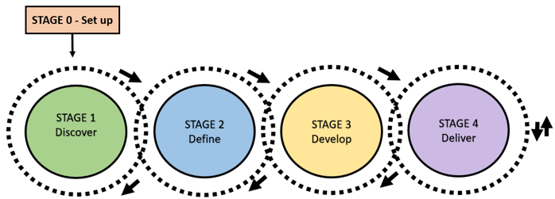
Regional Eye Care Programme
Regional Eye Care Programme summary status
Stage 0: Set up | A Programme Definition Document has been drafted. Garry Shuttleworth has been providing clinical support but a Clinical Lead needs to be identified. A Terms of Reference has been drafted in preparation for a Regional Board meeting.
Stage 1: Discover | A service status report has been prepared to detail the current service provision and available resources across the region, including: Facilities and locations Staff resources Eye care Measures Update in GIRFT recommendation Financial overview
Stage 2: Define | The current Paediatric regional model has been assessed to identify gaps between Hywel Dda's service provision and Swansea Bay’s service blueprint. A preliminary regional on-call rota has been created, but further discussions are needed. A meeting will take place on the 11th October to advance regional discussions between the two operational teams.

Slide 22
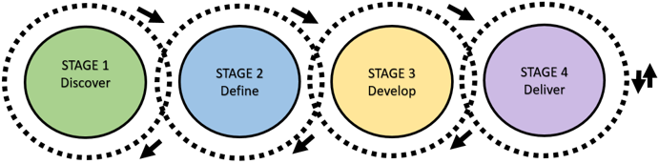
Regional Eye Care Programme
High Level Plan for Quarter 4 2024 and 2025 – 26
Key enabler:
Clinical engagement is crucial for advancing regional collaboration. To move forward with regional eye care initiatives, a Clinical Lead will need to be appointed.
Stage 2: Define 0-4 Months | Regional workshops will be arranged to identify challenges across the region and explore key areas for collaboration, in line with the main strategic priorities. A GAP analysis will be performed to evaluate current service models and define future models. Patient Pathways will be reviewed and optimised. Demand and capacity models will be created.
Stage 3: develop 4-8 Months | Benefit realisation, delivery plans and business cases will be developed
Stage 4: Deliver 8-12 Months | If practicable, operational and clinical teams will be supported to implement new ways of work

Slide 23

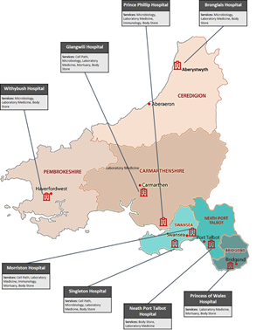
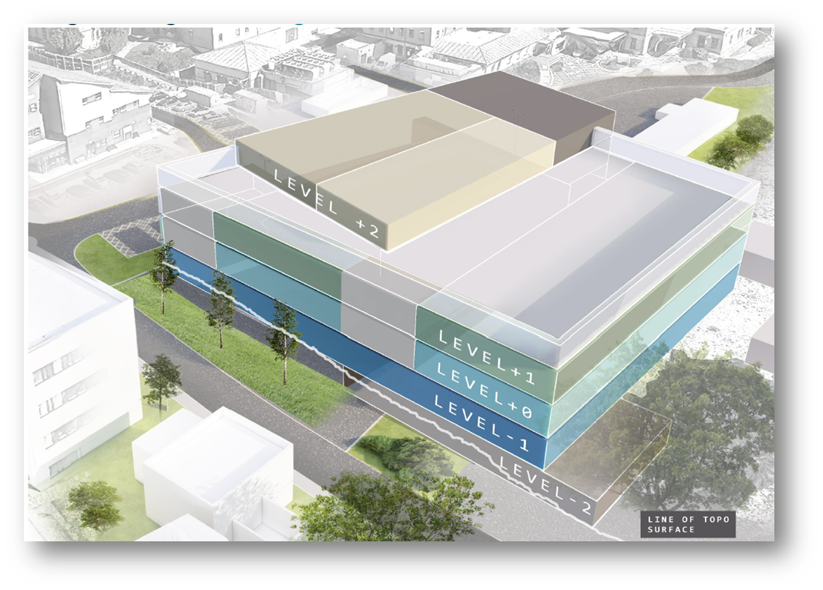
Regional Pathology Service
2 main components:
1. Regional Pathology service via Operational Delivery Network
2. Development of new Hub Laboratory and local laboratory refurbishments

Slide 24
Regional Pathology Service
Operational Delivery Network (ODN)
Memorandum of Understanding (MOU) supported by both Boards in May 2024
Gives Transitional status to ODN Board to develop final detail for approval of network arrangements (scheduled March 2025)
Service Specification and commissioning arrangements under development
Draft workforce plan for leadership roles developed
Mortuary working as a networked service already with regional leadership arrangements in place (internal audit of both HB mortuary governance arrangements planned for Q3/Q4 24/25)
Blood Sciences workforce resilience plan (individual HBs) to be considered on a regional basis
Pathology Digital Information system (LIMS 2.0) roll out being undertaken regionally (first deployment of Wales wide upgrade))
Improvement Cymru support to develop cellular pathology efficiency model which will support current and future operational improvement and delivery
2 rounds of in lab staff engagement undertaken
Visits to Bristol and Wolverhampton Networks undertaken to learn from their experiences
Network implementation and workforce change planned for April 2025 following Board approval of substantive MOU and commissioning arrangements
Network implementation supported by ARCH Pathology team (capital funded)

Slide 25
Regional Pathology Service
Development of new Hub Laboratory and local laboratory refurbishments
Hub Laboratory to provide blood sciences, cellular pathology and microbiology services on Morriston site
Relocation of cell path from Singleton and Glangwilli to Morriston. All sites to retain variation of hot blood sciences lab support and microbiology with local refurbishments where required.
Opportunity to move samples to meet D&C requirements and provide specialise tests in the new building that aren’t possible in region currently
Development of Precision Medicine unit in collaboration with All Wales Genomics and Swansea University
Supply Chain Partner appointed October 2022 to support OBC/FBC and build via WG capital
Internal funded for dedicated project leadership and support and clinical input into programme
Review of growth of scheme from SOC to OBC undertaken in late 2023. Revised scheme outturn cost (size reduction and retention of space in existing Morriston lab) proposed to WG in February 2024 with accompanying request for additional fee to develop business case.
Answer on fee awaited pending all-Wales capital programme prioritisation process (£138m capital cost for hub and refurbs)
Dedicated Pathology ARCH team now being redeployed due to contracts ending and fee not in place
Risk of staff engagement in whole programme with no clear trajectory to a new build and refurbishments
Consideration of alternative capital or location options a key task for Q3/4 pending WG prioritisation
OBC/FBC to approval is 24 months from recommencement. Build period is 36 months (tbc) from FBC approval

Slide 26

Radiation Physics Regional Work Activity
Simon Evans, Consultant Clinical Scientist, Head of Service
Radiation Physics provides scientific and technical support and expert advice in X-ray imaging physics, MR imaging physics, radiation protection, radioactive waste management, and radiation emergency planning to both Swansea Bay and Hywel Dda University Health Boards.
Our certified experts (Radiation Protection Adviser, Radioactive Waste Adviser, and Medical Physics Expert), appointed by both Health Boards in accordance with a strict regulatory framework, are central to the safe and effective delivery of high quality radiological imaging and radiation therapy services and ensure a consistent approach to radiation safety is applied throughout the region.
A number of direct mandatory services are also provided throughout the region including delivery of a comprehensive X-ray equipment quality assurance programme, patient dose assessment and advice on image optimisation, environmental radiation surveys of all controlled areas, leak testing of sealed radioactive sources.
We contribute to regional major incident planning providing specialist advice on the monitoring of radioactively contaminated/irradiated casualties and writing of action cards.
Our recently established MRI Physics Group, the first and only in NHS Wales, provides regional scientific support for the safe use of MRI from our certified MR Safety Expert and delivers a comprehensive MRI scanner quality assurance programme. The MRI Physics Group continue to be instrumental in improving access to essential MRI examinations for patients presenting with complex implanted medical devices.

Slide 27


Regional Diagnostics Programme
Endoscopy
The Bowel Screening Wales list undertaken for Swansea Bay, completed by Hywel Dda in PPH continues, providing an essential service, vital to ongoing resilience as BSW optimisation continues.
Honorary contracts were prepared and agreed for medics to work across boundaries when required.
There has been work to replicate/standardise Service SOP’s across the footprint including regularly reviewing the FIT process in line with local changes and centralised process changes.
The Band 4 competency pathway was agreed and is already being implemented in South West Wales.
Monthly meetings continue; utilised for sharing best practice, coordinating responses to stakeholder (providing critical mass). This includes regularly sharing ad feeding back on service D&C’s to National Endoscopy Programme.
Both Health Boards have executed their recruitment and training plans and there are plans to link further with NHS Exec, HEIW and Endoscopy Academy to further shape and plan a resilient workforce in the coming 5 years.
Radiology
The Swansea Bay Health Care Systems Engineering Team has been working to support Hywel Dda’s Radiology Service to replicate the Swansea Bay D&C dashboard. This work has already delivered results and enabled greater regional data visibility on capacity in the services. This work will continue into 2025.

Slide 28
NEXT STEPS
Principles for Regional Working:
Health Boards are equal partners
the aim is to develop sustainable local services which meet the population need in a cost effective way
changes are clinically led
changes are driven by best practice and a strong evidence base
there is clear outcome measurement (clinical/access) to support changes
service change prioritisation is determined by overcoming current access difficulties for patients (don’t fix what is not broken)
solutions minimise patient inconvenience/travel – 2 or at most 3 site working
as much of the pathway of care is provided as locally as possible (e.g.pre and post op at local hospital)
there are robust supporting patient transfer arrangements to ensure patient safety is maintained
the use of virtual and remote ways of working and service delivery are enhanced
there is an approach that leads to equalisation of access times to minimise waits for patients
there is shared operational governance processes (e.g waiting lists)
there is as much digital alignment as possible
the changes are supported by a pooled fund approach with adequate risk share arrangements between the Health Boards to ensure there is no detriment/gain.
supporting contracting arrangements are kept simple and support this pooled fund arrangement. They will be designed to promote and drive arrangements and behaviours that are described within the principles of joint working

Slide 29
NEXT STEPS - PRIORITIES
Surgical – in priority order
Orthopaedics – continuation and enhancement of the current model
Ophthalmology
General Surgery
Urology
Gynaecology
Colorectal
Medical Specialties – in priority order
Dermatology
Stroke
All others excluded
Medical Takes
Excluded at present – but as the Regional model develops scope to include
Diagnostics
This needs to be linked to the All Wales work on diagnostics;
Prioritisation for local work
Endoscopy
Radiology
Taking a three phased approach;
Secondary care wait reduction to 8 weeks
‘One stop shop’ cancer diagnostic model development
Develop an ‘additional capacity’ plan driven by population needs to determine the ongoing model – devolved or centralised, supported by fit for purpose facilities with up to date technology.
Maternity and Neonatal Services
Maintain current configuration of maternity/neonatal services but develop a networked approach to professional governance. There will need to be a response to the JCC (WHSCC) review with any subsequent configuration changes this may propose.

Slide 30
Cancer TI Update

Slide 31
Single Cancer Pathway Performance

Slide 32
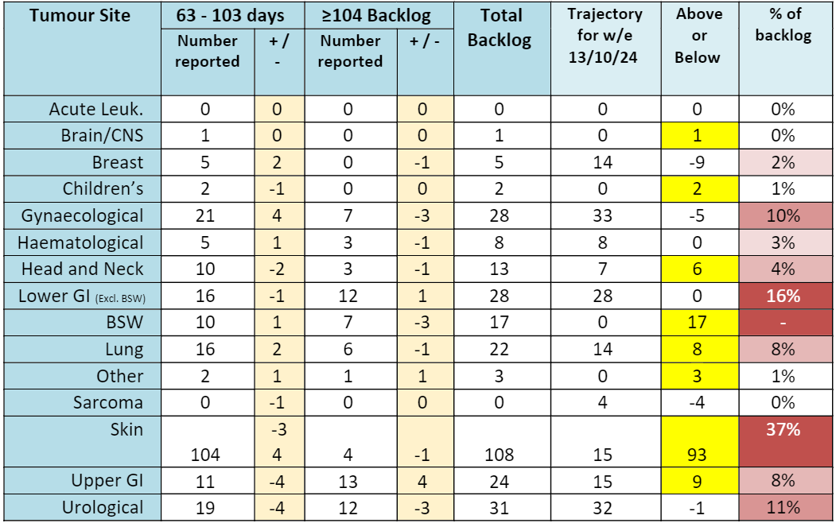
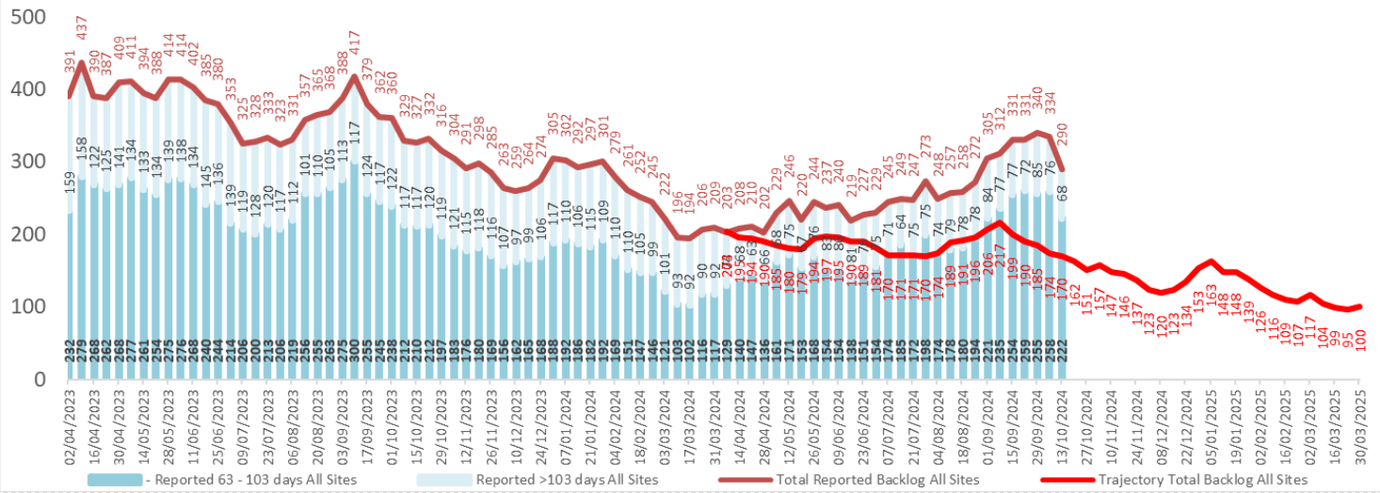
Backlog Trajectory (including BSW)
120 over trajectory. 37% are skin cancer pathways (108 patients). 16% are LGI pathways (28 patients).

Slide 33
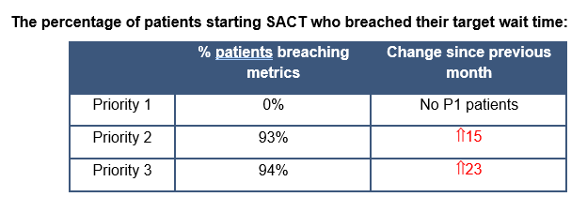
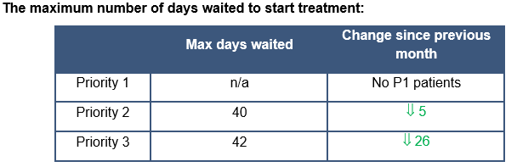
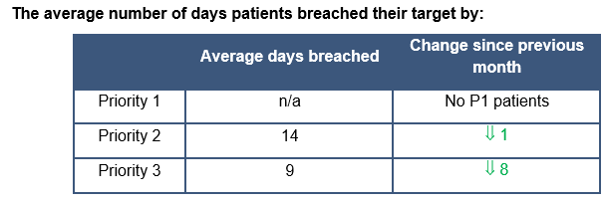
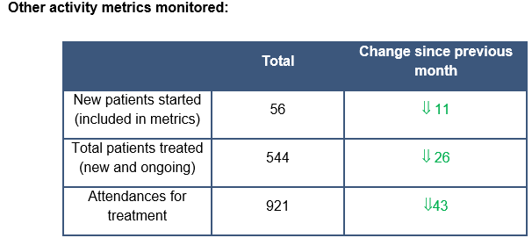
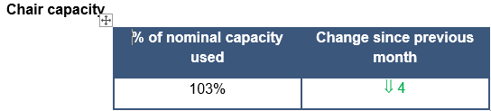
SACT (CDU Performance September)
Notes:
Chair capacity at 107% in August, down 3% from July.
There were very similar numbers of P2 and P3 patients starting treatment in August as there were in July. Overall, total number of patients again remained above available capacity to book into diary according to waiting time metrics.
Due to booking staff A/L and limited cover in July, there were some delays in patients being booked into the CDU diary to commence treatment, represented by the longest wait for P3 patients in August.

Slide 34
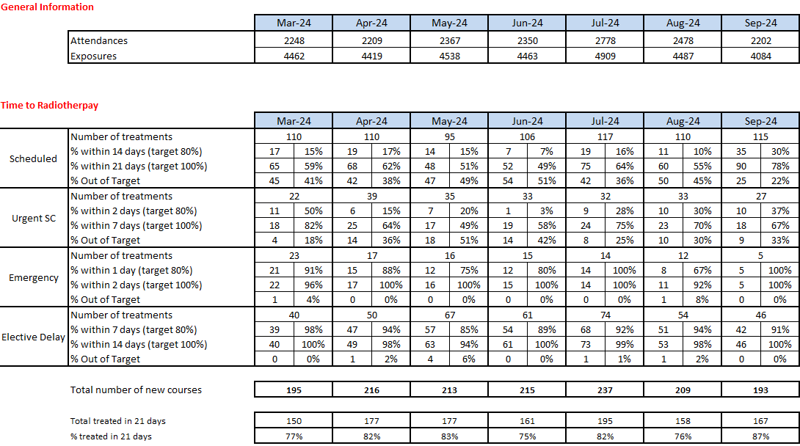
Radiotherapy Performance Detail
Notes:
Following a drop in demand in August we saw machine capacity return to a more manageable level towards the middle of September, this had a positive impact on our Time to Radiotherapy figures and a reduction in the number of patients breaching due to machine capacity issues. Demand in September returned to normal levels.

Slide 35
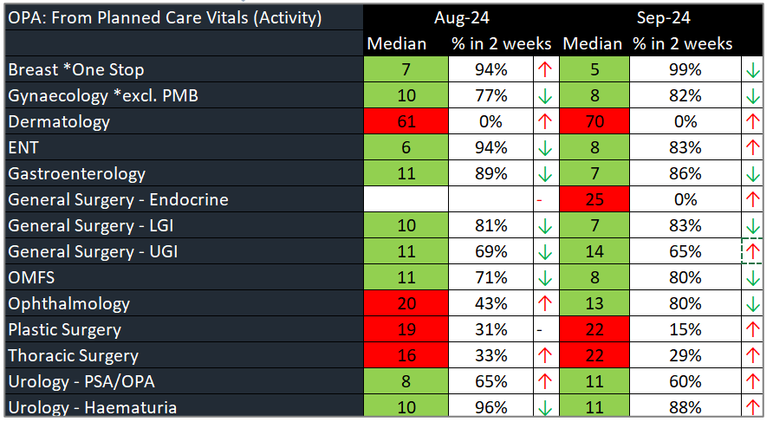
1st Outpatient Consultation within 10 days

Slide 36
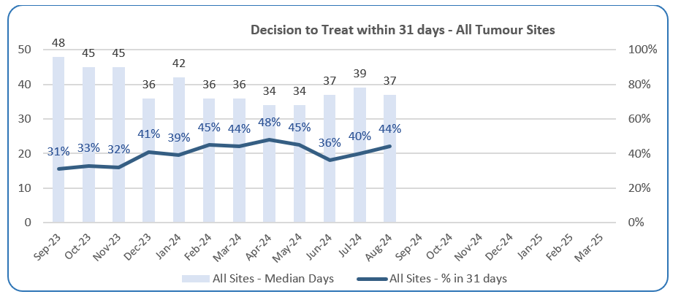
The median wait for a decision to treat within 31 days reduced back to 37 days for closed (treated) pathways in August with a correlating improvement in % achieving the measure to 44%.

Slide 37
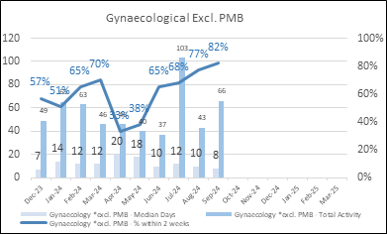
Gynaecology Update
Significant improvement with patients being seen within 2 weeks for USC appointment (median 8 days in Sept)
Locum consultant commenced in September – increased surgical capacity

Slide 38
Priorities/Focus Next Month
Continued focus on front end of pathway for all specialties
Review impact of daily meetings for USC OP capacity for dermatology, OMFS and plastic surgery (introduced Sept 9th)
Assess impact on capacity of agreed actions from skin workshop (inc. super clinics, locum consultant, job plan reviews)
Continued focus on cellular pathology
Identify additional surgical (upper GI in particular) and chemotherapy capacity

Slide 39
Urgent & Emergency Care

Slide 40
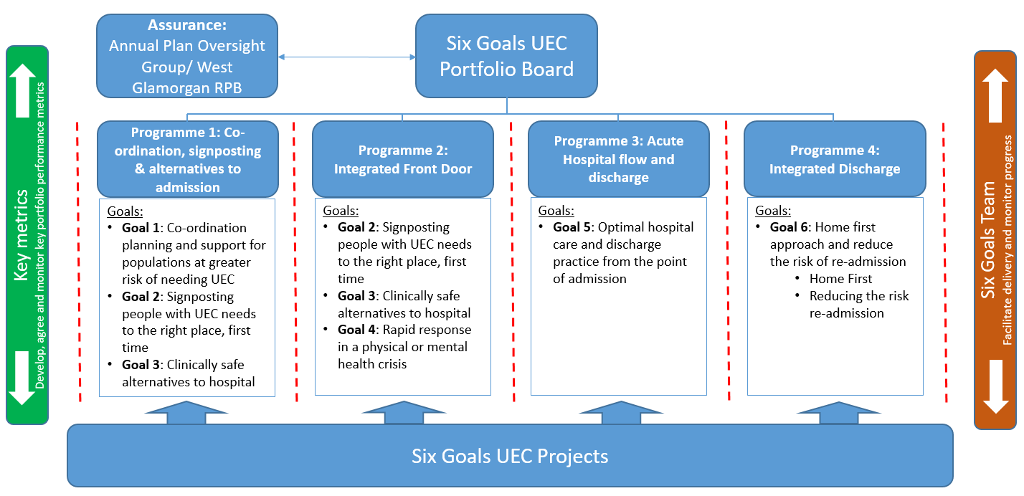
UEC Programme Board

Slide 41
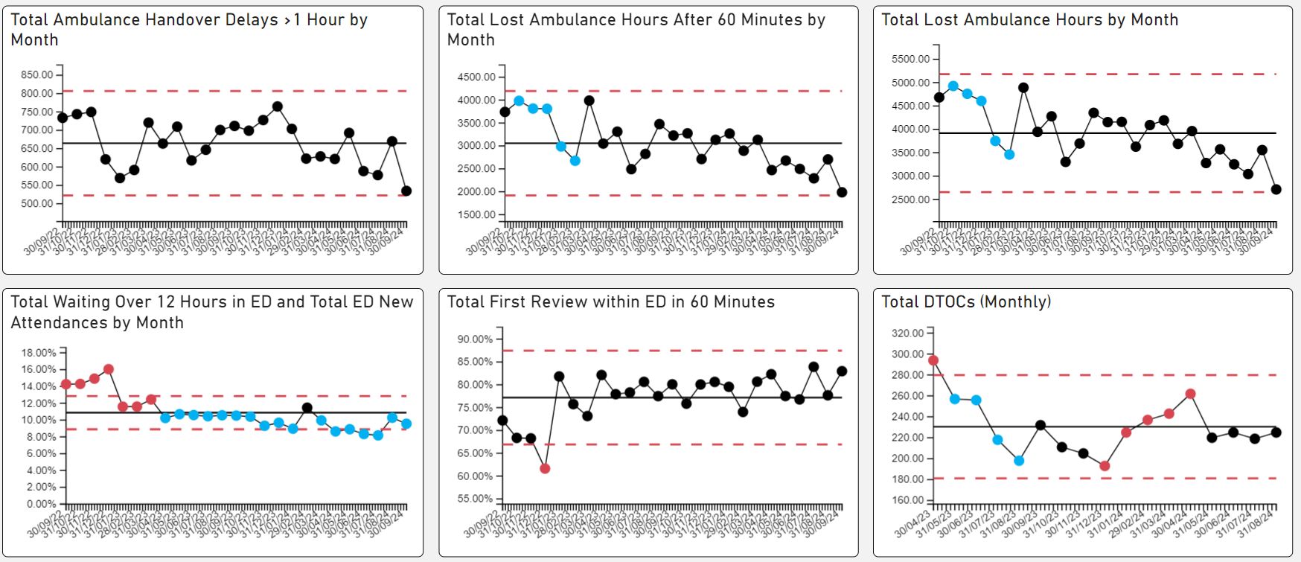
UEC – De-escalation KPIs

Slide 42
UEC – Plan for TI Response
Six main areas of work:
Frailty strategy – approved via Management Board – phase two coming on line in September
Grip & control operational management – Full Capacity protocol and zero tolerance on chair and trolley waits planned for launch in October 2024
  Review of community capacity and operating models: ACT & Virtual Wards
Senior decision makers at front door services
  Rota proposals shared with Acute Physicians
  Recruitment drive commenced for x5 Acute Geriatricians and x5 Acute Physicians
  Plan to implement new interim rota in October 2024 whilst recruitment takes place
Pathway of Care Delays (PoCD) – Multi Agency Discharge Event (MADE) undertaken in August and 6A’s audit follow up took place to improve discharge and transfer processes.
  Singleton & Morriston COP capacity under redesign for October 2024
Reconfiguration of Emergency Dept – funding received to develop reconfiguration plans – lead by Capital Planning.
Revised flow operating model: with consistent tactical command at Level 4 and introduction of revised internal escalation processes

Slide 43
UEC Summit October 2024
Patient Experience /Safety
AMU/SDEC
Discharge & The COP Patient
Pre Hospital Admission Avoidance
Frailty
Attendance
Management Board Representatives
Clinical and Ops Leads from the 7 themes
Emergency Department
Grip & Control Patient Flow
Excellence
Challenges
Future
“Nipping in the bud” principles; active in-person resolution (PALS)
Negative feedback follow-up
Deceased Property Management – reduction in lost property and immediate over to relatives
Active learning to make it better for the next patient/family
WAST/Hub pre-hospital pathways/triage
Community response-admission avoidance: DN’s/CRT/VW’s/ACT
GP Cluster services: Long term conditions management/commissioned services
Timely access to key front door services – Vascular, STEMI, Renal, Burns
SAU: successful management of surgical intake within defined bed pool
Timely access for red calls/sick walk in patients
Support and collaboration across 111/GP’s/WAST/Police/EPRR and internal specialties
Pre-hospital triage by ANP’s – redirection/admission avoidance
Successful recruitment into key advanced practice roles
Increased activity evident since relocation of the service
Successful use of community pathways
Improved turnaround of patients less than 48 hrs
Achievement of the national standard: 30% of acute medical intake managed through same day services
Excellent multi-disciplinary working with twice daily Board Rounds
Daily in-reach service from Gastroenterology, Respiratory, Neurology & Cardiology (Oct 24)
Improved Registrar medical cover since August 24.
New daily tactical Command structure in place
Improved focus on patient safety
Evidence of daily grip and control
Improved partnership working with PCT colleagues
Weekly review and escalation processes in place
Good use of SIGNAL to indicate D2RA patient pathways
Management of patient/family expectation
Space and Comfort including improved stimulus (Clocks, TV’s, Radios)
Communication – both internal & external – lost patients
VW/ACT balance
Improved integration of admission avoidance services in Community
Integrated hub workforce
Access to down stream bed pool – extended waits for beds
Overcrowding can mask inconsistent processes within the ED
Limited streaming opportunities to other ‘front door’ services (capacity) - right patient, right service, first time
Increasing acuity and complexity
Getting the right patients into the Frailty front door for assessment
Access to down stream bed pool
Recruitment of COTE Consultant- workforce challenges
Creating a well defined integrated SDEC model of care
Developing a hybrid workforce model to enhance the SDEC offer
Overcrowding of AMU and outliers in SDEC
Maximising community services to avoid attendance at hospital (ACT capacity)
Alignment of the medical workforce to provide senior decision makers at all front door services
Current flow model aligned to Service Groups - gatekeeping
Multiple flow management teams/processes
Poorly defined bed pools
No system wide escalation
Current service does not deliver D2RA
System design fault: COP patients remain in acute site-disabling front door services
Understanding capacity and demand for community services aligned to each pathway
Improved Communication - Door answering, telephone answering.
Revisit of Communication Strategy – co-production and improved decision-making
Improved collaborative working to support patients in crisis both within and outside of the Health Board
One integrated UEC navigation hub (WAST, Frailty, SDEC, Community pre-conveyance triage)
Hot clinics
Direct access pathways – in patient specialty teams
Integrated hub, same day services and hot clinics – co-located
Improved triage and navigation process for front door services
Greater ED retrieval opportunities
Redesigned ED footprint and flow
Integration of Frailty into the Integrated UEC Hub
Co-location with same day service/hot clinics
Build on the alignment of community pathways/services to maximize care at home
Integration of Frailty into the Integrated UEC Hub
Co-location with same day service/hot clinics
Build on the alignment of community pathways/services to maximize care at home
Centralised flow function – ‘hub & spoke’
Development of centralised IDH – management of all pathways
Pooling of flow resources into centralized functions
Implementation of Integrated Discharge Strategy including:
Development of Integrated Discharge Hub as central Health Board discharge function
Realignment of services and resources to deliver reduced POCD (D2RA P1) including resourced intermediate step up/step down bed pool (D2RA P3)
Delivery of refreshed Pathways of Care Delay Action Plan (To achieve Ministerial Targets)
Implementation of new Communities structure and delivery of transformation work in CRT & Home First

Slide 44
HCAI TI Position to 30.09.24

Slide 45
Progress against TI goals: 01 Apr – 30 September 2024

Slide 46
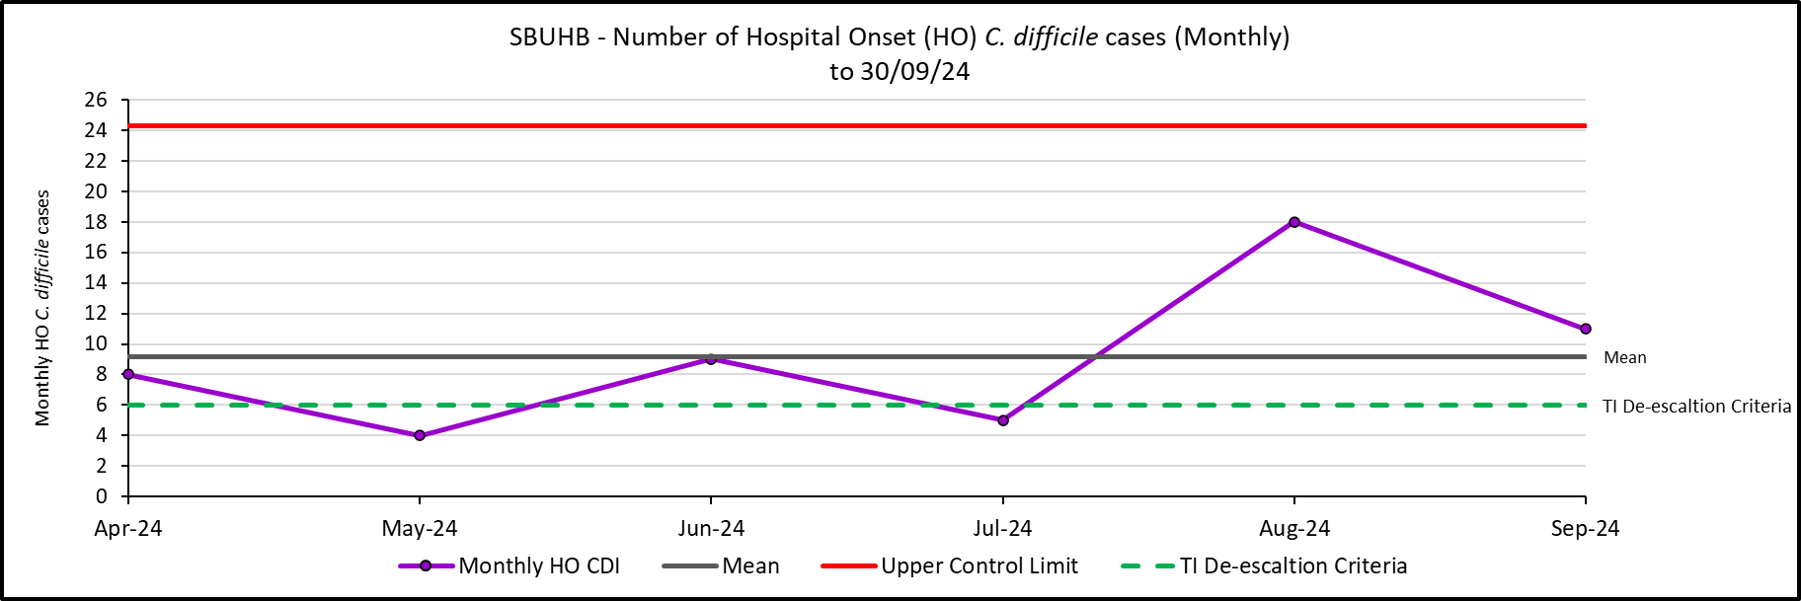
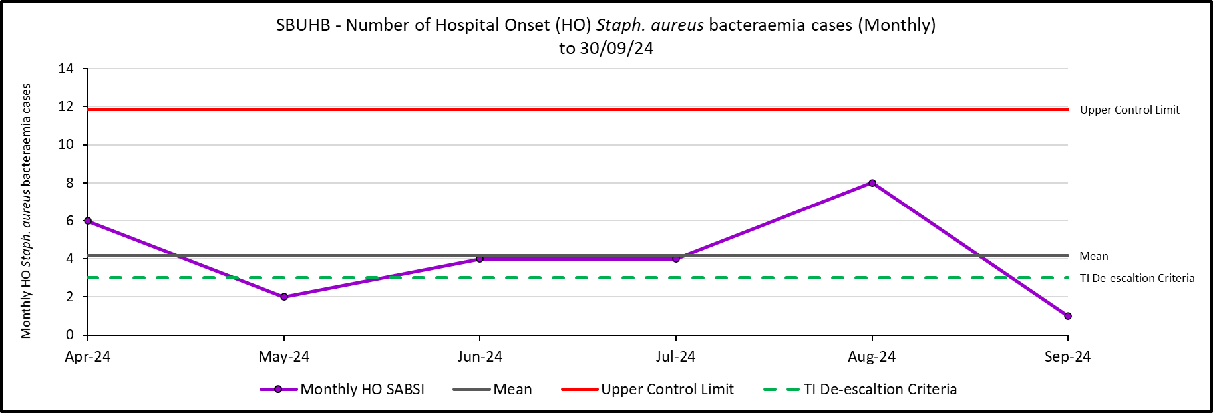
Hospital Onset HCAI TI Criteria, C. difficile and Staph. aureus to 30/09/24

Slide 47
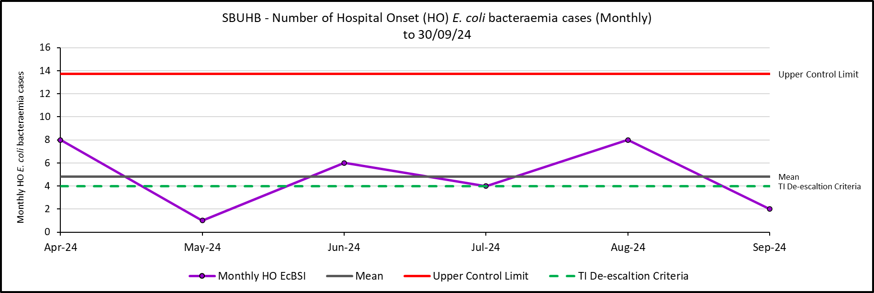
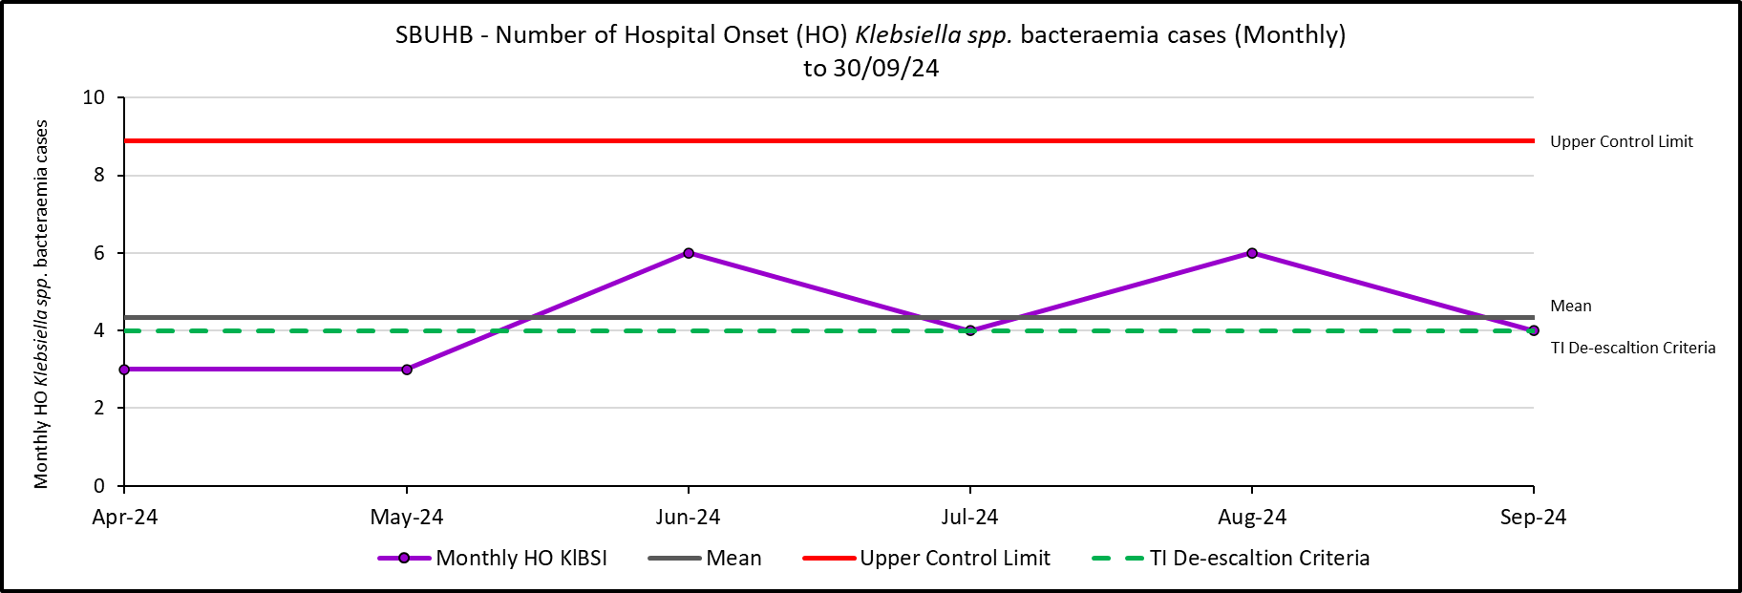
Hospital Onset HCAI TI Criteria, E. coli and Klebsiella spp. bacteraemia to 30/09/24

Slide 48
Antimicrobial Stewardship: 72-hour review, FY 2025 Q1
Swansea Bay University Health Board Compliance
All Wales Compliance (12 month rolling average)
72-hour review
  Outcome of 72-hour review:
  Change (escalate/de-escalate)
  Continue
  IV to Oral Switch
  Stop
72-hour review
  Outcome of 72-hour review:
  Change (escalate/de-escalate)
  Continue
  IV to Oral Switch
  Stop
92%
78%
5%
9%
76%
63%
8%
8%
11%
20%

Slide 49
Outbreaks of infection and associated beds out of use
In September, there were 8 clusters/outbreaks of infection (a number continued on from those reported in August). Majority of these were COVID-related. Two were caused by Norovirus.
Of the 8:
7 in Morriston (133 bed days lost to date, with an average of 19 bed days lost per ward);
1 in Ty Olwen (9 bed days lost to D&V, causative agent not identified).
Site Teams continue to balance of risks between USC pressures and IPC risks, supported by IPC team.
Generally, C. difficile clusters do not result in beds out of use, as the clusters are identified retrospectively. Patients prioritised for single rooms.

Slide 50
Focus for the next month
Gold C. difficile High Incidence Management Group continue, with Silver Groups reporting into Gold.
Undertake review of literature relating to CDI risk prediction and assess applicability to SBU cases.
Continue with AMU IV-to-Oral board round pilot, which commenced end of September 2024.
Cross-health board IPC discussions to identify key issues and learning.
Approach to PHW Anaerobic Reference Unit & HARP team for an improved understanding of what is considered to be causing the national (UK-wide, in addition to Wales) increase in C. difficile.

Slide 51
Finance

Slide 52

Building Blocks for Recovery & Sustainability (R&S) Assessment
Actions underway since Month 1 have focused on enhancing the grip and control over the options routinely deployed on the use of Health Board Resources. For the purposes of the revised assessment these can be categorised into two areas:
Part 1. Board Oversight and Governance put in place aligned to the Accountability Letter
Part 2. Actions from the focus on expenditure grip and control following the Month 1 reported position
Action / Output | Timescale
Deficit Financial Plan submitted | End March 2024
Accountability Letters issued to Delegated Budget Holders – set out all funding issued, with deficit sitting centrally | End April 2024
Requirement in response to Accountability Letters all areas submit Financial Strategy to achieve breakeven | End May 2024
Financial Strategies breached delegated budgets and first round Options | End June 2024
First Round Star Chamber Meetings | 11th-24th July
Further submission of Options with Green & Ambers assumed as Just Do Its and reds for further discussions at Star Chamber | 14th Aug 2024
Second Round Star Chamber Meetings | 19th-23rd Aug 2024
Discussion at PFC on Next Steps to presentation and recommendation of Red Options to Board. | 27th Aug 2024
Briefing Independent Members to provide update on Options & Financial Assessment | 3rd Sept 2024
Presentation and discussions of Red Options at Executive Team for conclusion on recommendations to Board by 9th September | 4th Sept 2024
Board briefing on Assessment for submission 26th September | 10th Sept 2024
Briefing Independent Members to provide update on Options & Assessment at a special meeting of the Performance and Finance Committee | 17th Sept 2024
Action / Output | Timescale
Chief Executive Officer (CEO) set out a number of actions to address the run rate pressures and during May 2024 the CEO also established clear actions for each Executive Team member. These additional actions focused on: Medical Staffing Variable Pay – Acting Medical Director Nursing (Registered and Unregistered) Variable Pay – Director of Nursing Review Bank – Acting Director of Workforce Review Non-Pay Outsourcing – COO Maximising Value & Sustainability opportunities – Director of Finance & Performance The variable pay work identified £13.5m of opportunities which are integrated into this assessment | 15th May 2024
Recovery & Sustainability Team established, working directly to the Director of Finance and Performance (SRO) leading on a three-programme approach supported by the existing Finance PMO Team. | 8th July 2024
Immediate pause on Admin & Clerical (A&C) Bank/Agency/Overtime and also a pause on all A&C Recruitment, with new vacancy panel being developed to increase the scrutiny on A&C posts being put in place after the 3 month pause. | 17th July 2024
Board authorised the Executive Team to consider and approve actions to reduce controllable expenditure. | 27th July 2024
Commencement of the specific review of investment and choices made through IMTP process over last 3-4 years. Work to date has focused on Omnicell Invest to Save (Non-Pay Theatres) and Emergency Department in Morriston. | 29th July 2024
Special Executive Team to consider options to reduce or cease controllable expenditure. Agreed reduction in Travel, Office Equipment, Telephones and Building/Maintenance Costs, which could reduce run rate by £0.9m in 2024/25. | 31st July 2024
Special Executive Team to consider options to reduce or cease controllable expenditure focusing on Variable Pay and the opportunities highlighted, which could reduce run rates by £13.5m. | 7th Aug 2024
Issued instruction to Service Areas on the Variable Pay Control targets for 2024/25, with 25% reduction required by end September and a further 25% reduction by the end of December. This has the potential to reduce Variable Pay by £13.5m by the 31st March 2025. | 12th Aug 2024
Issue further instructions to Service Areas on controllable expenditure agreed by the Executive Team, focusing on Travel, Office Equipment, Telephones and Building/Maintenance Costs. | 13th Aug 2024
Extract: P14-16 Recovery & Sustainability Assessment 26th September 2024
Notes:
This is a generic copy slide.

Slide 53

Summary R&S Assessment Submission 26th September
PART 1 = £85.5m: The output from the work undertaken through July-September, provided an initial assessed deficit of = £85.5m. Within the £85.5m deficit:
Service Areas identified £38.9m of green and amber schemes and a further £38m of Red Schemes
Red schemes were assessed and initially £12.4m were recommended to proceed by the Executive Team to the Board
Health Board now has a further 210+ given the number of schemes and SB’s historic trend on performance delivery a risk adjustment of £13.3m was been included.
PART 2 = £68.4m: The Finance Team has been assessing all aspects of the position and has identified potential non-recurrent opportunities of £17.1m. If these were achieved in full the £85.5m deficit would reduce to £68.4m. Within the £17.1m:
Each of these schemes has a risk of non-delivery and only £6.6m are RAG Green
These N/R opportunities provide the HB with time to develop and implement both the Full Year effect of agreed Red, Amber, and Green schemes, alongside the Recovery & Sustainability Board embedding across the HB.
PART 3 = £64.1m: Of the £38m of red options only £12.4m were initially recommended to proceed, leaving a further £20m (Pool 2 and 3) to support further savings. The initial assessment of Pool 2 and 3 is that a further £4.3m is possible. Thus, taking the assessed deficit down to £64.1m.
PART 4 = £50.8m: within the initial assessment was a Risk Adjustment for the non-delivery of schemes totalling £13.3m. Should all options/schemes deliver then the £13.3m built into the £85.5m would support the further reduction of the financial position for 2024/25.
SUMMARY: there is a line of sight to £50.8m on the basis that: (1) all elements of the assessment are delivered in full; and (2) any risks detailed in the financial assessment submitted on the 26th September are mitigated in full.
Notes:
This is a generic copy slide.

Slide 54
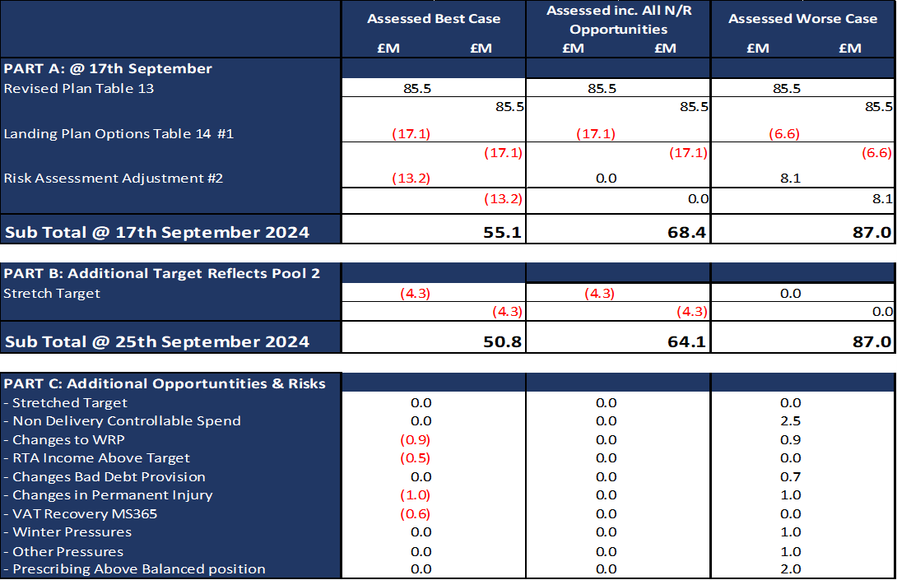
Summary R&S Assessment by Best to Worse Case
1. Assessed inc. all N/R Opportunities (Middle column) in table opposite reflects the £64.1m referred to on slide 8. Assumptions = all Green/Amber and Red (Pool 1) deliver as per the plan, the stretch target is achieved, the full £17.1m N/R options are delivered and no risks materialise as per Part C.
2. Assessed Best Case (Left column) - building on point 1 above the movement from the £64.1m to the £50.8m in this option is that the Risk Assessment Adjustment built into the £85.5m starting point is too prudent and all the savings options presented are delivered in full. This would result in a further £13.3m of savings so taking the position from £64.1m to £50.8m. However, this does not assume any of the opportunities or risks detailed in Part C.
2. Assessed Worse Case (Right column) - building on point 1 above the movement from the £64.1m to the £87.0m in this option is (1) the Risk Assessment Adjustment built into the £85.5m starting point is not sufficient and (2) not all of the N/R opportunities are achieved. The £87.0m does not reflect any risks detailed in Part C.
Extract: P28 Recovery & Sustainability Assessment 26th September 2024
Notes:
This is a generic copy slide.

Slide 55
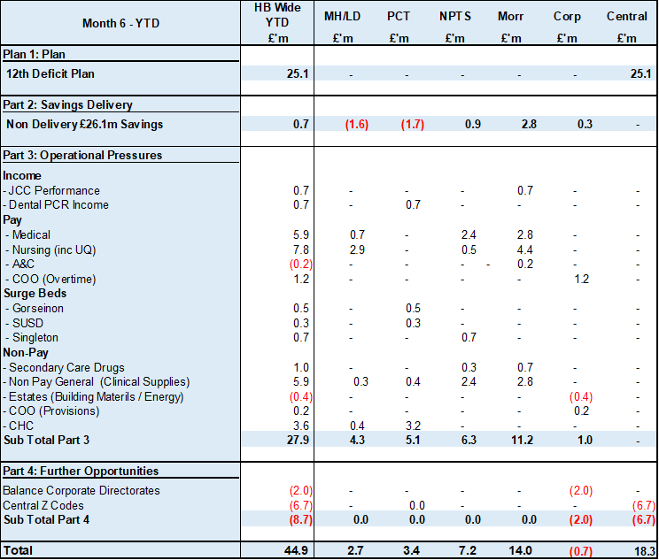
Summary of Drivers In Month & YTD @ Month 6
Notes:
This is a generic copy slide.

Slide 56
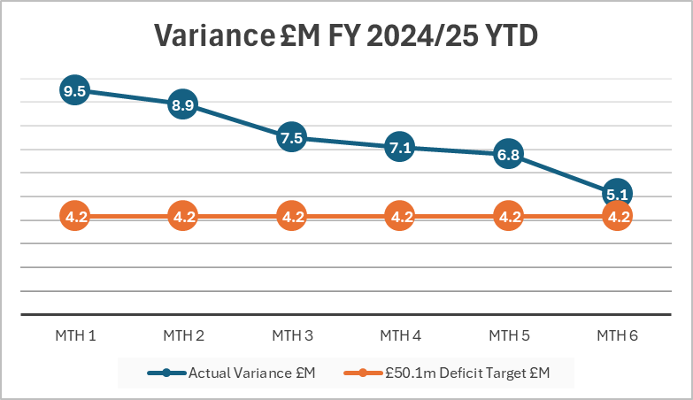
Key Performance Indications @ Month 6: Variance YTD
Key points of note:
£2m reduction in monthly variance from Month 1 to end of Q1
Further £2m reduction in monthly variance from end Q1 to end Q2
Improved identification of savings from Month 1 (£4.5m) to Month 6 (£48.7m) – refer to slide 13.
Reduction in the actual spend on Variable Pay between Q1 and Q2 – refer to slide 14.
Reduction in variance Month 5 to Month 6:
  £0.7m reduction in variable pay;
  N/R Opportunities linked to 23/24 Balance Sheet Release impacting Pay and Non Pay;
  Limited indication at this point of change in the underlying spend across Service Areas.

Slide 57
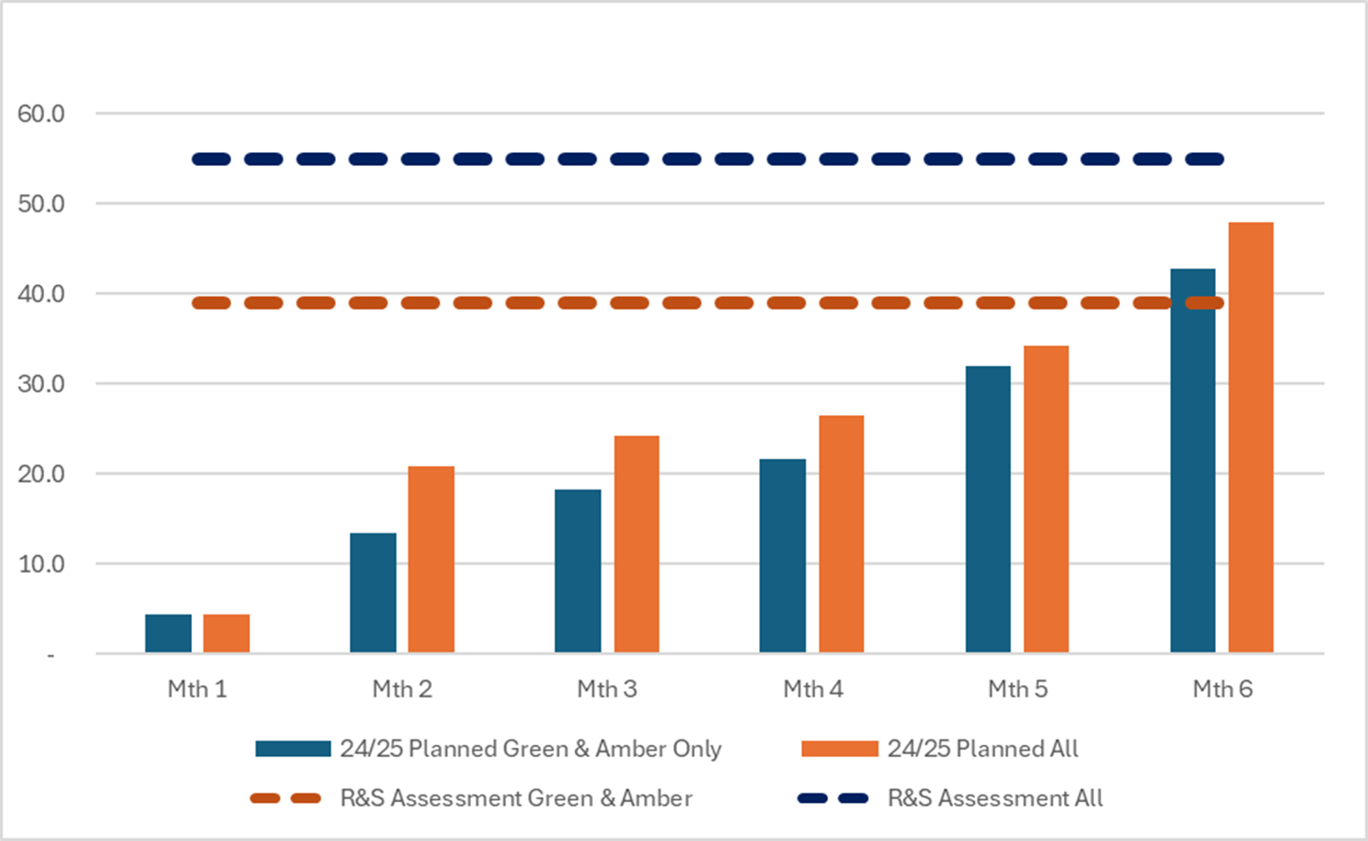
Key Performance Indications @ Month 6: Savings
Key Points of note:
For 2024/25 and as noted under section ‘Principles Underpinning 2024/25 £50.1m Deficit Plan’ on slide 2, the HB adopted a new approach to simply the management of the financial position for Budget Holders. Instead of setting budgetary targets all areas were simply required to maintain within funding envelope. All actions supporting a breakeven position are then classified as a saving on the trackers.
Since Month 1 the value of all identified savings has increased from £4.5m to £48.0m at the end of Month 6.
The proportion of Red Schemes as a percentage of the overall identification has reduced from 36% in Month 2 to only 11% in Month 6.
Total value of schemes on the trackers is £48.0m, the targets as per the financial assessment including the controllable expenditure is £54.9m or £51.4m excluding the controllable expenditure.

Slide 58
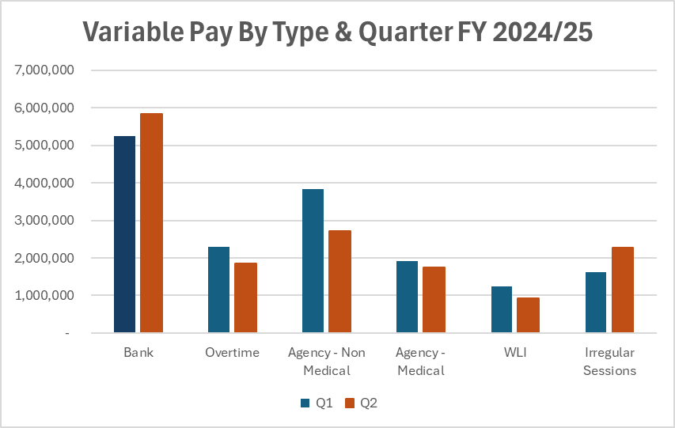
Key Performance Indications @ Month 6: Variable Pay
Key Points of note:
Spend in Q2 is £0.8m lower than Q1 and the average monthly spend £0.27m lower in Q2 than Q1.
Control total set was a 25% reduction in Variable Pay by the end of September and a further 25% reduction by end of December. This still allows the Health Board to commit £3m of spend per month to support roster and rota gaps. But at the end of September, the Health Board was £0.9m off this target.
Non Medical Agency spend has seen the most significant reduction, with some reduction in Medical Agency. However, Bank and ADH/Irregular sessions has increased.

Slide 59
Delivery Against Financial Assessment @ mth 6

Slide 60
Summary Meeting WG
Finance meeting with WG, NHS Executive and HB representatives on 9th October. Key points:
  The Financial Recovery & Sustainability Assessment and the risks included within the document, submitted on 26th September were understood.
  The Financial Recovery & Sustainability Assessment was balanced and addressed the most challenging choices possible but it did not affect delivery of key targets, UEC capacity, bed capacity or Continuing Healthcare (that may affect partners) at this stage.
  There were another £20m of Red options the HB is keeping under continual review, but these were consciously not in the September assessment due to impact and deliverability and a further £5m of options were not recommended. This was understood.
  Clear message that £50.1m (or better) is the target and there is no additional cover above this value.
  There is still a need to achieve target control total and balance in future years and the HB outlined work was underway, through a framework and change in planning approach, but current focus was on improving in-year delivery and the recurrent benefits of those actions
  HB set the momentum in establishing the Recovery and Sustainability Programme and are working tirelessly to identify more opportunities to a) reduce risk in year and b) support enhanced delivery in future years on the journey to sustainability. This was acknowledged.
  Monthly Monitoring Returns submitted on Friday 11th Oct did not include a change in the forecast, but have incorporated within the letter the work to describe the position as working to get to £50.8m, but with clear risks around the £13.3m and other risks contained within the Financial Recovery & Sustainability Assessment.

Slide 61
Key Messages
HB Financial Assessment – line of sight to £50.8m if all options presented are delivered.
Month 6 Overspend £5.1m, which is reduction of £1.7m from previous month driven by £0.7m reduction VP but remaining reduction linked to £1m of N/R opportunities.
Variable Pay – reduction In-Month of £0.7m, with spend of £4.9m against target of £4.0m. Remains £0.9m over 25% reduction target set for end September.
Significant increase in the value of planned savings identified from £34.1m at Mth 5 to £47.9m at Mth 6 – these now need to translate into being delivered.
WG Meeting 9th October 2024 – 2024/25 £50.1m (or better) is the target.
Inaugural meeting held on Recovery & Sustainability Board 21st October.
Notes:
This is a generic copy slide.

Slide 62
Planning

Slide 63
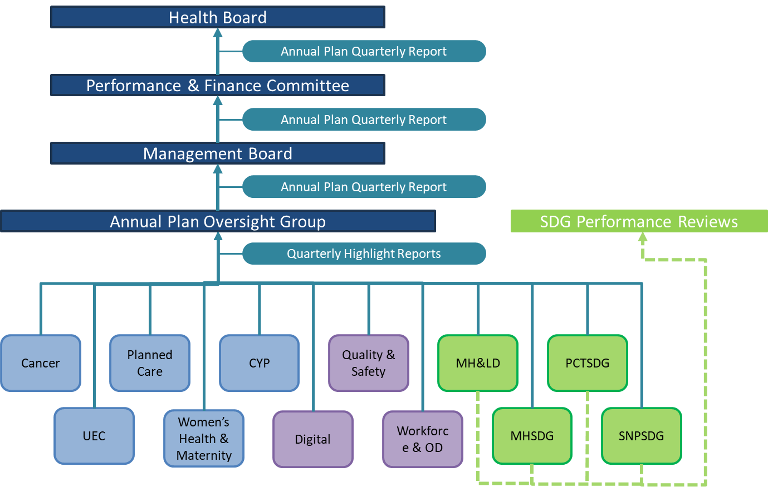
Assurance
How does the Board assure itself that key elements of the plans are being delivered, and how they are impacting on performance and delivering accountability conditions?
System and Service Delivery Group Highlight Reports are reviewed Quarterly at the Annual Plan Oversight Group which ensures the opportunity to review Risks, escalated issues and interdependencies.
A collated quarterly report is received by Management Board, Performance and Finance Committee and Board on the delivery of the of the actions in our Annual Plan, the achievement against our trajectories, the mitigation sand revised timescales agreed and the key risks being managed across system areas.
Annual Plan Oversight Group
63

Slide 64
Risks
What are the highest risk areas in delivering this year’s plan and what mitigating actions are in place?
The following areas have been identified at Q2 as having the greatest risk to delivery:
UEC - Continuing delivery of improvements urgent and emergency care are at risk due to lack of access to funding | A UEC summit took place on 2nd October. Following this summit the UEC plan is being reviewed and revised as part of the Annual Plan Mid-Year Review process. This will update the UEC plan to ensure continued improvements.
Digital – Implementation of key digital systems and work has been impacted by delays and changes to national programmes and changes in the digital Strategic direction | The digital actions in the Annual Plan will be reviewed as part of the Mid-Year Review which will consider the changing strategic approach and direction to set out clear actions for the final two quarters.
Outpatients – Delivery of the outpatient transformation programme. | Digital team are working to resolve local issues with WPAS that are holding up delivery, project manager has been appointed for SOS & PIFU and Clinical Leads identified for all areas and a Digital Task and Finish Group will be established.
Mental Health & LD – Capital approval from WG is required for a number of MH actions to proceed. | Internal HB discussions continue while awaiting decisions from WG.

Slide 65
Maternity and Neonatal: Update on Independent Review and Timescales

Slide 66
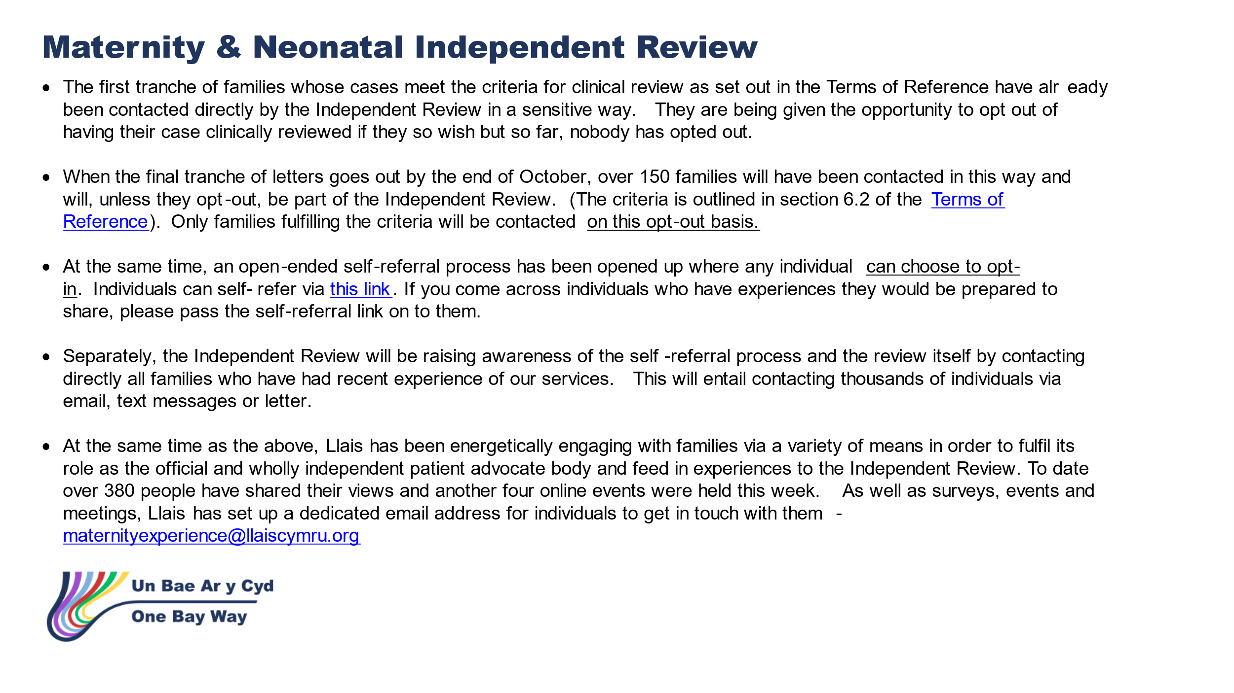
Notes:
This is a generic copy slide.

Slide 67
Targeted Intervention –
Patient Feedback

Slide 68
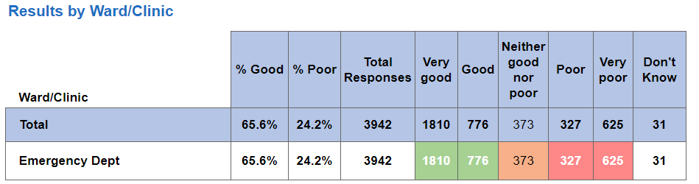
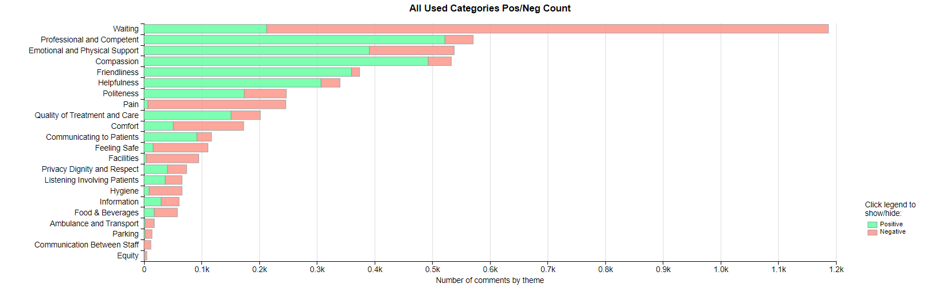
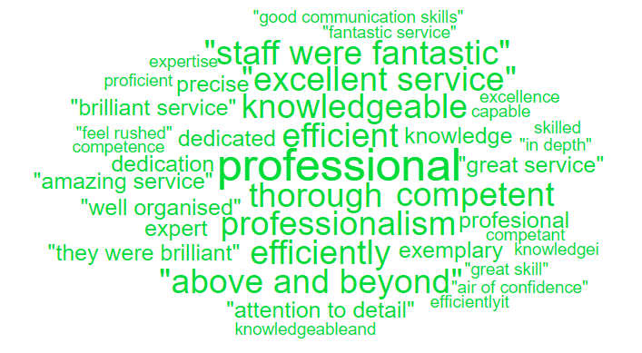

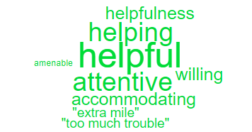
Urgent and Emergency Care – Complaints/Feedback (ED & MIU)
The graph below shows the number of complaints ED and MIU have received per month compared with the same period the previous year;
Heat map below showing F&F scores; when asked the question ‘Overall, how was your experience of our service’
Emergency Department Themes
Top 3 complaint themes;
Delay/Lack of treatment/assessment
Attitude/Behaviour of clinical staff
Inappropriate discharge
Positive feedback from CRAG reviews on complaint responses;
Good clear and concise responses
Excellent opening paragraphs – very sensitive description of having to put the legal paragraphs in to be compliant with the PTR.
Appropriate use of standard paragraphs evident

Slide 69
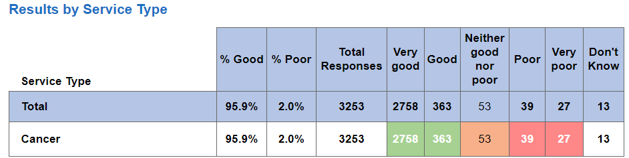
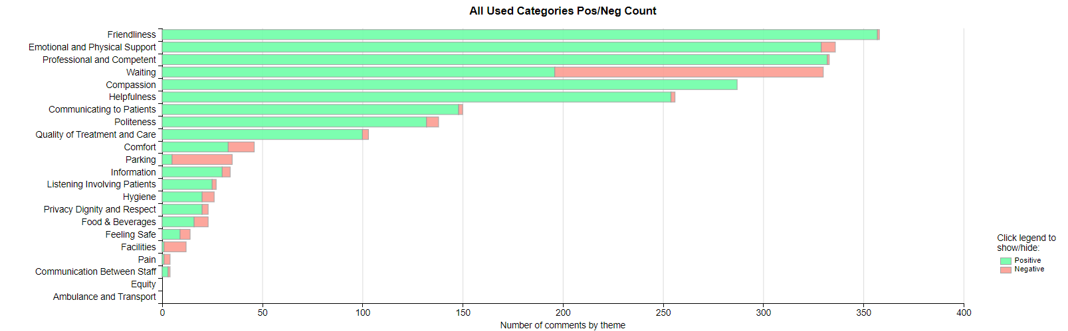
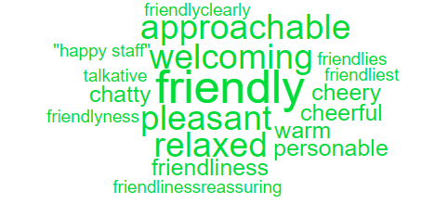

Cancer Services – Complaints/Feedback
The graph below shows the number of complaints cancer services have received per month compared with the same period the previous year;
Heat map below showing F&F scores; when asked the question ‘Overall, how was your experience of our service’.
Top 3 complaint themes;
Delay/Lack of treatment/assessment
Communication – insufficient/incorrect information
Delay in appointment
Positive feedback from CRAG reviews on complaint responses;
Some responses were sent within 30 days, others missed the target but this was recognised and ex gratia payments offered
All complaint files kept up to date which is good practice
Attempts to contact complainants via telephone – much more personal approach
All standard PTR paragraphs included

Slide 70
CAMHS – Complaints/Feedback
The graph below shows the number of complaints CAMHS have received per month compared with the same period the previous year;
Positive feedback from CRAG reviews on complaint responses;
Timely responses
Apologetic response with remedial action such as staff reflected, communication reviewed, process for checking patients belongings reviewed
HB values added to response
Contact made with complainant offering meeting and reiterated in response
Top 3 complaint themes;
Communication – insufficient/incorrect information
Inappropriate discharge
Inappropriate support for mental health

Slide 71
Complaints Performance
Overdue complaints;
ED
11 over 30 working days, this includes 2 over one year and 2 over six months.
MIU
0 over 30 working days
Cancer
9 over 30 working days, this includes 24 over six months
CAMHS
1 over 30 working days
Action being taken;
Bi-weekly reports sent to each Service Group with all overdue complaints
Bi-weekly meetings with each Service Group to discuss and review overdue complaints
Monthly CRAG meetings where a % of closed complaint responses are reviewed and feedback provided to complaint handlers

