Slide 1


Performance & Finance Committee
Morriston Service Group
29.10.2024

Slide 2

High Level Summary
Top 3 Actions to address position:
Deliver variable contract income position
Reduce variable/ premium cost pay
Deliver recovery plan actions aligned with latest organisation approval.

Slide 3
Agenda Detail
Health Board & Service Group Financial Summary
In-Month Revenue Position
Savings Performance
Key Drivers
Risks, Next Steps & Mitigating Actions
Appendices

Slide 4

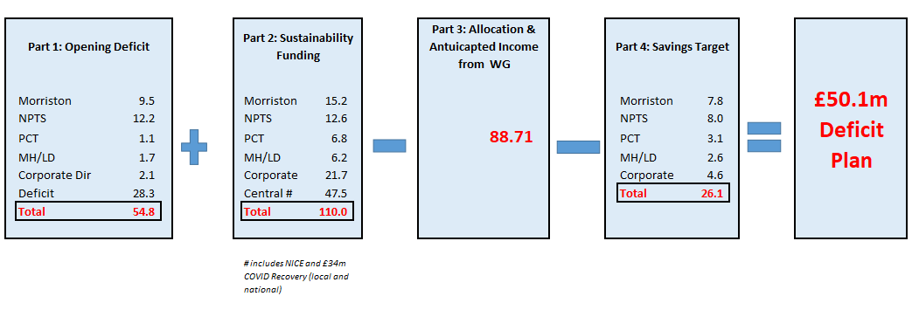
Health Board Summary Elements of Original £50.1m Deficit Financial Plan
Note: Specific elements from Part 1, 2 and 4 of the plan that relate to this service area are summarised on the next slide.

Slide 5

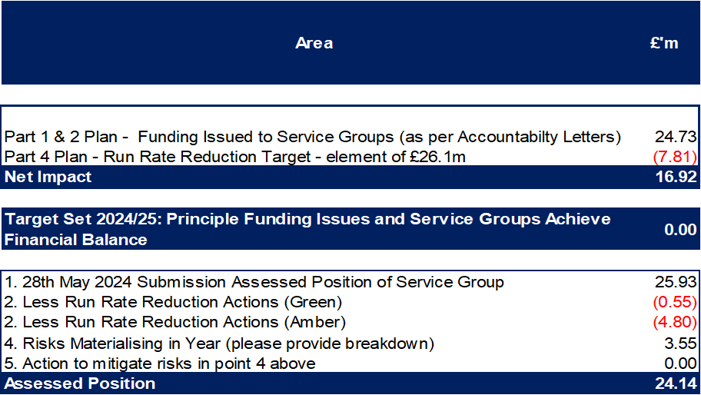
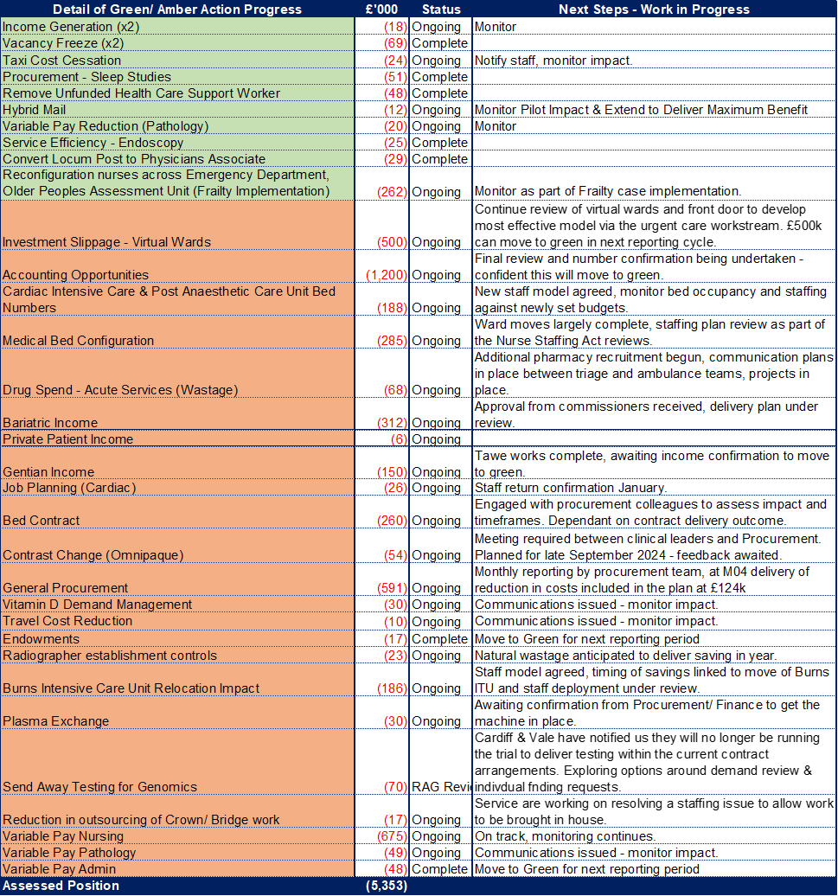
Service Group Element of Original £50.1m Deficit Financial Plan
Note:
Table below demonstrates how the assessed value from table above reconciles to the opening value in the tables on the next slide

Slide 6
Service Group Element of Recovery & Sustainability Financial Assessment
Key Messages:
A control total of £15.6m has been issued to the Service Group on the 10th October 2024, based on the elements shown. This is a challenge given the year to date position of a £13.9m overspend in M06.
The table shows the plan, consisting of additional variable pay and travel cost reduction, recovery schemes (risk rated and categorised as per Executive Board agreement) and a stretch target.
Balancing the clinical risks and performance delivery agenda with the financial challenge is key and the Service Group is working with Executive colleagues and those in other Service Groups to find the right balance to deliver the best possible financial bottom line.
There has been timeline slippage between the submission of savings scheme ideas and decision which will impact ability to deliver in full schemes in pool 1.
Review of pool 2 and 3 is underway as well as other mitigating actions that may be taken to deliver as high a recovery value as possible and look toward the stretch target.
A new forecast is being prepared taking into account this information.

Slide 7

2024/25 In Year Health Board Position

Slide 8
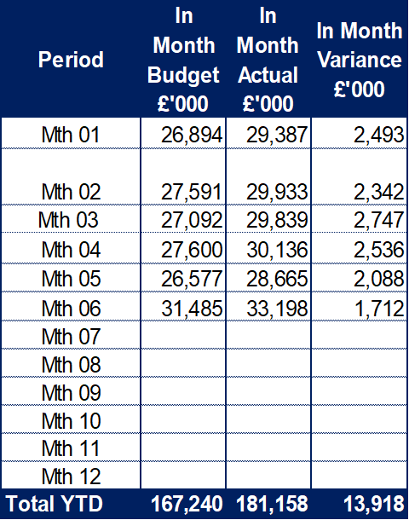
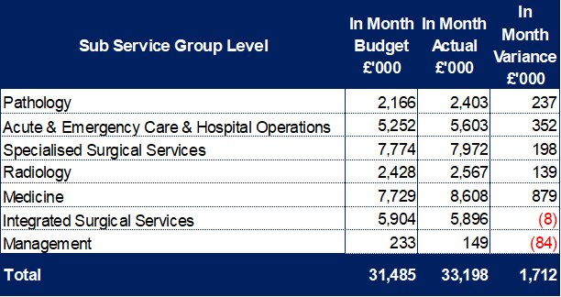
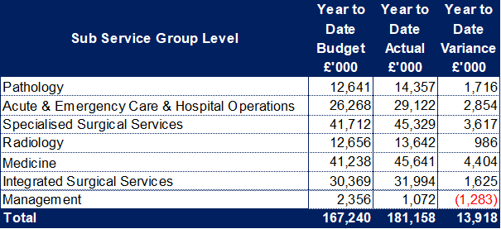
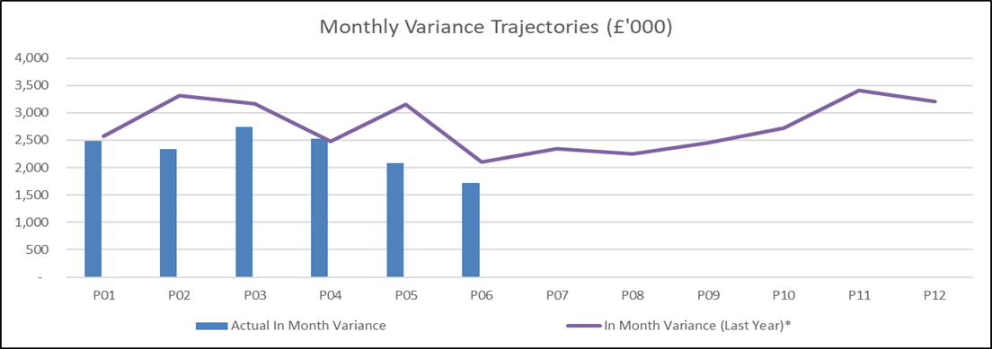
Service Group Position By Month & Divisions
Key Messages:
The improvement between month 05 and 06 is largely due to one off accounting gains linked to contract provisions in Pathology and the newly transferred in virtual ward service. There is some underlying non pay improvement, but the income position also deteriorated due to under delivery of income related services.
The accounting gains form part of the planned benefits expected in year and reflected in the recovery plan.
Underlying this, whilst there are pockets of improvement on the pay position, the overall spend profile is largely stable, excluding recovery work and service change.
A budget reset was undertaken in month 04, reflecting the current plans. There remains some reserve balance held in Management and released to reflect both investment slippage to date and workforce funding not yet released pending workforce plan submissions from Divisions for acute medical staffing and pathology.
All Divisions have pressures, but these are most significant in Medicine and Acute & Emergency Care for core service. Specialised has some specific issues linked to the Cath Lab project and holding the cost of reduced Cardiac activity compared to baseline budgets, as well as high consumable costs for work undertaken.
Divisional leads continue to work on their individual savings and recovery plans, with a focus on delivering a sustainable plan for 25/26 as well as recovery in 24/25.

Slide 9
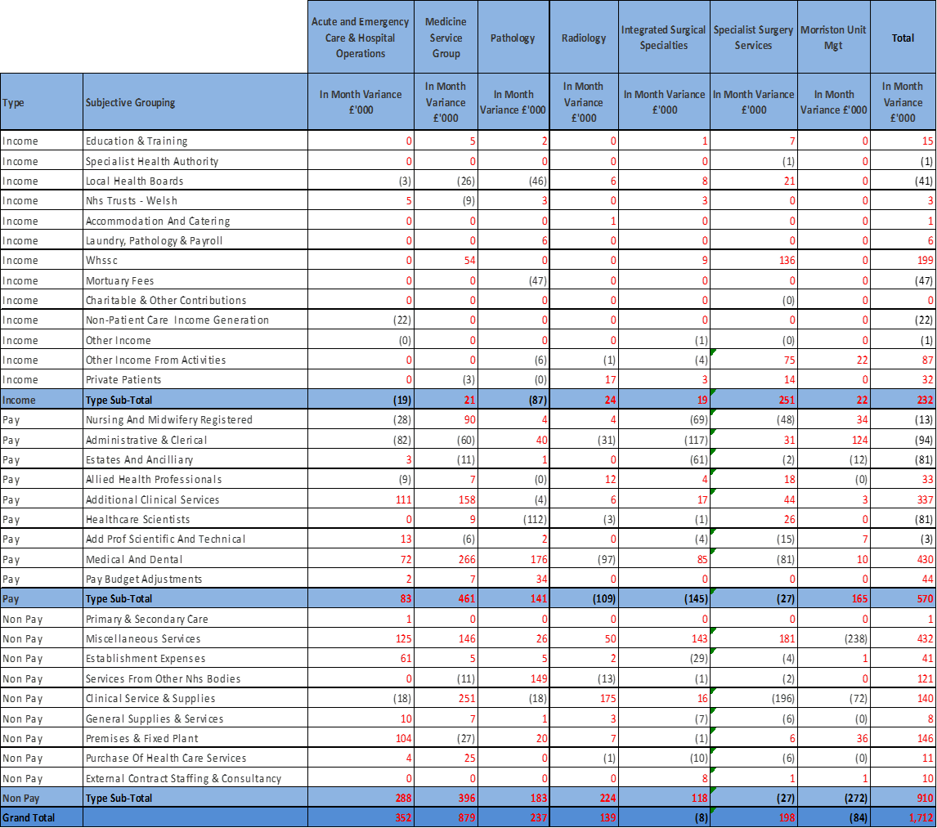
In month Service Group Position By Division & Type Expenditure/Income
Pay Pressures
Healthcare Support Workers, particularly in the Acute Medicine Unit, Emergency Department, Elderly Care & Stroke wards. A result of both additional capacity and a number of patients requiring enhanced monitoring. There is also an element of pay uplift yet to be funded for this staff group which will be rectified on receipt of funds from Welsh Government.
Medical Staff; some additional sessions linked to activity delivery and planned cover but also rota gaps due to sickness and fill rate following rotation of non consultant posts. Pay award processed in month 06 with funding.
Administration & Clerical and Ancillary pay underspend to be offset to vacancy factor (pay budget adjustments line) remaining underspend links to temporary management structure gaps and vacancies held/ delayed as a result of financial recovery cost controls.
Non Pay Pressures
Miscellaneous is the net budgetary CIP requirement offset with any unallocated reserves (slippage/ accounting support)
Clinical Supplies & Services continues to see significant pressures in Neurology blood products, maintenance contracts and consumables in cardiology, although the in month position improved following the planned release of accounting gains.
Premises & Fixed Plant reflects ongoing pressures of bed hire and repairs, exacerbated by the fact that Swansea Bay is out of contract with the service provider so operating on a series of block arrangements.
Income Pressures
JCC contract delivery
Historic Income CIP (plastics)
Private Patient Income

Slide 10

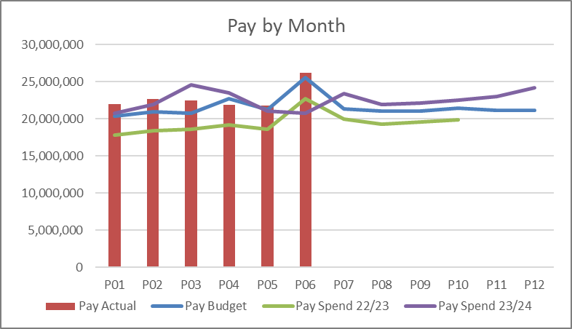
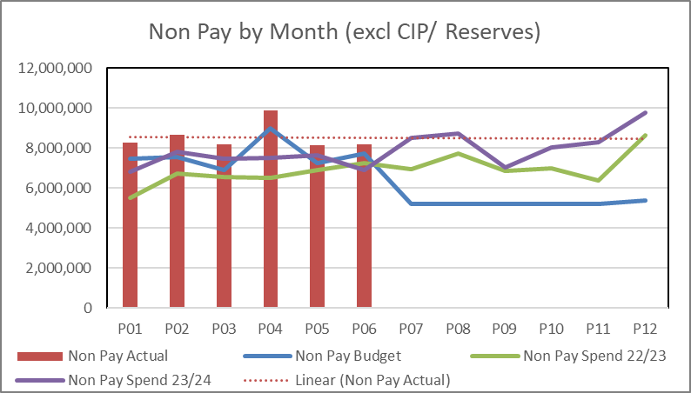
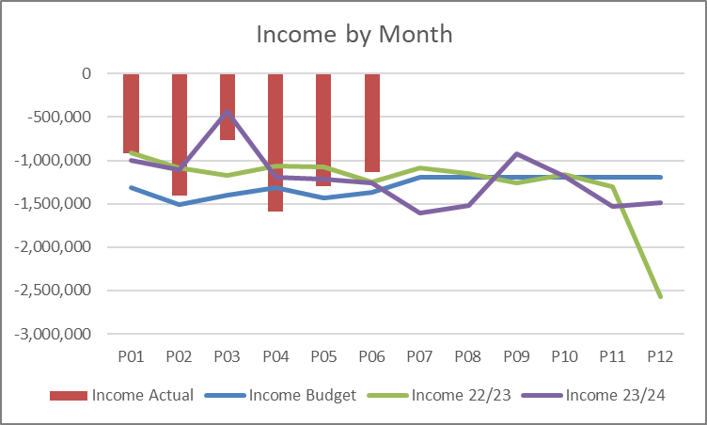
financial performance: Overall trends
Pay
A medical and dental pay award with back pay was applied in month 06 (and funded) which skews the month on month trend data. If the impact of this was excluded the overall trend of expenditure is largely stable, variable pay is reducing but there has been some increase in substantive costs following planned recruitment to deliver services.
Non Pay
In month variations linked to activity in particular in areas of high cost consumables (cardiology/ cardiac service) can be seen in the overall position for non pay but the trend line remains stable, despite efforts to deliver savings linked to procurement, waste limitation and standardisation. Work continues to look at specific pressure areas where increased demand is impacting spend (pathology/ diagnostics) and capture inflation pressures and areas of opportunity.
Income
Fluctuations seen month on month linked mainly to delivery of activity based income contracts, in particular cardiac surgery and cardiology procedures. These procedures have significant non pay costs associated and so lower income delivery will align to lower non pay spend, however underperforming against the core contract results in an inability to recovery funding for the fixed service costs. Focus on maximising delivery continues.

Slide 11
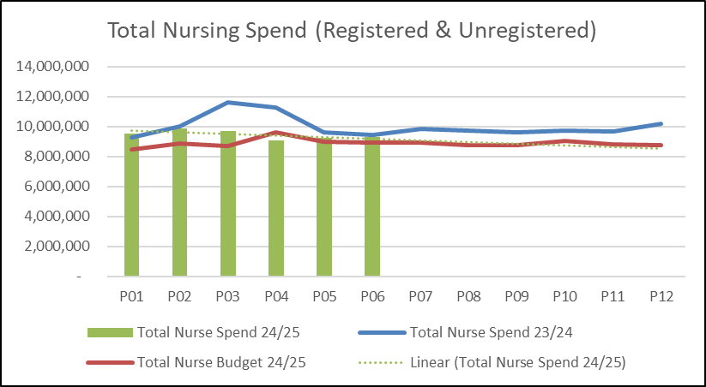
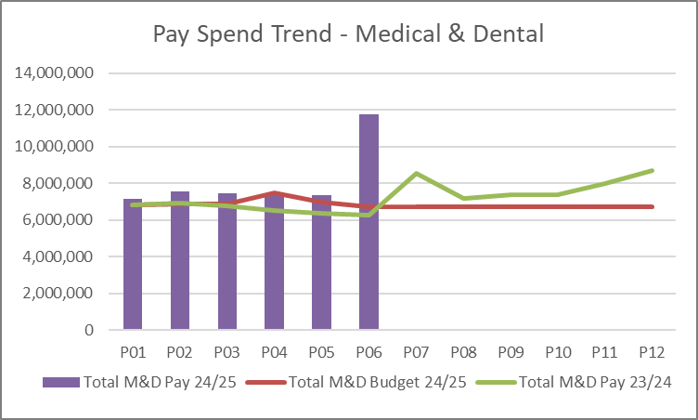
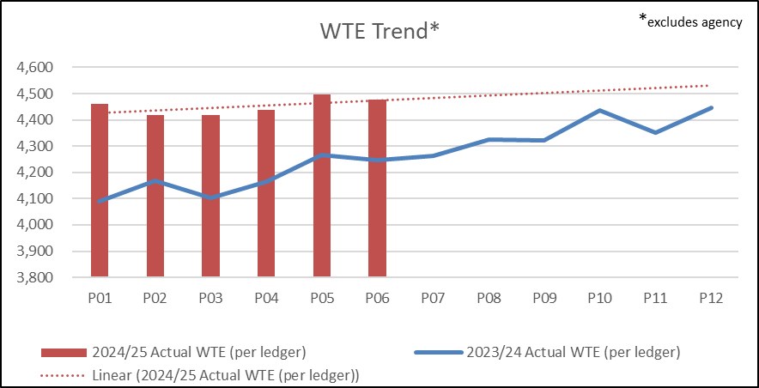
Pay Summary
Total nurse expenditure shows a reducing trend. This reflects sustained reduction in the cost of registered nurses following continued variable pay reduction, and in particular the reduction of premium cost agency cover for this staff group. Healthcare Support Worker costs remain largely stable at this stage with forward plans focusing on sickness reduction, recruitment into gaps to remove variable pay and support acuity with lower additionality.
Medical staff pay in month increased due to the pay award and associated backpay, if this is excluded then the pay trend is largely stable across the Service Group, there is a small reduction beginning to be seen at month 05, continued focus on sustaining this is part of the ongoing work of the group. The driver for the reduction is decreased agency costs, improved fill for middle grade rota’s in acute medicine and decreased variable pay in Pathology.
WTE, the main driver for the increase from 23/24 average wte is due to the successful recruitment of registered nurses, supporting the replacement of agency cover, although there were increases for Healthcare Scientists and Medical staff too compared to the 23/24 average. Through Q2 of 24/25 there is an increase in the training grade wte which should support plans to reduce reliance on variable pay cover (both externally provided and internal additional sessions).

Slide 12
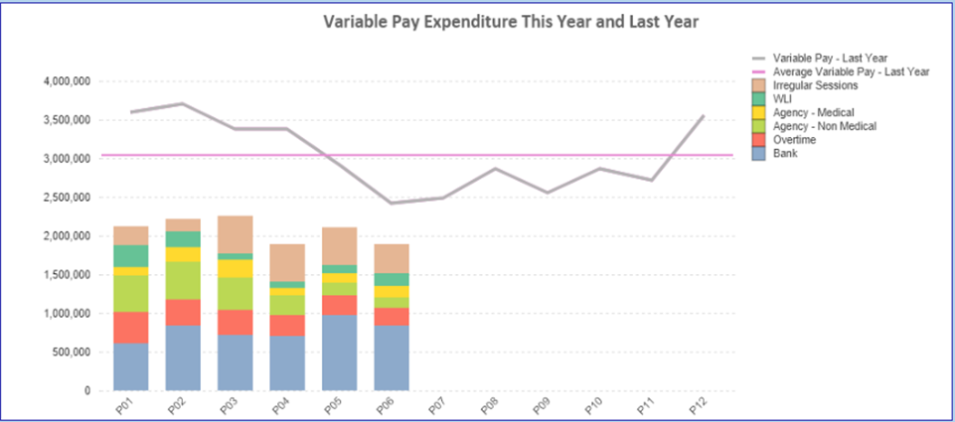
Pay : Variable Pay Actual Spend
Key messages:
Variable pay has reduced significantly compared to 23/24.
The largest reduction is across Registered Nursing, where the overseas recruitment strategy and increased scrutiny (sickness, rostering, cross cover) have delivered significant improvements. Variable pay for registered nurses has reduced by £845k per month compared to the 23/24 total average (£1.3m Q1 23/24 vs Q1 24/25). There are some benefits linked to accruals which will not be available beyond month 6 and some of this benefit will have been offset by increased substantive pay and higher levels of shift cover allowing improved delivery of the nurse staff acting nurse levels.
Variable pay has reduced for medical staff with the largest reduction in monthly agency costs where the average monthly spend has reduced by £60k compared to 23/24. Irregular session costs have also reduced compared to 23/24, although there was a small increase in the second quarter of 24/25 due to planned activity changes associated with recovery work and developments.
The service groups spend is slightly higher than the 25% total targeted reduction by the end of September, however it has delivered better than target for agency and overtime reductions. Whilst waiting list initiative and additional hours payments remain above targeted level this is linked to activity delivery and the service group continues to work towards delivering that activity in the most cost effective way. The greatest concern in delivering the targeted variable pay reduction is with bank usage which has grown compared to 23/24. This is mainly within the Healthcare Support Worker space and reflects the challenges around unfunded bed capacity and ongoing acuity (in particular increased patients requiring support with Mental Health issues).

Slide 13
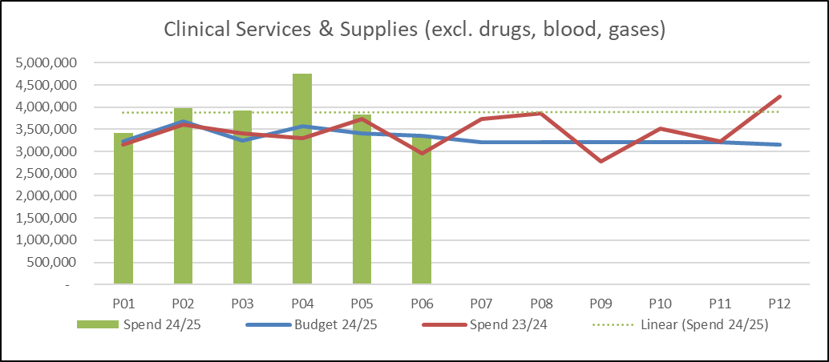
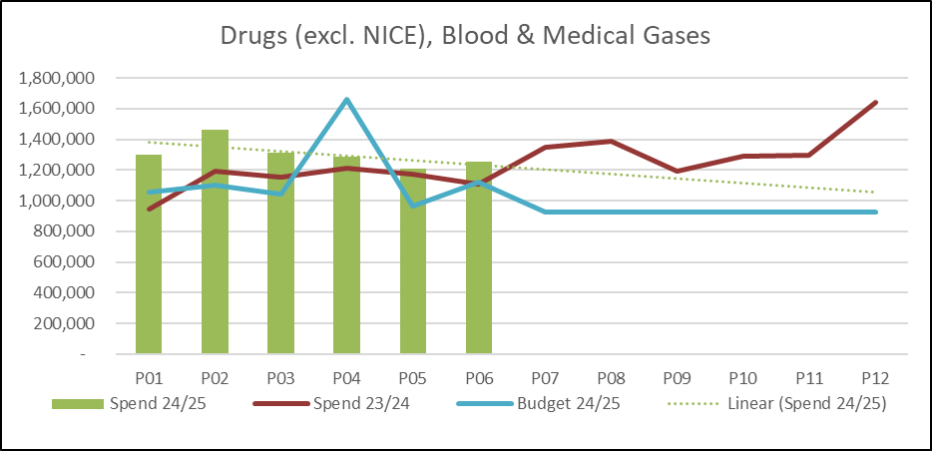
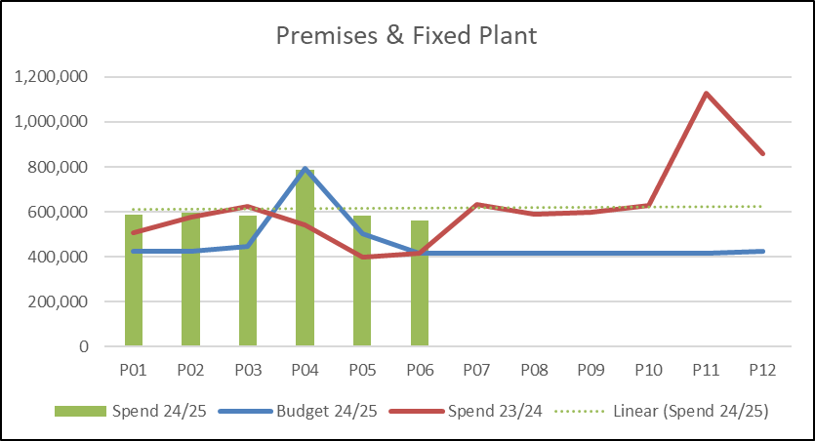
Non Pay: key drivers
Clinical services & supplies are the main driver for the overspend on non pay lines (outside unachieved savings). The main pressures within this spend category include; hire of the catheter lab (£60k per month) which is expected to cease in this calendar year, cardiology consumables (average £40k per month over budget, around £15k of which is offset by increased income), endoscopy consumables (£42k per month overspend), skin products (£41k per month overspend) linked to activity delivery, managed service contracts for pathology testing (£61k per month overspend) linked to higher than planned activity growth, recovery plans include measures to manage demand. Finally maintenance contracts (£80k per month overspend) in diagnostic areas (radiology, endoscopy, pathology) have increased reflected aged equipment and more frequent breakdowns this is being reviewed with capital colleagues and through the consideration of future managed service contracts for diagnostics.
On the drugs and blood lines the greatest pressure is blood products supplied for Neurology (£54k per month overspend), this reflects significant growth and inflationary pressures above those funded through the plan in 24/25. A second plasma exchange machine has been purchased which will support management of this pressure going forward. Other pressure areas include drug costs for Gastroenterology and Endoscopy (£25k per month) which are being reviewed to ensure all specialist drug funding is being reclaimed and where drug swaps are available they are being enacted, and that forward recovery recognise the full cost associated with the activity.
Premises & fixed plant costs continue to overspend due to the pressures associated with bed hire and repairs due to aged bed stock and the Health Board contract needing renewal to enable replacement and preferential rates.

Slide 14

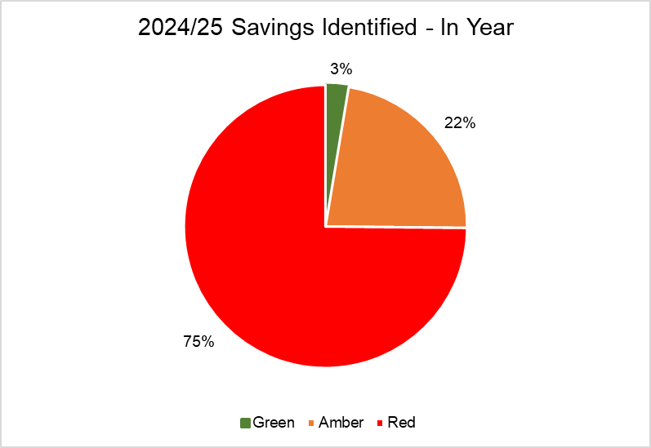
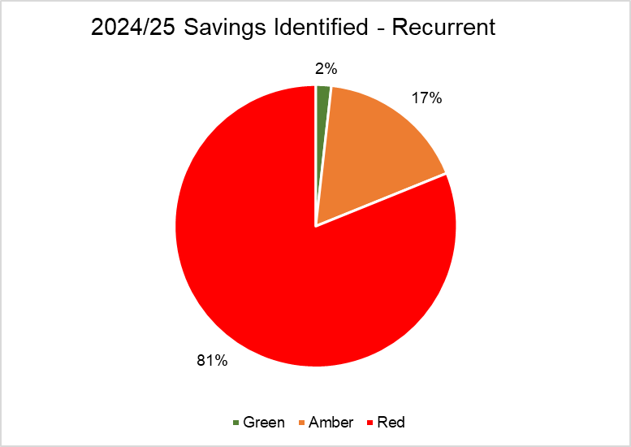
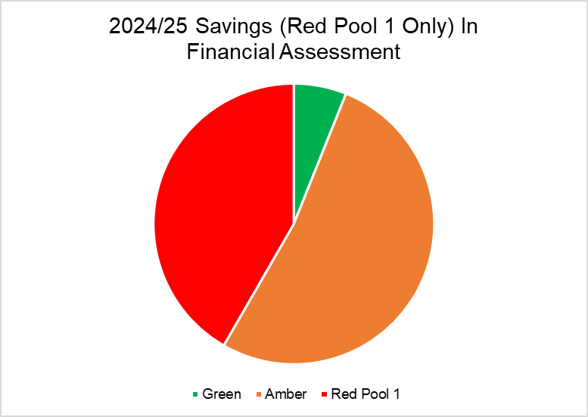
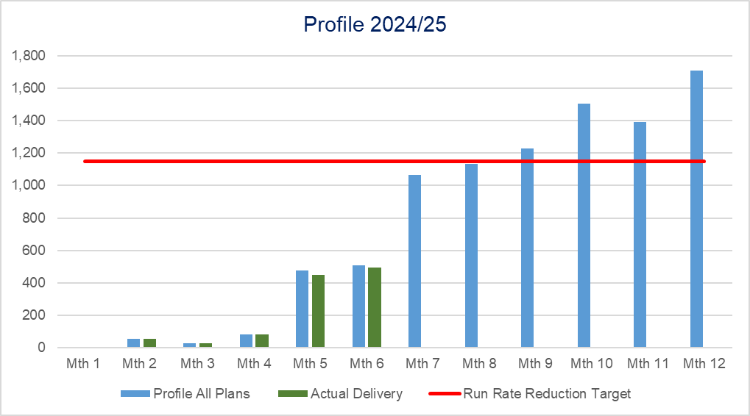
Savings Summary From Financial Assessment

Slide 15
Savings Detail (Green)

Slide 16
Savings Detail (Amber)

Slide 17
Savings Detail (Red Pool 1)

Slide 18
Savings Detail
Green/ Amber
2 schemes are showing signs of slippage:
Procurement – a target of £591k cost reduction was set based on predicted procurement delivery at the start of the year, evenly profiled would result in a delivery of £296k year to date. The September procurement savings tracker shows £345k delivered as cash releasing, however of this only £189k has been assessed as delivering against baseline spend (i.e. financial plan start point), leaving a shortfall of £107k. The Service Group is working with colleagues to develop a robust forecast to year end.
Bed Reduction – 9 beds Medicine; following ward moves it was anticipated that a saving would be made on nurse establishments, recent review under Nurse Staffing Act has not recommended any reduction. The nursing team are reviewing what other opportunities may be exploited, although this must be taken in the context of current bed pressures.
2 schemes require focus to support delivery due to risks emerging:
Cardiac Intensive Care/ Post Operative Care Unit Bed reduction
Bed management contract
Red Pool 1 and 2
Triangulating risk assessment versus explicit performance deliverables (cancer, Urgent Care, 104 weeks)
Considering priority order for implementation
Risk assessing and reprofiling financial opportunity following time delay from submission to decision
A number of schemes require support from procurement/ digital/ commissioning/ partnerships and alignment between Service Groups

Slide 19

Identification Opportunities & Risk
Further Risks:
Implementation timescales/ managerial capacity for any recovery schemes
Challenge of staff engagement against perceived deliverability
Winter
Inter group consequences of recovery plan options pursued such as Therapies vacancies impact on Length Of Stay/ Bed Plan
Additional inflationary and demand pressures (testing, inter organisation agreements, maintenance, blood products, skin)
Delivery of contract activity and prioritisation of limited theatre capacity
Funding for pay award reflecting true cost/ risk of reporting capability diluted due to pay award and service realignment
Further Opportunities:
Service redesign (Virtual Wards/ Acute Community Teams/ Full Frailty Implementation/ Interventional Radiology/ Vascular)
Aligning demand and capacity, improved medical cover availability as staff return from sickness and junior rota’s are better filled.
Delivery of a Community Diagnostics Centre (25/26 opportunity)
Digitalisation (lab med, letters, booking)

Slide 20
Action to Date & Next Steps To Be Taken By Service Group
Business meetings with triumvirate teams have moved to weekly to create pace and close monitoring of progress
All Division triumvirates have reviewed plan submissions and reported back on deliverability, Service Group is reviewing red schemes again to determine order of priority jointly with Executive colleagues
Refresh of impact assessment – feedback to Board colleagues via agreed route
Monitoring delivery against plans

