Slide 1


Performance & Finance Committee
Morriston Service Group
25th November 2025

Slide 2

Agenda Detail
Health Board & Service Group Financial Summary
In-Month Revenue Position
Savings Performance
Key Drivers
Risks, Next Steps & Mitigating Actions
Appendices

Slide 3

Summary

Slide 4
Summary Health Financial Plan & Service Group Element
FINANCIAL PLAN 2025/26
SERVICE GROUP ELEMENT PLAN
OPENING BUDGET

Slide 5

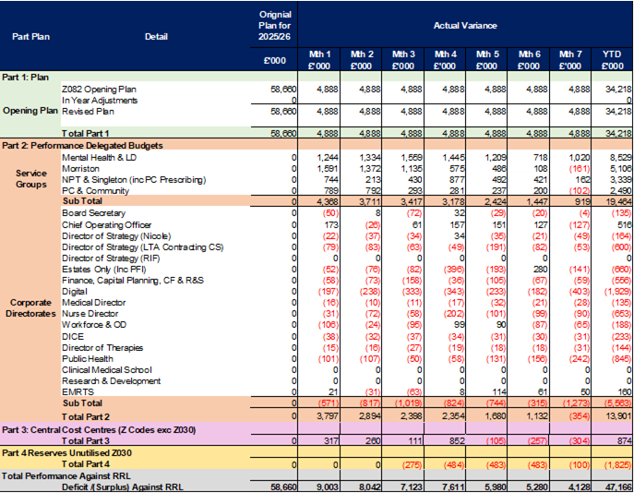
2025/6 In Year Health Board Position & Service Group Element

Slide 6
Service Group Position By Month & Divisions
KEY MESSAGES
Morriston Service Group is £5.1m overspent against budget year to date, £0.2m underspent in month.
There has been a steady improvement in variance over quarter 2 continuing into month 07 driven by:
  Reduced pay costs including reductions in variable pay (particularly nursing and administrative and clerical staff) and substantive pay, linked mainly to holding vacancies in administration roles.
  Improved savings delivery
  Release of appropriate additional funding (income and budget) linked to planned care delivery and projects
The Divisions are all spending in excess of allocated budget with an offset on the management area related to one off accounting benefits and investment slippage (treated as non recurrent savings to offset other shortfalls).
Divisional overspends are mainly driven by unachieved cost improvement targets with other specific operational pressures including:
  Clinical equipment and consumables (Hospital Operations and Specialist Surgery)
  Postage
  High nursing unavailability, including an increase in maternity leave compared to underlying funding

Slide 7
Year-To-Date Service Group Position By Division & Type Expenditure/Income
Income
There is year to date overachievement (underspend) on income of £0.8m. This is mainly due to income from activities for Jointly Commissioned services. There has also been additional income generated through other inter NHS activity and private patients. This income in part offsets pressures seen on the clinical supplies non pay spend lines due to the high cost of associated consumables in some of these services (i.e. cardiology devices).
Operating Income is underachieving by £0.06m, there are a number of drivers none of which are material individually. It is anticipated that there will be some recovery during the second half of the year to this position due to better staff availability in the income generating services.
Non-Pay
An overspend of £6.8m total, of which £2.8m is on operational budgets and £4.3m is savings shortfall.
Savings shortfall shows against the miscellaneous line, along with budgetary reserves which total £0.4m and offset the savings shortfall.
Of the operational overspend £1.9m is clinical supplies and services. The largest element of which relates to Specialist and Integrated Surgical Services including high-cost devices. This is offset partially by the income over performance described above, however some procedures are not funded via additional income, and we continue to see increasing cost and demand for associated consumables. Work is ongoing with the procurement team to identify opportunities to reduce the cost of these items. Other significant pressures in clinical supplies include blood product spend (within Medicine Division) which continues to increase above funded growth year on year and drugs and other consumables in areas that have additional bedded patients.
Premises and Fixed Plant are overspent by £0.8m due to the cost of bed and equipment hire. Some of this pressure is driven by additional bedded areas, some by price; new contractual arrangements are due to be implemented to resolve the pricing gap.
Establishment expenses are overspent due to the cost of postage. Reviews of the impact of additional work for planned care are ongoing to ensure all associated funding has been claimed, and there remains benefits from digitisation to be realised to reduce the size of this variance going forward.
Pay
An underspend of £0.9m year to date. The largest component of this is the £0.8m underspend on Administration & Clerical staff, which is due to vacancies both related to delays in recruitment and temporary holds in response to the financial challenge whilst service plans are reviewed.
There remains an element of underlying budget to issue to lines which sits under ‘Pay Budget Adjustments’ and drives that underspend, it predominately relates to nursing staff so nets down that overspend.

Slide 8

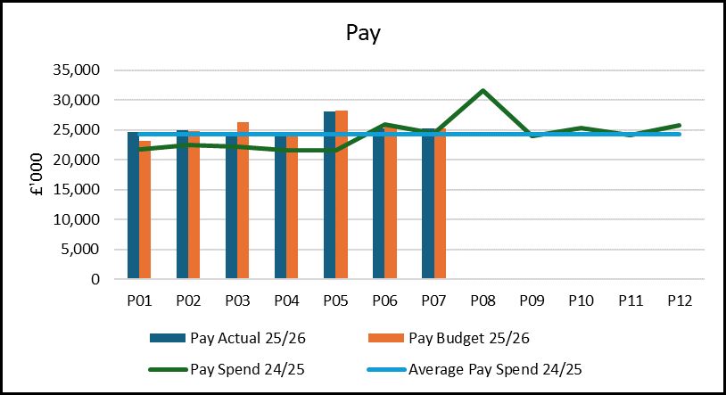
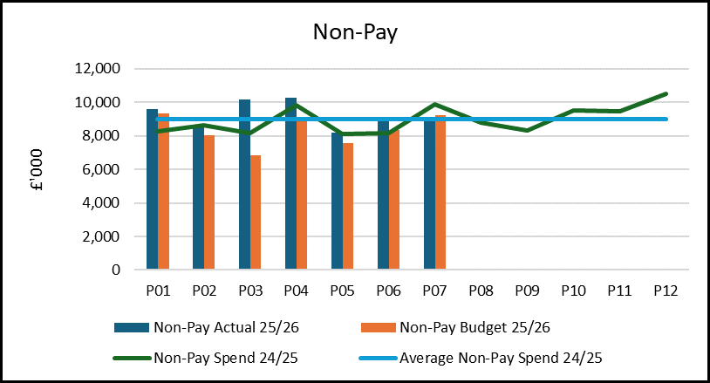
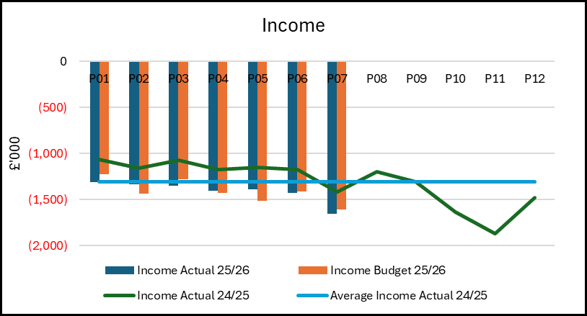
Drivers: Summary
Pay: Monthly expenditure is 3.4% higher than the 2024-25 average. This is driven by the 2025-26 pay award, paid in August (P05), and an increase in the Health Board NI costs, offset by a reduction in variable pay. Variable pay has reduced from the 2024/25 average by 12% (c£0.2m average per month) but some of this has been offset by recruitment into substantive posts. The total pay cost of delivering services is remaining relatively stable, although there has been a significant increase in vacant administrative posts.
Non-Pay: Monthly expenditure has been higher than the 2024/25 average in most months, with low spend months being due to natural activity fluctuations and in some cases one off benefits of rebates. Some of this average increase has been funded via the inflation allocation and funding for anticipated blood product and managed service contract growth (demand linked), however there remains an overspend on the clinical supplies lines in particular. Both growth and inflation on blood products has been above plan values and the cost of clinical consumables remains challenging despite measures to improve stock management and waste. Work with procurement continues to manage these pressures.
Income: Income is higher than in 2024/25 and this reflects activity performance for clinical services including some additional private patient income. There is a variable cost of delivery associated with this income which is seen in both non pay and variable pay costs.

Slide 9
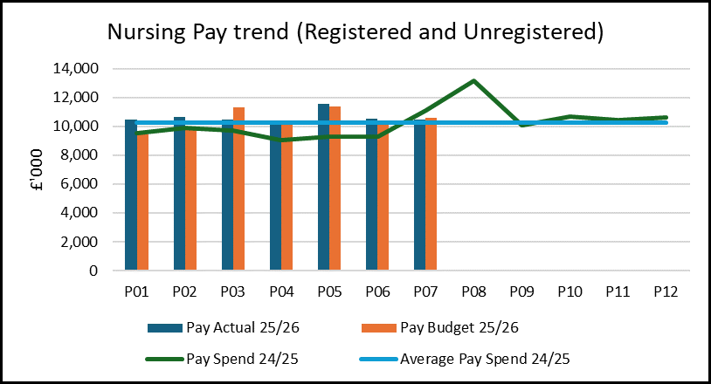
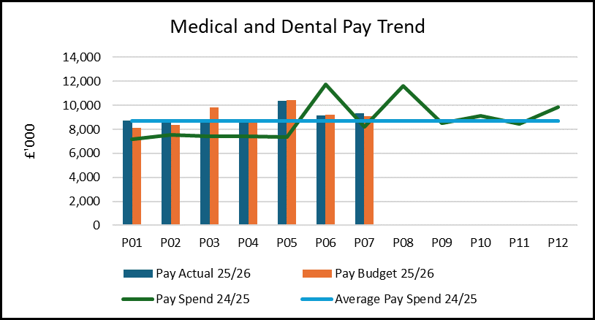
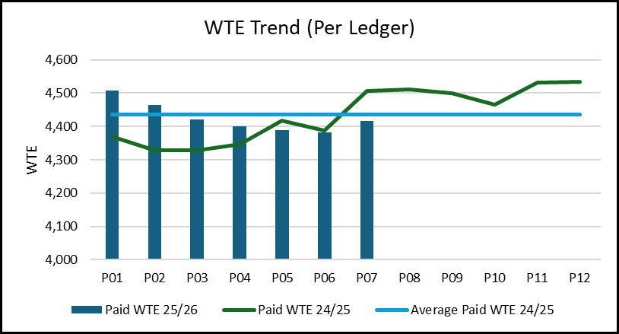
Drivers: Pay
  Nursing pay is above the average of 24-25 but there is increased cost in the new year from the increased employers NI and the pay award. When this is adjusted for the net cost of nurse pay would have been slightly lower due to reductions in variable pay. However, it is recognised that there is more opportunity to reduce variable pay linked to unavailability which remains high in some areas, this is being pursued via the savings workstreams.
  Medical staffing expenditure is also above the 2024-25 average. Again, there is increased expenditure from NI and pay award, but a small improvement in the variable pay position when considered in the context of a small increase in vacancy levels. Due to anticipated retirements, it is likely there will be a short-term increase in variable pay through the final quarter of 2025/26 as they are recognised as hard to recruit posts.
  The WTE staffing has reduced during the year linked to variable pay and some leavers with delayed recruitment, along with some service transfer. The increase seen in P07 represents the new student streamline nurses which will eventually reduce variable pay reliance, but which remain in supernumerary posts for the initial employment weeks.

Slide 10
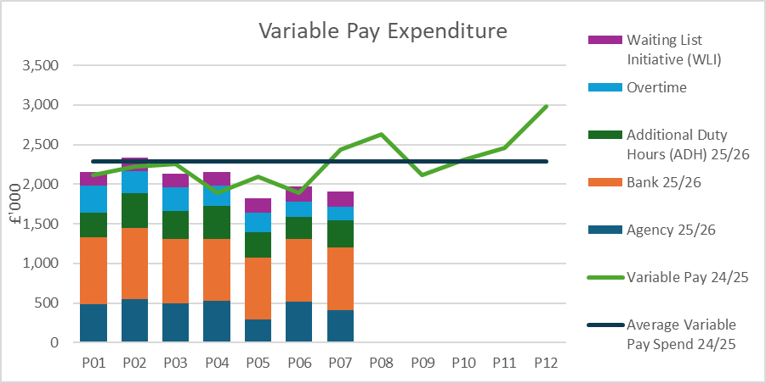
Drivers: Variable Pay & Performance Against 30% Reduction (Actual)
The Service Group continued to utilise variable pay to support service delivery in several areas, most significantly for medical and nursing staff.
Variable pay overall is lower than the 2024/25 average by £0.2m per month, with particular improvement in both qualified and unqualified nursing costs due to removing the majority of agency use and flexibly utilising substantive staff across the site to limit other variable pay. Although this has been offset partly by increases in substantive staff. In recent months there has been some increase in agency use linked with a specific patient requiring specialist input the costs of which are being recovered.
Medical variable pay includes the cost of outsourcing radiology reporting to Everlight which is recognised as required to maintain diagnostic performance. It also includes some specialist input for specific hard to recruit services such as Interventional Radiology. As a result, it is unlikely to reduce these costs significantly in year, although work continues to limit exposure to additional variable pay wherever possible whilst maintaining key services and create long term sustainable staffing models.

Slide 11
Drivers: Non-Pay (Actual)
Clinical Supplies
Containing clinical supplies costs continues to be challenging due to the direct link with activity delivery and exposure to inflationary pressures. The average cost is 3.2% higher than in 2024/25 which is more than the inflationary allocation. Some of this is offset by income. Procurement have supported savings delivery in several areas including Intensive Care and Cardiology consumables and Diabetic devices, the group continue to work closely with colleagues to identify further opportunities.
Some of the average cost increase is due to our ability to deliver more Interventional procedures following recruitment to the previously fragile service, this should deliver benefits in the utilisation of theatres longer term and reduce costs in that space, although there have been some initial set up costs.
Establishment Costs
Postage costs are the main driver for this expenditure which is both higher than in 2024/25 and the allocated budget. Postage costs have been subject to cost and volume increases compared to last year and the pursuit of savings through implementation of digital solutions continues.
Premises & Fixed Plant
The cost of hire and repair of beds and mattresses, along with other clinically necessary equipment (chairs/ hoists) continues to drive cost increases. This is again both a price and volume issue and work is ongoing with procurement to deliver lower costs in this area.

Slide 12

Savings Summary
Savings delivery has steadily improved through the year, with the group now forecasting delivery at £9.7m against a target of £16.1m.
Some of the in-year delivery is due to one off accounting opportunities which are being released through months 6 and 7 and driving that peak, the group will continue to develop plans for recurrent delivery working with the available corporate support.
There are several pipeline schemes which are being pursued with expected benefit into 2026/27 financial year, this is managed via the weekly Recovery & Sustainability meetings in group.
Forecast delivery is dependant on reducing ‘surge’ bed capacity in the final months of the year, this has risk through the winter months and is dependent on wider system performance. The Service Group continues to develop improvement cycles to increase patient flow and is actively working through the Urgent & Emergency Care programme to deliver a sustainable bed position, engaged with both system partners and the other Service Groups.

Slide 13

Identification Opportunities & Risk
Further Opportunities for 25/26:
Patient flow improvements
Management of Clinically Optimised Patients
Contract negotiations with external providers (NHS and Non-NHS) who support activity delivery within Pathology and Radiology
Potential to increase income delivery via surgical services efficiencies (or reduce recovery spend)
Delivery of the bed contract
Digitisation
New Diabetic Pump/ Monitor Standard Operating Procedure to limit exposure to more expensive pumps
Individual Patient Funding Request agreements for expensive procedures
Project slippage
Variable pay management (linked to incoming student streamliners and recruitment and active redeployment of staff)
Phase 4 diagnostic funding
Further Risks:
Winter Pressures including activity surges and staff availability
Inflation/ growth on high value contracts including blood products
Contract negotiations
Job rebanding (Band 2 to 3)
Pay disputes
Impact on diagnostics of activity delivery linked to central targets
Increased over establishments due to service constriction
Savings gap does not close and/ or delivery is impacted by external factors.
Increased levels of managerial/ administration vacancies increase risks of delivering service priorities

Slide 14
Actions & Next Steps To Be Taken By Service Group
Service Group needs to continue to work to reduce expenditure to manage the current cost pressures; including reducing any premium expenditure costs (variable pay) with monitoring activities to maintain assurance that there’s a continued improvement on run rate.
Service Group to continue to develop savings plans to mitigate shortfall, including increased recurrent delivery.
Clear demand and capacity plan development particularly for services that have seen increases in year beyond the underlying position and funded recovery activities.
Engage in the 2026/27 planning cycle to support clear identification of risks and opportunities required for plan decision making.

Slide 15
Appendices

Slide 16
Savings Schemes in place – Green Recurrent

Slide 17
Savings Schemes in place – Green Non Recurrent

Slide 18
Savings Schemes in place – Amber

Slide 19
Additional Savings Schemes – Red & Pipeline

