Slide 1


Targeted Intervention Update
November 2024

Slide 2
Planned Care

Slide 3
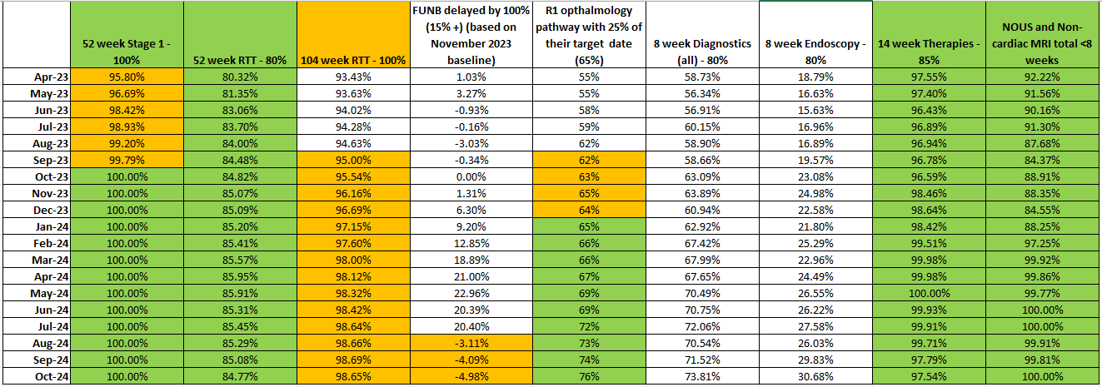
Planned Care Performance – October

Slide 4
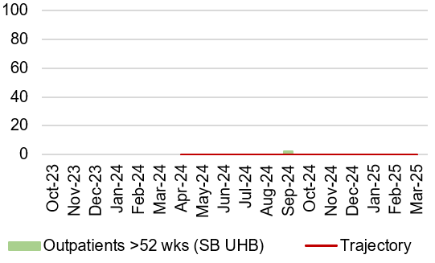
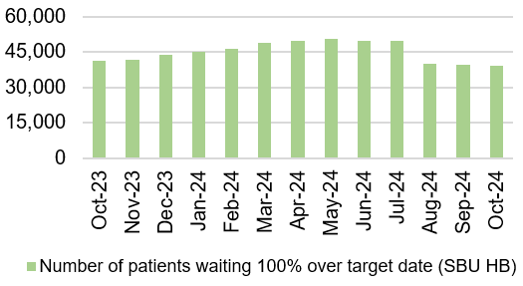
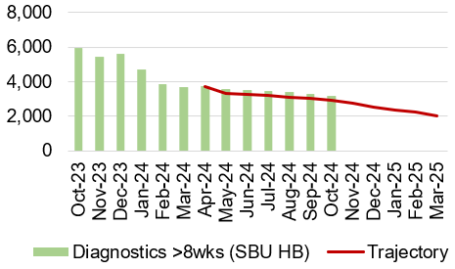
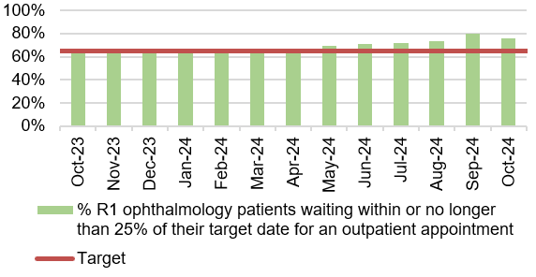
Planned Care Performance – October

Slide 5
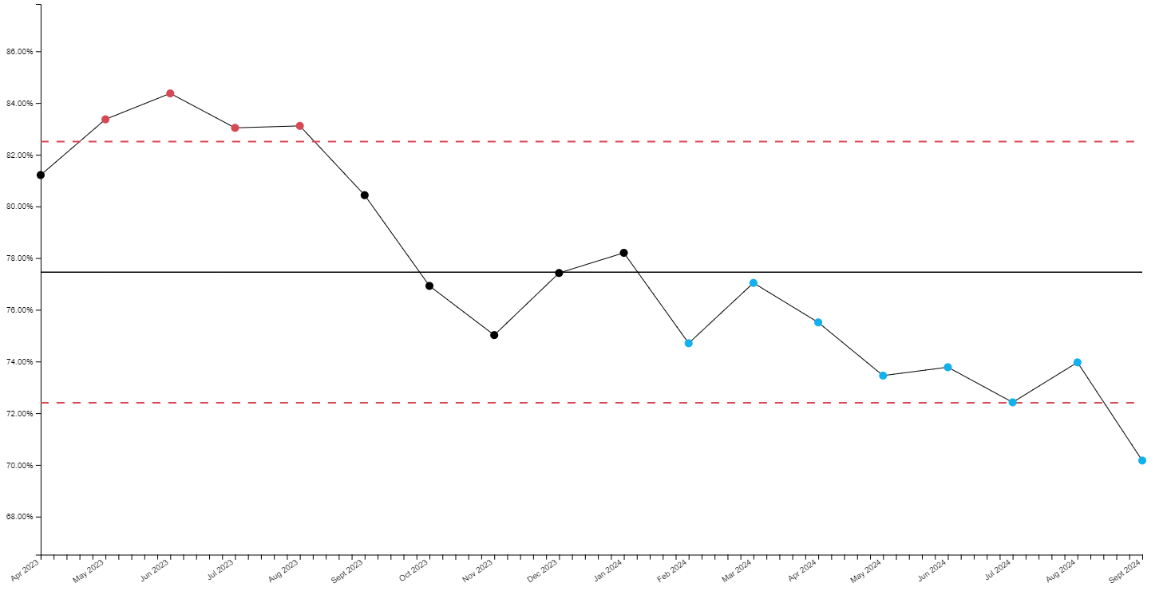
Percentage of Endoscopy waits over 8 weeks

Slide 6
Cancer TI Update

Slide 7

Suspected Cancer Pathway Performance

Slide 8
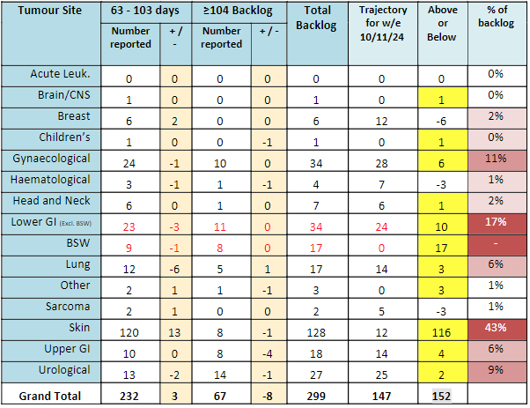
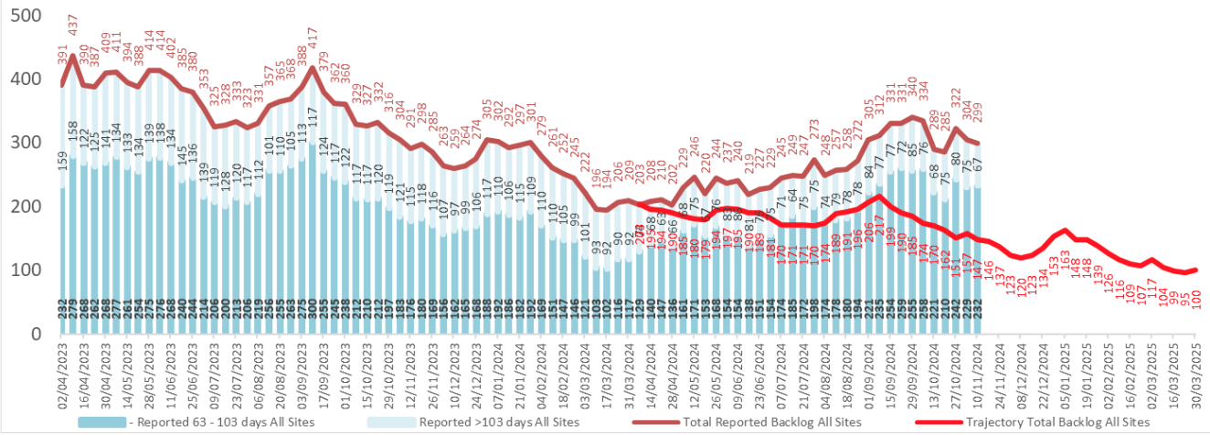
Backlog Trajectory (including BSW)
152 over trajectory. 43% are skin cancer pathways (128 patients). 17% are LGI pathways (51 patients).

Slide 9
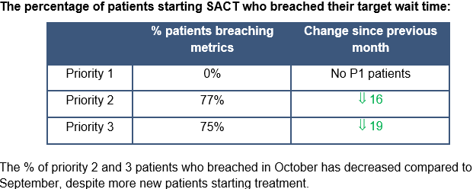
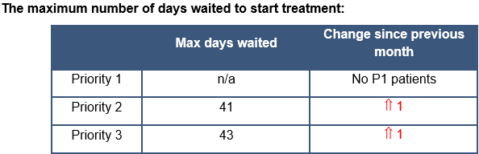
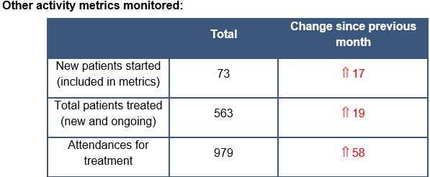
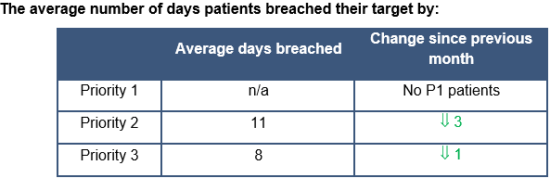
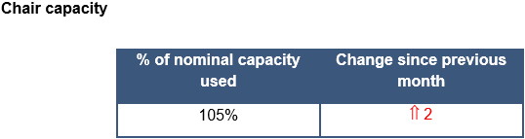
SACT (CDU Performance October)
Notes:
P1 – 2 days
P2 – 14 days
P3 – 21 days

Slide 10
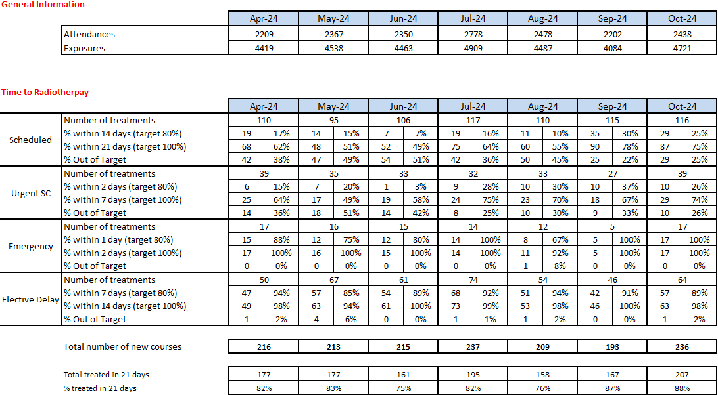
Radiotherapy Performance Detail
Notes:
Update

Slide 11
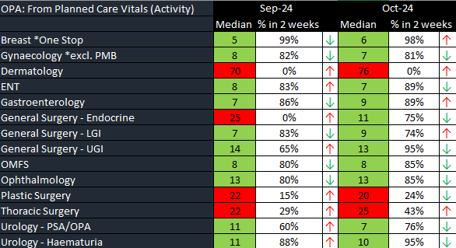
1st Outpatient Consultation within 10 days
Notes:
Update

Slide 12
The median wait for a decision to treat within 31 days reduced to 36 days for closed (treated) pathways in September, however % achieving the measure fell to 39%.
Notes:
Update

Slide 13
Gynaecology Update
Significant improvement with patients being seen within 2 weeks for USC appointment (median 7 days in Sept)
Locum consultant commenced in September – increased surgical capacity
Notes:
Update

Slide 14
Priorities/Focus Next Month
Continued focus on front end of pathway for all specialties
Review impact of daily meetings for USC OP capacity for dermatology, OMFS and plastic surgery (introduced Sept 9th)
Assess impact on capacity of agreed actions from skin workshop (inc. super clinics, locum consultant, job plan reviews) – follow up meeting arranged 27/11/2024
Continued focus on cellular pathology – job plan reviews in progress
Identify additional surgical (upper GI in particular) and chemotherapy capacity
Notes:
Update

Slide 15
Urgent & Emergency Care

Slide 16
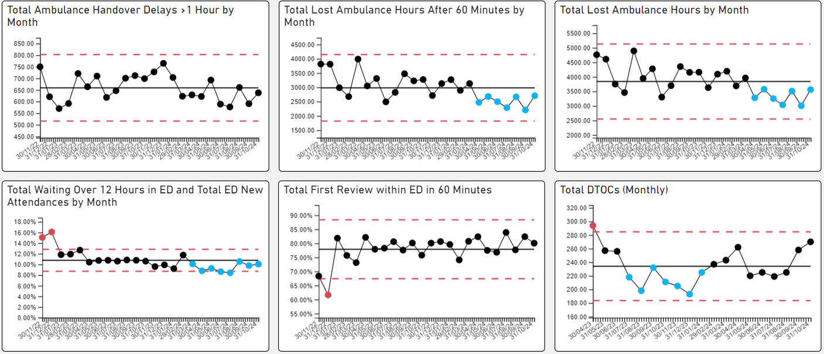
UEC – De-escalation KPIs

Slide 17
UEC – Plan for TI Response
Six main areas of work:
Frailty strategy – Came online in September 2024
Grip & control operational management – Full Capacity protocol and zero tolerance on chair and trolley waits planned for launch in October 2024
  Review of community capacity and operating models: ACT & Virtual Wards
Senior decision makers at front door services
  Rota proposals shared with Acute Physicians
  Recruitment drive commenced for x5 Acute Geriatricians and x5 Acute Physicians
  Plan to implement new interim rota in October 2024 whilst recruitment takes place
Pathway of Care Delays (PoCD) – Multi Agency Discharge Event (MADE) undertaken in August and 6A’s audit follow up took place to improve discharge and transfer processes.
  Singleton & Morriston COP capacity under redesign for October 2024
Reconfiguration of Emergency Dept – funding received to develop reconfiguration plans – lead by Capital Planning.
Revised flow operating model: with consistent tactical command at Level 4 and introduction of revised internal escalation processes

Slide 18
HCAI TI Position to 31.10.24

Slide 19
Progress against TI goals: 01 Apr – 31st October 2024

Slide 20
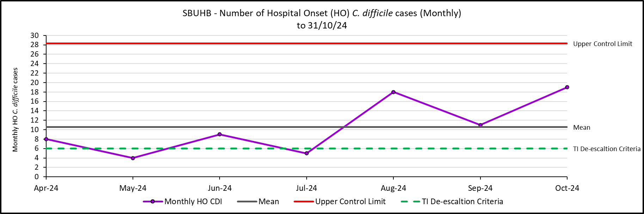
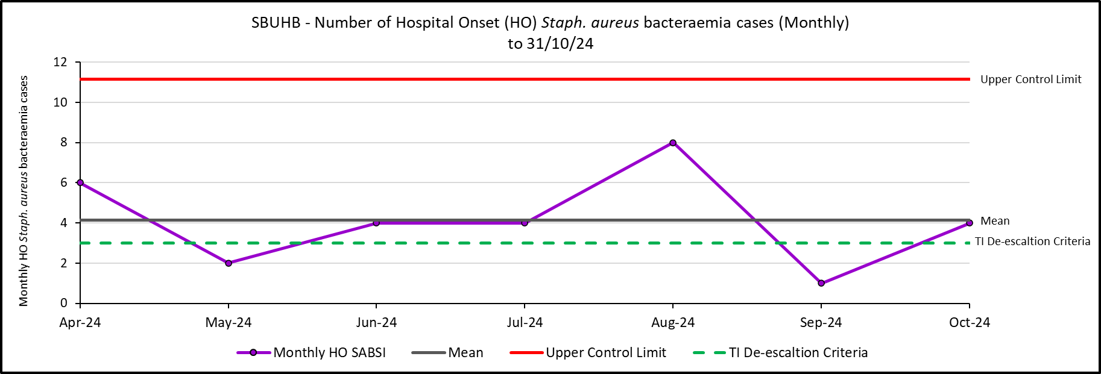
Hospital Onset HCAI TI Criteria, C. difficile and Staph. aureus to 31/10/24

Slide 21
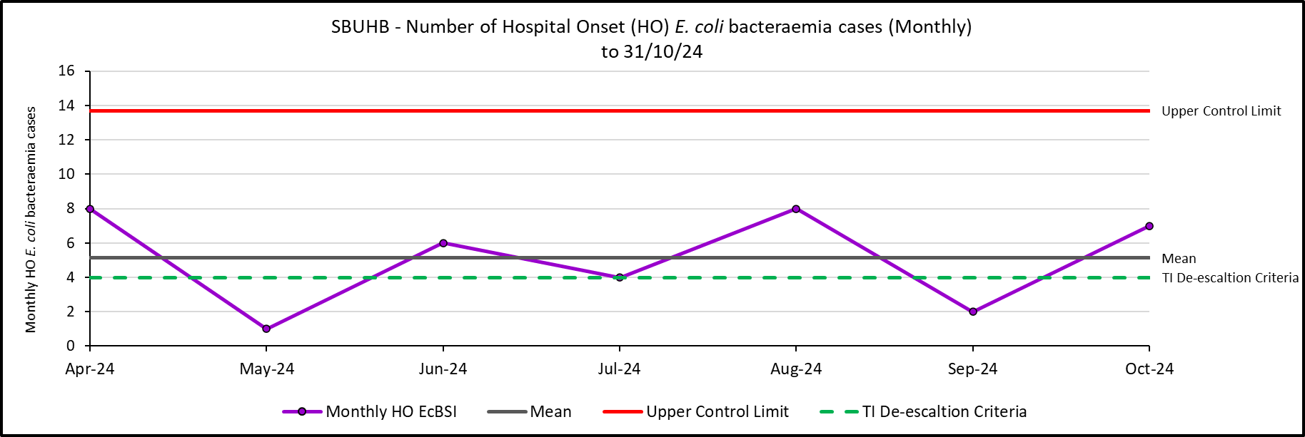
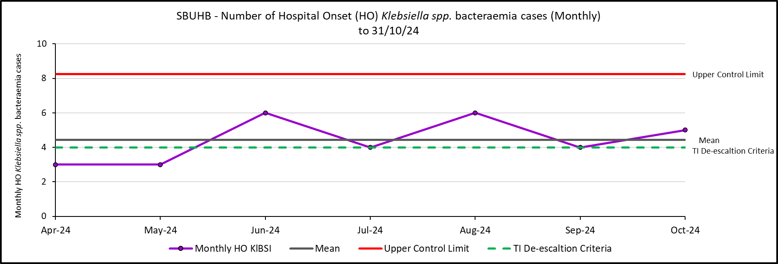
Hospital Onset HCAI TI Criteria, E. coli and Klebsiella spp. bacteraemia to 31/10/24

Slide 22
Antimicrobial Stewardship: 72-hour review, FY 2025 Q1
Swansea Bay University Health Board Compliance
All Wales Compliance (12 month rolling average)
72-hour review
  Outcome of 72-hour review:
  Change (escalate/de-escalate)
  Continue
  IV to Oral Switch
  Stop
72-hour review
  Outcome of 72-hour review:
  Change (escalate/de-escalate)
  Continue
  IV to Oral Switch
  Stop
92%
78%
5%
9%
76%
63%
8%
8%
11%
20%

Slide 23
Outbreaks of infection and associated beds out of use
During October, there were 16 infection related incidents/outbreaks associated with respiratory viruses (some of these were a continuation from those first reported in September). The majority of these were COVID-related. Three were caused by Influenza.
12 in Morriston (48 bed days lost, on average 4 bed days per ward).
1 in Singleton (17 bed days lost).
2 in Neath (4 bed days lost).
1 in Gorseinon Hospital (0 bed days lost).

Slide 24
Focus for the next month
Gold C. difficile High Incidence Management Group continues, with Silver Groups reporting into Gold.
The Digital Intelligence development team and the IPCT will recommence work developing an application that will facilitate the monitoring and analysis of hospital acquired infection case reviews.
Continuing work relating to C. difficile risk stratification.
Scoping exercise with Digital team aiming to improve GP discharge summaries by highlighting risk factors for C. difficile.
Clinical teams in Morriston continue to roll out the newly developed prescribing audit tool for hospital acquired pneumonia. Awaiting initial data.
Cross-health board IPC discussions to identify key issues and learning.
Reviewing evidence for, and scoping with other organisation, the risk-benefit associated with the creation of a C. difficile cohort ward.

Slide 25
Summary Financial Position
Month 7 FY 2024/25
7th November 2024

Slide 26
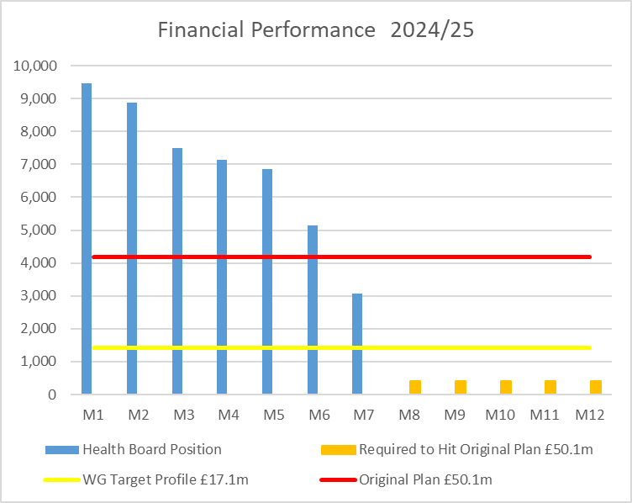

Financial Performance Month 7
 | In Mth |  | YTD
 | £'m | RAG | £'m | RAG
Performance Against RRL | 3.1 |  | 48.0
Performance Against £50.1m Plan | -1.1 |  | 18.8
During September, the Health Board submitted a revised Recovery & Sustainability Assessment for 2024/25. Formal feedback has been received and the Health Board is required to deliver as a minimum a £50.1m deficit in 2024/25, noting that the control total set by Welsh Government remains £17.1m.
In Month 7 there is an in-month overspend of £3.1m.
YTD at Month 7 is an overspend of £48.0m
Overall, the Health Board YTD position is £18.8m off the delivery of the original March submitted £50.1m deficit plan.
In the graph above the orange bars illustrate the potential financial change required to be able to deliver the original £50.1m deficit.
The yellow line depicts the level required if the HB were to achieve the £17.1m control total.
Notes:
This is a generic copy slide.

Slide 27

Summary Month 7 & Movement In Month
Notes:
This is a generic copy slide.

Slide 28
Summary of the Mth 7 & YTD Position
Notes:
This is a generic copy slide.

Slide 29
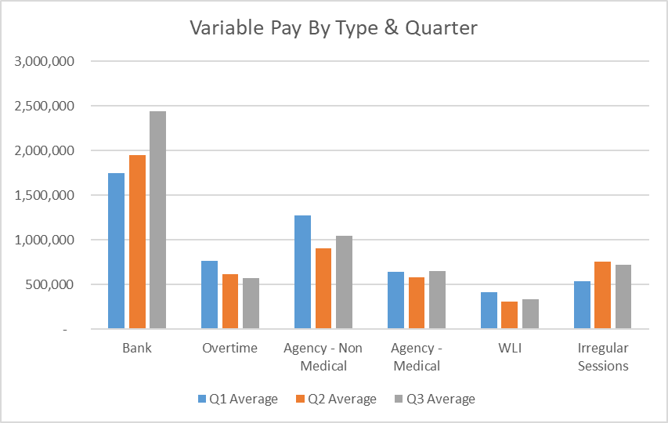
Summary Variable Pay
Variable Pay Target - the HB set a target for variable pay to be reduced by 25% versus the average spend in Q1 by the end of Q2, with a further 25% reduction at the end of Q3. The reduction at the end of Q2 would require variable pay spend to reduce to £4.0m a month from Month 6. The actual variable pay spend at Month 7 was £5.8m, £1.8m short of the target set.
Notes:
This is a generic copy slide.

Slide 30
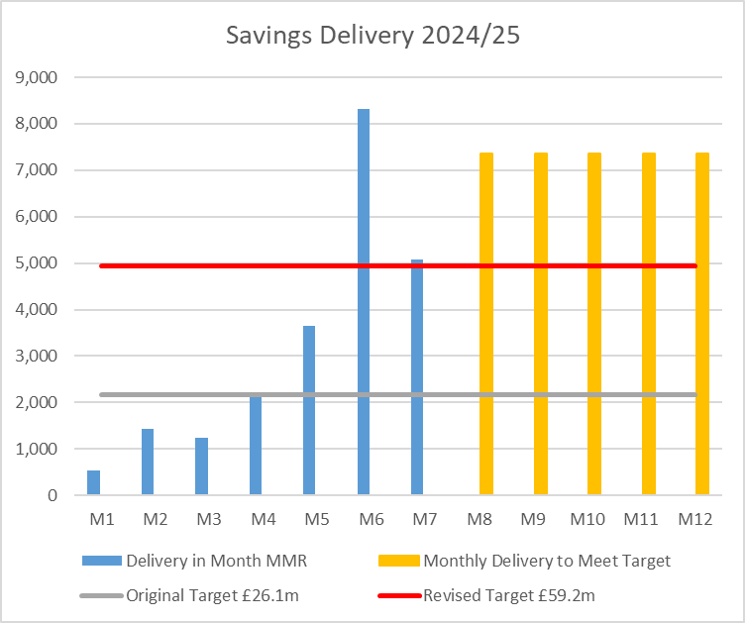
Summary of Savings Position @ Mth 7
Notes:
This is a generic copy slide.

Slide 31
Planning & Strategy

Slide 32
TI: Strategy & Planning
The de-escalation criteria (assumed as carry over from EM conditions, as per Final Escalation Framework June 2024) for Strategy and Planning and the proposed corresponding actions are:
De-escalation Criteria | Action
Submission of a balanced and credible three-year medium-term plan or acceptable annual plan in line with the current planning framework. | Development of Annual Plan process underway building on the plan for 2024/25 for submission of an Annual Plan set in a three year context.
Evidence of a clear roadmap and implementation of the health board’s Clinical Services Plan. | Development of Refreshed Clinical Service Plan
Welsh Government’s confidence in delivery based on an assessment against an agreed planning maturity matrix. | Undertake a baseline assessment against the Planning Maturity Matrix with update assessment to take place 12 months later
Progress made with regional planning. | Establishment of the Joint Committee with Hywel Dda

Slide 33
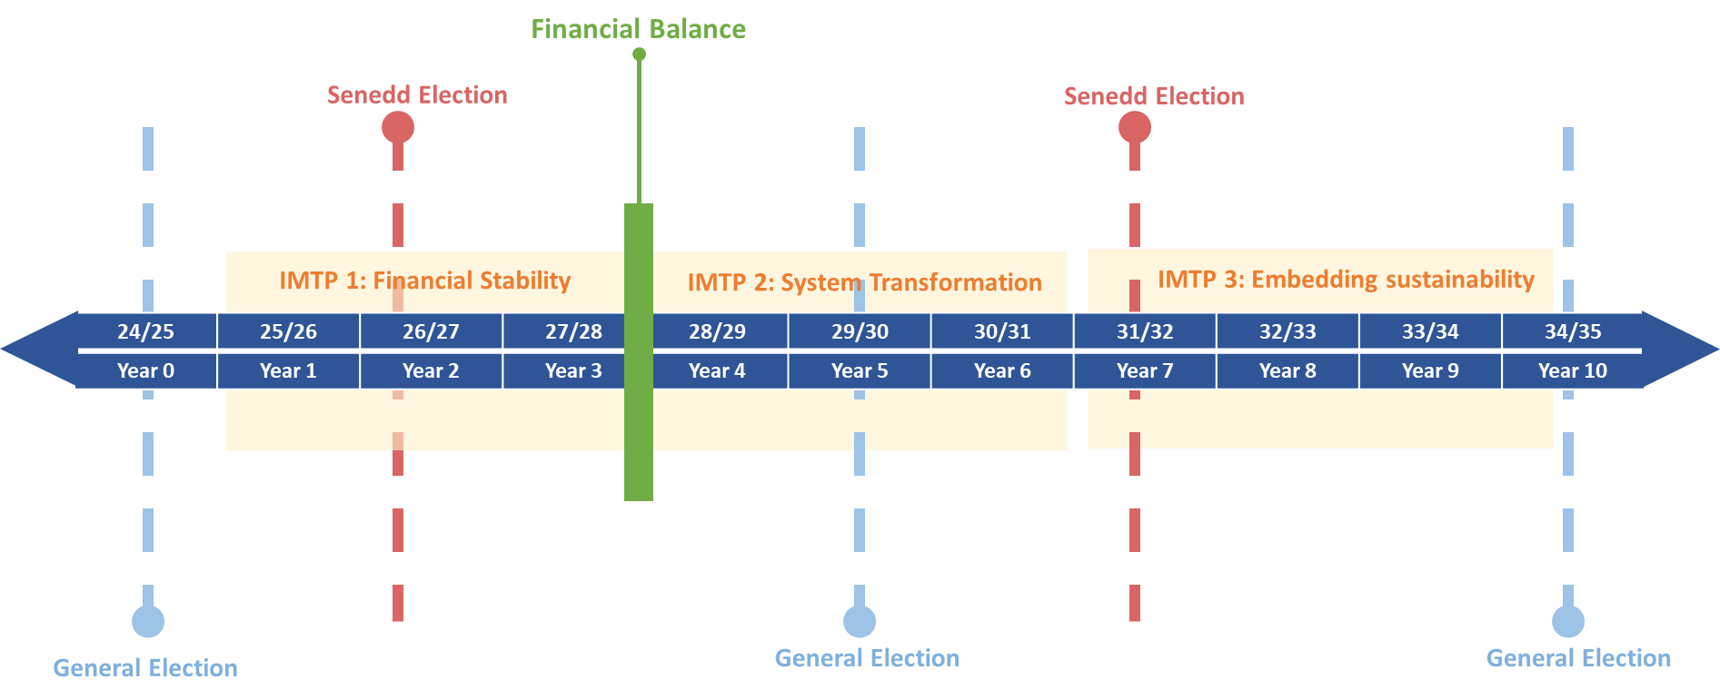
THE NEXT 10 YEARS & HEALTH BOARD PRIORITIES 2025/26
This plan will lay the foundations for delivering our long-term strategy and achieving sustainability through a recovery and sustainability programme approach. Our priorities for this first phase of that journey are therefore very clear.
Health Board Priorities:
Financial Control
Deliver Performance in Targeted Intervention areas
Maintain safe services

Slide 34
Annual Plan Development: KEY MESSAGES
Our plan this year will take a different approach, with an emphasis on understanding our services and challenges through a Baseline Assessment.
We must be successful this year to start this 3 year plan from the strongest position possible
Plan must be for recovery, sustainability and delivery
This plan will not be asking for GMOs or Business Cases seeking funding
We must start savings planning now as part of the planning process
All new cost for the Health Board must be consumed within the allocation when known (this includes growth, demand increase, inflation and any local specific pressures)
Support Service Areas to align budgets to outputs, but within the existing funding envelope, supported by comprehensive demand and capacity, bed and theatre plans
We will look for further opportunities to support budget holders and other accountable individuals with the skills required to be the best they can be

Slide 35
Clinical Services Plan: Key Points
We have delivered on or progressed a number of the main commitments in the CSP 2019/20 particularly in relation to the purpose and function of our hospital sites as centres of excellence and also including: Integrated Clusters; Virtual Wards; Outpatient Modernisation; Stroke Early Supported Discharge and Acute Stroke Unit; Community Mental health and Emotional Wellbeing Strategy; Frailty; Surgical Services Remodelling.
The Exec Team agreed on 24th July to extend the CSP 2019 for a further 12 months, continuing to deliver against remaining key areas of the CSP.
The focus for 2025/26 will be exploiting regional opportunities across the South West Wales as well as continuing to transform out of hospital services, children and young people services, and population health management.
In 2025/26 foundational work will be undertaken before a refreshed CSP is published in 2026.

Slide 36
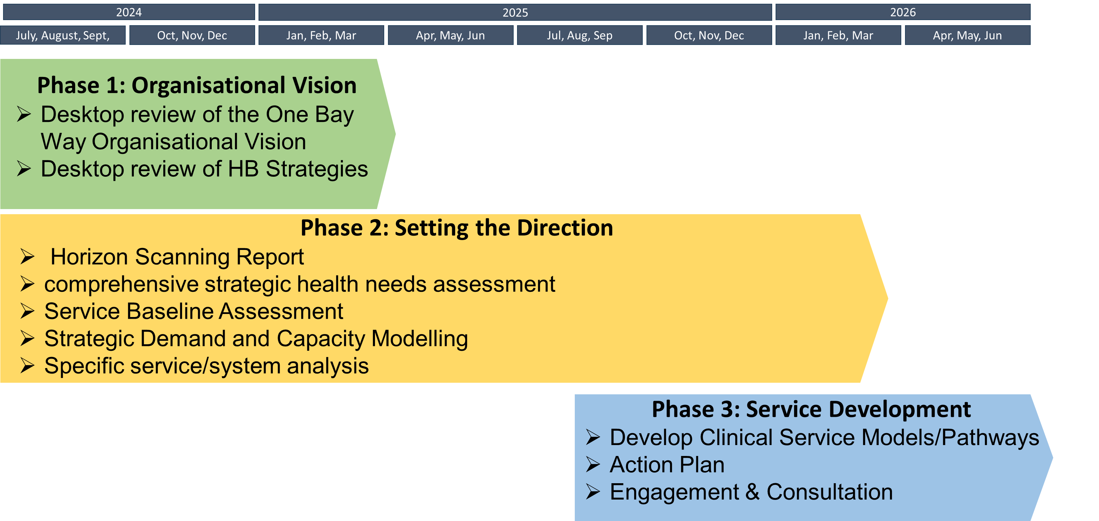
Clinical Services Plan Timeline
Work to review the HB vision and strategies is underway to ensure cohesion across strategies
The Service Baseline Assessment is being initially developed as part of the Annual plan 2025/26 process

Slide 37
Planning Maturity Matrix
As noted there is an expectation to undertake an exercise to establish the maturity of our planning processes, which includes:
  Conducted initial baseline assessment against the maturity Matrix through the Integrated planning Group to include proposed Action Plan (11th June)
  ESG to reviewed initial IPG assessment and agree final scoring (17th July)
  Update at Board Briefing (October)
  Board Development Session (December)

Slide 38
Targeted Intervention –
Patient Feedback

Slide 39
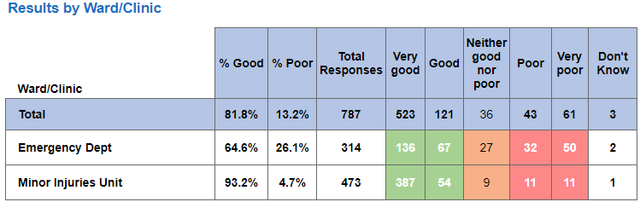
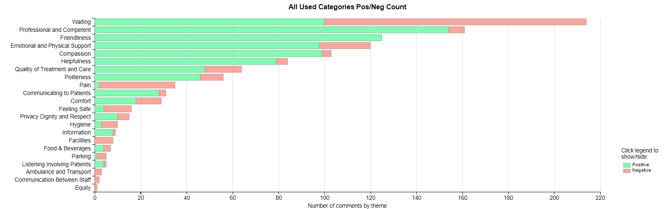


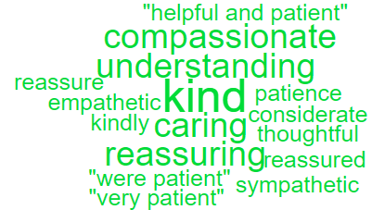
Urgent and Emergency Care – Complaints/Feedback (ED & MIU)
The graph below shows the number of complaints ED and MIU have received per month compared with the same period the previous year;
Heat map below showing F&F scores; when asked the question ‘Overall, how was your experience of our service’.
Emergency Department & MIU Themes
Top 3 complaint themes;
Delay/Lack of treatment/assessment
Delay/Lack of diagnosis
Attitude/Behaviour of clinical staff
Positive feedback from CRAG reviews on complaint responses;
Complainants contacted personally by staff – much more personal approach and makes them feel listened to.
Offer of meeting which has now been taken up by complainant and arrangements made.

Slide 40
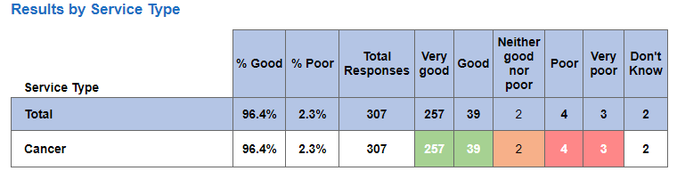
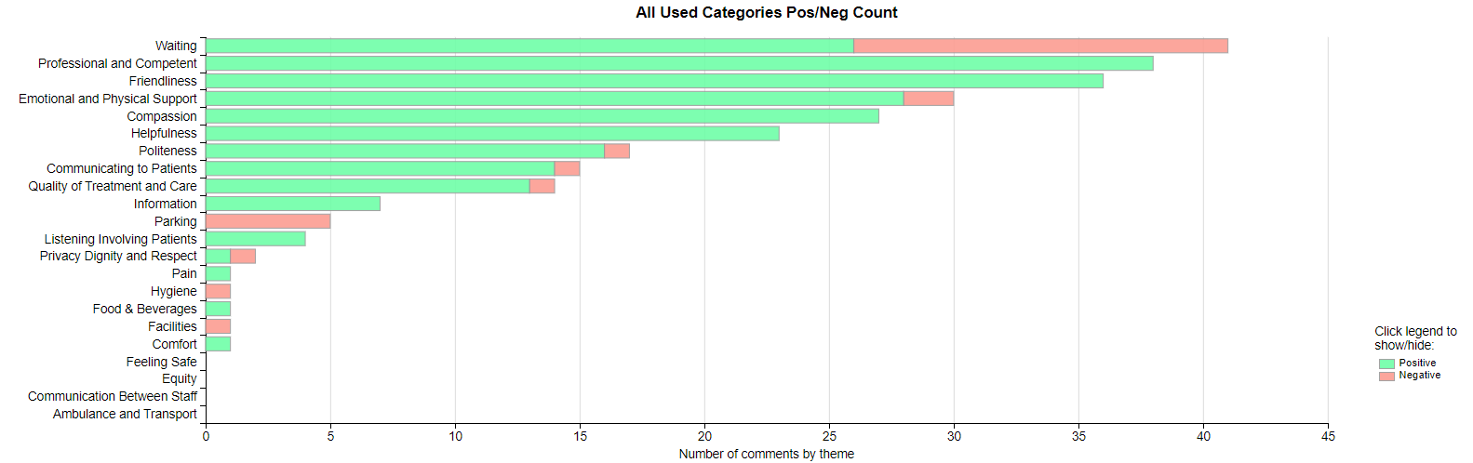
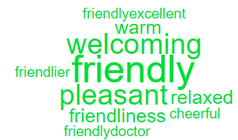
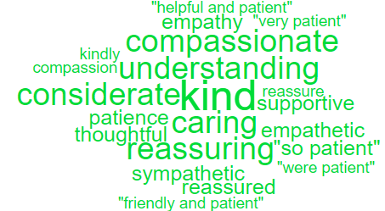
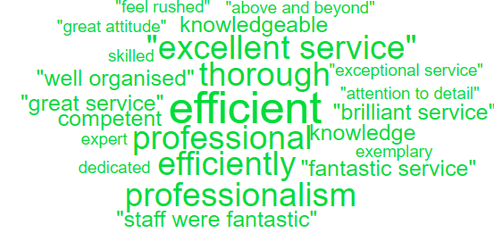
Cancer Services – Complaints/Feedback
The graph below shows the number of complaints cancer services have received per month compared with the same period the previous year;
Heat map below showing F&F scores; when asked the question ‘Overall, how was your experience of our service’.
Top 3 complaint themes;
Delay/Lack of treatment/assessment
Communication – insufficient/incorrect information
Delay/Lack of diagnosis
Positive feedback from CRAG reviews on complaint responses;
Details of lessons learnt and new service directives included – this is good and evidences the steps being taken as a result of these complaints.

Slide 41
CAMHS – Complaints/Feedback
The graph below shows the number of complaints CAMHS have received per month compared with the same period the previous year;
Positive feedback from CRAG reviews on Mental Health complaint responses;
Timely responses
Apologetic response with remedial action such as staff reflected, communication reviewed, process for checking patients belongings reviewed
HB values added to response
Contact made with complainant offering meeting and reiterated in response
Top 3 complaint themes;
Communication – insufficient/incorrect information
Inappropriate/unsafe discharge

Slide 42
Complaints Performance
Overdue complaints;
ED
10 over 30 working days
MIU
0 over 30 working days
Cancer
9 over 30 working days, this includes 1 over a year
CAMHS
2 over 30 working days
Action being taken;
Bi-weekly reports sent to each Service Group with all overdue complaints
Bi-weekly meetings with each Service Group to discuss and review overdue complaints
Monthly CRAG meetings where a % of closed complaint responses are reviewed and feedback provided to complaint handlers

