Slide 1


Performance & Finance Committee
Neath Port Talbot Service Group
26/11/2024

Slide 2

High Level Summary
NPTS SG @ Mth 7 | Service Group | Health Board
Target Variance Annual | 0.0 | 50.1
Target Variance YTD | 0.0 | 29.2
YTD Variance | 7.8 | 48.0
YTD from Target Variance | 7.8 | 18.8
Variance % HB YTD Value | 16%
Top 3 Actions to address position:
To deliver expenditure reduction to the value of Green and Amber schemes
Reduce variable/ premium cost pay
Progress recovery plan actions aligned with latest organisation approval.

Slide 3
Agenda Detail
Health Board & Service Group Financial Summary
In-Month Revenue Position
Savings Performance
Key Drivers
Risks, Next Steps & Mitigating Actions
Appendices

Slide 4

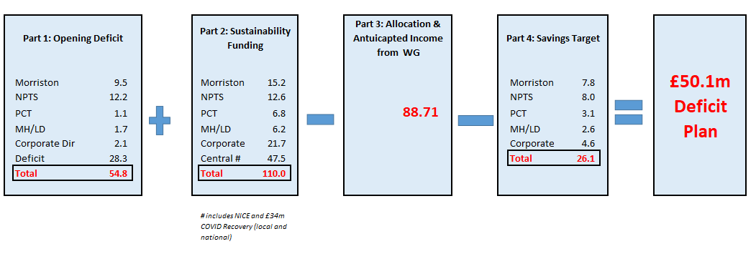
Health Board Summary Elements of Original £50.1m Deficit Financial Plan
Note: Specific elements from Part 1, 2 and 4 of the plan that relate to this service area are summarised on the next slide.

Slide 5

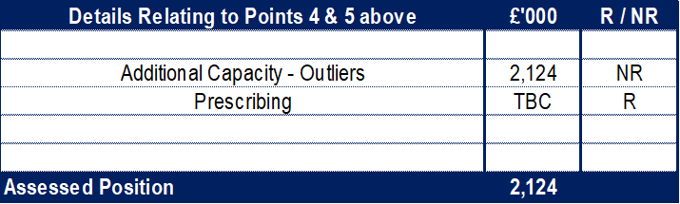
Service Group Element of Original £50.1m Deficit Financial Plan
Note:
See detail of above on slides 15 and 16
Note:
Table, left, demonstrates how the assessed value from table above reconciles to the opening value in the tables on the next slide

Slide 6
Service Group Element of Recovery & Sustainability Financial Assessment
Key Messages on Delivery:
A control total of £11.8m has been issued to the Service Group on the 10th October 2024, based on the elements shown. This is a challenge given the year to date position of a £7.8m overspend in M07.
The table shows the plan, consisting of additional variable pay and travel cost reduction, recovery schemes (risk rated and categorised as per Executive Board agreement) and a stretch target.
Balancing the clinical risks and performance delivery agenda with the financial challenge is key and the Service Group is working with Executive colleagues and those in other Service Groups to find the right balance to deliver the best possible financial bottom line.
There has been timeline slippage between the submission of savings scheme ideas and decision which will impact ability to deliver in full schemes in pool 1.
Review of pool 2 and 3 is underway as well as other mitigating actions that may be taken to deliver as high a recovery value as possible and look toward the stretch target.
A revised assessment was prepared building in the updates following Month 7 closedown, and was included in the briefing provided to Independent Members on 19th November. The SG will continue to update the assessment as we progress through the next 2 months.
Notes:
Where does this come from?

Slide 7

2024/25 In Year Health Board Position
Notes:
Corporate Reports

Slide 8
Service Group Position By Month & Divisions
Period | In Month Budget £'000 | In Month Actual £'000 | In Month Variance £'000
Mth 01 | 28,791 | 30,879 | 2,088
Mth 02 | 28,662 | 29,601 | 939
Mth 03 | 27,435 | 28,737 | 1,302
Mth 04 | 30,334 | 31,112 | 778
Mth 05 | 28,723 | 29,825 | 1,102
Mth 06 | 33,573 | 34,344 | 771
Mth 07 | 30,749 | 31,599 | 850
Total YTD | 208,267 | 216,097 | 7,830
Key Messages:
Months 6 and 7 saw improvements in the variance run rate but has materially been due to non-recurrent benefits already reflected in the recovery plan.
The majority of the Year-To-Date (YTD) variance is driven by overspends in the Surgical Division, particularly so in the support services and Trauma & Orthopaedics (T&O).
Theatres (£3.2m) is driven by a combination of both Pay (£0.4m) and Non-Pay (£2.7m) where the capacity volume is not financially sustainable within existing budgets, accompanied by premium agency costs arising due to vacancies as well as staff unavailability in specialist areas like Cardiac Anaesthetics.
Anaesthetics (£1.7m) is driven entirely by Pay (£1.8m) and is due to: volume of additional work needed to maintain current Theatres timetable; number of vacancies required backfilling by Additional Duty Hours (ADH) – all of which come at a premium rate, which in Anaesthetics’ case is closer to Waiting List Initiative (WLI) rate.
T&O (£1.6m) is predominantly driven by non-pay overspends linked to the volume of Implants and Appliances which is not financially sustainable within current budget.
In addition to the Surgical services, £0.8m of the variance is due to the additional bed capacity, above funded levels, open on the Singleton site. This is in addition to staffing costs incurred by Morriston Service Group for the temporary redeployment of Ward K staff to Ward 8
Divisional leads continue to work on their individual savings and recovery plans, with a focus on delivering a sustainable plan for 25/26 as well as recovery in 24/25.
Sub Service Group Level | In Month Budget £'000 | In Month Actual £'000 | In Month Variance £'000
Surgery | 9,520 | 10,411 | 891
Cancer Services | 5,201 | 5,299 | 98
Group Management | 351 | 217 | (134)
Womens and Childrens | 4,813 | 4,956 | 143
Hospital Operations & Site | 1,568 | 1,642 | 74
Integrated Medicines Management | 9,296 | 9,074 | (222)
Total | 30,749 | 31,599 | 850
Sub Service Group Level | YTD Budget £'000 | YTD Actual £'000 | YTD Variance £'000
Surgery | 65,565 | 72,066 | 6,501
Cancer Services | 36,655 | 37,147 | 492
Group Management | 883 | 1,133 | 250
Womens and Childrens | 33,725 | 34,722 | 997
Hospital Operations & Site | 11,068 | 12,037 | 969
Integrated Medicines Management | 60,371 | 58,991 | (1,379)
Total | 208,267 | 216,097 | 7,830
Notes:
Local Reports

Slide 9
In month Service Group Position By Division & Type Expenditure/Income
Key Drivers:
Pay – Medical Staff
Anaesthetics (£223k) continues the overspending trend, for the reasons referenced on the prior slide, with £218k resulting from ADHs paid at near WLI rate.
T&O (£42k) continues to overspend in line with run rate and results from an establishment unsustainable under current budgets, as well as incurring premium variable costs from the backfilling of gaps
Obs & Gynae (£48k) continues the overspending trend of £49k per month to date. This is predominantly due to the use of ADH shifts with the reason for use split: 26% sickness; 43% vacancies, and; 31% additional capacity/other.
Haematology (£100k) on appearance is a deterioration on run rate but actually is consistent with run rate – this is as a result of redistribution of funding between pay codes. The trending overspend is as a result of 1x post (equivalence in sessions) above funded establishment and 2 consultant posts being at premium agency rate.
Non Pay
Miscellaneous is the net budgetary CIP requirement offset with any unallocated reserves (slippage/ accounting support) plus £250k non-recurrent benefit referenced on previous slide.
Clinical Supplies & Services continues to see significant pressures in both Theatres and T&O as referenced in the previous slide.
In addition, Haematology Blood Products are £50k overspent in month, in what appears to be a step change in spend from the beginning of this financial year – this is currently being investigated further.
Cancer Drugs continue to cause a pressure with a £32k overspend in month, early reviews would indicate that these are linked to non-National Institute for Health and Care Excellence (NICE) drugs.
Notes:
DoF Matrix – local reports

Slide 10

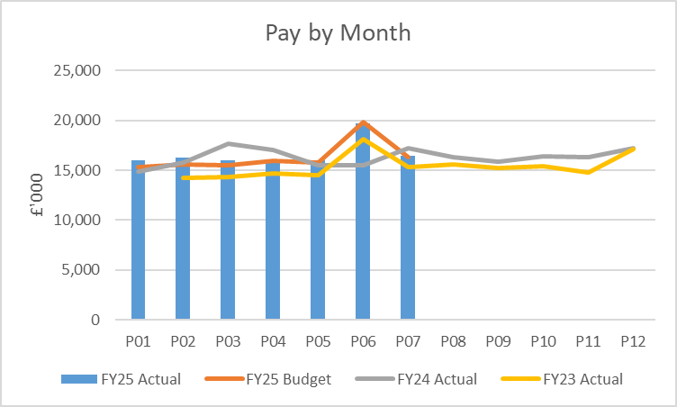
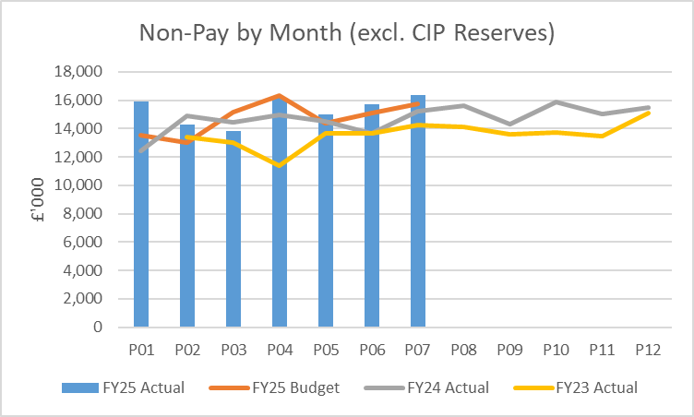
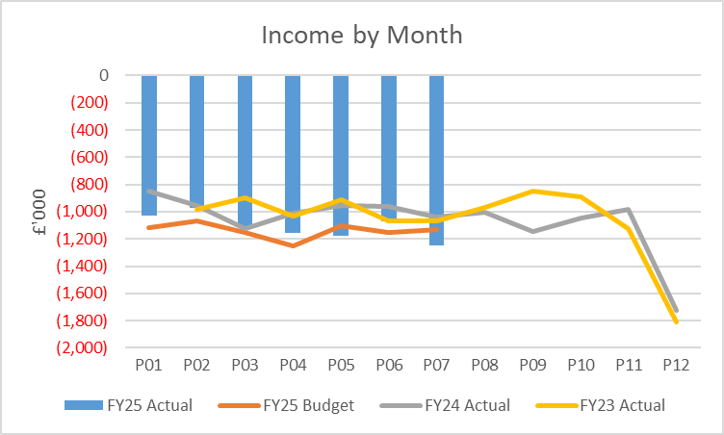
financial performance: Overall trends
Pay
A medical and dental pay award (2023/24) with back pay was applied in month 06 (and funded) which skews the month on month trend data (NB: the 24/25 pay award and associated back pay will be paid in Month 8). If the impact of this was excluded the overall trend of expenditure is largely stable, elements of variable pay is reducing but there has been some increase in substantive costs following planned recruitment to deliver services. The impact of Student Streamlining is expected to see substantive cost increase without initially seeing a corresponding decrease in variable pay.
Non Pay
Month on month variations are largely attributable to the variation in NICE approved high cost drugs, where funding is issued centrally to Service Groups on a usage basis per month. Other large variations in Clinical Service and Supplies Costs are largely seen in activity driven areas such as Theatres, where stock levels and activity levels play a part in monthly variation.
Income
Month 7 saw improvement in income levels relating to Private Patient Income and Pancreatic Income, although the scale of the improvement in the former is currently understood to non-recurrent in the short term.

Slide 11
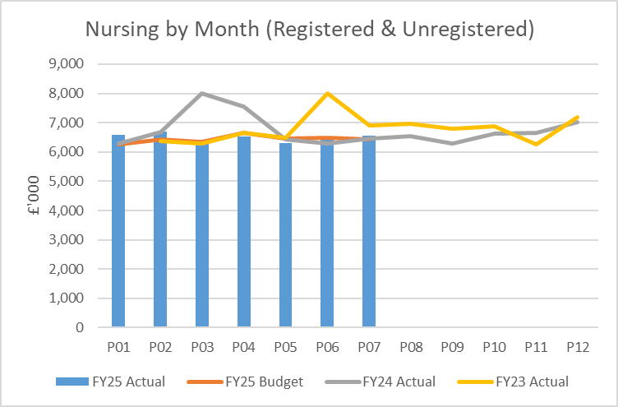
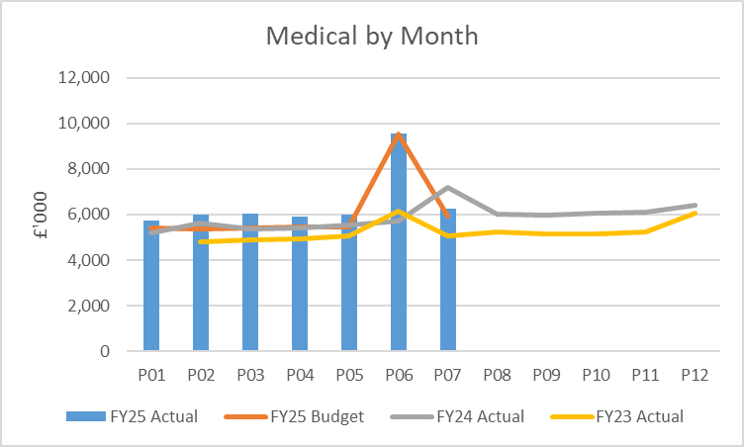
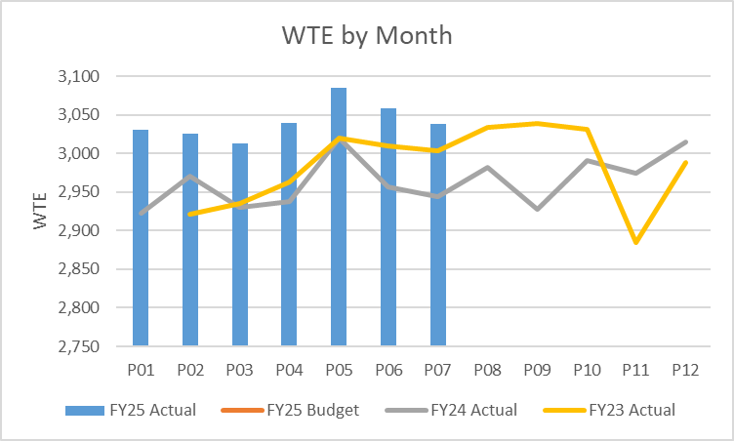
Pay Summary
Total nurse expenditure shows an increasing trend and can largely be attributable to the increasing levels of additional (outlier) capacity open on the Singleton site.
A medical and dental pay award (2023/24) with back pay was applied in month 06 (and funded) which skews the month on month trend data (NB: the 24/25 pay award and associated back pay will be paid in Month 8). The spike in WTE reported in M5 was as a result of the rotation of training grades between organisations and being incorrectly charged through Single Lead Employer (SLE) – the financial value was adjusted to reflect this whilst corrected by Shared Services.

Slide 12
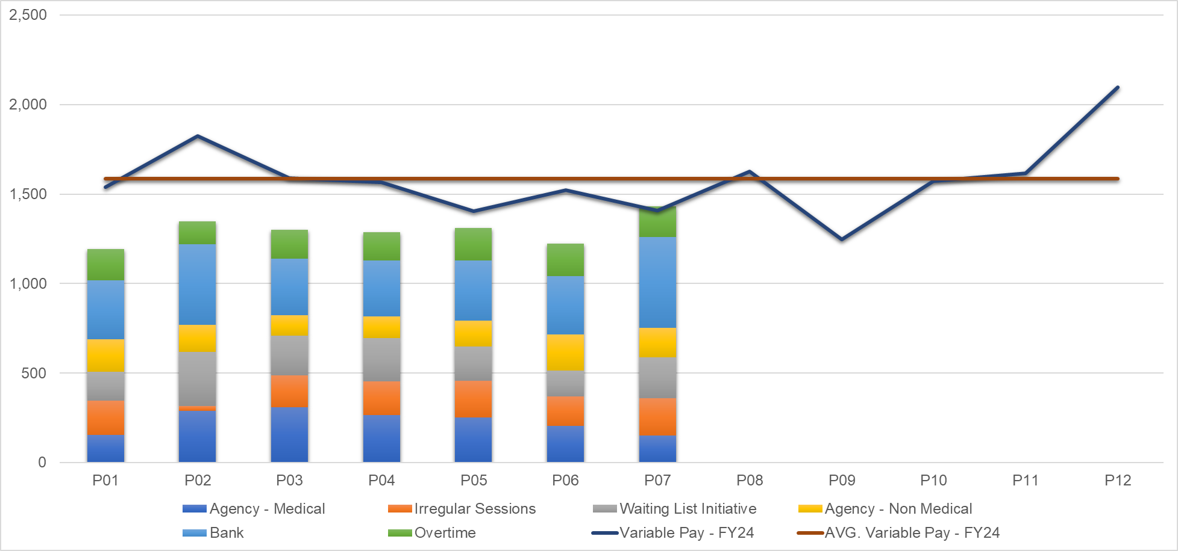
Pay : Variable pay
Staff Group | £'000 |  |  |  |  |  |  |  | Q1 Average £'000 | Q2 Average £'000
 | P01-25 | P02-25 | P03-25 | P04-25 | P05-24 | P06-24 | P07-24
ADD PROF SCIENTIFIC AND TECHNICAL | 9 | 4 | 6 | 4 | 4 | 5 | 9 |  | 6 | 4
ADDITIONAL CLINICAL SERVICES | 181 | 302 | 221 | 186 | 210 | 215 | 320 |  | 234 | 204
ADMINISTRATIVE & CLERICAL | 27 | 8 | 18 | 29 | 13 | 13 | 18 |  | 17 | 19
ALLIED HEALTH PROFESSIONALS | 10 | 10 | 46 | 48 | 113 | 121 | 57 |  | 22 | 94
ESTATES AND ANCILLIARY | 1 | 0 | (10) | (9) | 0 | 0 | 0 |  | (3) | (3)
HEALTHCARE SCIENTISTS | 8 | 8 | 3 | 4 | 4 | 6 | 5 |  | 7 | 5
MEDICAL AND DENTAL | 508 | 617 | 709 | 695 | 648 | 515 | 588 |  | 611 | 619
NURSING AND MIDWIFERY REGISTERED | 450 | 401 | 308 | 330 | 320 | 346 | 435 |  | 386 | 332
Grand Total | 1,193 | 1,349 | 1,300 | 1,287 | 1,312 | 1,222 | 1,432 |  | 1,281 | 1,274
Type | £'000 |  |  |  |  |  |  |  | Q1 Average £'000 | Q2 Average £'000
 | P01-25 | P02-25 | P03-25 | P04-25 | P05-24 | P06-24 | P07-24
Additional Hours - Medical Staffing (ADH) | 192 | 26 | 177 | 186 | 204 | 163 | 210 |  | 132 | 185
Agency | 335 | 442 | 424 | 389 | 398 | 409 | 315 |  | 400 | 399
Overtime | 175 | 130 | 161 | 158 | 183 | 180 | 171 |  | 155 | 173
Waiting List Initiative (WLI) | 163 | 302 | 221 | 241 | 191 | 145 | 227 |  | 229 | 192
Bank | 328 | 449 | 317 | 312 | 336 | 326 | 508 |  | 364 | 325
Grand Total | 1,193 | 1,349 | 1,300 | 1,287 | 1,312 | 1,222 | 1,432 |  | 1,281 | 1,274
Cumulatively, variable pay expenditure for 24/25 is significantly improved vs 23/24. Q2 variable pay spends marginally decreased vs Q1. However, M7 saw a spike in spend levels to the highest YTD which only in part can be described by increased levels of spend linked to increasing levels of additional capacity in Singleton. Of the £200k increase between months 6 and 7, £35k was linked to increased additional capacity; £40k increase in Neuro rehab; an offsetting increase and decrease of £60k in Anaesthetics and Theatres, respectively; £30k Opthalmology including Locum On Call cover; £23k Neath Surgical Wards; £47k Neonates as activity increases; £25k Obs & Gynae; £33k Midwifery
Notes:
Variable pay report needs updating because qlkiview no longer exists

Slide 13
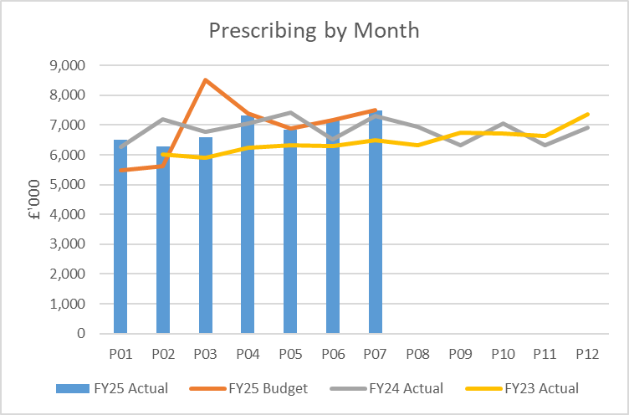
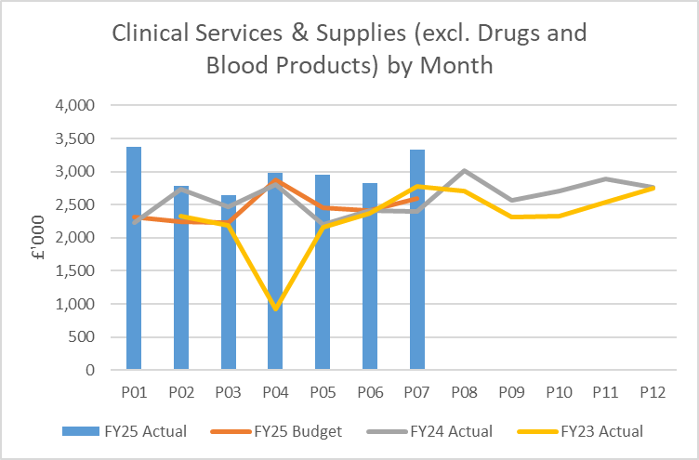
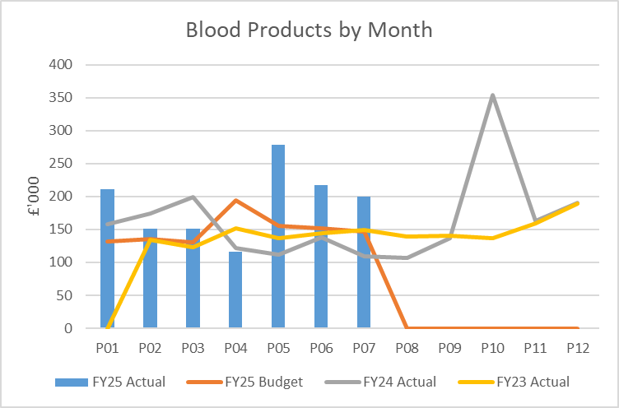
Non Pay: key drivers
61% of Clinical Services & Supplies (excl. Drugs and Products) expenditure is seen in the Surgical Division with Theatres and T&O accounting for 37% and 18%, respectively. These expenditure areas are also contributing to the increased spend levels in 24/25 vs 23/24 due to the following reasons: Increased activity; Inflationary Pressures; Non-recurrent benefits taken in 2023/24.
Haematology Blood Products - which along with Rheumatology to a lesser extent is the biggest consumer of blood products - is a current cause for concern. Expenditure levels have clearly increased vs 2023/24 with further investigation underway to understand the drivers of this spend. There is often natural monthly variation in spend but the last 3 months have seen a continued increase vs historic levels, albeit on a reducing basis.

Slide 14

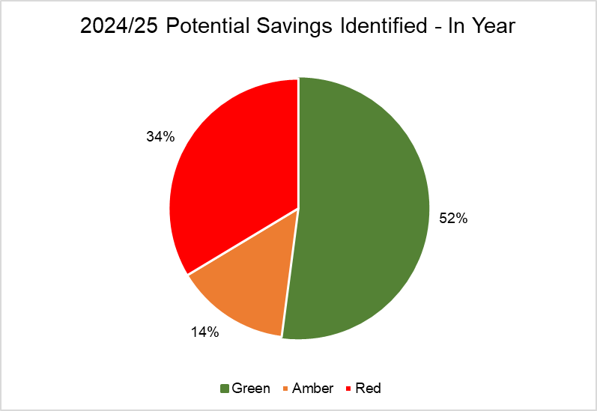
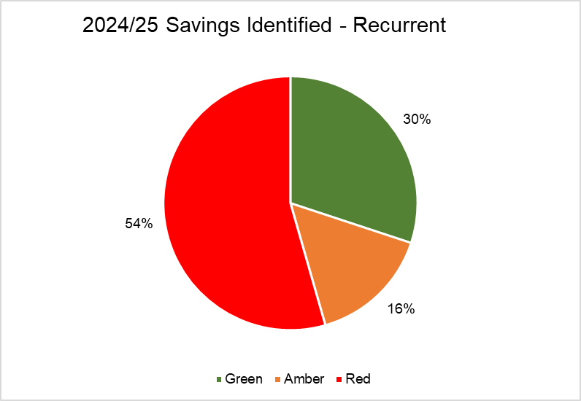
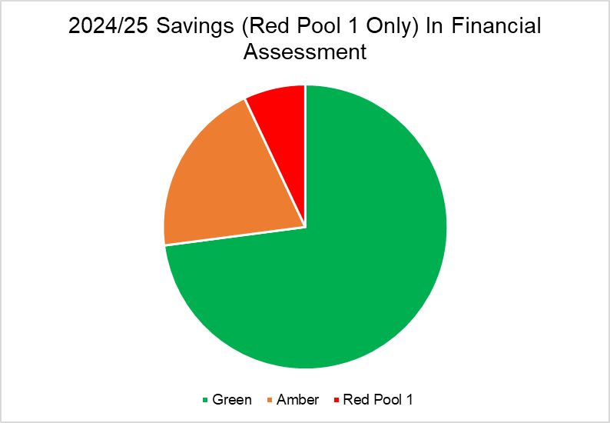
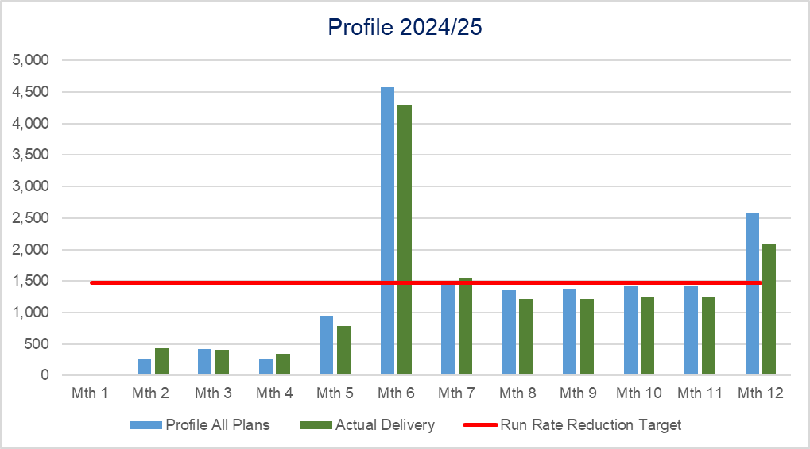
Savings Summary From Financial Assessment (25th September)
Notes:
CIP

Slide 15
Savings Detail (Green)
Detail of Green Schemes | Planned Achievement £'000 | Status | Next Steps - Work in Progress
Rivaroxaban | 350 | On Target to be delivered
Primary Care Work Plan | 1,390 | On Target to be delivered | Anticipated to Over Achieve but needs further review
Contract for Sugammadex | 200 | Delivered
Liquid Meds in Childrens | 33 | Delayed / Slipped | • SBAR for switch to Ceyesto brand of Melatonin liquid written by MM and approved by Community Paediatrics in September 2024 • Singleton, Neath and Morriston hospital sites all using Ceyesto since September/October 2024. • First month savings (October 24) around £3.5k • Forecasts need to be altered down (21k this year, 42k full year saving) – slight reduction due to bottle size/expiry date of new preparation.
Service Review | 294 | Delivered
Non Recurrent Opportunities | 500 | Delivered
VAT Oxygen | 150 | Delivered
Storage | 3 | Delivered
Tattoo less Treatment-Savings on medical grade | 1 | On Target to be delivered | Implementation within Breast services in place, work has begun on all thorax patients – project progressing well.
MEMS maintenance contract Review | 360 | On Target to be delivered | Ongoing and based on current run rate savings could be higher
Paediatrics- Move to Paperlite, cessation of off-site secure storage & use of external venues | 2 | On Target to be delivered
WFI-Increase in fee-paying patient activity | 94 | Delayed / Slipped | Progressing but delayed – Marketing campaign being reviewed but issues raised by Dice team around compliant website so further work taking place to market WFI. More fee-paying patients planned for treatment.
WFI-Commissioning Arrangements - Part1 | 35 | Delayed / Slipped | Awaiting meeting to be scheduled with JCC/SBUHB. Benchmarking work and proposal document completed.
WFI-Realignment of Required Facilities | 25 | Delivered
WFI-Travel Expenses | 5 | Delivered
WFI-Reduction in anaesthetic sessions from reduction in theatre sessions | 48 | On Target to be delivered
WFI-Reduction in Consultant Intensity Bandings | 2 | On Target to be delivered
WFI-Self Funding medical Arrangements | 9 | On Target to be delivered
Reserves Alignment | 1,365 | Delivered
Purchase of Annual Leave | 41 | On Target to be delivered | On target to be delivered (need to confirm is already within run rate)
Reserves Slippage | 1,349 | Delivered
Reassessment of Run Rates | 430 | Delivered
Reassessment of Run Rates | 1,789 | Delivered
Reduction Of Surge Beds | 846 | Delivered
Run Rate Vacancies | 1,800 | Delivered
Run Rate Vacancies | 127 | Delivered
Other Procurement | 180 | Delivered
Recovery Scheme Adjustment to Balance to Plan | 302 | Delivered
 | 11,730
Notes:
CIP

Slide 16
Savings Detail (Amber)
Detail of Amber Schemes | Planned Achievement £'000 | Status | Next Steps - Work in Progress
Ticaglaor | 170 | Delayed / Slipped | to be reviewed post month 7 for trajectory of both this and PC work plan Savings have started to be realised in the last couple of months (Jul 24 - £885, Aug 24 - £3,896) – but you would expect the saving to increase month on month as new patients are started on prasugrel and existing patients prescribed ticagrelor stop their treatment.
Primary Care Rebates Review | 0 | On Target to be delivered | New Addition
10% Reduction in Variable Pay | 1,419 | At Risk | over delivery of other schemes
Procurement | 1,000 | Delayed / Slipped | over delivery of other schemes & further actions to review additional option
IMM-Spend to Save ( Drugs Transformation HCD) | 25 | On Target to be delivered | Benefits sit in corporate pot
Hywel Dda SLA Alignment of Commissioning Arrangements | 200 | On Target to be delivered | Formal written SLA sent to HDUHB 14/10/24
RT Immobilisation Research-Work with Suppliers to provide research using free/discounted equipment | 4 | Delayed / Slipped | Confirm if already in run rate, if not aim to be delivered in month 7-12
Electronic Reception-Change the current model to patients self booking in with volunteer support | 10 | Delayed / Slipped | E- reception roll out underway – delay will be staff re-deployment process ?OCP
Radio pharmacy Pricing-price tariff | 157 | On Target to be delivered | Savings built into base forecast, based on ongoing work savings could be higher
Gynaecology-Intensity Banding: | 5 | Delayed / Slipped | Complete for WFI. For gynae delayed at present due to colleague continues on Long Term Sickness. • Sickness Meeting recently cancelled due to personal reasons. • Meeting rearranged to End of November to discuss at this meeting
WFI-Generate income from medication sales | 22 | Delayed / Slipped | Complete – income being received.
WFI-Price increase in fee-paying fees | 29 | Delayed / Slipped | This is complete - Variability is Activity
WFI-Commissioning Arrangements - Part2 | 107 | At Risk | Unlikely to deliver in year, recurrently still on track
Do not replace current over establishment of junior and senior clinical fellow posts - 4 leaving and don’t replace | 76 | 0 | Assessed that will deliver non recurrently. Have reduced form 4 to 3 further reduction will impact clinically
 | 3,224
For Note Under Delivery of Green & Amber Schemes has been broadly mitigated by over delivery on Green & amber schemes
Notes:
CIP

Slide 17
Savings Detail (Red Pool 1)
Detail of Red Pool 1 Schemes | Planned Achievement £'000 | Next Steps - Work in Progress
tests reduce currently unfunded by JCC 90 k - annual cost pressure. | 45 | Link in with JCC to acquire agreement to fund
Reduction of beds on Ward M Paediatric Surgical Ward - removing 1 Registered Nurse per shift - 4 beds last quarter. | 65 | This scheme has been reviewed in detail - significant risk around this and also not going to release the savings first thoughts - service aware now has to find replacement scheme
Withdraw offer of employment of 2 MTI posts due to commence Feb 2025 | 30 | This scheme has now been reviewed in detail and Medical HR advice received, not able to withdraw offer but with predicted leavers from service, service is expecting to replace with alternative scheme from not backfilling
Implementation of capped rates for M&D Locums (internal & agency) across NPTSSG / UHB - this will contribute to reduce locum spend for General Pediatrics last quarter | 25 | Process in place to scrutinize requests for locum cover costs above capped rates - kept to a minimal, risk assessed and escalated to Unit Medical Director as per agreed process.
Pay within Welsh Cap for Locums. Rates for locum shifts are negotiable and service has maximum amount based on SBUHB guidance however often service pays above rates to cover shifts at short notice | 26 | Process in place to scrutinize requests for locum cover costs above capped rates - kept to a minimal, risk assessed and escalated to Unit Medical Director as per agreed process.
Review contractual agreement with HEIW | 37 | Unlikely to be achieved, however, discussions be held in relation to this
WFI-commissioning Arrangements - Part3 | 511 | Meetings being held with commissioning and briefing paper in draft re next steps and support required to deliver this action.
Increase in number of LTA contract cases with JCC at current pricing model would potentially increase costs | -30 | Meetings being held with commissioning and briefing paper in draft re next steps and support required to deliver this action.
scope to increase fee-paying patients. | 56 | Process in place to allow an increase in the numbers on previous years.
Backfill capacity. The number of lists in TASS that are not utilized by the surgeon/specialty and do not offer them to backfill | 300 | This is being actioned as part of the weekly TASS meetings. Theatre lists in Morriston and Singleton are rarely not utilized
Ophthalmology Loss of Funding | 55 | Paper submitted to Star Chamber with options for addressing the funding gap - decision awaited
Theatres unavailability and sickness reduction. | 10 | Deep dive into hotspot sickness areas have taken place and process and policy compliance reviewed. Absence summits are being established in further hotspot areas. HR Business partners are finalizing a paper that can be discussed in divisional finance meeting on 18th Nov
 | 1,130
Notes:
CIP

Slide 18

Identification Opportunities & Risk
Further Risks:
Implementation timescales/ managerial capacity for any recovery schemes
Challenge of staff engagement against perceived deliverability
Winter
Inter group consequences of recovery plan options pursued such as Therapies vacancies impact on Length Of Stay/ Bed Plan
Additional inflationary and demand pressures (inter organisation agreements, maintenance, blood products)
Delivery of contract activity and prioritisation of limited theatre capacity
Funding for pay award reflecting true cost/ risk of reporting capability diluted due to pay award and service realignment
Potential negative impact on staff experience, staff wellbeing and ability to retain staff.
Further Opportunities:
To review the recommendations from the Akeso review of Pharmacy stock management processes and develop an action plan to stratify further actions needed to develop.
Review efficiencies/sessions reviewed as part of the O&G review of job plans pending sign off by Consultant colleagues
Review of Potential Areas for consideration from The Repository of Opportunities

Slide 19
Action & Next Steps To Be Taken By Service Group
New Governance arrangements in place since qtr1 – with Divisional Business Assurance and Accountability meetings running over 9 week period and monthly Division financial recovery meetings
Forecast undertaken at directorate and divisional level to support with monthly grip and control for Divisional financial recovery meetings

Slide 20
Appendices

Slide 21

Appendix 1: Red Pool 2 and 3
Detail of Red Pool 2 Schemes | £'000
Bed Optimisation (Reduce Footprint Ward D to avoid Variable Pay) | 144
Ward 8 Remaining Surge Capacity | 149
Ward 4 - Surge Capacity (Med/Onc) | 266
The AOHAU is a service that was established on 23/01/2023, upon implementation of the Acute Medical Services Redesign (AMSR), to manage both: an admission area for both Oncology and Haematology, and; to provide an ambulatory area for Oncology. The service operates from 8am to 8pm Monday to Friday with a skeleton staff provision over the Weekends. The AOHAU currently costs in the region of £509k annually to run, consisting of additional unfunded staffing through variable pay and redeployment of staff from the existing Acute Oncology Service (AOS). | 382
Stop paying adhoc junior doctor cover (mainly tier 2 level) for Post Operative Patients at Morriston Hospital for Gynae Oncology | 14
Gynae Oncology Juniors 1x Senior Clinical Fellow: 2 Year Contract 2x Junior Clinical Fellow: 6 Month Contract Do Not Appoint to these posts/move staff to other areas in UHB to reduce overspend. All posts are unfunded in the establishment. | 60
Allocate deep dive Review of all consultant/SAS job plans. Exercise has been benchmarked with CTM Health Board to look at DCC and SPA split and we benchmark well. Around 33% of our workforce undertake more than 10 session jobs plan. As part of job planning review plan to encourage additional DCC sessions where able to Stop all ADH spend immediately | 1,075
Theatre activity reduced in line with Theatre nursing budget | 630
Elective/Emergency Activity to be constrained within Orthopaedics (Morr/SDSU) implant budget | 2,100
Reduction of Blood Product spend | 100
Reduce Ward Capacity to surgical demand, not accepting COP patients | 253
Usage of new theatre sessions used by other specialties other than orthopaedics and urology | 71
Theatre Non-Pay - Expenditure reduction linked to decision to reduce theatre capacity to within funded levels. Scale to be determined upon decision to reduce activity and further upon prioritisation of demand within any re-stated capacity. | TBC
T&O Speciality Doctor | TBC
Impact Of Omnicell- Non Recurrent Impact - Stockholding | TBC
Impact Of Omnicell- Recurrent Impact | TBC
 | 5,244
Detail of Red Pool 3 Schemes | £'000
Bed Optimisation Neath (32 Beds reduction) | 736
Midwife Sonographers posts are not funded within the establishment. Appointed to at risk due to the needs of the service (1x B8A & 4x B7) | 70
Do not continue with appointments of Streamline Midwifes at WTE and offer the commissioned hours of 22.5 hours. 17 WTE. | 132
Do not cover AAU Triage with two Midwifes as requested in the HIW Inspection. Costs associated with Bank/Agency currently being used to cover the gaps to ensure two midwifes are on shift. | 188
 | 1,126

