Slide 1


Performance & Finance Committee
Morriston Service Group
24th March 2026

Slide 2

Agenda Detail
Health Board & Service Group Financial Summary
In-Month Revenue Position
Savings Performance
Key Drivers
Risks, Next Steps & Mitigating Actions
Appendices

Slide 3

Summary

Slide 4
Summary Health Financial Plan & Service Group Element
FINANCIAL PLAN 2025/26
SERVICE GROUP ELEMENT PLAN
OPENING BUDGET

Slide 5

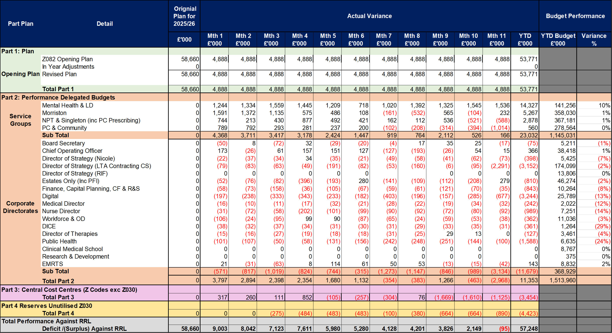
2025/6 In Year Health Board Position & Service Group Element

Slide 6
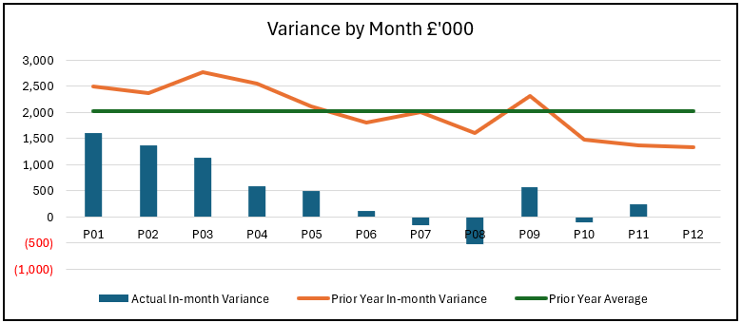
Service Group Position By Month & Divisions
KEY MESSAGES
Morriston Service Group (MSG) overspent against budget by £0.2m in February (month 11), taking the year-to-date position to £5.3m overspent against allocated budget.
There has been a reduction in core overspend as the year has progressed, however this has been supported by one-off benefits including balance sheet releases (mainly months 06-08) and backdated income.
There remains an underlying improvement through quarter 3 driven by a review of maintenance costs, improved income delivery, wider vacancy holding in response to the financial position and a drop in pay costs for Pathology.
The improvement linked to Pathology expenditure has reduced capacity which is having an adverse impact on activity backlog. Plans to increase spending back to underlying levels to resolve this backlog are under discussion with the Board.
In month, three Divisional areas are underspent:
  Unit management, driven by financial benefits from the balance sheet and unallocated reserves released for project slippage.
  Integrated surgery, driven by reduced maintenance commitments in Radiology (including an element of benefit released from prior year accruals)
  Specialist surgery, driven by vacancies in Pathology and overachieved cardiology income.
Year-to-date all Divisions are overspent with the exception of unit management which holds the benefit of non recurrent financial benefits and slippage on unallocated project reserves.

Slide 7
Year-To-Date Service Group Position By Division & Type Expenditure/Income
Income
Income from activities has overachieved against plan by £2.5m year-to-date with the main variance shown as over delivery of the Joint Commissioning Committee (JCC) contract. This relates mainly to delivery of specialist cardiology procedures, including those involving high-cost devices which form part of the offsetting pressure seen in clinical supplies expenditure.
Income from operations has a smaller over achievement linked to delivering work for other organisations, the most material element being sterile services support to Sancta Maria hospital.
Non-Pay
The overspend of £9.1m year to date consists of;
£4.5m shown as miscellaneous, of which £5.5m is the cost improvement shortfall offset by £1.0m of unallocated reserves (including non recurrent project slippage)
£2.7m clinical supplies pressure, of which c£2.0m relates to the aforementioned JCC overperformance. Other pressures include £0.2m linked to increased activity in Interventional Radiology, £0.1m blood products, with further pressures linked to activity across a few small service areas including drug spend in both renal services and ward areas.
£1.6m premises and fixed plant which is £2.0m pressure on cost of beds offset by underspends on digital equipment, software and maintenance.
£0.4m establishment expenses of which £0.3m is postage.
Pay
An underspend of £1.2m year to date, consisting of a significant underspend on administrative (£1.4m), ancillary (£0.7m) and additional clinical staff (£0.6m) working in laboratory medicine (£0.4m) and cellular pathology (£0.1m). All due to long term vacancies, many of which are now being held as financial recovery planning continues. These underspends are partially offset by the continued overspends for medical, allied health professionals and nursing staff linked to unavailability, surge cover and over establishments.

Slide 8

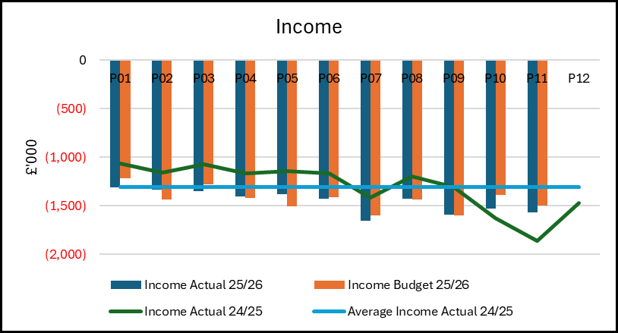
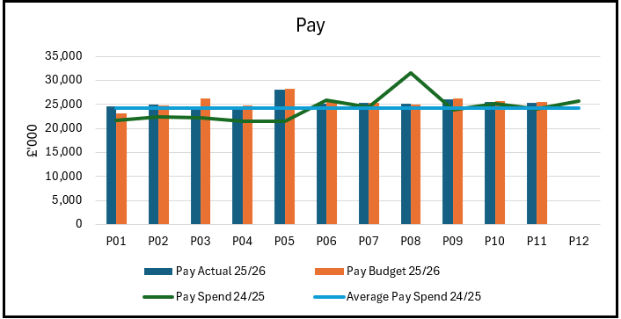
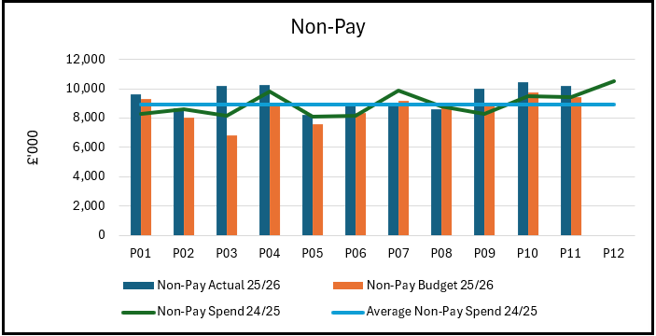
Drivers: Summary
Income:
Income has been consistently above budget through this year, reflecting both the over performance against the activity-based contracts (which incur associated non pay expenditure) and some new income generation for services offered to other providers including Sancta Maria. There has been increased delivery in most income generating services from quarter 2 onwards, driven by increased capacity (staff availability) and through agreeing to do additional work for other Health Boards to support their waiting lists.
Pay:
Pay has remained relatively stable overall for ‘actual’ trend, notwithstanding the pay award mostly processed in month 05 and the impact of the decision for re-banding the health care support workers from 2 to 3 (mostly processed in month 09). There are movements within those numbers consisting of a small increase overall for substantive staff costs, linked to pay awards and some recruitment earlier in the year as well as student streamlining. This is offset with a reduction in variable pay in the last half of the year.
Non-Pay:
Non pay expenditure is slightly higher than the average spend in last financial year when adjusted for one off financial changes and NICE funded drugs, reflecting inflation pressures and activity in some key service areas (specialist surgery, interventional radiology, pathology). This aligns both to the increased challenge of maintaining waiting times, meeting diagnostic targets, front door demand and bed surge. For meaningful analysis a deeper review on individual lines and the mitigations being taken is required, for example increased Interventional Radiology activity has led to increased stent expenditure in that service, there is likely an offsetting reduction in surgical intervention required, however those non pay lines sit within another service group and cannot be directly matched to the change in interventional radiology (correlation not necessarily causation in terms of data relationships).

Slide 9
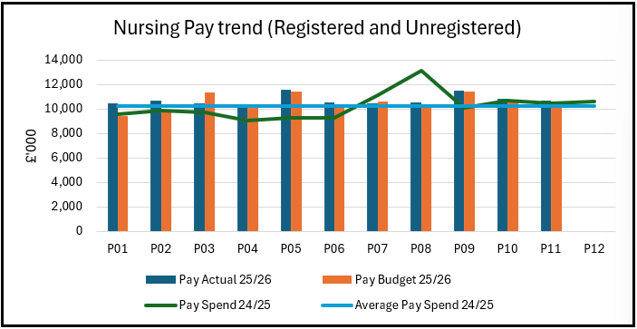
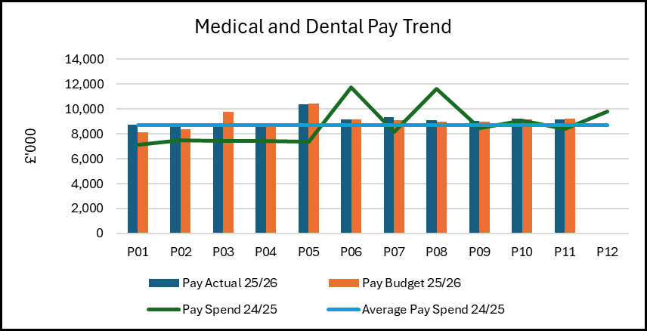
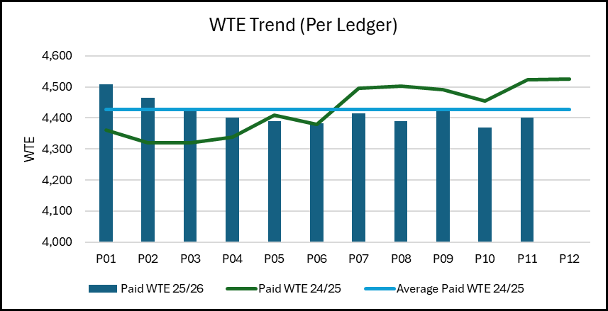
Drivers: Pay
  Nursing pay is above the average of 24-25 but there is increased cost in the new year from the increased employers NI and the pay award (including rebanding of the health care support workers). These awards have had associated funding in year where there are staff in post. When this is adjusted for the net cost of nurse pay across the service group would have been slightly lower due to reductions in variable pay for registered nursing. However, it is recognised that there is more opportunity to reduce variable pay linked to unavailability which remains high in some areas, in both registered and unregistered staff groups - this is being pursued via the savings workstreams.
  Medical staffing expenditure is also above the 2024-25 average. Again, there is increased expenditure from NI and pay award, but a small improvement in the variable pay position when considered in the context of an increase in vacancy levels in the last quarter. Due to recent retirements and other leavers, it is likely there will be a short-term increase in variable pay and/ or outsourcing for Pathology through March and into early 2026/27 to maintain activity as they are recognised as hard to recruit posts. The Service Group reflected this in the 2026/27 cost assessment but recognise the challenges of the financial position and the direction from Welsh Government on a no investment plan for 2026/27.
  The WTE numbers have reduced during the year linked to both variable pay and some leavers with delayed recruitment. The main areas of reduction include administrative staff, where vacancies are being actively held as part of recovery planning; registered nursing, which has benefited from some variable pay reductions and the need to hold turnover to move back within establishment and both healthcare support workers and lab workers where turnover and slow replacement has had an impact. For these areas variable pay is bridging some of that gap. Workforce planning to align with the new year strategic aims will be key to stabilise essential staffing and agree forward workforce profiles.

Slide 10
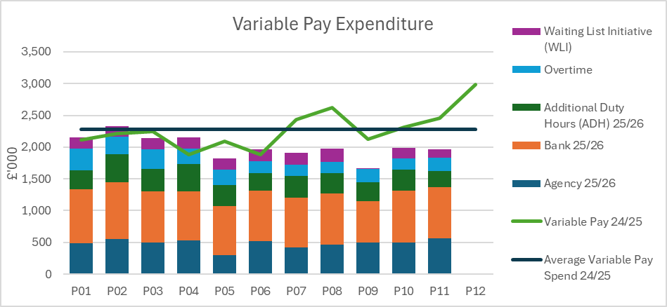
Drivers: Variable Pay & Performance (Actual)
Variable pay is lower than in 2024/25 (average monthly spend reduced by £0.3m).
Reduction is across all staff groups and forms of variable pay at the bottom line with only Ancillary (sterile services) staff and Everlight outsourcing (which reports on the agency line) staying broadly static. This is due to ongoing vacancies for sterile services and an increase in Radiology capacity gaps along with the impact of in year target delivery.
The second half of the year also has reduced when compared to the first half of 2025/26, some of this reduction has been as the result of increased substantive staffing (successful recruitment) so the saving is only the premium element of cover, not the total spend reduction.
Work continues to tackle the areas that are driving operational cost pressures against budget allocations, in particular nursing variable pay driven by unavailability but despite significant workstreams that have been recognised by corporate colleagues as best practice, overall unavailability remains high.
Diagnostic services (radiology, pathology) are reliant on variable pay currently to maintain services. In some areas; for example out of hours reporting this is a cost-effective solution, in others workforce scarcity means that it will a longer road to reducing that reliance and move to lower cost in house staffing models.

Slide 11
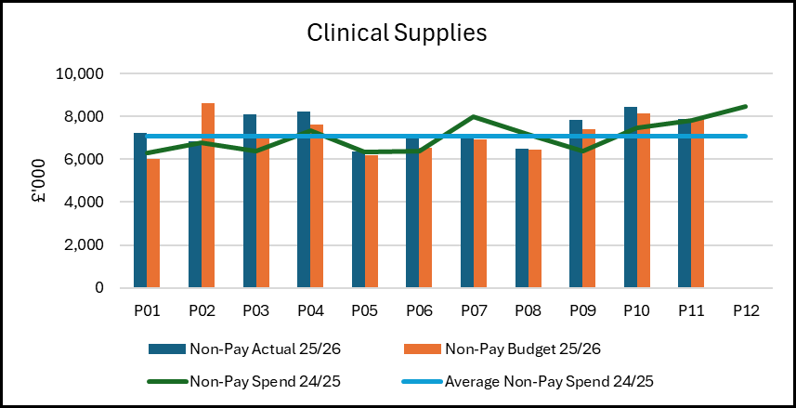
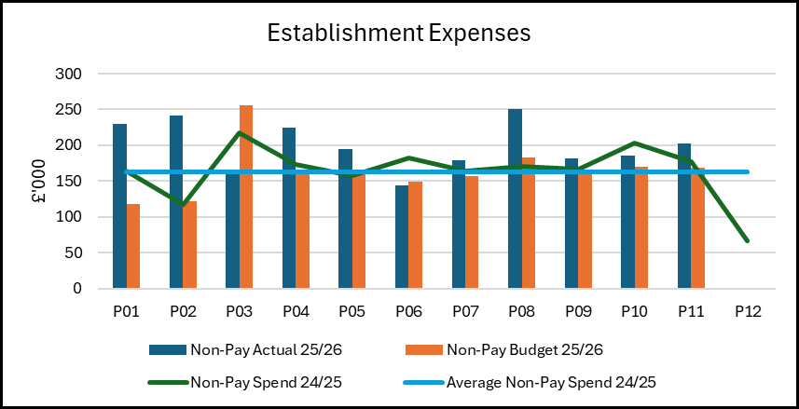
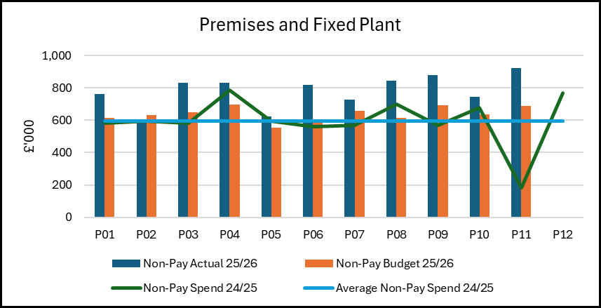
Drivers: Non-Pay (Actual)
Clinical Supplies
Spend has increased by c3% compared to 24/25 when adjusted for NICE drugs and one-off issues, this is more than any inflation/ growth funding issued. Procurement has had success in reducing cost on some key lines and agreeing discounts and rebates, but it remains an area of challenge, particularly when balanced with the need for cost savings. Work has been undertaken to review stock levels and look at product limitation with small benefits achieved to the bottom line in year and further benefit expected next year. Some of the increase is offset by income delivery described in earlier slides, and this activity is the main driver for month-on-month fluctuations.
Establishment Costs
Postage costs are the main driver for this expenditure which is both higher than in 2024/25 and the allocated budget. Postage costs have been subject to cost and volume increases compared to last year and the pursuit of savings through implementation of digital solutions continues. There is ongoing work to review the impact of the phase 3 and 4 recovery work on the volume increases to determine if further funding can be received in year from available Welsh Government sources.
Premises & Fixed Plant
The cost of hire and repair of beds and mattresses, along with other clinically necessary equipment (chairs/ hoists) continues to drive cost increases in year, with the fluctuations being ad hoc repairs. This is again both a price and volume issue and work is ongoing with procurement to deliver lower costs in this area. The new Health Board wide bed contract implementation planned for early 2026/27 following initial delays is expected to have a positive impact on the underlying deficit.

Slide 12

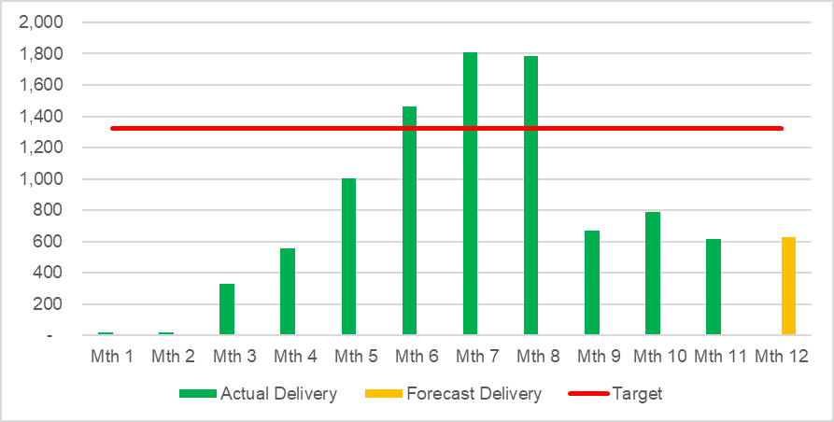
Savings Summary
Shortfall of £6.2m in year forecast; being partly mitigated by operational underspends and non recurrent project slippage.
Recurrently the shortfall is £10.0m actions to tackle this include;
  Review all non recurrent schemes for recurrent opportunities
  Continued regular reviews with Divisional leads to generate ideas and gain delivery assurance
  Utilise the Health Board wide thematic plans to determine local benefit opportunity
  Divisional review of medium-term vacancy position to convert operational underspends to long term cost improvements.
  Review of profit and loss position for income delivering services
  Workforce plans to drive out cost benefits on premium pay
  Review available efficiencies in planned care programme

Slide 13

Identification Opportunities & Risk
Further Opportunities for 25/26:
Final accrual review across device costs (Non-Recurrent c£0.3m)
Out of Hours Interventional Radiology cover agreement (£0.2m to £0.3m)
Individual Patient Funding Arrangements (<£0.1m)
Variable pay controls (no trajectory)
Activity delivery changes (no trajectory)
Recruitment to vascular interventional radiology leading to lower variable pay (<£0.1m)
Further project slippage (Non-Recurrent £0.1m)
Impact of Health Board wide non pay controls and vacancy freezes (no trajectory)
Digital benefits (2026/27)
Service efficiency schemes (2026/27)
Phase 4 diagnostic funding
Further Risks (into 2026/27):
Underlying position assessment assumed no vacancy fill (with minimal exceptions), the impact assessment to services of holding vacancies into next year requires further work.
Further streamlining costs/ increased shift fill rate (underlying position is predicated on continuation of current ‘status quo’ for shift fill
Inflation/ Growth on high value areas (i.e. Blood Products £0.3m in year/ £1.1m recurrent)
Managed Service Contract renewals
Response to potential for ‘backlog’ growth when capacity retracts (particularly diagnostics) as outsourcing monies run out – being realised in Pathology currently
Activity delivery linked to national targets
Job re-bandings (band 2 to 3 non nursing and other areas)
Resolution of pay disputes against SBUHB
WLI Pay Award/ Pay Disputes
Renal workforce position as new unit opens (dependant on activity placement)
Bed Hire Price fluctuation/ bed stock assessment given changing needs
Delivery of contract activity and prioritisation of limited theatre capacity/ bed spaces
Ability to track and ‘join’ up planning /decision impacts on forecast assessment

Slide 14
Actions & Next Steps To Be Taken By Service Group
Management of new/ emerging cost pressures particularly linked to diagnostic activity delivery.
Service Group needs to continue to work to reduce expenditure to manage the current cost pressures; including reducing any premium expenditure costs (variable pay) with monitoring activities to maintain assurance that there’s a continued improvement on run rate.
Service Group to continue to develop savings plans to mitigate shortfall recurrently.
Clear demand and capacity plan development particularly for services that have seen increases in year beyond the underlying position and funded recovery activities.
Continue to engage in the 2026/27 planning cycle to support clear identification of risks and opportunities required for decision making.
Engage in delivery of Health Board wide planning requirements such as the 5% headcount reduction, sickness absence and reduction of key non pay costs. Tracking delivery and impact as required.
Clear communication of new year budgets and plan targets to individual budget managers as it becomes available.

