Slide 1
Swansea Bay University Health Board
Integrated Performance Report
June 2025

Slide 2
Report Overview
The Health Board Integrated Performance Report will provide updates against all areas under escalation with Welsh Government, all performance metrics outlined within the NHS Wales Performance Framework 202-26, along with updates against the Delivery Expectations and the Ministerial Enabling actions as outlined in the NHS Wales Planning Framework 2025-2028
Section 1: Updates against all Escalation areas with Welsh Government
Section 2: Performance against the Health Board’s Strategic Objectives
Section 3: Updates on Ministerial Enabling Actions

Slide 3
Section 1:
Updates against all Escalation areas
with Welsh Government

Slide 4

Delivery against Targeted Intervention and Enhanced Monitoring Criteria 2024/25
TI Area (Level 4) | Criteria to achieve | Performance (May -25)
Cancer | 60% performance maintained for 3 months against the SCP target. | 60% (April - 25)
UEC | Continuous reduction of ambulance handovers over an hour of at least 11% in three consecutive months and maintained for 3 months (Based on Q2/Q3 2023 baseline | 599 (4.8% reduction)
 | Continuous improvement towards no more than 7% of patients waiting over 12 hours at each individual site and across HB | 11.71%
 | Median time from arrival at emergency department to assessment by a clinical decision maker should not exceed 60 minutes | 86.33%
 | Continuous reduction in delayed pathways of care of 5% for three consecutive months and then maintained for three months (based on Oct-Dec 23 baseline) | 191
HCAIs | A clear improvement plan based on a root cause analysis to address the issue of hospital onset HCAIs. | In place
 | C-Diff: reduce the number of hospital onset infections by 40% and maintain for 3 months (from a baseline of the average number of cases in quarter 3 of 10 cases to no more than 6 per month | 4 cases
 | Staph aureus: reduce the number of hospital onset infections by 25% and maintain for 3 months (from a baseline of the average number of cases in quarter 3 of 4 cases to no more than 3 per month | 5 cases
 | E-coli: reduce the number of hospital onset infections by 20% and maintain for 3 months (from a baseline of the average number of · cases in quarter 3 of 5 cases to no more than 4 per month) | 5 cases
 | Klebsiella: reduce the number of hospital onset infections by 10% and maintain for 3 months based on 2017/18 figures (baseline –54 cases in 2017/18, reduce to average of at most 4 per month) | 9 cases
Finance | Detailed Updates included in the monthly Escalation Report
Strategy & Planning | Detailed Updates included in the monthly Escalation Report
Dashboard

Slide 5
Delivery against Targeted Intervention and Enhanced Monitoring Criteria 2024/25
Escalation Area (Level 3) | Criteria to achieve | Performance (May-25)
CAMHS | 80% of LPMHSS mental health assessments undertaken within 28 days from the date of receipt of referral | 87.2%
 | 70% of therapeutic interventions started within 28 days following an assessment by LPMHS | 22%
 | 85% of HB residents in receipt of secondary mental health services who have a valid care and treatment plan | 98% - meets de escalation criteria
Planned Care | 100% of open outpatient pathways to be waiting less than 52 weeks and maintained for 3 month | 100%
 | Continuous improvement towards 75% of all open outpatient pathways waiting less than 26 weeks | 69.45%
 | 100% of open pathways to be waiting less than 104 weeks and maintained for 3 months | 100%
 | Continuous improvement towards 80% of all open pathways waiting less than 36 weeks | 73.44%
 | 12% reduction in the number of patients delayed by 100% for their follow up appointment in three consecutive months and maintained for 3 months (Based on the November 2024 baseline.) | 7.39%
 | 68% R1 ophthalmology patient pathways to be waiting within or no longer than 25% of their target date for an outpatient appointment and maintained for 3 months | 75.64%
 | 85% of patients waiting for a diagnostic test to be waiting less than 8 weeks and maintained for 3 months | 80.67%
 | 85% of patients waiting for a diagnostic endoscopy to be waiting less than 8 weeks and maintained for 3 month | 32.06%
 | 85% of patients waiting for a NOUS and non cardiac MRI to be waiting less than 8 weeks and maintained for 3 months. | 99.84%
 | 90% of patients waiting for therapies to be waiting less than 14 weeks and maintained for 3 months | 99.91%
Maternity & Neonates | Detailed Updates included in the monthly Gold Report

Slide 6
Section 2:
Summary of the performance against the Health Boards Strategic Objectives

Slide 7





SBUHB Strategic Objectives and Quality Aspects
Our refreshed Strategic Objectives –aligned to ‘a Healthier Wales’ articulate the future state of Swansea Bay UHB as a high-quality organisation. We have set out what this looks like for our population, communities, staff , partners and services and are developing strategic indicators that will tell us if our efforts are delivering our objectives
People of Swansea Bay live healthier, equitable and more equal and prosperous lives
Every child has the best start in life
All children, young people and adults are enabled to maximise their capabilities and have control over their lives
Good work and fair employment is created for all
A healthy standard of living is ensured for all
Healthy and sustainable places are created through placemaking
The role and impact of ill-health prevention is strengthened
Racism, discrimination and their outcomes are tackled
Environmental sustainability and health equity are pursued together
Care is high quality, safe, efficient and delivers the best possible outcomes for people
Care is safe, it helps people and avoids harm
Care is evidence based, effective and improves outcomes
Care is timely and delivered by the right person in the right place
Care is efficient
Care delivers equitable outcomes regardless of demographic, socioeconomic or geographic factors
Care is person centred and delivered with compassion, dignity and mutual respect
Care is delivered in safe and appropriate settings supported by innovative digital solutions
Care is delivered around the patient in the most appropriate setting as close to home as possible supported by digital and data solutions
Care settings are fit for purpose, appropriately designed and equipped
Secure, trusted and insightful data and digital platforms empower staff to deliver more and higher quality care and improved patient outcomes and population health
We have a digitally inclusive culture, where patients, clinicians and non-clinical colleagues work collaboratively to create effective and efficient services and patients are empowered to make informed and meaningful choices about their health and care
Through where and how they are delivered, services contribute to the environmental, economic, social and cultural well-being of Swansea Bay
The health board is a great place to work where staff feel valued and work together towards a common goal
Our Workforce is engaged, motivated and healthy; they feel valued, fairly-rewarded and supported
The Health Board is recognised as an employer of choice
We have a well-planned workforce with the right number of skilled people working on the right things
People feel ready for our digital future
People are supported to develop the skills and capabilities they need
People role model collective and compassionate leadership and live our values
We are diverse and inclusive, ensuring all voices are heard
The health board is a resilient, financially sustainable and responsible organisation
The health board is financially balanced and able to invest in service transformation and change
Decisions are made balancing short-term improvements and long-term impacts
Resources are used efficiently and proportionately, reducing waste and variation
The environmental impact of health care delivery in Swansea Bay is minimised
The health board invests in and works with others locally and responsibly, using our assets to positively contribute to the community
Citizen stakeholders are meaningfully involved and engaged in decision making
The health board has the capacity to effectively plan for and respond to incident and emergencies

Slide 8
People of Swansea Bay live healthier, equitable and more equal and prosperous lives
Childhood Immunisations | Target | May-25
Percentage of children who are up to date with the scheduled vaccinations by age 5 (‘4 in 1’ preschool booster, the Hib/MenC booster and the second MMR dose) | 95% | 90.3% (Mar-25)
Percentage of children receiving the Human Papillomavirus (HPV) vaccination by the age of 15 | 90% | 85.7% (Mar-25)
Influenza & Covid Immunisations
Percentage uptake of the influenza vaccine in adults 65 years and over | 75% | 68.5% (24/25)
Percentage uptake of the COVID-19 vaccination for all those eligible – Spring Booster | 70% | 43.1% (May-25)
Smoking Cessation
Percentage of adult smokers who make a quit attempt via smoking cessation services | 5% Annual target | N/A
Percentage of adult smokers who make a quit attempt via smoking cessation services who are CO-validated as quit at 4 weeks | 40% annual target | N/A
Screening
Percentage of patients offered an index colonoscopy procedure within 4 weeks | 90%
Percentage of well babies entering the new-born hearing screening programme within 4 weeks | 90%
Percentage of eligible new-born babies who have a conclusive bloodspot screening result by day 17 of life | 95%
DE
DE
DE
DE

Slide 9
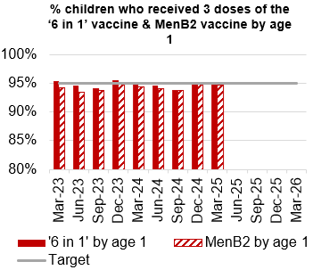
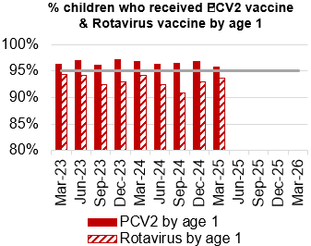
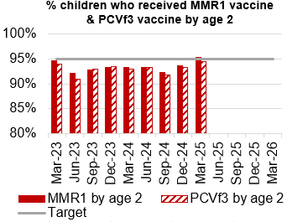
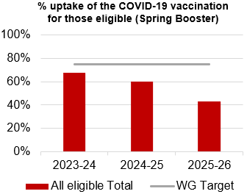
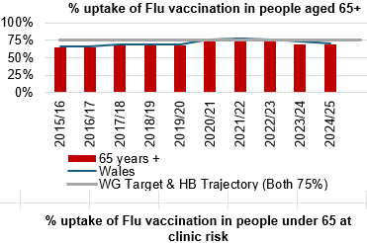
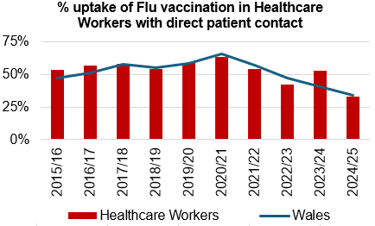
Immunisations
Actions/Updates
Performance against the immunisation targets is reported in arrears on a quarterly basis
Updated targets have been set for the new financial year which can be seen on the graphs above

Slide 10
Care is high quality, safe, efficient and delivers the best possible outcomes for people
Accident & Emergency | Target | May-25
4 -hour performance | 95% | 64.34%
12-hour performance | 0 | 1,435
Number of A&E Attendances | N/A | 12,251
Number of Clinically Optimised Patients (HB wide) | Continuous Reduction | 191
Number of cancelled Electives | 0 | 28
Median time of arrival to assessment within 60 minutes | 97% | 86.33%
Ambulance
Percentage of emergency response to red calls arriving within (and including) 8 minutes | 65% | 48.9%
Median emergency response time to amber calls | 12-month reduction | 159
Median time from arrival at an emergency department to assessment by a clinical decision maker should not exceed 60 minutes | 97% | 86.33%
Total Handovers lost over 15 minutes | 0 | 2551
DE
TI
DE
TI
TI
TI

Slide 11
Care is high quality, safe, efficient and delivers the best possible outcomes for people
Stroke | Target | March -25
Percentage of admission within 4 hours | 95% | 15.4%
Percentage of stroke patients receiving a CT scan within 1 hour | 95% | 62.5%
Percentage of patients assessed by a stroke consultant within 24 hours | 95% | 65%
Percentage of patients to receive a mechanical Thrombectomy | 10% | 0%
Planned Care | Target | May – 25
Percentage of patients waiting < 26 weeks for an outpatient appointment | 75% | 69.45%
Total number of patients waiting > 36 weeks | 80% | 73.44%
Number of patients waiting at Stage 1 > 52 Weeks | 0 | 0
Total number of patients waiting > 104 Weeks | 0 | 0
Diagnostics & Therapies | Target | May – 25
Number of patients waiting > 8 weeks for diagnostics | 0 | 2,462
Number of patients waiting > 8 weeks for an Endoscopy | 0 | 2,278
Number of patients waiting > 14 weeks for Therapies | 0 | 5
Number of children waiting > 6 weeks for Audiology | 0 | 345
TI
TI
TI
DE
TI
DE

Slide 12
Care is high quality, safe, efficient and delivers the best possible outcomes for people
FUNB | Target | May -25
Number of patients waiting for an outpatient follow-up (booked and not booked) who are delayed past their agreed target date (All Specialties) | N/A | 70,162
Total number of patients waiting 100% over their target date | 0 | 41,272
Total number of patients waiting for a follow-up appointment | N/A | 153,822
Mental Health & Learning Disabilities | Target | April – 25
Percentage of mental health assessments undertaken within (up to and including) 28 days from the date of receipt of referral | 80% | 96%
Percentage of therapeutic interventions started within (up to and including) 28 days following an assessment by LPMHSS | 80% | 93%
Percentage of patients waiting less than 26 weeks to start a psychological therapy in Specialist Adult Mental Health | 80% | 46.8%
Quality & Safety | Target | May – 25
Number of service user feedback experience responses on CIVICA | Monthly improvement | 6,778
Percentage of complaint responses sent within 30 working days | 80% | 68% (March-25)
Number of Nationally Reported Incidents | N/A | 8
Number of New Never Events | N/A | 2
TI
DE
DE
DE

Slide 13
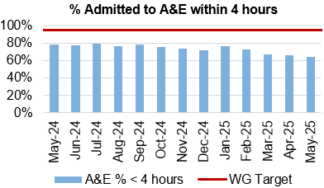
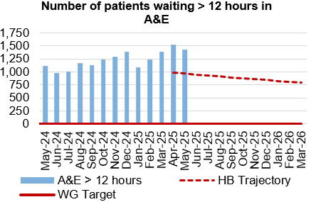
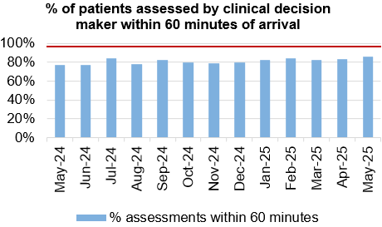
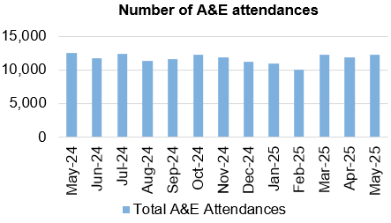
Unscheduled Care
Dashboard
Actions/Updates
Revised flow operating model/Anglesey Ward: Anglesey ward test of change commenced 2nd June. 25 bedded general medical ward has been opened as a key enabler to test changes in the operating model across the UEC pathway. Significant improvements already realised, particularly in respect of ambulance handover, lost hours, ED patient turnaround time. 8 PDSA’s in total scheduled during the next 6-week period.
UEC capital redesign – Following executive discussion, letters sent from CEO to Judith Paget (NHS Wales CEO) to outline the current tests of change in progress that will influence the capital request. There is also an expression of interest to pursue a digital platform to underpin the UEC pathway.

Slide 14

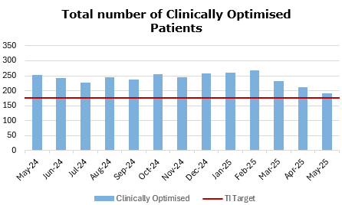
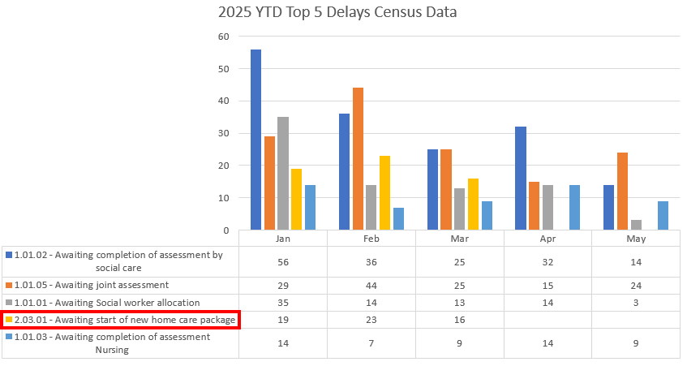



Pathways of Care Delay: Action & Intervention
Code changes in April saw Awaiting Start of New home care package split into two, which is why the code featured heavily in Q1, but is no longer ‘Top 5’ for 2025, YTD.
3.25%
WG target -15% reduction in total delays,
20% reduction in assessment delays,
20% reduction in total days delayed from March 2024 baseline
What specific improvements have been delivered?
Trusted Assessor T & F established Feb-March leading to new model for delivery
T & F on Mental Capacity Assessment to improve process and update SOP
New daily live state dashboard launched February
Integrated Discharge Hub extended to front door in April (funding required to continue this)
Patients are only allocated to P3 (Long term residential or nursing care) in extreme circumstances and should be put on P2 (Reablement). The majority of delays previously were for P3 patients.
Achieved reductions across Top 5 worst performing codes between January and May
Next Steps: Regional D2RA programme being established to deliver some system wide transformational change, to enable 100 POCD to be achieved by March 2026
92.6%
Next steps for supporting improvement
Focus on delivering operational improvement in partnership with D2RA programme
Regional Operation Assurance Group Workshop on Demand & Capacity and Performance 24.06.25
Additional scrutiny meetings with leads to address this weeks rises
Specific programmes of work with MH/LD & Gorseinon

Slide 15
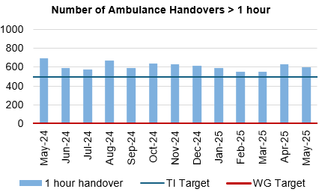
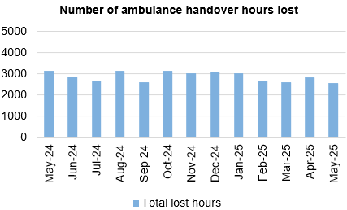
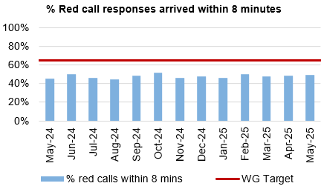
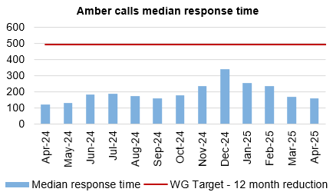
Ambulance
Dashboard
Actions/Updates
Grip & control operational management – Full Capacity protocol and zero tolerance on chair and trolley waits in full operation with additional 3:30 huddle now in situ at Morriston Hospital. Health Board launch of ‘your next patient’ commences Monday 16th June 2025.
UEC Care co-ordination Hub – Funding application submitted to Six Goals to extend the role and function of the UEC care coordination hub over the seven-day period. Initial priority to deliver five day single point of access and to implement the national ticket to ride framework.

Slide 16
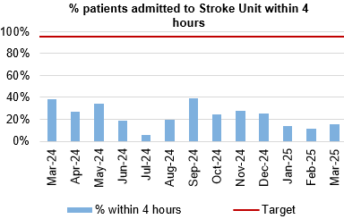
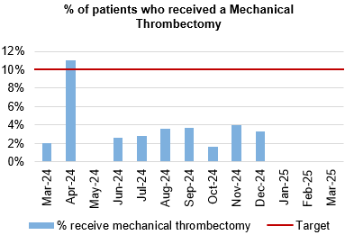
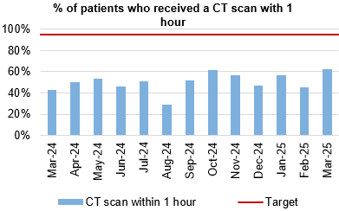
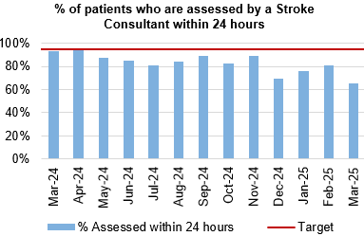
Stroke
Actions/Updates
Due to changes to the Sentinel Stroke National Audit Programme (SSNAP) data repository in October 2024, there have been significant challenges in extracting data from the national system. However, access has now been restored with updated indicators and reporting options. Despite this progress, the NHS Executives’ Quality Improvement Measures (QIM) portal will not be operational until June 2025 therefore this data will not be included in this report. In the interim, the service has implemented local arrangements to extract and report relevant data which is included within this report. Additionally, the digital team is actively developing a BI dashboard to provide comprehensive reporting on both national indicators and local performance metrics. This initiative aims to identify constraints and bottlenecks, ensuring targeted improvements in patient care and service delivery.

Slide 17
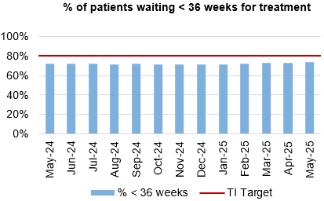
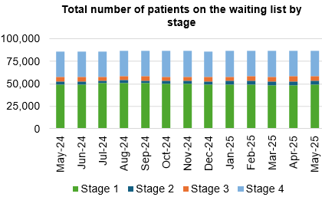
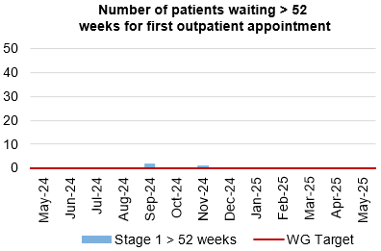
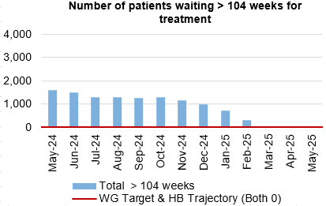
Planned Care
Dashboard
Actions/Updates
The Health Board have maintained the Stage 1 > 52 weeks target of 0 for May 2025.
The Health Board have maintained the number of patients waiting > 104 weeks for treatment target of 0 for May 2025.
Welsh Government have provided updated de-escalation criteria for all planned care metrics which reflect encouragement towards an improved position. Focus has now been placed on achieving a new Targeted Intervention Target for patients waiting <36 weeks for treatment.
Key Risks to delivery include the current physical infrastructure to hold additional clinics, workforce availability, funding and willingness of patients to attend out of hours

Slide 18
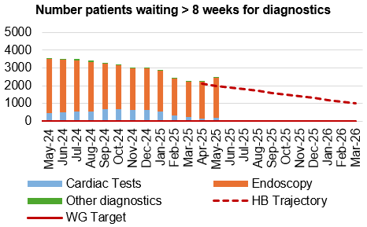
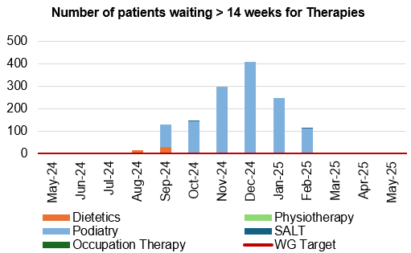
Diagnostics and Therapies
Actions/Updates
The total number of patients waiting > 8 weeks for diagnostics has increase in May 2025 to 2,461, compared to 2,239 in April 2025.
Updated targets have been set for diagnostic de-escalation criteria which encourage further improvement, with the target for patients waiting < 8 weeks for diagnostics increasing to 85% from 80%.
A noticeable increase in patients waiting over 8 weeks for diagnostics has been recorded. Focussed actions are being undertaken to improve the Endoscopy position and have been identified on the following page.

Slide 19
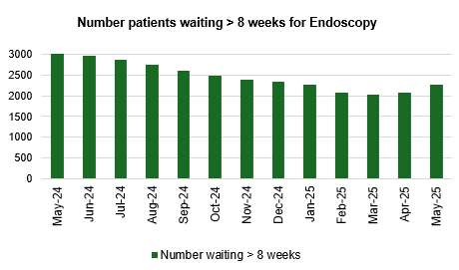
Endoscopy: Action & Intervention
What are the main risks impacting performance?
Previous underfunding has led to a lack of capacity versus demand in all patient cohorts, including surveillance already identified as high-risk category
Delayed approval of request for further funding to support phased increase of internal lists
Q1 position compromised due to conversion of endoscopy referrals from increased Gastroenterology insourcing through Q4 last year from recovery monies to improve the stage 1 position. This was raised as a risk prior to implementing.
Increased USC demand. More work required to understand this increase.
3.25%
What actions are being taken to improve?
Continuation of insourcing to close gap of unfunded sessions
Ongoing recruitment now progressing since confirmation of funding
More capacity devoted to surveillance
Mobile Endoscopy Unit financially approved to support the backlog throughout 25/26.
92.6%

Slide 20
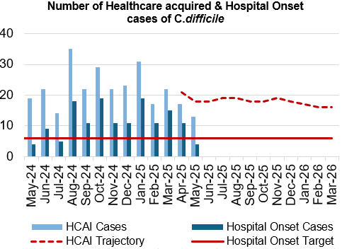
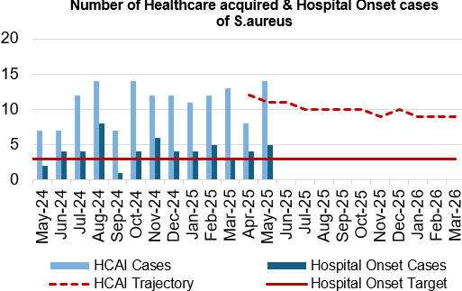
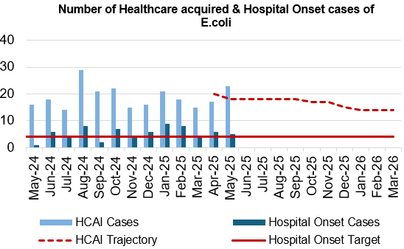
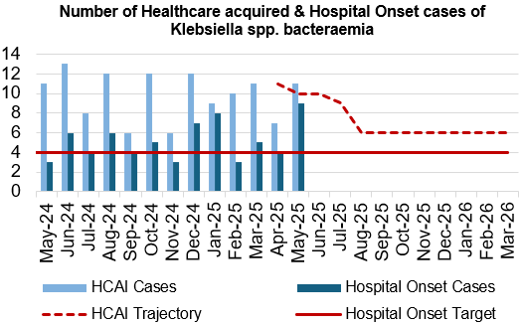
Infection, Prevention & Control
Dashboard
Actions/Updates
Gold C. difficile High Incidence Management Group continues, with Silver Groups reporting into Gold.
The Digital App for HCAI incident case reviews moves into user acceptability testing.
New C. difficile Standards: Risk Assessment & Governance Framework agreed by Management Board. Formalise launch of Standards.
Continued focus on improving antimicrobial stewardship, in particular the outcomes of antimicrobial review.
Collaborative work with ED team, Domestic Services Team and IPC on cleaning schedules and requirements in ED.

Slide 21
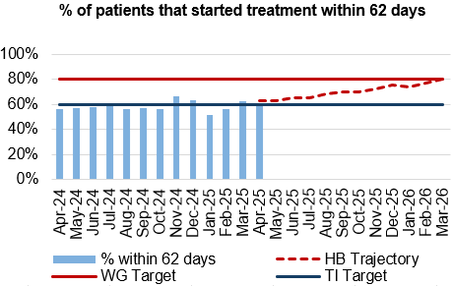
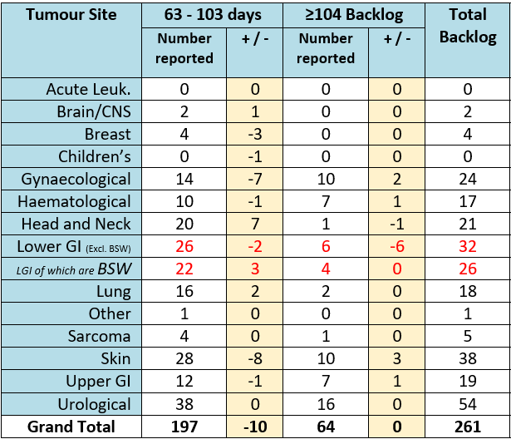
Cancer
Actions/Updates
In April 2025, the service reported 60% of patients had started treatment within 62 days which is above the Welsh Government TI target of 60%. Additional actions are being undertaken to improve performance;
  Continued focus on front end of pathway for all specialties
  Continued focus on cellular pathology, workforce review - several posts going through vacancy control process; ongoing discussions to address backlogs that impact performance. Identify opportunities to improve turnaround times for urological USC’s.

Slide 22
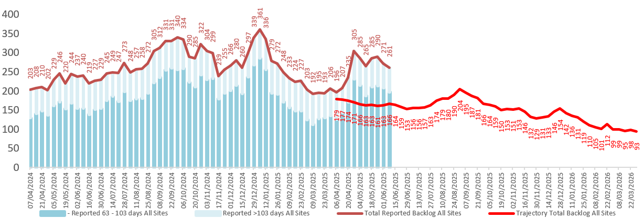
Cancer
Actions/Updates
The backlog has seen a recent reduction and continues to move towards the outlined trajectory, with additional actions being undertaken to improve performance:
  Identify additional surgical capacity, increase preassessment capacity to support theatres scheduling. Additional chemotherapy capacity (business case agreed).
  Further actions/improvement in Skin as seasonal demand increases, LGI, Urology and Lung.

Slide 23
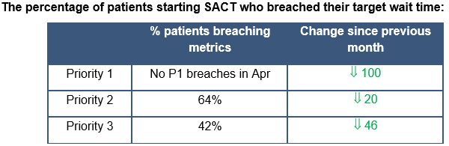
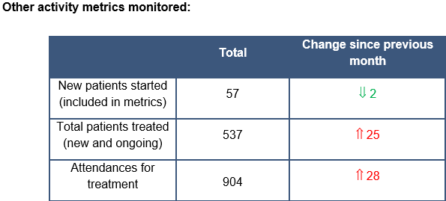
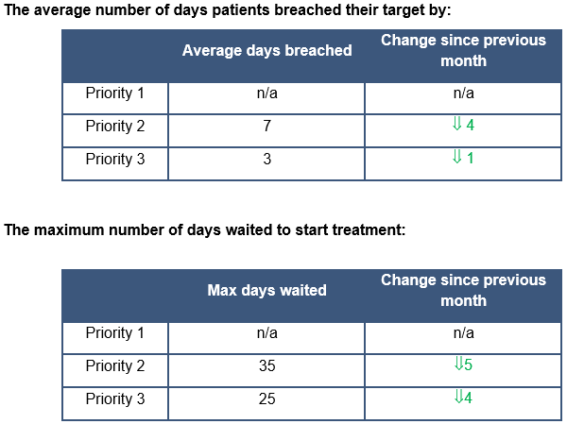
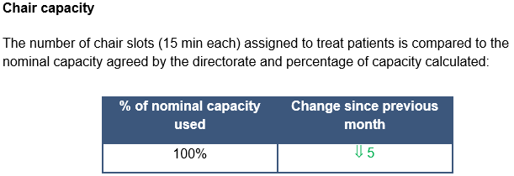
Cancer: Systematic Anti-Cancer Therapy (SACT)
What specific improvements have been delivered?
There were no priority 1 patients treated in April. There were noticeable improvements in the % of patients breaching for priority 2 and 3 patient groups
For P2 and P3 patients the average number of days a patient breached their target by has reduced, and the maximum number of days waited has also improved.
There were a large number of patient deferrals during April which has likely created space in the diary for patients to be treated sooner, reflecting the fall in maximum wait and the average number of days breached.
The number of patients starting SACT decreased slightly in April, but attendances and the total number of patients treated increased. There was another reduction in patients being treated on Ward 12, which may have contributed to the increase in attendances to CDU. A number of these patients could have attended over multiple days, also contributing to higher attendances. However, as there are still staff shortages, Area 3 continues to be closed at times throughout the month. Despite this, the high number of attendances has kept the nominal chair capacity at 100% this month.
3.25%
92.6%

Slide 24
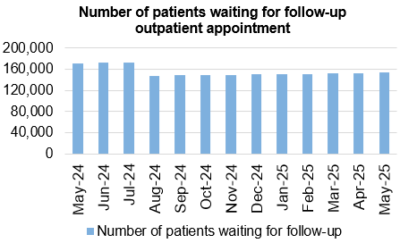
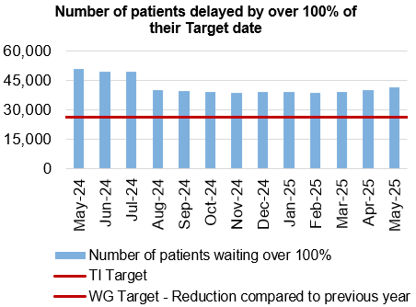
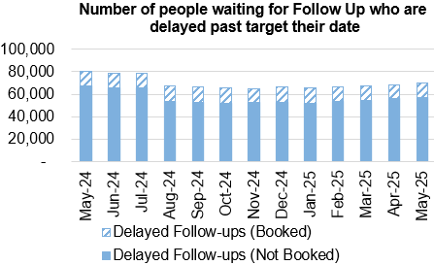
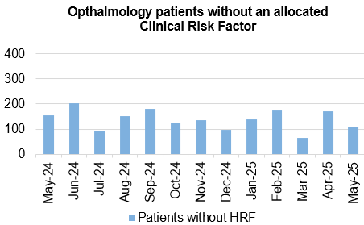
Follow-Ups & Activity

Slide 25
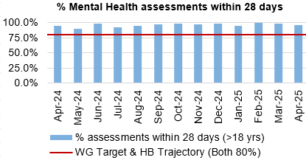
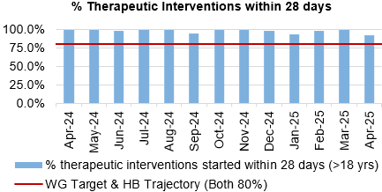
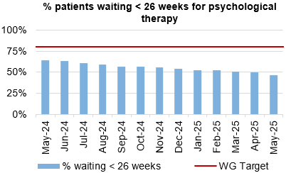
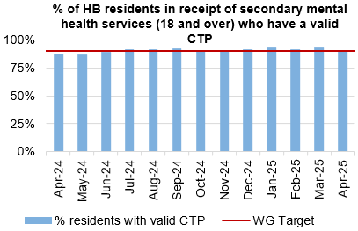
Mental Health & Learning Disabilities
Actions/Updates
Welsh Government has identified Mental Health and Learning Disabilities (MH&LD) as an area of concern, with regards to oversight and escalation. Assurance has been sought with regards to the key areas of concern within the Service Group
The Health Board has commenced work in advance of the receipt of the report and is setting up a Transformation Programme. This has been informed by a review of the service by an external advisor.

Slide 26
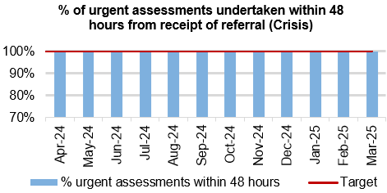
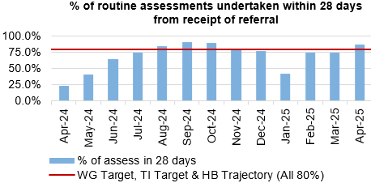
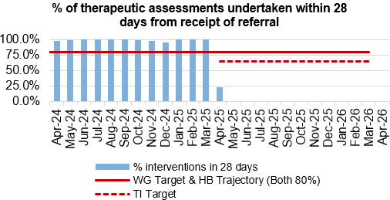
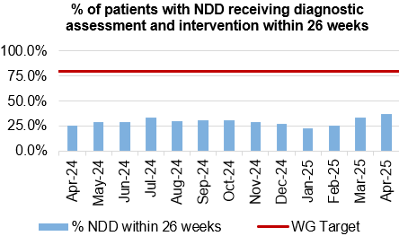
Child and Adolescent Mental Health Service (CAMHS)
Actions/Updates
Inaccurate reporting of Part 1B data has been corrected, revealing poor compliance with national performance metrics for first intervention timescales due to capacity constraints. The necessary notifications to the NHS Performance and Improvement team ahead of the next Level 3 Enhanced Monitoring Meeting.
Further work is underway to manage capacity issues within the Part 1B team, utilising agency staff where required, this will be reviewed on a rolling monthly basis.

Slide 27




Patient Experience & Concerns
Actions/Updates
There were 5,707 friends and family surveys completed in May 2025 which is an increase on the previous month where 4,926 surveys were completed.
Of those surveys completed, the 91% of patients would highly recommend the services they received.
There were 202 concerns receive in May 2025, and 69% of those concerns had responses sent within 30 days in March (May data is not yet available).

Slide 28




Serious Incidents and Risks
Actions/Updates
There were eight Nationally Reported Incidents reported in May 2025 and there were two new never events reported.
In May 2025, there were 136 open risks with a score >20 recorded for the Health Bord and there were 293 open risks with a score >16.
There were 166 hospital falls recorded in May 2025

Slide 29




Quality & Safety
Actions/Updates
The percentage of completed discharge summaries saw a reduction in May 2025, decreasing to 66% from 77% in April 2025
There were 116 Pressure Ulcers reported in April 2025, of which 52 were recorded in the Community.
Crude mortality rates increased in April 2025 to 0.72% from 0.68% in March 2025

Slide 30




Theatre Efficiency
Actions/Updates
The Planning Framework sets out enabling actions that must underpin the delivery priorities to successfully achieve the core service and changes required. These include value projects, digital innovations, workforce developments, financial sustainability and ways of working. The enabling actions and planning framework have been incorporated into SBUHB’s Theatre performance framework and work is currently underway to report against these measures.
During May 2025 there were 3,312 total cases completed across all sites, of which 601 were recorded as ‘trauma’ cases.

Slide 31






Fractured Neck of Femur (NOF)

Slide 32






Primary Care

Slide 33
Care is delivered in safe and appropriate settings supported by innovative digital solutions
Quality Aspect | Action | Outcome
Care is delivered around the patient in the most appropriate setting as close to home as possible supported by digital and data solutions | Implementation of Rio to support integrated teams in Mental Health, Learning Disabilities and Community Services. Increase patient adoption of the Swansea Bay Patient Portal (SBPO). Increased access to services through the development of electronic self-referral forms for the population of Swansea Bay. Implementation of Digital Maternity to support a single pregnancy record with real time recording of information in community and hospital settings. | 750 users in integrated teams will be supported by a digital solution in the community. Empowering patients to make informed and meaningful choices about their health. Shared Care record for maternity with a patient facing app.
We have a digitally inclusive culture where patients, clinicians and non-clinical colleagues work collaboratively to create effective and efficient services and patients are empowered to make informed and meaningful choices about their health. | The digital platforms listed above will support clinicians to work collaboratively and effectively. Additionally, patients will be empowered to manage their own health through the increased adoption of: Swansea Bay Patient Portal (SBPO) in conjunction with the roll out of Hybrid Mail to improve patient communication by delivering outpatient letters digitally via the SBPP. Implementation of Digital Health Assessments (DHA’s) to include the Waiting Well holistic assessment question set. Pilot the use of artificial intelligence to increase the efficiency and timeliness of clinical coding. | Effective and efficient services enabled by digital technology. Empowering patients to make informed and meaningful choices about their health. Data insights will inform clinical and operational decisions to improve patient outcomes

Slide 34
Care is delivered in safe and appropriate settings supported by innovative digital solutions
Quality Aspect | Action | Outcome
Secure, trusted and insightful data and digital platforms empower staff to deliver more and higher quality care and improved patient outcomes and population health | Implementation of a new pathology digital system (LIMS2.0) Implementation of a new Radiology Information System and Picture Archiving and Communication System (PACS). Enhancements to Signal functionality to support patient flow. Implementation of Open Eyes to provide a digital eye care Electronic Patient Record (EPR). Go live of the WNCR paediatric module, in line with the National Programme. e-Prescribing and Medicines Management - Deliver successful integration with National Shared Medicines Record and Pharmacy Stock Control. Implementation of Hospital Initiated Referral (HIR), enabling a consistent approach to dealing with referrals and a mechanism to monitor and analyse to inform service change Implement the ED app to facilitate data capture of the WECDS and explore options for the procurement of a solution to support unscheduled care. Replacement of the core networks at Morriston and Singleton. Replacement of the Singleton Hospital network by replacing the hospital network switches which provide access to computers, video surveillance systems, and medical equipment. Replacement of the wireless network at Neath Port Talbot Hospital. The replacement of the computer backup system providing additional protection against cyber-attacks. A suite of Quality and Safety dashboards to visualise key measures reporting from multiple systems. Data literacy and Value training programme to support staff in the use of data and digital technology. | Implementation of key digital platforms to enable staff to deliver higher quality of care. The refresh of infrastructure technology to strengthen the Health Board’s cyber resilience.

Slide 35


The health board is a great place to work where staff feel valued and work together towards a common goal
Dashboard
Actions/Updates:
Performance against the performance and development review compliance has deteriorated slightly in May 2025 to 71.12% from 71.16% in April 2025. Performance is currently below the Welsh Government target of 85%
Compliance with the 85% Welsh Government target has been maintained over the last year with regards to staff completing mandatory training. Performance has improved to 88.71% in May 2025 from 88.18% in April 2025.

Slide 36

Workforce Sickness
May 2025
Reason | FTE Days Lost | %
Anxiety/Stress/Depression/Other psychiatric illnesses | 11,017.00 | 36.2%
Other musculoskeletal problems | 3,487.00 | 11.5%
Gastrointestinal problems | 2,409.00 | 7.9%
Injury, Fracture | 1,706.00 | 5.6%
Other known causes - not elsewhere classified | 1,533.00 | 5.0%
Actions/Updates:
The in-month workforce sickness rates have improved slightly in May 2025 to 6.41% from 6.82% in April 2025
The 12-month rolling rate increased marginally to 7.04% in May 2025 from 7.08% in April 2025
Anxiety/Stress/Depression/Other psychiatric illnesses has remained the top reason for sickness absence over the last year
Detailed pieces of work are being undertaken within the service groups to address large areas of sickness with workforce colleagues

Slide 37

The health board is a resilient, financially sustainable and responsible organisation
Revenue Financial Position
The Plan submitted at the end of March, which has not been approved reported a £58.7m deficit with a requirement to deliver £55.4m of savings.
The control total for 2025/26 set by Welsh Government remains £17.1m.
In Month 02 there is an in-month overspend of £8.04m which is £3.16m above the planned deficit for the month, and £7.26m above the planned deficit year to date).

Slide 38


The health board is a resilient, financially sustainable and responsible organisation
Workforce Spend
The pay budgets are underspent by £0.5m in Month
Variable pay is £370k lower in May 2025 (£5.306m vs £5.676m) when compared to the same period last year.
The biggest spends are attributable to ADH, Bank and Agency which make up 82% of the total variable pay spend.
Percentage of non-NHS invoices paid within 30 days of receipt of goods or valid invoice
PSPP was achieved in month at 95.39% vs a target of 95%. (April ‘25 97.11%).
Although PSPP was achieved in the month there still remains issues with delays in receipting and processing of invoices.

Slide 39


The health board is a resilient, financially sustainable and responsible organisation
Capital Financial Position
The forecast outturn capital position for 2025/26 is an overspend of £1.083m. Allocations are anticipated from Welsh Government which will balance this position. The forecast outturn capital position assumes income from disposals of £0.800m.
Any All Wales Capital schemes where a high/medium risk is reported are closely monitored and discussed at the Capital Review progress meetings with Welsh Government.
Agency spend as a % of the total pay bill
Agency spend as a total percentage of the total play bill has slightly increase in May 2025 to 1.77% from 1.65% in April 2025.

Slide 40
Section 3:
Updates on Ministerial Enabling Actions

Slide 41
Enabling Actions
Operational Productivity and Efficiency – Urgent and Emergency Care
Improve timely access to care, reducing the length of wait in key areas of the UEC stream through addressing variation
Delivery of the Urgent Emergency Care (UEC) Enabling Actions are firmly embedded in the Health Board UEC 6 Goals Programme. We will implement key initiatives aimed at enhancing patient care and operational efficiency. The focus on falls and breathing problems will drive the reworking of pre-hospital pathways, ensuring timely access to respiratory services. Additionally, management of frailty will be expanded to prevent unnecessary pre-hospital admissions, thereby optimising resource allocation. Improvements to front door services will streamline patient flow, enhancing operational management across the board. A comprehensive review of the beds will be undertaken as part of a Health Board-wide assessment of bed provision. Furthermore, working with our partners in the Local Authorities through the RPB, the ‘Discharge to Recover & Assess’ model will ensure patients receive appropriate care and support during recovery, reinforcing the commitment to patient experience improvement.
SBUHB Baseline Information
# | Enabling Action | Current position (March 2025)
1 | Implementation of community falls response- 6 goals | Improved Level 1 provision by increasing roll-out of iStumble with care and nursing homes. This supported by procurement of lifting cushions for homes and roll-out of supporting St Johns Ambulance training
2 | Implementation of the remote clinical assessment services framework - 6 Goals | Single Point of Access (SPOA) trailed with a Multi-disciplinary Team (MDT) consisting of Acute Physicians, GPs, Geriatricians, Advanced Nurse Practitioners & WAST paramedics co-located to discuss incoming patients and confirm the most appropriate place for treatment.
3 | Implementation of acute frailty model at the front door- 6 goals | Developed overarching frailty strategy and implemented Older Persons Assessment Unit (OPAU) as part of ‘front door’ services (rapid assessment and turnaround) .
4 | Implementation of the Welsh Health Circular - Ambulance Handover Guidance - 6 Goals | GIRFT SEDIT site visit/ tool and baseline data used to drive activity alongside Welsh Government Emergency Department Quality Statement. Direct pathways in place for certain conditions. Agreed processes in place re; pre-alerts. Booking in and triage processes in place.
5 | Implement the Optimum Hospital Flow Framework | Piloted Integrated Discharge Hub (IDH) to facilitate a single discharge process. Embedded SAFER Board Rounds.
6 | Maintaining the actions within the 50 Day challenge that can be delivered consistently with minimal additional resource, within organisation and as a priority within regional partnership arrangements. Ensure consistent delivery of effective integrated discharge planning, utilising the National Discharge Guidance issued by the 6 Goals Programme. | Current position is outlined within the weekly reporting templates submitted to WG. There will be a continued Regional focus during 2025/26 on maintaining the actions within the 50-day challenge and delivering the POCD/ CAC targets (taking into account any previously noted funding constraints). Aligning with the 6 Goals for Emergency Care, D2RA / flow will continue to be a regional priority during 2025/26. A regional dashboard is in place to monitor compliance against CAC/ POCD National targets. Regional targets will be set early in the financial year. Regional and internal Governance arrangements are in place to monitor compliance and delivery.

Slide 42
Operational Productivity – Planned Care
Improving timely access to care, reducing unwarranted variation in clinical productivity
We are committed to enhancing timely access to planned care by implementing our Outpatients Transformation Programme focused on modernising outpatient services. This includes introducing patient-initiated follow-ups and virtual reviews, enabling active discharge processes to streamline patient flow. Furthermore, we are committed to delivering improvements in Surgical and Theatres. We aim to right-size theatre and anaesthetic capacities, while also improving efficiencies within all surgical specialities. Taking forward the major capital prioritised case to operationalise the OR1 Theatres at Neath Port Talbot Hospital, will also support our planned care ambitions. The Planned Care Board will monitor all of the key planned care performance measures and delivery of related Enabling Actions set out below, which have been incorporated into respective SBUHB Outpatients and Theatres Board’s Performance Frameworks. While many measures will be available for reporting as of April 2025, further developments will be required once national data definitions and standards have been clarified.
Baseline Information
# | Enabling Action | Current position (March 2025)
7 | Implement national guidelines with thresholds by Clinical Implementation Network (CIN) and procedure. This includes delivery of effective outpatients through See on Symptom (SOS) and Patient Initiated Follow-up (PIFU) by default. Individual CINs will establish PIFU / SOS targets by specialty & sub-specialty on an ongoing basis by March 2025 | There are 83 nationally agreed pathways regarding SOS and PIFU. Clarification will be sought as to whether all 83 pathways will be mandated in SBUHB, and this will be overseen in the Health Board by a Clinical Committee which will be established. General Surgery has 39/83 pathways and we intend do use this speciality as the pilot test bed to ascertain the best method of pathway application. Funding will be requested from planned care monies to assist with moving patients currently on Follow Up Waiting List (FUWL) onto the 39 national pathways. New FUWL dashboard developed by SBU HCSE team to enable us to track the impact of CIN pathway implementation on our waiting list size, make up and consultation outcomes. This allows us to track compliance with CIN pathways to individual consultant level. Request submitted nationally to allow us to include SOS/PIFU flag in latest release of Welsh Patient Administration System (WPAS), which would allow patient outcomes vs SOS/PIFU consultations to be tracked going forward. This is expected to go live around May 2025, and is tied into waiting list disaggregation with Cwm Taf Morgannwg University Health Board (CTM). Example views available currently shown in Figures 1-3 on page overleaf:

Slide 43




Slide 44
Operational Productivity – Planned Care
Improving timely access to care, reducing unwarranted variation in clinical productivity CONTINUED
Baseline Information
# | Enabling Action | Current position (March 2025)
8 | All new Cataract referrals should be direct listed to treatment stage of the pathway following an admin triage by the end of Q2 | Subject to securing funding, a plan will be developed to undertake the administration triage stage. In addition, a way of monitoring the % of new referrals directly listed, will be developed going forward, to track compliance on this metric.
9 | Ensure monitoring of DNA/CNA rates is in place for every Outpatient clinic. When DNA/CNA as a combined rate is greater than 5%, overbooking additional patients should be implemented and monitored. | Currently CNA and DNA rates are available for all CIN specialities via the FUP Vitals Dashboard (see Figures 4-7 on next page). A new view will be created to show the combined view as required by the metric. Clinical decisions required as to the appropriateness of further overbooking clinic slots as many clinics overrun and are dependent on DNAs to run to time. Assessment also required on capability of the system, i.e. how long is needed to see a new patient vs FUP patient vs New USC vs follow up USC and also determining how long we currently allocate in standard template. Dashboard developed to enable tracking of DNA rates across all specialities via the Planned Care App (see Figure 8 overleaf)
10 | Implementation of CIN follow up criteria both prospectively and retrospectively to established Follow-up waiting lists. | Dashboard developed by Healthcare System Engineering (HCSE) team to allow tracking of effect that implementation of follow up CIN criteria will have on follow up waiting lists and appointment outcomes. Example views in figures 9-10 overleaf.
11 | On 90% of days planned care inpatient/day case/theatre recovery capacity should be protected from unscheduled care pressures and outlying of patients by the end of Q1. | Requires further consideration internally as to monitor in practice as currently unable to track this.
12 | Ensure effective utilisation of theatre capacity through: - Reducing late starts to less than 20%; - Reducing early finishes to less than 10%; and - Increasing session utilisation to the GiRFT standard of 85% by March 2026. | We have created views within surgical pathway dashboard that allows tracking of late starts (locally defined as; any list which starts 15 or more mins later than its intended start time) and early finishes (locally defined as; any list which ends 15 mins earlier than its intended finish time) list utilisation vs GIRFT 85% target and cancellation rates. See Figures 11-12 overleaf. However, clarification is required on the definition of late starts and early finishes for HBs to use, also if targets stipulated are based on number of lists or the total funded list time available. Locally we have included a Gannt chart view of individual cases and used utilisation vs effectiveness calculated from what was planned vs what was delivered.

Slide 48
Operational Productivity – Planned Care
Improving timely access to care, reducing unwarranted variation in clinical productivity [CONTINUED]
Baseline Information
# | Enabling Action | Current position (March 2025)
13 | Improvement in the implementation and delivery of High Volume Low Complexity (HVLC) Theatre lists, with an initial focus on: - Arthroplasty 90% compliance with GiRFT standard of 4 primary joints/day, 2 by end of quarter 2; - Cataract 90% of lists to have 7 Cataracts per list by end of Q2 - 90% of the time achieve at least 6 HVLC general surgery procedures on an all day list made up of hernia or gallbladders by end of Q2. | Through mapping and measuring the behaviour of our system and subsequently calculating what it can deliver, we are able to show that not all surgeons are able to deliver 4 joints a day; some completing 3 whilst starting on time/finishing on time/ 85% + utilisation rate; others completing 4 joints comfortably but having utilisation figures below 85% and having enough spare time to do 5 joints. As such, we are able to manually calculate compliance against these standards, however we feel that we will get more out of our system if we schedule to what is capable of being delivered – tracking increased activity and scheduling to the speed that the individual consultant is capable of working at. We have developed a dashboard (Figure 13 overleaf) that shows how each consultant benchmarks against their colleagues who do the same procedure, based on start of anaesthetic to time patient leaves theatre. This is being used to inform that can reliably fit into the available space capacity. An additional view allows us to track what was planned, how long we predicted the work would take and how long it actually took (Figures 14a-b overleaf).
14 | Deliver improvements in day surgery rates, with an expectation to achieving a BACDS day case rate of 70% from April 2025, moving to 80% by the end of June 2025 | Further clarification required regarding the definition of a day case. This metric can be calculated manually at present. To be accurate we will need to include all surgical procedures completed in outpatient settings, such as the Plastic Surgery Treatment Centre. Once we have clarity on the definition, we can put together a view to track % compliance over time, to be available within the Surgical Vitals dashboard.
15 | Consistent clerical and clinical validation should be in place on an ongoing basis and reported quarterly for impact. | We have developed several digital solutions that provide clinicians with direct access to their waiting lists. Access has been made available to all service managers and clinicians as part of the roll out, and they have been encouraged to undertake admin and clerical validation of waiting lists, starting with patients who are most overdue. Individual performance by main speciality and consultants is available. See Figures 15a-c overleaf. In addition, training programme established to support the accuracy of the information being inputted into digital systems, as admin and clerical error patterns were identified as an issue.

Slide 50


Slide 51


Workforce Productivity
Maximise workforce productivity and efficiency, strengthening value and effective deployment of workforce
Our People Plan approved by the Board in 2024 confirms we are committed to maximising workforce productivity and efficiency through strategic initiatives that strengthen the value and deployment of its workforce. By implementing workforce-related programmes aligned with ministerial priorities, we aim to significantly reduce agency expenditure. A key focus will be the effective execution of job planning policy, ensuring that 100% of Consultants possess an agreed job plan. This will be supported by speciality level reviews in update of existing job plans aligned to robust demand and capacity planning. To further enhance health at work, line managers will receive timely Occupational Health advice to facilitate employees' swift return post-sickness absence, fostering improved attendance and workplace morale. The Recovery & Sustainability Board, established in 2024 and chaired by the CEO, will monitor delivery of the following Enabling Actions.
Baseline Information
# | Enabling Action | Current position (March 2025)
16 | Fully implement the actions outlined in the Variable Pay & Agency Control Framework Welsh Health Circular | Spend on variable pay in 23/24 was £35m and forecast to be £20m in 24/25, a predicated saving of £15m from last year which is predominantly down to Registered Nursing. Enhanced controls on Agency and recruitment also implemented.
17 | Deliver a further continued and sustained reduction in agency expenditure, with a target 30% reduction in 2025/26 from 2024/25 outturn, and ensuring no off-contract expenditure.
18 | Ensure a reduction in agency spend on Healthcare Support Worker, Admin & Clerical, and Estates & Ancillary staff to zero by 30th September 2025

Slide 52

Workforce Productivity
Maximise workforce productivity and efficiency, strengthening value and effective deployment of workforce
Baseline Information [CONTINUED]
# | Enabling Action | Current position (March 2025)
19 | Ensure effective implementation of job planning policy, to include ensuring that > 90% of all Consultants have an agreed job plan in place at all times by 30 September 2025. | All job plans will be completed and in place by 31st March 2025.
20 | Ensure a reduction in sickness absence in 2025/26 in comparison to 2024/25, through maximising adherence to the requirements of agreed attendance at work policies and adhering to the all-Wales Occupational Health minimum service levels | ‘In month’ sickness absence levels, including Long Term and Short Term in December 24 (7.76%) and January 25 (7.71%) sickness represent a peak across the 12-month period. These months do typically represent a peak, due to winter season and associated illnesses. This is supported by a corresponding rise in short term absences across Dec and Jan, with ‘cough, cold and flu’ absence reason being double the next highest reason. The rolling 12-month total for sickness which is 7.08% across SBUHB. Over the 12 months, ‘Stress, Anxiety, Depression’ is the dominant contributor being associated with 37% of all absences in this period. The next highest reason over the period is ‘Musco skeletal’ accounting for approx. 12% of all absences, the third highest reason being ‘Cough, cold, flu’ at 11% of all absences. The majority of all absences over the 12 months (4.92%) are attributed to long term illnesses

Slide 53
Maximising Value for Money
Continue to optimise value for money and contribution to overall efficiency through key non-pay areas, optimising both efficiency and effectiveness
We are committed to taking action on the recommendations from the Value & Sustainability Board, with local implementation being driven through the Recovery & Sustainability Board. In 2025, a series of key programmes will be delivered aligned to the Enabling Actions, such as; Accelerating non pay opportunities, examples including review of skin products substitutes used in Burns & Plastics and Dermatology , seeking to achieve cost efficiencies without compromising quality. National opportunities via V&S Board been identified for 2025/26, and work is progressing with organisations on these. A model for the progression and adoption of savings schemes is being developed, and common principles to encourage All Wales or regional approaches are being considered. Clinical engagement will be key to progressing standardisation and product rationalisation which will be a focus area for 2025/26.
Baseline Information
# | Enabling Action | Current position (March 2025)
21 | Non-Pay - ensure implementation of Value & Sustainability Board recommendations, which includes local implementation of clinically endorsed and mandated product choice to maximise market share and deliver best value. | For SBUHB, the work on procurement and non-pay, the Focus is placed on the following priorities; Price and Volume, Contract Negotiations and Management, Management of Service Contracts. In response to this, the National Welsh Shared Services Partnership (NWSSP) has set an annual targets of cash releasing savings for health boards across Wales for 2024-25. The SBUHB savings plan target has been updated to £3.464m. Currently SBUHB are reporting a cash releasing saving of £3.6m to February 2024, against a profile target of £3.175m. The All Wales V&S procurement workstream recently gave an update on the progress made to date, with savings of £34.8m reported in year exceeding the original target of £20.4m. In addition to the cash releasing savings, there has been significant avoidance of inflationary pressures which exceeded the level of recognised cost pressures reported. The workstream reported that actions such as competitive tendering and benchmarking have contributed to achievement this year. The local Procurement team continue to report on an operational savings to the Procurement Savings Board but focus on the priorities set out by the Value and Sustainability Procurement workstream. New governance process established to report to SBUHB Recovery and Sustainability Board on in-year achievements, expected delivery

Slide 54
Maximising Value for Money
Continue to optimise value for money and contribution to overall efficiency through key non-pay areas, optimising both efficiency and effectiveness
[CONTINUED] We are committed to taking action on the recommendations from the Value & Sustainability Board, with local implementation being driven through the Recovery & Sustainability Board. In 2025, a series of key programmes will be delivered aligned to the Enabling Actions, such as; Medicines – Acting on national recommendations balanced with consideration to resource requirements, these have identified national medicines financial savings opportunities, in supporting health boards to: Choose the best value product; Minimise losses from local procurement; Eliminate no or low value prescribing We will also develop a comprehensive Medicines Management Strategy which will build on and consolidate the existing work in train to optimise the use of medicines, support patient outcomes, and manage resources effectively.
Baseline Information
# | Enabling Action | Current position (March 2025)
22 | Medicines Management - ensure full implementation of the high value medicines Value & Sustainability Board programme, which includes delivering opportunities against each of the four programme areas (maximise use of biosimilars, switch to generics, preferential use of medicines in primary care, restrict low value prescriptions) | Monthly Highlight report produced detailing the SBUHB position against the ten V&S recommendations The January 2025 SBUHB V&S Medicines highlight report in summarised below to provide current status on all of these. Noted that further work will be taken forward in 25/26 to strengthen reporting, e.g. summary of overall performance against the V&S recommendations, trajectory for each recommendation in order to show progress, timing and estimated values of savings or efficiencies which could be attained, data on SBUHB performance against peers. Overall RAG status rated green with good progress made against the majority of the Value and Sustainability Board recommendations. Link to Highlight Report providing the detail :

Slide 55
Maximising Value for Money
Continue to optimise value for money and contribution to overall efficiency through key non-pay areas, optimising both efficiency and effectiveness
[CONTINUED] We are committed to taking action on the recommendations from the Value & Sustainability Board, with local implementation being driven through the Recovery & Sustainability Board. In 2025, a series of key programmes will be delivered aligned to the Enabling Actions, such as; CHC Programme: Strengthened commissioning approach to be implemented in 2025/2026.
Baseline Information
# | Enabling Action | Current position (March 2025)
23 | CHC - ensure implementation of Value & Sustainability Board recommendations which include continued actions to improve clinical and financial effectiveness associated with packages of care. This includes implemented a standard digital solution to support effective intelligence capture on a national basis | A review by the former National Collaborative Commissioning Unit (NCCU) identified a number of opportunities for the Health Board to strengthen its commissioning approach through the establishment of a central commissioning function. CHC Programme Board established to design an optimum model for SBUHB which will aid in streamlining processes, negotiating contracts, ensuring consistent pricing as well as working with Local Authority partners on a joint fee setting process. A proposal to implement a pooled budget for continuing care with both LAs is being jointly developed through the RPB. Commissioning Committee (NWJCC) is leading the CHC Workstream of the Value and Sustainability Board which is focusing on 7 recommendations that may result in better improvements within a programme of national cooperation such as pricing, standardised training and an all-Wales digital solution. However, dedicated financial resource is required to implement the recommendations through a programme management approach and procurement of the IT system. Welsh Government are being approached for the funding on an invest to save basis. The implementation of the recommendations is dependent on obtaining dedicated funding.

Slide 56
Maximising Value for Money
Continue to optimise value for money and contribution to overall efficiency through key non-pay areas, optimising both efficiency and effectiveness
Ongoing refresh of the Health Board Estates Strategy which will include primary care estate.
Baseline Information
# | Enabling Action | Current position (March 2025)
24 | Estate - ensure ongoing actions to strengthen estate utilisation including the appropriate repurposing and disposal of under-utilised estate. | Completed Estates Strategy May 2022 which included space and utilisation reviews and concluded that due to the age of much of our estate, many of our clinical environments were not designed for the service function they are now providing. As services have grown and developed, they have expanded on an ad hoc basis into environments that are less than optimal for modern patient care in many instances The strategic objectives cannot be achieved with the existing infrastructure (estates and IT) due to restricted envelope footprint. Estate utilisation is ongoing process informed by the 6 Facet Survey. Given the age of the buildings and with over 50% of the estate in Condition C or worse the cost of repurposing would be prohibitive for the benefits realised as a consequence. That said there is a proactive approach, which includes a number of initiatives, e.g. •Repurposing of a Phlebotomy space on the first floor of Morriston Hospital following the transfer of Phlebotomy services to a newly refurbished suite in the HVS. •Conversion of a redundant Treatment Room on Dyfed Ward, Morriston Hospital, to provide much needed waiting space for patients of the Theatre Admissions Unit. The Health Board has recently centralised the Medical Records function off site in the Enterprise Park (Ty Samlet). Vacated space is in the process of being repurposed to provide much needed clinical and management accommodation (which is needed in turn to repurpose the Management Centre at Morriston Hospital to consolidate partnership arrangements with the University of Swansea). In addition, the Health Board is actively pursuing options for rationalising Cefn Coed Hospital, although site disposal is dependent upon more suitable adult mental health facilities; and the Health Board will be reviewing its Primary Care estate as part of a restructuring of the Operational Estates department, which will focus on ensuring that space needs to be fit for purpose. Land & Property Disposals ▪ Phillips Parade disposal completed. ▪ Morriston Land disposal expected to complete Q1 2025/26 ▪ Reviewing options to support WG request for suitable sites to support the Affordable Housing Task & Finish Group for immediate development, ▪ Feasibility studies arranged on potential to sell strip of land adjacent to Baglan HQ (short-term) ▪ Bottom gravel car park, Morriston adjacent to staff accommodation (long-term) ▪ Field to the north of Morriston (long-term)

Slide 57
Improving Value Optimising Outcomes and Minimising Variation
Support improvements in outcomes, effectiveness, and value, through optimising how resources are utilised and focus on improving outcomes
Cancer focus - Improving cancer care remains a key priority for the Health Board; this includes the delivery of cancer pathways that are wider than the Single Cancer Pathway key performance metric, for example, time to diagnostics (straight to test), SACT and radiotherapy pathway waiting times are essential for excellent patient outcomes and these are monitored through the Cancer Programme and Information Group. Delivery of the National Optimal Pathways for Cancer remains the ambition for all tumour sites, and we are committed to working towards these optimal standards.
Baseline Information
# | Enabling Action | Current position (March 2025)
25 | Ensuring full implementation of the nationally optimised pathways in the cancer recovery programme | Agreement that NOPs are widely followed by each tumour site MDT in SBU -however local issues with timeliness •Wales Cancer Operational Managers Group exploring how NOPs can be measured as the Cancer Tracker cannot collect the data required as the useful information is collected in free text and is unreportable in this format • There is no consistency between NOPs and no allowance for variation on sequencing of processes for each stage from initial referral through to DC • Due to the above issues we are unsure of where we truly are with delivery of all NOPs •We are able to report data in a number of pathways, per tumour sites, included in the NOPs, e.g. time to diagnostics, time to treatment, time to pathology. However unable to do all of the bespoke reporting as stated in the NOPs. The HB has set its own local targets for some reporting areas, e.g. pathology turnaround time, as it is felt the NOP targets are unachievable •Links to NHS Cancer Recovery funded Colorectal Pilot -data gathering from this •Suggest to include monitoring of NOP in new JD and SOP for MDT Leads
26 | Ensuring full compliance with straight to test guidance | Data as per NHS Exec Cancer Resources, SCP compliance assessment dashboard: % compliance STT: Apr 24 = 78% May 24 = 78% Jun 24= 80% Jul 24= 77% Aug 24 = 74% Sep 24 = 76% Oct 24 = 78% Nov 24= 77% Dec 24 = 78%

Slide 58
Improving Value Optimising Outcomes and Minimising Variation
Support improvements in outcomes, effectiveness, and value, through optimising how resources are utilised and focus on improving outcomes
Diabetes focus We have taken a number of strategic and operational actions to improve performance against the diabetes eight Care Standards and has signed up to the Tackling Diabetes Together programme. The Diabetes Development & Planning Group has been re-established to focus on the key goals of: Keeping patients with diabetes well and prevent complications Reducing the prevalence/onset of diabetes The aim is also to build on work already undertaken, to establish a community multi-disciplinary diabetes service to deliver specialist care for more complex patients.
Baseline Information
# | Enabling Action | Current position (March 2025)
27 | Ensure progress with the implementation of Value & Sustainability Board High Value High Impact pathway - Diabetes | To deliver this agenda, performance against the Care Standards is key, with particular focus on improving the reporting against the Care Standards elements, particularly in relation Type 1 diabetes. Performance against the eight Care Standards is measured via the National Diabetes Audit tool, which is fed by the Audit+ digital system; only data held in GP records is uploaded and so secondary care data is not included. A robust digital solution will be explored so that a more accurate performance position can be demonstrated, as the Health Board’s performance position (as per Ministerial Delivery Expectations Trajectories) is much higher than nationally reported. In terms of cluster development, the Health Board’s largest GP practice has enrolled in a pilot for patients to have urine home testing pilot (Urine albumin), with the initial engagement and compliance rates being extremely positive. Each cluster now has a dedicated secondary care consultant from whom advice and expertise can be sought for more complex patients. Through the Primary Care Academy, a Diabetes Training Programme is offered to general practice with scoping/planning training for HCSWs.
28 | Ensure progress with the implementation of Value & Sustainability Board High Value High Impact pathway - Bone Health | Duplicate of EA.13
29 | Ensure progress with the implementation of Value & Sustainability Board High Value High Impact pathway - Arthroplasty (Hip & Knee) | Duplicate of EA.13

Slide 59
Improving Value Optimising Outcomes and Minimising Variation
Support improvements in outcomes, effectiveness, and value, through optimising how resources are utilised and focus on improving outcomes
The Health Board Digital Strategy (approved 2025) sets out how we will deliver service driven transformation by cultivating a collaborative and inclusive digital culture. This will underpin the organisational ambitions and deliver tangible benefits to every citizen and colleague, whilst supporting and sustaining our high-quality organisation. The aspiration is for the Health board to become a UK exemplar for digital, technology and data innovation in health and care.
Baseline Information
# | Enabling Action | Current position (March 2025)
30 | Ensure implementation of national digital priorities, specifically the implementation of the digital maternity system, and NHS Wales app. | All national digital priorities have been included in the Annual Plan 25/26 – see Digital Delivery Actions. Digital Maternity Cymru business case is on track to be approved by the Board in March 2025 and will be submitted to WG as per JP letter 5th Feb 2025. In SBUHB a Digital Midwife is in post and is leading the work. Recruitment of resources in line with implementation plan set out in the business case can commence once funding letter has been received from WG, with the expectation to fully deliver the system by 31st March 2026. Plans for 25/26 include expanding the use of Electronic Test Requesting and Reporting by Q3/Q4. Digital Plan for 25/26 include supporting the Cyber Response Plan, which requires implementing an immutable backup storage system and replace existing backup hardware. Immutable backups enhance cyber security protection i.e. when created, backups cannot be altered, deleted or modified in any way. This ensures that even if a cyber-attacker gains access to the system, they cannot tamper with these backups, rendering them a reliable and secure means of data recovery.
31 | Support the implementation and roll-out of the NHS Wales app for maximum impact and benefit to include the uptake of its use for repeat prescriptions.
32 | Eradicate unsupported systems and devices and ensure a clear cyber response plan for the organisation.

Slide 60

Improving Value Optimising Outcomes and Minimising Variation
Support improvements in outcomes, effectiveness, and value, through optimising how resources are utilised and focus on improving outcomes
All-Wales INNU Implementation Group established to review a number of INNU Guidelines on an All-Wales basis. One representative from each Health Board invited to contribute to the review. Phase 1 of the review has commenced, relating to the following 8 interventions: 1. Inguinal Hernia 2. Haemorrhoidectomy 3. Tonsillectomy 4. Removal of adenoids for glue ear 5. Grommets for glue ear 6. Carpal tunnel decompression 7. Excision of ganglion in the hand and wrist 8. USS guided shoulder injections Following this initial pilot phase, a rolling programme to review every intervention on the INNU will be implemented if the pilot phase is successful. Local work is planned to developing an amendment to the current INNU dashboard in order to ensure that we can specifically track INNU activity within the 8 priority areas in line with phase 1. The Dashboard developed to date by Informatics shows activity undertaken in relation to SBU’s local INNU policy, there are a number of exclusions that have been applied to the data e.g. malignant pathways, in an attempt to cleanse the information. Further work to be done to ensure that the tracked activity remains accurate, this is heavily reliant on validation from secondary care clinicians, and we will be progressing with this in 25/26.
Baseline Information
# | Enabling Action | Current position (March 2025)
33 | Progress implementation of the national approach to Interventions not normally undertaken (INNU) - Deliver the 8 priority procedures determined for implementation as part of Phase 1. | The table below shows the number of patients that received the named interventions from 1st April 2022 – to 27th February 2025. This information has been taken from the INNU Dashboard, further development work required as described above:
34 | Progress implementation of the national approach to Interventions not normally undertaken (INNU) - continue to implement ongoing recommendations throughout 2025/26 | Awaiting All Wales Policy Development

Slide 61
Improving Value Optimising Outcomes and Minimising Variation
Support improvements in outcomes, effectiveness, and value, through optimising how resources are utilised and focus on improving outcomes
Baseline Information
# | Enabling Action | Current position (March 2025)
35 | Ensure delivery of effective referral management processes. This includes consistent implementation of Health Pathways (Pathway Alliance Programme) across all Health Boards with the rapid adoption of the 282 pathways within the programme | NHS Executives have included the following measures to be achieved by March 2025: 38/50 Lead Region Pathways live on Wales Collaboration which includes: 2023/24 – 19 published 2024/25 – 19 published 115/100 Pathways live on Swansea’s site which includes: 2023/2024 – 57 published 2024/2025 – 58 published 13,852 / 5,000 site views Lead Region Pathways – 7 Lead Region Pathways have been published in Q4 so far. 1 Pathway has been sent for publication. A further 4 Pathways are at Final Draft Stage and 2 Pathways are out for Wider Review (2-week consultation period). The projected total for Lead Region Pathways at the end of Q4 is between 40-44 Pathways, noting that this figure may fluctuate based on risks already identified (delays within national Pathway Sharing model and engagement with colleagues). ‘Lift & Shift’ Pathways – 115 ‘Lift & Shift’ Pathways live on Swansea’s local site, with 10 published so far in Q4. ‘Lift & Shift’ Pathways – utilisation has increased by nearly 60% from start of January to end of February, with thanks to Head of Primary Care. End of February site views = 13,852.

