Slide 1


Performance & Finance Committee
MHLD Service Group
24 June 2025

Slide 2

Agenda Detail
Health Board & Service Group Financial Summary
In-Month Revenue Position
Savings Performance
Key Drivers
Risks, Next Steps & Mitigating Actions
Appendices

Slide 3

Dashboard

Slide 4
Summary Health Financial Plan & Service Group Element
FINANCIAL PLAN 2025/26
SERVICE GROUP ELEMENT PLAN
OPENING BUDGET

Slide 5

2025/6 In Year Health Board Position & Service Group Element

Slide 6
Service Group Position By Month & Divisions
KEY MESSAGES
The MHLD Service Group has brought forward an underlying deficit, ULD, of £5.7m from 2024-25, of which £2.2m is funded from the Health Board Financial Plan. There will be need to reduce expenditure by the balance of £3.5m. In addition, MHLD has been set a savings target in the new year of £5.7m giving an overall expenditure reduction target in 2025-26 of £9.2m. Funding of £2.8m has been provided from the Plan for CHC inflation in 2025-26 but the Service Group is required to manage new year growth from existing resource. CHC for this purpose includes commissioning of all complex care.
In month 02 of the new financial year MHLD is reporting an overspend of £1.334m and a Year to Date overspend of £2.577m. The in-month position has worsened by £0.09m compared to month 01, the deterioration is all in pay and largely in medical staffing.
The high-level breakdown of the in-month overspending in month 02 is:
• Underlying position from last year = £0.248m
• Shortfall on savings delivery = £0.432
• Cost of Adult MH placements not reflected in the ULD assessment = £0.654m
There is some improvement in the underlying position, and this can be attributed to:
• Some improvement in variable pay
• Increased underspending from vacancy in A&C and Psychology budgets
• Additional funding for buvidal
• Additional funding for drugs and non-pay inflation from the HB plan.
The Service Group has only identified savings of £0.695m against target leaving a shortfall of £5.1m
From the second half of the last financial year the Service Group has not been able to admit all new adult MH patients and has had to commission a high number of cases in the private sector. There are currently 22 patients placed in the private sector giving rise to the cost of £0.654m in month.

Slide 7
In month Service Group Position By Division & Type Expenditure/Income
Income - £0.009m over in month
The pressures come from the income targets for the Veterans Service with C&V and for PBM/PBS training.
Pay - £0.292m over in month
The pressure is in medical staff and ACS offset by underspending from vacancy in A&C and Psychology.
There is increased expenditure in Medical staffing from increased ADHs and consultant back-pay. Across Nursing, the variable pay has increased by £23,487 from £749,087 in month 01 to £772,574 in month 02.
In month 02, the level of underspend in both A&C and Psychology is reduced due to an increased headcount.
In month pressure in pay from the disaggregation of the LTA with CTM for EIP and Dechrau Newydd.
Non-Pay - £1.033m over in month
The majority of the overspend is due to commissioned Adult beds in the private sector due to Inpatient pressures and the savings shortfall.
CHC reported an overspend of £533,666 which includes expenditure of £653,465 for the privately commissioned Adult Inpatient and PICU beds.
The charge for the savings shortfall is £432,209.
Other pressures in non-pay primarily relate to drug issues and transport. The pressure in drugs is due to the volume of pharmacy and FP10 issues. During the first two months, there has been further increase in the cost of buvidal. The increased transport costs are from the adult privately commissioned beds. There is a step up in expenditure during the month following some PO and receipting issues in month 01 resulting in a catch up in month 02.

Slide 8

Drivers of Position (Actual)
Income
Overall income is down compared to the last year, but this is due to some non-recurrent income in the last year. The increased income in month 02 is due to additional funding from HEIW for the MH Workforce Plan. Income is largely to target in the new year to date.
Pay
Pay in in the new financial year is at a similar level to that at the end of the last financial year. The Medical and Nursing variable pay continues to be very high, albeit there has been some reduction in variable pay. It is the variable pay that is driving the large overspending against pay budget.
Non-Pay
There are two large cost pressures in non-pay in the new financial year being the costs of the adult privately commissioned placements and the charge for the savings shortfall. It has not been possible to admit a large number of cases directly into the in-house adult MH provision resulting in admission directly into the private sector. There is a large gap between savings delivery and the target that has been set giving rise to a large charge in the financial position.

Slide 9
Drivers: Pay Summary (Actual)
Pay is at a similar level in month 01 to that at the end of the last financial year albeit there is some reduction in variable pay.
Variable pay expenditure remains very high in the new year primarily in nursing and medical staffing and to a lesser extent agency A&C expenditure. The A&C agency is largely across the Mental Health division.
In medical staffing agency usage has increased in month and ADH decreased. Agency has increased by £4,298 to £211,399 with continued usage across a number of services. The monthly ADH accrual had been too high at the end of the last financial year and the expenditure was expected to reduce accordingly in month 01.
In nursing there had been recruitment at RN and HCSW level alongside increased variable pay at the end of the last year. In month 01 there has been a reduction in nurse variable pay compared to the end of the last year, with an overall reduction from £978,984 in month 12 of last year to £749,087 in month 01, the reduction is spread across RN and HCSW Bank and agency cover.
In month 02, A&C agency usage totalled £13,340.

Slide 10
Drivers: Variable Pay & Performance Against 30% Reduction (Actual)
Key messages:
There is continued high variable pay in the new financial year within both medical and nurse staff groups.
Medical staffing variable pay is from agency and additional duty hours. The agency usage is largely due to vacancy, maternity leave and sickness cover. ADH usage derives from covering rota gaps and sickness absence, mainly within consultant shifts. Agency has increased in month 02 due to additional cover for Adult MH and CAMHS.
Nursing variable pay is driven by bank and agency cover for vacancy, sickness absence and fluctuations in patient acuity. Actual unavailability from sickness is greater than the allowance built into funded establishments. Cover for acuity is due to increases in nursing levels to comply with safe staffing to manage patient requirements. This type of cost is also above the funded establishment value. The acuity levels include additional staffing for Rowan ward as a consequence of the fire in Taith Newydd.
The Health Board has been set targets to reduce agency expenditure as part of the NHS Wales Planning Framework. The target is to reduce all agency expenditure by 30% based on the 2024-25 outturn and to cease the use of all ancillary, A&C, and HCSW agency staffing by the end of September 2025. The MHLD SG met its share of this target in month 01 but is below target in month 02 due to the increased medical agency expenditure.

Slide 11
Drivers: Non-Pay (Actual)
The main drivers of overspend in non-pay are the commissioning of complex care and the charge for the shortfall against savings target. There is also cost pressure against Clinical Service and Supplies, establishment expenses and CHC.
The overspend in Clinical Service and Supplies is from pharmacy issues and FP10 prescribing. There is the increased cost of ADHD drugs and further increase in the prescribing of buvidal in substance misuse services.
In establishment expenses the overspending is largely from transport costs. The increased transport costs relate to the admission of Adult MH patients directly into the private sector.
The overspending against the commissioning budgets is due to the Adult MH cases, there are currently 22 placed at a cost of £0.654m. There is also new year growth of £0.154m The position is helped in month by some non-recurrent reductions relating to the last financial year, including 2 MH s117 cases, £0.118m. And there is a benefit against baseline of £0.157m due to the review and right-sizing in 2024-25.

Slide 12

Savings Summary

Slide 13

Identification Opportunities & Risk
Further Opportunities for 25/26:
Further work up of savings schemes for inclusion in the savings plan, this will include
  Additional commissioning income
  Investment in digital technology and process
  Service modernisation
  Repatriation of out of area commissioned placements into in-house services
  Review and right sizing of commissioned care
Recovery of costs of additional staffing on Rowan Ward through the Welsh Risk Pool claim relating to the fire at Taith Newydd in the last financial year.
Variable pay reduction from Medical and Nursing Variable Pay Reduction Plans. This will largely come from recruitment and from reducing current high levels of sickness absence.
Reduced number of Adult MH placements in the private sector.
Further Risks:
Increased Nursing variable pay from increased acuity, sickness absence, and turnover
Additional costs of band 2 to 3 Support worker agreement
Further increase to number of Adult MH placements in the private sector
Impact of move to Alliance model for substance misuse services
Impact of new guidance for cleanliness standards for medium and low secure services.
The cost of CHC growth in the new year
There are risks in the Service Groups saving plans that will require support from the wider Health Board being; reduction in bed capacity across OPMHS, regional funding arrangements for Complex Care; and the current over funding of joint commissioned packages of care

Slide 14
Actions & Next Steps To Be Taken By Service Group
The Service Group needs to reduce expenditure against the underlying deficit to the level of the funding provided in the Health Board’s 2025-26 Financial Plan. This will include reducing agency expenditure.
The agency staff reduction will come from the actions in response to the NHS Wales 2025-26 Planning Framework and specifically.
  Deliver a further continued and sustained reduction in agency expenditure, with a target 30% reduction in 2025-26 from 2024-25 outturn, and ensuring no off-contract expenditure.
  Ensure a reduction in agency spend on Healthcare Support Worker, Admin & Clerical, and Estates& Ancillary staff to zero by 30th September 2025.
Further action is required on the delivery of the Medical and Nursing Variable Pay Reduction Plans. Medical agency expenditure has increased during the year and nursing variable pay is away from the profile of the Plan
Delivery of savings to the target of £5.696m. Action is required to convert the Red schemes to Green and Amber and identify further savings opportunities. To date savings of only £0.696m have been identified and there is risk of delivery for these savings schemes. There are several schemes that require workup for delivery. And further savings opportunities need to be identified to close the gap.

Slide 15
Appendices

Slide 16

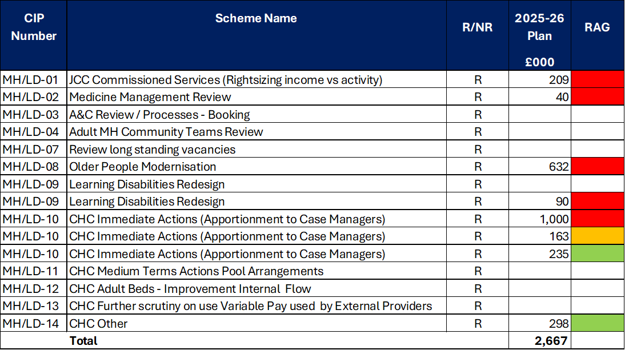
Appendix 1: Schedule Savings Schemes

