Slide 1
Performance & Finance Review
Morriston Service Group
25th June 2024
Notes:
The purple line indicates Morriston Hospital Service Group, so this slide can be used for matters which relate to MHSG.

Slide 2
agenda
Executive Summary
In-Month Revenue Position
Appendix 3: Trend Graphs
Appendix 2: Governance Arrangements
Savings Performance
Key Drivers
Service Risks & Opportunities
Appendix 1: Service Group Provided Services
Financial Risks & Next Steps
Appendix 4: Savings Detail

Slide 3
executive summary – Service Background, Structure & Context
Morriston Service Group (MSG) base opening allocation of £271m for 24/25 with further allocations supporting high cost drugs and performance recovery to follow in year.
MSG has had significant challenges in delivering within it’s funding envelope for a number of years, although progress has been made on reducing overall run rate and removing excess expenditure over the last 12 months particularly in nursing; further strategic work is ongoing to develop services in a way that can deliver efficiently and effectively within allocated funding levels.
There have also been a number of changes in the last year with Service Group Director Sue Moore joining in September 2023 and transfers between service groups through the latter half of 23/24 financial year to align organisational strategy. There remain a few smaller transfers yet to process in 2024.
A new service group structure is in the process of implementation following an OCP with the aim of reorganising services and shoring up managerial capacity to deliver against performance and financial challenges (see appendix 1 and 1a for service breakdown pre and post OCP).
New Divisional structure summary:
MSG closed the 23/24 financial year with a budgetary over spend of £33.1m, carrying significant pressure into the new financial year despite success in year on reducing both nursing and medical variable pay rates carried into 24/25 and closure of wards on site to support decant and infection control work, whilst ensuring patients could still be cared for in an appropriate setting.
Clear strategic approach going forward based around active risk management, local accountability, clear communication and performance escalation.
Acute & Emergency Services and Hospital Operations
Medicine
Integrated Surgical Services
Specialised Surgical Services
Management (including Quality & Governance)
Radiology
Pathology
Morriston Service Group

Slide 4
executive summary – In Year Financial Performance Summary
Key Messages:
Key Drivers:
Nursing pay:
  Cost pressure per post (incremental pay growth)
  Surge capacity (Acute Medicine)
  Cost of cover (sickness, acuity & vacancies)
Medical & Dental
  Acute & Emergency Medicine; Consultant and Non Consultant pressures to run appropriate baseline services plus additional front door cover.
  Cover of LTFT trainee’s in a number of specialities
  Surgical pressure linked to multi site cover and sickness
  Pathology & Radiology activity demand
Clinical Supplies & Services;
  Neurology Blood products; above inflation price increases and activity growth
  Cardiology consumables and device cost increases
  Radiology and pathology consumables
  Additional patient numbers bedded
Specialist & Other Income under performance; mainly Cardiac. Offset with over performance in other areas but at a premium cost.
Further detail showing trends can be seen in later slides for information.
The Service Group has assessed it’s underlying deficit brought forward into the new financial year at c£37m.
The Health Boards 2024-25 financial plan issued a net funding allocation of £16.9m to Morriston Service Group supporting the 23/24 brought forward savings gap, some long standing cost pressures, inflation and a small amount of new investment offsetting risks.
Taking into account the above, the local assessment is of an opening deficit of c26m.
The Service Group will need to reduce expenditure run rate and deliver on budgetary savings in order to manage within available financial resource and create a sustainable forward plan.
At month 02 there is a year to date overspend of £4.8m, this extrapolates to £28.9m at year end. However, there are improvements anticipated due to actions being undertaken.
The Service Group financial plan has not yet closed the gap between funding and expected expenditure as such not all budgets have been issued to lines. Some funds are held with in the management cost centres as released reserves. Work continues to align funding to plans and further close the financial gap.

Slide 5

In month financial performance: variance by division
Key Messages:
Current ledger reflects existing agreed service structure. OCP now complete and ledger will be reorganised to reflect this
Largest pressures continue to be seen in Medicine – though this will split across 2 new divisions going forward allowing for more focus on key issues
Reserves are being released in 1/12ths as appropriate but held on reserve line centrally whilst work continues on the plan gap; a separate reconciliation has been provided of likely ‘landing’ position post fund allocations to finance colleagues
In month variance improved by £150k from month 1; but there were numerous ups and downs and nothing that would indicate a sustainable downturn in trend.

Slide 6
Service Risks & Opportunities
Risks | Opportunities | Progress
Bed Base/ Surge/ Acuity | Singleton Surge Bed Position / Surge Resolution LOS/ Discharge Management Frailty Pathway Work SDEC Redesign | Reduction in beds open at Singleton to support flow (c60 at April, c20 June 2024) Frailty strategy approved, wards closed at Morriston saving £3m to reinvest in delivery of Frailty Unit which will support LOS SDEC redesign complete supporting improved patient experience and laying foundation for new ways of working
Medical Staffing (Decision Makers & Rota Gaps, Premium Costs) | Acute Medical Rota Design | New rota proposal developed and reviewed. Implementation beginning.
Premium Staffing Costs – Nursing, Medical & Dental | Substantive Workforce Recruitment Sickness and absence management Roster efficiency | Substantive registered nurse vacancies significantly reduced. Focus on recruiting to healthcare support worker gaps. Medical posts to support above strategic work actively in recruitment Non Consultant rota’s better staffed going forward Well embedded review processes for rota management Comprehensive sickness audit programme undertaken with support for management and staff to continue improvements. Additional workforce support built into the post OCP structures.
Interventional Radiology | Long Term Strategy Development & Service Redesign | External support engaged and early reports produced. Locum cover in place to maintain safe service with substantive recruitment being undertaken
Non Pay (Inflation/ Practice Change) | Procurement Maintenance Contract Review Bed Hire Drug management (waste/ swaps) | Work in progress across all domains in local plans, with support from procurement and pharmacy colleagues. Reporting mechanisms under review as part of local governance arrangements post OCP.
Activity Growth/ Recovery | Demand & Capacity Plans Specialist Commissioning Cost Review & Negotiation | Developed and under review with Planned Care. Work on activity based costs for consumables linked to specialist work (Cardiology/ Cardiac) progressing, plans to complete and engage in commissioner discussions
Other | Income Generation Clarity of managerial structures to support decision making Pathology workforce design (ARCH) | Local plans identifying income opportunities being built into recovery position. New structures in implementation. ODN structure agreed
Further Work Planned
ED design post frailty implementation Right-size services: Cardiac ITU/ HDU/ PACU Theatre Sessions commissioned (align to D&C) Job Planning Efficiency Strategic service reduction (value based outcome analysis)

Slide 7
Key Expenditure Drivers: Identification of Further Opportunities
Actions being taken of areas of highest spend:
Medical & Dental: Variable Pay £546k in month, reduction targets set for all teams of 25% net reduction. Local plans in development. Redesign of rotas and job planning.
.
Registered Nursing: Variable pay £534k in month, reductions expected through unavailability management across all areas. The impact of reducing patients waiting in acute service areas could reduce costs by up to £80k per month. Strategic plans to reorganise the bed base will further impact expenditure rates.
Additional Clinical Services (Healthcare Support Workers): As for registered nursing with continued and increased scrutiny on unavailability and cover arrangements plus focus on recruitment to fill vacancies.
Allied Health Professionals and Healthcare Scientists: £417k variable pay per month – targeting a 50% net reduction through review of demand and capacity plans and ensuring staff are focussed into clinical activities.
Establishment Expenses: reduce costs of postage, stationary and printing linked to exploiting digital opportunities.
Services from Other Bodies and Purchase of Health Care: reviewing whether service contracts meet the Health Boards needs in the most cost effective way.
Clinical Supplies and Services: Procurement target a net reduction in run rate alongside internal reviews of consumables to ensure stock management. Consumables linked to activity delivery being reviewed against funded growth and external income sources to ensure cost recovery.
Premises & Fixed Plant: Bed hire - to be brought into a new contract in the latter half of the year, in the interim robust processes to manage available bed stock.

Slide 8
Savings delivery performance
  Opportunities identified with actions against them (detail in appendix 4):

Slide 9
Other Financial Risks
  Opening position assessment in the financial plan is not a forecast. It is based on 23/24 outturn, adjusted for known items.
  However there are risks to be monitored and mitigated;
    Interventional Radiology Service
    Activity Growth (particularly diabetes, blood products, renal)
    Inflation
    Changes to arrangements for inter group charging
    Implementation of IT contracts linked to radiology (RISP) and potential ‘legacy equipping’ issues. As well as Critical Care (WICIS)
    Support staffing for change programmes linked to TI and delivering operational strategy may be required
    Recruitment of ‘streamlining’ students on anticipated turnover, where turnover may not materialise
    Potential for Joint Commissioning to amend contract rates
    Expansion of robotic surgery sessions will have associated consumables costs
    Planned investment into stroke for 24/25 has not been supported in the financial plan
    Infection control linked expenditure
    Management of equipment nearing end of life

Slide 10
Discussion Points & Next Steps
Morriston Next Steps:
  Divisional plans brought to Financial Improvement Board May 2024; further work to develop into action plans – 1-1 meetings with SGD and FBP in place.
  Internal financial plan has a shortfall and a number of risks to mitigate – development of options.
  Divisional Annual Planning by 30th June 2024.
  Reflection of plan decisions in financial ledger allocations.
  Implementation of OCP outcome – reflection in ledger, budgetary delegations.
  Service transfers (Dermatology/ ACT/ Virtual Wards)
  Continued embedding and improvements in Internal Governance
Support:
  Risk management (IPC/ Capital/ IR/ Vascular/ Base Plan shortfall/ Surge/ Front Door)
  Space to enact plans and see results
  Benchmarking information
  Budget manager training (systems & skills)
  Expert analysis

Slide 11
Appendix 1
Service Group: Provided Services – Pre OCP
Clinical Support Services
Integrated Surgical Services
Specialised Surgical Services
Medicine & ECHO
Performance & Operations
  Hospital Sterilisation & Disinfection Unit (HSDU)
  Critical Care
  Pathology
  Radiology
  Major Trauma Network
  Urology
  Cleft
  Ear, Nose & Throat (ENT)
  Oral & Maxillofacial Surgery (OMFS)
  General Surgery
  Vascular
  Artificial Limb and Appliance Services (ALAC)
  Burns & Plastics
  Cardiothoracic
  Cardiology
  Orthopaedics (Wards only)
  Acute & Emergency Medicine
  Care of the Elderly
  General Medicine
  Endoscopy, Gastroenterology & Respiratory
  Renal
  Stroke, Neurosciences, Diabetes & Endocrine
  Site
  Business Intelligence
  Quality & Safety

Slide 12
Appendix 1a
Service Group: Provided Services – Post OCP
Acute & Emergency Service & Hospital Operations
Integrated Surgical Services
Specialised Surgical Services
Medicine
Pathology
Radiology
Management & Governance
  Major Trauma Network
  Acute & Emergency Medicine (incl. MIU)
  Care of the Elderly (Frailty)
  Site Management
  Business Intelligence
  Urology
  Cleft
  Ear, Nose & Throat (ENT)
  Oral & Maxillofacial Surgery (OMFS)
  General Surgery
  Artificial Limb and Appliance Services (ALAC)
  Hospital Sterilisation & Disinfection Unit (HSDU)
  Burns & Plastics
  Cardiothoracic
  Cardiology
  Critical Care
  Orthopaedics (Wards only)
  Vascular Access
  General Medicine
  Endoscopy, Gastroenterology & Respiratory
  Renal
  Stroke, Neurosciences
  Diabetes & Endocrine
  Cellular Pathology
  Laboratory Medicine
  Phlebotomy
  Care After Death
  Microbiology
  POCT
  CT
  MR
  Ultrasound
  Interventional Radiology
  PACS/ RISP
  Quality & Safety
  Central Management
  Workforce support

Slide 13
Appendix 2 – Governance Arrangements
The following arrangements are already in place within the Service Group for Financial Reporting and Scrutiny:
Group Level:
Financial Performance Report to MSG Board (Quarterly)
Financial Performance Update to Operational Management Group (Bi-Weekly, standing agenda item, used flexibly to discuss pertinent financial issues and share progress)
Financial Improvement Board (Monthly, chaired by Group Director)
Update to Clinical Cabinet (ad hoc)
Update to Professional Nurse Forum (ad hoc)
Nurse Workforce Scrutiny Group (Weekly, chaired by DoN)
Divisional Level:
Financial Performance Report to Divisional Board (Monthly)
Divisional Business Meetings (Monthly/ Bi Weekly)
Budget holder meetings – targeting areas of higher financial risk (either due to value or volatility of expenditure) with frequency flexed to match service requirement.
Additional Scrutiny & Control:
Working groups in high risk areas for workforce planning (Pathology, Acute Medicine, UEC)
Vacancy Control Panel (Weekly – triumvirate and BPs)
Enhanced agency/ locum sign off processes
Scheme of delegation and procurement hierarchy (reviewed regularly – most recently in May 2024)
MSG is undergoing a managerial OCP which will better align capacity with operational and financial risk management. As part of completion of this process through June and July further review of the meeting structures and efficacy alongside forward requirements will be undertaken.

Slide 14
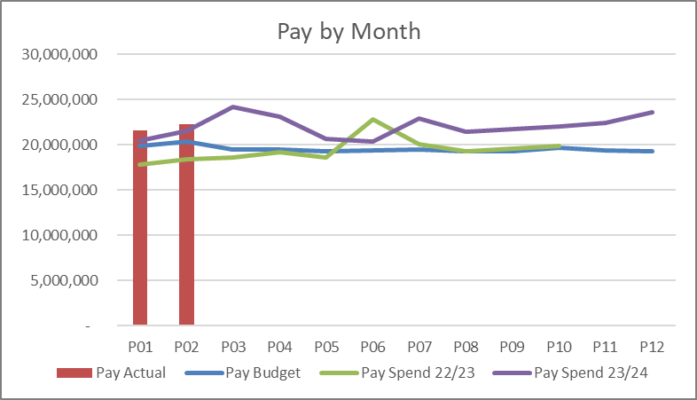
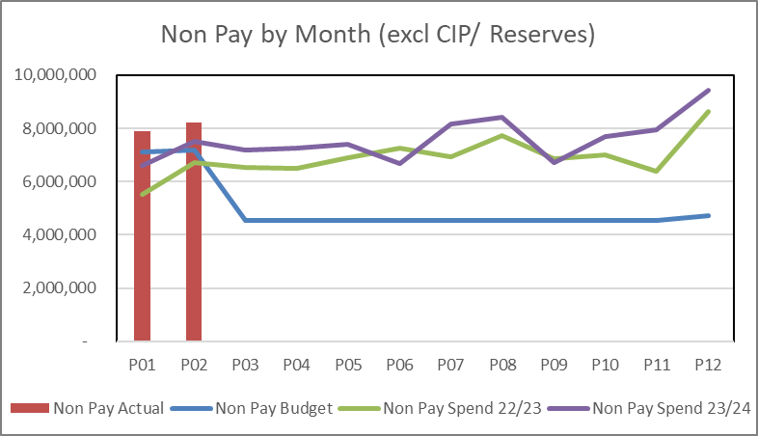
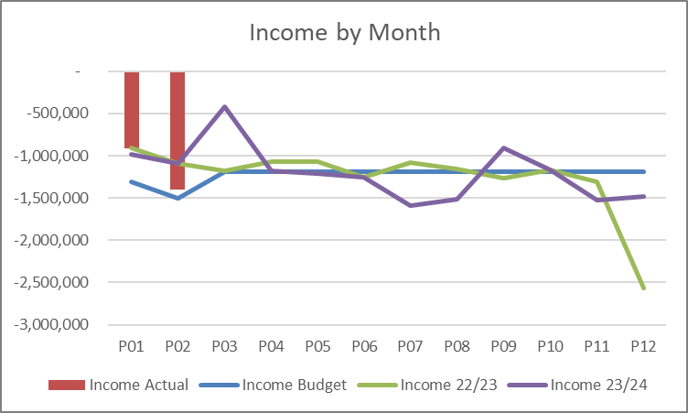
Appendix 3: Trends Overall trend – Actuals
Direct meaningful comparisons in pay are difficult due to the timing and mixture of back pay in pay awards during 23/24. However, if the annualised average is compared between 23/24 and current year, pay has slightly reduced, largely driven by lower nurse agency expenditure.
Expenditure remains above allocated budgets, with key pressures at the front door and acute medicine services for nursing and medical staffing, as well as within the pathology workforce (medical and scientific staffing).
Non pay spend average for the first 2 months of 24/25 financial year is c6% higher than the average across 23/24, c8% if year end movements are excluded. Adjusting for high cost drugs and devices still leaves an above inflationary allocation increase in spend. Main areas where pressures are known to be issues include growth in diabetic pumps & monitors, increased Cardiology device and associated consumables (volume and price increases, only part off set by income), continued surge pressure in general consumables and spend associated with end of life equipment maintenance/ replacement.
Income levels in month 2 have improved to stay ahead of 23/24 average but it is too early to take that as a trend indication. Gaps against budgetary expectations include specialist commissioning income and a series of long standing historic targets that have not been met post Covid and are under review as part of budget setting in Q1.

Slide 15
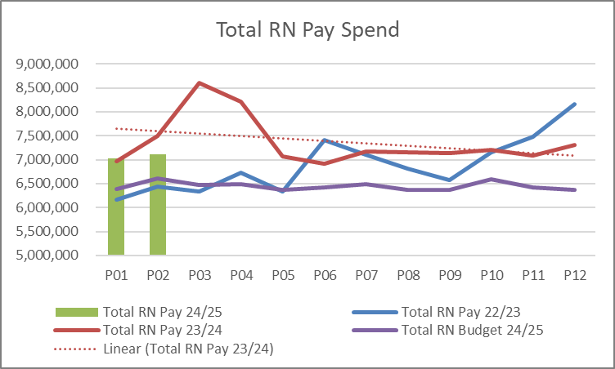
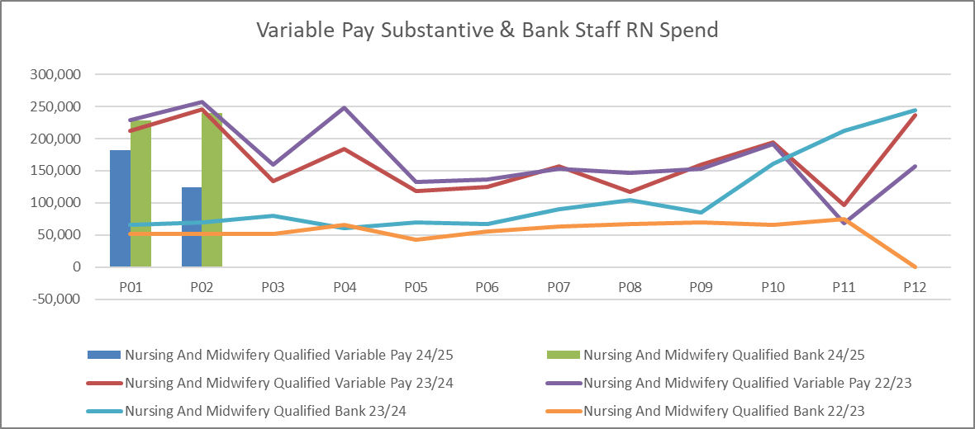
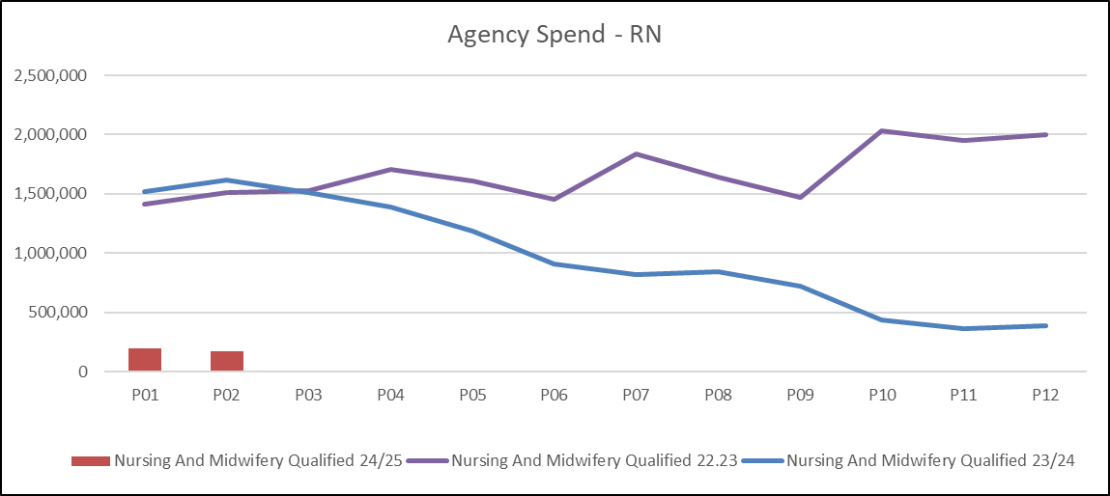
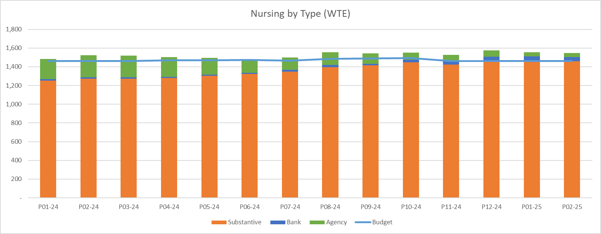
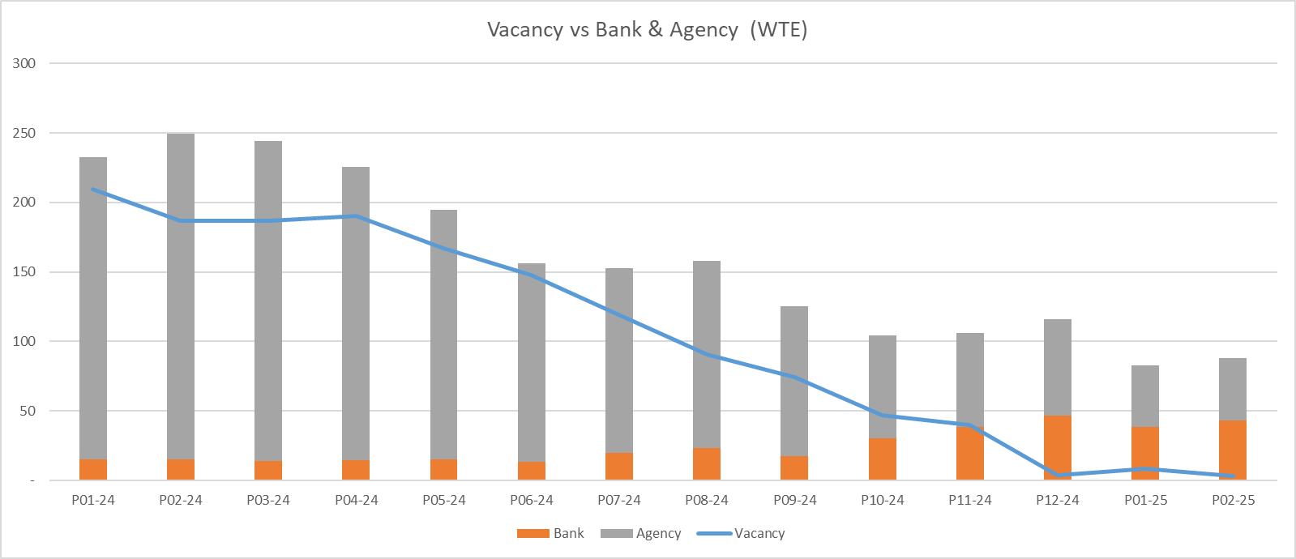
Appendix 3: Trends – Registered Nursing
Total monthly average pay for RN’s has reduced as a result of the significant reduction in agency expenditure, although substantive costs have increased for pay award and recruitment and there has been uplift in non agency variable pay to cover where required. Position adjusted for inflation and service change does show lower overall pay costs for RN.
Total wte utilised (incl. cover) across the service group has remained largely static from April 2023, reflecting service change and new investments (Surgical Assessment Unit, MIU, Surge) alongside better fill rates.
Unavailability remains above ‘allocation’ levels – averaging 31%to 32%, against a cover allowance in budget of 26.9%.
Surge in the form of Singleton beds, and ED and EMU pressures remain a key issue to resolve.

Slide 16
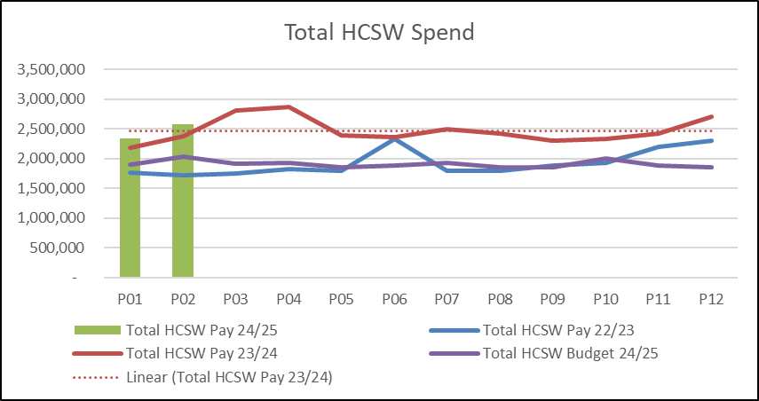
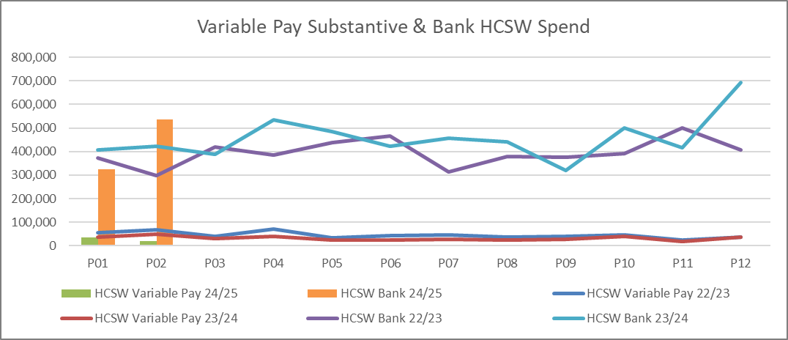
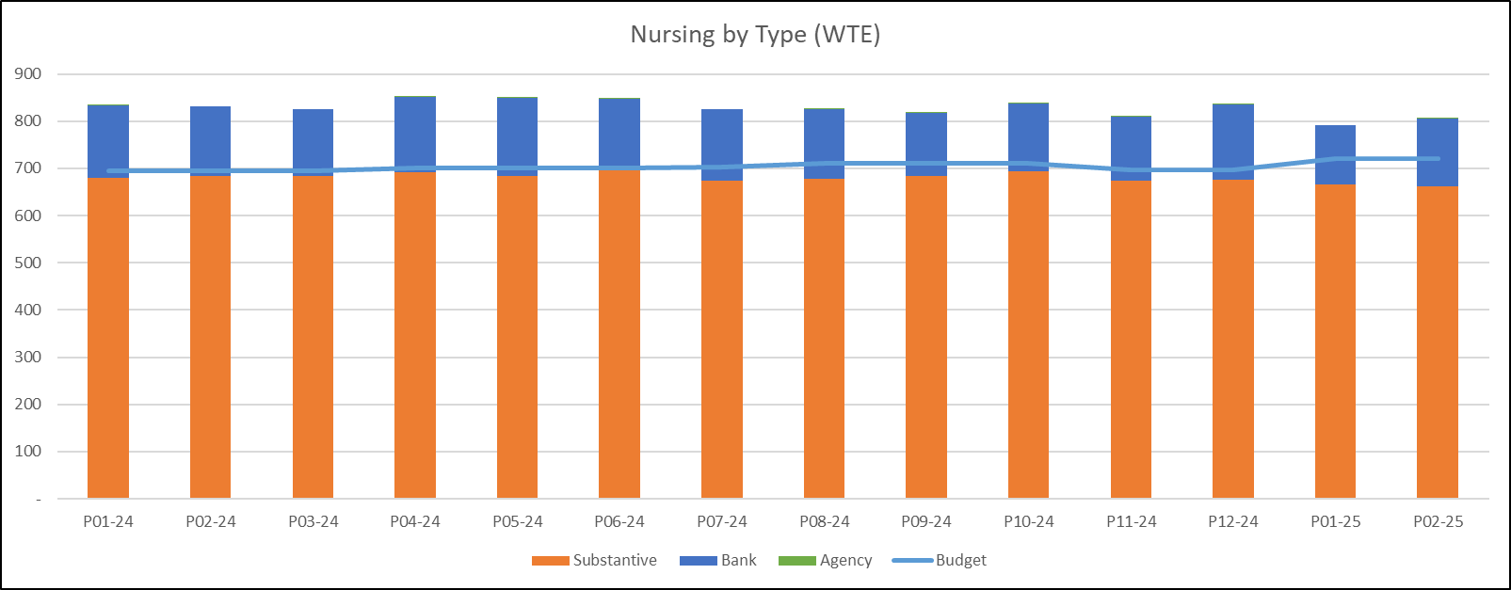
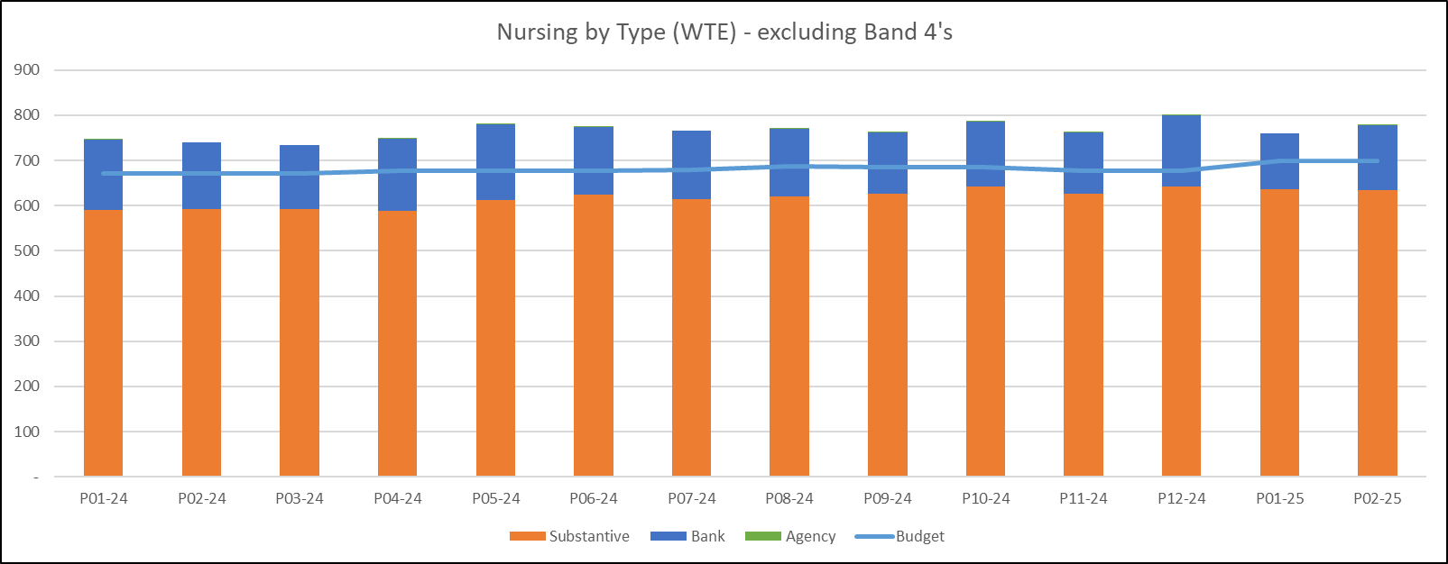
Appendix 3: Trends – Unregistered Nursing
Overall pay trend largely stable when amended for inflation, reflecting reductions in ‘pre registration’ nurse numbers in 23/24 who have now moved to registered lines offset by planned investments and related recruitment.
Substantive vacancies in this staff group totalling 69.98wte in month 2, however there are 15.83wte in the recruitment pipeline.
Challenges in managing surge, acuity & sickness, continued weekly monitoring, scrutiny and review.
Sickness audits
Renewed focus on recruitment and retention for HCSW

Slide 17
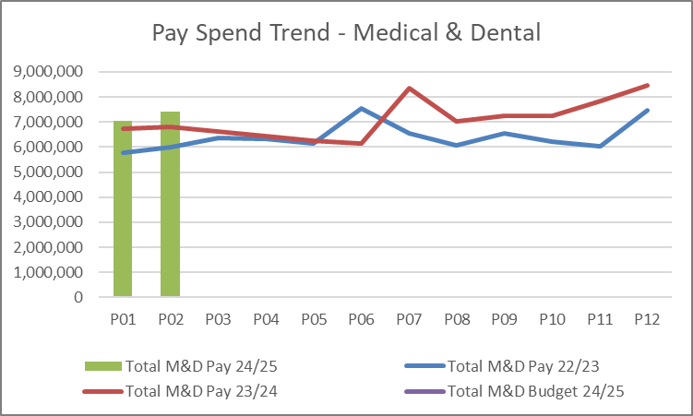
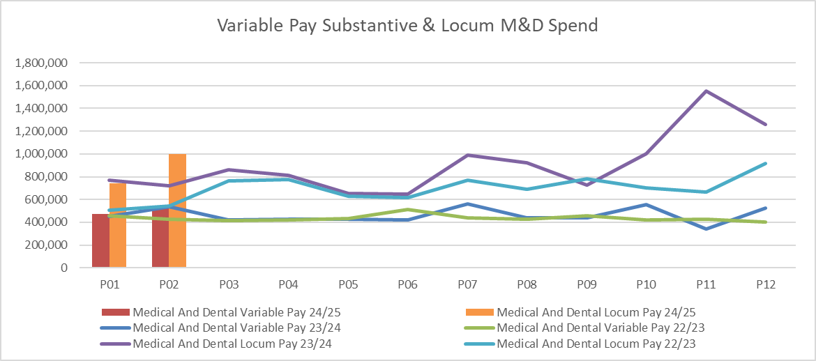
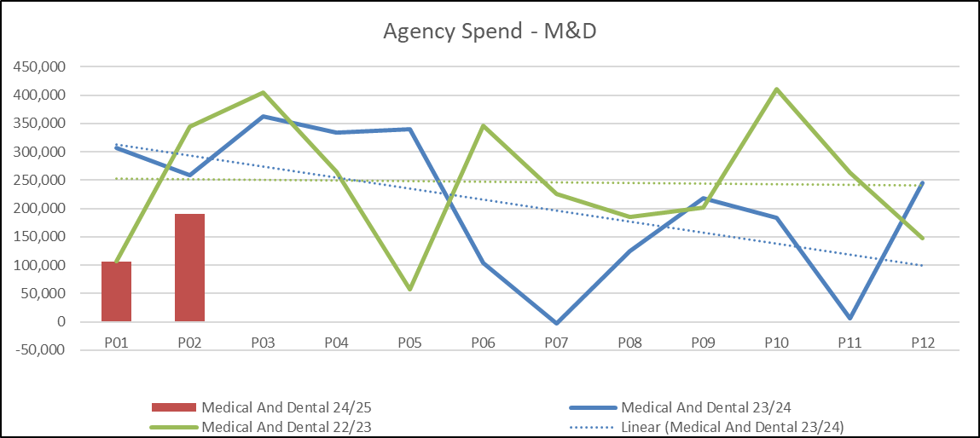
Appendix 3: Trends – medical & dental pay
Overall pay trend largely stable if exclude impact of Industrial Action, small reduction.
High cost agency significantly reduced in 23/24 with a focus on recruitment and use of lower cost cover options.
Active recruitment ongoing in May 2024 for Acute Physicians & Geriatricians linked to UEC strategy.
Rota redesign work being completed to confirm baseline for consultant and non consultant staffing.
Challenges in managing sickness, gaps in training rota’s including those driven by LTFT trainees, baselining post service changes.
Process improvements around information flows to allow better forecasting of costs and ledger management of fluctuations.

Slide 18
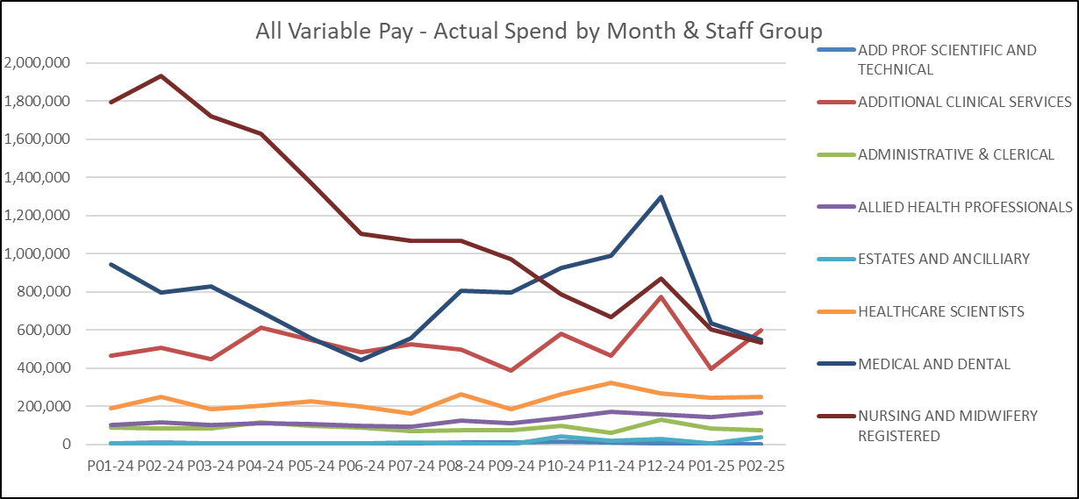
Appendix 3: Trends – all variable pay trajectories
Actions underway/reasons for movement:
Comprehensive plan of recruitment and unavailability management for registered nursing with the impact of the very successful overseas recruitment campaigns now showing in variable pay spend with further reductions expected.
Medical & Dental trends are skewed by the impact of Industrial Action at the end of 23/24, work to redesign core rota’s, recruit substantive staff and stabilise services anticipated to reduce costs in year.
Healthcare scientist and Allied Health Professions spend link to activity delivery in Pathology and Radiology with workforce redesign underway and consideration of all options to release substantive clinicians time for clinical delivery.

Slide 19
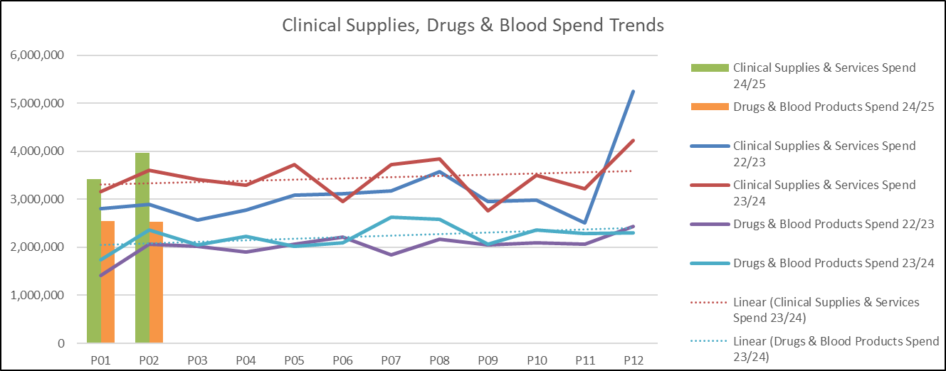
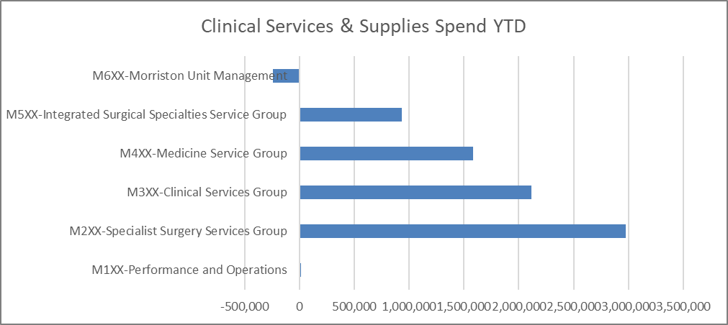
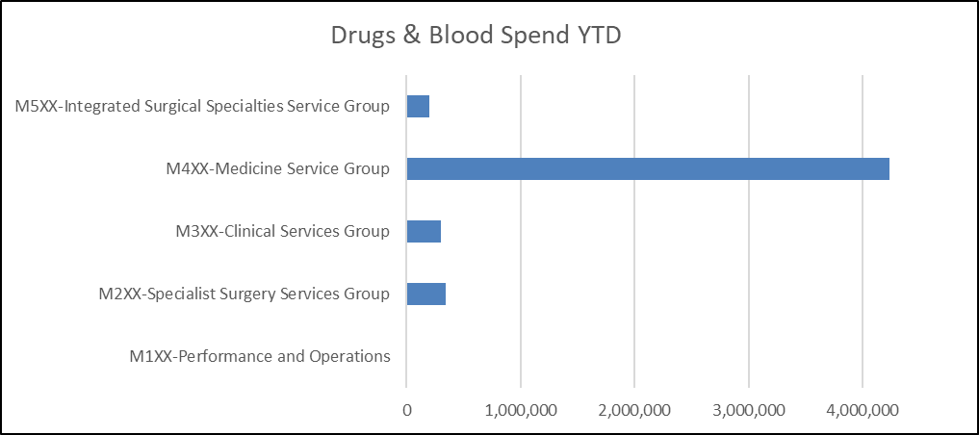
Appendix 3: Trends – clinical services & supplies, drugs
Clinical supplies & service trend line in year largely flat if exclude ‘year end’ stock changes; against challenging CIP targets historically in this area.
Year on year increase expenditure trend in excess of allocations, in particular where there has been growth in the service (diabetes, neurology, cardiology)
Limited value in looking at the ‘global’ picture; deep dives into specific areas provide more detail. If unable to deliver proportionate real terms spend reductions then increased pressure on the pay allocations to recover financial position.

Slide 20
Appendix 4: Savings Plan Detail

