Slide 1


Performance & Finance Committee
Morriston Service Group
29th July 2025

Slide 2

Agenda Detail
Health Board & Service Group Financial Summary
In-Month Revenue Position
Savings Performance
Key Drivers
Risks, Next Steps & Mitigating Actions
Appendices

Slide 3

Dashboard

Slide 4
Summary Health Financial Plan & Service Group Element
FINANCIAL PLAN 2025/26
SERVICE GROUP ELEMENT PLAN
OPENING BUDGET

Slide 5

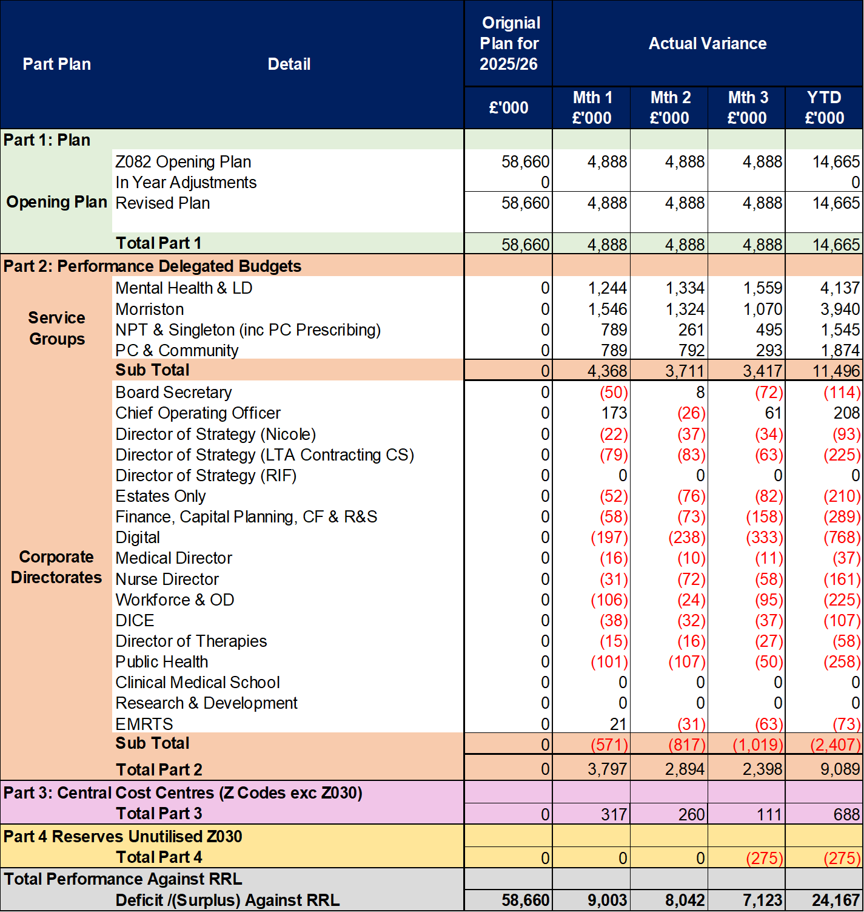
2025/6 In Year Health Board Position & Service Group Element

Slide 6
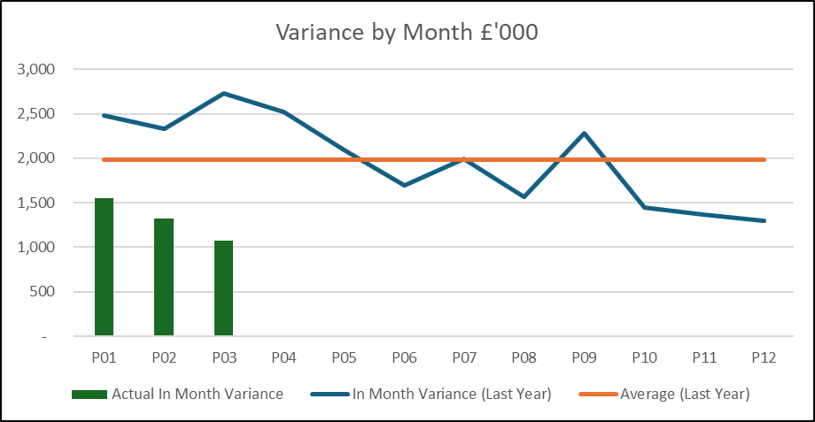
Service Group Position By Month & Divisions
KEY MESSAGES
Morriston Service Group (MSG) has an assessed opening 2025/26 underlying deficit of £30.9m excluding new year growth and inflation, but assuming that long standing underspends continue and all 2024/25 savings plans listed as green/ amber deliver a full year effect. The full assessed deficit has been funded via the Health Boards financial plan. In addition funding for assessed growth on diabetes devices and blood products has been issued. All other growth, demand and service pressures are expected to be managed and the Service Group deliver a break even position.
The Service Group has been set a savings target for the year of £16.1m
In month 03 Morriston is reporting an overspend of £1.070m and a Year to Date overspend of £3.941m.
The largest element of the in month overspend to budget related to unachieved cost improvement against the delegated target at £0.940m in month. The cost improvement position is further detailed on slide 12, year to date the position is adverse to budget by £3.5m.
Overall the in month position has improved by £0.254m compared to month 02, driven mainly by the variable pay position. Income performance also improved on commissioned activity although this mostly offsets the marginal cost of activity delivery, rather than improving the bottom line variance. The small remaining income benefit offsets an increase in clinical consumables spend in unrelated areas, which is driven by ordering practices on non stock items ahead of anticipated activity delivery.
The position excluding cost improvement targets is largely as per the underlying position assessment utilised in planning for 2025/26. However, there are both areas of improvement and those where pressures have been worse than expected. Whilst they are netting off at this point in time, close monitoring is being undertaken to ensure that the benefits can be maintained as far as possible and that the pressures are being actively managed.

Slide 7
In month Service Group Position By Division & Type Expenditure/Income
In month 03 the final of the planned budget reallocations were complete, which moved funding from non pay reserves to realign the base budgets to the underlying plan assumptions. This can be seen on this statement as a large in month overspend on miscellaneous services with significant offsetting underspends on a variety of pay lines.
This change followed extensive reviews and discussions with the managerial teams. As a result in month the line by line breakdown of variance is less meaningful, but the year to date position is correct and the in month will be correct going forward.
Whilst the in month position is exaggerated due to the funding movements, the broad areas of performance remain true.
Pay is slightly improved when compared to the plan, with small improvements in medical and nursing spend linked to variable pay. The largest element however is due to vacancies which are being actively managed as the cost improvement gap is reassessed and planned for.
Non pay has some pressures both in clinical consumables and premises and fixed plant. The former driven by activity and in part offset by income and the allocation of inflationary and growth funding, the latter linked to ongoing pressures with the cost of bed hire.
The main pressure remains the unachieved cost improvement target, which shows under Miscellaneous Services.
Income performance was worse than anticipated through month 01 and month 02 but has recovered in month 03 providing some assurance as to the forward view.

Slide 8

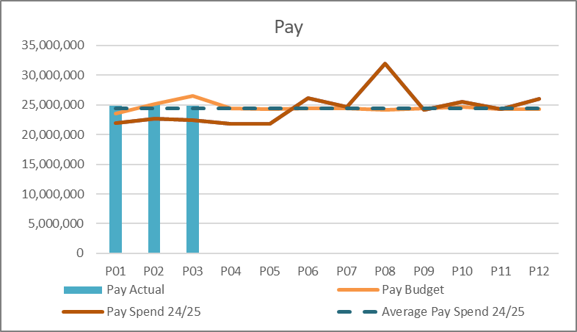
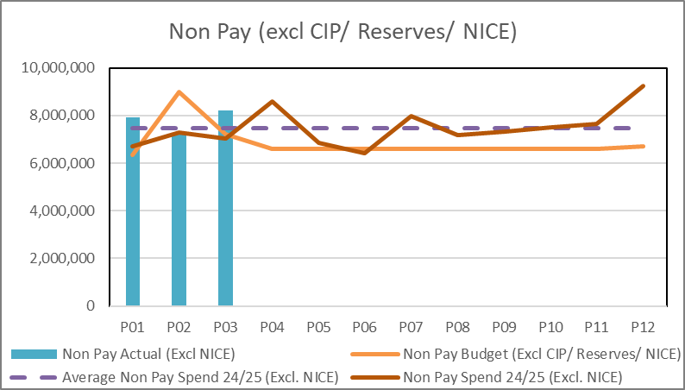
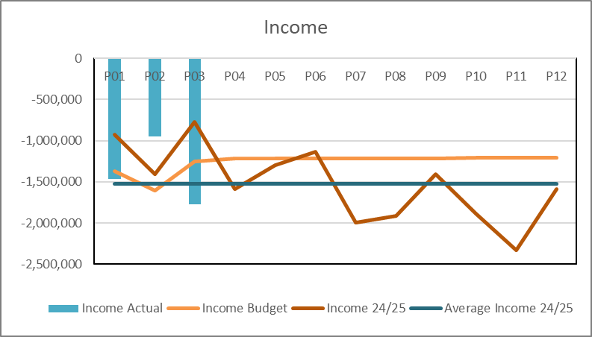
Drivers of Position (Actual)
Pay: Actual expenditure trend remains relatively stable across quarter 1, and very similar in total average monthly cost to 2024/25 as the in year pay award is yet to be issued. Overall a small reduction in monthly average of total variable pay (-3%) is offset by a slight increase in substantive pay, although due to the concentration of bank holiday enhancements in quarter 1, this is not clear evidence of an upward overall substantive trend.
Having realigned the pay budgets to match the underlying assessments, a small underspend is now reported against budget to date. Some of this is clearly due to gaps between vacancies and recruitment, work continues as to whether there are posts/ assumed variable pay that can be released to savings given actions being undertaken to date.
Non Pay: Excluding high cost (NICE) drugs non pay in quarter 1 is running at a higher average cost than the equivalent period in 24/25 and higher than the average spend from 24/25. The position against budget must be considered against the income position, some specific higher cost consumables are within Cardiology which is supported by income delivery (Joint Commissioning Committee contracts). It can be seen there are over performance on the income line offsetting these costs. Areas of concern when compared to the underlying assessment at this stage are; diabetes pumps and monitors, postage, bed hire and consumables in radiology and pathology. The majority of these pressure areas are driven by activity. It is expected that diabetes pumps and monitors will level out over the year with increased ordering in quarter 1 preparing for expected roll out in the coming quarter, the bed contract implementation will reduce exposure in that area and hybrid mail roll out should reduce postage. Other consumables require further analysis, but continued demand growth is a factor with savings schemes being developed linked to demand management going forward.
Income: Some activity challenges in delivering the Joint Commissioning Committee contracts in month 01 and 02 (bank holidays, theatre closures) have abated in month 03 leading to improved performance. In addition the final part of 24/25 saw increased income in delivering savings schemes for that year. Income expectations are under review for 25/26 to ensure alignment of budgets and where possible cashing against cost improvement plans.

Slide 9
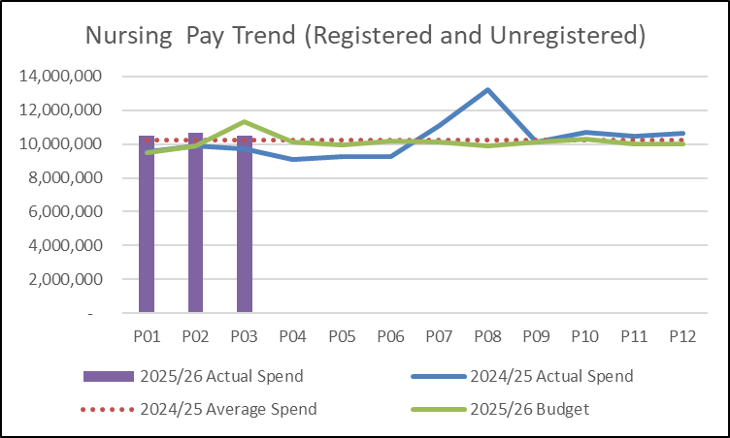
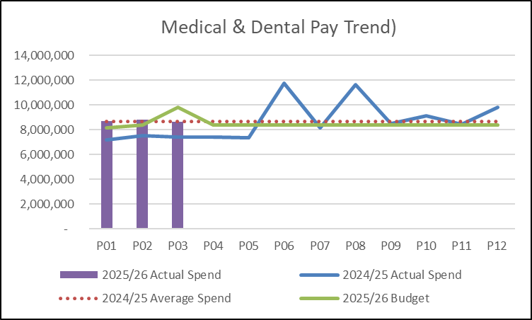
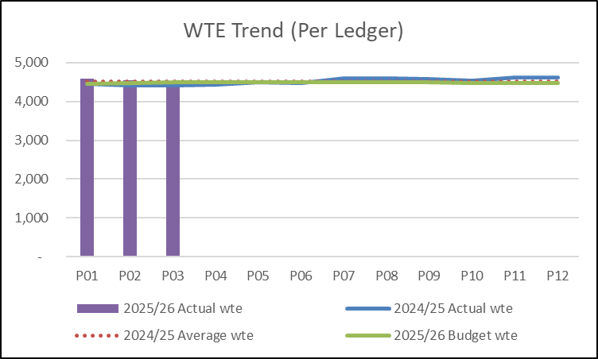
Drivers: Pay Summary (Actual)
Pay trend for the two highest spending groups, nursing and medical staff, has remained largely static through quarter one despite some reductions in variable pay at month 03.
Both the nursing and medical pay trend holding stable in month 03 despite the opening of Anglesey as part of the Urgent Care ‘test of change’ is a positive indication of the managerial controls in place to ensure that staff are redeployed to gaps where possible and variable pay exposure limited. This will continue to be monitored as the extension to the test of change has been agreed.
As yet pay awards have not been applied, although they will receive additional funding when that is actioned.
The registered nurse workforce has no vacancies at this time when considered as a whole group, the focus as we move forward is on reducing the continuing variable pay position linked to unfunded bed areas and unavailability.
The unregistered workforce continues to have a number of vacancies which are mainly covered by bank.
Whole Time Equivalent numbers remain steady which is expected given limited vacancies and the slowing of recruitment due to enhanced scrutiny.

Slide 10
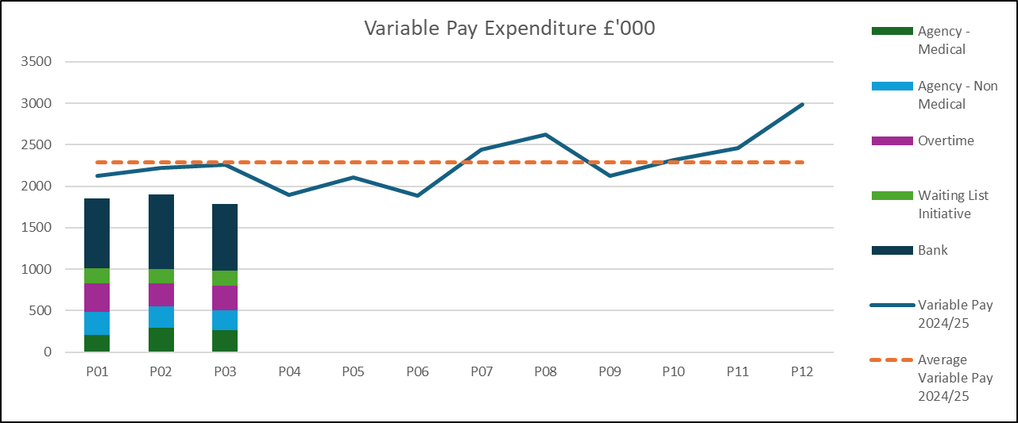
Drivers: Variable Pay & Performance Against 30% Reduction (Actual)
Key messages:
There is now limited use of agency staff across the Service Group. Agency staff use is largely limited to 3 areas; Radiology, Laboratory Medicine and Acute Medicine. The acute medical rota has had some gaps supported by agency staff on an ad hoc basis, this has reduced significantly and continues to be monitored. In addition a small number of Emergency Department nursing shifts are covered by agency which is anticipated to cease soon following successful recruitment in April. Within Laboratory Medicine and Radiology the service is currently reliant on variable pay including agency staff (medical and healthcare scientists) to deliver the required activity to meet performance targets and ensure the Interventional Radiology service is operational.
Waiting list initiatives continue to be used to support the delivery of surgical capacity, in particular planned care additional work.
Bank nursing is being used to support unfunded beds (surge) and gaps due to unavailability for both registered and non registered staff, this is starting to reduce followed concerted efforts by the leadership team. Work on reducing unavailability in particular sickness continues.
There is also some administrative staff bank in use, linked to planned care funded work and some gaps in staffing the Emergency Department and Acute unit receptions.
The Health Board has been set targets to reduce agency expenditure as part of the NHS Wales Planning Framework. The target is to reduce all agency expenditure by 30% based on the 2024-25 outturn and to cease the use of all ancillary, A&C, and HCSW agency staffing by the end of September 2025. As above, this target is only now breached by medical staffing and Healthcare Scientists linked to delivery of specific diagnostic services.
A further variable pay reduction target to close the financial planning gap has been issued internally, work is ongoing to risk assess our ability to meet that target going forward when considering continuation of planned care and activity delivery.

Slide 11
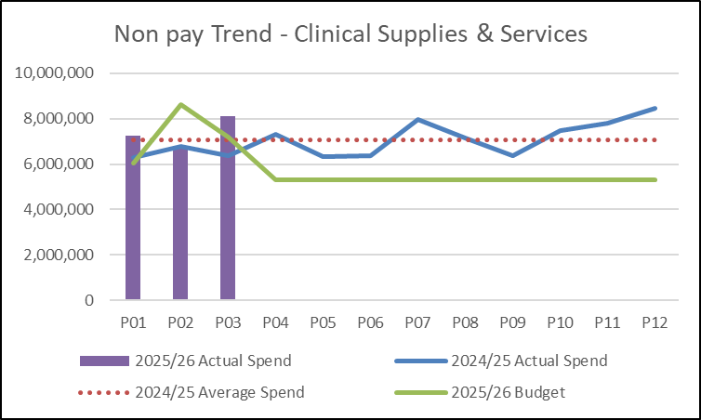
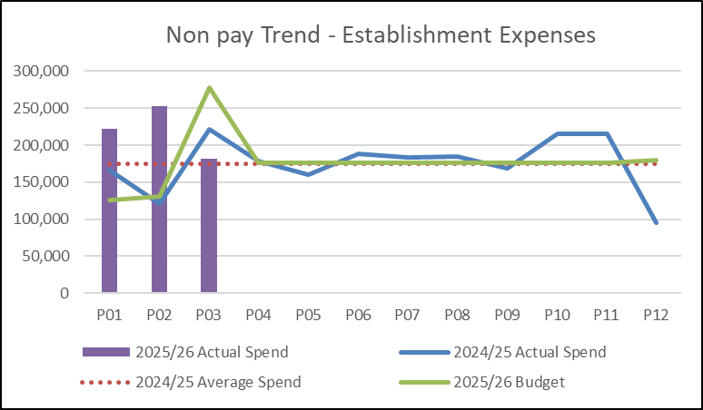
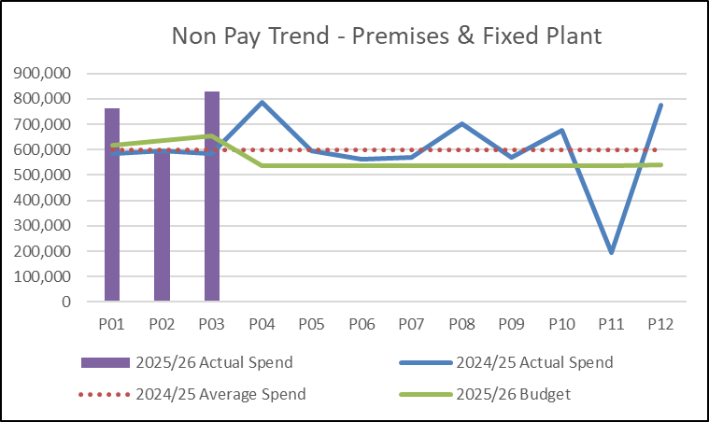
Drivers: Non-Pay (Actual)
Clinical Supplies are overspent by £310k year to date. The actual expenditure includes high cost drugs (NICE) which receives matched funding and can result in quite large fluctuations with no impact to the budgetary variance. The spend increase seen in month 3 (increase of £1.2m) was £0.5m drugs and blood products, a large increase on NICE funded spend offset by decreases in non NICE drugs. £0.5m increase in spend on heart valves, supported by income funded via the Joint Commissioning Committee. £0.2m is split equally between diabetes monitoring devices and testing reagents for Pathology and fully driven by activity. The cost pressure year to date sits across Pathology, Radiology and Acute Services and related to spend increases in excess of the underlying assessments and which are demand driven. Work is ongoing to assess whether any of this links directly back to planned care changes.
Establishment expenses are overspent by £123k year to date, with £93k of pressure on postage and carriage reflecting increases in both cost and volume through quarter four beyond those reflected in the financial plan. Expediting digital solutions and ensuring all additional volume linked to recovery plans is funded are key mitigations in that area. The remaining overspend links to one off legal costs that are not expected to continue. The reduction in spend seen in month 03 was an end of quarter truing up of the postage position, processes have been reviewed to limit these fluctuations going forward.
Premises & Fixed Plant is overspent by £285k year to date. There is a £375k overspend on bed and chair hire, this pressure had been anticipated to significantly reduce following the award of the new Health Board wide bed contract, which is yet to be implemented. This is offset with some maintenance credits during the first quarter. The cost increase in month 03 of £232k, was due to £79k fluctuating utilities charges linked to costs flowing from the new renal unit contract in Bridgend – this is funded and does not worsen variance. £68k linked to bed and equipment hire cost fluctuations truing up the quarterly position following data review. The remaining value are small individual changes across multiple lines and not of concern with regards the bottom line expenditure run rate.

Slide 12

Savings Summary

Slide 13

Identification Opportunities & Risk
Further Opportunities for 25/26:
Further work up of savings schemes for inclusion in the savings plan, this will include
  Additional commissioning income
  Investment in digital technology and process
  Service modernisation & efficiencies
  Demand management
  Outpatient efficiencies
  Accounting gains
  Project funds
Recovery of costs for additional work undertaken in recovery space to ensure complete cost recovery.
Variable pay reduction following the local implementation of new Health Board wide capped expenditure.
Review of use of nursing headroom and associated rostering.
Impact of ‘test of change’ on the overall cost of urgent care performance.
Further Risks:
Recovery work impact on diagnostic spend, flows of recovery funds.
Waiting List Initiative Pay Award/ Pay Disputes
Site Acuity/ Surge
Renal Transition Plan
Bed Contract Implementation
Implementation timescales/ managerial capacity for a number of work programmes including recovery
Challenge of staff engagement against perceived deliverability
Inter group consequences of recovery plan options
Additional inflationary and demand growth pressures (testing, inter organisation agreements, maintenance, blood products, skin, diabetes)
Delivery of contract activity and prioritisation of limited theatre capacity
Increased nursing variable pay from increased acuity, sickness absence, and turnover
Additional costs of band 2 to 3 Support worker agreement

Slide 14
Actions & Next Steps To Be Taken By Service Group
The Service Group needs to manage new emerging pressures to ensure spend does not breach the underlying assessment.
The Service Group needs to continue to develop and deliver its cost improvement plans to meet the full £16.1m target recurrently, and utilise non recurrent means to bridge the timing gaps that are now inevitable through the 2025/26 financial year.
Further work is required to understand the impact of changing demand profiles and those driven by recovery work in supporting clinical services to ensure no adverse impact on the financial position.
The Service Group has undertaken a series of budgetary accountability meetings with the senior teams, with some further roll out through the hierarchy progressed. Additional sessions are planned to ensure the management teams supporting them have the core budget management skills required and know how to access benchmarking data and local and national resources to aid in generation of savings ideas.

Slide 15
Appendices

Slide 16

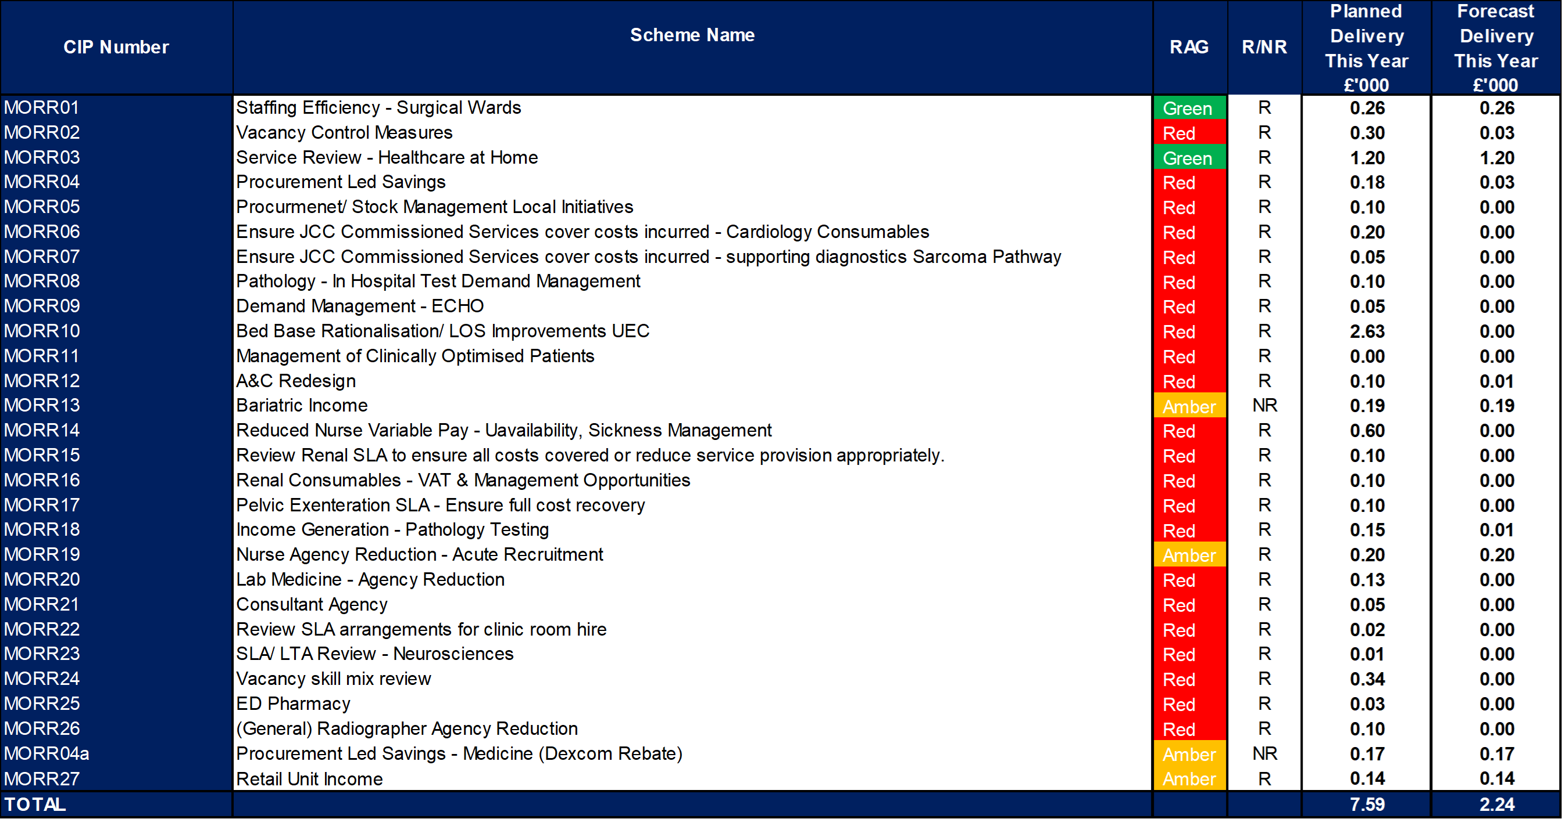
Appendix 1: Schedule Savings Schemes

