Slide 1


Update on Immunisation Performance
23 January 2024

Slide 2
Data sources for Immunisation
COVER data reports
  Issued by PHW on a quarterly and annual basis
  Provide coverage data against programmes
  Issued in arrears
Local data
  Provide real time data on numbers immunised
  Enable targeted actions while campaigns are ‘live’

Slide 3
Coverage of Imms at 4 years by LHB

Slide 4
Coverage of Imms at 4 years by LHB

Slide 5
All Wales uptake

Slide 6
Examples of gap from target, Apr – June 2023
For 3 doses of the 6 in 1 vaccine (94.6%) we were above the Welsh average (94.2%). To reach 95% target we would need to vaccinate 13 additional children in this quarter.
1 doses of MMR at 2 years (92.1%) we were slightly below the Welsh average (93.2%). To reach 95% target we would need to vaccinate 42 additional children in this reporting quarter.
2 doses of MMR at 5 years (88.3%) we are slightly below the Welsh average (89.3%) To reach 95% target we would need to vaccinate an additional 49 children in this reporting quarter

Slide 7
2-3 Years Fluenz Uptake in SBUHB
The latest IVOR report shows poor uptake across SBUHB for 2-3 year olds Fluenz.
The target rate for uptake is 75%, and the following slides provide a summary of current uptake levels across NPT and SC
SBUHB Summary 2023-24 - 7 Nov 23
 | Children 2 to 3 years
 | Denominator | Immunised | Uptake (%)
Neath Port Talbot | 2,536 | 474 | 18.7%
Swansea | 4,572 | 1,141 | 25.0%
SB Total | 7,108 | 1,615 | 22.7%
Wales | 60,514 | 16,176 | 26.7%
 | All 2 and 3 year olds
 | Denominator | Immunised | Uptake (%)
Llwchwr | 913 | 303 | 33.2%
Bay Health | 1,076 | 265 | 24.6%
City Health | 995 | 244 | 24.5%
Upper Valleys | 559 | 137 | 24.5%
Penderi | 817 | 190 | 23.3%
Afan | 987 | 184 | 18.6%
Cwmtawe | 771 | 139 | 18.0%
Neath | 990 | 153 | 15.5%

Slide 8
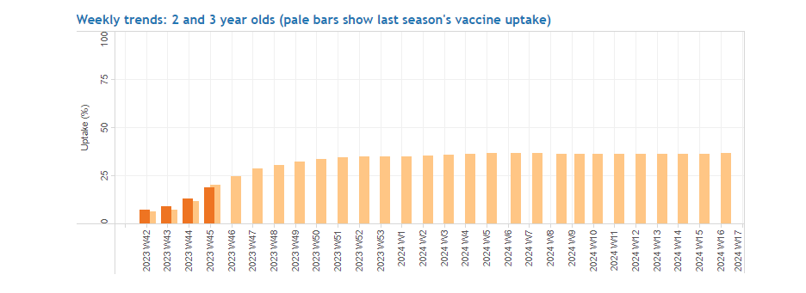
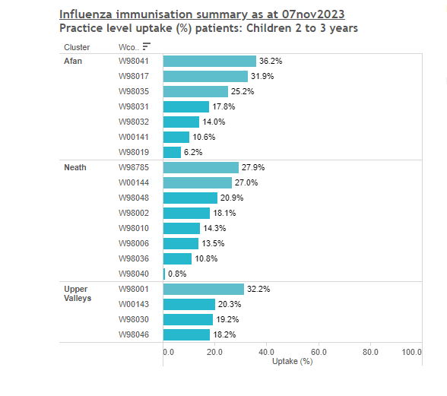
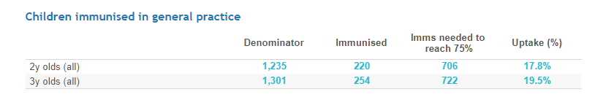
Neath Port Talbot LCA 2 to 3 year old flu.

Slide 9
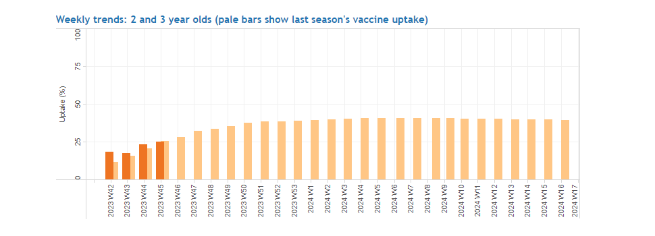
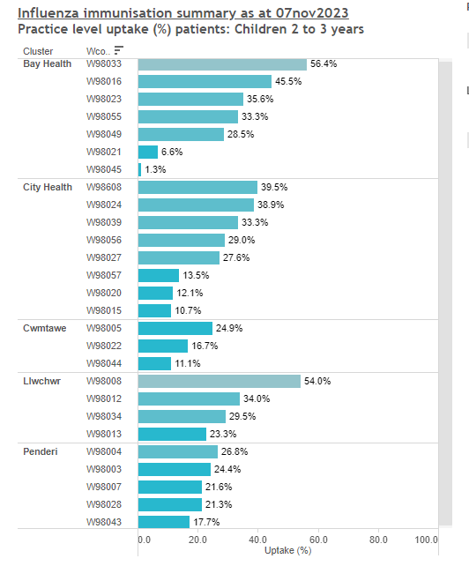
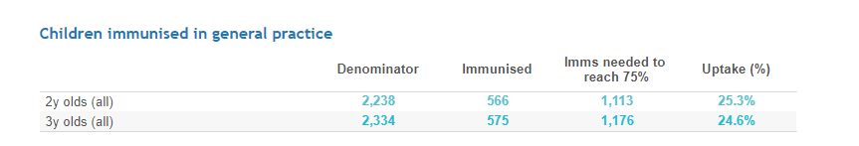
Swansea LCA 2 to 3 year old flu.

Slide 10
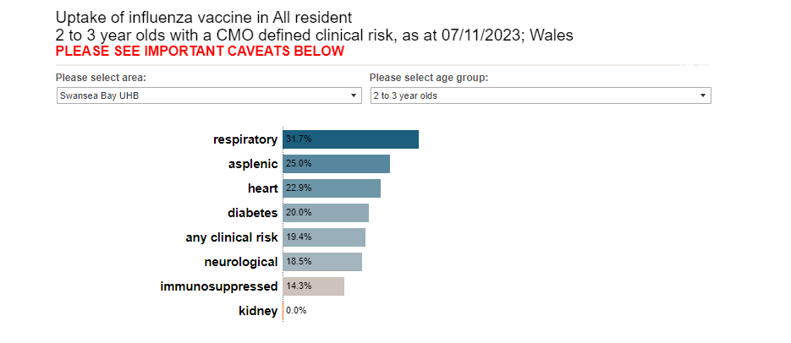
Uptake for at risk 2 to 3 year olds:

Slide 11
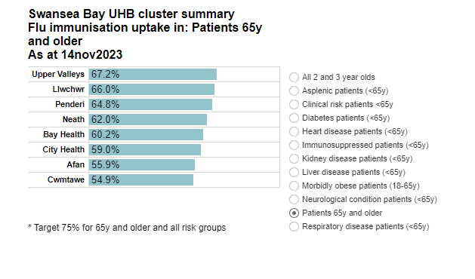
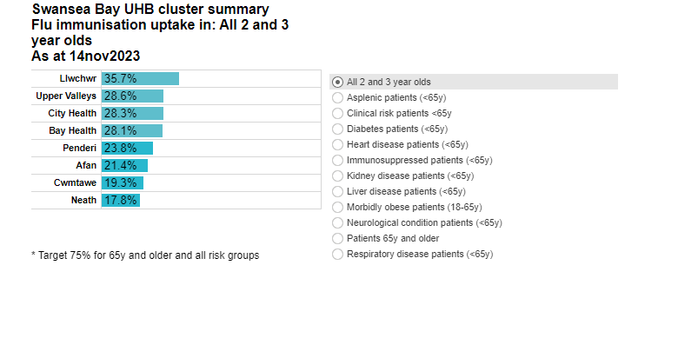
Flu Uptake 65+ and 2 – 3 year olds:

Slide 12
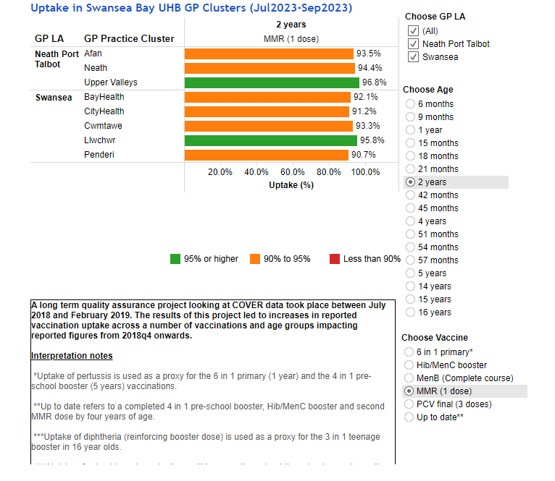
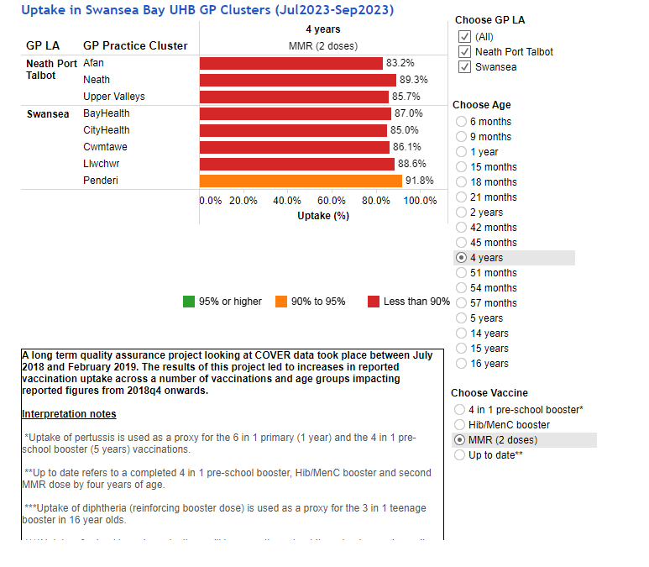
MMR 1st and 2nd dose:

Slide 13
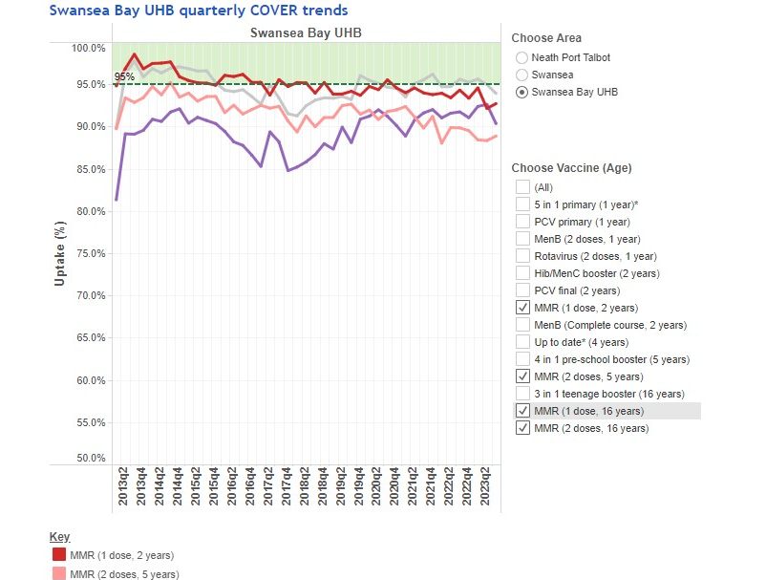
MMR Trends

Slide 14
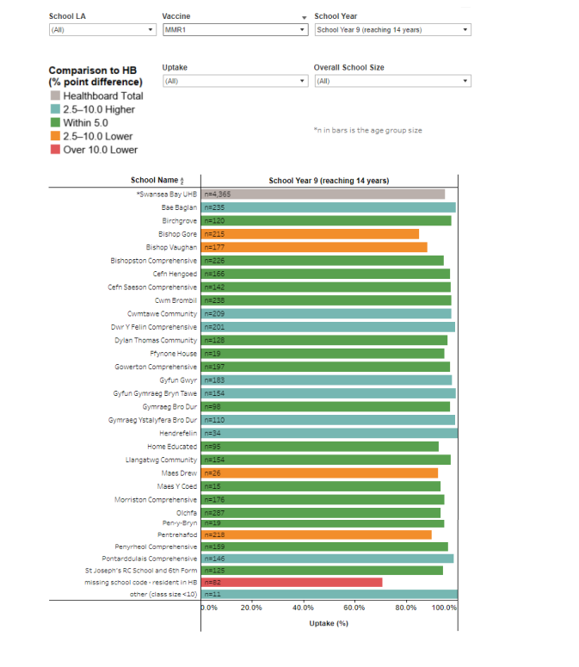

Slide 15
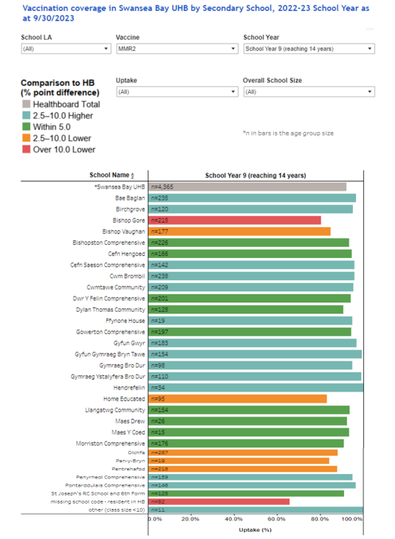

Slide 16
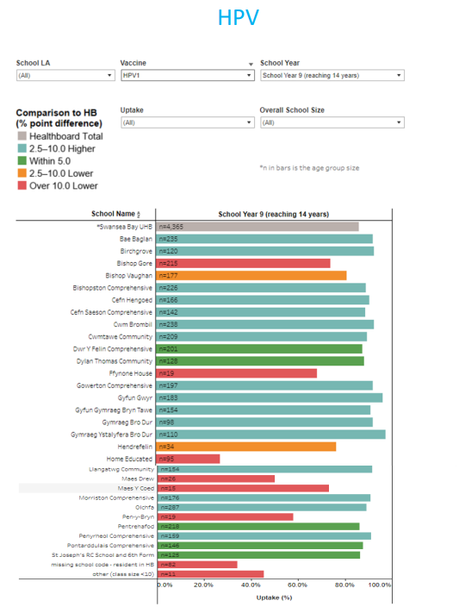

Slide 17
Opportunities for improvement on uptake:
Swansea Flying Start childcare settings have been identified as an opportunity to enhance uptake and accessibility for Flu
A pilot offering Flu in nursery settings is underway
Monitoring of GP Flu plans (Forecast delivery VS Actuals Immunised = Mop up plans if required)
Offerings at LVCs (Aberavon / Gorseinon) or Mobile unit offering in low uptake areas.
Call and re-call support from Immunisation Team
Ongoing Management of waiting lists to ensure Data Quality
Active Health board communications regarding Flu and Childhood Immunisations as a whole

