Slide 1
Swansea Bay University Health Board
Integrated Performance Report
February 2026

Slide 2
Report Overview
The Health Board Integrated Performance Report will provide updates against all areas under escalation with Welsh Government, all performance metrics outlined within the NHS Wales Performance Framework 202-26, along with updates against the Delivery Expectations and the Ministerial Enabling actions as outlined in the NHS Wales Planning Framework 2025-2028
Section 1: Updates against all Escalation areas with Welsh Government
Section 2: Performance against the Health Board’s Strategic Objectives
Section 3: Service Specific Updates

Slide 3
Section 1:
Updates against all Escalation areas
with Welsh Government

Slide 4

Delivery against Targeted Intervention and Enhanced Monitoring Criteria 2025/26
TI Area (Level 4) | Criteria to achieve | Performance (Jan -26)
Cancer | 60% performance maintained for 3 months against the SCP target. | 62% (Dec- 25)
UEC | Continuous reduction of ambulance handovers over an hour of at least 11% in three consecutive months and maintained for 3 months (Based on Q2/Q3 2023 baseline | 445 (35% increase)
 | Continuous improvement towards no more than 7% of patients waiting over 12 hours at each individual site and across HB | 11.66%
 | Median time from arrival at emergency department to assessment by a clinical decision maker should not exceed 60 minutes | 84.11%
 | Continuous reduction in delayed pathways of care of 5% for three consecutive months and then maintained for three months (based on Oct-Dec 23 baseline) | 175 (3.5% Increase)
HCAIs | A clear improvement plan based on a root cause analysis to address the issue of hospital onset HCAIs. | In place
 | C-Diff: reduce the number of hospital onset infections by 40% and maintain for 3 months (from a baseline of the average number of cases in quarter 3 of 10 cases to no more than 6 per month | 3 cases
 | Staph aureus: reduce the number of hospital onset infections by 25% and maintain for 3 months (from a baseline of the average number of cases in quarter 3 of 4 cases to no more than 3 per month | 3 cases
 | E-coli: reduce the number of hospital onset infections by 20% and maintain for 3 months (from a baseline of the average number of · cases in quarter 3 of 5 cases to no more than 4 per month) | 3 cases
 | Klebsiella: reduce the number of hospital onset infections by 10% and maintain for 3 months based on 2017/18 figures (baseline –54 cases in 2017/18, reduce to average of at most 4 per month) | 2 cases
Finance | Detailed Updates included within the report
Strategy & Planning | Detailed Updates included within the report
Maternity & Neonates | Detailed Updates included within the report
Dashboard

Slide 5
Delivery against Targeted Intervention and Enhanced Monitoring Criteria 2025/26
Escalation Area (Level 3) | Criteria to achieve | Performance (Jan-26)
CAMHS | 80% of LPMHSS mental health assessments undertaken within 28 days from the date of receipt of referral | 93.5%
 | 70% of therapeutic interventions started within 28 days following an assessment by LPMHS | 75.6%
 | 85% of HB residents in receipt of secondary mental health services who have a valid care and treatment plan | 97%
Planned Care | 100% of open outpatient pathways to be waiting less than 52 weeks and maintained for 3 month | 100%
 | Continuous improvement towards 75% of all open outpatient pathways waiting less than 26 weeks | 80.33%
 | 100% of open pathways to be waiting less than 104 weeks and maintained for 3 months | 100%
 | Continuous improvement towards 80% of all open pathways waiting less than 36 weeks | 75.17%
 | 12% reduction in the number of patients delayed by 100% for their follow up appointment in three consecutive months and maintained for 3 months (Based on the November 2024 baseline.) | 23.26%
 | 68% R1 ophthalmology patient pathways to be waiting within or no longer than 25% of their target date for an outpatient appointment and maintained for 3 months | 72.64%
 | 85% of patients waiting for a diagnostic test to be waiting less than 8 weeks and maintained for 3 months | 66.64%
 | 85% of patients waiting for a diagnostic endoscopy to be waiting less than 8 weeks and maintained for 3 month | 47.68%
 | 85% of patients waiting for a NOUS and non cardiac MRI to be waiting less than 8 weeks and maintained for 3 months. | 65.65%
 | 90% of patients waiting for therapies to be waiting less than 14 weeks and maintained for 3 months | 100%

Slide 6
Level 4 – Cancer
Criteria to Achieve | Current Performance
60% performance maintained for 3 months against the Single Cancer Pathway (SCP) target. | October – 56% November – 52% December – 62%
Actions being taken to improve include:
Continued focus on front end of pathway for all specialties
Commencing demand and capacity work in relation to the cancer pathway supported by Transformation Team
Outsourcing pathology backlog for Skin, Urology and LGI
Detailed Dermatology demand and capacity exercise, supported by Healthcare Systems Engineering team currently in progress.
Phase 2, business case development for the long-term provision of complex gynae-oncology surgery commences.
Mobilisation workshop for Board-owned Cancer Improvement Programme and unified delivery plan scheduled for Monday 9th March

Slide 7
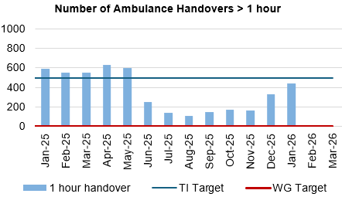
Level 4 – Unscheduled Care
Criteria to Achieve | Current Performance
A continuous reduction of ambulance handovers over an hour of at least 11% in three consecutive months and maintained for 3 months (Based on quarter 2 and 3 2023 baseline). | November – 162 (6.4% reduction) December – 329 (103% increase) January – 445 (35% increase)
Continuous improvement towards no more than 7% of patients waiting over 12 hours at each individual site and across the health board. | November – 8.83% December – 9.95% January – 11.66%
Actions being taken to improve include:
Revised flow operating model: The revised operating models implemented as part of the test of change in Morriston remain in place. However, increase in demand for emergency care, high levels of patient occupancy driven by medical bed day utilisation has challenged the Health Board’s ability to maintain flow and thus the level of ambulance handover performance achieved following the tests of change. The emergency pressures have tipped the Health Board into two formal Business Continuity incidents, consistent with the pattern currently seen across NHS Wales. These system pressures continue, however there is evidence to demonstrate that the improvements implemented in June 2025 continue to have impact.
UEC capital redesign – Recent communication from the Chief Executive to the Director General of NHS Wales sets out an urgency to progress to an Electronic Patient Record across the Urgent and Emergency care services. Whilst there remains ambition to co-locate front door assessment processes with the emergency department, this programme of work cannot be progressed in the absence of Capital investment.

Slide 8
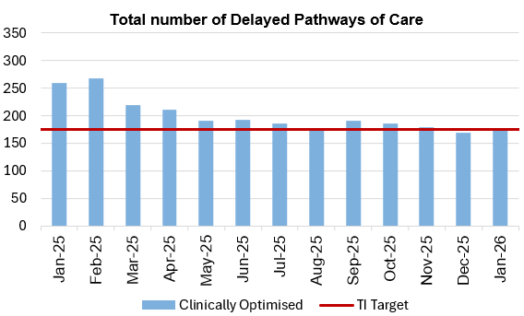
Level 4 – Unscheduled Care
Criteria to Achieve | Current Performance
Median time from arrival at an emergency department to assessment by a clinical decision maker should not exceed 60 minutes. | November -89.62% December – 84.87% January – 84.11%
A continuous reduction in delayed pathways of care of 5% for three consecutive months and then maintained for three months (based on Oct-Dec 23 baseline). | November – 179 December – 169 (In target) January – 175 (In target)
Actions being taken to improve include:
Full implementation of D2RA model – Focus on D2RA has rapidly shifted into understanding the demand and capacity position for pathway 2 beds and utilisation of that bed pool. Therapy led audit undertaken in December of all patients occupying a pathway 2 bed. Data analysis in progress with Deloitte’s support. Early indication is that there is opportunity to work with Local Authority partners to potentially reduce the Pathway 2 bed pool and enhance the Pathway 1 offer. Deloitte are now finalising a proposal to formalise the integrated discharge hub to deliver a centralised discharge and transfer function based on previous process mapping and joint working with Local Authority partners. There remains a lot of scrutiny on the pathway of care delay position and the Health Board are working with LA partners to revise the memorandum of understanding in respect of D2RA and to refresh the POCD action plan in line with recent Welsh Government communications.
Pathway of Care Delays (PoCD) – The PoCD position continues to challenge patient flow at a time where both ED and ambulance attendance has increased. Despite significant effort being invested in managing the Clinically Optimised patients, the outputs remain limited resulting in patients spending extended periods of time in hospital when they are deemed clinically optimised. Managing this position is closely linked to the D2RA programme of work and is very much dependent on the actions of Local Authority partners in respect of pathways 1 & 3.

Slide 9
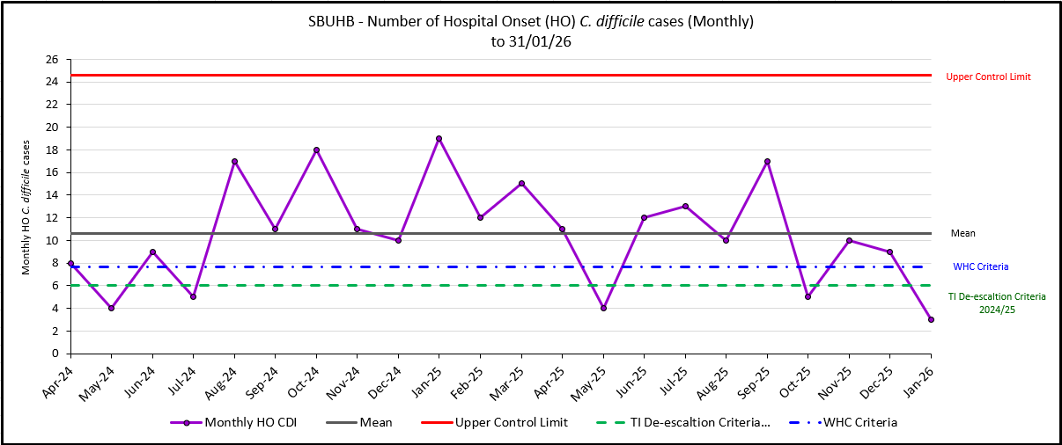
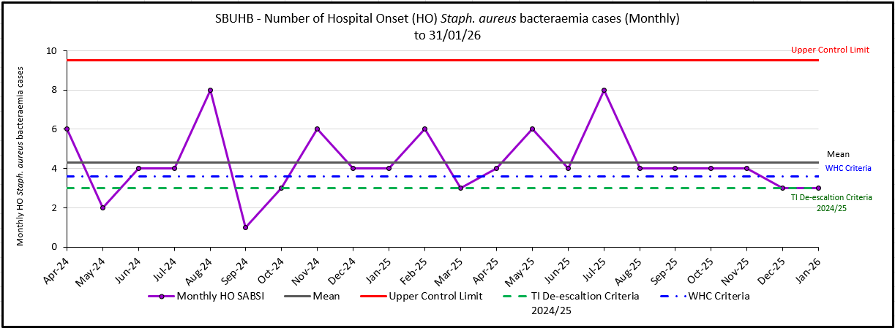
Level 4 – Healthcare Acquired Infections
Criteria to Achieve | Current Performance
A clear improvement plan based on a root cause analysis to address the issue of hospital onset HCAIs. | In Place
C-Diff: reduce the number of hospital onset infections by 40% and maintain for 3 months (from a baseline of the average number of cases in quarter 3 of 10 cases to no more than 6 per month | November – 10 December – 9 January - 3
Staph aureus: reduce the number of hospital onset infections by 25% and maintain for 3 months (from a baseline of the average number of cases in quarter 3 of 4 cases to no more than 3 per month | November – 4 December – 3 January -3

Slide 10
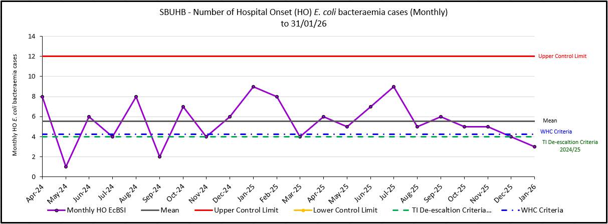
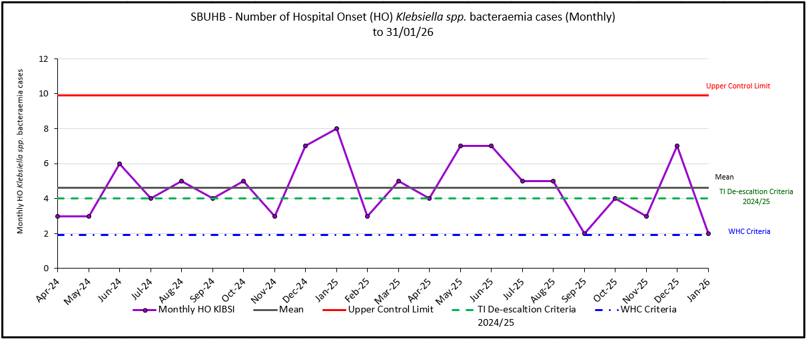
Level 4 – Healthcare Acquired Infections
Criteria to Achieve | Current Performance
E-coli: reduce the number of hospital onset infections by 20% and maintain for 3 months (from a baseline of the average number of · cases in quarter 3 of 5 cases to no more than 4 per month) | November – 5 December – 4 January -3
Klebsiella: reduce the number of hospital onset infections by 10% and maintain for 3 months based on 2017/18 figures (baseline –54 cases in 2017/18, reduce to average of at most 4 per month) | November – 3 December – 7 January - 2

Slide 11
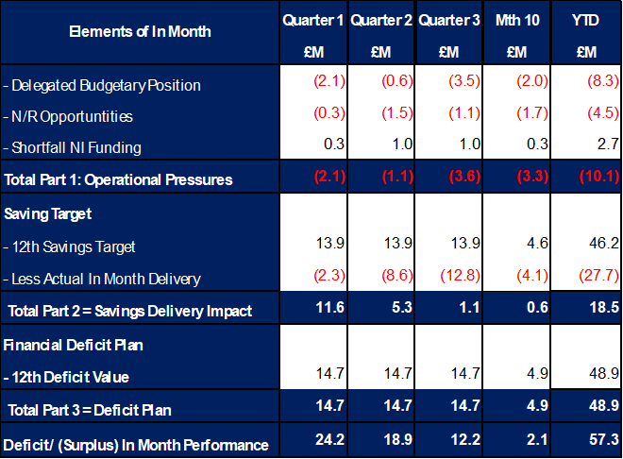
Level 4 – Finance
The Health Board’s assessment on performance against the £58.7m deficit has three components Operational Pressure, Savings Target, and Planned Deficit. Performance against these three elements at Month 10 is summarised in Table 1 below. At Month 10 there was an In-Month deficit of £2.1m, which is £2.8m below the £58.7m planned deficit, with the YTD position reporting a £57.3m deficit, which is £8.46m above £58.7m plan.
Table 1: Delivery YTD
It is clear from Table 1 that the Year-to-Date issue remains the non-delivery of savings. This shortfall in delivery YTD is in part mitigated by ‘Delegated Budget’ position underspending and the central N/R opportunities as set out in the 11 September 2025 submission delivering. Whilst excluding the non-delivery of saving most areas are within the delegated operational budgets, the key exception to this is Mental Health & LD Services. Throughout the year there have been pressures linked to pay, CHC and also Temporary Adult Placements. The latter issue has resulted in an in-month pressure of £0.8m, with YTD expenditure of £6.1m. At its peak during November 2025 Temporary Adult Placements stood at 33, and at the time of closing the ledger for Month 10 this was at 27.

Slide 12
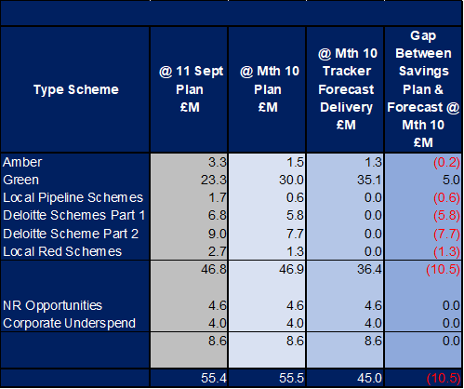
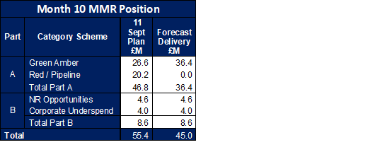
Level 4 – Finance
On savings performance the submission made on 11 September 2025 set out the Plan to deliver the £55.4m savings in 2025/26. This was a combination of (1) Part A - budgetary releasing savings delivery supported by our external strategic partner; alongside (2) Part B - delivery of underspends in the operational budgets specifically around the corporate directorates and N/R opportunities. The monitoring of the performance for Part A is undertaken through the existing governance arrangements, using the Health Board’s savings trackers. This data is then used to complete the WG Monthly Monitoring Return (MMR) Savings Tables. However, as Part B are improvements in run rate and not a formal budgetary savings this element of the plan is not reported in Savings Tables of the WG MMR, but is incorporated in the wider monitoring tables, within the return. A summary of the assessed performance and the profile of delivery over 2025/26 is provided in Tables 2a:
As you will see from the table there is still significant work to be completed to ensure the two parts of the Deloitte schemes translate to Green and Amber, although there has been some improvement since Month 9.
Table 2b: Summary of Savings
Table 2a: Summary Performance against £55.4m
As well as non-delivery of the £55.4m savings target summarised in table 2b, the Health Board has seen pressures in operational areas such as Mental Health (as noted above), alongside the pressures linked to Employers National Insurance Contribution (ENIC) funding and additional Nurse Streamline numbers. This has culminated in the Health Board needing to identify further actions to address the £58.7m deficit plan.
Regarding the delivery of the £46.8m the top section of Table 2b below demonstrates the original plan at 11 September 2025, the plans as per the trackers at Month 10 and the forecast delivery at Month 10. The scheme type is split based on the Amber and Green as per the MMR, Local Red schemes, Local Pipeline ideas and those schemes presented by Deloitte. As the Local Red schemes, Local Pipeline ideas and those schemes presented by Deloitte move to Green and Amber the value of the Plan figure will reduce.

Slide 13
Level 4 – Finance
Post Month 9 closedown the Health Board undertook an assessment of the 2025/26 outturn based on data provided by Service Areas in November 2025 and the actual trend over Quarter 3 and concluded that without further intervention and actions, the Health Board would likely end the year £10m-£12m above plan. Following Month 10 closedown and some non-recurrent improvements in Morriston and NPTS Service Groups this assessment has been reduced to range from £7.5m-£10m but the actions and mitigations must still be delivered:
On 16 December 2025 the Board agreed a series of actions, and at the Board meeting on 29 January 2026 a series of further actions were agreed to complement those from December and are summarised below:
29 January 2026 Board meeting, approved a paper that set out further actions to address the savings shortfall, which are summarised below:
  Increase in variable pay restriction. It was estimated that December 2025 action would need to reduce Variable Pay by £2.3m per month for Month 10-12. If this is not delivered the target would need to increase to £3.5m in Month 11 and 12.
  The Health Board has committed to the continued delivery of its 104 week planned care target through months 10-12. This remains the case. Analysis is anticipated by 2 February 2026 which will identify theatre lists with non cohort patients in them (outside of emergency, urgent and cancer care). The plan is to move any 104 week premium rate cases into planned cases to reduce variable pay and consumable spend. The commitment to 104 week delivery will not be affected.
  A detailed analysis will set out the optimal bed model for the 3 acute hospitals across the Health Board. The intention of this analysis is to identify the highest cost beds within the Health Board and to set out how those bed numbers can be reduced in line with pathway improvements service realignment.
  Non pay restrictions are already in place with plans to reduce spend by 50% for months 10-12. Following receipt of the month 10 financial position further one-off restrictions will be assessed, with further updates provided in section below on Informal Executive Meeting (09/02/26).
As well as the actions set out by the Board in both December 2025 and January 2026 further non-recurrent opportunities were identified. Post Month 10 these were reviewed again and summarised in Table 3 below. For clarity only those schemes rated green are confirmed as deliverable, with the viability and value of those Red and Amber schemes continuing to be assessment through Month 11 and 12, to support the delivery of the £58.7m on a non-recurrent basis.

Slide 14
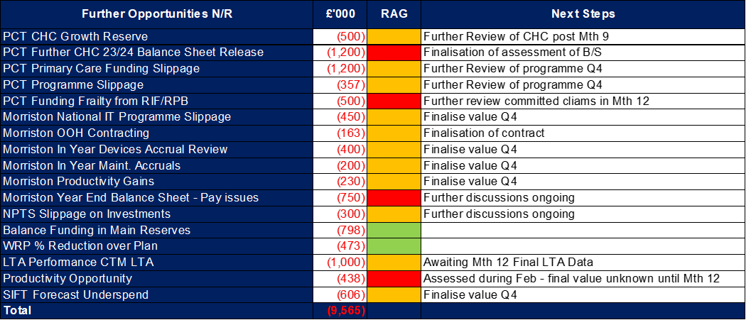
Level 4 – Finance
Further discussions have been undertaken Post Month 10:
Informal Executive Meeting (09/02/26) - the following further actions were agreed, which will support the delivery of the Board actions from December 2025 and January 2026:
  HB will assess cohorting Clinically Optimised Patients at Morriston Hospital to follow Singleton model. De-classify as NSA wards and staff accordingly and releasing the demand for Variable Pay across Nursing and Health Care Support Workers.
  In addition to reducing out of hours premium rate planned care capacity; assessment now underway of non 104 week cohort capacity planned in last 7 weeks of 2025/26 for decision. This will exclude paediatric, emergency, urgent, follow on and cancer treatment.
  Of the list presented on 4 February (referenced in Touchpoint Pack 11/02/26) an urgent review of the outputs is being undertaken to assess what can be brought forward into 2025/26.
  B/F non pay system controls, which will include additional justification of requests on Oracle for certain non-pay categories as well as weekly panel to assess requests.
The Health Board will need a combination of the actions agreed at December 2025 and January 2026 Board meetings, and materialisation of some of the further opportunities in Table 3 to achieve the deficit plan of £58.7m, although it is the first set of actions that will be critical in delivering the recurrent position in 2026/27
Table 3: Summary N/R Opportunities @ Month 10

Slide 15
Level 4 – Strategy & Planning
Updates against the de-escalation criteria outlined by Welsh Government can be found below;
De-escalation Criteria | Actions – Updated Feb 2026
Submission of a balanced and credible three-year medium-term plan or acceptable annual plan in line with the current planning framework. | Accountable Officer letter submitted on 12th Feb to Welsh Government which confirms that the Health Board will not be able to submit the statutory balanced Integrated Medium-Term Plan for 26/29. Health Board remains focused on delivery of our 2025/26 plan (forecast £58.7m deficit position). This is in addition to urgent work working on reducing our run rate from 2025/2026 into 2026/2027 to improve the opening position. Work is ongoing with Deloitte to define the ‘flight path’ to a sustainable financial position and a sustainable model of service provision. The flight path will be completed for inclusion in our end of March 2026 submission and will set out the sequenced actions required over the planning period. Indications are that a multi-year financial recovery programme is required, underpinned by service reconfiguration, site rationalisation and organisational restructure.
Evidence of a clear roadmap and implementation of the health board’s Clinical Services Plan. | Second meeting of the Clinical Reference Groups for Integrated Community Care and Networked Hospitals to be held 25th February. Further plan for patient, public and clinical engagement being refreshed in February/March 26
Welsh Government’s confidence in delivery based on an assessment against an agreed planning maturity matrix | Re-assessment submitted to Welsh Government 28 November. Positive follow up discussion held with WG to discuss submission
Progress made with regional planning | Previous Regional Joint Committee 18th August. Subgroup updates were received for: Regional Health Economy, Clinical Services Planning, Workforce and OD, Data and Digital, Finance and Commissioning, Research and Innovation. The Regional Drive and Delivery Group, Chaired jointly by Abi Harris and Phil Kloer, met on 16 October and provides oversight of subgroup work programmes. Full updates are scheduled to be reviewed at the next RJC meeting 22 January.

Slide 16

Level 4 – Maternity & Neonates
Criteria to Achieve | Current Performance
Ensure that the recommendations and actions in the Independent Review are progressed in line with agreed timescales and report progress to Welsh Government monthly, highlighting risks to delivery. | Perinatal improvement programme has been established Dec 2025 Exec led workstreams are underway Dec 2025 Quarterly Perinatal updates to Board ongoing Perinatal Improvement Programme agreed in principle by Health Board Jan 2026; with Independent Oversight Panel for scrutiny.
Ensure that the agreed actions in the family-led review into Swansea Bay maternity services are progressed in line with agreed timescales and report progress to Welsh Government monthly, highlighting risks to delivery. | The agreed actions of the family led review have been integrated to the Independent Review improvement plan – Jan 2026
Receive a positive assessment from the Welsh Government independent observer on progress against the agreed maternity and neonatal action plan. | We await the outcome of the assessment process – anticipated Feb 2026
Agree a set of sustainability conditions with Welsh Government that can be used to track improvements. | Have developed Perinatal reporting to Board through Quality & Safety committee Jul 2025 Routinely reviewing staff retention and well-being plan – revised plan signed off Jan 2026 Pulse surveys underway – quarterly Robust Governance processes in place – Dec 2025
Evidence effective Board scrutiny and oversight of maternity and neonatal services. | Complete Governance structure in place – July 2025; updated Dec 2025
Embed the maternity and neo-natal dashboard across the service to demonstrate that data is driving real decision making. | Complete
Regularly review the risk register, appropriate risk management, and mitigations. | Ongoing The risk register is reviewed at monthly Perinatal committee and flagged at Quality & Safety Committee and through to the Board
Regularly review against agreed outcomes to demonstrate that there is continued embedding of the LRI/NRIs, complaints and concerns process within quality governance, ensuring responses in a timely manner. | Ongoing Monthly reporting through Perinatal Committee and Board Ward to Board reporting
Evidence a joint and effective PMRT meetings across the service with engagement of affected families. | Ongoing Part of the improvement plan and reported through Perinatal committee

Slide 17
Level 4 – Maternity & Neonates
Criteria to Achieve | Current Performance
Maintain the required staffing establishment at appropriate numbers and grades. | Ongoing Reported monthly through Perinatal committee, into Quality & Safety committee and into Board. Key element of performance report
Achieve and maintain training compliance rates for all staff in maternity and neonatal services. | Complete Reviewed at monthly performance and perinatal committee – key element of the report
Demonstrate required corrective action against Patient Reported Outcome Measures and Patient Reported Experience Measures data for maternity and neonatal services. | Ongoing All reported monthly through Perinatal committee, into Quality & Safety committee and into Board. Additional requirements included in perinatal improvement plan
Evidence how women and family feedback shapes service design within the health board. | Ongoing – Perinatal Improvement Plan outlines engagement blueprint as follows: Service specific engagement undertaken by the service itself, mostly using its own contact with service users; ongoing rolling programme with reporting through Perinatal Committee. Service specific engagement undertaken by corporate teams, particularly DICE and the independent review’s engagement lead “Always on” engagement at a pan-Health Board level which sees generic engagement activity offering up insights and feedback relevant to the maternity and neonatal services. Ongoing Mapping of groups across the Swansea and Neath Port Talbot areas – to be completed April 2026 Develop a Network of Sounding Boards that builds on work being undertaken as part of the Women’s Health Plan – April 2026
Provide assurance that clinical leadership is consistent, visible, effective, and that leadership development support is in place. | Ongoing Senior clinical staff present as required by BAPM guidance; underpinned by audit cycle and key indicators which include care planning in decision making. Reported to Perinatal Committee on monthly basis. Multidisciplinary Team Development Programme rooted in compassionate leadership, culture and behaviours to be delivered between Feb and April 2026; first session held 6 Feb 2026.
Provide assurance and evidence of an improving culture through appropriate surveys, and/or qualitative assessment for maternity and neo-natal services. | Ongoing Reported through monthly Perinatal committee and includes: Workforce heat maps that cover staff feedback Patient feedback Guardian service Patient voices forum Pulse surveys Feedback from all visitors reporting positive change

Slide 18
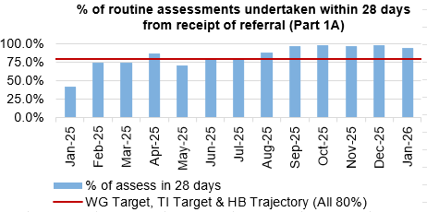
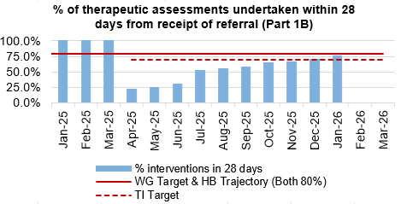
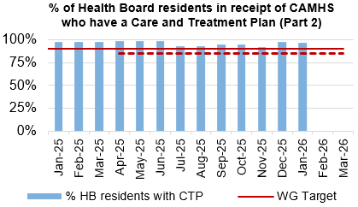
Level 3 – CAMHS
Criteria to Achieve | Current Performance
80% of LPMHSS mental health assessments undertaken within 28 days from the date of receipt of referral | November – 97% December – 98% January – 93.5%
70% of therapeutic interventions started within 28 days following an assessment by LPMHS | November – 66% December – 70% January – 75.6%
85% of HB residents in receipt of secondary mental health services who have a valid care and treatment plan | November – 92% December -98% January – 97%

Slide 19
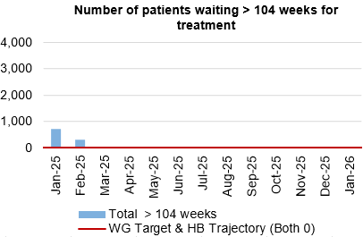
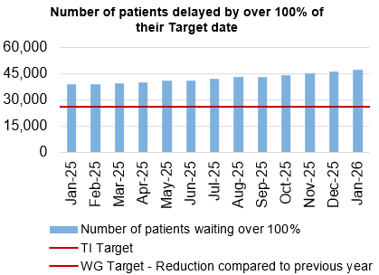
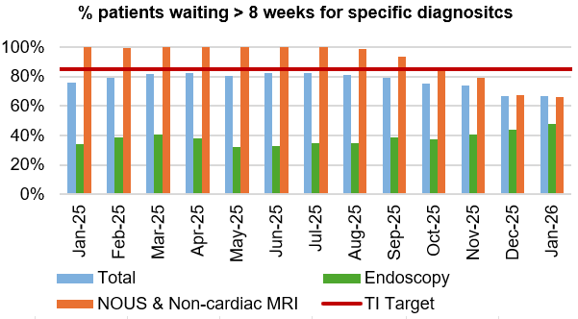
Level 3 – Planned Care
Criteria to Achieve | Current Performance (January 2026)
100% of open outpatient pathways to be waiting less than 52 weeks and maintained for 3 months. | 100%
Continuous improvement towards 75% of all open outpatient pathways waiting less than 26 weeks. | 80.33%
100% of open pathways to be waiting less than 104 weeks and maintained for 3 months. | 100%
Continuous improvement towards 80% of all open pathways waiting less than 36 weeks. | 75.17%
12% reduction in the number of patients delayed by 100% for their follow up appointment in three consecutive months and maintained for 3 months (Based on the November 2024 baseline). | 23.26% increase against baseline
68% R1 ophthalmology patient pathways to be waiting within or no longer than 25% of their target date for an outpatient appointment and maintained for 3 months. | 72.64% - meets de-escalation criteria
85% of patients waiting for a diagnostic test to be waiting less than 8 weeks and maintained for 3 months. | 66.64%
85% of patients waiting for a diagnostic endoscopy to be waiting less than 8 weeks and maintained for 3 months. | 47.68%
85% of patients waiting for a NOUS and non-cardiac MRI to be waiting less than 8 weeks and maintained for 3 months. | 65.65%
90% of patients waiting for therapies to be waiting less than 14 weeks and maintained for 3 months. | 100%

Slide 20
Section 2:
Summary of the performance against the Health Boards Strategic Objectives

Slide 21





SBUHB Strategic Objectives and Quality Aspects
Our refreshed Strategic Objectives –aligned to ‘a Healthier Wales’ articulate the future state of Swansea Bay UHB as a high-quality organisation. We have set out what this looks like for our population, communities, staff , partners and services and are developing strategic indicators that will tell us if our efforts are delivering our objectives
People of Swansea Bay live healthier, equitable and more equal and prosperous lives
Every child has the best start in life
All children, young people and adults are enabled to maximise their capabilities and have control over their lives
Good work and fair employment is created for all
A healthy standard of living is ensured for all
Healthy and sustainable places are created through placemaking
The role and impact of ill-health prevention is strengthened
Racism, discrimination and their outcomes are tackled
Environmental sustainability and health equity are pursued together
Care is high quality, safe, efficient and delivers the best possible outcomes for people
Care is safe, it helps people and avoids harm
Care is evidence based, effective and improves outcomes
Care is timely and delivered by the right person in the right place
Care is efficient
Care delivers equitable outcomes regardless of demographic, socioeconomic or geographic factors
Care is person centred and delivered with compassion, dignity and mutual respect
Care is delivered in safe and appropriate settings supported by innovative digital solutions
Care is delivered around the patient in the most appropriate setting as close to home as possible supported by digital and data solutions
Care settings are fit for purpose, appropriately designed and equipped
Secure, trusted and insightful data and digital platforms empower staff to deliver more and higher quality care and improved patient outcomes and population health
We have a digitally inclusive culture, where patients, clinicians and non-clinical colleagues work collaboratively to create effective and efficient services and patients are empowered to make informed and meaningful choices about their health and care
Through where and how they are delivered, services contribute to the environmental, economic, social and cultural well-being of Swansea Bay
The health board is a great place to work where staff feel valued and work together towards a common goal
Our Workforce is engaged, motivated and healthy; they feel valued, fairly-rewarded and supported
The Health Board is recognised as an employer of choice
We have a well-planned workforce with the right number of skilled people working on the right things
People feel ready for our digital future
People are supported to develop the skills and capabilities they need
People role model collective and compassionate leadership and live our values
We are diverse and inclusive, ensuring all voices are heard
The health board is a resilient, financially sustainable and responsible organisation
The health board is financially balanced and able to invest in service transformation and change
Decisions are made balancing short-term improvements and long-term impacts
Resources are used efficiently and proportionately, reducing waste and variation
The environmental impact of health care delivery in Swansea Bay is minimised
The health board invests in and works with others locally and responsibly, using our assets to positively contribute to the community
Citizen stakeholders are meaningfully involved and engaged in decision making
The health board has the capacity to effectively plan for and respond to incident and emergencies

Slide 22
People of Swansea Bay live healthier, equitable and more equal and prosperous lives
SBUHB organisational strategy indicators | Target/standard | Time period (reporting frequency) | Most recent data available
Percentage of children who are up to date with the scheduled vaccinations by age 5 (‘4 in 1’ preschool booster, the Hib/MenC booster and the second MMR dose) | 95% | Jul-Sep 2025 (quarterly*) | 88.4%
Percentage of children receiving the Human Papillomavirus (HPV) vaccination by the age of 15 | 90% | Jul-Sep 2025 (quarterly*) | 85.8%
Percentage of adult smokers who make a quit attempt via smoking cessation services | 5% | 2024/25 (annually) | 3.5%
Percentage of eligible adults who participate in bowel screening | 60% | 2023/24 (annually**) | 64.2%
Welsh Government Immunisation targets 2025/26 | Target/standard | Time period (reporting frequency) | Most recent data available
Percentage uptake of influenza vaccine in adults 65 years and over | 75% | February (monthly) | 67.1%
Percentage uptake of COVID-19 vaccine for all those eligible | 75% | February (monthly) | 54.1%
*Data is released by PHW 8 weeks after the end of the quarter: next update will be available 28/02/26
**PHW have agreed to provide more up-to-date data on screening uptake in SBUHB from 2026/27, reported quarterly

Slide 23
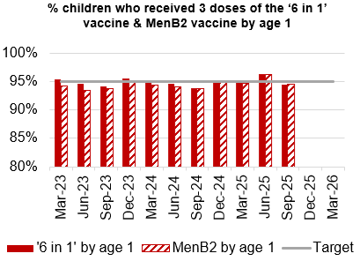
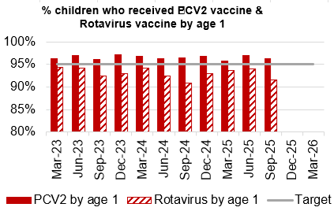
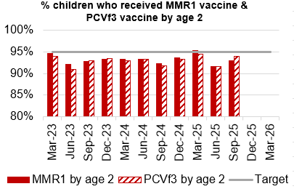
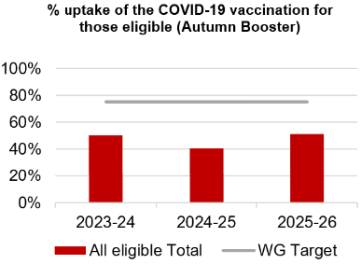
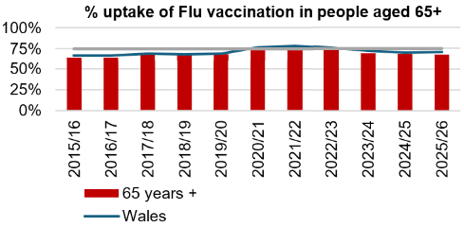
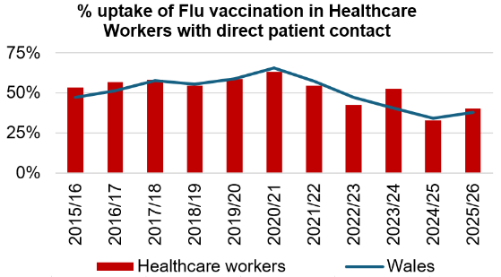
Immunisations
Actions/Updates
Performance against the immunisation targets is reported in arrears on a quarterly basis
Updated targets have been set for the new financial year which can be seen on the graphs above

Slide 24
Care is high quality, safe, efficient and delivers the best possible outcomes for people
Accident & Emergency | Target | Jan-26
4 -hour performance | 95% | 70.81%
12-hour performance | 0 | 1,272
Number of Delayed Pathways of Care (HB wide) | Continuous Reduction | 175
Number of cancelled Electives | 0 | 29
Median time of arrival to assessment within 60 minutes | 97% | 84.10%
Ambulance
Median emergency ambulance response time to purple: arrest category calls | 6-8 minutes | 7.49 (Dec-25)
Median emergency ambulance response time to red: emergency category calls | 6-8 minutes | 9.20 (Dec-25)
Total Handovers lost over 15 minutes | 0 | 1,776
Total Handover Delays > 45 minutes | 0 | 529
DE
TI
DE
TI
TI

Slide 25
Care is high quality, safe, efficient and delivers the best possible outcomes for people
Stroke | Target | Dec -25
Percentage of admission within 4 hours | 95% | 31.9%
Percentage of stroke patients receiving a CT scan within 20 minutes | 40% | 12.5%
Percentage of patients assessed by a stroke consultant within 14 hours | 95% | 48.1%
Percentage of patients to receive a mechanical Thrombectomy | 10% | 0%
Planned Care | Target | Jan – 26
Percentage of patients waiting < 26 weeks for an outpatient appointment | 75% | 80.33%
Total number of patients waiting < 36 weeks | 80% | 75.08%
Number of patients waiting at Stage 1 > 52 Weeks | 0 | 0
Total number of patients waiting > 104 Weeks | 0 | 0
Diagnostics & Therapies | Target | Jan – 26
Number of patients waiting > 8 weeks for diagnostics | 0 | 6,059
Number of patients waiting > 8 weeks for an Endoscopy | 0 | 1,444
Number of patients waiting > 14 weeks for Therapies | 0 | 0
Number of children waiting > 6 weeks for Audiology | 0 | 139
TI
TI
TI
DE
TI
DE

Slide 26
Care is high quality, safe, efficient and delivers the best possible outcomes for people
FUNB | Target | Jan -26
Number of patients waiting for an outpatient follow-up (booked and not booked) who are delayed past their agreed target date (All Specialties) | N/A | 78,567
Total number of patients waiting 100% over their target date | 0 | 47,379
Total number of patients waiting for a follow-up appointment | N/A | 161,799
Mental Health & Learning Disabilities | Target | Jan – 26
Percentage of mental health assessments undertaken within (up to and including) 28 days from the date of receipt of referral | 80% | 90%
Percentage of therapeutic interventions started within (up to and including) 28 days following an assessment by LPMHSS | 80% | 80%
Percentage of patients waiting less than 26 weeks to start a psychological therapy in Specialist Adult Mental Health | 80% | 40.4%
Quality & Safety | Target | Jan – 26
Number of service user feedback experience responses on CIVICA | Monthly improvement | 7,253
Percentage of complaint responses sent within 30 working days | 80% | 53% (Nov-25)
Number of Nationally Reported Incidents | N/A | 11
Number of New Never Events | N/A | 0
TI
DE
DE
DE

Slide 27
Unscheduled Care

Slide 28
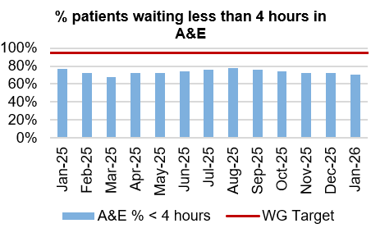
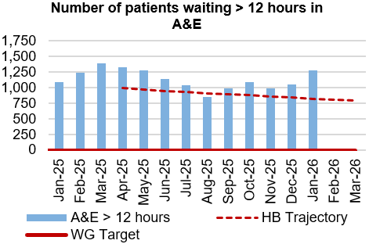
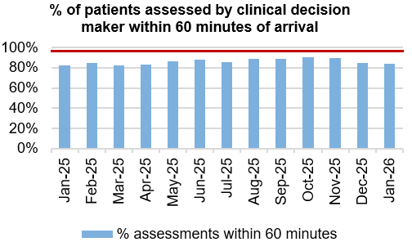
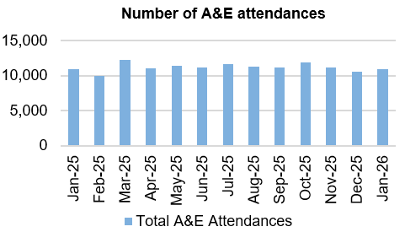
Unscheduled Care
Dashboard
Actions/Updates
Full implementation of D2RA model – Focus on D2RA has rapidly shifted into understanding the demand and capacity position for pathway 2 beds and utilisation of that bed pool. Therapy led audit undertaken in December of all patients occupying a pathway 2 bed. Data analysis in progress with Deloitte’s support. Early indication is that there is opportunity to work with Local Authority partners to potentially reduce the Pathway 2 bed pool and enhance the Pathway 1 offer. Deloitte are now finalising a proposal to formalise the integrated discharge hub to deliver a centralised discharge and transfer function based on previous process mapping and joint working with Local Authority partners. There remains a lot of scrutiny on the pathway of care delay position and the Health Board are working with LA partners to revise the memorandum of understanding in respect of D2RA and to refresh the POCD action plan in line with recent Welsh Government communications.
UEC Care co-ordination Hub – The single point of access has been in place since the 1st October 2025 and the first data submission took place on the 21st November. There is specific focus on the “clinical conversation before convey”, aimed at reducing conveyance of patients from care homes where clinically appropriate to do so. Work is also focussed on the management of patients who fall with the implementation of a level 2 Falls service made up of therapy technicians and a registered therapist, supported by St Johns ambulance provision. There has been limited impact in respect of Falls provision and the Health Board are working with WAST to develop a PDSA that may increase the non-conveyance rate to hospital following a fall. It is recognised that the hub has been resources via six Goals funding and has potential to expand if further funding were made available.

Slide 29

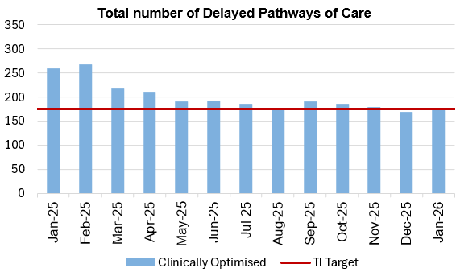



Pathways of Care Delay: Action & Intervention
Site | Delayed Pathways of Care: January 6th | Delayed Pathways of Care: January 13th | Delayed Pathways of Care: January 21st | Delayed Pathways of Care: January 27th
Learning Disabilities | 9 | 9 | 8 | 7
Mental Health | 36 | 36 | 36 | 36
Morriston Hospital | 71 | 65 | 67 | 68
Neath Port Talbot Hospital | 38 | 32 | 28 | 29
Singleton Hospital | 27 | 34 | 36 | 37
Total | 181 | 176 | 175 | 177
3.25%
WG target -15% reduction in total delays,
20% reduction in assessment delays,
20% reduction in total days delayed from March 2024 baseline
What specific improvements will be delivered?
Further optimize assessment and recovery bed models
Continue refining IDH processes to improve consistency and timeliness
Expand and standardize alternative settings to support discharge and flow
Progress joint work on NPT transfers to Singleton
Maintain POCD sprint methodologies and system-wide coordination
Under the Older People’s Programme, all Processes and Pathways are being mapped and where necessary reengineered - workshops are starting and will continue though the next few months
Reduce LOS through improved Board Rounds and enhanced MDT approach
What have we done to achieve the positive reduction
Discharge Sprint continued over the last 2 months of which 36 of our Longest Stays were discharged – accounting for 2,379 bed days
Focus on individuals waiting for reablement and those needing a LTPOC; these POCD’s have reduced and flow has improved
Established assessment and recovery beds to support earlier decision-making and flow
Adjusted IDH processes to better meet increased demand and acuity
Increased use of alternative settings to reduce pressure on acute beds
Used existing escalation and coordination arrangements to manage system pace and complexity
92.6%

Slide 30
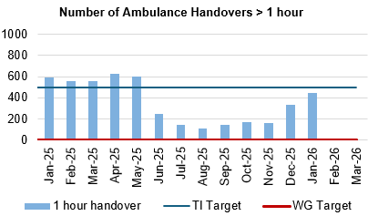
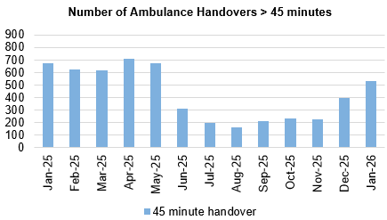
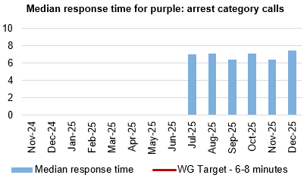
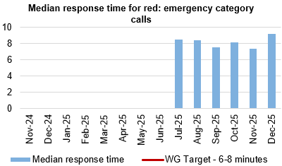
Ambulance
Dashboard
Actions/Updates
Revised flow operating model: The revised operating models implemented as part of the test of change in Morriston remain in place. However, increase in demand for emergency care, high levels of patient occupancy driven by medical bed day utilisation has challenged the Health Board’s ability to maintain flow and thus the level of ambulance handover performance achieved following the tests of change. The emergency pressures have tipped the Health Board into two formal Business Continuity incidents, consistent with the pattern currently seen across NHS Wales. These system pressures continue, however there is evidence to demonstrate that the improvements implemented in June 2025 continue to have impact.
UEC capital redesign – Recent communication from the Chief Executive to the Director General of NHS Wales sets out an urgency to progress to an Electronic Patient Record across the Urgent and Emergency care services. Whilst there remains ambition to co-locate front door assessment processes with the emergency department, this programme of work cannot be progressed in the absence of Capital investment.

Slide 31

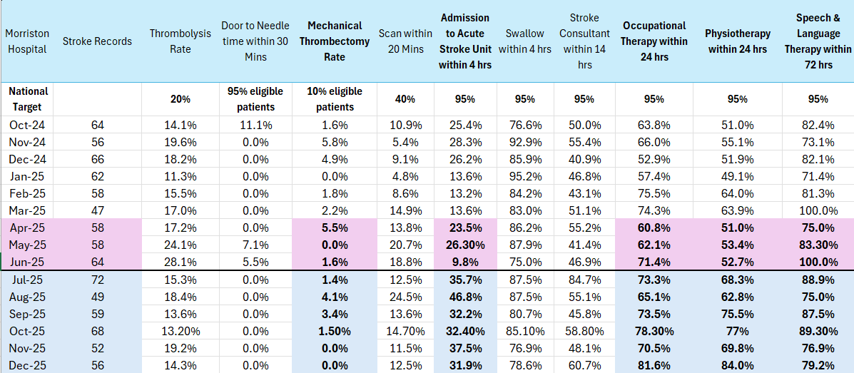
Stroke
Actions/Updates
Compliance against the 4-hour access target and the ring-fencing of beds for admission to the Acute Stroke Unit continues to remain challenging due to system wide pressures. However, work is taking place to improve flow between Morriston Hospital and Neath Port Talbot (NPTH).
Funding still not received to implement a 24/7 stroke consultant rota.
Performance against the new KPI metrics remain challenging.
Continued high compliance of thrombolysis rate, swallow assessments and therapeutic assessments.
Performance against the new KPI CT head within 20 minutes has positively increased
Reducing door to needle time for Thrombolysis is an area for improvement, more so since the introduction of the new KPI
Increase of Mechanical Thrombectomy remains a priority.

Slide 32
Planned Care

Slide 33
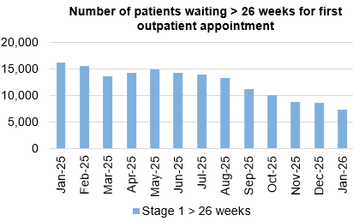
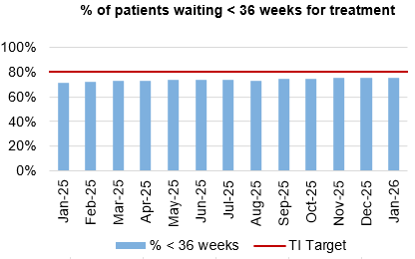
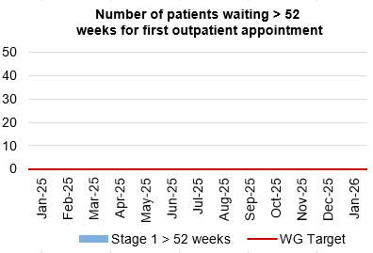
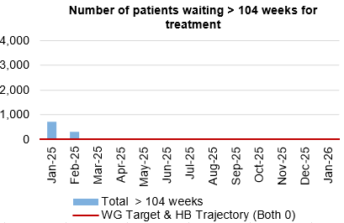
Planned Care
Dashboard
Actions/Updates
The Health Board have maintained the Stage 1 > 52 weeks target of 0 for January 2026.
The Health Board have maintained the number of patients waiting > 104 weeks for treatment target of 0 for January 2026.
Robust monitoring via live dashboards with revised Planned Care scrutiny structure due to go live in March providing clearer operational grip.
Outpatient Redesign Workplan for 26/27 agreed at OPRRG.
Targeted elimination of long waits through focused additional activity until end of March.
Q1 26/27 baseline reset within core capacity is planned via the Deloitte-supported productivity analysis.

Slide 34
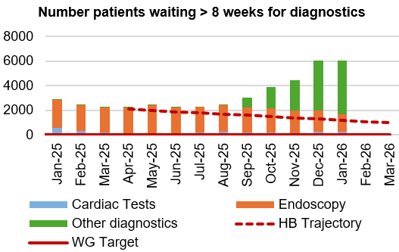
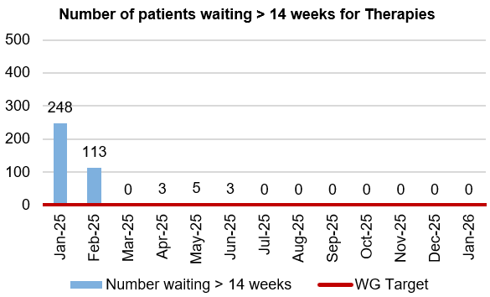
Diagnostics and Therapies
Actions/Updates
The total number of patients waiting > 8 weeks for diagnostics has increased in January to 6,059 compared to 6,042 in December 2025. The increase in the number of patients waiting > 8 weeks for diagnostics is mainly a result of a significant increase in Radiology waits.
As part of the recovery plan, the WG have funded a mobile Endoscopy unit which has been sited on Morriston Hospital to support additional capacity. The unit was unfortunately non-operational throughout the month of December 2025, due to a leak in the roof. The unit has however been running live activity again since the 30th December and is supporting the reduction of the number of patients waiting > 8 weeks for an Endoscopy.
The number of patients waiting > 14 weeks for therapies has been reported as 0 in January 2026

Slide 35
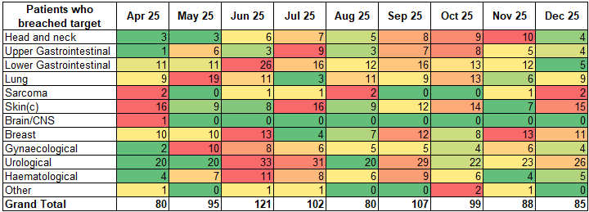
Cancer Performance & Breaches
The Health Board reports 62% for December 2025. Resubmission of July – September 2025 performance demonstrates an uplift to 65% (from 61%), 64% (from 61%), and 63% (from 60%) respectively.
At time of submission of Decembers data, the volume of unreported pathology specimens for patients known to pathway was 17, this is the lowest volume in several months.

Slide 36
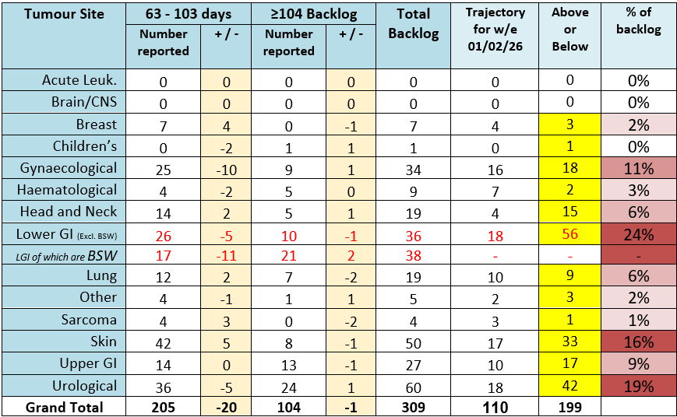
Cancer Backlog

Slide 37
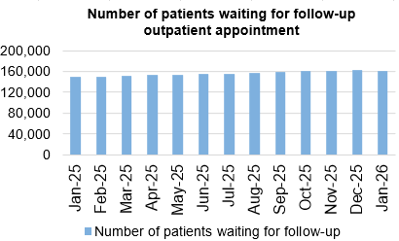
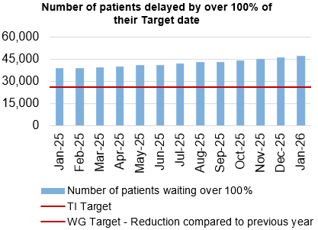
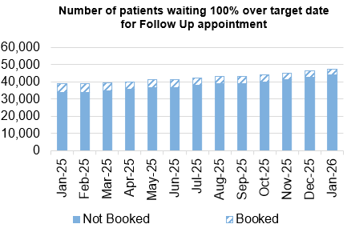
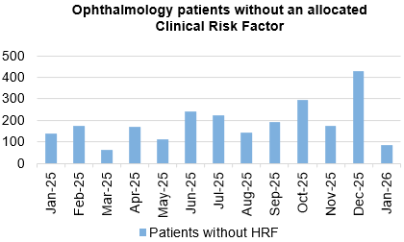
Follow-Ups & Activity

Slide 38
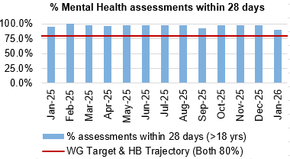
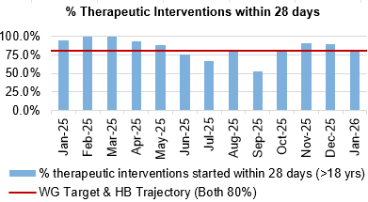
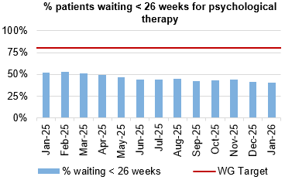
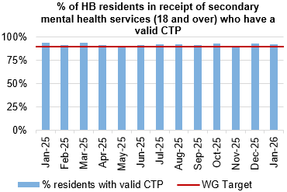
Mental Health & Learning Disabilities
Actions/Updates
The service continues to meet all of the Welsh Government targets, apart from for patients waiting < 26 weeks for Psychological therapies. Waits within this area continue to be a concern Nationally and the service are working closely with Welsh Government colleagues for a solution.
The Health Board continues to report on the work being undertaken as part of the Transformation programme, routine updated are provided to Board.

Slide 39
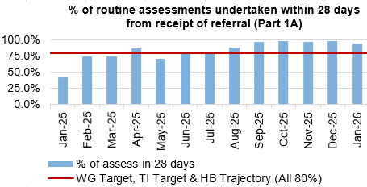
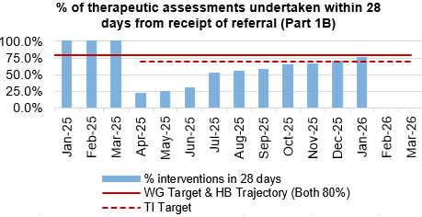


Child and Adolescent Mental Health Service (CAMHS)
Actions/Updates
CAMHS Part 1B:
Recruitment to vacancies has been successful, however additional vacancies and maternity leave weakens the capacity pool to almost pre-recruitment levels​. Despite this, the recovery plan roll out is underway, which includes changes to the delivery of the initial therapeutic offer for 1:1 intervention, which enables young people to commence support more quickly​.
This has resulted in 5 months of small, but consistent improvement in the Part 1B performance irrespective of staffing challenges, which is now at 75% (Submitted for Jan 2026)​
Weekly meetings continue over booking and utilisation of capacity and using our staffing resource as flexibly as possible​
Review ongoing of any non-clinical vacancies that could be converted to clinical posts in order to make the service sustainable going forwards.

Slide 40




Theatre Efficiency
Actions/Updates
The Planning Framework sets out enabling actions that must underpin the delivery priorities to successfully achieve the core service and changes required. These include value projects, digital innovations, workforce developments, financial sustainability and ways of working. The enabling actions and planning framework have been incorporated into SBUHB’s Theatre performance framework and work is currently underway to report against these measures.
NPTSSG are currently undertaking focussed work to reduce late starts and maximise efficiency within theatre’s

Slide 41






Fractured Neck of Femur (NOF)

Slide 42






Primary Care
Actions/Updates
GMS escalation levels are currently remaining steady as we head into the winter period.
The number of ACORNS completed is showing a steady increase towards the target as the year goes on.
Floride varnish remains over target for both children and adults.
The number of patients for eye health care Wales (emergency eye care) has increased from an average of 2,245 per month last year to an average of 2,641 per month this year to date. There is a slight increase in the number of patients receiving low vision services with an increase in domiciliary visits in particular.
Common ailments consultations continue to increase with an average of 900 more consultations per month in comparison to 24/25. If this trend continues this would be a further 17% increase on last year.

Slide 43
Quality & Safety

Slide 44




Infection, Prevention & Control
Dashboard
Actions/Updates
Gold C. difficile High Incidence Management Group.
Continuation of QI Project in Acute Medical Unit focusing on AMS and 72-hour review, improving switch to oral route for administration.
Trial of new microfibre cleaning systems.
Procurement of additional high-level disinfection equipment (UV-C).
Primary care QI projects to reduce urinary tract infections in care home residents.
Review of prescribing guidelines for antibiotic prophylaxis during prolonged surgical interventions.
Repeat Hospital Acquired Pneumonia antimicrobial audit.

Slide 45




Serious Incidents and Risks
Actions/Updates
There were 11 Nationally Reported Incidents reported in January 2026 and there were no new never events reported. The detail surrounding the nature of the reported NRI’s can be found on the subsequent pages.
In January 2026, there were 108 open risks with a score >20 recorded for the Health Bord which is slightly higher than the figure reported in December. There were 248 open risks with a score >16, which again is a slight increase compared to 246 in December 2025.
There were 166 hospital falls recorded in January 2026

Slide 46

NRIs/NE’s/EWNs – January 2026
What is the data telling us?
Graph 1 – Number of NRIs / NE’s reported to P&I (includes retrospective reporting of: 2 avoidable pressure damage; 3 IUDs/Neonatal Death ‘Must Reports’)
Graph 2 – 39 NRIs open with NHSWP&I – 17 open past closure date of which 6 are awaiting outcome of external reviews; 2 infant deaths require receipt of external review before closure can occur; 6 remain under investigation. 6 outcome forms with service groups to complete
Graph 3 – Outcome forms submitted in month (44% performance)
What are we doing about it?
Weekly review with PSI investigator to:
  monitor progress of corporate investigations; identify barriers
  escalate outstanding actions required
Fortnightly service group meetings:
  service group investigations - progress towards closure date discussed
  updates on PSI investigation given
  escalate to service group barriers identified with corporate PSI investigations
Service Group Directors contacted separately for outstanding actions
Data presented and discussed at health board Patient Safety and Compliance Group; Quality and Safety Group; Patient Stakeholder and Experience Group - Service Group assurance sought against outstanding actions for completion of investigation / outcome form
What do we expect to see change and when?
Reduction in number of overdue investigation outcomes forms
Reduction in number of NRIs/NEs reported through recommendations/learning monthly
EWNs – January 2026
Risk or adverse publicity – partner of staff member in possession of indecent images of a child
Personal effects of deceased baby cremated in error by funeral director due to error in dates recorded

Slide 47
NRI Learning (YCFFs) – January 2026
Domain 1 – Situational Factors | Team Factors: Consultant made a follow up plan for the patient regarding Fracture management but did not make a separate follow up plan for the cast and skin checks Individual Staff Factors: Ward recently relocated from neighbouring hospital | Patient factors: Normal observations and 18+ hours post fall gave a false impression. Reduced mobility; previous falls The patient’s physical health was deteriorating, reduced mobility, increased risk of developing skin damage. Presence of chest infection, weight 40kg, nutritionally compromised
Domain 2 – Local Working Conditions | Workload and staffing issues: High Unit Workload – ED was extremely busy with a high number of patients | Drugs, equipment and supplies: Should have been discharged with an air mattress
Domain 3 – Organisational Factors |  | Staff training and education: Clinician Error: Lack of verification before referral submission; Change of referral process caused confusion; Query in relation to the cross-checking of x-rays during the procedure; Treatment plan was not saved correctly to R4, potential human error
Domain 4 – External factors | Design of equipment: System compatibility issues
Domain 5 – Communication and Culture | Safety culture: Policies were not followed for head trauma. Inadequate skin checks Should have been discharged with an air mattress Carers should have escalated the damage they noticed a couple of days after discharge, to the senior carer Delay in rehab (physio/OT) being commenced Failure to escalate to Pressure Ulcer Prevention and intervention Service (PUPIS and Tissue Viability Service (TVN) in response to the altered skin integrity Failure to escalate the deteriorating patient in the community or change of need to Caseload Holder or Team Lead Failure to increase frequency of visits in response to change of need | Verbal and Written communication: The midwife responsible for booking the pregnancy did not have the conversation about FGM A follow up appointment was not made by the admin team. The clinical letter dictated by the Consultant did not correspond with the outcome as his outlined a plan of cast/ skin check in one month. Poor documentation relating to skin checks Carers should have escalated the damage they noticed a couple of days after discharge, to the senior carer Poor communication resulting in missed opportunities to provide off loading and pressure prevention advise to patient and Care staff Incomplete documentation, care plans, Purpose T, skin bundle and risk assessments, including nutrition and falls

Slide 48

Quality Improvement (QI) Spotlight
Improvement in Practice project by Simone Hopkins (Anticoagulation Clinical Nurse Specialist)
Problem - Delayed thromboprophylaxis (TPX) (over 14 hours), increases the risk of hospital-acquired thromboembolism (HAT), potentially causing serious harm or death.
Aim - To increase the % of patients who receive their first dose of clinically appropriate TPX, from 80% to 95%, on the chosen ward by April 2026.
Median: 80%
Median: 90%
How will we measure impact (Improvement measures)
Weekly audit on target ward to see if they received their first dose of TPX within 14 hours of admission.
Monitoring of the HAT potentially avoidable incidents.
PDSA 1:
Email to all Consultants
PDSA 2:
HEPMA prompt
PDSA1 – Targeted email campaign to Consultants to increase awareness.
Reflection/ Next Steps
PDSA 2 – System prompt within HEPMA to improve timeliness; initial audits show improvement
Monitor ward performance for sustained improvement
Review patient care benefits
Identify potential for organisational spread

Slide 49




Falls Prevention
  January 2026
Page 1
Project Team: Senior Responsible Officer: Helen Annandale, QP lead – Eleri D'Arcy
Underlying causes:
Ageing population with increasing frailty picture
Increased demand on WAST and front door services
Limited alternative WAST response to level 1 and level 2 falls regionally
Inconsistent approach to falls advice in community/primary care
Reduced access and provision of falls clinics across region
Insufficient access to appropriate strength and balance exercise provision
Some ward areas including AMU do not have an environment which enables safe monitoring of patients at risk of falls
Risk assessment and care planning inconsistent and inaccurate in some areas of HB
What is the Data telling us?:
In-patient falls rate remains below National average
January 2026 has seen the lowest falls rate (3.26/1000 bed days) since June 2023
Falls rate by ward has seen biggest reduction at Cefn Coed site across all older persons wards
Falls related attendance to MIU up 20% compared to last month but on par with previous year. ED attendance for falls 7% higher than prev year.
There have been 4 NRI falls related incidents in the last 12 months (Jan25--Dec25) compared to 10 in the previous 12 months = 60% decrease
Care Home falls project continuing roll out – now live across 15 homes and preparatory work across other sites complete – current ambulance call out rate at under 18% (compared to previous 94%) with a total of 555 falls incidents reported.
Health Board wide data
Falls rate /1000 bed days by ward Dec '25
What are we doing about it:
Regional Falls Prevention taskforce enabling collaboration
Primary Care action plan agreed
Roll out of level 1 falls response across care homes and Dom care – live across all Swansea based Dom care services and 15 care homes (reduced uptake across NPT)
Enhanced falls response service- referral rate remains low , performing at 82% stay home rate for those referrals accepted
3 patient engagement events attended with over 40 meaningful interactions with members of public re falls prevention and active ageing
Dance to Health to return in house due to temporary funding from Afan cluster
WAST - Conveyed calls (over 60yrs)
What do we expect to see change?
Reduction in WAST call out from care homes following falls incident (goal – 30% reduction per site by March '26) - ON TRACK
Falls rate not exceeding 5.0 (falls/1000beddays) over proceeding 12 months – ON TRACK
Reduction in conveyance to hospital via WAST for level 2 falls (WG target of 25% reduction) - OFF TRACK (current rate 16% reduction) - new service still in set up phase - service exploring offer of enhanced response to patients in ED and OPAU to improve admission rates (whilst still building service to reduce conveyance)

Slide 50




Patient Experience & Concerns
Actions/Updates
There were 7,253 friends and family surveys completed in January 2026 which is an increase on the previous month where 5,489 surveys were completed.
Of those surveys completed, the 93% of patients would highly recommend the services they received.
There were 172 concerns received in November 2025, and 53% of those concerns had responses sent within 30 days in November.

Slide 51
Complaints – January 2026
**Please note two graphs only go up as far as November, this is due to the 30 working days for complaints received in Dec/Jan not being up yet
What is the data telling us?
Graph 1 – is indicating that a number of complaints are not compliant with the 30 working day target for responding to formal complaints in line with the Putting Things Right Guidance.
Graph 2 – 166 new formal complaints in January which is an increase compared to 162 in December.
Graph 3 - The average number of days taken to close a formal complaint has increased by 1 working days compared to the previous month. Average days for November being 30 days which is within the Welsh Government target of 30 working days.
Graph 4 - The number of overdue formal complaints is increasing bi-weekly. As of the 27th January 2026, 302 formal complaints were overdue
What are we doing about it?
Bi-weekly report run on all overdue complaints which is sent to each Service Groups requesting updates.
Bi-weekly drop-in sessions where complaint handlers can join to discuss any issues.
Bi-weekly meetings with Service Groups to discuss open complaints and Ombudsman cases.
Test to Change in SNPT to trial new way of managing complaints and trying to resolve early on.
Corporate are supporting individual service groups with the aim of reducing the number of overdue complaints
What do we expect to see change and when?
There is evidence to indicate that there is a reduction in the overdue complaints as shown in graph 3
.
Early engagement with the complainant combined with listening meetings which will support an empathetic and compassionate handling of the complaint.

Slide 52




Patient Experience – January 2026
What is the data telling us?
Graph 1 – Illustrates that Swansea Bay UHB’s overall score consistently exceeds the benchmark of 85%, maintaining a performance of 90% or higher.
Graph 2 – Displays the overall satisfaction scores across the different Service Groups.
Graph 3 – Highlights wards/clinics achieving scores above 100%, based on more than 24 responses..
Graph 4 – Identifies the wards/clinics with the lowest satisfaction percentages.
What are we doing about it?
The system generates weekly feedback summaries for Service Group Leads, enabling timely action on low scores and recognition of positive feedback and comments.
Ongoing drop-in feedback sessions are held to support teams in using Civica effectively and managing their feedback constructively.
For alerts flagged as very poor or poor, the Action Manager is triggered. This tool tracks the progress and resolution of issues within Civica, managed by the PALS and Quality & Safety departments.
What do we expect to see change and when?
We expect departments to take ownership of their low scores and implement improvements based on the feedback provided. Our role is to ensure timely alerts and supply weekly comment reports to support this process.
.
Graph 1
Graph 3
Graph 2
Graph 4

Slide 53




Quality & Safety
Actions/Updates
The percentage of completed discharge summaries was 65% in January 2026, which is higher than the figure which was reported in December.
There were 121 Pressure Ulcers reported in December 2025, of which 46 were recorded in the Community.
The percentage of episodes clinically coded within 1 month of discharge increased to 80% in December 2025.

Slide 54



Pressure Ulcers: Action & Intervention
Page 1
Pressure Ulcers – Action & Intervention
Goal – To reduce the amount of patients developing HB acquired avoidable pressure damage by 20% by end of March 2026
What is the Data telling us:
159 incident reported, 32% increase on December 2025
Inpatient rate :2.6 % per 1,000 bed days for January 2026 (0.1% rate increase). There is no national average.
The highest inpatient rates = Morriston (R 2.6) in early 2025, and the lowest NPSSG (R 1.1).
PCS rates prove challenging due to inaccuracy on caseload dashboards.
Harm Profile
Severity: November to January data:
87% of all health board acquired incidents remain superficial in nature,
13 % deep in nature,
3% severe harm. Due to a backlog of cases requiring scrutiny review this picture may not be accurate
The trajectory reflects an increase in incidents deep damage
Please note this position may change pending validation through scrutiny process
Quarter 3 Data (validated)
9 % reduction in the total number of Health board acquired incidents reported and a 15 % reduction when comparing April 2024 to Nov 2025 to April to Nov 2025
8% reduction in deep tissue damage
70% all HBAs investigated deemed unavoidable (15% improvement since Q1)
Over 90% of all community damage incidents investigated were deemed unavoidable.
Underlying causes:
Patient vulnerability (esp. first 72h of admission).
Staff knowledge, skills and application of risk management principles
Delays in receiving specialist equipment
Limited prevention training, lack of tissue viability expertise Delayed/incomplete digital charting; limited use of medical photography.
Whole system pressure affecting timeliness of scrutiny review panels
What we are doing about it:
Improvement in number of incidents closed (65% in Quarter 3) increasing accuracy of data
Pressure Ulcer Strategic Group, scrutiny panels, peer reviews.
Audit of documentation and care provided
Multi-layered education (face-to-face, Teams, videos
Development of PU pathways, policies, and improvement plans supported by All Wales Tissue Viability Forum.
Centralised Tissue Viability service, digital wound imaging (Improvement Cymru), bed contract finalisation. Shared education, champions and skills programme
Quality Improvement awareness campaign 2026
What we expect to see (Outcomes by 2026):
↓ 20% PU rates in acute sites; ≤1.6/1000 bed days.
↓ 20 % avoidable PU in HB.
↓ Reduce total number of HBA incidents by 10%
↓ Reduce HB acquired Deep damage by 10%

Slide 55


Mortality: Action & Intervention
3.25%
The summary of deaths in the Emergency Department can be seen below:
Mortality Data Summary
The crude mortality rate has seen a minor increase in January 2026, reporting 1.54% compared to the previous figure of 1.53% in December 2025.
Crude mortality over the last 4 years is within the control limits and the recent data reflects the predicted decline of mortality as expected during summer months
The summary of deaths in the Emergency Department has remained relatively stable in recent months
92.6%

Slide 56
Maternity & Neonates

Slide 57




Maternity & Neonates
Perinatal Mortality - Stillbirths | Perinatal Mortality - Neonatal Deaths
There have been 11 stillbirths during this period, all are included in the MBRRACE reporting data. One case did not receive any antenatal care within Swansea Bay; one was an unknown pregnancy that delivered pre-hospital with maternity services involved postnatally to provide care and support.
There have been seven neonatal deaths between January 2025 and November 2025 and of these cases only five are reportable to MBRRACE as two were over 28 days of life. Of these five, only two will be represented in the MBRRACE report as deaths <24 weeks gestation are not included in the final report for analysis. The three deaths not included in MBRRACE analysis were extremely pre-term (less than 24 weeks) at the limit of viability .
There have been no deaths reported since August 2025. This is lower than what has been seen in recent years for SBUHB. December data required to make a final assessment.
Perinatal Morbidity – HIE Grade 2 and 3 | Maternal Morbidity – PPH <1.5litres
There have been five cases of HIE reported in this period. All babies survived to discharge with good outcomes. There is limited data published to allow National benchmarking. Latest published data from National Neonatal Research Database (NNRD) is 4 years out of date (Department of Health, 2021 data). This reports a UK average incidence for Moderate and Severe HIE cases of 1.59/1000 births (1.49-1.70).
Due to the low number of HIE and births in SBUHB a rolling 12-month HIE incidence reporting is more appropriate. This shows that in November our moderate to severe rolling 12-month HIE rate was 1.84/1000 births. This represents a 45% decrease since its peak in April 2024 of 3.32/1000 births. The 2025 HIE rate up until November was 1.68/1000 births.
The NMPA published 2023 data for National benchmarking and reported postpartum haemorrhage incidence as 3.41/1000 births (2.98-3.79). SBUHB rate for postpartum haemorrhage in 2025 was reported as 2.49/1000 births, lower than the National benchmark. This showed a steady reduction from 2024 data, of 3.51/1000 births.

Slide 58


Maternity & Neonates
Maternity Triage - BSOTS
Birmingham Symptom Specific Obstetric Triage System (BSOTS) is the Maternity services emergency department to support women experiencing concerns or urgent complications with their pregnancy or postnatal period. The following metrics help the system understand how effective, efficient, timely and safe our triage system is in responding to these. In October 466 women were reviewed in triage and assessed for ongoing care requirements. Initial trigae within 15 minutes, standard is 90% - rate in October 90.80%. There were 4 incidents reported due to delay in obtaining medical review following initial assessment and risk stratification for yellow, amber and red pathways, which amounts to a breach of time for review of 6.9%. There were no incidents relating to harm reported as a result. Where breach in time to review is identified, an additional measure which looks at what time review was achieved will be introduced. Singleton Maternity Triage Team celebrated 1 year since roll out of BSOTS in November 2024. During this period 5955 women attended for review - 4426 women self-referred, 526 were referred by Antenatal Clinic, 588 were referred by other allied health professionals.
Workforce – Maternity Staffing Establishment | Workforce – Neonatal Staffing Establishment

Slide 59



Maternity & Neonates
Perinatal Training Compliance
 | There have been some challenges within the Neonatal medical workforce due to unavailability, this has been mitigated with flexible working arrangements which has meant there has been no gap in service. A Neonatal Consultant was successfully recruited on the 9th December, with 1 expected return following maternity leave in January. Obstetric workforce – 2 fixed term gaps for career break and other leave have been covered with no vacancies impacting on services. Training compliance is improving across the board and individual staff out of compliance have been emailed to complete their mandatory training. Respective line managers follow up is in place.

Slide 60
Care is delivered in safe and appropriate settings supported by innovative digital solutions
Communication with primary care ​ | Target​ | Oct 25​ | Nov 25 ​ | Dec 25 ​
% of discharge letters sent to GP ​ | 100% | ​69% | 73%​ | 71%​
Digital Inclusion ​ | Target​​ | ​ | ​ | ​
Total number of citizens that have downloaded the NHS Wales App | ​TBC | 72,651 | 75,406 | 77,829 (16% of population)
Total number of outpatients that have downloaded the Swansea Bay Patient Portal | 50%​ | 33,949 | 37,388 | 40,699 (​14% of outpatients)
% of Digital Health Assessment forms Completion Rate | 60%​ | 34.32%​ | 27.22%​ | 56.15% (2652 completed forms)
Diagnostic requesting ​ | ​ | ​ | ​ | ​
% of secondary care pathology tests raised electronically ​ | ​90% | ​83% | ​83.2% | ​85%
% of primary care pathology tests raised electronically ​ | ​95% | 95%​ | 95%​ | 95%​
Supporting safe discharge ​ | Target​ | ​ | ​ | ​
% of patients with a recorded estimated date of discharge | ​100% | 38% | 35% | 37%

Slide 61


Care is delivered in safe and appropriate settings supported by innovative digital solutions
National and Local Digital System availability​ | Target​ | Oct 25​ | Nov 25 ​ | Dec 25 ​
National | ​99.90% | 99.96% | 99.98% | 99.998%
Local | ​99.90% | 99.996% | 100% | 100%
Data Driven Organisation​ | Target​ | Oct 25​ | Nov 25 ​ | Dec 25 ​
No. Staff attended Digital Intelligence Data Literacy Course | 10 | 0 | 10 | 0
No. Unique Users Accessed Digital Intelligence Analytical Tools | 356 | 493 | 480 | 456
M365 Digital Champions engagement over the previous 12 months

Slide 62
Care is delivered in safe and appropriate settings supported by innovative digital solutions
A summary of the digital projects and their delivery status has been outlined below for Quarter 3:
Title | RAG Status | Rationale for RAG Status
D01 & D04 - Unscheduled and Emergency Care Solution encompassing delivery of the WECDS dataset | Amber | There is a requirement to provide a digital system to span UEC, rationalising the 7 different systems currently deployed across the UEC footprint. The solution must deliver against the WECDS dataset whilst also serving as replacement solution for the national WEDS solution in the MIU. The contract for WEDS in the MIU expires in May 2026. The digital team along with operational colleagues are developing a document to set out the proposed way forward for consideration by Execs at the end of Jan.
D02 - Pathology digital system replacement (LIMS 2.0) | Red | SBUHB Cellular Pathology’s go-live was delayed from November due to defect resolution and bulk data upload issues. A revised date of 12 January 2026 is confirmed. Blood Sciences aims for an ambitious Wales-wide go-live by end of Q1, but 217 critical defects pose significant risk. Microbiology is planned for a “big bang” implementation by April 2026, with confidence in meeting this deadline. Blood Bank faces risks as its current LIMS module becomes unsupported from August 2026, and the national migration plan is only now being worked up. To mitigate delays, a backup plan with estimated SBUHB costs of £0.4m per quarter is under review. These delays are recorded on the Health Board risk register (Datix ID 3114, score 16).
D03 - Radiology digital systems replacement (RISP) | Red | SBUHB is scheduled to go live with the Radiology system on 23 February 2026, with strong resource commitment across digital and operational teams. Quarter 3 saw good progress in system configuration and PACS data migration. Risks remain around testing (starting 5 January) and checks of scanner connectivity (21 January–11 February) potentially surfacing critical defects. The project team is closely monitoring the critical path and dependencies with DHCW, Soliton, and Philips. Concerns persist about Philips’ capacity to meet milestones; escalations continue, including a request to meet with their Managing Director in early January. Financial risk exists if Philips misses deadlines, with a potential impact of £150k. The Fuji PACS contract has been extended to March 2027 as mitigation to any further delays.

Slide 63
Care is delivered in safe and appropriate settings supported by innovative digital solutions
Title | RAG Status | Rationale for RAG Status
D05 - Patient Portal/NHS App | Green
D06 - Connecting Care (Rio Implementation across Integrated Teams) | Green
D07 - Hybrid Mail | Green
D08 - Signal | Green
D09 - Welsh Clinical Portal - Hospital Initiated Referrals | Green
D10 - Digital Health Assessments | Green
D11 - Welsh Nursing Care Record - Paediatrics | Green
D12 - Digital Maternity Cymru | Amber | RAG status remains as Amber due to ongoing concerns regarding the limited integrations scheduled for delivery in readiness for go live in March 2026. A clinical risk assessment has been undertaken, which is being escalated nationally. There is also slippage within the configuration workstream, however the team remain committed to working to meet the challenging timescales which were agreed nationally.
D13 - e-Prescribing & Meds Management (shared medicines record) | Amber | There is still a dependency on System C to provide us with development timescales and costs. We are working with System C to review what is required to develop the integration to the SMR, with a view this capability will be on their roadmap for 26/27.
D14 - WPAS and associated services disaggregation | Green
D15 - Implement Open Eyes (Open ERS/Open EPR) | Amber | Open Eyes continues to well received by the Ophthalmology Service. Welsh Government have written to all organisations to mandate the implementation of the Electronic Referral System solution to support WGOS pathways which is currently being configured nationally by DHCW. Timescales for completion are unavailable. In addition, DHCW are yet to engage with Health Boards to agree a rollout schedule.
D16 - Welsh Intensive Care Information System - Implementation | Green
D17 - Expand Electronic Test Requesting to cardiology | Amber | Timescales elongated for a number of integrations due to: - Awaiting supplier quote for Development (SpaceLabs) - Timelines extended for all cardiology integrations - New API DHCW Process to undertake
D18 - Systemic Anti-Cancer Therapy (SACT) | Green | Contract extended for 3 years. New procurement process for replacement system being planned
D19 - In-Touch - Go Live with 'In Touch' in Singleton Hospital | Green

Slide 64
Care is delivered in safe and appropriate settings supported by innovative digital solutions
Title | RAG Status | Rationale for RAG Status
D20 - Millcare System in Sexual Health | Green
D21 - WPAS Roll out across Mental Health, Learning Disabilities and Primary Care and Therapies | Green
D22- Cyber Secure Back Ups | Green
D23 - NPT wireless equipment replacement | Amber | Prioritisation of another Delivery Action with support ending soon (D29 - Call Manager Upgrade to Cloud Voice)
D24 - Laptop, PC, iPad and Printer Replacement | Green
D25 - Additional Server Equipment including Storage | Green
D26 - Imprivata Rollout | Green
D27 - Implement New Core Network at Morriston & Singleton | Amber
D28 - Windows 10 Removal | Green
D29 - Call Manager Upgrade to Cloud Voice | Amber | The implementation had stalled in Q3 due to the lack response from a third-party supplier (Call Recording Supplier). Work now continues with the migration partner and the migration is now due to commence in January 2026.
D31 - Creation of a measures to be visualised in Dashboard pulling data from various systems | Green
D32- Re-banding of Coding Staff and Development of Auto-coding Software | Green
D33 - Data Literacy and Value | Green
D34 - National Data Resource (NDR) | Green
D35- Health Records Centralisation | Green
D36 - Digital Cellular Pathology | Amber | Publication of national Invitation to Tender delayed as not all Health Boards have yet agreed a Business Case.
D37 - eTriage | Amber | This is on hold as the requirements to integrate with WEDS (Symphony) did not make the investment worthwhile, due to the Symphony contract expiring August 2026. SBUHB will continue to engage with DHCW to inform the integration requirements for the UEC App.

Slide 65


The health board is a great place to work where staff feel valued and work together towards a common goal
Dashboard
Actions/Updates:
Performance against the performance and development review compliance has improved slightly in January 2026 to 73.78% from 73.73% in December 2025. Performance is currently below the Welsh Government target of 85%
Compliance with the 85% Welsh Government target has been maintained over the last year with regards to staff completing mandatory training. Performance has improved slightly to 88.97% in January 2026 from 88.79% in December 2025.

Slide 66

Workforce Sickness
November 2025
Reason | FTE Days Lost | %
Anxiety/Stress/Depression/Other psychiatric illnesses | 11,204.71 | 35.8%
Cold, Cough, Flu - Influenza | 4,011.57 | 12.8%
Other musculoskeletal problems | 3,024.59 | 9.7%
Gastrointestinal problems | 2,334.21 | 7.5%
Other known causes - not elsewhere classified | 1,737.73 | 5.6%
Actions/Updates:
The in-month workforce sickness rates have reduced slightly in January 2026 to 7.76% from 8.04% in December 2025
The 12-month rolling rate also increased slightly in January 2026, reporting 7.19% compared to 7.17% in December 2025.
Anxiety/Stress/Depression/Other psychiatric illnesses has remained the top reason for sickness absence over the last year
Detailed pieces of work are being undertaken within the service groups to address large areas of sickness with workforce colleagues

Slide 67

The health board is a resilient, financially sustainable and responsible organisation
Revenue Financial Position
The Plan submitted at the end of March, which has not been approved reported a £58.7m deficit with a requirement to deliver £55.4m of savings. The Control Total for the Health Board set by Welsh Government remains £17.1m.
In Month 10 there is an in-month overspend of £2.1m which is £2.7m below the planned deficit of £4.9m for the month.
The YTD overspend is £57.3m. This is £8.5m above the planned deficit of £48.9m.

Slide 68


The health board is a resilient, financially sustainable and responsible organisation
Workforce Spend
The pay budgets are underspent by £1.1m in Month
Variable pay is £0.762m lower in January 2026 (£4.527m vs £5.289m) when compared to the same period last year.
The biggest spends are attributable to ADH, Bank and Agency which make up 84% of the total variable pay spend.
Percentage of non-NHS invoices paid within 30 days of receipt of goods or valid invoice
PSPP was achieved in month at 96.36% vs a target of 95%. (Cumulatively we remain above the target at 96.38%).
There still remains issues with delays in receipting of invoices which is affecting the achievement of PSPP.

Slide 69


The health board is a resilient, financially sustainable and responsible organisation
Capital Financial Position
The forecast outturn capital position for 2025/26 is an overspend of £0.450m. Allocations are anticipated from Welsh Government which will balance this position.
Any All Wales Capital schemes where a high/medium risk is reported are closely monitored and discussed at the Capital Review progress meetings with Welsh Government.
Agency spend as a % of the total pay bill
Agency spend as a total percentage of the total play bill has decreased in January 2026 to 1.30% from 1.43% in December 2025.

Slide 70
Section 3:
Service Specific Updates

Slide 71
Unscheduled Care

Slide 72

Performance
UEC Targeted Intervention performance - summary against de-escalation criteria (Correct as on 10/02/26)

Slide 73
Performance
WINTER REVIEW
Rising Demand
Both ambulance and self‑presenting attendances are increasing.
Demand pressure is strongest during late 2025 and early 2026.
Deteriorating Handover Flow
Handover delays and time lost surge significantly from autumn 2025 onward.
This produces a cascading effect into ED occupancy and waiting times.
Growing ED Congestion
Rising >4h and >12h waits reflect worsening internal flow.
ED capacity is consistently outstripped by demand, especially during winter peaks.
Winter 2025–26: System Breaking Point
All six overarching PDSA indicators simultaneously peak in Jan 2026.
Prolonged periods of Business Continuity throughout January.
This convergence signals maximum operational strain, caused by:
  High bed occupancy
  Reduced discharge flow, especially with COP levels
  Seasonal acuity
  Resultant, ongoing ambulance handover failures
Executive Summary
Morriston hospital experienced short-lived relief during summer/autumn 2025 followed by a significant and sustained decline in flow performance through late 2025 and early 2026.
Length of stay, bed availability, ED turnaround time, and extended waits all indicate escalating systemic pressure, particularly driven by slow inpatient flow and, therefore, insufficient bed capacity.
This culminates in a winter period where all metrics peak simultaneously, demonstrating a need for targeted interventions in LOS management, discharge processes, and inpatient/community services / social care capacity planning.

Slide 74

Ambulance patient handover performance

Slide 75


Time to assessment
*NOTE: Time to first review in ED represents time to triage
SBUHB system picks up, and time stamps the ‘triage nurse’ when they log on as initial clinician
Aborting above step has been trialled but prevents further functionality in WPAS for our processing of patients prior to a clinician reviewing
Solution would involve a system change* (e.g. time stamp on use of ‘named clinician’ rather than generic ‘triage nurse’ or opening the functionality without need to add ‘initial clinician’ first) – *NOTE: this may involve a new system or changes to existing system to facilitate

Slide 76



Waits in ED
Patient Flow and Decompressing ED
Across all four charts, a consistent story emerges:
1. Summer 2025 brought temporary relief, but the system deteriorated again into winter.
All flow indicators improve mid‑year, then decline sharply thereafter.
2. Length of Stay is a critical bottleneck.
Higher LOS in Q4 2025 limits bed turnover, worsening flow across ED and admissions.
3. Bed availability at 9am is insufficient year‑round.
Even mid‑year improvements still leave >20 patients awaiting beds every morning.
4. ED pressures increase as inpatient pressures rise.
ED turnaround time and >12‑hour waits follow the same seasonal rise as LOS, indicating that back‑end constraints are driving front‑end performance.
5. Winter 2025/26 represents a convergence of all major risks.
All four indicators worsen at the same time, reflecting a whole‑hospital flow challenge

Slide 77


ED attendances – MONTH-ON-MONTH VARIANCE vs BASELINE MONTH (2024)
(Feb 2024 excluded – Leap Year)
DEMAND: Strong Upward Movement Across Mid–Late 2025
From July to December 2025, every month shows a positive increase compared to the 2024 baseline, ranging from +2.76% to +9.25%.
Consistent year‑on‑year demand growth in the second half of 2025
Sustained pressure on ED capacity
A break from the mixed pattern seen earlier in the year
Monthly ED demand varies significantly, with the busiest month (Oct 25) being 22.6% higher than the quietest month (Jan 2025).
This trend is visible in months: Jul (+5.87%), Aug (+9.25%), Sep (+7.51%), Oct (+8.18%), Nov (+4.04%), Dec (+2.76%).
The highest single increase in the full dataset is January 2026 at +12.96% above the 2024 baseline.
ED attendances - WEEKLY CHANGE vs 2024 Calendar Year Baseline (2024)

Slide 78

Length of Stay
LOS – all hospital sites (combined)
Increasing profile of <48 hours LOS through 2025 and into 2026 suggests increased efficiency at turning around those patients that can be treated quickly & discharged
Decreasing profile of LOS 22 days or more may suggest that activity aligned to tackling ‘problem cohorts’ re; discharge is being carried out
Increasing profile of LOS 48hr-12 days and 13-21 days may suggest that it is the patient cohort that require treatment and align with increased demand profile at ED – may also be influenced by challenges re; slow inpatient flow

Slide 79


MORRISTON HOSPITAL ONLY
COP patients currently represent roughly 14% of total bed occupancy, depending on the week, an improvement from early values that trend near 20%
Mid‑year this falls closer to 14–16%, reflecting a period of better discharge flow.
Into autumn and winter, the percentage rises again, with several weeks exceeding 18–19%.
The latest values settle around 13–15%, but the fluctuations remain frequent.
These values show that for substantial parts of the year:
1 in 5 hospital beds were occupied by a patient medically fit for discharge.
This creates a significant bottleneck for unscheduled care and elective recovery.
High COP occupancy correlates with periods where LOS, ED waits, and handover delays were also deteriorating.

Slide 80
Safety & oversight in the waiting room
Specific actions within ED waiting room include:
  Lead Nurse and Consultant wear bodycams to have the ability record any challenging aspects of behaviour and to act as a deterrent for anti-social behaviour (this in addition to Security Officers on site also wearing bodycams)
  CCTV has been upgraded again to record behaviour in the department/ waiting area and can share with Police should further actions be required
  Any previous patient anti-social/ challenging behaviour is recorded on the patient record/ system – this highlights management plans in line with that patient
To reduce risk in the ED department whole system actions are undertaken which are anticipated will decrease overcrowding within the ED and therefore improve safety (limit need for enhanced oversight over and above current BAU processes) Works underway to improve risk (whole system actions include):
  Wherever possible to have senior decision maker at the front door
  Older Persons Assessment Unit (OPAU) provides in-reach activity (and pull) from ED to assess, treat and turnaround as quickly as possible (direct access to WAST bypassing ED)
  Implemented ‘Your next Patient’ flow model as so to pull patients away from ED
  Direct access to SDEC - Redirection and pull from ED and AMU also in place.
  UEC SPOA launched (with a collocated IDH) - these collocated teams with the dual function of getting the patients to the right place first time, by reviewing referrals from primary and community-based clinicians, the WAST stack, and if appropriate avoiding conveyance to the Emergency Department.
  D2RA is a regional priority to implement a true discharge to recover then assess process rather than assessment within hospital(s)

Slide 81
Planned Care

Slide 82


Slide 83

Planned Care Performance – January 2026
Notes:
52 week & 104 week
8 week
14-week therapies

Slide 84


Planned Care Performance – January 2026
Notes:
52 week & 104 week
8 week
14-week therapies

Slide 85
RTT Validation – Embedding Sustainable Control
What we are doing:
Ongoing systematic validation of RTT Stage 1-3 pathways
Pilot of automated AI solution complete and now due to rollout across a further 10 specialties
Manual Stage 2 and 3 validation is continuing through Q4 (as per agreement to utilise WG funding with NW)
Strengthening SOPs via refreshed Outpatient Redesign work
Revised scrutiny meetings to embed strengthened oversight
Emerging impact:
Clearer line of sight on backlog position
Earlier identification of follow-up risk
Improved clinical ownership of pathway accuracy
Increased Board assurance on data robustness

Slide 86


Planned Care Performance – January 2026
Notes:
52 week & 104 week
8 week
14-week therapies

Slide 87
Diagnostics
What we are doing
Centralised dashboard visibility of diagnostic waiting lists
Risk-based prioritisation aligned to cancer and urgent pathways
Endoscopy recovery supported by expanded capacity
Application of Elective Toolkit productivity principles to diagnostics
Timeout session planned for 27th Feb to set priorities for Diagnostics Board
Outcome we are driving
Reduce unwarranted variation
Earlier identification of delay risk through improved BI
Stronger operational grip on capacity and demand alignment

