Slide 1


Targeted Intervention Update
February 2025

Slide 2
Urgent & Emergency Care Six Goals Programme

Slide 3

Performance

Slide 4
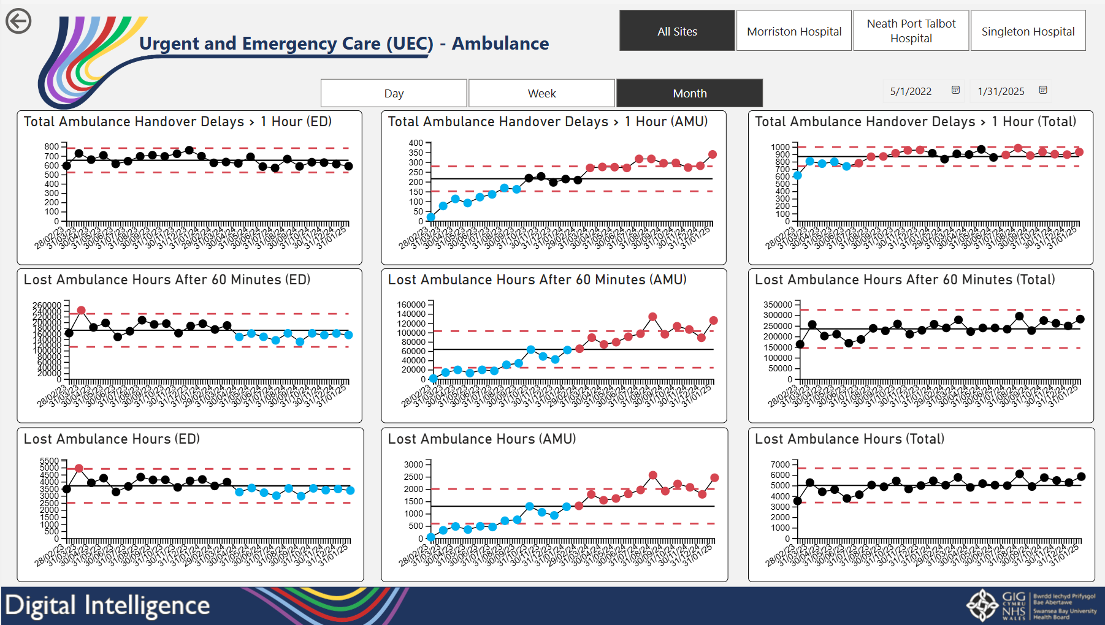

Slide 5
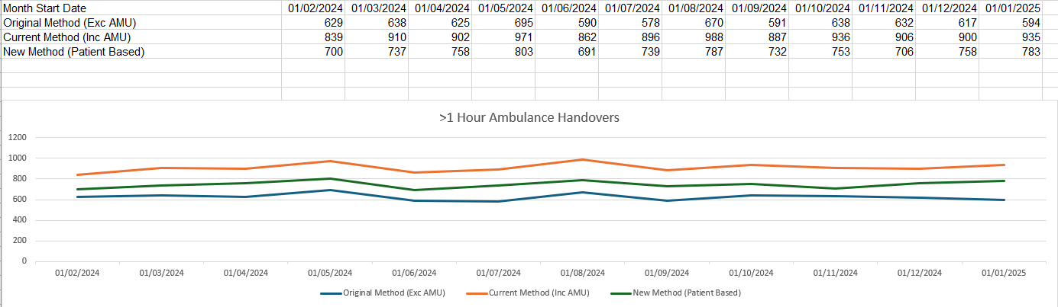
Ambulance Handover Performance Patient Based >1 hour

Slide 6
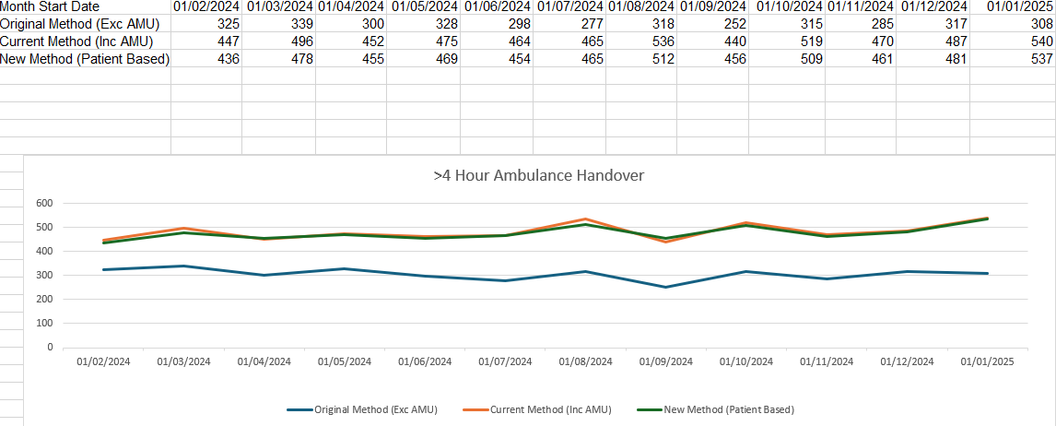
Ambulance Handover Performance Patient Based >4 hours

Slide 7
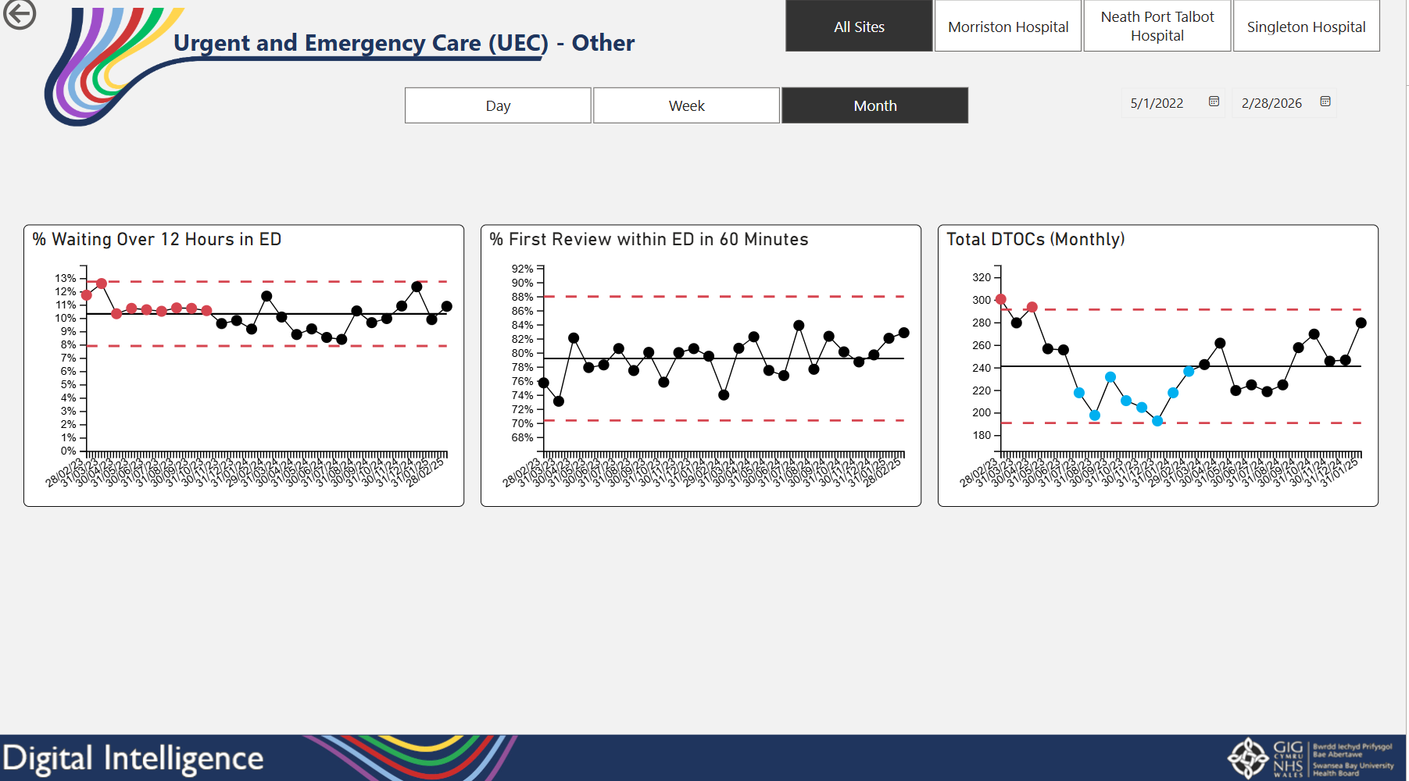

Slide 8
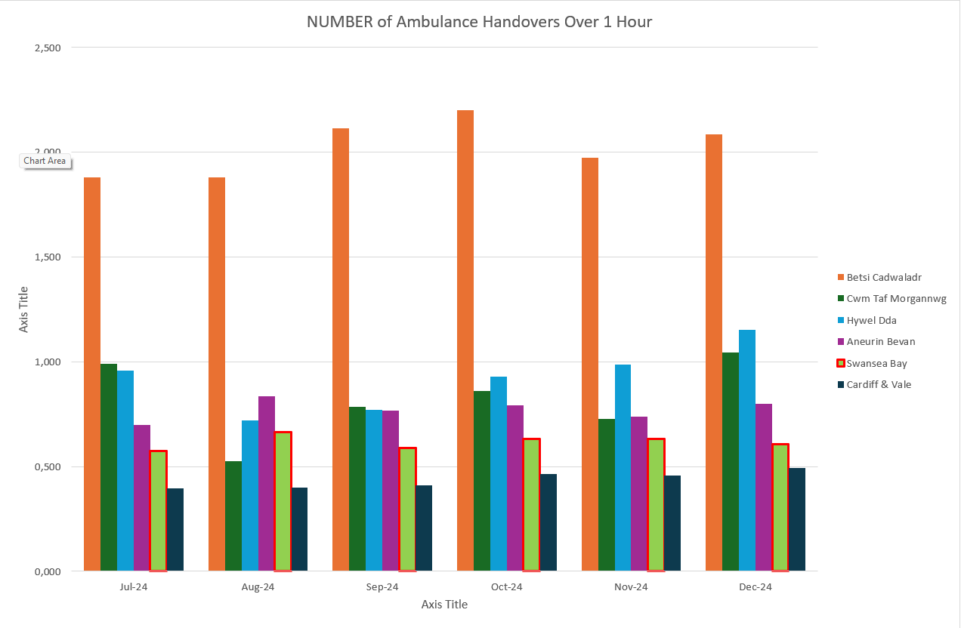

Slide 9
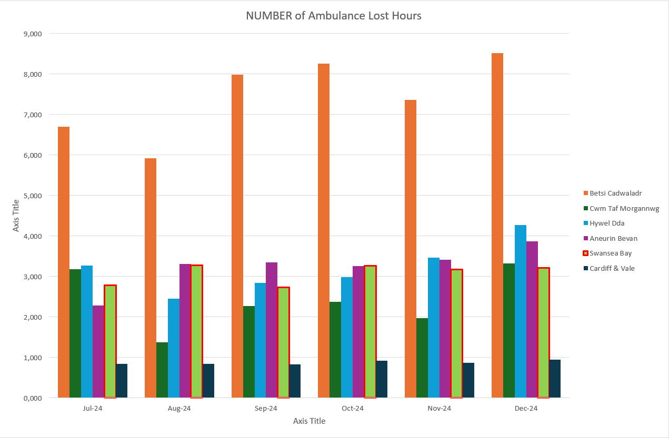

Slide 10
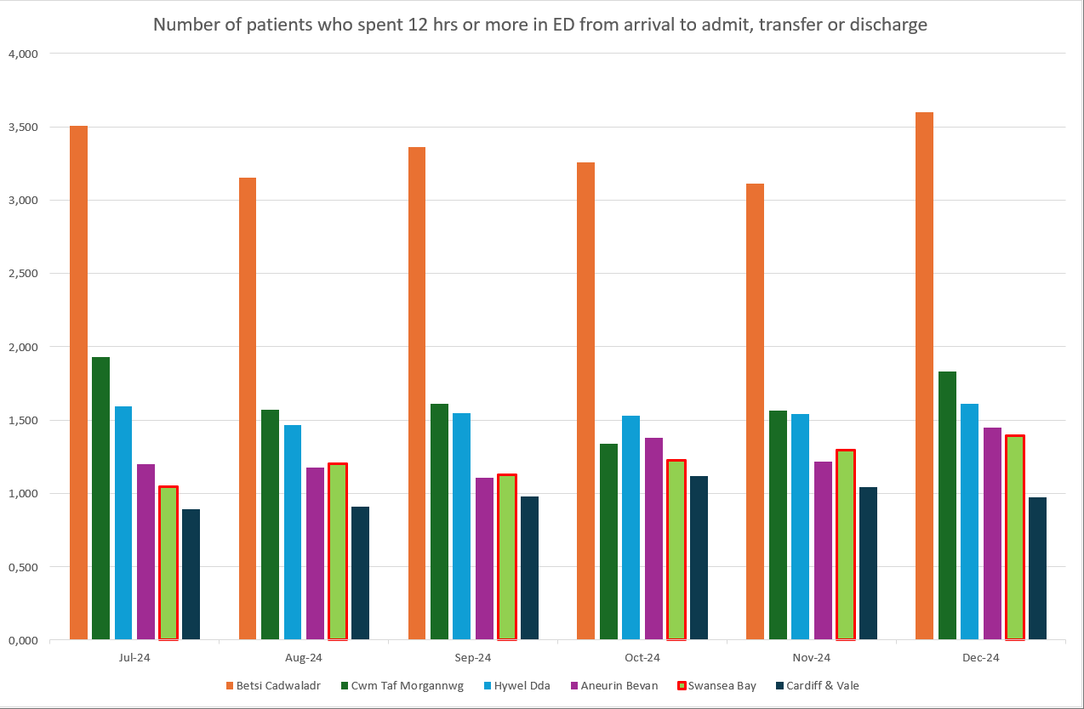

Slide 11
Actions Taken

Slide 12
Actions Taken
Use of unfunded surge capacity to meet the urgent care demand
Weekly COO led Clinically Optimised Escalation meeting
Silver cell approach to support daily operating
COO/Director led safety huddles -3 times per day
Additional medical/nursing resource to support additional patients
Continued risk assessed boarding on wards
Twice daily board/ward rounds
Flexible use of elective capacity
Increased senior decision makers across UEC pathway – re-purposed DCC’s
D2RA Executive agreement West Glamorgan RPB and Health Board – Shared Purpose and Memorandum of Understanding

Slide 13
Shift away from Emergency Department

Slide 14
Shift away from the Emergency Department
Further growth of the UEC Care Co-ordination Hub – vision/ambition defined through task and finish group
Pre hospital triage of Care Home WAST activity from scene with a view to redirection/non conveyance
UPCC/SDEC pull from the Emergency Department
Reduced ambulance conveyance locally
Temporary reconfiguration of the ED to enable more assessment space co-located with the Emergency Department
Introduction of a Medical Nurse Navigator role to promote early discharge and pull from the Emergency Department

Slide 15
Planned Care

Slide 16
Cancer

Slide 17
Cancer Performance - % treated within 62 days
63% of patients were treated within target on the Suspected Cancer Pathway in December 2024.
In line with WG reporting schedules, the HB has resubmitted data for Q2, confirming an uplift in performance of between 2% and 4% for each month, demonstrating a sustained performance of 60% for 6 consecutive months.
Notes:
215 confirmed newly diagnosed patients were treated in month, approx. 12% lower than the 12 month average.

Slide 18
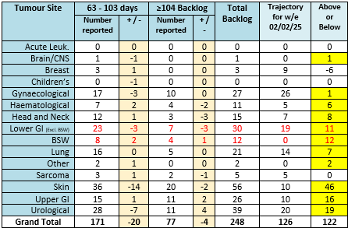
Cancer Backlog - 62 & 104 days
The highest volume tumour groups of Skin, LGI, Urology and Upper GI remain most significantly off trajectory; however backlog volumes in Skin have reduced by more than 60% over the last month.
Notes:
Skin, LGI & UGI most significantly off trajectory. Noting volume increase over the Christmas period.

Slide 19
Breast Position
First OPA waits sustained and backlog remains below trajectory. Good progress made around DTT times and overall performance improved.

Slide 20
Skin Position
Albeit a small improvement in Dermatology outpatient waits, utilisation of capacity and WLIs increased activity significantly and an important step to recover the position.

Slide 21
Gynaecological Position

Slide 22
Lower GI Position

Slide 23
Urological Position

Slide 24
USC First outpatient waits within 2 weeks
The table demonstrates the median wait days for new USC outpatient activity undertaken, and percentage of patients seen within two weeks. The waits are unadjusted, therefore include any patient unavailability. These services are under daily monitoring arrangements.

Slide 25
Decision to Treat within 31 Days – Treated Pathways
The chart demonstrates the median wait days to Decision to Treat for treated patients along with the percentage meeting 31 days.

Slide 26
Decision to Treat within 31 Days – Treated Pathways
Notes:
July is the most up to date information at this time

Slide 27
Pathology Turnaround Times

Slide 28
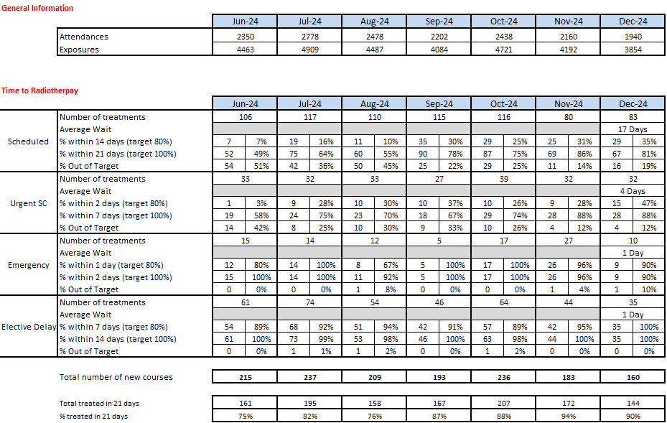
Radiotherapy Waits – December 2024
Notes:
Slight fall in % treated within 21 days, however performance was high at 90%. The biggest challenge remains the Scheduled and Urgent cohorts.

Slide 29
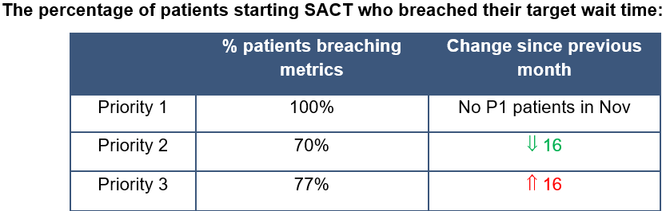
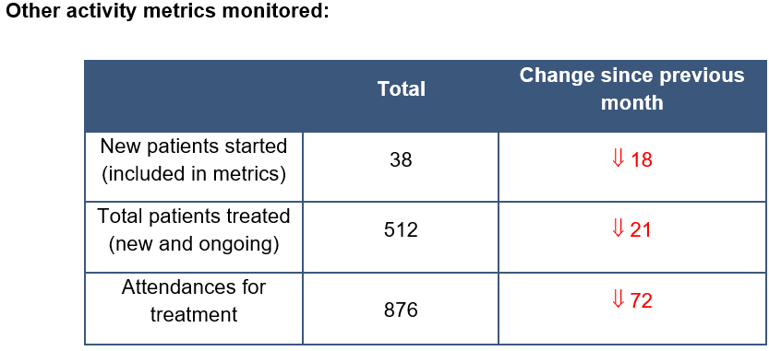
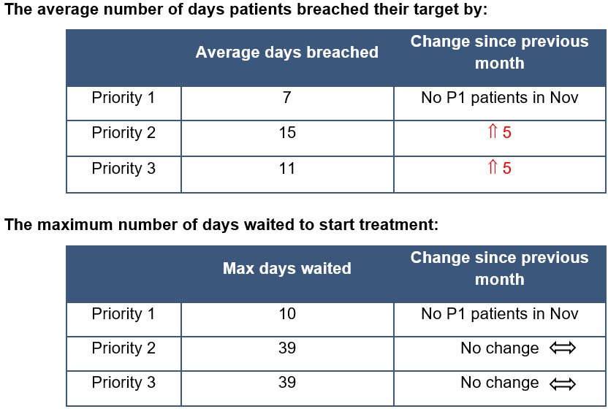
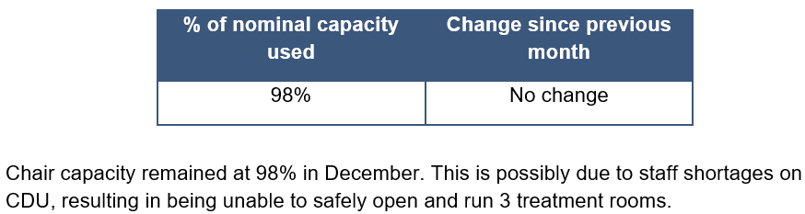
SACT Waits – December 2024
Notes:
All Priority 1 patients breached in December. The % of priority 2 patients who breached in December decreased compared to November but the % of priority 3 patients who breached increased.
Although priority 2 patients show an overall decrease in the percentage that breached, there was a significant reduction in the number of P2 patients overall.
More priority 3 patients breached in December and overall waited longer to start SACT compared to the previous month. This demonstrates the lack of available capacity in the CDU diary.
It is again important to note that the ward was utilised even more than in November for ‘day-case’ patients to receive treatment to avoid significant delays that would impact on patient outcomes. These patients were started sooner than would have been possible on CDU, so this data does not fully reflect the times these patients would have waited. This gives the false impression of improvement in capacity in CDU which is not the case.
Business case to increase chair capacity is progressing.

Slide 30
First Definitive Treatment waits
In addition to monitoring waits to Decision to Treat, the wait from DTT to Treatment is now reviewed. The graph below demonstrates the median wait to treatment for all treatment modalities, all tumour groups. National Optimal Pathways describe waiting times should be within 21 days of decision to treat, however we are also monitoring % receiving treatment within 31 days of DTT.

Slide 31
First Definitive Treatment waits
Waits to FDT for the three primary anti-cancer treatment modalities are shown below.
Notes:
There is of course variation between waits and tumour groups for each of the main treatment modalities, detail that has been shared with services.

Slide 32

Priorities/Focus Next Month
Continued focus on front end of pathway for all specialties
Assess impact on capacity of agreed actions from skin workshop (inc. super clinics, locum consultant – interviews w/c 10/02/2025, job plan reviews)
Continued focus on cellular pathology
Identify additional surgical (upper GI in particular) and chemotherapy capacity
Radiology cancer performance review
Further actions/improvement in Skin, LGI, Urology and Lung. Progress against actions to be monitored through CPIG

Slide 33
Planned Care Performance

Slide 34
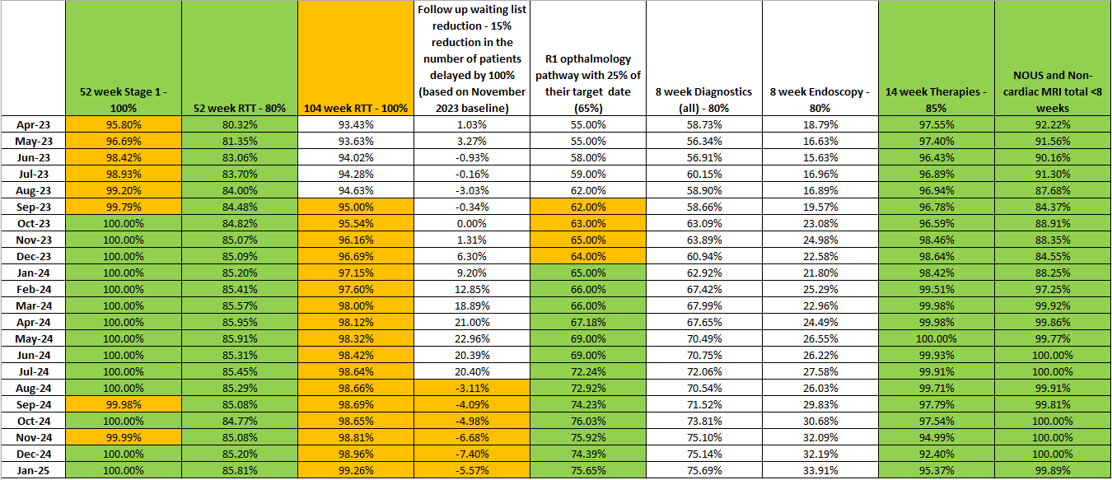
Planned Care Performance –January 2025

Slide 35
Planned Care actions to
Robust monitoring via live dashboards
Weekly monitoring meetings chaired by Service Group Directors
Bi-weekly oversight meeting chaired by the Chief Operating Officer
Specific support commissioned for Gynaecology improvement plans
Focussed work being undertaken within the Podiatry service to improve future therapy waiting list position.
Demand and capacity planning underway to assess potential delivery risks for 2025/26.
Notes:
This is a generic copy slide.

Slide 36
CAMHS

Slide 37
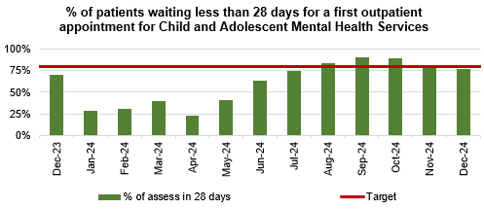
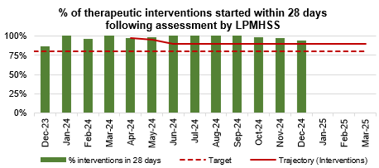
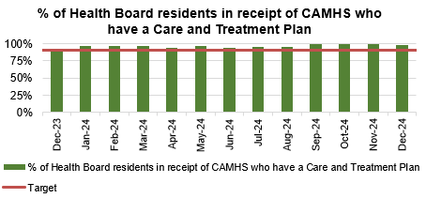
CAMHS Performance
Notes:
This is a generic copy slide.

Slide 38
HCAI TI Position to 31.01.25

Slide 39
Progress against TI goals: 01 Apr – 31st January 2025

Slide 40
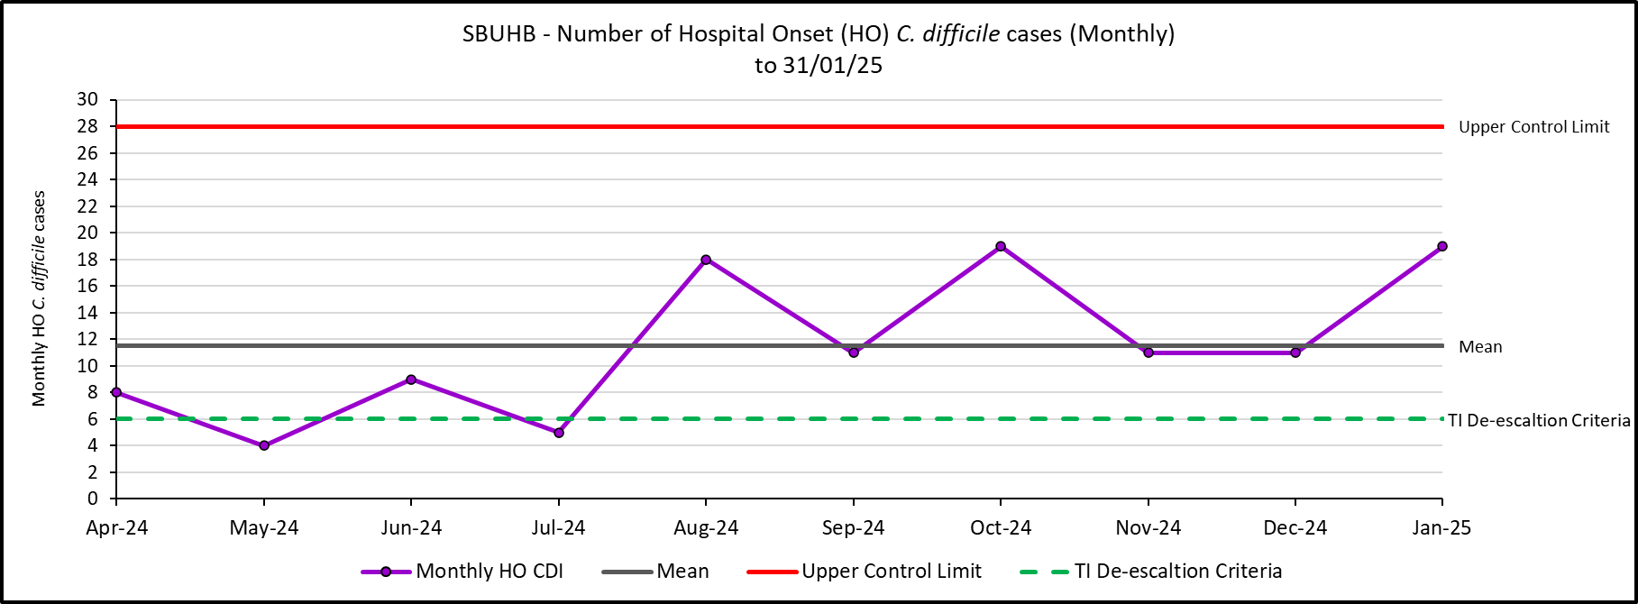
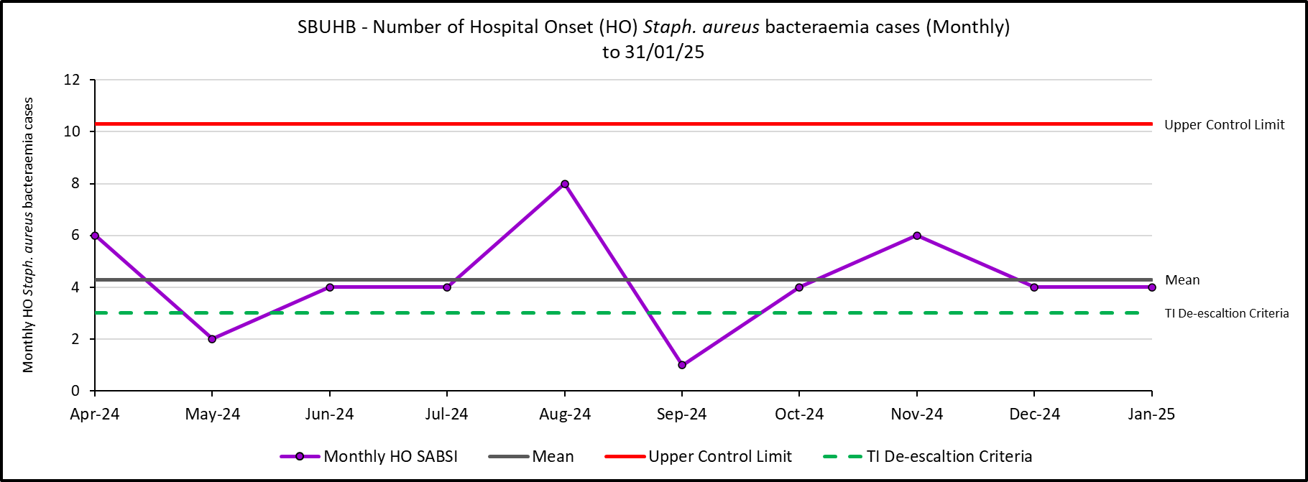
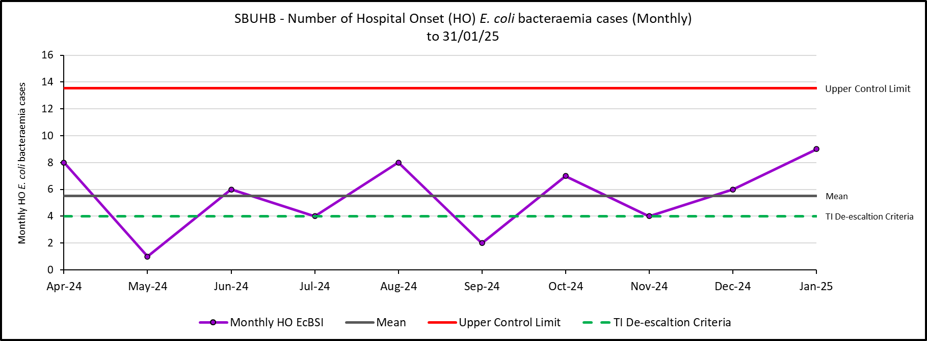
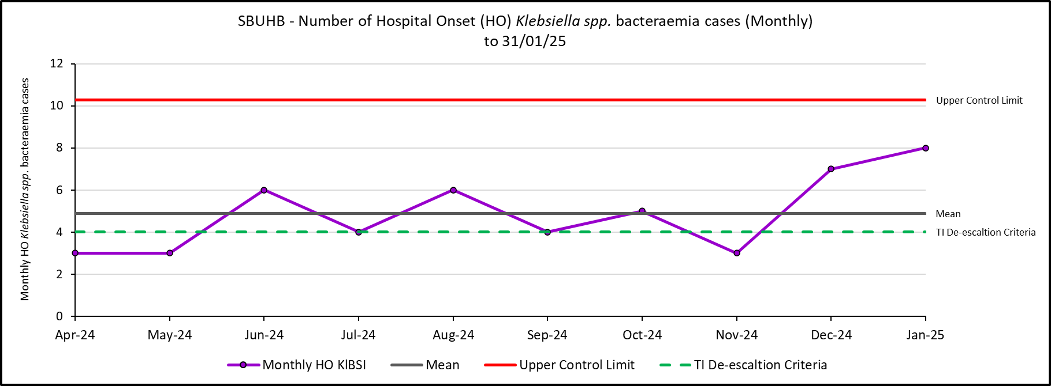
Hospital Onset HCAI TI Criteria to 31/01/25

Slide 41
Antimicrobial Stewardship: 72-hour review, FY 2025 Q2
(Q3 results currently unavailable)
Swansea Bay University Health Board Compliance
All Wales Compliance (12 month rolling average)
Compliance to guidelines
72-hour review
  Outcome of 72-hour review:
  Change (escalate/de-escalate)
  Continue
  IV to Oral Switch
  Stop
Compliance to guidelines
72-hour review
  Outcome of 72-hour review:
  Change (escalate/de-escalate)
  Continue
  IV to Oral Switch
  Stop
90%
89%
88%
81%
5%
8%
71%
66%
4%
7%
21%
19%

Slide 42
Outbreaks of infection and associated beds out of use
During January 2025, there were 14 infection related incidents/outbreaks (including 4 outbreaks that commenced in December 2024 and concluded in January 2025).
9 in Morriston: 5 Influenza; 3 COVID-19; 1 Norovirus (179 bed days lost).
1 in Singleton: COVID-19 (0 bed days lost).
2 concurrent in Gorseinon Hospital: 1 Influenza; 1 COVID-19 (0 bed days lost).
2 in Mental Health Facilities: both Influenza (1 bed day lost).
During January, there was 1 genomically-linked outbreak of C. difficile identified in Morriston (involving 2 patients). There were no bed days lost as a consequence.
ALL outbreaks are reported within Datix Cloud IQ

Slide 43
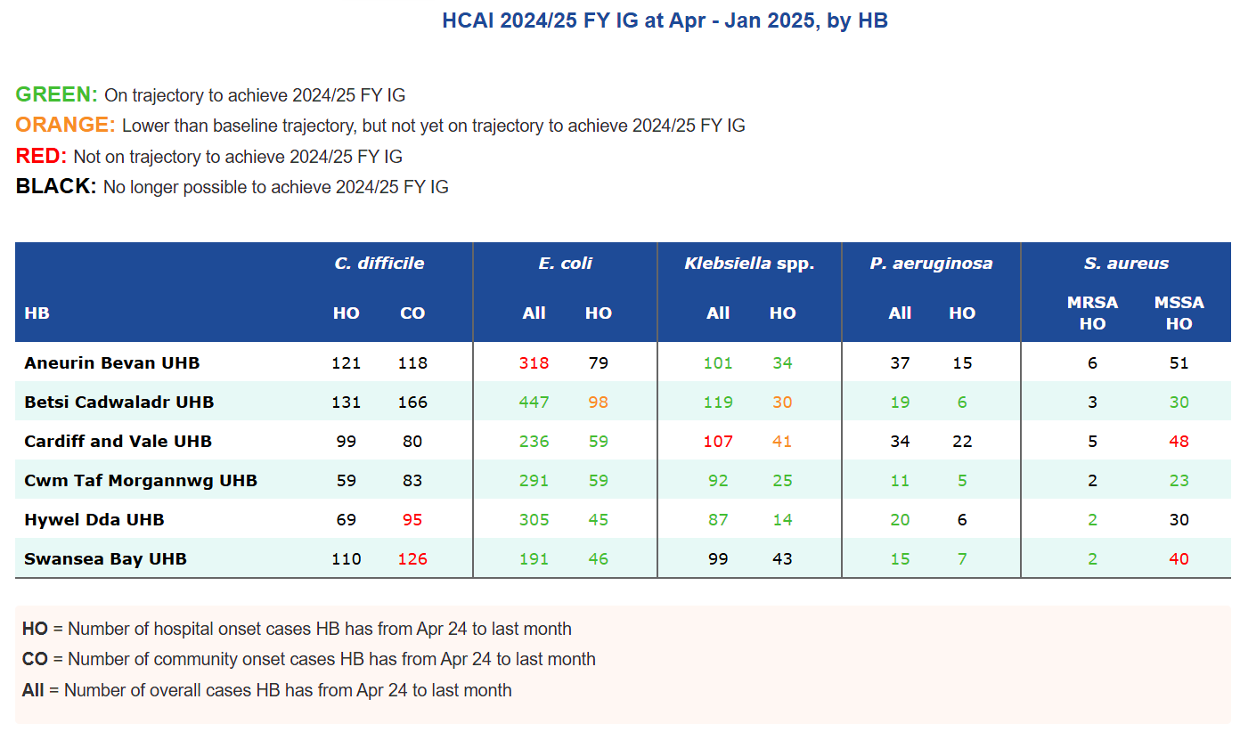
WHC HCAI & AMR 2024/25 Improvement Goals

Slide 44
Focus for the quarter
Gold C. difficile High Incidence Management Group continues, with Silver Groups reporting into Gold.
The Digital App for HCAI incident case reviews: the pilot has been delayed to late January, with feedback anticipated in February, which will inform revisions, with an ambition to launch in early March 2025.
The C. difficile risk stratification project work continues.
The prescribing audit for hospital acquired pneumonia has been completed and provisional results shared at Gold and to form basis of further discussions with prescribing teams.
Following presentation of C. difficile paper to Management Board:
  Proposal for review of funding regarding cleaning agreed in principle. To develop a programme for financial review for a phased approach, initially with a focus on areas of highest risk.
  Development of a supportive toolkit for staff, and a corresponding governance framework to record and escalate when there is deviation from standard protocol for suspected and confirmed C. difficile isolation, and post-C. difficile high level cleaning processes.

