Slide 1


Performance & Finance Committee
Morriston Service Group
25.02.2025

Slide 2

High Level Summary
Top 3 Actions to address position:
Improve patient flow/ reduce use of unfunded capacity
Reduce variable/ premium cost pay
Reduce cost of clinical consumables in key areas (diagnostics/ specialist services)

Slide 3
Agenda Detail
Health Board & Service Group Financial Summary
In-Month Revenue Position
Savings Performance
Key Drivers
Risks, Next Steps & Mitigating Actions
Appendices

Slide 4

Health Board Summary Elements of Financial Plan
Note: Specific elements from Part 1, 2 and 4 of the plan that relate to this service area are summarised on the next slide.

Slide 5

Service Group Element of Financial Plan
The end of year control total target for Morriston Service Group is £15.6m.
Forecast outturn is £24.35m (reassessed for Recovery & Sustainability Board 12th February 2025). A shortfall of £8.3m to the control total.
Morriston has worked with the Recovery and Sustainability Director and through the Board to identify opportunities and mitigate the shortfall where possible and continues to do so as year end approaches.
All overspend mitigations are now reported as savings schemes (see slides 14 to 17 for detail) or run rate reductions and updated and reviewed fortnightly for the Recovery & Sustainability Board.
There remain both risks and opportunities within this forecast for 24/25 outturn. The service is committed to delivering the best possible outturn whilst maintaining patient care.

Slide 6

2024/25 In Year Health Board Position

Slide 7
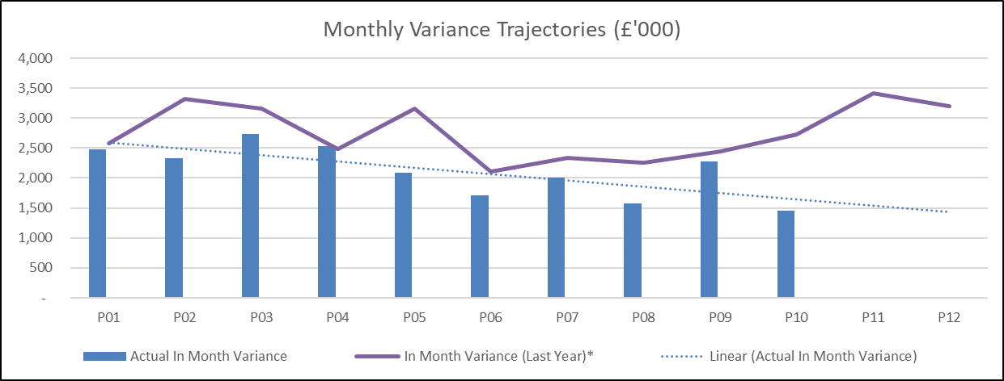
Service Group Position By Month & Divisions
Key Messages:
At month 10, Morriston Service Group is £21.2m overspent. This consists of £24.3m overspends in Divisions, which are partly offset by £3.1m of non recurrent accounting opportunities and reserves held centrally in year. These opportunities and the majority of reserves will not be available into 25/26.
The improvement between month 09 and 10 is part of the planned trajectory to year end and includes a number of backdated funding and income streams which have now been confirmed after work with clinical and commissioning colleagues to review services delivered.
All Divisions have pressures, but the most significant overspend is in Medicine. A large proportion of this is linked to medical staffing which will include cover for the acute rota and services now under the Acute & Emergency Care & Hospital Operations Division, but here are also pressures due to unfunded bed capacity, and demand growth in neurology and diabetes impacting non pay spend. Specialised has some specific issues linked to the Cath Lab replacement project earlier in the year and holding the cost of reduced Cardiac activity compared to baseline budgets. Alongside this there are increasing consumables costs in most areas.
No area is meeting it’s savings target, although some progress has been made in recent months it is largely non recurrent at this stage.
The cost of covering additional unfunded capacity and demand for support services across all areas is also driving the overspend.
Divisional leads continue to work on their individual savings and recovery plans, with a focus on delivering a sustainable plan for 25/26 as well as improving the final months of 24/25.

Slide 8
In month Service Group Position By Division & Type Expenditure/Income
Pay Pressures
Health Care Support Workers (additional clinical services) and Registered Nursing; continuing pressure with high use of bank cover for vacancies, sickness and acuity across wards. Result of both additional capacity both on wards and across the Urgent Care footprint and a number of patients requiring enhanced monitoring.
Medical Staff; some additional planned care sessions linked to activity delivery but continued pressure in the acute medical rota linked to both gaps and delivering capacity for cover across the acute rota’s and into additional capacity areas. Ongoing issues with unfunded sessions in surgery and premium pay costs in Pathology to maintain the full service and meet demand. Some reduction in the variable pay has been seen but it remains over budget.
A&C underspend to be offset to vacancy factor (pay budget adjustments) and linked to temporary management structure gaps.
Non Pay Pressures
Clinical Supplies & Services continue to see cost increases driven by both demand (volume) and price in most areas. Key issues include; medicine - diabetic pumps and devices and neurology blood products, Pathology testing consumables to support activity and complete testing for the upcoming systems change over, Specialist Surgery consumables for Cardiology and Burns and Plastics; although these are partly offset by income over achievement.
Services from Other Bodies; work to support activity delivery to meet performance targets.
Establishment Expenses; increased inter site travel supporting workers who are moving between sites alongside high postage costs driven by price and demand. Digitisation should reduce this going forward.
Premises & Fixed Plant continues to be driven by the high costs of bed hires and repairs pending new contract arrangements which are in train.
Income
In month over performance includes some backdated income linked to the commercial retail units, alongside ongoing overperformance in our activity contracts, although some of this comes at a premium cost of delivery.

Slide 9

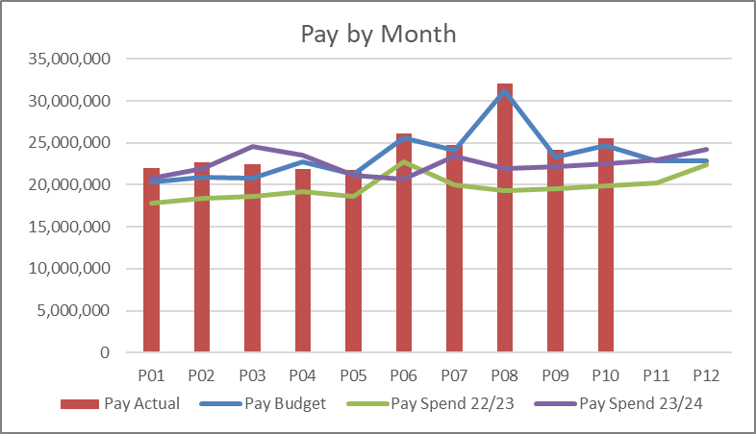
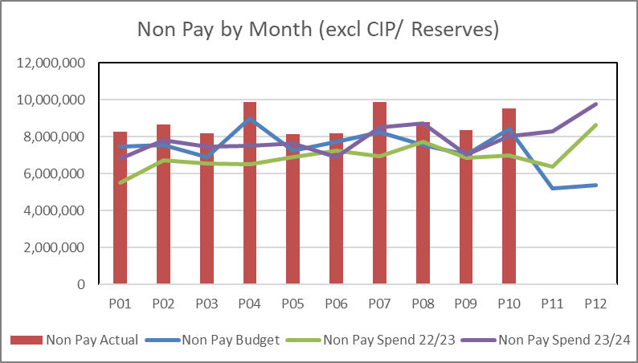
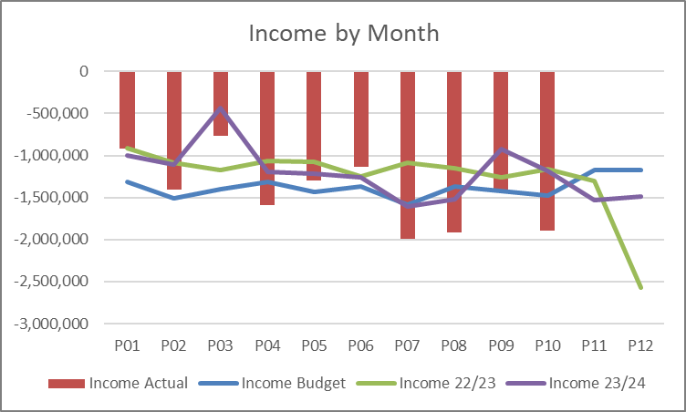
financial performance: Overall trends
Pay
If the peaks for pay awards and backpay which have occurred in month 08 and 10 are removed pay is remaining largely stable overall. Reductions in some variable pay areas have been offset by substantive increases and also planned increases in other areas supporting service change. The key issues continue to be managing variable pay for medical and nursing staff, which in part is dependant on resolving the continued winter bed pressures and demand and capacity gaps.
Non Pay
In month variations linked to activity in particular in areas of high cost consumables (cardiology/ cardiac service) can be seen in the overall position for non pay but the trend line remains stable, despite efforts to deliver savings linked to procurement, waste limitation and standardisation. Work continues to look at specific pressure areas where increased demand is impacting spend (pathology/ diagnostics) and capture inflation pressures and areas of opportunity. It must be noted that the majority of pay pressure sits in the clinical consumables lines and reflects the demands on the service. The service group team work closely with procurement and pharmacy to try and limit our exposure and ensure best practice is in place to avoid waste, but to date the total pressures have not abated despite some pockets of improvement.
Income
Fluctuations seen month on month linked mainly to delivery of activity based income contracts, in particular cardiac surgery and cardiology procedures. These procedures have significant non pay costs associated and so lower income delivery will align to lower non pay spend, however underperforming against the core contract results in an inability to recover funding for the fixed service costs. Focus on maximising delivery continues and this can be seen in the overall improving trend line from month 07. In addition there has been focus on ensuring activity data accuracy where it impacts income flows.

Slide 10
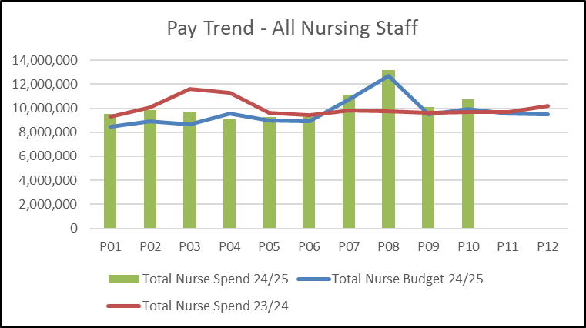
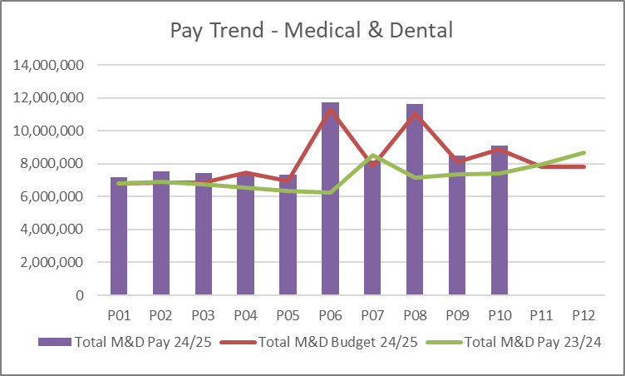
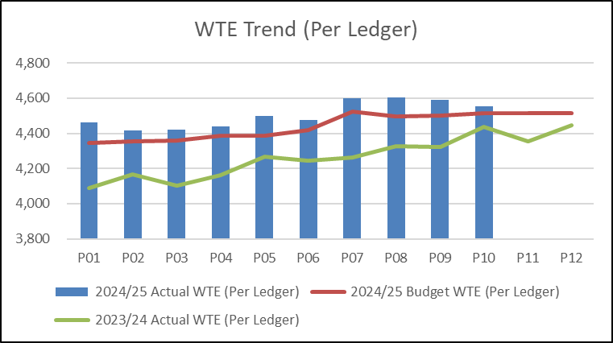
Pay Summary
Total nurse expenditure had shown a reducing trend through the first half of the year linked to lower variable pay for registered nursing, and unregistered staff remaining stable. However, through quarter 3 costs have started to increase, partly due to predicable winter pressures (both on the service demand and staff sickness levels) but also the funded pay awards which can be seen in the budget uplift. The focus remains on stabilising the workforce, filling vacancies and improving patient flow to decongest all patient areas which will have a positive impact on nursing cost.
Excluding the pay award peaks Medical staff pay has also remained largely stable, again with increases in the winter months linked both to planned service change (Interventional Radiology strategy) and winter cover. There has been some success in managing variable pay costs down in Medicine and Acute Services but this has been offset by other increases linked to delivering activity (Pathology and Radiology) and the aforementioned Interventional Radiology strategy.
WTE, the main driver for the increase from 23/24 average wte is due to the successful recruitment of registered nurses, supporting the replacement of agency cover, although there were increases for Healthcare Scientists and Medical staff too compared to the 23/24 average. Through Q3 of 24/25 there is an increase in the training grade wte and there is also an increase in nursing staff, partly linked to service transfers in from Primary Care but also previously mentioned pressures leading to increased bank staff use (partly offset by agency reduction which carries no wte). This continues to be closely monitored and challenged.

Slide 11
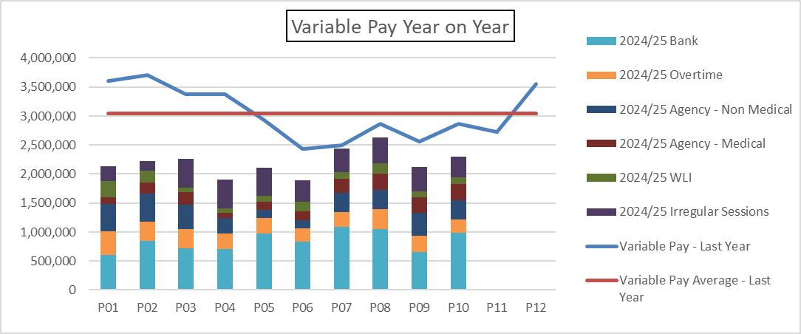
Pay : Variable Pay Actual Spend
Key messages:
Variable pay has reduced by an average of £800k per month compared to 23/24, in particular agency reduced significantly following successful nurse recruitment through 23/24 and removal of expensive medical agency to replace with lower cost options (including recruitment and NHS locum use). In quarter 3 both types of agency slightly increased, for non medical staff this reflected both pay awards and increased urgent and critical care pressures where agency is used for speciality skills cover. For medical staff there are both pay rate changes to align to pay awards, front door pressures and a planned use of external support for the fragile Interventional Radiology service.
One consequence of increased substantive registered nurses and reduced agency has been a greater use of bank staff to cover shifts when needed, this is seen in the increased cost of bank relative to last year. In addition there has been increased bank costs for Health Care Support Workers (shown as ‘additional clinical staff). These costs have been driven by increased requests for acuity cover, ongoing vacancies and the management of further additional capacity beds.
All service groups were set a target in year of reducing variable pay to no more than 50% of the quarter 1 average by the end of quarter 3. Morriston has not succeeded in delivering this. However, working with both the Medical Directors office, Workforce colleagues and Nurse Directors office, there has been assurance that variable pay is only being incurred when necessary for delivering safe care and/ or maintaining the trajectories of recovery work and supporting diagnostics – some of which is delivered via variable pay means.
Morriston continues to try and develop a substantive workforce in hard to recruit areas to allow delivery of the required activity (pathology, radiology), but will continue to incur some variable pay to maintain activity trajectories in both diagnostics and surgery. In addition, we are actively working to reduce sickness and vacancies in all staff groups but with particular emphasis on Health Care Support Workers, and improve patient flow to decongest our acute care areas and allow release of those staff.

Slide 12
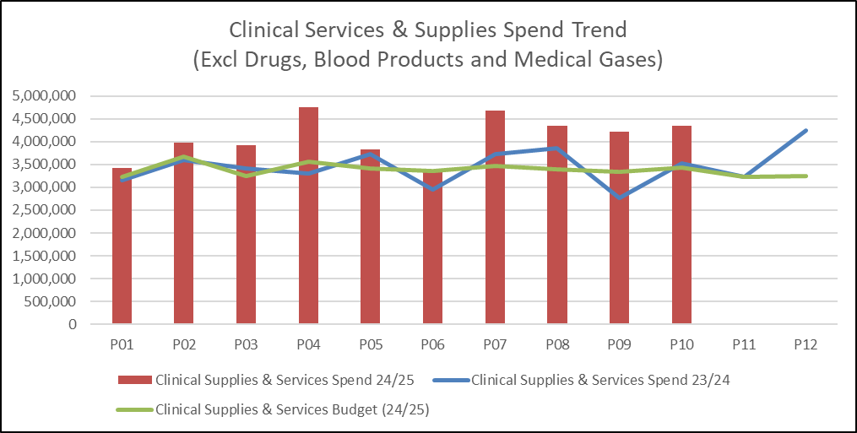
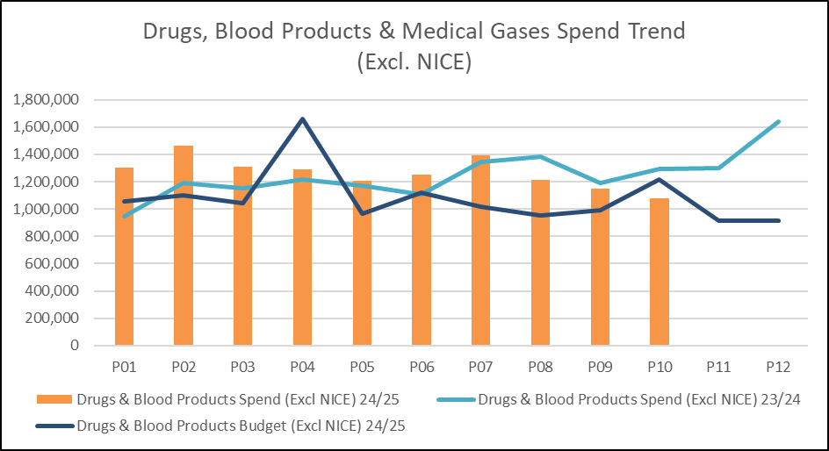
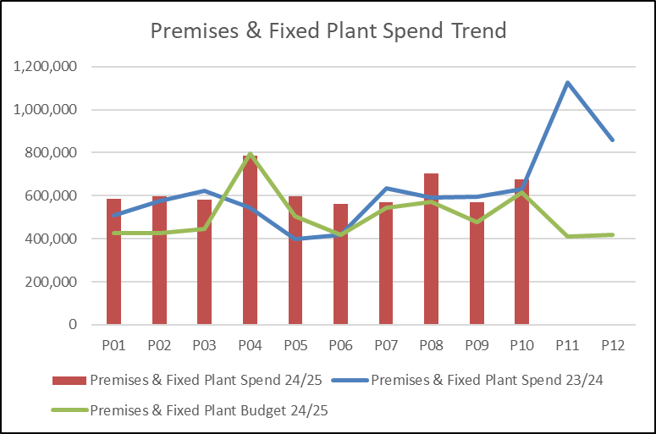
Non Pay: key drivers
Clinical services & supplies are the main driver for the overspend on non pay lines (outside unachieved savings). The main pressures within this spend category include; hire of the catheter lab (£60k per month) which is ended in November, cardiology consumables (average £45k per month over budget, around £14k of which is offset by increased income), endoscopy consumables (£37k per month overspend), skin products (£44k per month overspend) linked to activity delivery, managed service contracts for pathology testing (£59k per month overspend) linked to higher than planned activity growth, recovery plans include measures to manage demand. Finally maintenance contracts (£80k per month overspend) in diagnostic areas (radiology, endoscopy, pathology) have increased reflected aged equipment and more frequent breakdowns this is being reviewed with capital colleagues and through the consideration of future managed service contracts for diagnostics. A savings scheme to review and reduce costs where possible and consider other options for future delivery is being pursued and will see some benefit in quarter 4.
On the drugs and blood lines the greatest pressure is blood products supplied for Neurology (£58k per month overspend), this reflects significant growth and inflationary pressures above those funded through the plan in 24/25. A second plasma exchange machine has been purchased which will support management of this pressure going forward. In recent months additional occupancy in acute services and critical care has also driven increased consumables both for drugs and general clinical supplies.
Premises & fixed plant costs continue to overspend due to the pressures associated with bed hire and repairs due to aged bed stock and the Health Board contract needing renewal to enable replacement and preferential rates.

Slide 13

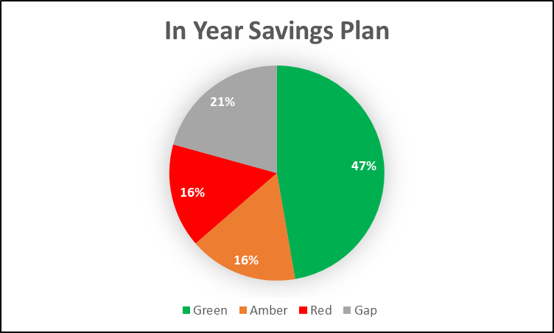
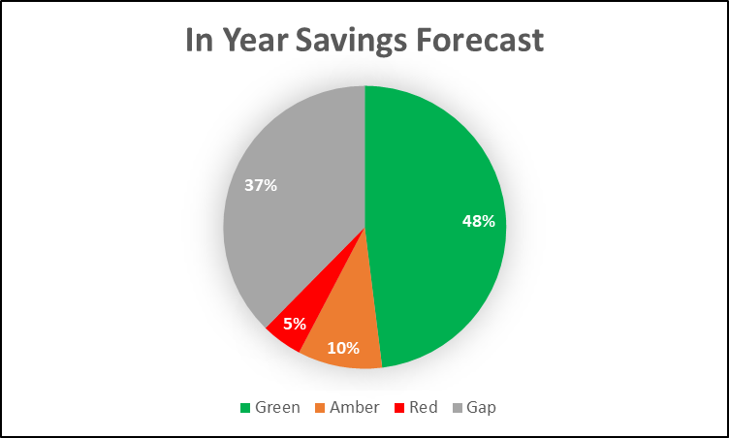
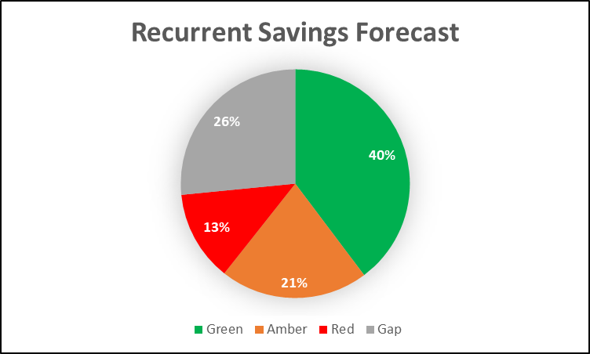
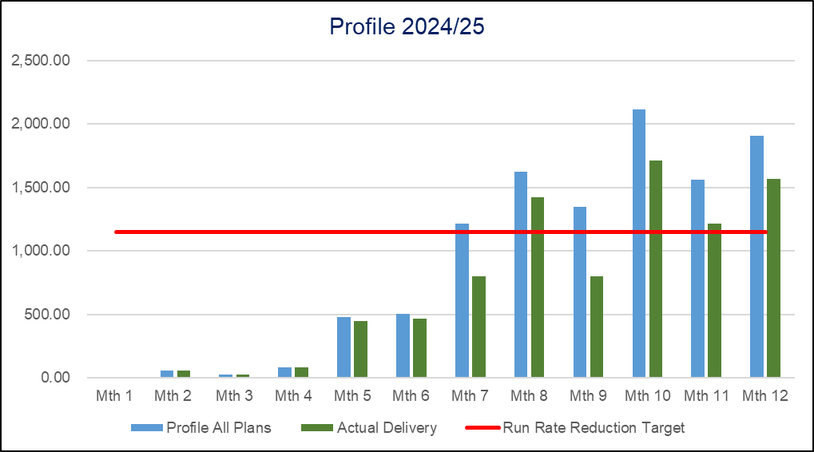
Savings Summary From Financial Assessment

Slide 14
Savings Detail (Green)

Slide 15
Savings Detail (Amber)

Slide 16
Savings Detail Red Schemes

Slide 17
Savings Detail
The Service Group has worked hard to move schemes to green where possible, now showing over £6m of schemes in the green category compared to just £0.6m in month 06 when last presenting to Performance and Finance Committee. Procurement savings in this category are under delivering reflecting the challenge of managing non pay given ongoing inflationary pressures, however other areas have over delivered to plan and are offsetting the shortfall in year.
There are £2.2m of planned amber schemes, which are variable in delivery value and continue to be monitored. Delivery in this area is forecast at £1.3m a shortfall of £0.9m to plan. The main shortfalls include:
£0.3m nursing for Medicine beds. It had been expected that a smaller staffing establishment could be implemented following some ward reconfigurations but post Nurse Staffing Act review the professional judgement was made that this was not possible.
£0.2m on income delivery for Bariatrics and Plastics work. Whilst we continue to over perform in this category the case mix is lower for Bariatric (more low value work reducing margins) and some plastics work has been deferred to allow theatre capacity to be released to other specialities to deliver performance targets.
£0.2m Bed Contract Savings; assumed that the contract would be in place by quarter 4 it is not yet completed and signed off so has slipped in terms of delivery.
£0.1m variable pay reduction linked to lower than expected recruitment
There are other shortfalls that reflect slower delivery than anticipated but the majority of savings can be seen delivering, with the exception of expected radiology clinical supplies reductions.
Red schemes of £2.2m have a lower delivery value of £0.6m. These schemes are the hardest to deliver due to dependency on external factors (VAT/ national guidance/ contract negotiation) or potential impact on clinical risk. As per the table, some schemes are no longer being pursued, others will require ongoing focus to get over the line and the service continues to pursue and seek corporate support where available.
All other ideas which were originally badged as pool 2/ 3 after Executive review have been explored with some being put forward for further work going into 25/26.
The challenge of finding ongoing and recurrent savings to close the remaining gap remains a focus for Morriston.

Slide 18

Identification Opportunities & Risk
Further Opportunities for 25/26:
Service redesign (Virtual Wards/ Acute Community Teams/ Full Frailty Implementation/ Interventional Radiology/ Vascular Hybrid Theatre/ Emergency Department)
Digitalisation (lab med, letters, booking)
Aligning demand and capacity, improved medical cover availability as staff return from sickness and junior rota’s are better filled.
Delivery of a Community Diagnostics Centre (26/27 opportunity)
Opportunity of managed service contracts for equipment
Improved/ increased contracting with other Health Boards for activity delivered to their population
Closure working with pharmacy to maximise drugs savings
Closure working with GP partners to manage incoming test demand (pathology)
Further Risks:
Winter Pressures and Site Acuity
Implementation timescales/ managerial capacity for any recovery schemes
Challenge of staff engagement against perceived deliverability
Inter group consequences of recovery plan options pursued such as Therapies vacancies impact on Length Of Stay/ Bed Plan
Additional inflationary and demand pressures (testing, inter organisation agreements, maintenance, blood products, skin)
Delivery of contract activity and prioritisation of limited theatre capacity
Recovery work impact on diagnostic spend

Slide 19
Action to Date & Next Steps To Be Taken By Service Group
Continued focus on delivering best closing position for 24/25
Focus on improving flow to allow bed base to retract back into core capacity
Action cost control measures as per Health Board Recovery & Sustainability Programme
Demand and Capacity reviews
Pursuing schemes to deliver recurrently into 25/26 (review of current schemes and new ideas)
Work with Recovery & Sustainability team to identify new opportunities using benchmark data sets
Continue to reduce variable pay
Continue close monitoring of position and progress against plans

Slide 20
Appendices

Slide 21

Appendix 1: Morriston Red Pool 2 and 3

