Slide 1
Swansea Bay University Health Board
Integrated Performance Report
December 2025

Slide 2
Report Overview
The Health Board Integrated Performance Report will provide updates against all areas under escalation with Welsh Government, all performance metrics outlined within the NHS Wales Performance Framework 202-26, along with updates against the Delivery Expectations and the Ministerial Enabling actions as outlined in the NHS Wales Planning Framework 2025-2028
Section 1: Updates against all Escalation areas with Welsh Government
Section 2: Performance against the Health Board’s Strategic Objectives
Section 3: Service Specific Updates

Slide 3
Section 1:
Updates against all Escalation areas
with Welsh Government

Slide 4

Delivery against Targeted Intervention and Enhanced Monitoring Criteria 2025/26
TI Area (Level 4) | Criteria to achieve | Performance (Nov -25)
Cancer | 60% performance maintained for 3 months against the SCP target. | 56% (Oct- 25)
UEC | Continuous reduction of ambulance handovers over an hour of at least 11% in three consecutive months and maintained for 3 months (Based on Q2/Q3 2023 baseline | 162 (6.4% reduction)
 | Continuous improvement towards no more than 7% of patients waiting over 12 hours at each individual site and across HB | 8.83%
 | Median time from arrival at emergency department to assessment by a clinical decision maker should not exceed 60 minutes | 89.62%
 | Continuous reduction in delayed pathways of care of 5% for three consecutive months and then maintained for three months (based on Oct-Dec 23 baseline) | 179 (3.8% Reduction)
HCAIs | A clear improvement plan based on a root cause analysis to address the issue of hospital onset HCAIs. | In place
 | C-Diff: reduce the number of hospital onset infections by 40% and maintain for 3 months (from a baseline of the average number of cases in quarter 3 of 10 cases to no more than 6 per month | 10 cases
 | Staph aureus: reduce the number of hospital onset infections by 25% and maintain for 3 months (from a baseline of the average number of cases in quarter 3 of 4 cases to no more than 3 per month | 4 cases
 | E-coli: reduce the number of hospital onset infections by 20% and maintain for 3 months (from a baseline of the average number of · cases in quarter 3 of 5 cases to no more than 4 per month) | 5 cases
 | Klebsiella: reduce the number of hospital onset infections by 10% and maintain for 3 months based on 2017/18 figures (baseline –54 cases in 2017/18, reduce to average of at most 4 per month) | 3 cases
Finance | Detailed Updates included in the monthly Escalation Report
Strategy & Planning | Detailed Updates included in the monthly Escalation Report
Maternity & Neonates | Detailed Updates included in the monthly Perinatal Report
Dashboard

Slide 5
Delivery against Targeted Intervention and Enhanced Monitoring Criteria 2025/26
Escalation Area (Level 3) | Criteria to achieve | Performance (Nov-25)
CAMHS | 80% of LPMHSS mental health assessments undertaken within 28 days from the date of receipt of referral | 97% (Oct-25)
 | 70% of therapeutic interventions started within 28 days following an assessment by LPMHS | 65% (Oct-25)
 | 85% of HB residents in receipt of secondary mental health services who have a valid care and treatment plan | 95% (Oct-25)
Planned Care | 100% of open outpatient pathways to be waiting less than 52 weeks and maintained for 3 month | 100%
 | Continuous improvement towards 75% of all open outpatient pathways waiting less than 26 weeks | 78.46%
 | 100% of open pathways to be waiting less than 104 weeks and maintained for 3 months | 100%
 | Continuous improvement towards 80% of all open pathways waiting less than 36 weeks | 75.08%
 | 12% reduction in the number of patients delayed by 100% for their follow up appointment in three consecutive months and maintained for 3 months (Based on the November 2024 baseline.) | 17.54%
 | 68% R1 ophthalmology patient pathways to be waiting within or no longer than 25% of their target date for an outpatient appointment and maintained for 3 months | 73.29%
 | 85% of patients waiting for a diagnostic test to be waiting less than 8 weeks and maintained for 3 months | 73.94%
 | 85% of patients waiting for a diagnostic endoscopy to be waiting less than 8 weeks and maintained for 3 month | 40.42%
 | 85% of patients waiting for a NOUS and non cardiac MRI to be waiting less than 8 weeks and maintained for 3 months. | 79.51%
 | 90% of patients waiting for therapies to be waiting less than 14 weeks and maintained for 3 months | 100%

Slide 6
Section 2:
Summary of the performance against the Health Boards Strategic Objectives

Slide 7





SBUHB Strategic Objectives and Quality Aspects
Our refreshed Strategic Objectives –aligned to ‘a Healthier Wales’ articulate the future state of Swansea Bay UHB as a high-quality organisation. We have set out what this looks like for our population, communities, staff , partners and services and are developing strategic indicators that will tell us if our efforts are delivering our objectives
People of Swansea Bay live healthier, equitable and more equal and prosperous lives
Every child has the best start in life
All children, young people and adults are enabled to maximise their capabilities and have control over their lives
Good work and fair employment is created for all
A healthy standard of living is ensured for all
Healthy and sustainable places are created through placemaking
The role and impact of ill-health prevention is strengthened
Racism, discrimination and their outcomes are tackled
Environmental sustainability and health equity are pursued together
Care is high quality, safe, efficient and delivers the best possible outcomes for people
Care is safe, it helps people and avoids harm
Care is evidence based, effective and improves outcomes
Care is timely and delivered by the right person in the right place
Care is efficient
Care delivers equitable outcomes regardless of demographic, socioeconomic or geographic factors
Care is person centred and delivered with compassion, dignity and mutual respect
Care is delivered in safe and appropriate settings supported by innovative digital solutions
Care is delivered around the patient in the most appropriate setting as close to home as possible supported by digital and data solutions
Care settings are fit for purpose, appropriately designed and equipped
Secure, trusted and insightful data and digital platforms empower staff to deliver more and higher quality care and improved patient outcomes and population health
We have a digitally inclusive culture, where patients, clinicians and non-clinical colleagues work collaboratively to create effective and efficient services and patients are empowered to make informed and meaningful choices about their health and care
Through where and how they are delivered, services contribute to the environmental, economic, social and cultural well-being of Swansea Bay
The health board is a great place to work where staff feel valued and work together towards a common goal
Our Workforce is engaged, motivated and healthy; they feel valued, fairly-rewarded and supported
The Health Board is recognised as an employer of choice
We have a well-planned workforce with the right number of skilled people working on the right things
People feel ready for our digital future
People are supported to develop the skills and capabilities they need
People role model collective and compassionate leadership and live our values
We are diverse and inclusive, ensuring all voices are heard
The health board is a resilient, financially sustainable and responsible organisation
The health board is financially balanced and able to invest in service transformation and change
Decisions are made balancing short-term improvements and long-term impacts
Resources are used efficiently and proportionately, reducing waste and variation
The environmental impact of health care delivery in Swansea Bay is minimised
The health board invests in and works with others locally and responsibly, using our assets to positively contribute to the community
Citizen stakeholders are meaningfully involved and engaged in decision making
The health board has the capacity to effectively plan for and respond to incident and emergencies

Slide 8
People of Swansea Bay live healthier, equitable and more equal and prosperous lives
Childhood Immunisations | Target | Sep-25
Percentage of children who are up to date with the scheduled vaccinations by age 5 (‘4 in 1’ preschool booster, the Hib/MenC booster and the second MMR dose) | 95% | 90.2%
Percentage of children receiving the Human Papillomavirus (HPV) vaccination by the age of 15 | 90% | 84.2%
Influenza & Covid Immunisations
Percentage uptake of the influenza vaccine in adults 65 years and over | 75% | 63.6% (25/26)
Percentage uptake of the COVID-19 vaccination for all those eligible | 75% | 42.4% (Oct-25)
Smoking Cessation
Percentage of adult smokers who make a quit attempt via smoking cessation services | 5% Annual target | N/A
Percentage of adult smokers who make a quit attempt via smoking cessation services who are CO-validated as quit at 4 weeks | 40% annual target | N/A
Screening
Percentage of patients offered an index colonoscopy procedure within 4 weeks | 90%
Percentage of well babies entering the new-born hearing screening programme within 4 weeks | 90%
Percentage of eligible new-born babies who have a conclusive bloodspot screening result by day 17 of life | 95%
DE
DE
DE
DE

Slide 9
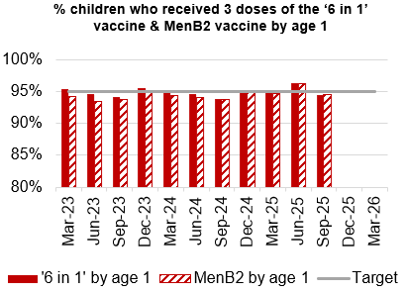
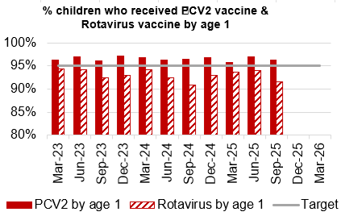
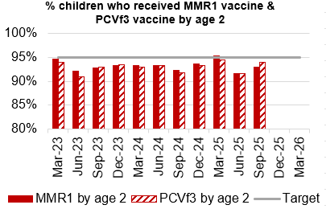
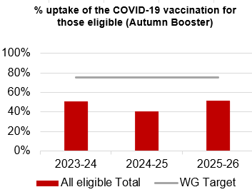
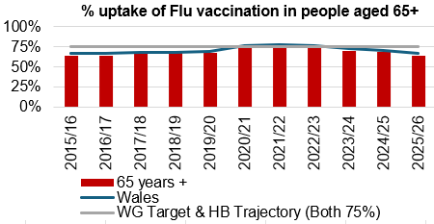
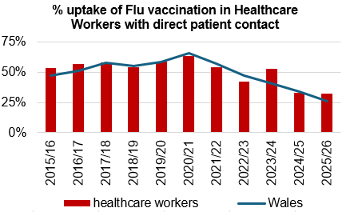
Immunisations
Actions/Updates
Performance against the immunisation targets is reported in arrears on a quarterly basis
Updated targets have been set for the new financial year which can be seen on the graphs above

Slide 10
Care is high quality, safe, efficient and delivers the best possible outcomes for people
Accident & Emergency | Target | Nov-25
4 -hour performance | 95% | 72.26%
12-hour performance | 0 | 984
Number of Delayed Pathways of Care (HB wide) | Continuous Reduction | 179
Number of cancelled Electives | 0 | 17
Median time of arrival to assessment within 60 minutes | 97% | 89.62%
Ambulance
Median emergency ambulance response time to purple: arrest category calls | 6-8 minutes | 7:12
Median emergency ambulance response time to red: emergency category calls | 6-8 minutes | 8:17
Total Handovers lost over 15 minutes | 0 | 410
Total Handover Delays > 45 minutes | 0 | 225
DE
TI
DE
TI
TI

Slide 11
Care is high quality, safe, efficient and delivers the best possible outcomes for people
Stroke | Target | Oct -25
Percentage of admission within 4 hours | 95% | 32.4%
Percentage of stroke patients receiving a CT scan within 20 minutes | 40% | 14.7%
Percentage of patients assessed by a stroke consultant within 14 hours | 95% | 58.8%
Percentage of patients to receive a mechanical Thrombectomy | 10% | 1.5%
Planned Care | Target | Nov – 25
Percentage of patients waiting < 26 weeks for an outpatient appointment | 75% | 78.46%
Total number of patients waiting < 36 weeks | 80% | 75.08%
Number of patients waiting at Stage 1 > 52 Weeks | 0 | 0
Total number of patients waiting > 104 Weeks | 0 | 0
Diagnostics & Therapies | Target | Nov – 25
Number of patients waiting > 8 weeks for diagnostics | 0 | 4,434
Number of patients waiting > 8 weeks for an Endoscopy | 0 | 1,828
Number of patients waiting > 14 weeks for Therapies | 0 | 0
Number of children waiting > 6 weeks for Audiology | 0 | 88
TI
TI
TI
DE
TI
DE

Slide 12
Care is high quality, safe, efficient and delivers the best possible outcomes for people
FUNB | Target | Nov -25
Number of patients waiting for an outpatient follow-up (booked and not booked) who are delayed past their agreed target date (All Specialties) | N/A | 75,332
Total number of patients waiting 100% over their target date | 0 | 45,177
Total number of patients waiting for a follow-up appointment | N/A | 161,751
Mental Health & Learning Disabilities | Target | Oct – 25
Percentage of mental health assessments undertaken within (up to and including) 28 days from the date of receipt of referral | 80% | 98%
Percentage of therapeutic interventions started within (up to and including) 28 days following an assessment by LPMHSS | 80% | 82%
Percentage of patients waiting less than 26 weeks to start a psychological therapy in Specialist Adult Mental Health | 80% | 42.8%
Quality & Safety | Target | Nov – 25
Number of service user feedback experience responses on CIVICA | Monthly improvement | 6,558
Percentage of complaint responses sent within 30 working days | 80% | 45% (Sep-25)
Number of Nationally Reported Incidents | N/A | 6
Number of New Never Events | N/A | 0
TI
DE
DE
DE

Slide 13
Unscheduled Care

Slide 14
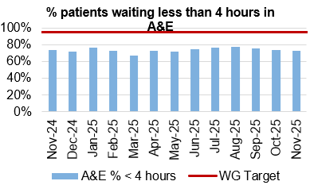
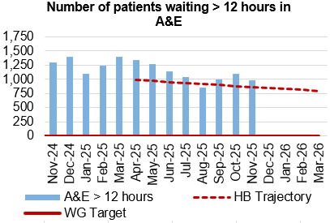
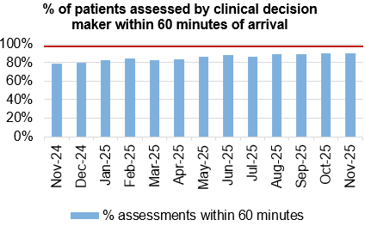
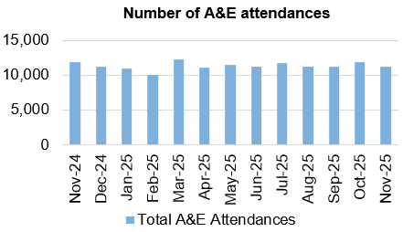
Unscheduled Care
Dashboard
Actions/Updates
*A&E reporting mechanisms have been updated in previous months which has been reflected in the submitted performance data to Welsh Government and the changes have been backdated for the purpose of the reports*.
Full implementation of D2RA model – Focus on D2RA has rapidly shifted into understanding the demand and capacity position for pathway 2 beds and utilisation of that bed pool. Recent process mapping events suggest that there is significant opportunity to improve the pathway for patients and designate the bed pools based on the needs of patients. Due to the current pathway of care delay position, work is in progress to transfer 30 clinically optimised patients from Morriston to Singleton Hospital to reduce reliance on unfunded surge capacity and poor environments of care for patients.
UEC Care co-ordination Hub – The single point of access has been in place since the 1st October 2025 and the first data submission took place on the 21st November. There is specific focus on the “clinical conversation before convey”, aimed at reducing conveyance of patients from care homes where clinically appropriate to do so. Work is also focussed on the management of patients who fall with the implementation of a level 2 Falls service made up of therapy technicians and a registered therapist, supported by St Johns ambulance provision.

Slide 15

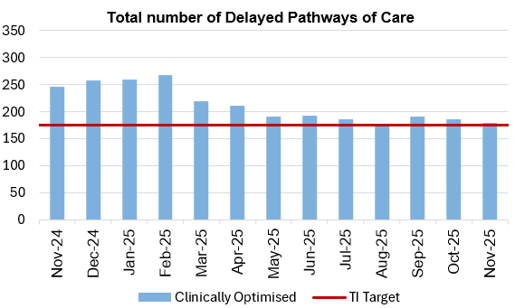



Pathways of Care Delay: Action & Intervention
Site | Delayed Pathways of Care: November 4th | Delayed Pathways of Care: November 11th | Delayed Pathways of Care: November 19th | Delayed Pathways of Care: November 25th
Learning Disabilities | 7 | 8 | 8 | 8
Mental Health | 39 | 35 | 39 | 40
Morriston Hospital | 100 | 92 | 77 | 74
Neath Port Talbot Hospital | 34 | 35 | 35 | 40
Singleton Hospital | 16 | 16 | 20 | 21
Total | 196 | 186 | 179 | 183
3.25%
WG target -15% reduction in total delays,
20% reduction in assessment delays,
20% reduction in total days delayed from March 2024 baseline
What specific improvements will be delivered?
Reduce LOS through improved Board Rounds and enhanced MDT approach
Continued accountability and ownership via weekly review and 3 monthly refresh of Action Plan
Reduce LOS through improved operational process when staff are absent-SOP
Reduced LOS due to improved confidence and understanding of MCA process
Reduced LOS if we can adopt HDUHB TA model for TA
Deloitte Activity in conjunction with West Glamorgan:
  Map D2RA pathways
  Process mapping workshops
  Changes required escalated to appropriate board
What is currently supporting the reduction:
Robust weekly accountability meetings implemented with all sites – led to improved engagement & traction on delivery
POCD Action Plan is refreshed on a 3 monthly cycle
Weekly internal census and validation approach in place
Monthly accountability meetings by site
Board Round Refresh- Workshops underway
Improving operational process to reduce delays due to sickness/AL.
Recirculated MCA/BI Guidance
Invited HDUHB colleagues to present on Trusted Assessment Model for MCA to promote shared learning
92.6%

Slide 16
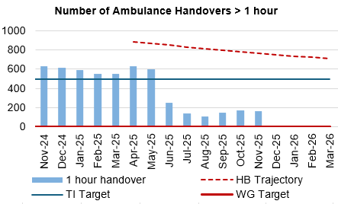
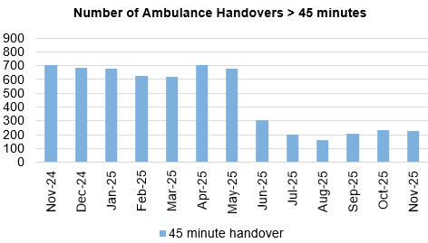
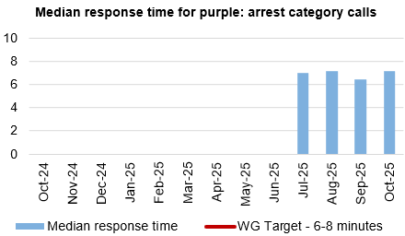
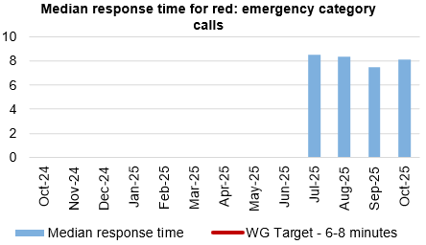
Ambulance
Dashboard
Actions/Updates
Revised flow operating model: The revised operating models implemented as part of the test of change in Morriston remain in place. However, increase in demand for emergency care further complicated by a rise in respiratory illness picture is challenging the system. The indicators continue to demonstrate improvement in ambulance handover and lost ambulance hours, however performance against 12-hour and pathway of care delays remains a key challenge.
UEC capital redesign – Recent communication from the Chief Executive to the Director General of NHS Wales sets out an urgency to progress to an Electronic Patient Record across the Urgent and Emergency care services. Whilst there remains ambition to co-locate front door assessment processes with the emergency department, this programme of work cannot be progressed in the absence of Capital investment.

Slide 17
Planned Care

Slide 18
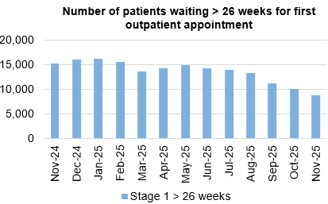
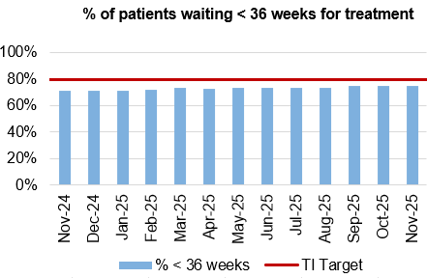
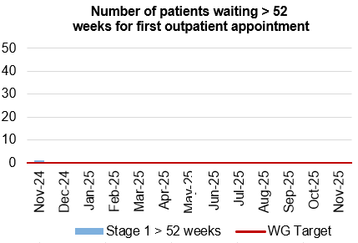
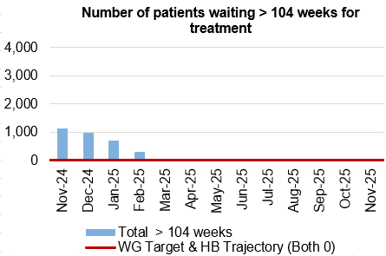
Planned Care
Dashboard
Actions/Updates
The Health Board have maintained the Stage 1 > 52 weeks target of 0 for November 2025.
The Health Board have maintained the number of patients waiting > 104 weeks for treatment target of 0 for November 2025.
towards an improved position. Focus has now been placed on achieving a new Targeted Intervention Target for patients waiting >36 weeks for treatment. Welsh Government have provided updated de-escalation criteria for all planned care metrics which reflect encouragement
Key Risks to delivery include the current physical infrastructure to hold additional clinics, workforce availability, funding and willingness of patients to attend out of hours

Slide 19
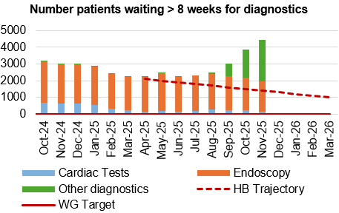
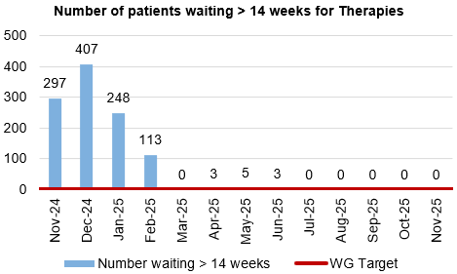
Diagnostics and Therapies
Actions/Updates
The total number of patients waiting > 8 weeks for diagnostics has increased in November to 4,434 compared to 3,873 in October 2025.
Updated targets have been set for diagnostic de-escalation criteria which encourage further improvement, with the target for patients waiting < 8 weeks for diagnostics increasing to 85% from 80%.
The additional Gastroenterology insourcing gained from recovery monies to support the stage 1 position through Q4, resulted in a greater volume of referrals for Endoscopy which meant further pressure on the 2025/26 Q1 position.
The number of patients waiting > 14 weeks for therapies has been reported as 0 in November 2025

Slide 20
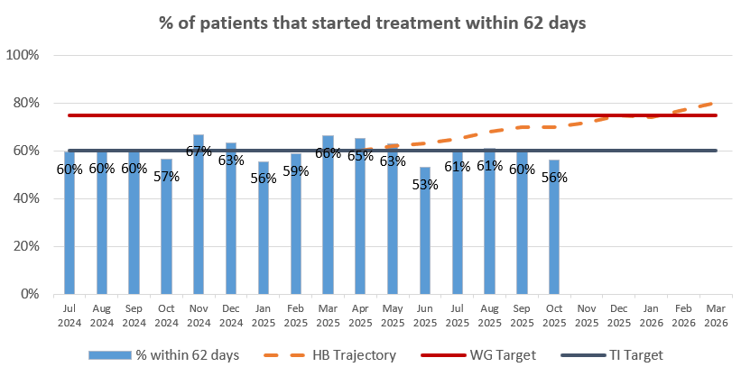
Cancer
Actions/Updates
In October 2025, the service reported 56% of patients had started treatment within 62 days which is below the Welsh Government TI target of 60%.
A detailed overview of the actions being undertaken to improve performance against all tumour sites can be found in Appendix 2.

Slide 21
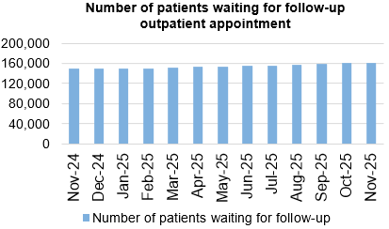
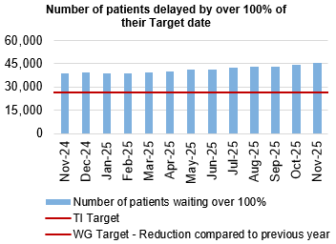
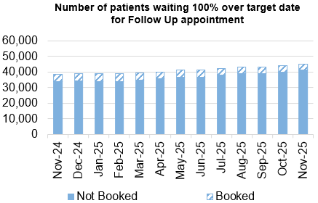
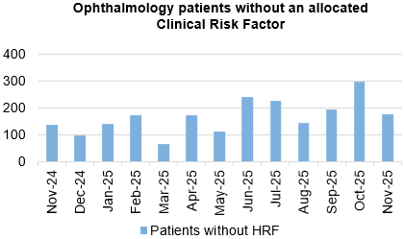
Follow-Ups & Activity

Slide 22
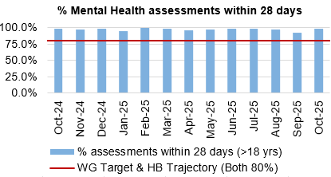
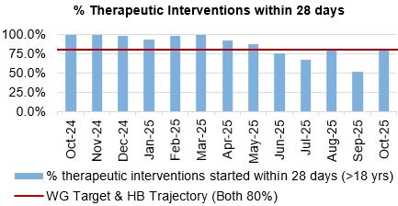
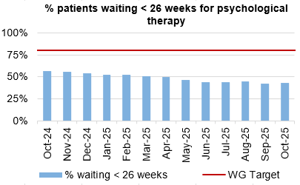
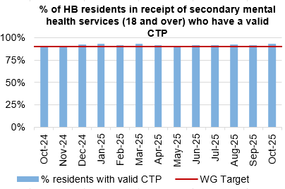
Mental Health & Learning Disabilities
Actions/Updates
Welsh Government has identified Mental Health and Learning Disabilities (MH&LD) as an area of concern, with regards to oversight and escalation. Assurance has been sought with regards to the key areas of concern within the Service Group
The Health Board has commenced work in advance of the receipt of the report and is setting up a Transformation Programme. This has been informed by a review of the service by an external advisor.

Slide 23
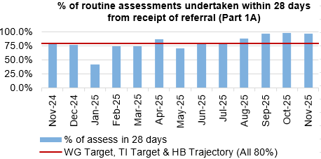
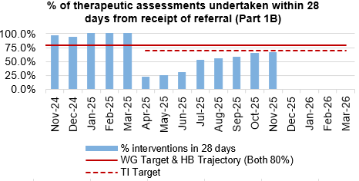
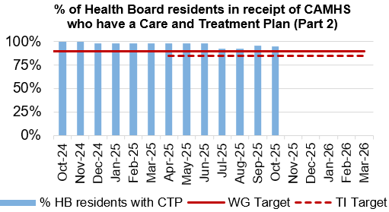
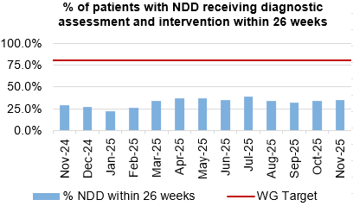
Child and Adolescent Mental Health Service (CAMHS)
Actions/Updates
CAMHS Part 1B – Performance against Part 1B will remain a challenge until the backlog of >28-day waiters is cleared. However, the recovery plan put in place will support this, and the planned Demand and Capacity review will help to identify the gap.
CAMHS part 1B now shows a slight increase from previously reported performance to 66% for the last reporting period (November) from a previous position of 65%.
Part 1A has been maintained at 97% in November, with Part 2 also maintaining performance against the trajectory reporting 95% in October (November figures not available at the time of publishing).

Slide 24
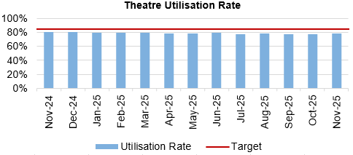
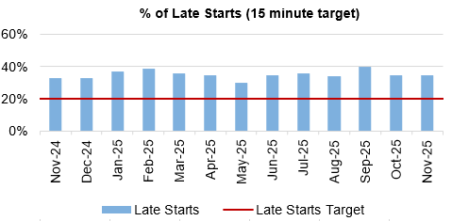
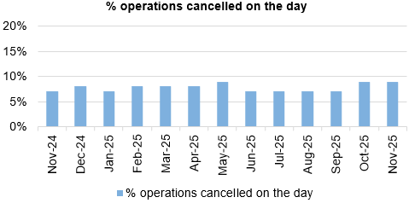
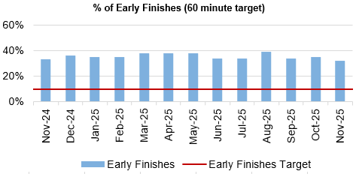
Theatre Efficiency
Actions/Updates
The Planning Framework sets out enabling actions that must underpin the delivery priorities to successfully achieve the core service and changes required. These include value projects, digital innovations, workforce developments, financial sustainability and ways of working. The enabling actions and planning framework have been incorporated into SBUHB’s Theatre performance framework and work is currently underway to report against these measures.

Slide 25
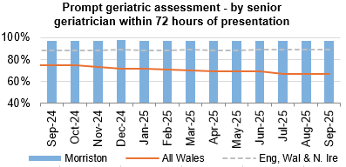
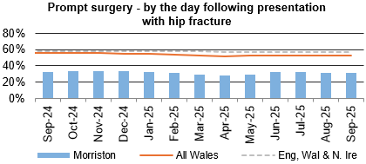
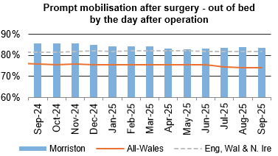
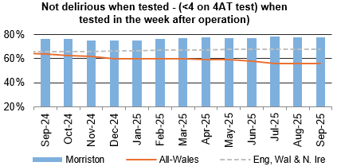
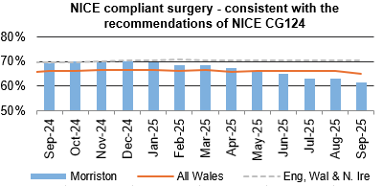
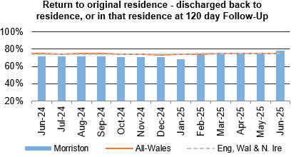
Fractured Neck of Femur (NOF)

Slide 26
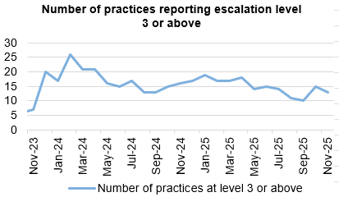
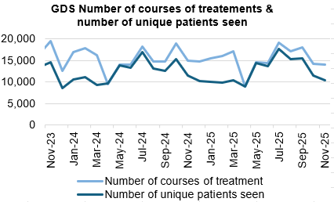
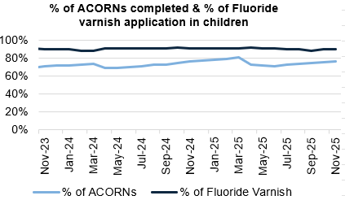
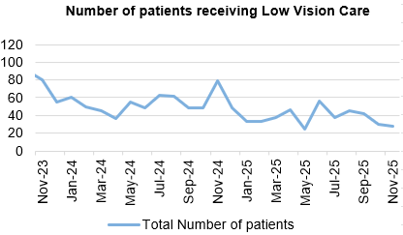
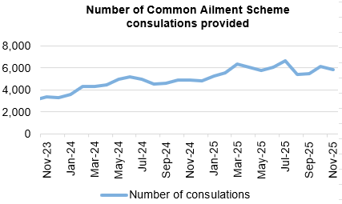
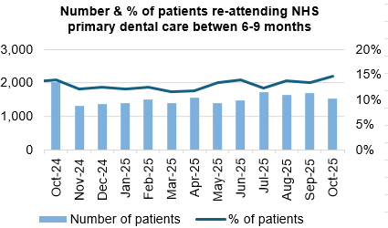
Primary Care
Actions/Updates
GMS escalation levels are currently remaining steady as we head into the winter period.
Refinement of the information on the self-assessment exercise for GMS sustainability has led to 10 practices being identified as in need of support. This is a reduction from 17.
The number of ACORNS completed is showing a steady increase towards the target as the year goes on.
Floride varnish remains over target for both children and adults.
The number of patients for eye health care Wales (emergency eye care) has increased from an average of 2,245 per month last year to an average of 2,641 per month this year to date. There is a slight increase in the number of patients receiving low vision services with an increase in domiciliary visits in particular.
Common ailments consultations continue to increase with an average of 900 more consultations per month in comparison to 24/25. If this trend continues this would be a further 17% increase on last year.

Slide 27
Quality & Safety

Slide 28




Infection, Prevention & Control
Dashboard
Actions/Updates
Gold C. difficile High Incidence Management Group.
Monitoring of C. difficile Standards: Risk Assessment & Governance Framework.
Continuation of QI Project in Acute Medical Unit focusing on AMS and 72-hour review and improving switch to oral route for administration.
Scoping exercise to explore the feasibility of extending role of ward based enhanced cleaner.
Trial of new Microfibre cleaning systems
Primary care QI projects to reduce urinary tract infections in care home residents

Slide 29




Serious Incidents and Risks
Actions/Updates
There were six Nationally Reported Incidents reported in November 2025 and there were no new never events reported. The detail surrounding the nature of the reported NRI’s can be found on the subsequent pages.
In November 2025, there were 102 open risks with a score >20 recorded for the Health Bord which is the same figure reported in October. There were 243 open risks with a score >16, which again is a slight increase compared to 242 in October 2025.
There were 186 hospital falls recorded in November 2025

Slide 30

Nationally Reported Incidents & Early Warning Notifications
What is the data telling us?
Graph 1 – Number of NRIs/Never Events reported to NHSWP&I. November 2025 included 4 avoidable in-patient falls (combined forms)
Graph 2 – 33 open NRIs open with NHSWP&I – 12 open past closure date of which 6 are awaiting outcome of external reviews. Plus 2 infant deaths require receipt of external review before closure can occur
Graph 3 – Total number of outcome forms submitted per month
What are we doing about it?
Weekly review with PSI investigator to:
  monitor progress of corporate investigations; identify barriers
  escalate outstanding actions required
Fortnightly service group meetings:
  service group investigations - progress towards closure date discussed
  updates on PSI investigation given
  escalate to service group barriers identified with corporate PSI investigations
Service Group Directors contacted separately for outstanding actions
Data presented and discussed at health board Patient Safety and Compliance Group; Quality and Safety Group; Patient Stakeholder and Experience Group - Service Group assurance sought against outstanding actions for completion of investigation / outcome form
What do we expect to see change and when?
Reduction in number of overdue investigation outcomes forms
Reduction in number of NRIs/NEs reported through recommendations/learning monthly
EWNs – November 2025
Ward experiencing increased Infection Prevention and Control period of Covid-19 infection. 3 of the 14 patients who tested Covid-19 positive within the outbreak period have died – all have Covid 19 recorded on the death certificate
Potential for adverse media attention – in-patient suicide HMP Swansea

Slide 31
NRI Learning (YCFFs) – November 2025
Domain 1 – Situational Factors | Task characteristics: Monotonous task | Patient factors: Extreme preterm infant, born at 23+3 weeks gestation. Placental Histology findings - monochorionic diamniotic (MCDA) fused twin placenta; acute chorioamnionitis of twin 2; haematoma with features of infarction Patient not highlighted as risk of falls on previous assessment Intermittent confusion. Normally independently mobile. Recent falls. Stage 4 aggressive breast cancer patient put on steroids to help with pain relief
Domain 2 – Local Working Conditions | Workload and staffing issues: High Unit Workload in Antenatal Clinic Deficit in healthcare numbers
Domain 3 – Organisational Factors | Physical environment: Staff behind curtains at time of fall - poor visibility Patient tripped over inappropriately placed mobile drip stand Placement of patient at risk of falls on ward Support from other departments: Laboratory services Scheduling and bed management: Lack of available speciality bed meant prolonged ED stay | Staff training and education: Education around steroid use and the need for a steroid pathway within SBUHB so that staff are fully aware of the monitoring that is needed for these patients and the importance of prescribing prophylactic medication. Inadequate training in maternity services, poor uptake of Sickle Cell and Thalassaemia module on the NHS e-Learning website at the time of the incident
Domain 5 – Communication and Culture | Safety culture: Gap within the health board in relation to monitoring patients on steroids - there needs to be a set steroid pathway to help identify and monitor these patients | Verbal and Written communication: Risk assessments not completed / partially completed Poor communication between primary and secondary services. It should have been clearly identified within the patient notes about steroid use and the need to be monitored

Slide 32




Falls Prevention
Falls Prevention
  November 2025
Page 1
What is the Data telling us?:
In-patient falls rate remains below National average
The numbers of injurious incidents causing moderate harm or above Sept'24-Oct'25 is down 40% from the previous year
Falls rate by ward has fallen with Derwyn ward reducing from 18.3 to 15.75 falls/1000beddays and AMU from 15.37 to 13.42falls/1000beddays
Falls related attendance to MIU down 14% compared to same time last year. ED MGH up 4% when comparing the same period.
There have been 5 NRI falls related incidents in the last 12 months (Sept'24-Aug'25) compared to 10 in the previous 12 months = 50% decrease
Calls to WAST continue to increase however since starting the level 1 falls response in care homes project, calls to WAST from all Care homes have reduced by 8% (this is impact of project in just one care home – due to roll out across all care homes by Dec 2025)
Underlying causes:
Ageing population with increasing frailty picture
Increased demand on WAST and front door services
Limited alternative WAST response to level 1 and level 2 falls regionally
Inconsistent approach to falls advice in community/primary care
Reduced access and provision of falls clinics across region
Insufficient access to appropriate strength and balance exercise provision
Some ward areas including AMU do not have an environment which enables safe monitoring of patients at risk of falls
Risk assessment and care planning inconsistent and inaccurate in some areas of HB
Safe Care partnership work on deconditioning progressing
What are we doing about it:
Regional Falls Prevention taskforce enabling collaboration
Primary Care action plan agreed
Enhanced falls response service launched (initial data suggests 50% stay home rate from otherwise inevitable conveyence)
Falls page on Waiting Well internet pages
falls policy update Nov 25.
Falls response project won NHS Wales award and shortlisted for HSJ award
Safe Care partnership work on deconditioning concluded
3 patient engagement events attended with over 40 meaningful interactions with members of public re falls prevention and active ageing
What do we expect to see change?
Reduction in WAST call out from care homes following falls incident (goal – 30% reduction per site by March '26)
Falls rate not exceeding 5.0 (falls/1000beddays) over proceeding 12 months
Reduction in conveyance to hospital via WAST for level 2 falls (WG target of 25% reduction)

Slide 33




Patient Experience & Concerns
Actions/Updates
There were 5,565 friends and family surveys completed in November 2025 which is a reduction on the previous month where 6,332 surveys were completed.
Of those surveys completed, the 92% of patients would highly recommend the services they received.
There were 190 concerns received in September 2025, and 45% of those concerns had responses sent within 30 days in September.

Slide 34
Complaints
What is the data telling us?
Graph 1 – is indicating that a number of complaints are not compliant with the 30 working day target for responding to formal complaints in line with the Putting Things Right Guidance.
Graph 2 – 170 new formal complaints in November which is a decrease compared to 216 in October.
Graph 3 - The average number of days taken to close a formal complaint has decreased by 1 working day compared to the previous month. Average days for September being 33 days which is over the Welsh Government target of 30 working days.
Graph 4 - The number of overdue formal complaints is increasing bi-weekly. As of the 25th November, 300 formal complaints were overdue
What are we doing about it?
Bi-weekly report run on all overdue complaints which is sent to each Service Groups requesting updates.
Bi-weekly drop-in sessions where complaint handlers can join to discuss any issues.
Bi-weekly meetings with Service Groups to discuss open complaints and Ombudsman cases.
Test to Change in SNPT to trial new way of managing complaints and trying to resolve early on.
What do we expect to see change and when?
Reduction in the overdue complaints by January 2026, in readiness for the new Putting Things Right Guidance being introduced in April 2026.
Early engagement with the complainant combined with listening meetings which will support an empathetic and compassionate handling of the complaint.
**Please note two graphs only go up as far as September, this is due to the 30 working days for complaints received in Oct/Nov not being up yet

Slide 35
Patient Experience
What is the data telling us?
Graph 1 – Illustrates that Swansea Bay UHB’s overall score consistently exceeds the benchmark of 85%, maintaining a performance of 90% or higher.
Graph 2 – Displays the overall satisfaction scores across the different Service Groups.
Graph 3 – Highlights wards/clinics achieving scores above 100%, based on more than 25 responses..
Graph 4 – Identifies the wards/clinics with the lowest satisfaction percentages.
What are we doing about it?
The system generates weekly feedback summaries for Service Group Leads, enabling timely action on low scores and recognition of positive feedback and comments.
Ongoing drop-in feedback sessions are held to support teams in using Civica effectively and managing their feedback constructively.
For alerts flagged as very poor or poor, the Action Manager is triggered. This tool tracks the progress and resolution of issues within Civica, managed by the PALS and Quality & Safety departments.
What do we expect to see change and when?
We expect departments to take ownership of their low scores and implement improvements based on the feedback provided. Our role is to ensure timely alerts and supply weekly comment reports to support this process.
Graph 1
Graph 3
Graph 2
Graph 4

Slide 36




Quality & Safety
Actions/Updates
The percentage of completed discharge summaries was 67% in November 2025, which is the same figure which was reported in October.
There were 118 Pressure Ulcers reported in October 2025, of which 35 were recorded in the Community.
There was a reduction in the percentage of episodes clinically coded within 1 month of discharge, decreasing from 74% in September to 63% in October.

Slide 37




Pressure Ulcers: Action & Intervention
Page 1
Pressure Ulcers – Action & Intervention
Goal – To reduce the amount of patients developing HB acquired avoidable pressure damage by 20% by end of March 2026
What is the Data telling us: Overview
Key Data Points
Pressure Ulcer Incident Reporting is now on a downward trajectory. By Quarter 3 2025 we have sustained 9 % reduction in total numbers of Heath board acquired incidents reported and a 15 % reduction when comparing April 2024 to Nov 2025 to Oct to April 2025. Graph 1: Total number of HB acquired incidents across SBU (hospital, community, MH & LD combined). Graph 2: Governance and Incident closures.
Primary and community services have seen 27% decrease compared to the previous 2 quarters, a significant improvement. Normally, PCS shows quarter-to-quarter fluctuations (both increases and decreases). A sustained decrease is atypical and should be examined carefully. The inpatient incident rate is 1.8 per 1,000 bed days, 0.1 % increase to 2024. Morriston has seen a total rate reduction, now down to (R 2.1 )per NPSSG has seen a total rate of (R 1.5) The Highest inpatient rates were observed in Morriston (R 2.6) early 2025, and the lowest NPSSG (R 1.1).
Total number of HB acquired incidents across SBU (hospital, community, MH & LD combined (Graph 1). Graph 2: Governance and Incident closures.
Harm Profile
Severity: 90 % of all HBA incidents remain superficial in nature . 10% are deep in nature. 76% of deep damage ulcers developed under PCS in patients’ own homes. 24 % In our Hospital settings. 13% NPSSG & 14% MSG. 6 NRI HB incidents have been reported in 2025 a more reflective picture of deep damage avoidability scrutiny panel outcomes. Graph 3: : The HB levels of damage reported with or without an avoidability status per SG.
The HB have seen a 8% reduction in deep tissue damage
70% all HBA investigated deemed unavoidable (15% improvement)- since quarter 1
Over 90% of all community damage incidents investigated were deemed unavoidable.
Governance & Learning Of incidents closed in the last quarter: we now see an Improving picture that 65% of all incidents have been investigated and closed. This still requires work and the efficiency of investigating and scrutiny is key to this.
70% deemed unavoidable 30% deemed avoidable which is a significant improvement however with 35% not investigated or closed, this cannot reflect total status until end of next quarter.
:. Quarter figures will be run again in February 2026.
Graph 4: PCS HBA incidents.
Underlying causes:
Patient factors: Vulnerability, deconditioning (esp. first 72h of admission).
Leadership/Process accountability, admin gaps. Management of teams
Risk assessment & care planning: Incomplete or poorly linked to interventions; staff skill gaps in ulcer recognition, repositioning, and offloading.
Equipment/Resources: Delays in dynamic mattress/bed provision; no targeted support in high-incidence wards.
Education/Training: Limited prevention training, lack of tissue viability expertise, weak engagement in QI.
Documentation/Technology: Delayed/incomplete digital charting; limited use of medical photography.
Governance/Learning: Gaps in guideline implementation and feedback systems
Risks:
Limited access to accurate data; executive dashboards don’t reflect site-level SG data.
Lack of medical photography for validation (RR 15 / 3701).
Insufficient Tissue Viability Nurse (TVN) resources.
Bed contract delays → risk to patients due to failing equipment.
Actions to Address Pressure Ulcers (HB):
Governance & Oversight: Pressure Ulcer Strategic Group, scrutiny panels, peer reviews.
Audits & Data: Spot audits, Datix QA audits, data reviews/cleansing. Service provision and Spot audits, Datix QA audits, data reviews/cleansing. Service provision and efficiency.
Education & Training: Multilayered education (face-to-face, Teams, videos), skills days, champions programme, Care home QI education, neonatal & maternity guidelines.
Pathways & Policies: Development of PU pathways, policies, and improvement plans supported by .
Resources & Technology: Centralised Tissue Viability service, digital wound imaging (Improvement Cymru), bed contract finalisation. Shared education, champions and skills programme
Collaboration: Shared responsibility across HB, data sharing. Lessons and good practice, accountability,
Leadership- Strengthen leadership and accountability
Key Outcome Measure/s
Graph 2
Graph 3
Graph 4
What we expect to see (Outcomes by 2026):
↓ 20% PU rates in acute sites; ≤1.6/1000 bed days.
↓ 20 % avoidable PU in HB.
↓ Reduce total number of HBA incidents by 10%
↓ Reduce HB acquired Deep damage by 10%
Improved staff skills, governance, and learning culture.
Equitable access to tissue viability services & medical photography across sites.
Better supported care homes.
Patients consistently receive “right care, right time.”

Slide 38


Mortality: Action & Intervention
3.25%
The summary of deaths in the Emergency Department can be seen below:
Mortality Data Summary
The crude mortality rate has seen a reduction in November 2025, reporting 1.32% compared to the previous figure of 1.49% in October 2025.
Crude mortality over the last 4 years is within the control limits and the recent data reflects the predicted decline of mortality as expected during summer months
The summary of deaths in the Emergency Department has remained relatively stable in recent months
92.6%

Slide 39
Care is delivered in safe and appropriate settings supported by innovative digital solutions
Quality Aspect | Action | Outcome
Care is delivered around the patient in the most appropriate setting as close to home as possible supported by digital and data solutions | Implementation of Rio to support integrated teams in Mental Health, Learning Disabilities and Community Services. Increased access to services through the development of electronic self-referral forms for the population of Swansea Bay. Implementation of Digital Maternity to support a single pregnancy record with real time recording of information in community and hospital settings. | 750 users in integrated teams will be supported by a digital solution in the community. Shared Care record for maternity with a patient facing app launching by end of March 2026.
We have a digitally inclusive culture where patients, clinicians and non-clinical colleagues work collaboratively to create effective and efficient services and patients are empowered to make informed and meaningful choices about their health. | The digital platforms listed above will support clinicians to work collaboratively and effectively. Additionally, patients will be empowered to manage their own health through the increased adoption of: Swansea Bay Patient Portal (SBPO) in conjunction with the roll out of Hybrid Mail to improve patient communication by delivering outpatient letters digitally via the SBPP. Implementation of Digital Health Assessments (DHA’s) to include the Waiting Well holistic assessment question set. Pilot the use of artificial intelligence to increase the efficiency and timeliness of clinical coding. | Over 20,000 patients are accessing the portal, increasing by 500-1000 per week, empowering them to make informed and meaningful choices about their health. Effective and efficient services enabled by digital technology. Empowering patients to make informed and meaningful choices about their health. Data insights will inform clinical and operational decisions to improve patient outcomes

Slide 40
Care is delivered in safe and appropriate settings supported by innovative digital solutions
Quality Aspect | Action | Outcome
Secure, trusted and insightful data and digital platforms empower staff to deliver more and higher quality care and improved patient outcomes and population health | Implementation of a new pathology digital system (LIMS2.0) Implementation of a new Radiology Information System and Picture Archiving and Communication System (PACS). Enhancements to Signal functionality to support patient flow. Implementation of Open Eyes to provide a digital eye care Electronic Patient Record (EPR). Go live of the WNCR paediatric module, in line with the National Programme. e-Prescribing and Medicines Management - Deliver successful integration with National Shared Medicines Record and Pharmacy Stock Control. Implementation of Hospital Initiated Referral (HIR), enabling a consistent approach to dealing with referrals and a mechanism to monitor and analyse to inform service change Implement the ED app to facilitate data capture of the WECDS and explore options for the procurement of a solution to support unscheduled care. Replacement of the core networks at Morriston and Singleton. Replacement of the Singleton Hospital network by replacing the hospital network switches which provide access to computers, video surveillance systems, and medical equipment. Replacement of the wireless network at Neath Port Talbot Hospital. The replacement of the computer backup system providing additional protection against cyber-attacks. A suite of Quality and Safety dashboards to visualise key measures reporting from multiple systems. Data literacy and Value training programme to support staff in the use of data and digital technology. | Implementation of key digital platforms to enable staff to deliver higher quality of care. The refresh of infrastructure technology to strengthen the Health Board’s cyber resilience.

Slide 41


The health board is a great place to work where staff feel valued and work together towards a common goal
Dashboard
Actions/Updates:
Performance against the performance and development review compliance has improved slightly in November 2025 to 72.79% from 72.28% in October 2025. Performance is currently below the Welsh Government target of 85%
Compliance with the 85% Welsh Government target has been maintained over the last year with regards to staff completing mandatory training. Performance has improved slightly to 88.10% in November 2025 from 87.41% in October 2025.

Slide 42

Workforce Sickness
November 2025
Reason | FTE Days Lost | %
Anxiety/Stress/Depression/Other psychiatric illnesses | 10,633.13 | 35.8%
Cold, Cough, Flu - Influenza | 3,208.05 | 10.8%
Other musculoskeletal problems | 2,965.23 | 10.0%
Gastrointestinal problems | 1,928.49 | 6.5%
Other known causes - not elsewhere classified | 1,382.50 | 4.7%
Actions/Updates:
The in-month workforce sickness rates have increased slightly in November 2025 to 7.60% from 7.40% in October 2025
The 12-month rolling rate also increased slightly in November 2025, reporting 7.13% compared to 7.09% in October 2025.
Anxiety/Stress/Depression/Other psychiatric illnesses has remained the top reason for sickness absence over the last year
Detailed pieces of work are being undertaken within the service groups to address large areas of sickness with workforce colleagues

Slide 43

The health board is a resilient, financially sustainable and responsible organisation
Revenue Financial Position
The Plan submitted at the end of March, which has not been approved reported a £58.7m deficit with a requirement to deliver £55.4m of savings. The Control Total for the Health Board set by Welsh Government remains £17.1m.
In Month 08 there is an in-month overspend of £4.2m which is £0.7m below the planned deficit of £4.9m for the month.
The YTD overspend is £51.4m. This is £12.3m above the planned deficit of £39.1m.

Slide 44


The health board is a resilient, financially sustainable and responsible organisation
Workforce Spend
The pay budgets are overspent by £87k in Month
Variable pay is £1.265m lower in November 2025 (£4.659m vs £5.924m) when compared to the same period last year.
The biggest spends are attributable to ADH, Bank and Agency which make up 82% of the total variable pay spend.
Percentage of non-NHS invoices paid within 30 days of receipt of goods or valid invoice
PSPP was achieved in month at 96.16% vs a target of 95%. (Cumulatively we remain above the target at 96.22%).
There still remains issues with delays in receipting of invoices which is affecting the achievement of PSPP.

Slide 45


The health board is a resilient, financially sustainable and responsible organisation
Capital Financial Position
The forecast outturn capital position is balanced.
Any All Wales Capital schemes where a high/medium risk is reported are closely monitored and discussed at the Capital Review progress meetings with Welsh Government.
Agency spend as a % of the total pay bill
Agency spend as a total percentage of the total play bill has decreased in November 2025 to 1.24% from 1.25% in October 2025.

Slide 46
Section 3:
Service Specific Updates

Slide 47
Stroke Performance

Slide 48
Challenges in the stroke pathway
Timely admission onto the Acute Stroke Unit (ASU) at Morriston Hospital
Inability to hold a stroke ‘ring fenced’ bed on the ASU at Morriston Hospital
Stroke outliers on other wards in Morriston due to lack of capacity on ASU at Morriston Hospital
Inability to undertake ‘discharge dependant’ therapeutic reviews
Regular inappropriate use of the therapies space on ASU – Often holding additional patients
Unnecessary delays with the flow of patients between ASU and Neath Port Talbot (NPT) Ward B2
Poor compliance against several National Stroke KPI’s
Poor staff morale

Slide 49




Stroke Test of Change – June 2025
To improve the stroke pathway and current performance against National Stroke KPI’s, several tests of change were implemented in June 2025 by the Division that include:
The introduction of 1x dedicated stroke Ring-Fenced Bed on the Acute Stroke Unit
The use of an additional therapies space on Ward E for Stroke Care
    Improved staff morale
    Delivery of additional discharge dependant assessments
Launch of twice weekly Multidisciplinary Board Rounds with Morriston & NPT
    Fostered joint working across sites
    Improved communication in relation to patient care and upcoming bed availability
    Early identification of required bed demand for NPT
Implementation of a RAG joint stroke bed requirement list
  Identification of patients who require a bed on the ASU in order of clinical priority
  Ability to immediately list patients for transfer to NPT during board round ensuring beds on B2 are allocated to stroke patients as a priority
  The RAG provides forward planning and removes unnecessary delays
  Ability to provide NPT with the correct clinical information to support with transfer

Slide 50



Successful Outcomes
4 day reduction in Length of Stay (LOS) on ASU
40% increase in transfers from the ASU to NPT B2
36% increase in admissions and discharges onto the ASU

Slide 51

Successful Outcomes
Increase in improvement to several National Stroke KPI which include:
  Mechanical Thrombectomy
  Admission onto the ASU within 4 hours
  Stroke consultant review within 14 hours
  Occupational therapy, physiotherapy and Speech and Language therapy assessments

Slide 52
Next Steps
Further increase the stroke Ring-Fenced capacity to enable timely admission
Development of a dedicated stroke weekend plan
Implementation and expansion of the CT Perfusion service which will improve access to Thrombolysis and increase compliance
Introduction of the Tenecteplase to improve time to Thrombolysis
Implementation of the stroke ACP/CNS Pre-Triage Assessment
Expansion of the stroke specialised team - CNS/ACP cover 07:30am to midnight 7 days per week.
Continuation of the Early Supported Discharge Service (ESD) dealing with mild-moderate strokes.
Development of the Integrated Community Stroke Services (ICSS) dealing with moderate to severe strokes (business case in development)
Approved stroke funding not received - Despite being previously agreed at BCAG and Management Board , not receiving the final phase of investment is causing patient harm, poor outcomes, inequity of care and stress and anxiety for our workforce. At present there is no 24/7 stroke consultant rota. This is resulting in no weekend specialised ward rounds, delays in patient management, increased Length of stay, poor patient outcomes, no advanced stroke imaging, no thrombolysis or Mechanical Thrombectomy care and a totally inequitable service compared with 'in-hours' (all reflected in our performance data). We are currently an outlier compared to our neighbouring HB's who have 24/7 stroke consultant cover.
For Escalation

