Slide 1


Performance & Finance Committee
Neath Port Talbot & Singleton Service Group
November 2025

Slide 2

Agenda Detail
Health Board & Service Group Financial Summary
In-Month Revenue Position
Savings Performance
Key Drivers
Risks, Next Steps & Mitigating Actions
Appendices

Slide 3

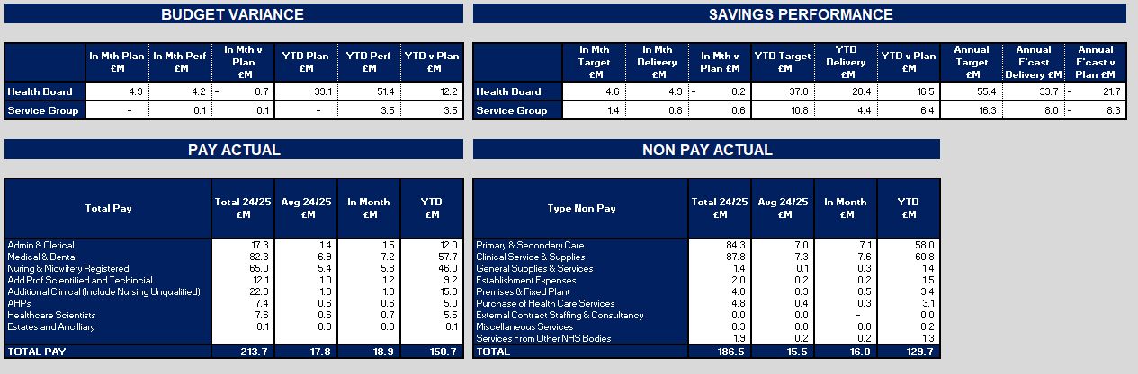
Dashboard

Slide 4
Summary Health Financial Plan & Service Group Element
FINANCIAL PLAN 2025/26
SERVICE GROUP ELEMENT PLAN
OPENING BUDGET

Slide 5

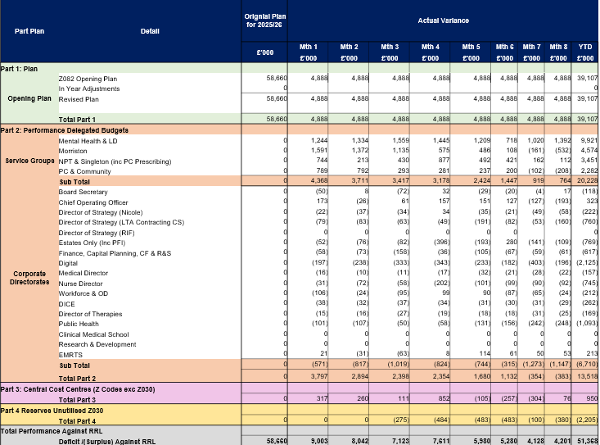
2025/6 In Year Health Board Position & Service Group Element

Slide 6
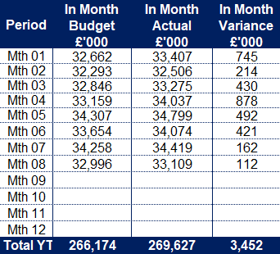
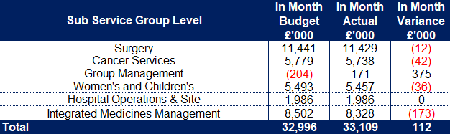
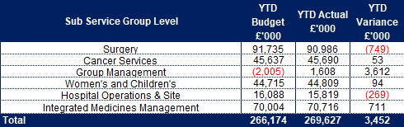
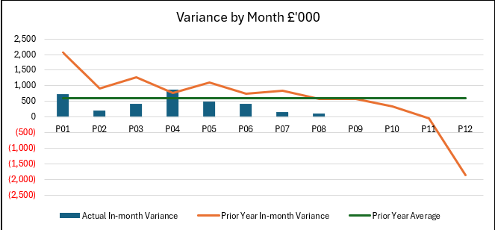
Service Group Position By Month & Divisions
KEY MESSAGES
Neath Port Talbot & Singleton Service Group (NPTSSG) has an assessed opening 2025/26 underlying deficit of £16.4m excluding new year growth and inflation but assumes that long standing underspends continue and all 2024/25 savings plans listed as green/ amber deliver a full year effect. This assessed deficit has been funded via the Health Boards financial plan. In addition, funding for assessed growth of Primary Care Prescribing and Systematic Anti-Cancer Therapy (SACT) has been issued. All other growth, demand and service pressures are expected to be managed, and the Service Group deliver a break-even position.
The Service Group was set a savings target for the year of £16.1m service transfers have changed this to £16.2m
In Month 8 NPTS is reporting an overspend of £0.112m and a Year to Date overspend of £3.452m.
Each division reported a break even or underspent position in month, recognising that within each division there will be areas of cost pressures that are being mitigated by areas of underspends, although they may not be directly related.
The position excluding cost improvement targets is largely within the underlying position assessment utilised in planning for 2025/26. However, there are both areas of improvement and those where pressures have been worse than expected. Whilst they are netting off at this point, close monitoring is being undertaken to ensure that the benefits can be maintained as far as possible and that the pressures are being actively managed.

Slide 7
Year-To-Date Service Group Position By Division & Type Expenditure/Income
Excluding the impact of unidentified savings vs target, the YTD financial position is better than the Underlying Deficit assessment.
Income is improved vs budget largely because of continued non-recurrent contribution from the provision of radiopharmacy services to Southeast Wales – this over delivery offsets increased associated cost on both the pay and non-pay lines (incl. Drugs for Radiopharmaceuticals at £204k). IMM arse also benefitting from £100k worth of rebate income above budgeted levels.
Despite this, areas of concern when compared to the underlying assessment at this stage include Establishment Expenses (£191k overspend YTD) and Premises & Fixed Plant (£495k overspent YTD). Premises & Fixed Plant overspends are driven by Cleaning Equipment and Materials (£205k) and Fixtures & Fittings – Bed Contract (£110k overspent).
The following areas of Clinical Services & Supplies cost pressures are offset by underspends in Surgery, namely Theatres and Clinical Engineering: Drugs (£154k incl. Drugs -£120k, Vaccines £21k, FP10s £190k, Medical Gasses £40k, Blood Products £22k). Clinical Service & Supplies excl. Drugs: Women’s Health overspend (£330k) consisting of £126k Neonatal Medical & Surgical Equipment which is materially driven by activity; Welsh Fertility Institute overspend of £97k; Midwifery £70k.
There is a risk that those spends currently lower than the assessed Underlying Deficit, and now therefore funded, increase and therefore expose the areas that are currently spending above Underlying Deficit assessed levels.
The pay expenditure YTD is lower than funding and therefore assessed underlying deficit although there is risk inherent within this position. Significant contributors to this underspend include Surgical Ward, Theatres, Patient Access, Community Paediatrics and Welsh Fertility Institute (WFI). Notable areas include: Anaesthetics, General Paediatrics, Oncology and Haematology, who’s overspends are offset by underspends elsewhere.

Slide 8

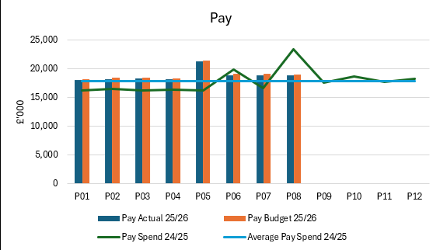
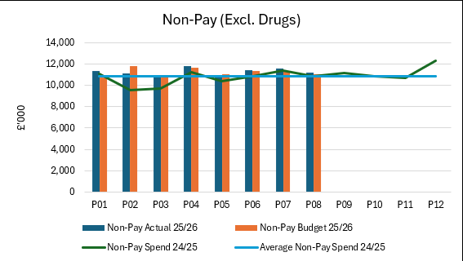
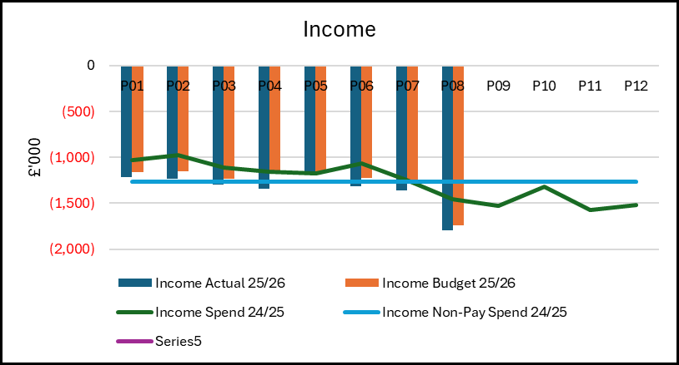
Drivers of Position (Actual)
Pay: Actual expenditure trend across the first third of the year is averaging £1.025m higher per month than the 24/25 average. 25/26 Pay award, including arrears, was paid in August (25/26) and November (24/25).
Band 2 to 3 uplift payments are expected to be paid in December with matched budget in year. The costs of the uplift will be reflected on the band 3 budget line with the in-year funding only expected to be reflected on the band 2 line until a decision is taken on how the recurrent costs are borne by the organisation within its financial plan.
Non-Pay: Spend for the year to date is £3.543m higher than last year’s average. £1.877m of this relates to Primary Care Prescribing; Drugs (incl. Drugs, Vaccines, FP10, Blood Products, Medical Gasses) £1,813m; Cataract Phase 2 Outsourcing £0.650m; Postage £0.145m; Neath Theatres Accommodation inflation £0.160m; Cleaning Equipment & Materials £0.1488m; Bed rentals and repairs £0.169m; M&SE/Appliances (incl. Implants) £0.487m.
Income: Income continues to deliver above target levels, in large part due to the non-recurrent income associated with the temporary provision of radio-pharmacy services to Southeast Wales. Income levels are currently at the average monthly level seen in 24/25 with M8 reflecting non-recurrent increases in rebate income in IMM and Out of Area Neonatal income.

Slide 9
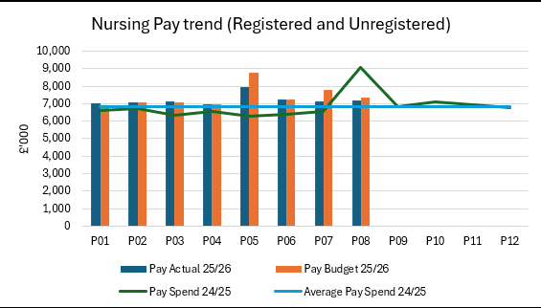
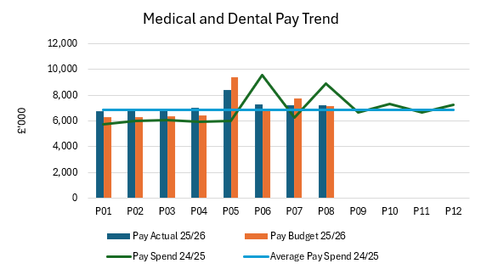
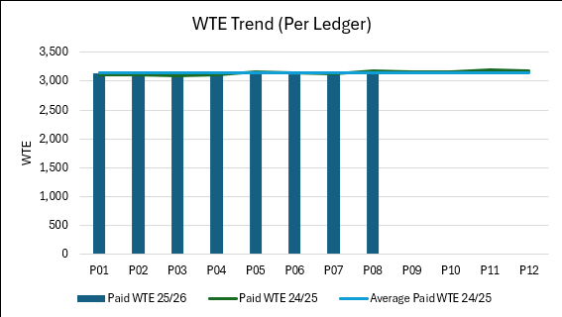
Drivers: Pay Summary
Medical staffing pay, on average, is £0.354m per month higher than the monthly average for 24/25. Areas with material spend that appears to be above pay award inflationary levels is predominantly Oncology where the growth in expenditure is ~13%
Monthly nursing pay, on average, is £0.371m per month higher than the monthly average for 24/25 – a growth of ~ 6%.
Beyond Medical and Nursing, IMM pay expenditure is 13% higher than in 24/25.
25/26 Pay Awards applied in August 25,26, accompanied by the related funding, and in November (24/25)
Paid Whole Time Equivalent numbers (which doesn’t include agency, ADH and WLI) are on average 8wte per month lower in 25/26 vs 24/25. However, M7 and M8 were higher despite the enhanced recruitment and variable pay scrutiny.

Slide 10
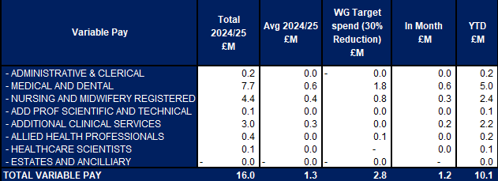
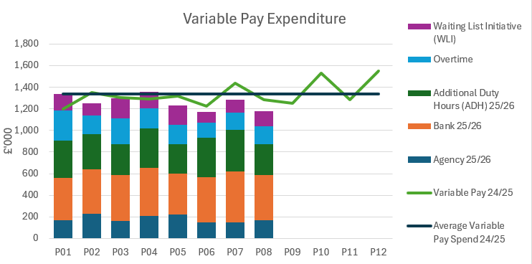
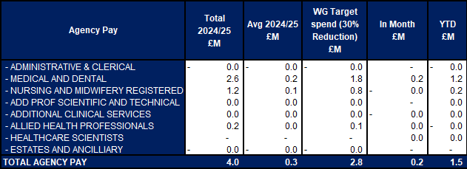
Drivers: Variable Pay & Performance Against 30% Reduction (Actual)
Key messages:
Variable pay spend for 25/26 is lower than the monthly average for 24/25 by £0.072m per month. This is driven by a £0.149m reduction in agency which is partially offset by a £0.035 increase in bank and £0.044m increase across the net of WLI and ADHs. These decreases are in Women & Children’s and Hospital Operations. These decreases are partially offset by increases in Surgical Specialties.
Months’ 4 onwards show a relative downward stepped change vs the first 4 months of the year.
.

Slide 11
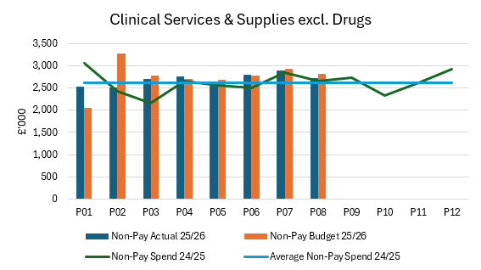
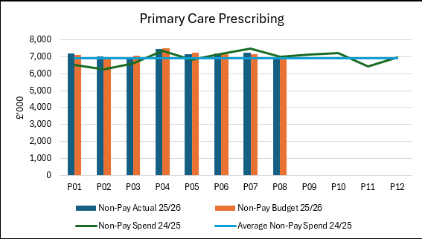
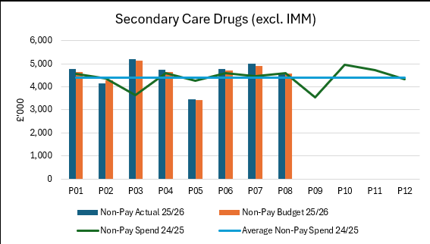
Drivers: Non-Pay (Actual)
On average, Clinical Services & Supplies spend is £0.063m per month higher than in 24/25 with the following services incurring notable increases YTD: Neonatal (£0.119m); T&O (£0.307m); Clinical Engineering (£0.178m); Medical Physics (£0.086m – including SE Wales Radiopharmacy related costs and Spinal (£0.080m).
Primary Care prescribing costs for the YTD are on average £235k per month higher than in 24/25. Due to a combination of savings delivery and 25/26 growth funding this increase is largely within funded levels with a YTD overspend of £0.173m. Continued close monitoring of growth required vs funding assumption.
Monthly Secondary Care drug costs, which consists primarily of NICE drugs, is on average £0.189m higher per month this year vs last year. This increase is largely seen in the following areas: £0.076m increase on average per month in Haematology vs prior year average; £10.024m increase on average per month in Oncology; £0.077m increase on average per month in Rheumatology; £0.014m on average per month in Gynaecology.

Slide 12

Savings Summary

Slide 13

Identification Opportunities & Risk
Further Opportunities for 25/26:
C3 Schemes (Part Year Effect)
D1 –D3 Schemes ( Part Year)
Non-Pay Bans in Place, Clinical Activity (review on Performance Underway)
Further progress of savings schemes for inclusion in the savings plan, including but not limited to
  Additional commissioning income
  Investment in digital technology and process e.g. Self check-in
  Service modernisation & efficiencies 26/27
  Accounting gains
Further Risks:
Recovery work impact on clinical support service spends, flows of recovery funds. Currently delivery is assumed within current forecast and further change will need to be worked through and mitigation developed
Waiting List Initiative Pay Award/ Pay Disputes in relation to anaesthetics – Risk & Benefit based on accounting opportunity
Operational Pressures – Winter Pressures
Impact of Band 2 to 3 in 26/27
Lower vacancy rate than assumed in Health Board financial plan- Ongoing Scrutiny of posts to maintain levels
Primary Care Prescribing volume and price growth greater than growth funding. Built Into in year forecast.
Impact of student streamliners. Built into Forecast

Slide 14
Actions & Next Steps To Be Taken By Service Group
The Service Group needs to manage new emerging pressures to ensure spend does not breach the underlying assessment.
The Service Group needs to continue to develop and deliver its cost improvement plans to meet the full £16.2m target recurrently and utilise non recurrent means to bridge the timing gaps that are now inevitable through the remainder of the 2025/26 financial year.
Further work is required to understand the impact of changing demand profiles and those driven by recovery work in supporting clinical services and clinical support services to ensure no adverse impact on the financial position.
The service group will need to work on key planning assumptions for 26/27 regarding reducing circa 5% on all A4C Pay Budgets, reduction in Variable Pay, and improvement on Sickness down to national Average. Reducing Expenditure on key Non-pay Lines through Maximising Managed Service Contracts , Maintenance Contracts, rationalisation of products, and general improvements in procurement strategy tied to efficient service delivery models
Continue Service Model Improvement In Theatres & Anaesthetics.

