Slide 1


Targeted Intervention Update
December 2024

Slide 2
All Wales Performance Overview

Slide 3
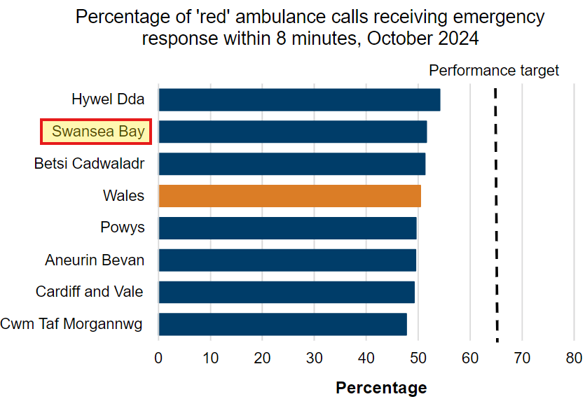

Slide 4
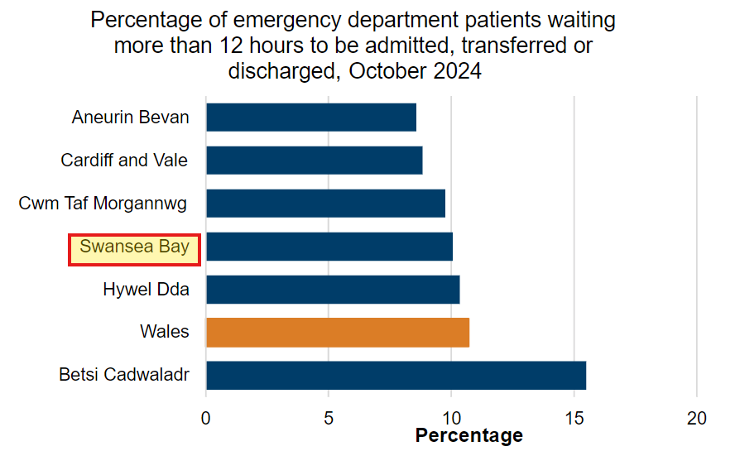

Slide 5
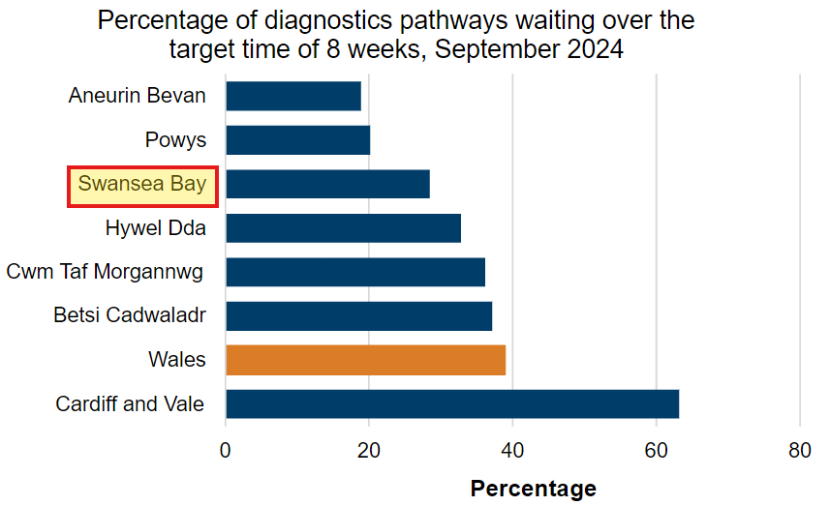

Slide 6
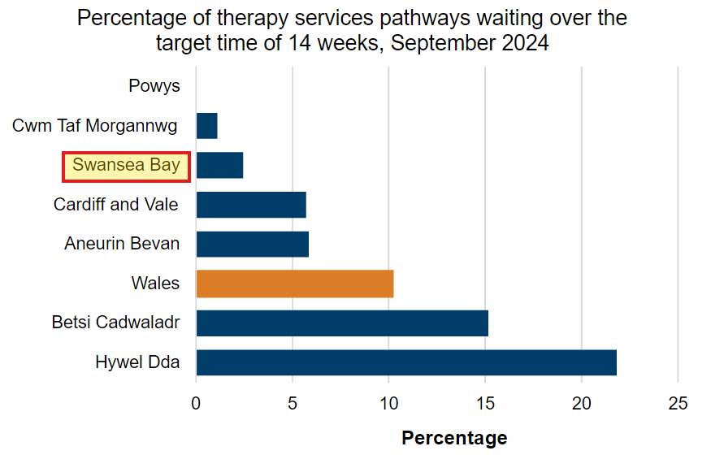

Slide 7
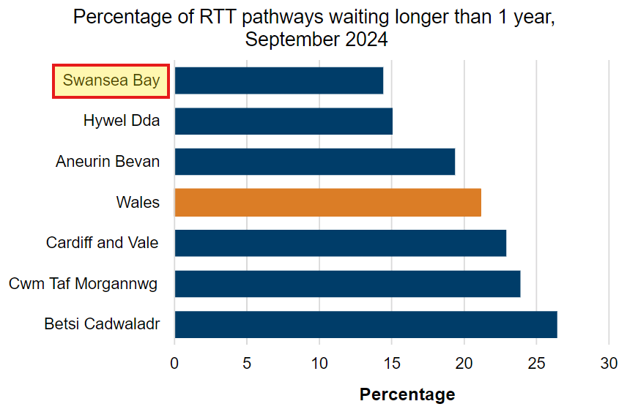

Slide 8
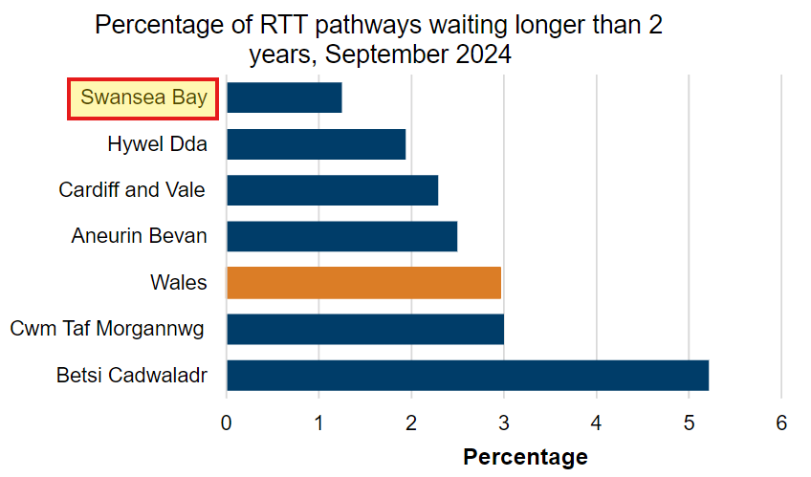

Slide 9
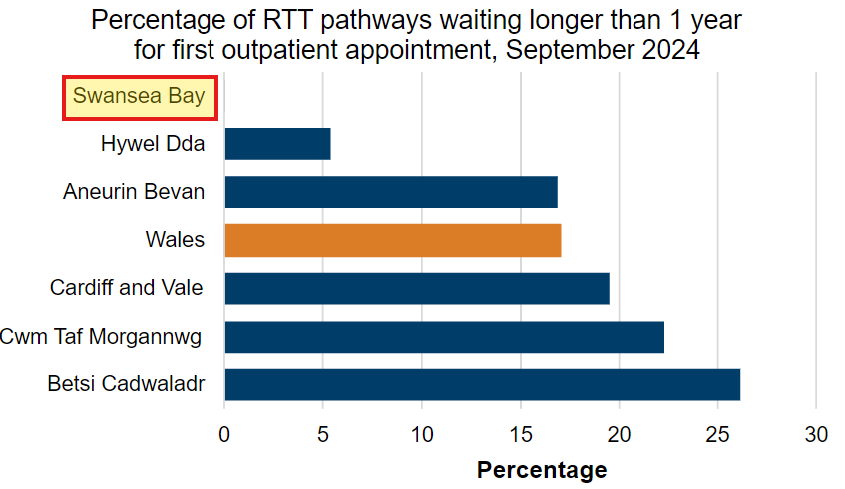

Slide 10
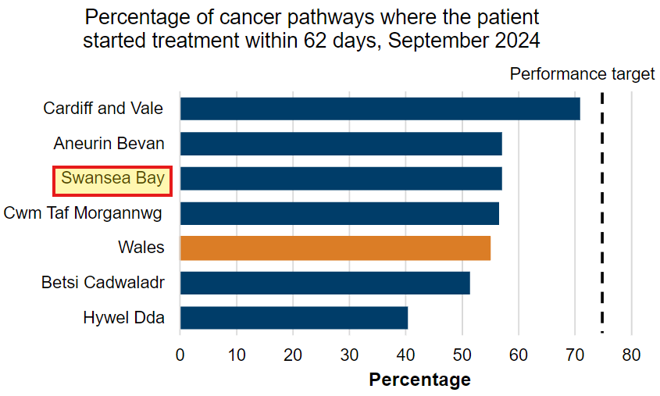

Slide 11
Urgent & Emergency Care Six Goals Programme

Slide 12
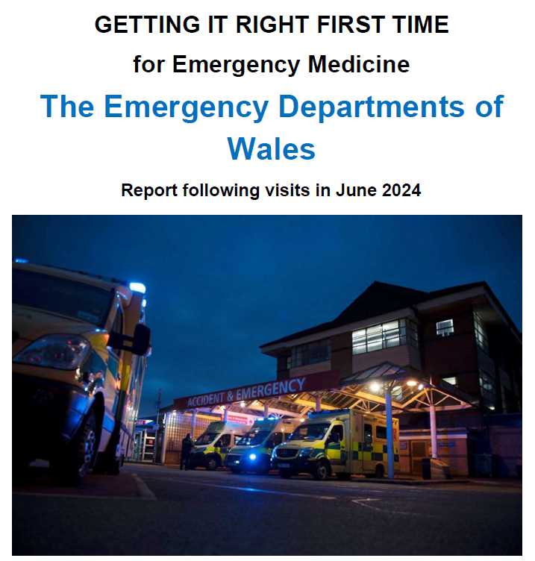

Swansea Bay UHB - GIRFT
The ED at Morriston Hospital is currently causing increased clinical risk for patients and is unpleasant as a place of work for staff. This was the view of both the GIRFT UEC team and the senior ex-members of NHSE’s Emergency Care Intensive Support Team (ECIST), who accompanied us on this visit. It was one of the two EDs in Wales which caused the most concern to the GIRFT team.

Slide 13

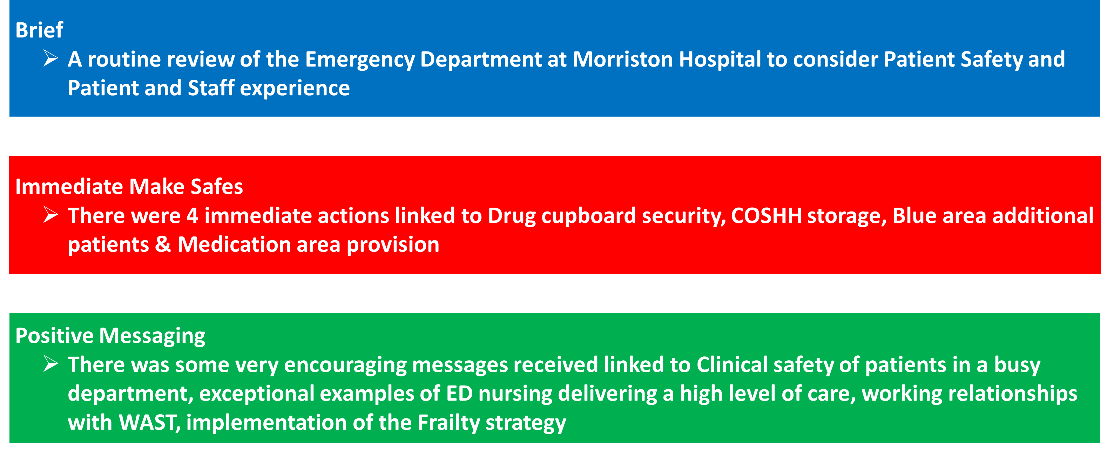
Swansea Bay UHB - HIW
Service: Morriston Hospital Emergency Department
Date of inspection: 27 to 29 November 2024

Slide 14
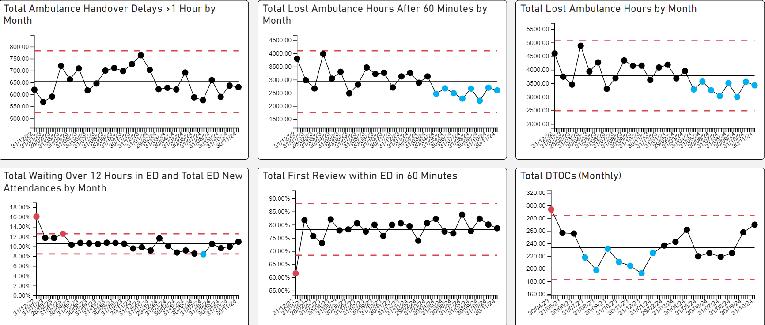
UEC – De-escalation KPIs

Slide 15

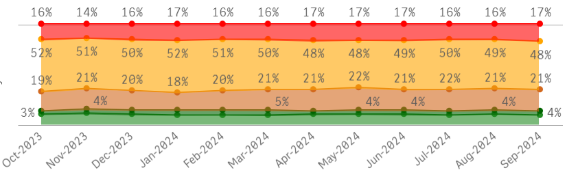
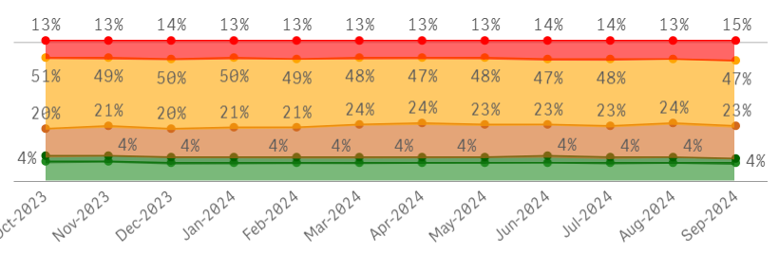
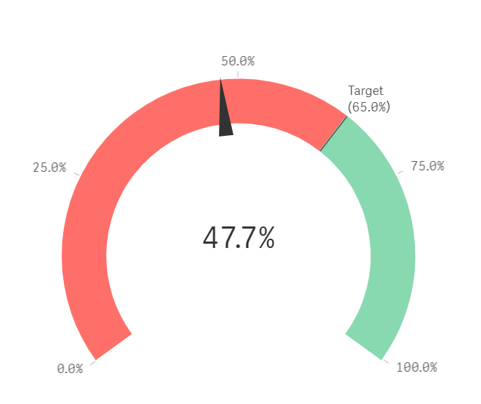
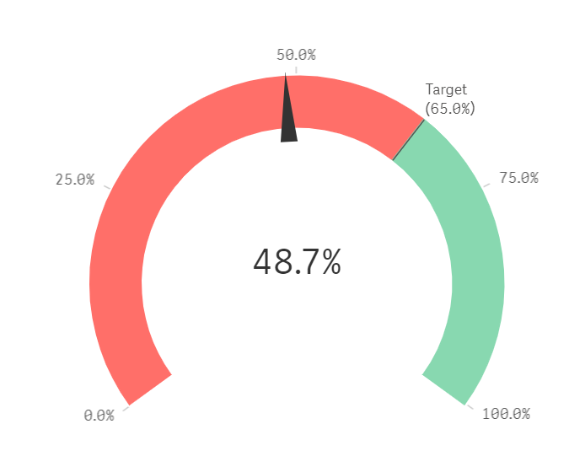
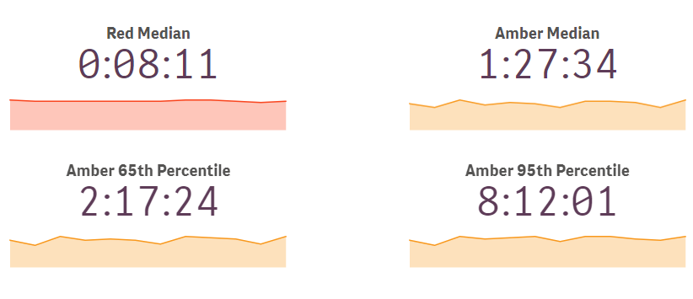
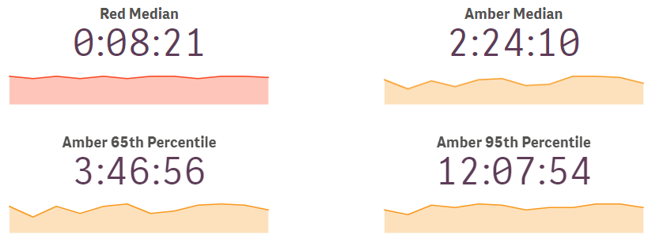
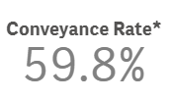




Demand & Performance – SBUHB vs pan-Wales (excl. SBUHB)
SBUHB
Pan-Wales
Welsh Ambulance Services NHS Trust

Slide 16
Urgent and Emergency Care – Summit
Summit I October 2024
Improvement work stream presentations
  Patient experience
  Pre-hospital/admission avoidance
  Front Door Emergency Department
  Frailty
  SDEC/AMU
  Grip and Control: HB Flow
  Discharge/management of COP cohort
Summit II December 2024
Review of UEC summit I actions
  Diagnostic Intelligence
  UEC Care Co-ordination Hub
  The Digital Challenge
  Integrated Discharge Hub
  D2RA

Slide 17
Patient Flow diagnostic findings
Three diagnostic reviews (HB/LA partners):
  Multi-Agency Discharge Event
  6A’s audit – (clinical case note review – MDT)
  21 day LoS review HB wide
  Key Findings:
  Of the 316 patient case notes reviewed, 220 were deemed not to “require a hospital bed”. This equates to 69.9% of patients.
Of the 220 patients that were not deemed to “require a hospital bed”, this equates to a total LOS delay of 15581 bed days, (Gorseinon 2244, Morriston 6385, NPT 6040 and Singleton 912)
Top 5 reasons for delays were awaiting completion of assessment, awaiting start of new home care package, awaiting social worker allocation, awaiting completion of adaptations and awaiting NH availability
The Age of the patient plays a significant factor in delayed discharges. Of the 220 patients that were not deemed to require a hospital bed the average age was 80 years old
6A’s demonstrated lost opportunity in terms of admission avoidance
MADE event uncovered multiple system and process issues in relation to flow and discharge planning

Slide 18
Overarching recommendations:
In common with all other recent reviews (MADE, 6 A’s Audit etc), a whole system senior Executive review and agreement to Discharge to Assess is urgently recommended.
It was noted that there was often conflict between the ward and family views, particularly around an entitlement to a hospital bed. The whole system implementation of an up to date, legally approved Choice Policy is urgently required. Within this policy, letters must be issued to patients to set expectations on admission and a clear escalation to experienced staff is required to support staff with difficult conversations.
The system are not clear about the designation of acute, sub acute and discharge to assess pathway 2 beds, nor have they got standards for a length of stay in each type of beds. This is resulting in a flow blockage throughout the system. It is recommended that a senior Executive decision is taken as part of the development of a true D2A system.

Slide 19
UEC Summit High Impact Solutions Xmas Reset
A designated consultant / matron and operational manager allocated to each ward.
Daily, morning ward rounds to be undertaken with the focus on “why patients need to stay” rather than can they be discharged
IDH to be present daily in the ED
Any patient not requiring the clinical care that only Morriston can provide is to be picked up by the IDH and the patient supported in the most appropriate way – which is not admission to Morriston Hospital
All non-ED, specialty expected patients are to be managed away from the ED:
  Medicine via AMU
  Surgical specialties other than orthopaedics via SAU
  Orthopaedics via the T&O Assessment bay on Ward H
Reinforcement of the Professional Standards expected for specialty referrals for patients referred from ED / AMU
All SGDs/SGNDs to agree the “pull” model to ensure there is clarity on any clinical criteria associated with transfers to sites other than Morriston. This will remove the need for TOCALs and other DLN input to inter-hospital transfers and hopefully provide a valuable resource to support D2RA.
Review of the services that we would want to expand to provide or bolster 7-day cover and work-up a plan for implementing ahead of Xmas and into Jan / Feb next year. For example:
  OPAU
  VW
  DN
  SDEC
Ensure Single point of access and Trusted Assessor models are implemented (even as a trial) ahead of the Xmas break and into next year

Slide 20
3 High Impact Solutions….
UEC Care Co-ordination Hub (in progress) – reduce attendance /conveyance.
Hospital at Home (redesign of ACT/VW in progress) – increase admission avoidance – community and front door turnaround
D2RA: 72 hour turnaround for 70% COP patients as follows:
-Pathway 1: Home with 4 double staffed calls per day – assess/adjust.
-Pathway 2: Designated bed pools/tailored workforce
-Pathway 3: Designated bed pool – max 6 week LoS – tailored workforce.
*D2RA Principles require support of Local Authority colleagues to ensure we are working harmoniously in this space
The above 3 high impact solutions are embedded into the full UEC/6 Goals programme of work being undertaken at SBUHB

Slide 21
Planned Care

Slide 22
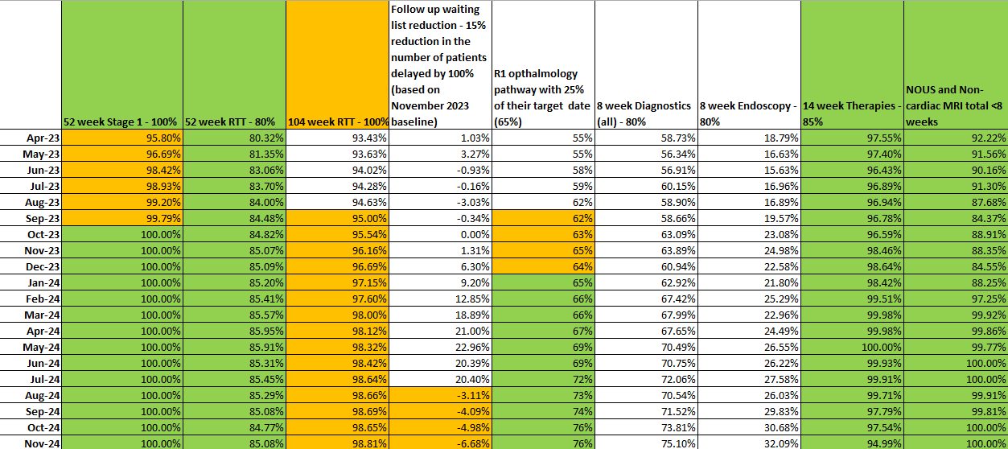
Planned Care Performance –November

Slide 23
Cancer TI Update

Slide 24
Cancer Performance - % treated within 62 days
Notes:
Reporting high volume treated (291), We’ve reported volumes over 280 before, however not at first submission.

Slide 25
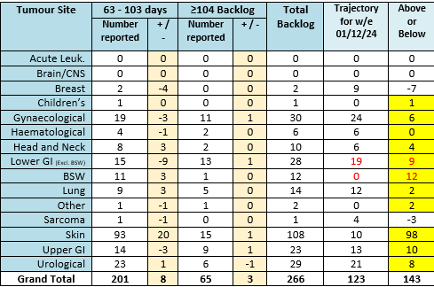
Cancer Backlog - 62 & 104 days
Notes:
Skin and LGI highest over trajectory

Slide 26
Breast Position
Notes:
Last month I said I expected improvement for performance in October, anticipating approx. 70% - reporting 68%

Slide 27
Skin Position

Slide 28
Gynaecological Position

Slide 29
Lower GI Position

Slide 30
Urological Position

Slide 31
USC First outpatient waits within 2 weeks
The table demonstrates the median wait days for new USC outpatient activity undertaken, and percentage of patients seen within two weeks. The waits are unadjusted, therefore include any patient unavailability. These services are under daily monitoring arrangements.
Notes:
Daily monitoring for Plastics, OMFS and Derm since 9th September 2024. OMFS however, already showing improvement prior to this.

Slide 32
Decision to Treat within 31 Days – Treated Pathways
The chart demonstrates the median wait days to Decision to Treat for treated patients along with the percentage meeting 31 days.
Notes:
July is most up to date available at this time

Slide 33
Decision to Treat within 31 Days – Treated Pathways
Notes:
July is the most up to date information at this time

Slide 34
Pathology Turnaround Times (information as at 1/12/24)

Slide 35
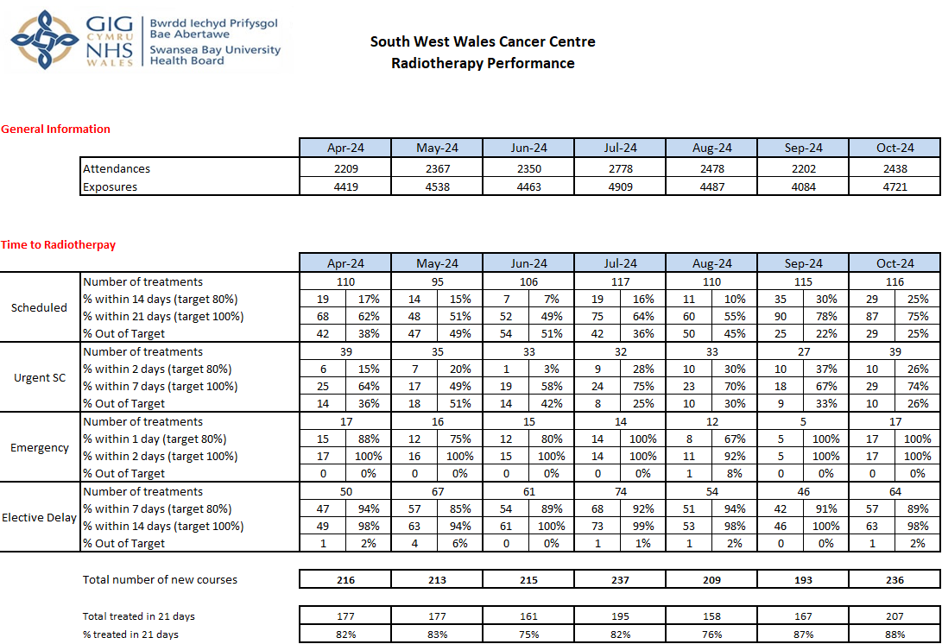
Radiotherapy Waits – October 2024

Slide 36
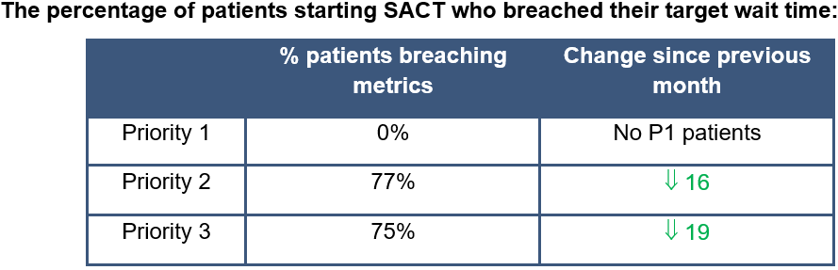
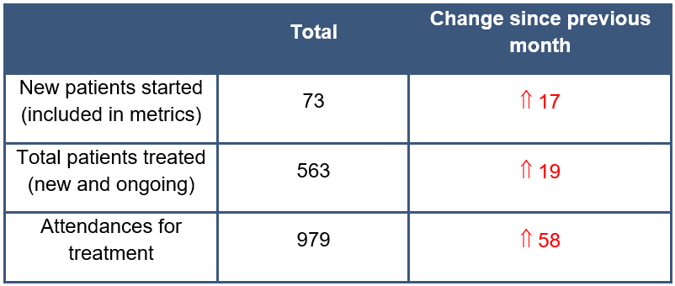
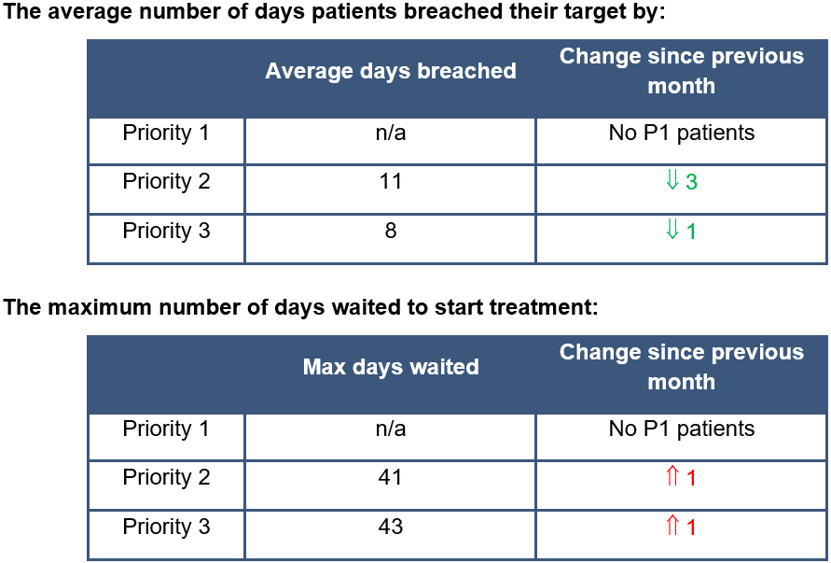
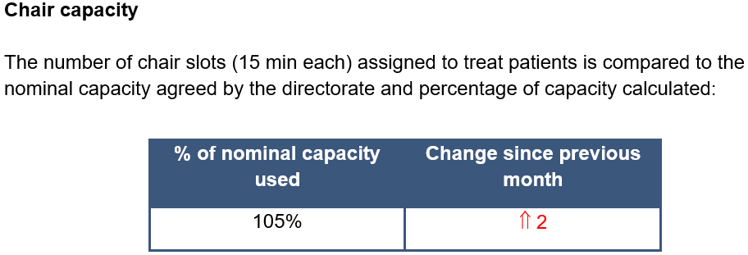
SACT Waits – October 2024
Notes:
The % of priority 2 and 3 patients who breached in October has decreased compared to September, despite more new patients starting treatment.
October waiting times show a decrease in the percentage of patients who breached, despite an increase in attendances for treatment and new patients. This figure may be reflective of the unusual presentation of the percentage of patients who breached in September. Having 77% of patients breach in October is more in keeping with the figures seen in recent previous months.
Despite the increase in number of patients, there was a reduction in the number of days patients waited beyond their breach date compared to last month.

Slide 37

Priorities/Focus Next Month
Continued focus on front end of pathway for all specialties
Review impact of daily meetings for USC OP capacity for dermatology, OMFS and plastic surgery (introduced Sept 9th)
Assess impact on capacity of agreed actions from skin workshop (inc. super clinics, locum consultant, job plan reviews)
Continued focus on cellular pathology
Identify additional surgical (upper GI in particular) and chemotherapy capacity
Notes:
Update

Slide 38
Mental Health –CAMHS

Slide 39
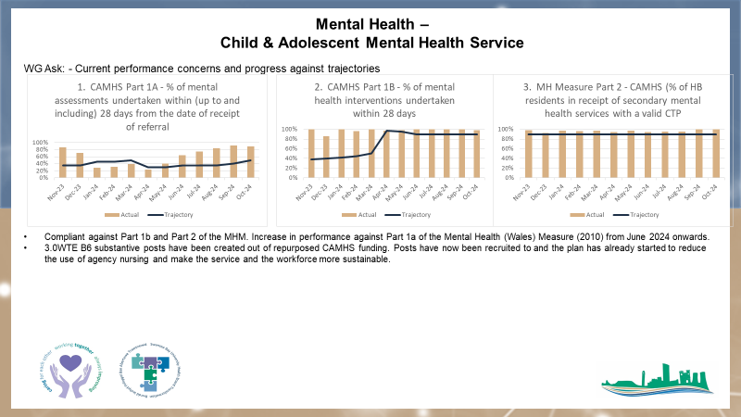
CAMHS
Notes:
Update

Slide 40
HCAI TI Position to 31.10.24

Slide 41
Progress against TI goals: 01 Apr – 30th November 2024

Slide 42
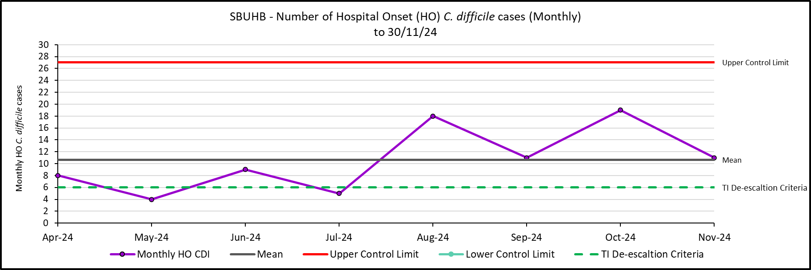
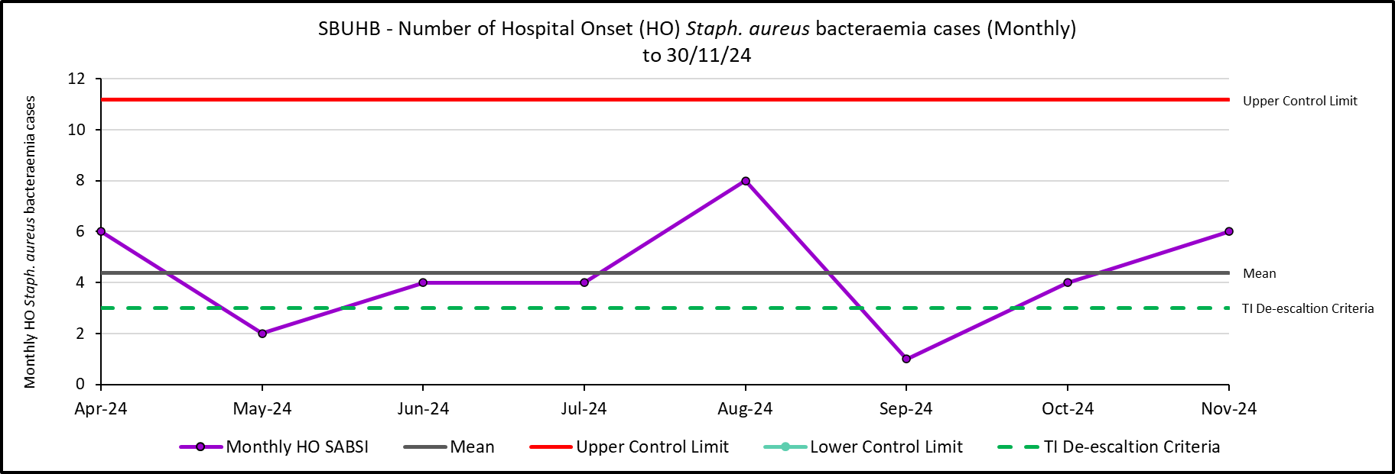
Hospital Onset HCAI TI Criteria, C. difficile and Staph. aureus to 30/11/24

Slide 43
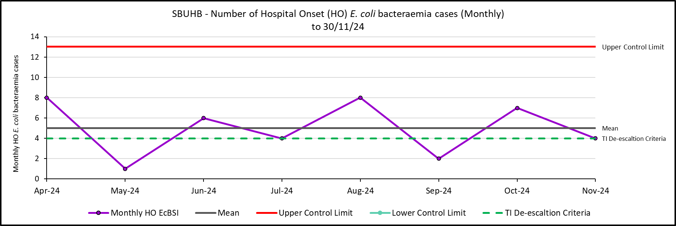
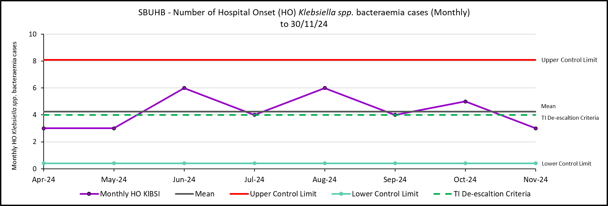
Hospital Onset HCAI TI Criteria, E. coli and Klebsiella spp. bacteraemia to 30/11/24

Slide 44
Antimicrobial Stewardship WHC/2024/038: SBUHB position at end of 2023/24
Primary Care Antimicrobial Improvement Goals
Goal 11a: A 10% reduction in total antimicrobial usage by 2029/30
GP in hours only in SBUHB: overall 4.3% reduction in consumption against the target (baseline 2019/20) as measured in DDDs/1000 STAR-PUs. (All-Wales reduction: 1.5%)
Primary Care* in SBUHB: overall 6.5% reduction in consumption against the target (baseline 2019/20) as measured in DDDs/1000 STAR-PUs. (All-Wales reduction: 4.3%)
Goal 12: 70% of total antibiotic use from the Access category
GP in hours only in SBUHB: 64.4% antimicrobial usage from Access Category as measured in DDDs. (All-Wales: 65.6%)
Primary Care* in SBUHB: 68.3% antimicrobial usage from Access Category as measured in DDDs. (All-Wales: 68.2%)
*Primary Care (PC) comprises all prescribing by GP in hours (GPIH), GP out of hours (GPOOH), Independent Prescribers, and the Common Ailments Service (Sore Throat and UTI scheme) dispensed in the community.
Secondary Care Antimicrobial Improvement Goals
Goal 11b: A 5% reduction in total antimicrobial usage by 2029/30
Secondary Care in SBUHB (acute hospital inpatient usage only): Overall 12.3% increase in consumption against the target (baseline 2019/20) as measured in DDDs/1000 Occupied Bed Days. Individual hospitals (All-Wales: increase 0.9%):
  Morriston* 10.0% increase
  Neath Port Talbot 11.1% increase
  Singleton** 13.5% reduction
Goal 12: 70% of total antibiotic use from the Access category
Secondary Care in SBUHB: Overall 65.9% antimicrobial usage from Access category as measured in DDDs (All-Wales: 63.9%). For the individual hospitals in SBUHB the Access category proportions were:
Morriston 65.8%
Neath Port Talbot 71.0%
Singleton 63.6%.
* The HARP report acknowledges historical data issues that will have affected the data for Morriston hospital and will be contributing to this increase
**Acute medicine relocated from Singleton to Morriston January 2023

Slide 45
Antimicrobial Stewardship: 72-hour review, FY 2025 Q2
Swansea Bay University Health Board Compliance
All Wales Compliance (12 month rolling average)
Compliance to guidelines
72-hour review
  Outcome of 72-hour review:
  Change (escalate/de-escalate)
  Continue
  IV to Oral Switch
  Stop
Compliance to guidelines
72-hour review
  Outcome of 72-hour review:
  Change (escalate/de-escalate)
  Continue
  IV to Oral Switch
  Stop
90%
89%
88%
81%
5%
8%
71%
66%
4%
7%
21%
19%

Slide 46
Outbreaks of infection and associated beds out of use
During November, there were 6 infection related incidents/outbreaks associated with respiratory viruses (some of these were a continuation from those first reported in October). There were 3 COVID-related; and 3 were Influenza.
2 in Morriston (50 bed days lost).
1 in Singleton (0 bed days lost).
1 in Neath (2 bed days lost).
2 in Gorseinon Hospital (1 bed day lost).
During November, there have been 2 identified genomically-linked outbreaks of C. difficile in Morriston (involving 2 patients in each of the outbreaks). There have been no bed days lost as a consequence.

Slide 47
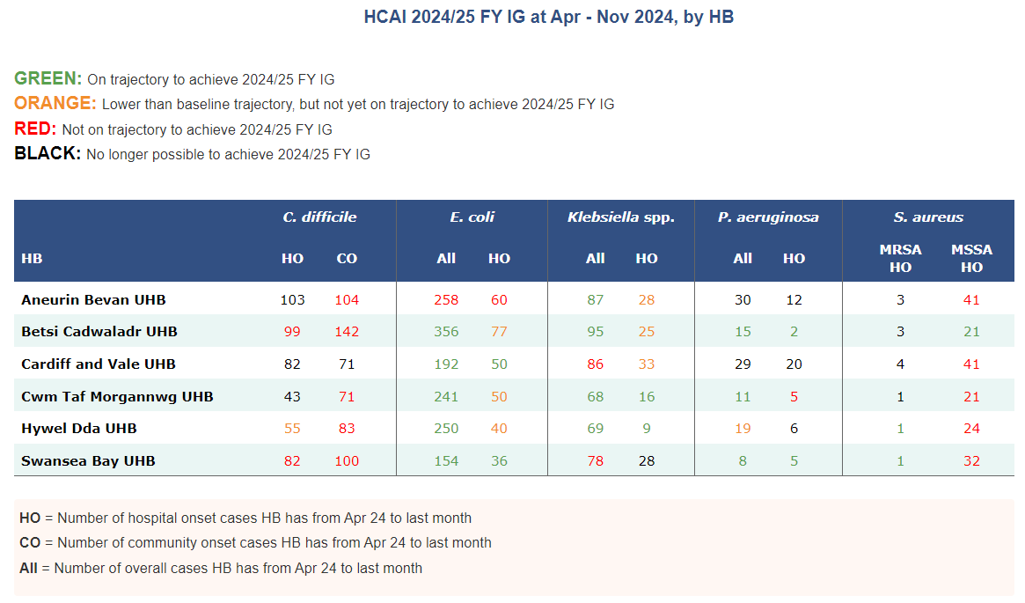
WHC HCAI & AMR 2024/25 Improvement Goals

Slide 48
Focus for the next month
Gold C. difficile High Incidence Management Group continues, with Silver Groups reporting into Gold.
The Digital Intelligence development team and the IPCT continue to refine the digital App for HCAI incident case reviews; commencing phase 1 with C. difficile cases. This is ready for testing during December 2024, with feedback in January, which will inform revisions, with an ambition to launch in early February 2025.
The C. difficile risk stratification project will focus on top 5 patient risks and pilot use in one ward to inform antimicrobial prescribing choices.
Clinical teams in Morriston continue to roll out the newly developed prescribing audit tool for hospital acquired pneumonia. Awaiting initial data.
Launch of Executive C. difficile communications campaign in January 2025.
Review of health board cleaning and disinfection standards for C. difficile, using risk-based approach to direct resources effectively and efficiently.

